Slide 2
Planner APIs in Microsoft Graph
Eray Chou (@erayc)
Principal PM Manager
Microsoft Planner

Slide 3
Agenda
Overview of Planner and Planner API
Updates to the Planner API
Demo of Planner API

Slide 4
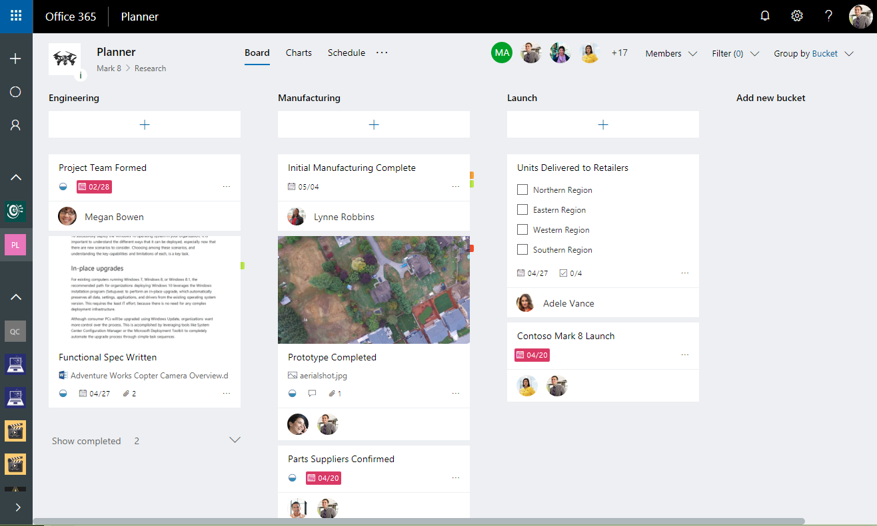
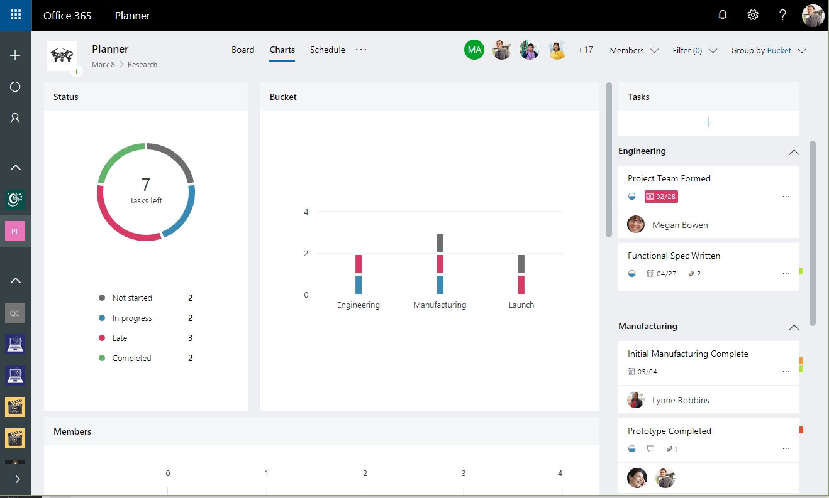
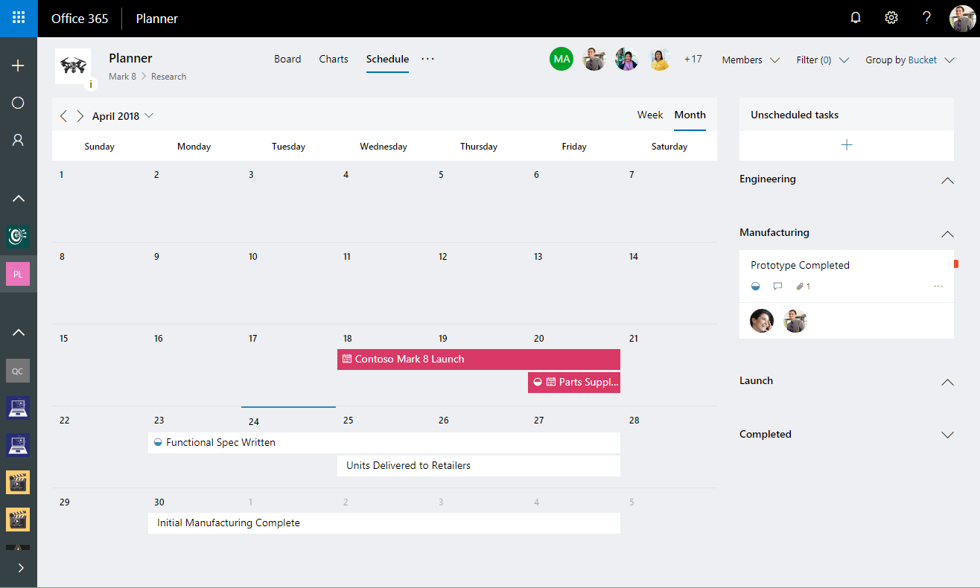
Planner: Collaborative task management for Office 365
Planner Board View
Planner Charts and Schedule views

Slide 5
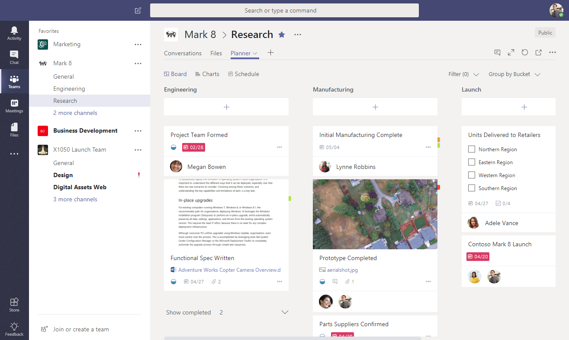
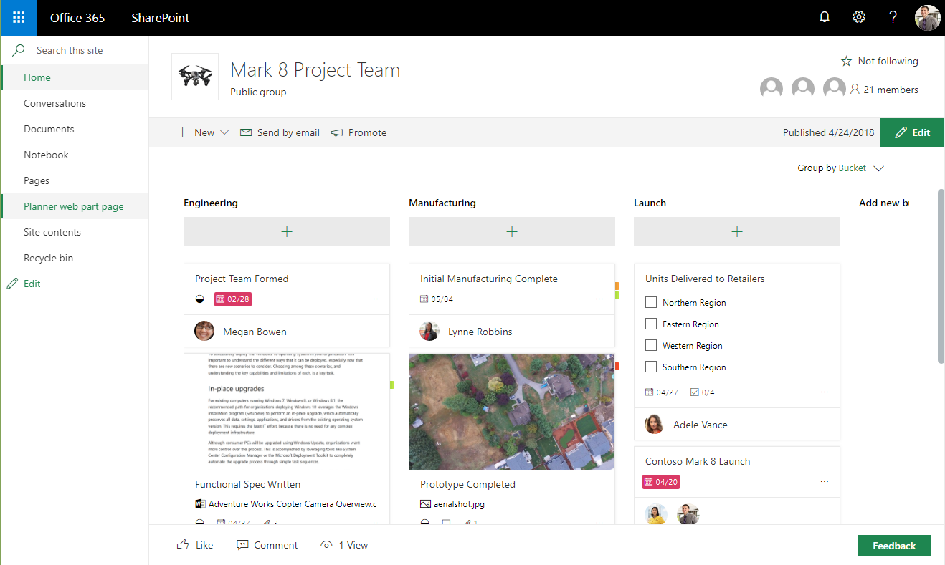
Planner: Built on Groups, integrated in Teams, SharePoint
Planner in Microsoft Teams
Planner in SharePoint
Planner Clients

Slide 6
Planner: Groups, Plans, Buckets, and Tasks
Group
Group
Plan
Bucket
Owns
Task
Plans
Bucket
Bucket
Task
Task
Task
Planner Board View

Slide 7
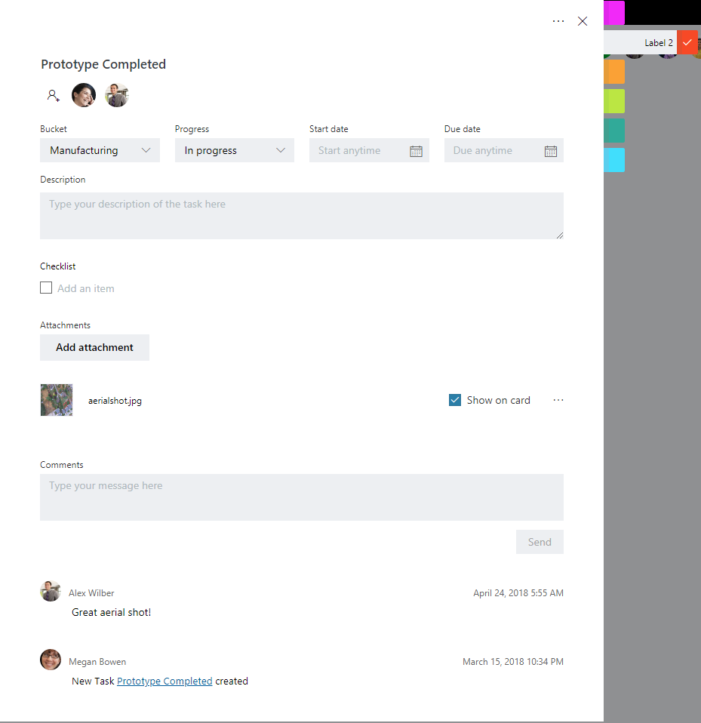
Planner: Task Details, Attachments, Conversations
Planner Task Details
Microsoft Graph
File Attachments powered by SharePoint
Comments powered by Outlook Group Conversations
Planner Board View

Slide 8
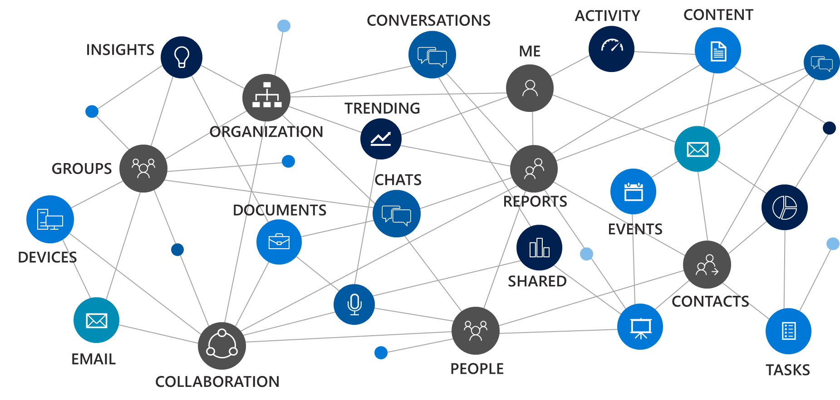
Microsoft Graph
a unified REST API
and comprehensive developer experience
for integrating the data and intelligence
exposed by Microsoft services.

Slide 9
Microsoft Graph
Unified REST API for Microsoft 365:
Azure Active Directory
Office 365 services:
SharePoint, OneDrive, Outlook/Exchange, Microsoft Teams, OneNote, Planner, and Excel
Enterprise Security and Mobility services:
Identity Manager, Intune, Advanced Threat Analytics and Advanced Threat Protection.
Windows 10 services:
Activities and Devices
Education
Read and write to the Tasks API at:
/v1.0/me/planner/tasks
/v1.0/planner/plans/<id>/tasks
/v1.0/groups/<id>/planner/plans

Slide 10
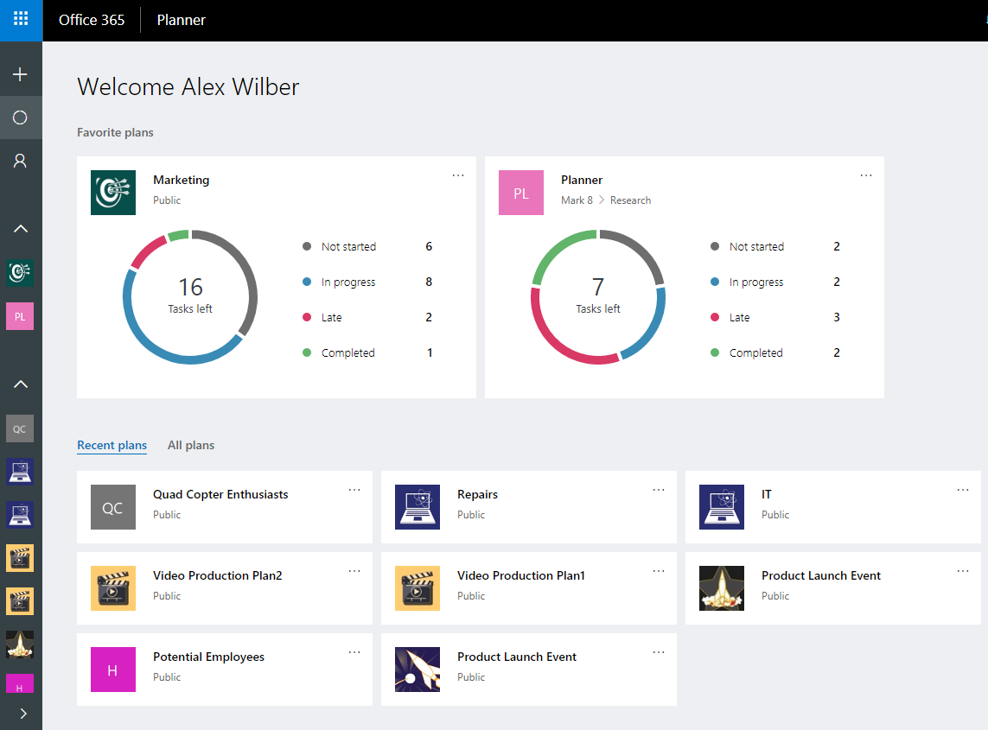
Recent API Updates: Favorite and Recent Plans
Favorite Plans
/beta/me/planner/favoritePlans
Recent Plans
/beta/me/planner/recentPlans
Favorite and Recent Plans
https://graph.microsoft.com/beta/me/planner/
Plan Context

Slide 11
Demo
Planner API

Slide 12
Thank you!

Slide 13
Get started today
https://graph.microsoft.com
Twitter
#MicrosoftGraph
GitHub
/MicrosoftGraph
StackOverflow
[MicrosoftGraph]

