Slide 1

Learn. Imagine. Build.
.NET Conf
Super Charge Your Debugging
in Visual Studio
Kaycee Anderson
@KayceeSue

Slide 2
Agenda
20+ Tips and Tricks for Visual Studio
Sneak peak at a feature coming soon
Preview look at Debugging in Production
  With Special Guest, Nikhil Joglekar

Slide 3
DEMO

Slide 4
Demo
IntelliTrace and Diagnostic Tools
  Summary Page
  Exception Events
  Historical Debugging
Debug.WriteLine
Exception Settings
Debugging Lambda Expressions
Click to Set next Statement
Edit and Continue
PerfTips
Run to Click
CPU Usage while Debugging
Memory Usage while Debugging

Slide 5
Demo Continued
Tracepoints
, nq modifier
JSON Visualizer
Exception Helper
  Inner Exceptions
  Exception Conditions
  Null Reference Analysis
Return Values
Step Into Specific
Pinned Data Tips
Debugger Display Attribute
Make Object Id
Run To Cursor from Call Stack

Slide 6
Step Back! What???
Soon to be in a public preview
Want it first?
Take this Survey: aka.ms/stepback

Slide 7
Learn. Imagine. Build.
.NET Conf
Snapshot Debugger
Cloud Scale Debugging in Visual Studio
Nikhil Joglekar
@nikjogo

Slide 8
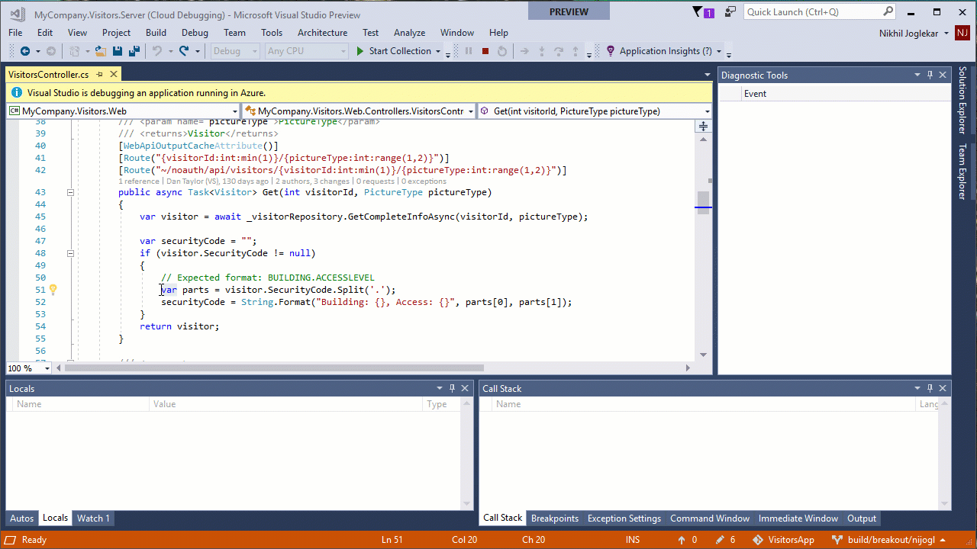
Aka.ms/snappoint

Slide 9
.NET

