Slide 2
Build intelligence into your business apps with ease using Bing APIs in Microsoft Cognitive Services
B8091
Ansuman Kar
Principal Software Engineering Manager
Brian King
Principal Group Program Manager

Slide 3

Cognitive Services
Microsoft
Cognitive
Services
Accelerate your journey to AI
Search
Access billions of web pages, images, videos, and news with the power of Bing APIs
Vision
From faces to feelings, allow your
apps to understand images and video
Speech
Hear and speak to your users by filtering noise, identifying speakers, and understanding intent
Language
Process text and learn how to recognize what users want
Knowledge
Tap into rich knowledge amassed from
the web, academia, or your own data

Slide 4
Search
Vision
Speech
Language
Knowledge
Bing Web Search
Bing Web Search
Computer Vision
Bing Speech
Bing Spell Check
Bing Spell Check
Academic
Knowledge
Bing Custom Search
Bing Custom Search
Custom Vision Service
Custom Speech Service
Linguistic Analysis
Custom Decision Service
Bing Image Search
Bing Image Search
Emotion
Speaker Recognition
Language Understanding
Knowledge Exploration
Bing Video Search
Bing Video Search
Face
Translator
Text Analytics
QnA Maker
Bing News Search
Bing News Search
Video
WebLM
Recommendations
Bing Autosuggest
Bing Autosuggest
Video Indexer
Entity Linking
Content Moderator
microsoft.com/cognitive

Slide 5







The Bing Search APIs
Web Search
Custom Search
Enhanced Search and Filtering Capabilities
Image Search
Web-
Scale
Secure (HTTPs)
High Performance
Video Search
REST
schema.org
JSON
News Search
Autosuggest
Ongoing Improvements and Support
Spell Check

Slide 6
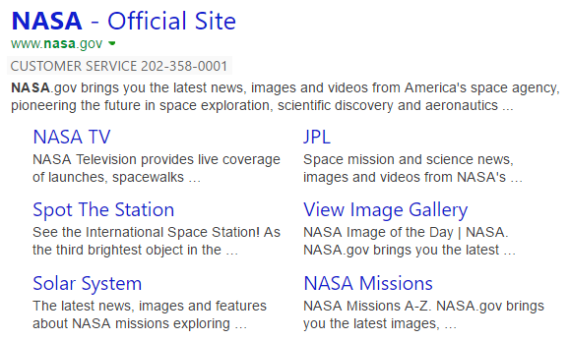

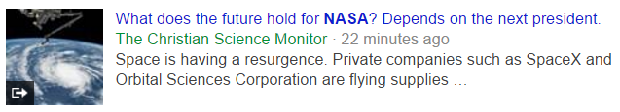
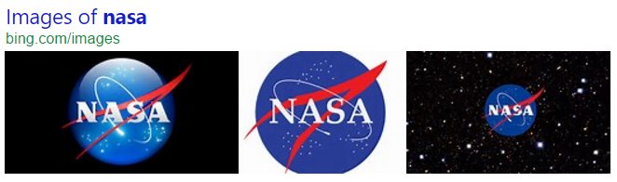
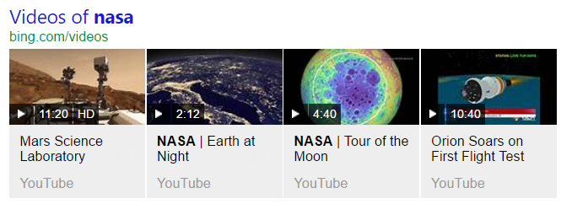
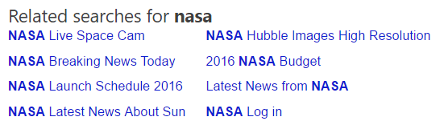
Web Search API
Web Search API
Get relevant web and answer results and metadata with one API call
https://api.cognitive.microsoft.com/bing/v7.0/search?q=nasa
Web
Results
Search Response
Deep Links
(1st Algo)
{
“_type”: “SearchResponse”,
“queryContent”: {…},
“webPages”: {…},
“news”: {…},
“images”: {…},
“videos”: {…},
“relatedSearches”: {…},
“rankingResponse”: {…}
}
News Results
Ranking Response
Image
Results
{
“answerType”:”WebPages”,
“resultIndex”:0,…
},
{
“answerType”:”News”,
“resultIndex”:1,…
}
Video Results
Related Searches
*screenshots show actual search results on bing.com

Slide 7



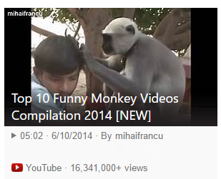
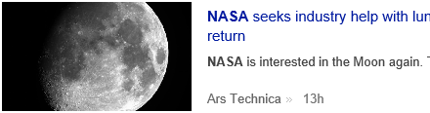
Vertical Search APIs
Get more results, features and metadata tailored to each search vertical
Image Search API
https://api.cognitive.microsoft.com/bing/v7.0/images/search?q=shuttle+launch
Enhanced metadata and filters (size, license, style, freshness, color)
Image insights (entity recognition, visually similar)
source: nasa.gov
Video Search API
https://api.cognitive.microsoft.com/bing/v7.0/videos/search?q=viral+videos
Enhanced metadata and filters (price, resolution, length, freshness)
Motion thumbnails (video preview)
source: youtube.com
News Search API
https://api.cognitive.microsoft.com/bing/v7.0/news/search?q=lunar+landing
News by category/market, and trending news
Rich article metadata (featured entities)
source: arstechnica.com
*screenshots show actual search results in bing.com

Slide 8
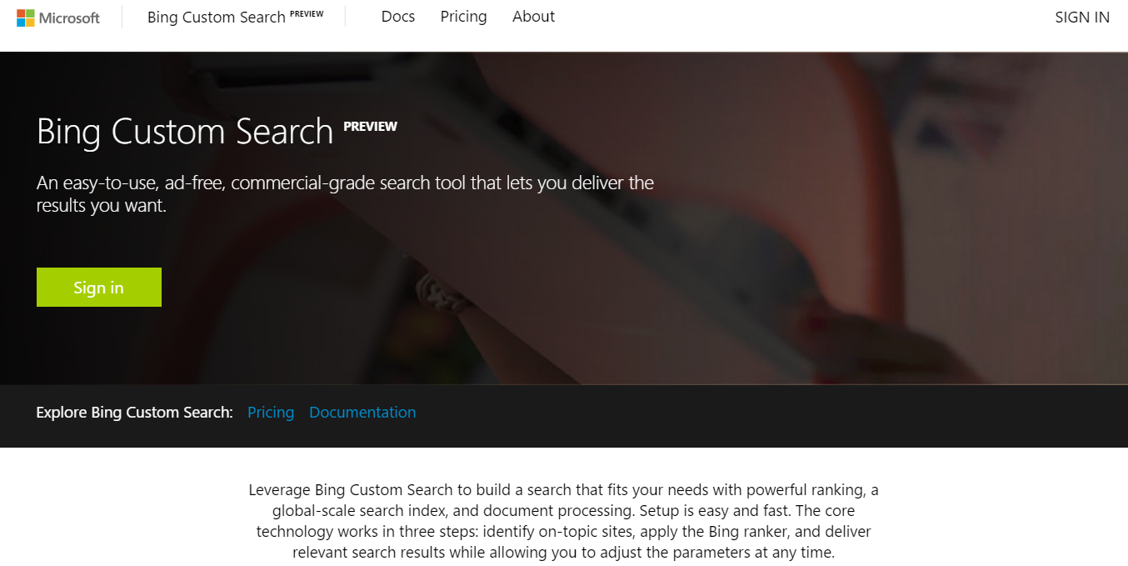
Custom Search Preview
Custom Search
https://customsearch.ai

Slide 9


Ways you can use Bing Custom Search
Site Search
Let your users search across all your websites
Pin top results
Control ranking
Custom Vertical Search
Design a custom search targeting hundreds of sites and webpages on a topic
Deploy internally, externally

Slide 10
Accessing the APIs
/* 1. Obtain an API subscription key from
microsoft.com/cognitive
2. Call REST endpoint, and pass API key via
special header */
GET https://api.cognitive.microsoft.com/bing/v7.0/search?q=nasa
HTTP/1.1
OCP-Apim-Subscription-Key: <API KEY>

Slide 11
Coding Demo
microsoft.com/cognitive
MakeMagicHappen();

Slide 12
Key Code Snippets
internal const string ImageSearchService = "https://api.cognitive.microsoft.com/bing/v7.0/images/details?";
var client = new HttpClient();
client.DefaultRequestHeaders.Add("Ocp-Apim-Subscription-Key", Constants.SearchKey);
client.DefaultRequestHeaders.Accept.Add(
new MediaTypeWithQualityHeaderValue("application/json"));
// Post request additional metadata and process response
var queryString = string.Format(“mkt={0}&setlang={1}&safesearch={2}&modules={3}",
“en-us”, “en”, "strict", “all“);
var uri = Constants.ImageSearchService + queryString;
var response = await client.PostAsync(uri, content);
if (response.StatusCode == HttpStatusCode.OK)
rawResults = await response.Content.ReadAsStringAsync();

Slide 13
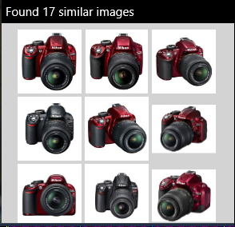
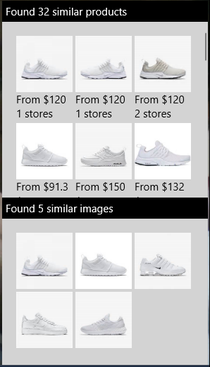
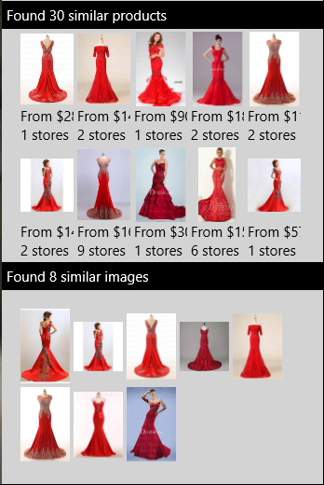
Searching with Images
*images show actual search results from Bing index

Slide 14
Custom Search Demo

Slide 15

Partner
Highlight
Trevor McFarland
VP Eng, Search @ AOL

Slide 16

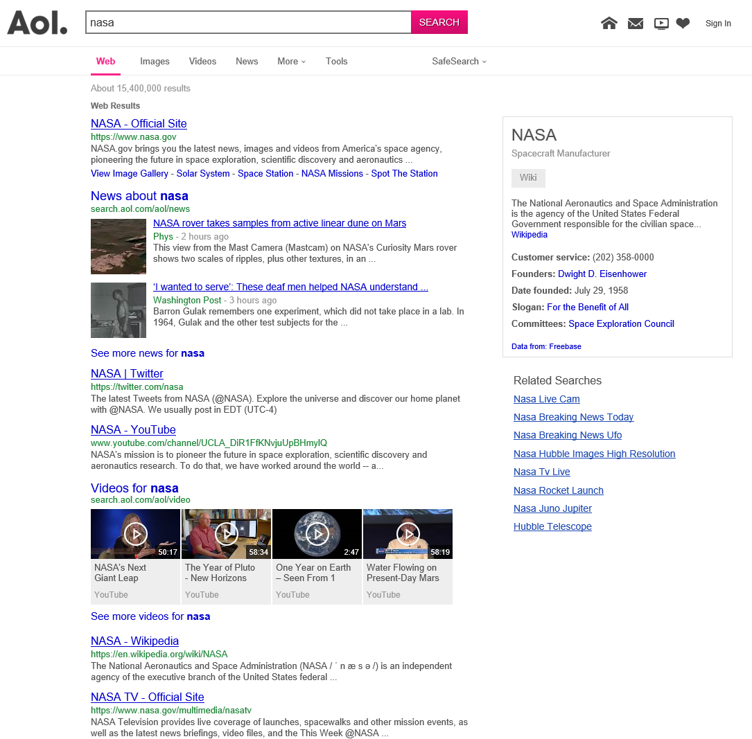
Leveraging the Bing APIs
Great range of features
World class relevance
Optimized performance
Intuitive JSON – Easy to Use
Great Development Partnership

Slide 17





It’s your turn …
Check us out on the web
microsoft.com/cognitive
Get your own Free Key
an API subscription key
Resources
Try out one of the API’s
There's so many to choose from
Use your new Key
Pass your key in via a header

Slide 18
Related Sessions @ Build
Session ID | Title | Day/Time | Location
B8903 | Open Q&A: Artificial intelligence tools for developers | 5/10 3:30 PM | [Complete]
B8092 | Using Microsoft Cognitive Services to bring the power of speech recognition to your apps | 5/10 5:00 PM | [Complete]
B8020 | Computer vision made easy: From pre-trained models to Custom Vision, Microsoft Cognitive Services has you covered | 5/11 10:30 AM | [Complete]
B8058 | Location intelligence and personalized experiences with Bing Maps | 5/11 5:30 PM | WSCC Hall 6C (740)
T6074 | Distill information into conversational, easy to navigate answers with Microsoft Cognitive Services QnA Maker | 5/12 2:20PM | Tech Talk B
Re-visit Build session recordings on Channel 9
#MSBuild

Slide 19
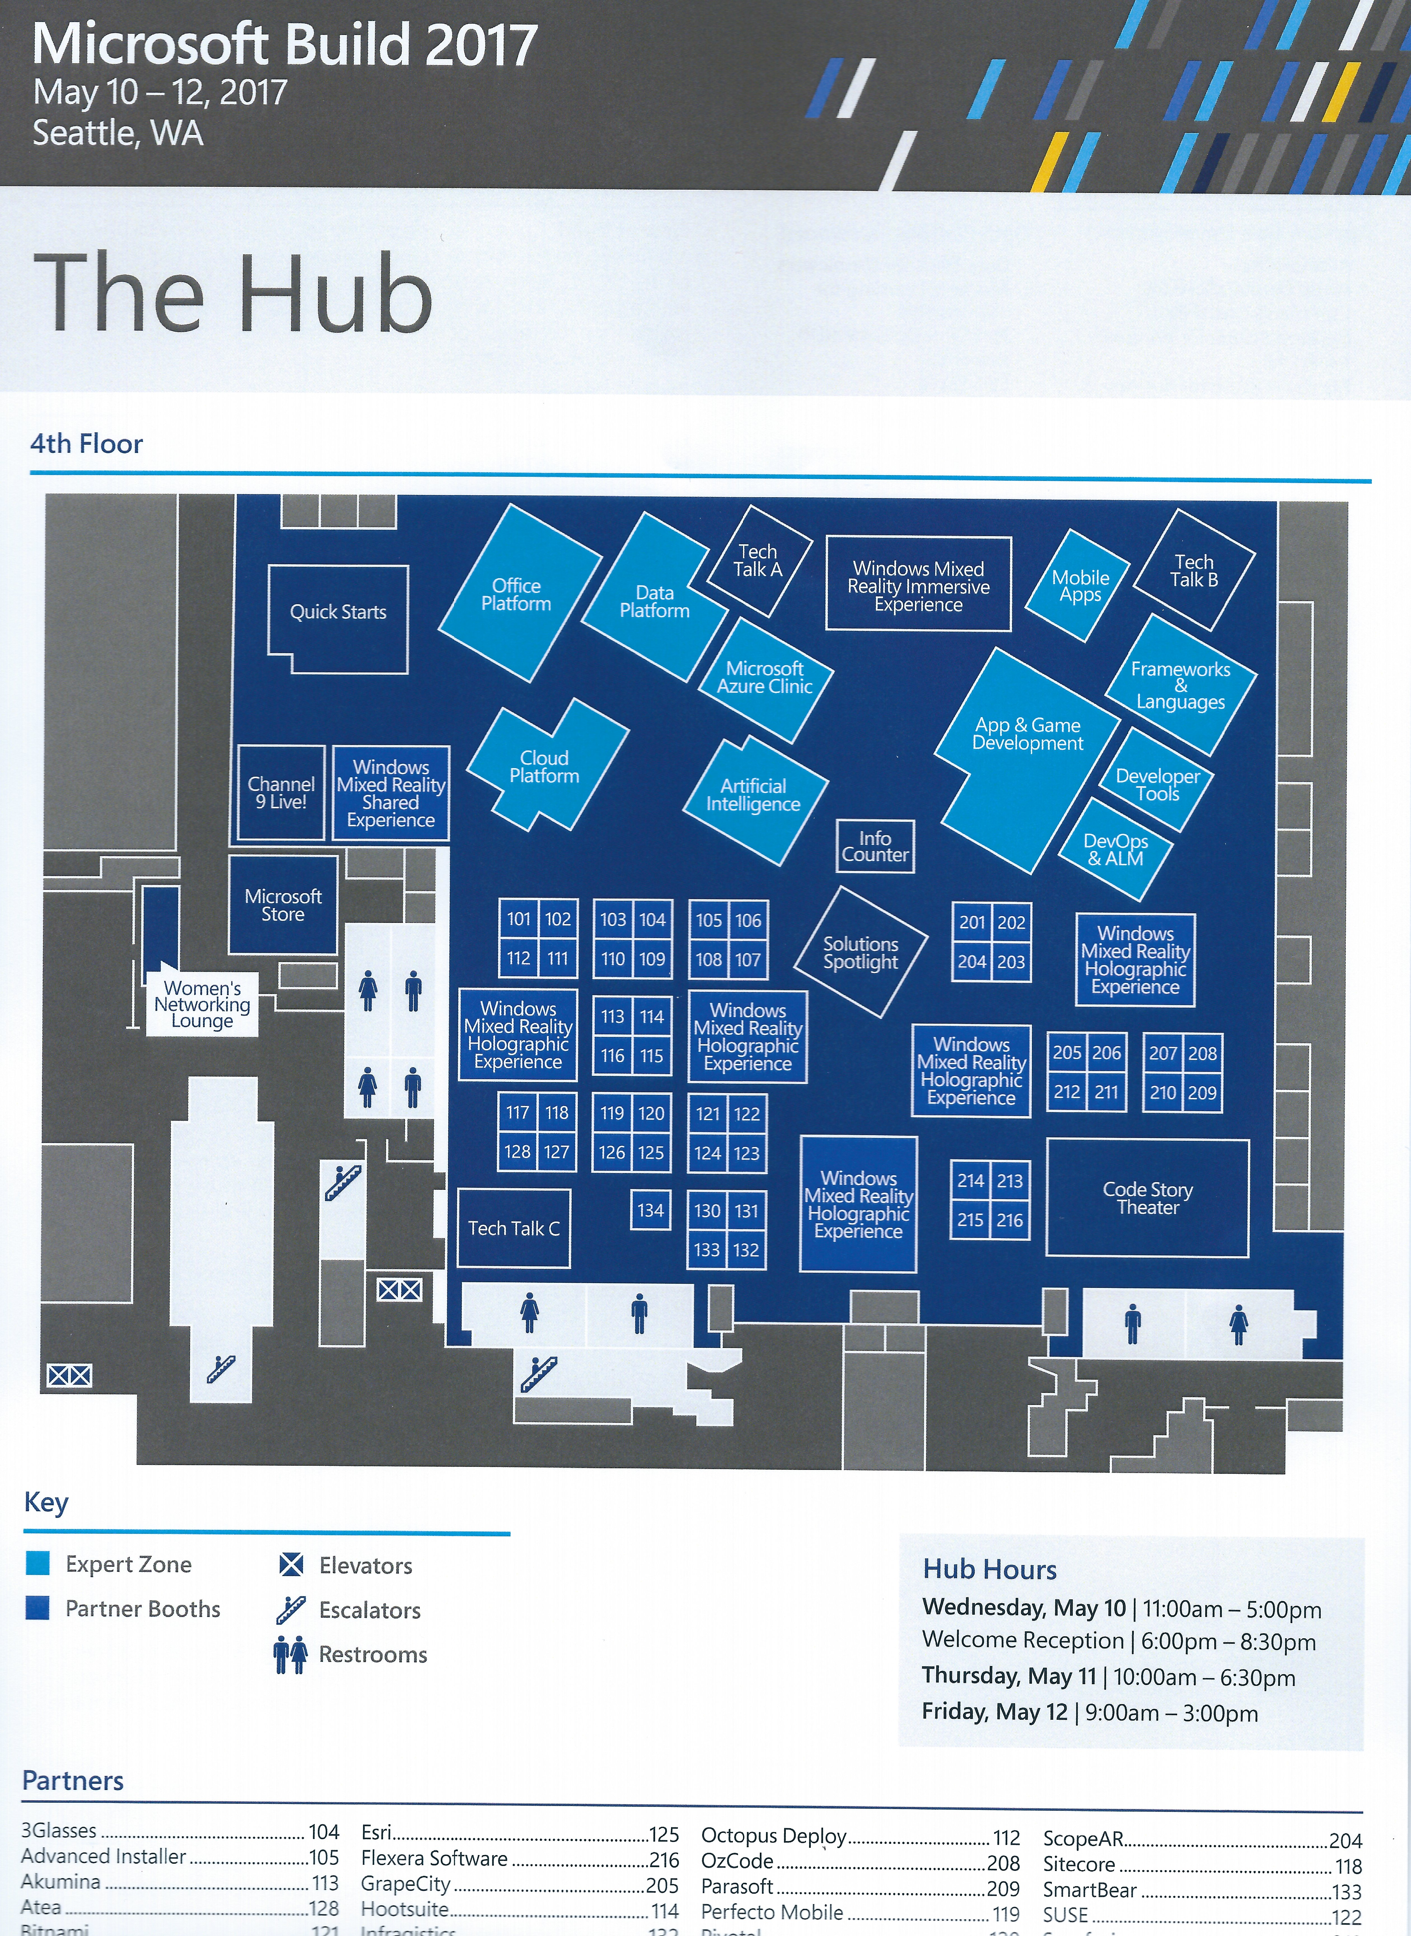
How To
Find Us In The Hub
You Are Here

