Slide 2
Speedup Interactive Analytics on Petabytes of Data on Azure
P4002
Yang Li
Co-founder & CTO, Kyligence
Qixiao Wang
Principal Technical Evangelist, Microsoft
James Baker
Principal Software Engineer, Microsoft

Slide 3
Big Data Interactive Analytics Requirements
Native SQL support on Hadoop
Sub-Second Query
Cloud Provision
Elastic Architecture
Notes:
Native SQL support on Hadoop
No data movement
ANSI SQL
BI connectivity
Easy deployment on Hadoop
Sub-Second Query
Interactive(Sub-second) Response
Consistency performance even on very large data
High Concurrency Access
Cloud Provision
Data Analytics as a Service
Pay as you go
Professional operations
Elastic Architecture
Scale up when data grows
Support Terabytes to Petabytes

Slide 4



Apache Kylin: Leading OLAP on Hadoop

Slide 5
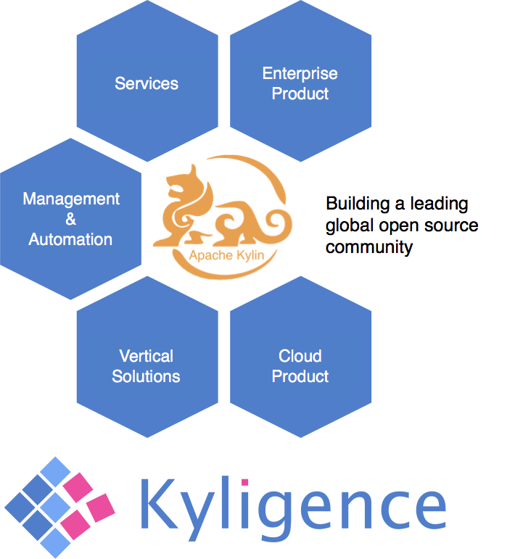
What is Apache Kylin
3,000 billion rows,
< 1 sec query latency
@toutiao.com, top 1 news feed app in China
60+ dimensions cube
@CPIC, top 3 insurance group in China
      JDBC / ODBC / REST API
      BI integration
BI Visualization
Interactive
Reporting
Dashboard
Apache Kylin
OLAP Engine
HDFS
Hive
HBase
Hadoop

Slide 6

How Kylin Works
Sort
Sort
Aggr.
Filter
Filter
Cuboid
Precalculate the Kylin Cube
Join
Tables
O(N)
O(flag x status x days) = O(1)
Notes:
How can Kylin go beyond O(N)? That is by precalculation.
So if I know the query pattern in advance, I could precalculate the Aggregate, Join, and Table Scan operators, to create a cuboid. If cuboid sounds unfamiliar, you can think it as a materialized summary table.
The summary table is transaction amount grouped by “returnflag”, “orderstatus”, and “date”. And because there are fixed number of return flags, order status, and let’s say the date range is limited too, for 3 years, there are about 1000 days. That means the number of rows in the summary table is at most “flag x status x days”, which is a constant in the big O notion.
That means, if execute the same SQL on the precalculated cuboid, the maximum rows to process is a constant. And that is why Kylin can be faster.

Slide 7
Precalculation Space
0-D(apex) cuboid
time
item
location
supplier
1-D cuboids
time, item
time, location
item, location
location, supplier
item, supplier
2-D cuboids
time, supplier
time, location, supplier
3-D cuboids
time, item, location
time, item, supplier
item, location, supplier
4-D(base) cuboid
time, item, location, supplier
Notes:
How can Kylin go beyond O(N)? That is by precalculation.
So if I know the query pattern in advance, I could precalculate the Aggregate, Join, and Table Scan operators, to create a cuboid. If cuboid sounds unfamiliar, you can think it as a materialized summary table.
The summary table is transaction amount grouped by “returnflag”, “orderstatus”, and “date”. And because there are fixed number of return flags, order status, and let’s say the date range is limited too, for 3 years, there are about 1000 days. That means the number of rows in the summary table is at most “flag x status x days”, which is a constant in the big O notion.
That means, if execute the same SQL on the precalculated cuboid, the maximum rows to process is a constant. And that is why Kylin can be faster.

Slide 8
Speed for Tomorrow
Response Time
O(N)
Online Calculation
O(1)
Apache Kylin
Data Size
Notes:
How can Kylin go beyond O(N)? That is by precalculation.
So if I know the query pattern in advance, I could precalculate the Aggregate, Join, and Table Scan operators, to create a cuboid. If cuboid sounds unfamiliar, you can think it as a materialized summary table.
The summary table is transaction amount grouped by “returnflag”, “orderstatus”, and “date”. And because there are fixed number of return flags, order status, and let’s say the date range is limited too, for 3 years, there are about 1000 days. That means the number of rows in the summary table is at most “flag x status x days”, which is a constant in the big O notion.
That means, if execute the same SQL on the precalculated cuboid, the maximum rows to process is a constant. And that is why Kylin can be faster.

Slide 9
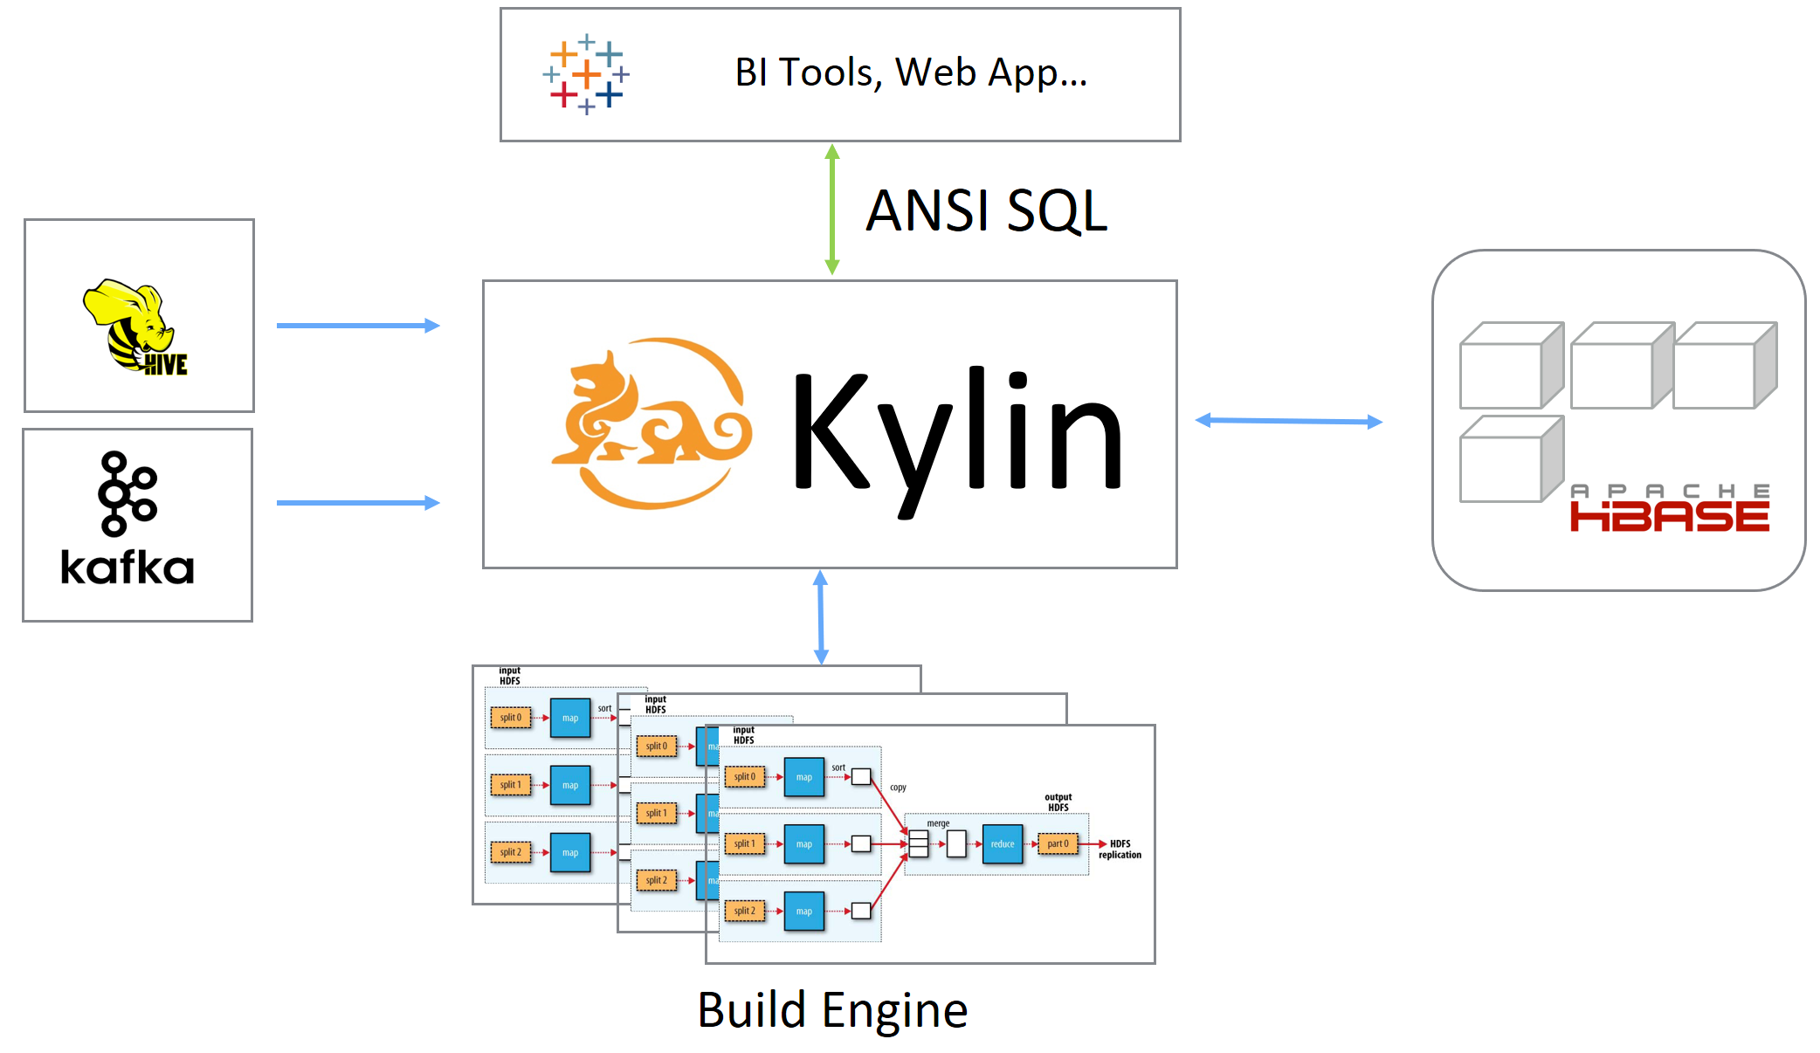
Kylin Architecture

Slide 10
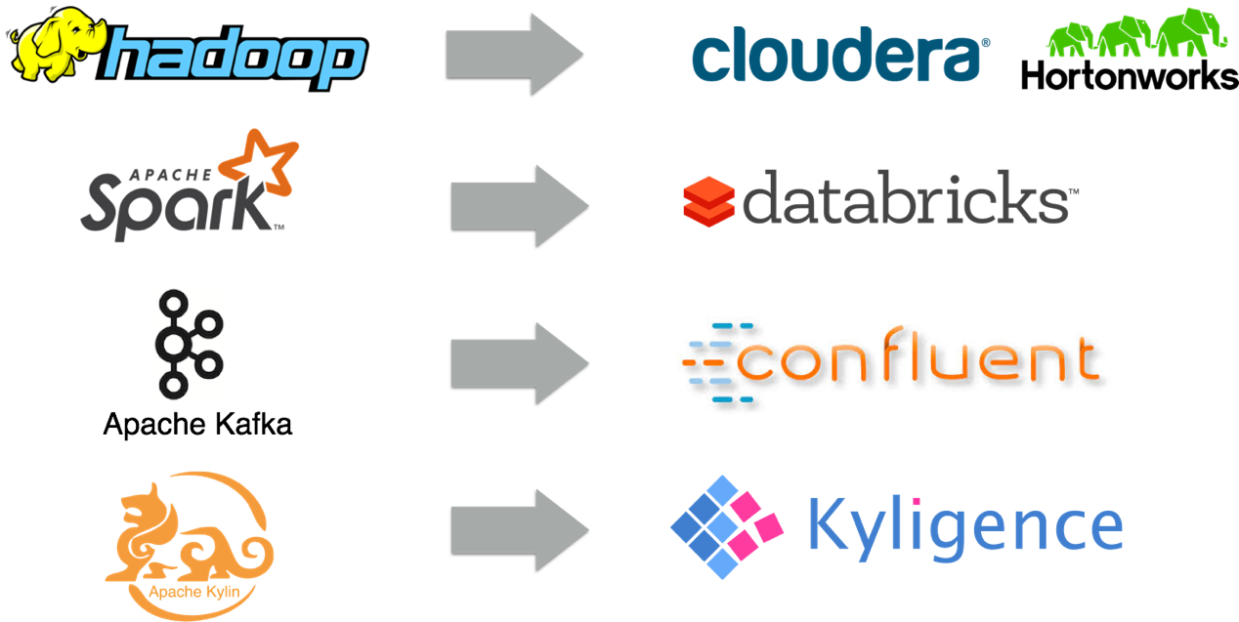
Kyligence = Kylin + Intelligence

Slide 11

Kyligence Analytics Platform on Azure
BI Visualization
Dashboard
Report
Solution
Managed Kylin Data Analytics Service
Cost Efficient
Elastic
Secure
Assisted Modeling
OLAP
Data Mart
Kyligence Analytics Platform
-- Powered by Apache Kylin
Big Data Platform
HDInsight (Hive, HBase, YARN)
Notes:
Easy Provision
One click KAP(Enterprise Kylin) deployment on Azure HDI
Full management tools
Low Overhead
No SQL rewrite, speed up query transparently
All hive applications migrate smoothly
Assets Protection
Reuse customer's existing BI tools
Reuse SQL skillsets
Efficiency Tuning
Kyligence managed analytics service, stable and efficiency
Cost Saving
Elastic extend/shrink cluster resource
Pay as you go

Slide 12
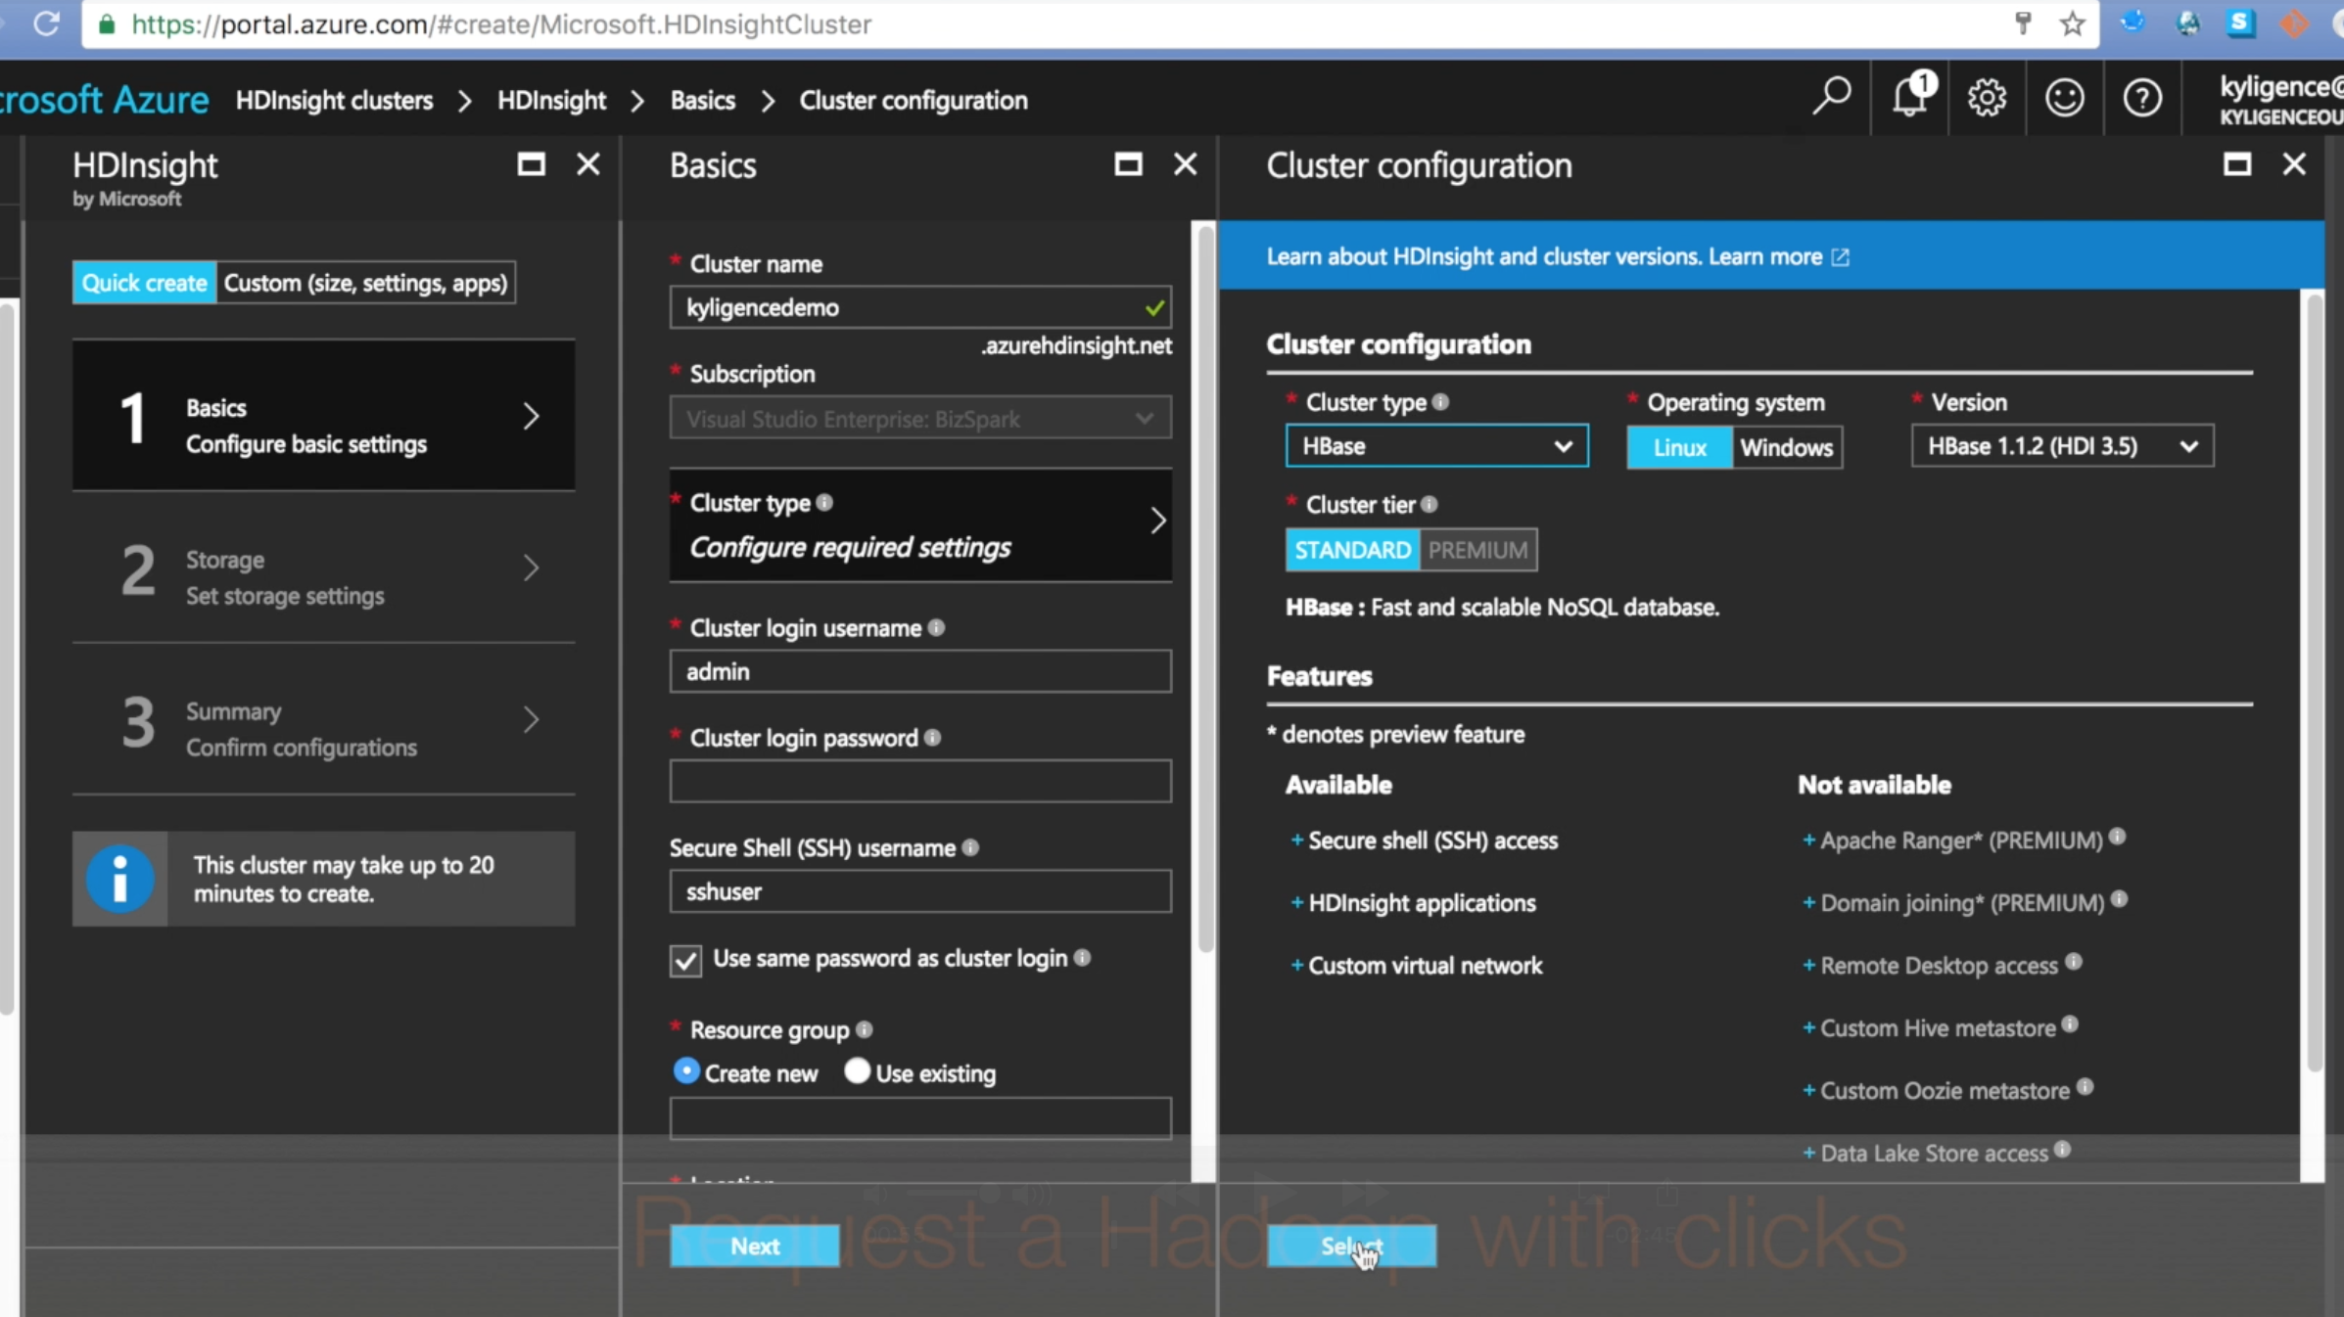
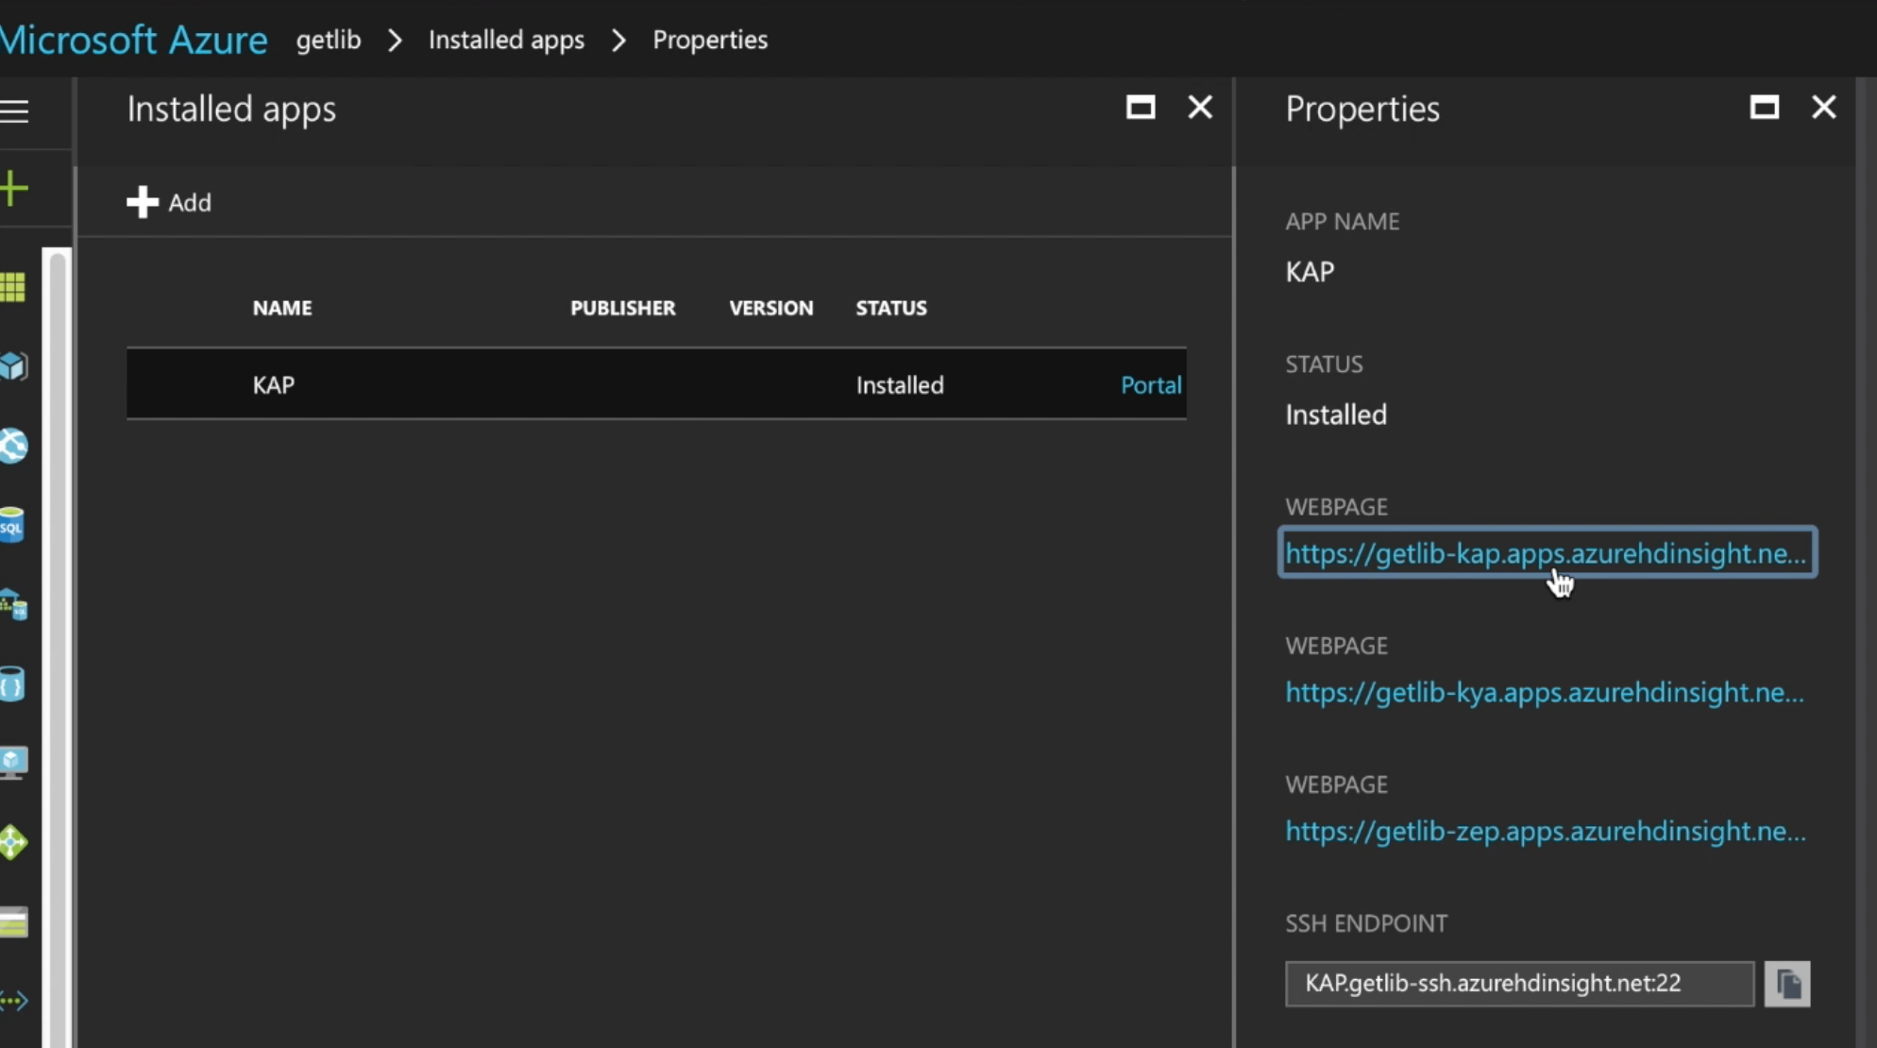
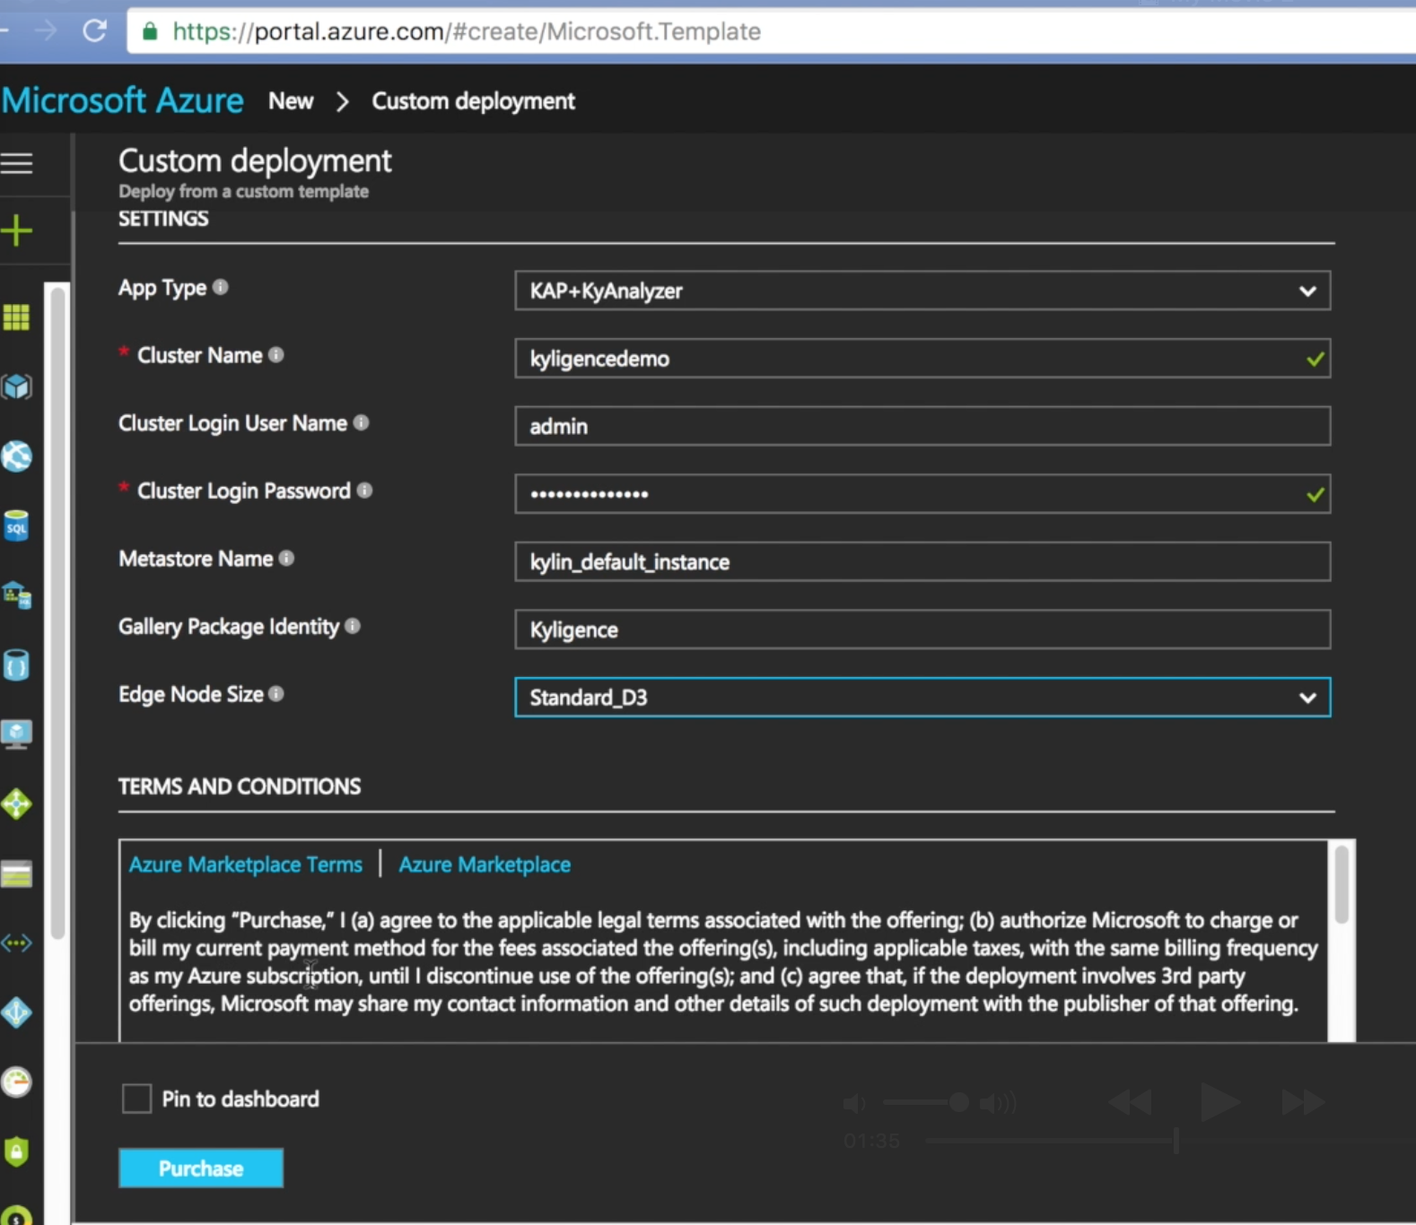
How to deploy KAP on Azure HDI
Create/Select HDI Cluster
Deploy KAP on Edge Node
Access KAP as HDI Application

Slide 13
Demo: Provision Kylin + HDInsight
China Azure Market
https://market.azure.cn/
Global ARM Template
https://github.com/Kyligence/Iaas-Applications/tree/kap230/KAP

Slide 14
Demo: Star Schema Benchmark
SSB on Kylin
https://github.com/Kyligence/ssb-kylin
SSB (SF=1000) on Azure builddemo
https://builddemo-kap.apps.azurehdinsight.cn/kylin

Slide 15
Demo: Excel & Tableau Integration

Slide 16
Demo: Streaming Analysis
Streaming Kylin
http://52.33.52.22:7070/kylin/
Zeppelin Analysis
http://build-demo.chinaeast.cloudapp.chinacloudapi.cn:9090

Slide 17
Call to action:
Install KAP on your HDInsight cluster
Go to https://kylin.apache.org to learn more about scalable OLAP cubes
In China, go to the Azure Marketplace to install KAP

Slide 18

Thank you!
BI Visualization
Dashboard
Report
Solution
OLAP
Data Mart
Kyligence Analytics Platform
-- Powered by Apache Kylin
Big Data Platform
HDInsight (Hive, HBase, YARN)

