Slide 2
Microsoft R Server: Development to Deployment Workflow
P4005
Mustafa Kasap
Senior Software Development Engineer

Slide 3
Microsoft R Server
Linux, Windows, Hadoop & Teradata
R Server Technology
High-performance, Scalable R
100% open source R
CRAN, Bioconductor, MRAN, GitHub compatibility
Big-data connectivity
Scalable analytics
Multi-platform
In-database, in-cluster scalability
Choice of IDE
CRAN
Microsoft R Open
DeployR
IDE
ConnectR
ScaleR
DistributedR
Open Source Components
Licensed Components

Slide 4
Microsoft R portfolio
Microsoft R portfolio
Community
Commercial
SQL Server
R Services
R Open
R Server
Windows
Linux
Hadoop
Teradata

Slide 5
Demo
R Server: Develop a solution & Deploy as WebService

Slide 6
MNIST Data
28
28
Database of 70K hand written digit image. i.e. 8

Slide 7
MNIST Data Format
28
28

Slide 8
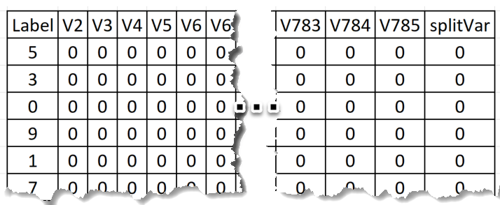
MNIST Data Format
Label Column
Digits: 0 to 9
28 x 28 = 784 pixels (features)
1 Image = 1 row
Train: 0
Test: 1
8

Slide 9
R Server Cluster
R Client
i.e. Cloud
Load Balancer
Web Node
Compute Node
Apps
SQL Server / PostgreSQL DB
Web Node
Compute Node

Slide 10
Resources
Application Developer Guide
https://msdn.microsoft.com/en-us/microsoft-r/operationalize/app-developer-get-started
Code Samples:
https://github.com/Microsoft/microsoft-r/ (Search MNIST)
Operationalize
https://msdn.microsoft.com/en-us/microsoft-r/operationalize/configuration-initial

