Slide 2
What’s New in Accessibility &
How to Get Started for Developers
Session Code Here
Jeffrey Petty
Program Manager,
Windows Accessibility

Slide 3
Overview
If you are new to accessibility, or are looking for an update, this is a great place to start:
  Look back
  Look forward
  Get started for developers
  For more information… http://msdn.Microsoft.com/accessibility
#MSBuild

Slide 4
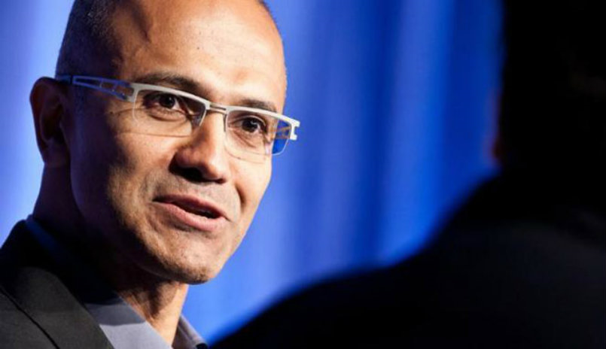
Our mission:
Empower every person and every organization on the planet to achieve more.
Notes:
We take our mission literally, where every person literally means every person on the planet.

Slide 5
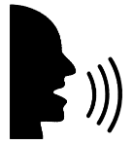


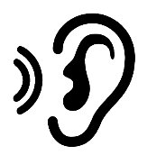
Windows is Built for Each of Us
vision
hearing
physical
cognition
Make your device easier to see or use without a screen.
Make your device easier to hear or use without sound.
Make your device easier to use of you have limited reach or strength.
Make it easier to focus and get things done with Windows.
#MSBuild
Notes:
As a result, we are building Windows for each of us.
For people with low vision, color blindness, and for people who are blind… we make your device easier to see or use without a screen.
For people with partial hearing loss or deafness… we make your device easier to hear or use without sound.
For people with limited reach or strength… we make your device easier to interact with.
For people with learning differences like dyslexia or cognitive disabilities… we make it easier to focus and do more.

Slide 6
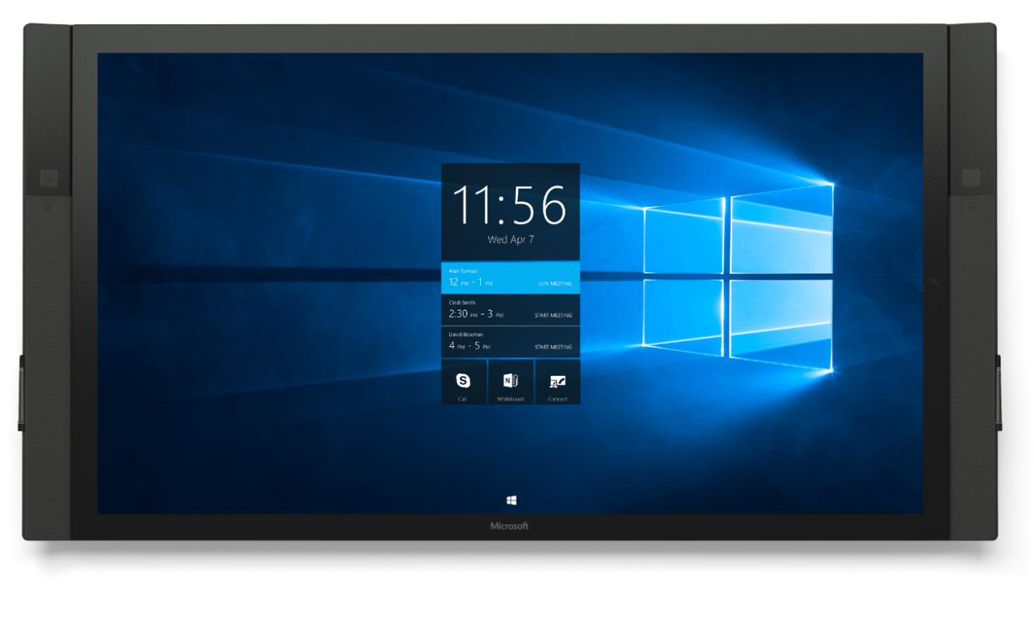
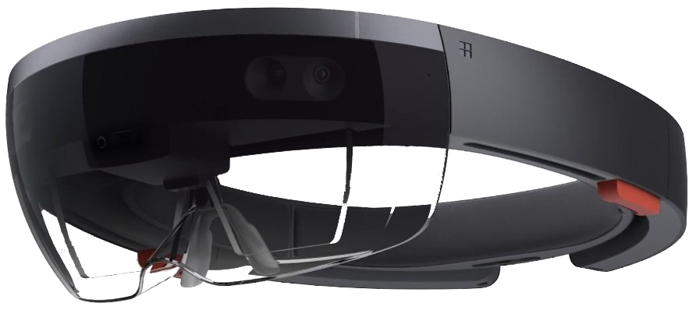
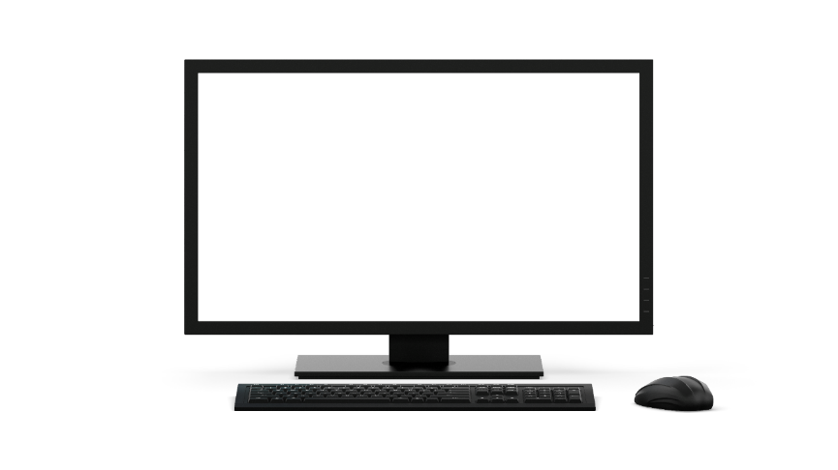
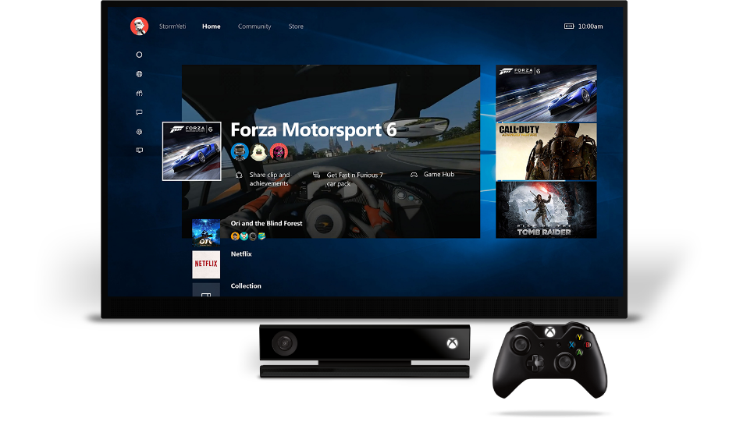
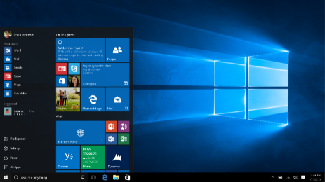
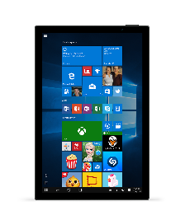
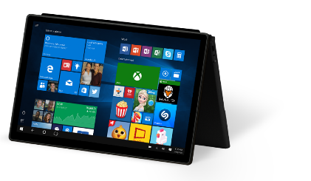
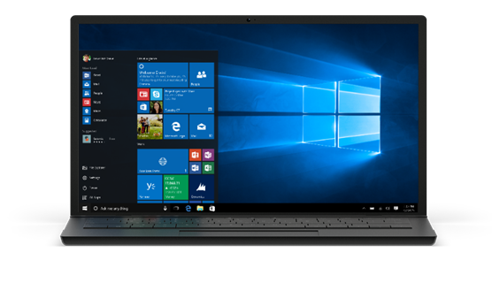
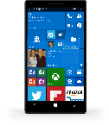
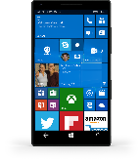


One Platform, Without Limits
ONE PLATFORM, WITHOUT LIMITS
Notes:
With Windows, we are creating One Experience, on One Platform with One Store.
What this means for accessibility is that you will be able to build accessible once and deploy accessible anywhere.
That is already true with PCs, Phones and Xbox today.

Slide 7
Our Screen Reading Journey
Needed
Wanted
Loved
OUR 1st PARTY ASSISTIVE TECHNOLOGY JOURNEY
PARALLELS THE WINDOWS JOURNEY
7
Notes:
It is a journey.
Our assistive technology journey parallels the Windows journey. Windows was ubiquitous and needed to perform many jobs. We are investing in experiences so that it is wanted and loved.
Our 1st party assistive technology is on a similar journey. For example, we invested in Narrator to ensure that you could install a 3rd party screen reader. We relied on 3rd parties to create great accessibility experiences. We have changed. Now we are investing to create delightful experiences. We are investing so that users prefer and even love our assistive technology.

Slide 8
Narrator in the Anniversary Update
Narrator in the Windows 10 Anniversary Update:
Faster, more reliable & accurate
Easier to use
Delightful voices
Better Windows & app experiences
“…I realized Microsoft was finally serious… but it did not work with my braille display.”
Cool Blind Tech 8.9.2016
“I’ll be a happy camper when Microsoft finally includes Narrator in Windows setup.” @Cambridgeport90 10.28.2016
“Narrator might not be a beautiful swan, but at least it is still on the same duck pond as the other screen readers.”
RNIB Radio 11.8.2016
Notes:
For example, in the Anniversary Update…

Slide 9
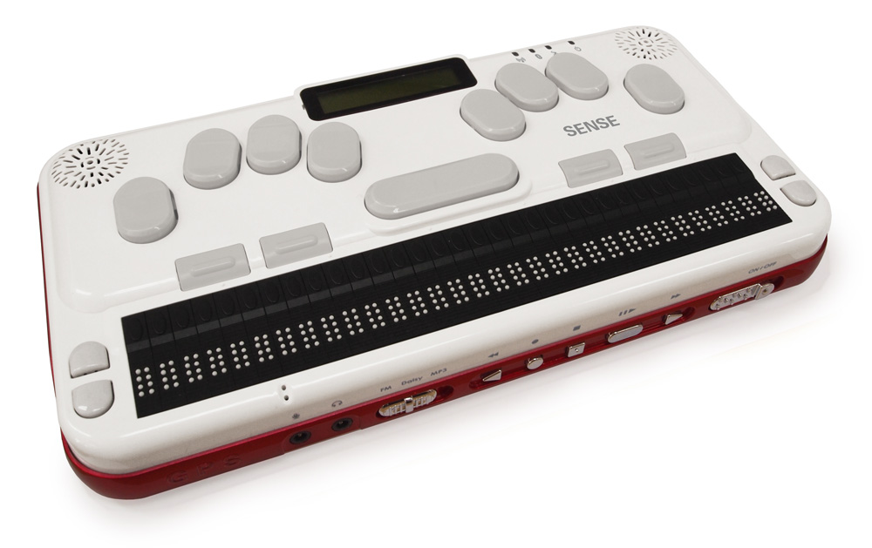
Narrator in the Creators Update
Narrator in the Windows 10
Creators Update:
Braille beta
Unassisted installation
Easier to use
Better Edge browsing, including for other screen readers
“If you're already running Windows 10, updating now is a no brainer…”
BlindBargains 4.12.2017
“Edge and Narrator?
Almost a dream come true for some, and for others, the dream is here.”
CoolBlindTech
4.12.2017
“Overall, Braille in Narrator is a fresh start, and in some ways even better than, say, BrailleBack on Android.”
CoolBlindTech 4.12.2017
Notes:
Fortunately, we are listening closely to our customers and were ready to address the feedback.

Slide 10
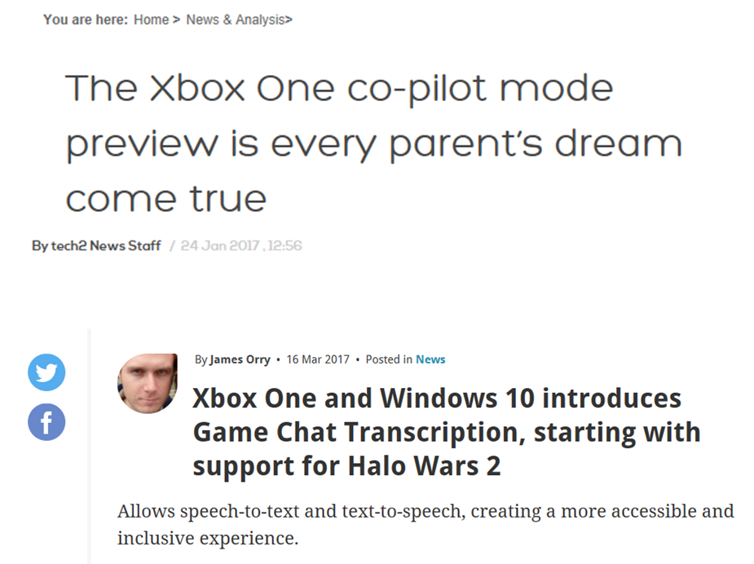
Other Features in the Creators Update
Other Features in the Windows 10
Creators Update:
Learning Tools in
Edge eBooks
Mono Audio
Xbox Co-Pilot &
In-Game Chat
Notes:
And, we invested in more than just screen reading.
Learning Tools in the new Edge eBook Reader include features like Read Aloud or simultaneously highlighting and voicing text. This improves reading for people with dyslexia and English language learners.
Mono audio simply combines the sounds from the left and right channel into a single audio signal, so you don’t miss anything if you are listening with one ear or have partial hearing loss in one ear.
Finally, Xbox is doing some really interesting work. Xbox implemented a feature called co-pilot, that enables two people to play one character using two different controllers. Not only is it great for great for people with disabilities to sometimes have a co-pilot, its great for kids and parents or friend too. It is a great example of inclusive design.

Slide 11
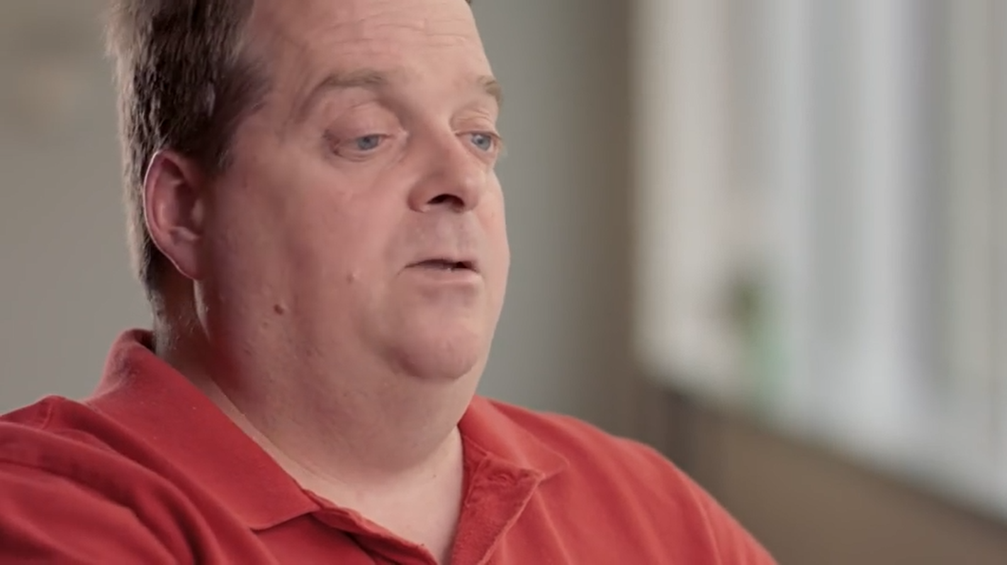
Windows 10 Craftsmanship Video
WINDOWS 10 Craftsmanship
http://aka.ms/win10craftsmanship
Notes:
I will close the look back with recommending a video that is available online.
The video is great. It shows many Windows teams showcasing improved user experiences for people with disabilities.
The reason I’m sharing it is not just that. Terry Myerson led the Surface Studio announcement with this video. That breadth of teams represented in the video and the fact that Terry chose to lead with it shows how deeply accessibility is becoming ingrained in our engineering culture at Microsoft.

Slide 12
Looking Forward for Users

Slide 13


Coming in Windows v.Next
Coming in Windows v.Next (Winter 2017)
All-day every day use of Narrator
All-day every day use of Magnifier
Easier for teachers to improve student learning outcomes
Windows 10 RS2
Windows 10 RS3
Notes:
We are going to continue to invest in Narrator. Users will see additional usability improvements and better support from third parties we are working closely with to ensure we have great first and third party experiences with Shell, Apps and Edge.
We are also investing in solutions for people with low vision. Magnifier will now follow Narrator focus and we are implementing font smoothing algorithms, which will help reduce eye fatigue for people who rely on Magnifier throughout their day.
And we are investing in bringing more Learning Tools features to Edge.

Slide 14
Get Started for Developers

Slide 15
Why Invest in Accessibility?
Reach
Usability
Compliance
Helping people
#MSBuild
Notes:
Its important to understand the space.
Some people invest to reach the broadest audience. They understand the audience is broader than the number of people with permanent disabilities. Everyone experiences temporary disabilities. A person that is in a noisy bar experiences hearing loss. A person with broken arm experiences limited mobility.
Some people invest in accessibility because considering the needs of different users leads to more usable experiences for everyone.
Some people invest to sell into governments, which require accessibility
Some people just want to help people. They invest in accessibility because it helps them find meaning in work to enable people to do more.
In our experience, there is no one reason to invest and a successful business case usually includes all of these reasons.

Slide 16
Design > Principles
Think universal
Make it personal
Keep it simple
Create delight
http://msdn.Microsoft.com/accessibility
#MSBuild
Notes:
Once your committed, these are some good principles to keep in mind.
These, and all of the guidance on the following slides is available at msdn.Microsoft.com/accessibility.
I wont go through all of the guidance, instead I will highlight a few things and share some straight forward demos.
Here I will just say, it is great to start with specific personas. For example, start with specific goals, e.g. to make an experience accessible for a person who is blind.
And, keep it simple. If you are creating a self voicing application, or are creating a separate experience within your application experience, you are likely headed in the wrong direction. This is not only unnecessary work, there are other personas and assistive technology like speech command and control that rely on the same application code that will be broken if you over complicate a user experience for the sake of someone who is blind.

Slide 17
Design > Practical steps
Describe the target audience
Talk to actual humans with specific needs
Choose a development framework wisely
Use standard Windows controls whenever possible
Design a logical hierarchy for your controls
Design appropriate visual UI settings
http://msdn.Microsoft.com/accessibility
#MSBuild
Notes:
All of these are good…

Slide 18
Build
Programmatic access
Keyboard navigation
Color and contrast
Respect user settings
Use a checklist
http://msdn.Microsoft.com/accessibility
#MSBuild
Notes:
Along with using common controls, these are the things we tend to emphasize.
Let’s jump into Visual Studio to look at some simple examples.

Slide 19
Build
Programmatic access
Keyboard navigation
Color and contrast
Respect user settings
Use a checklist
Turn on UI Analysis in Visual Studio to get help to find, triage and fix common errors
Launch Narrator
(Cntrl + Win + Enter) and use Narrator Dev Mode
(Cntrl + Shift + F12) to understand the blind user experience
http://msdn.Microsoft.com/accessibility
#MSBuild
Notes:
Along with using common controls, these are the things we tend to emphasize.
Let’s jump into Visual Studio to look at some simple examples.

Slide 20
Test
Run accessibility testing tools, like Inspect and AccEvent
Test keyboard accessibility
Verify the contrast ratio of visible text
Verify your app in high contrast
Verify your app with display and other user settings
Verify main app scenarios by using Narrator
Examine the UI Automation representation for your app
http://msdn.Microsoft.com/accessibility
#MSBuild
Notes:
I’ve already walked through tools like UI Analysis and Narrator Developer mode.
There are other, more advanced tools that can be helpful too. You can find instructions on all of these tools, including where to find them and how best to use them at http://msdn.Microsoft.com/accessibility.

Slide 21
Call to action
Continue your education at http://msdn.Microsoft.com/accessibility
  Accessibility in the Store
  Accessible custom controls
  Videos, code samples, etc.
  Much, much more
#MSBuild
Notes:
That’s a quick look at where we’ve been, where we’re going and how to get started.
For more information, be sure to visit http://msdn.Microsoft.com/accessibility
I hope you enjoy //BUILD 2017. Thanks for watching.

