Slide 2
Microsoft Graph – Delta Query and Webhooks
P4152
Jeff Sakowicz
Program Manager

Slide 3
Agenda
Microsoft Graph – Overview
Delta Query
Webhooks
Demos

Slide 4
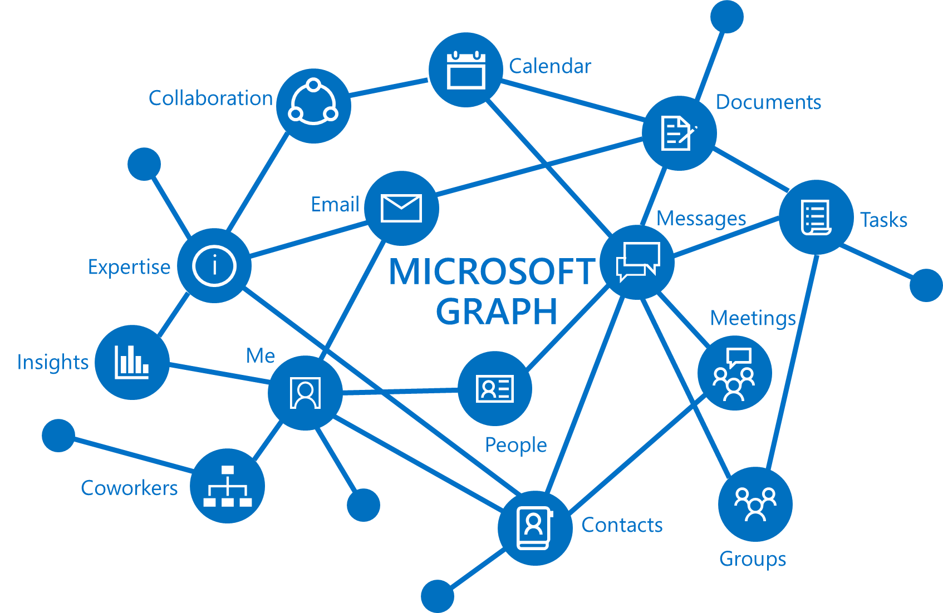
What is Microsoft Graph?
Connect to data that drives productivity and reach 100s millions of users
/me, /users, /groups, /messages, /drive
Relationships
/me/drive/items/<id>/
lastModifiedByUser
Commercial and consumer accounts
https://graph.microsoft.com

Slide 5
Delta Query
Learn what's changed without doing a full read
Useful for simple change tracking or complex sync jobs
New at Build 2017
Available on the v1.0 endpoint for Directory and Outlook
Note: already available in v1.0 for OneDrive

Slide 6
Calling Delta Query
First Request: GET https://graph.microsoft.com/v1.0/users/delta
Response contains the resource and either a nextLink or deltaLink URL
Next Request: GET https://graph.microsoft.com/v1.0/users/delta?$<token>
New at Build 2017: scoping filter support for users and groups in preview on /beta

Slide 7
Demo
Use Delta Query to scan for important messages in a User’s Inbox

Slide 8
Webhooks
Subscribe to push notifications for changes
Just a “poke” letting you know to come and get data
New at Build 2017
Preview for Users and Groups in /beta
Preview for Outlook consumer accounts in /beta

Slide 9
Using Webhooks
Create Subscription Receive Notification
{
"value":[
{
"id":"<subscription_guid>",
"expirationDateTime":"\"2016-05-11T22:11:09.952Z\"",
"clientState":"SecretClientState",
"changeType":"Created",
"resource":"Users/{user_guid}@<tenant_guid>",
"resourceData":
{
"@odata.type":"#Microsoft.Graph.User",
"@odata.id":"Users/{user_guid}@<tenant_guid>",
"@odata.etag":"W/\"CQAAABYAAADkrWGo7bouTKlsgTZMr9KwAAAUWRHf\"",
"Id":"<long_id_string>"
}
}
]
}
POST https://graph.microsoft.com/beta/subscriptions
Content-Type: application/json
{
"changeType": "created,updated",
"notificationUrl": "https://webhook.azurewebsites.net/notificationClient",
"resource": "/users/{user_guid}",
"expirationDateTime": "2017-05-12T11:00:00.0000000Z",
"clientState": "SecretClientState"
}

Slide 10
Demo
Use Webhooks and Delta Query to track changes to User profiles

Slide 11
Delta Query & Webhooks – Recap
Use Delta Query to track changes
Subscribe to webhooks to get push notifications
Delta Query and Webhooks are better together

Slide 12
Call to action
Learn more at https://developer.microsoft.com/en-us/graph/docs/concepts/delta_query_overview
Find SDKs and samples at
https://github.com/microsoftgraph
Connect with the team on:
Twitter using #MicrosoftGraph
stackoverflow.com [microsoftgraph] for developer questions
Re-visit Build session recordings on Channel 9

