Slide 2
Skype for Business - Product Feedback
BRK1101
Ali Rohani
Salana Adhikari
Mirunan Gunarajah

Slide 3
Session Objectives And Takeaways
Overview
Skype for Business - Feedback Framework
SfB Programs - How can I participate?
Sample
Feedback Trend
Additional Security on Mobile Devices
SfB for Mac
Structured Meetings
More…

Slide 4
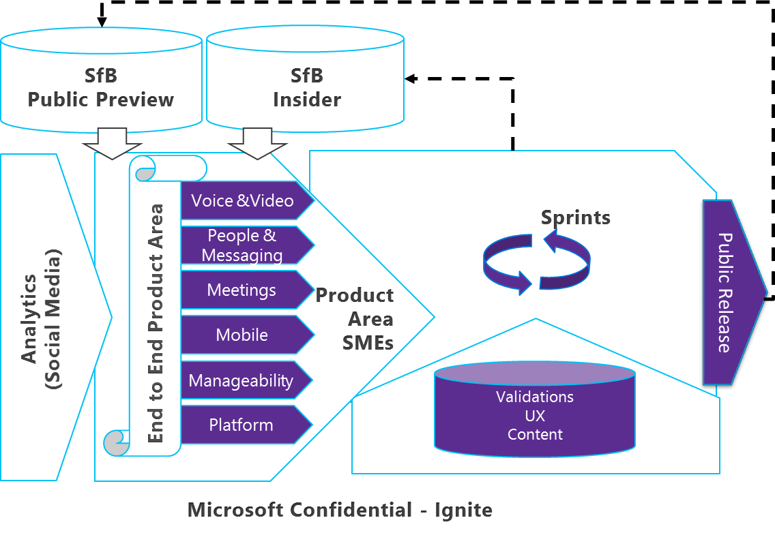
SfB Feedback Framework
A central framework and repository for end-to-end SfB feedback management which helps drive and contributes to strategic and tactical future product decisions.

Slide 5
Pre-release Programs
Want to help shape the next release of Skype for Business?
We're looking for customers and partners like you to share your feedback on the new features and experiences we're developing. If you get excited about trying new software and don't mind a bump in the road here and there, join our programs today!
Help shape the Skype for Business experience for millions of people
SfB Insider Program
Help shape the future of Skype for Business
Get early access to releases and deploy widely to business users
Your Users take part in feedback and validation activities and will be part of the exclusive community
SfB Preview Program
Access Skype for Business suite of products available more broadly prior to GA (aka ‘public preview’)
Try out software and get exposure to features that are still being developed
Insider nomination is open now!
http://aka.ms/sfbinsider

Slide 6
New features in SfB based on customer ask
In Place Upgrade
SQL Always On
Server Side Conversation History & Auto-Accept
Video Interop Server (VIS)
Call Quality Dashboard (CQD)
Skype Directory Search
Call Monitor

Slide 7
Sample Feedback Trends
Additional Security on Mobile
Additional authentication options
MDM Integration - Intune
SfB for Mac
  Updated Sfb Mac client
Enhance Presenter Functionalities
  Upload content into a meeting
  Whiteboard support
  Sharing screen into meeting
User Interface Improvements
  Optimize real estate in IM window
  IM copy/paste improvements
Improved Join Experience
  Improve robustness of join experience
  Full web client- People, Presence & Chat
Structured Meetings
  Roster Enable/Disable
  Q&A; Real-time feedback
  Attendance reports; Q&A report
Enhancing PSTN Join Experience
Conference ID length
Front-End Reliability
Patching Process Reliability Issues
Configure Upgrade Domains
Provide better insight into Win Fab state

Slide 8
Submit feedback: Ignite Participants
Submit your feedback via Interim form
http://aka.ms/sfbfeedback
Only open Month of May for Ignite Participants!

Slide 9
Q & A

Slide 10
Related Sessions
Title | Presenters | Session Date
A Deep Dive into Skype for Business Mobility | Kaushal Mehta, Mirunan Gunarajah | Tuesday, May 5 from 9:00 – 10:15 AM
Troubleshooting Skype for Business Scenarios | David Howe, Mohamad Saleem | Thursday, May 7 from 9:00 – 10:15 AM
Lync/Skype Product Feedback Capture | Mirunan Gunarajah, Salana Adhikari | Friday, May 8 from 9:00 - 10:15 AM
Deployment Strategies and Integration Scenarios with Microsoft Exchange and Skype for Business | Lynn Roe | Friday, May 8 from 10:45 AM – 12:00 PM

Slide 11
Join the conversation!
Share tips and best practices
with other Office 365 experts
http://aka.ms/office365network

Slide 12


Please evaluate this session
Your feedback is important to us!
Visit Myignite at http://myignite.microsoft.com
or download and use the Ignite Mobile App
with the QR code above.

