Slide 2
Introducing the Windows 10 App Model
BRK1303
Matthijs Hoekstra
Program Manager
OSG Eco system team
Matthijs.Hoekstra@Microsoft.com

Slide 3
Agenda
Why do we need an app model?
What is the Windows App Model

Slide 4
Why do we need an app model?

Slide 5
Why do we need an app model?
Windows has never had a definition of an app
You know it when you see it but it’s never written down
Started with .exe but…
How do you install it?
How do you store state?
How long does the app run for?
What’s the versioning story?
How do you integrate with the OS?
How do you integrate with other apps?
What can your app do?
The UWP App Model provides answers to these questions

Slide 6
What is the UWP Windows App Model
Defines the app lifecyle
Unified across all Windows devices
Scales from IOT→Mobile→PC→Xbox→Hololens
Cradle to Grave
Install
Runtime environment
Resource Management
Update
Data Model
Uninstall

Slide 7
UWP App Model
Inclusive of all apps that run on Windows
Universal Windows Apps
Existing apps
Phone Apps
Windows 8.1 Apps
Classic Windows Apps

Slide 8
Project Centennial Converting Classic Windows apps to run on the Universal Windows Platform

Slide 9
What now?

Slide 10
Defining the app model for Classic Windows Apps
Until now there has been no definition of an app on Windows
Lots of attempts but no systemic definition

Slide 11
Why an app model *now* for Desktop?
Windows ROT
The vast majority of the problem is registry growth/fragmentation
Uninstall is almost impossible to do 100%
MSI allows for custom actions and chaining MSI’s
Result: Your PC accretes more and more into the registry and file system over time hence ROT.

Slide 12
What does the app model mean?
AppX is the deployment model
Putting MSI on notice
Provides a better way to install/uninstall/update
Runtime isolates registry/disk access
Enforces App Model Policy
Integrate into the new app model

Slide 13
Windows Desktop App Model Policy
Allowed
Full API access
Existing Desktop app lifecycle
Denied
System components
Drivers – user or kernel mode
NT Services
Admin elevation
InProc extensibility
E.g. Shell Extensions,
Can harm the integrity of the system
Security / stability issues
Can render the system unusable

Slide 14
More information
Project Centennial: “Converting your Classic Windows App (Win32, Net, COM) to a Universal Windows app for Distribution in the Windows Store John Sheehan
http://channel9.msdn.com/Events/Build/2015/2-692

Slide 15
Getting your app
User promise:
Never regret installing an app
Where do I get the app from?
Store is the default place to get apps
Flexible deployment
Based on the phone model
Token enrolled on device then any app signed with that token can be installed from anywhere
AppX improvements
Size – support >150Gb

Slide 16
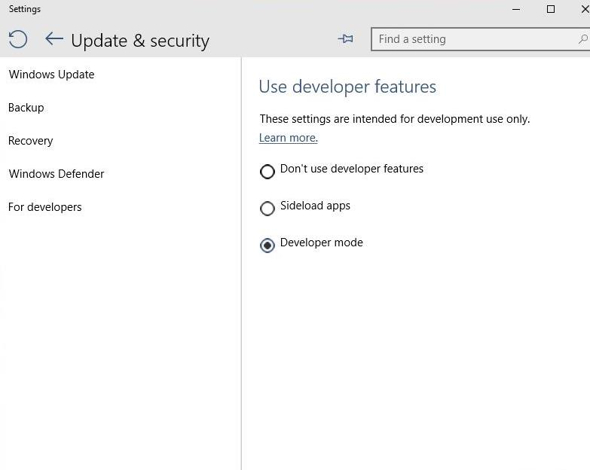
Developer Unlock
Cutting the cord!
Now just a setting on device
Registry key that can be controlled by enterprise
Limits
Phone: 20 apps
Desktop: Unlimited

Slide 17
Install apps on to Removable Storage
User can decide to install or move an app to Removable Storage
App is encrypted on the Removable Storage card for protection and isolation
Apps are enabled for Removable Storage by default
Opt out with a flag in the manifest

Slide 18
More Information
Windows 10 Universal App Deployments for Enterprises (John Vintzel) Wed May 6, 1:30PM – 2:45PM
Using the Business Store Portal with Windows 10 Devices (Tejas Patel, Ford McKinstry) Thu May 7, 1:30PM – 2:45PM
App Packaging and Deployment for Universal Windows Apps (Barclay Hill) http://channel9.msdn.com/Events/Build/2015/2-695

Slide 19
Multitasking
Resource Management
Scaling from low end phones to high end PCs
Extended Execution for foreground applications
Task completion scenarios
let me finish saving my file
Turn by turn navigation
Ask for more time
The amount of time is based on what device you’re running on
Always keep my app running
Tell the OS when you start that you intend to keep running
Triggers

Slide 20
App Resume policy
All UWP apps will resume be default
All 8.1 Phone apps and 8.0/8.1 Desktop apps also resume
Windows Phone 7.x and 8.0 apps do *not*
Why?
App Compatibility

Slide 21
What does this mean for your app?
Basically 2 models
Always resume the experience
Navigate back to home
Both are good models
Which should you choose?
Depends on your user model

Slide 22
Unifying the navigation model
Go back to where you came from
Evaluated Xbox, Windows, and Phone models
Back will behave much like Back button in Phone today
Navigates back in the app, then back to previous app
Start is special: cannot appear multiple times

Slide 23
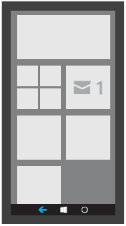
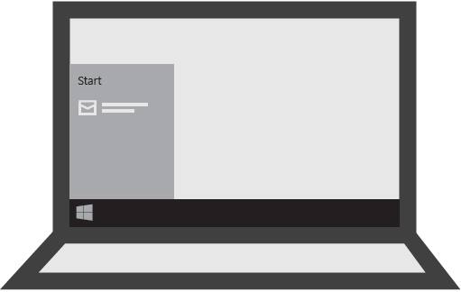
BACK BEHAVIOR: EXAMPLE
Same app on Mobile and Desktop

Slide 24
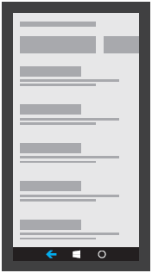
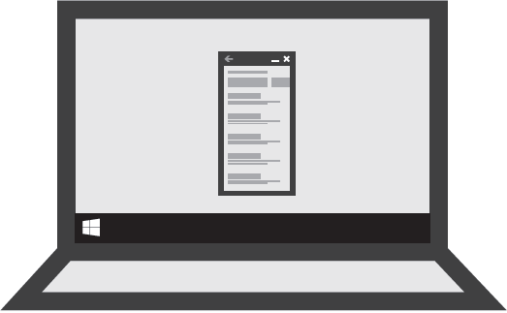
BACK BEHAVIOR: EXAMPLE
Same app on Mobile and Desktop

Slide 25
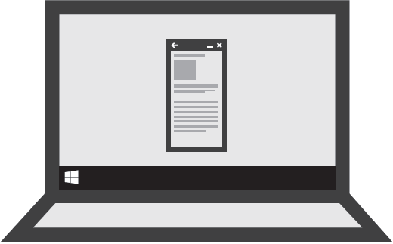
BACK BEHAVIOR: EXAMPLE
Same app on Mobile and Desktop

Slide 26
BACK BEHAVIOR: EXAMPLE
Same app on Mobile and Desktop
On desktop, Back button in the app chrome becomes disabled when it dead ends at the root of the app.

Slide 27
More information
Windows 10 Background Execution And Multi-Tasking (Michael Palermo, Jerry Nixon) Wed May 6, 3:15PM – 4:30PM

Slide 28
App Integration
Apps have traditionally on mobile devices been isolated
Isolation is good but…
Users want to get things done
What did the web teach us?
URL based activation/app model allows for apps to integrate easily
Keep it simple
Build it and let the ecosystem flourish
What did COM teach us?
Build it and let the ecosystem flourish
Complexity kills

Slide 29
Building a web of apps

Slide 30
Building a Web of Apps
Allow apps to integrate using the best of the web
URL based activation/communication
Foreground to Foreground
Very similar to the web model
Allows for custom scheme invocation skype:matthijshoekstra
New in 10 - the ability to return results, query for apps and enumerate apps
Foreground to Background
Application services
Enables you to “publish” a background task that can be called by other apps
Facebook & Twitter integration with the People app is a key example of this

Slide 31
App 2 App/App Services and 1st party apps
Using our own technology was a key feature for 10
Cortana and People app use app services extensively
People
Social Network Extensibility
Cortana
Voice Commands on Cortana’s canvas
Office & Skype
Skype: & Lync: for meeting requests
Interactive Toasts
Photos
Photo Editors
Camera
Lens

Slide 32
Example: Viber integration with Cortana
Define the app services in the appmanifest
Register the Voice Command Definition file with Cortana
In package.appxManifest
<Extensions>
<uap:Extension Category="windows.appService" EntryPoint="ViberServices.ViberVoiceCommandService">
<uap:AppService Name="ViberVoiceServiceEndpoint" />
</uap:Extension>
</Extensions>
In viber.vcd
<Command Name="SendMessage">
<Example> Tell Mark to buy ink and paper </Example>
<ListenFor RequireAppName="BeforeOrAfterPhrase"> Tell {contact} [to] {message} </ListenFor>
<VoiceCommandService Target="ViberVoiceServiceEndpoint"/>
</Command>

Slide 33
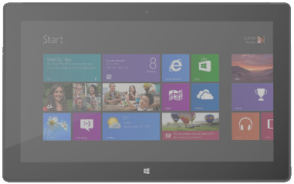
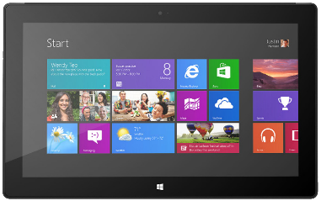
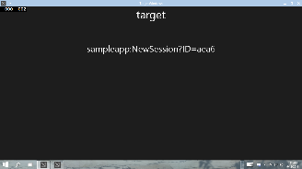
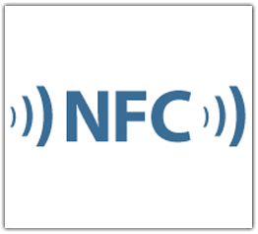
Scenario: Enterprise Suite of Apps
Product Scanner
Inventory App
Inventory
Service
Checkout App
Payment Gateway

Slide 34
More information
Building a Web of Apps (Daren May) Fri May 8, 10:45AM – 12:00PM

Slide 35
Engaging with your users

Slide 36
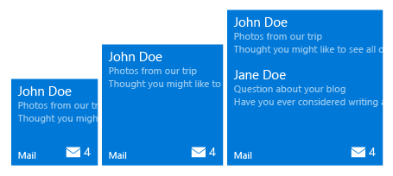
Adaptive Tile Template
Content adapts with the tile The new adaptive tile template works similarly to universal app patterns by allowing your content to adapt depending on the devices screen density. As you design your tiles it is important to keep in mind how you want your content to adapt to the tiles size on screens of different densities.
XML SAMPLE 1
<tile>
<visual>
<binding template="TileMedium">
<group>
<subgroup>
<text hint-style="subtitle">John Doe</text>
<text hint-style="subtle">Photos from our trip</text>
<text hint-style="subtle">Thought you might like to see all of</text>
</subgroup>
</group>
<group>
<subgroup>
<text hint-style="subtitle">Jane Doe</text>
<text hint-style="subtle">Questions about your blog</text>
<text hint-style="subtle">Have you ever considered writing a</text>
</subgroup>
</group>
</binding>
</visual>
</tile>
Min. Med Size
Max Med. Size

Slide 37
Demo

Slide 38
Action Center in Windows 10
The same look and feel for the Windows family
Behaviors inherited from Windows Phone Toast and Action Center… and more
Toasts automatically go into Action Center
Toasts can be expanded to view the full content
Chase individual notifications
Remove per app group
Remove individual notifications
Alarms and reminders can now be viewed inside Action Center
Action Center Change Trigger so you can keep your tile and action center in sync

Slide 39
More information
Tiles, Notifications, And Action Center (Christine Matheney, Jerry Nixon) Wed May 6, 1:30PM – 2:45PM

Slide 40
Universal Data Store
DirectAccess API’s for Contacts, Calendar
Read/Write access
Create your own custom fields/store
EmailRT
Access to Email on device
MessagingRT
Access to Messages on device

Slide 41
Summary
Easy for users to get all of your apps
More flexible multitasking
Unified navigation model
URI based app integration model
Universal Store and Search to integrate with Cortana
Richer Tiles and Action Center

Slide 42
More great Windows 10 Sessions this week
Building a Web of Apps (Daren May) Fri May 8, 10:45AM – 12:00PM
Tiles, Notifications, And Action Center (Christine Matheney, Jerry Nixon) Wed May 6, 1:30PM – 2:45PM
Windows 10 Background Execution And Multi-Tasking (Michael Palermo, Jerry Nixon) Wed May 6, 3:15PM – 4:30PM
From the Small Screen to the Big Screen: XAML (Harini Kannan) Fri May 8, 9:00 – 10:15AM
Getting Started with Windows XAML (Jerry Nixon) Wed May 6, 5:00PM – 6:15PM
New Universal UI/UX Features (Harini Kannan) Fri May 8, 12:30PM – 1:45PM
Building Windows Apps With Javascript is Even Easier (Michael Palermo) Tue May 5, 5:00PM – 6:15PM
Building Windows 10 Apps for Office 365 (Chakkaradeep) Thu May 7, 10:45AM – 12:00PM
Windows 10 Universal App Deployments for Enterprises (John Vintzel) Wed May 6, 1:30PM – 2:45PM
Using the Business Store Portal with Windows 10 Devices (Tejas Patel, Ford McKinstry) Thu May 7, 1:30PM – 2:45PM
Windows 10 for Mobile Devices: Enterprise Business Apps and App Management (Roel Schellens, Alan Meeus) Thu May 7, 10:45AM – 12:00PM

Slide 43
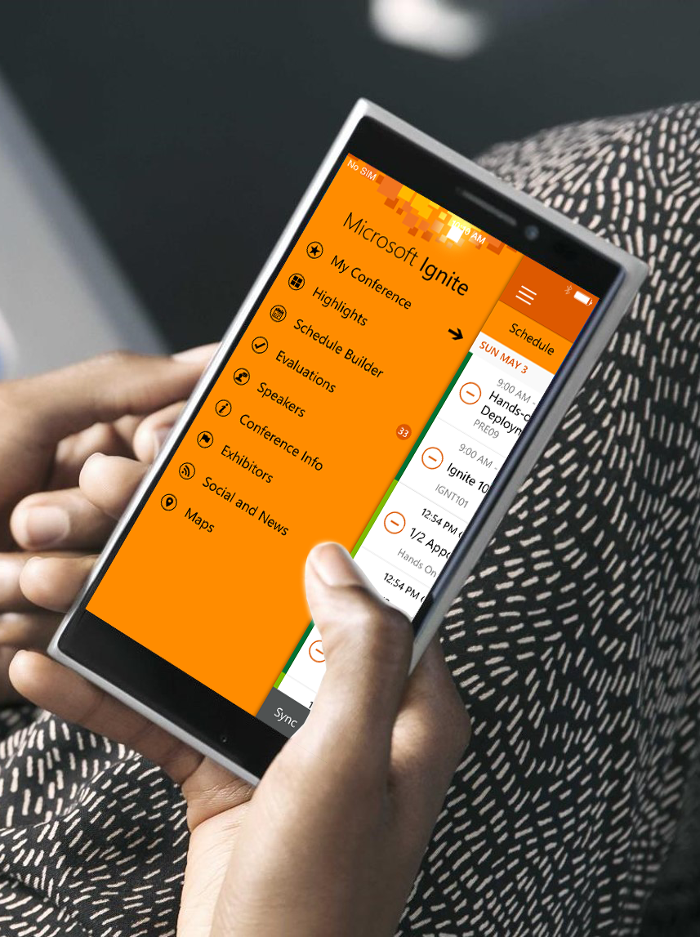
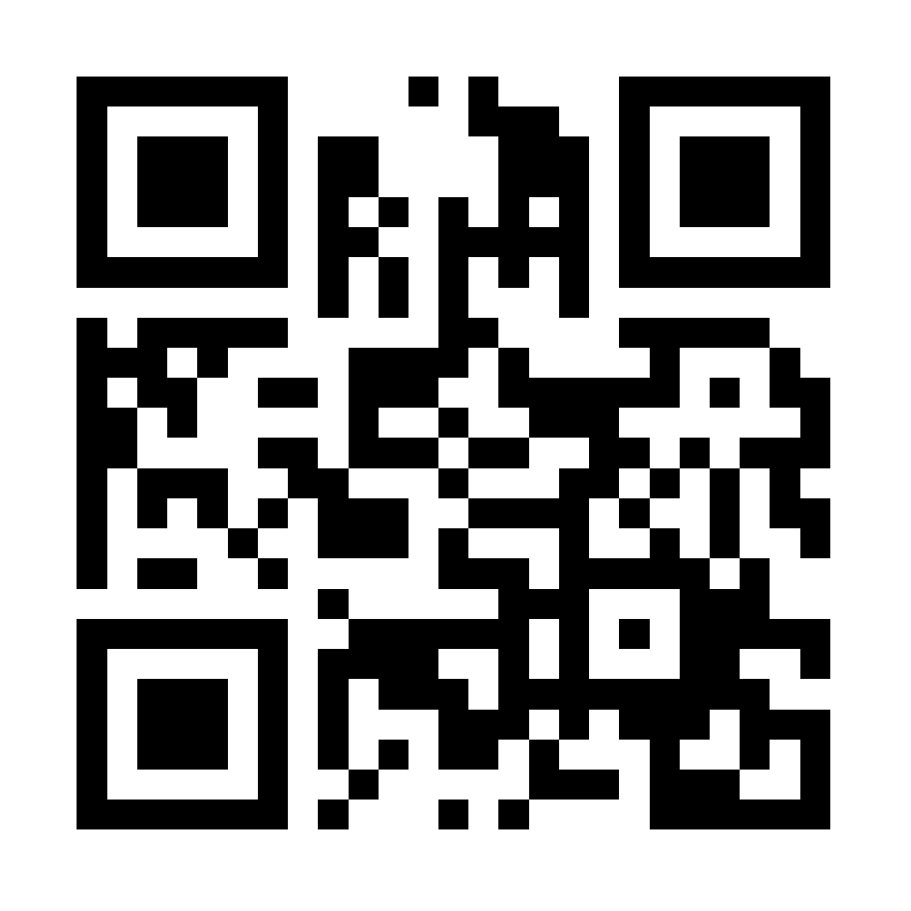
Please evaluate this session
Your feedback is important to us!
Visit Myignite at http://myignite.microsoft.com or download and use the Ignite Mobile App with the QR code above.

