Slide 2
Dell Forensic Files: IT Governance, Risk
& Compliance—Seeing the Unseeable
BRK1452
Thom Brainard
Product Marketing Manager
Dell Software

Slide 3

What is Governance, Risk and Compliance (GRC)?
“GRC is the automation of the management, measurement, remediation, and reporting of controls and risks against objectives, in accordance with rules, regulations, standards and policies.” - Gartner

Slide 4
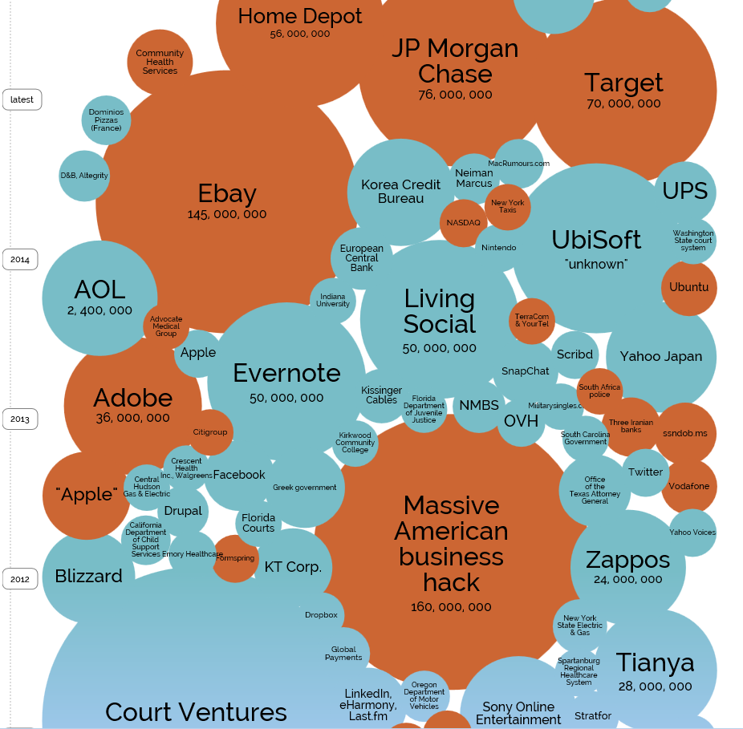
Why are we here?
Data breaches
Compliance failures
Penalties & fines
Damage to reputation
Loss of customers/revenue

Slide 5
2014 security threats by the numbers
63,437
55%
64%
Threats across organizations in 2014
Of insider misuse is privilege abuse, where internal actors abuse the access they’ve been entrusted with
Of data braches are caused by human error and system problems
80%
170M
Malware events across all organizations last year
99.9%
Of exploited vulnerabilities were compromised more than a year after a patch/fix was available.
Of cyber-espionage is done through internal systems
62%
Of organizations are unaware of security breaches and non-compliance for months
930M
The number of reported data breaches since 2005
$400M
Estimated financial loss from 700 million compromised records

Slide 6
Let’s talk compliance

Slide 7




Compliance challenges & pains
Compliance audits
No visibility
Manual processes
Security
Upcoming or failed audit
New requirements add more administrative tasks
Reporting is difficult
Limited resources
Don’t have a process to protect data
Don’t track what privileged users do
Can’t keep up with reviewing access rights
No alerting
Lack of visibility into environment and user activity
Don’t know when violations to security policies occur
The last to know when someone leaves or moves roles
Growing faster than manual processes can keep up with
Access, audits, permissions management, recovery, event log management

Slide 8
2014 PCI compliance by the numbers
80%
29%
64%
Of companies fail at interim assessment—unable to sustain security controls put in place
Of companies still fully compliant less than a year after successful validation
Of data braches are caused by human error and system problems
80%
205
Average number of days it takes an organization to detect a security breach
75%
The number of organizations that have to adhere to more than one compliance or departmental requirement
Of cyber-espionage is done through internal systems
62%
Of organizations are unaware of security breaches and non-compliance for months
0%
Companies found to be compliant at the time of a data breach (over last 10 years)
$5.9M
Average amount paid following a security breach

Slide 9
Difficulty answering common auditing questions?
Who has administrative access to Windows servers and workstations?
How do you know when sensitive systems and data are accessed?
Who can do what and where?
Who has access to what printers, shares, folders, files and SQL databases?
How are your servers and workstations configured such as general computer information, network settings, services running, installed programs, Service Packs and custom Registry keys?
How does the configuration of servers change over time?
What local users and groups along with membership exist on every server?
Which third-party applications are interacting with Active Directory?
How do you investigate a security breach?

Slide 10
IT GRC solutions from Dell

Slide 11


Slide 12

What drives our customers’ GRC needs
Required to adhere to external regulations such as PCI DSS, SOX, HIPAA
Adherence to internal policies and standards
Security breaches (internal and external offenders)
Leaks of sensitive data (accidental and maliciously motivated)
A failed IT audit

Slide 13
5 GRC operational challenges many organizations face
Inadequate visibility into current environment
Over-reliance on manual processes & scripts to manage, report on, and audit users and resources
Inconsistent or absence of a GRC strategy
Inadequate data protection
Failure to plan for and manage external & internal audits

Slide 14
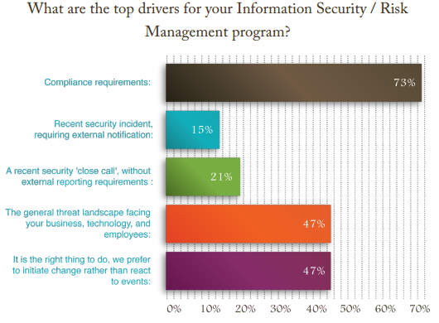
The value of compliance & security together
  A security approach to compliance vs. a compliance approach to security
IT GRC can be…
  a motivator for improving security AND meeting compliance
  a budget driver to buy auditing/security solutions
  a solution to keep the business accountable and proactive
  valuable to security programs

Slide 15
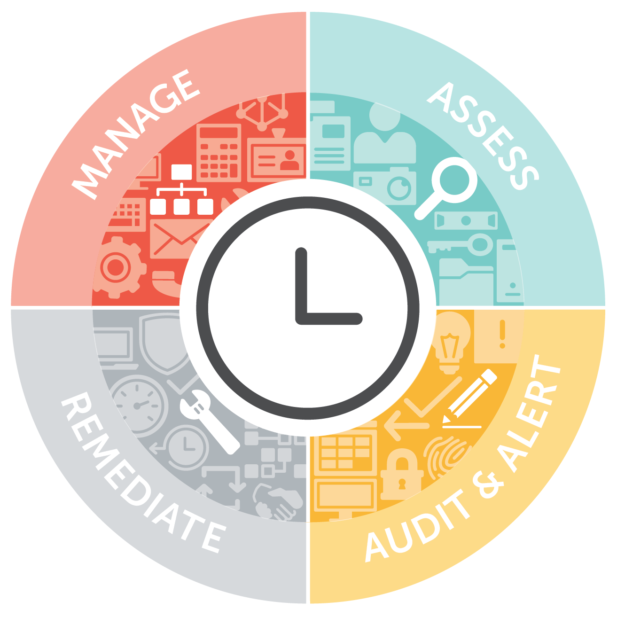
Continuous compliance
Around-the-clock peace of mind
Administer access rights
and permissions
Implement best-practice compliance reporting
Retain and retrieve data
Analyze access rights
and permissions
Determine configuration settings
Set baselines
Implement preventative controls
Report on and rectify deviations and security breaches
Discover and restore AD objects, forests, email content and mailboxes
Track key performance and security indicators
Audit and report on user activity
Enable real-time alerts

Slide 16
How our solutions help you pass audits
Prevention: Prevent critical changes to Active Directory, Exchange and sensitive files/folders.
Detection: Alert on suspicious activities in real time to monitor your critical controls, including changes to privileged/administrative accounts.
Reporting: Schedule and deliver audit-ready reports for HIPAA, PCI, SOX, FISMA and more.
Remediation: Quickly restore security settings, configurations and data to a known secure state.

Slide 17
How IT GRC solutions can prevent & detect data breaches
Assessment: Automate reporting on security and configuration settings across servers and systems (outdated patch levels,
Prevention: Prevent critical changes to Active Directory and other sensitive data.
Detection: Alert on suspicious activities in real time to monitor your critical controls, including changes to privileged/administrative accounts.
Remediation: Quickly restore security settings, configurations and data to a known secure state.
Forensics: Quickly analyze breaches to see who accessed what, when, on which server, from which workstation… and how!
When combined with other Dell security solutions (IAM, Data Protection, Endpoint Protection, SonicWALL, SecureWorks, etc.), no other vendor offers a complete end-to-end security solution.

Slide 18
Business value for Dell IT GRC
Minimizes the effort and investment required to achieve and maintain compliance with continuous system monitoring
Provides managers and auditors evidence of appropriate IT controls with peace of mind
Alleviates stress and complexity by interpreting data automatically in a human-readable format for faster and better decision making
Empowers executives, reduces risk and ensures compliance is met with reports to confidently address stakeholders
Controls costs using the same solutions to address compliance and security requirements, whilst improving operational activities

Slide 19
A closer look

Slide 20
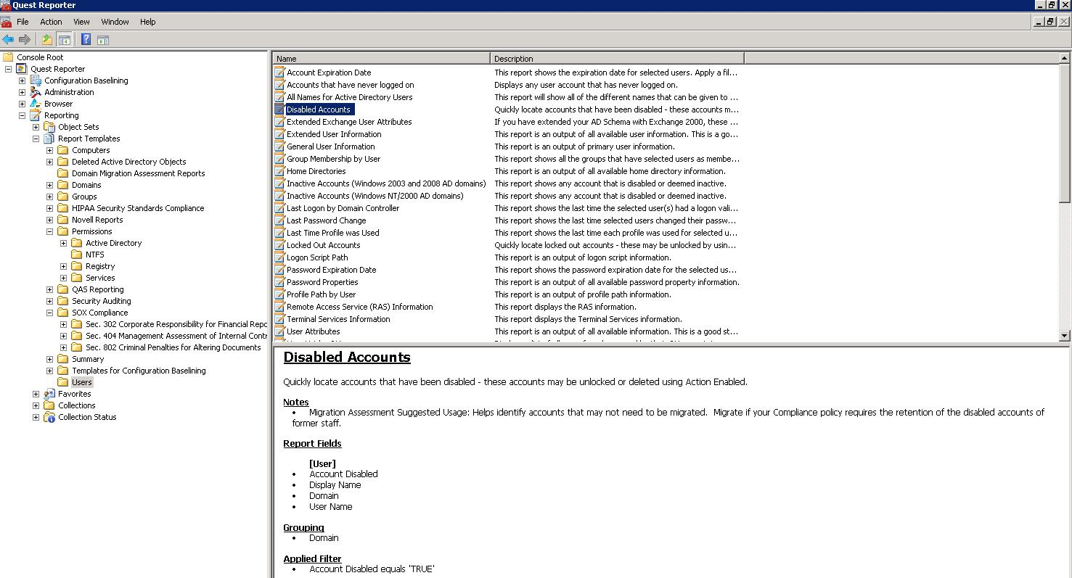
Active Roles Server
Simplified yet powerful management & security for Active Directory
Increasing security while more effectively delegating rights
Protecting critical data and enforcing policies to eliminate unregulated access
Granting users and administrators correct access to exactly what they need – nothing more
Built-in workflows that place approval and escalation processes around AD object creation
Enforces role-based administration eliminating the need for most admins to have native privilege access in AD.
Assess
Audit
Manage

Slide 21
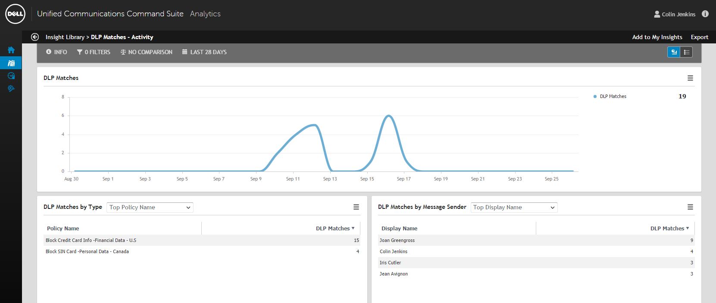
UCCS
Data leak protection (DLP) and communication policy enforcement
Protects intellectual property, personally identifiable information (PII) and other sensitive communications from leaving the company via email, reducing your legal risks.
Assess
Audit
Manage

Slide 22
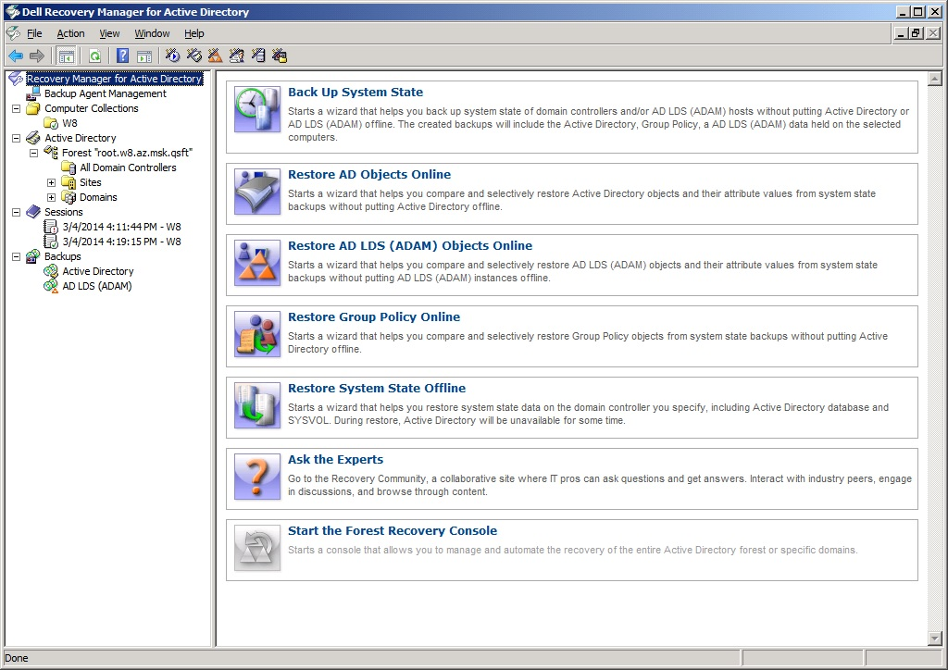
Recovery Manager
Maintain business continuity with streamlined backups and disaster recovery
Facilitates efficient search and recovery of lost data from individual objects,
permissions, email and files to full disaster recovery
Assess
Audit
Manage
Recover

Slide 23
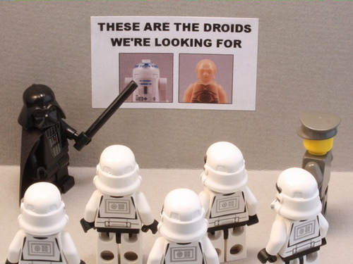
IT Search
IT data analysis

Slide 24
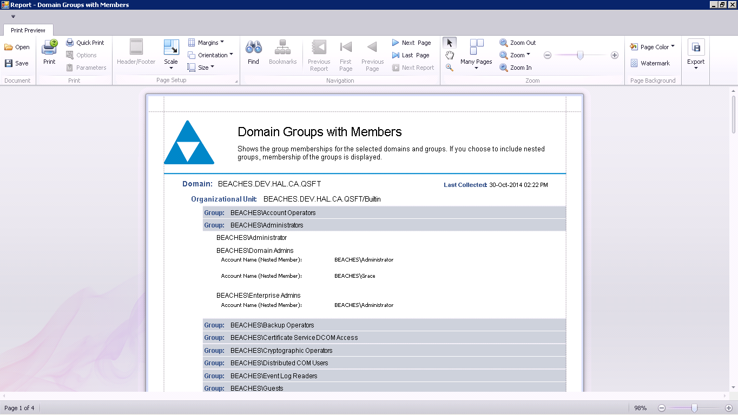
Enterprise Reporter
Gain visibility into your environment
Reporting and analysis tool enables you to provide Intelligence needed to decrease daily management workload
Assess

Slide 25
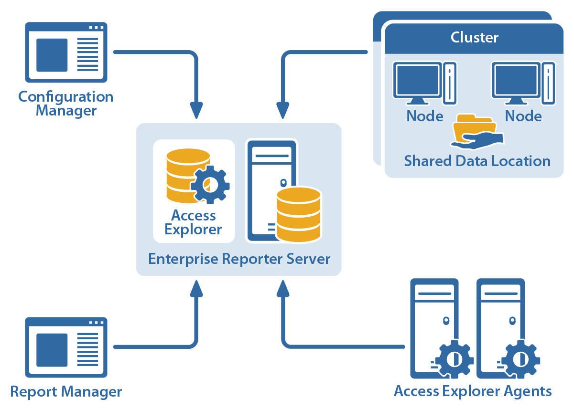
Enterprise Reporter
Enterprise Reporter is an automated, scalable solution for auditing, analyzing and reporting on Microsoft® Active Directory®, Windows Server®, SQL Server® and file servers across the enterprise. Predefined and customizable reporting tools make it easy to perform:
Compliance and security assessments
Pre- and post-migration analyses
File storage capacity planning and monitoring

Slide 26
Why Enterprise Reporter
Configuration visibility
Security assessment
Pre-migration
& storage analysis
How do I stay compliant with security best practices and compliance regulations?
How are my servers configured?
How do I tighten up security and pass the audit?
Who has access to what?
How do I ensure a smooth migration project?
How do I monitor storage usage and capacity?
What software is installed on my servers?
What local users and groups are present on servers?
What logins exist in my SQL server database?
Who has administrative access to Windows servers and workstations?
Where users have permissions to shares, folders and files on file servers and network filers?
Who has delegated rights in Active Directory?
How many domains, users and groups are there?
What data (accounts, files, etc.) can be excluded from migration?
Am I nearing storage capacity limits? Who are top violators of storage policies?

Slide 27
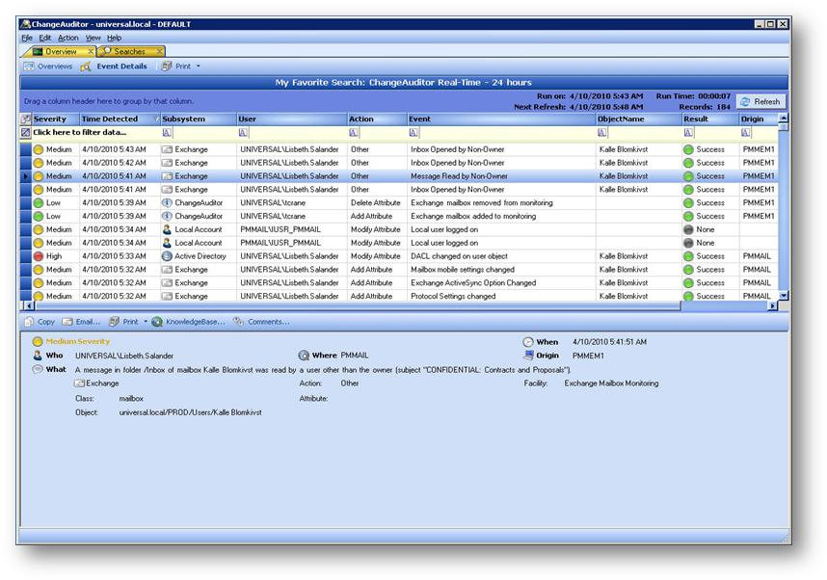
Change Auditor
Monitoring who’s doing what, when, where, why and from which workstation
Audits the activities taking place in your Windows environment and provides real-time alerts when vital changes occur while providing context in support of Why
Provides before and after values on all changes allowing you to keep on top of transition in your environment
Assess
Audit

Slide 28







Change Auditor
Change Auditor provides complete, real-time change auditing, in-depth forensics and comprehensive reporting on all key configuration, user and administrator changes for Active Directory, ADLDS, AD Queries, Exchange, SharePoint, Lync, VMware, NetApp, Windows File Servers, EMC, and SQL Server. Change Auditor also tracks detailed user activity for web storage and services, logon and authentication activity and other key services across enterprises.
Who
Made the change?
Where
Was the change made from?
What
Object was changed?
Why
Was the change made (comment)?
Real-time
smart alerts
to any device
When
Was the change made?
Workstation
Where the change originated from

Slide 29
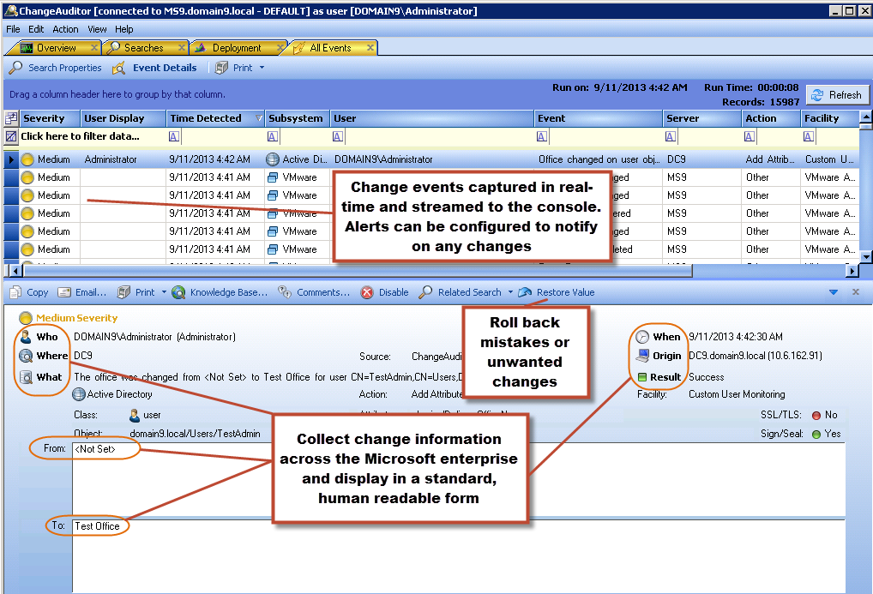
Visibility into enterprise-wide activities from one console

Slide 30
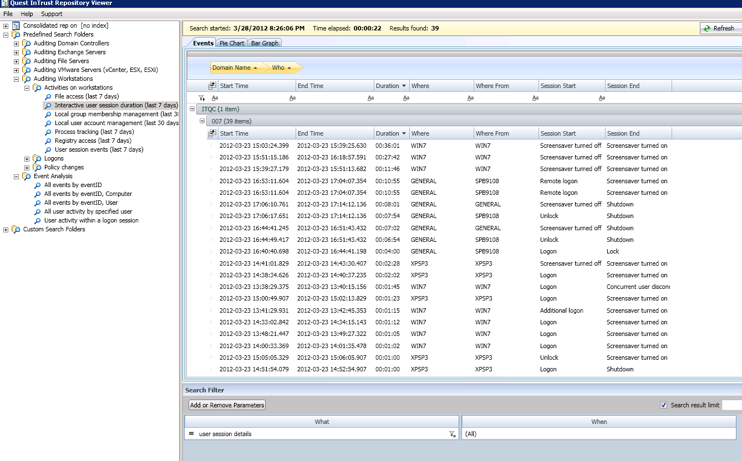
InTrust
Event log management for security and compliance
Reduces the complexity and cost of event log management and collects, stores, reports and alerts on event log data
Assess
Audit
Manage

Slide 31
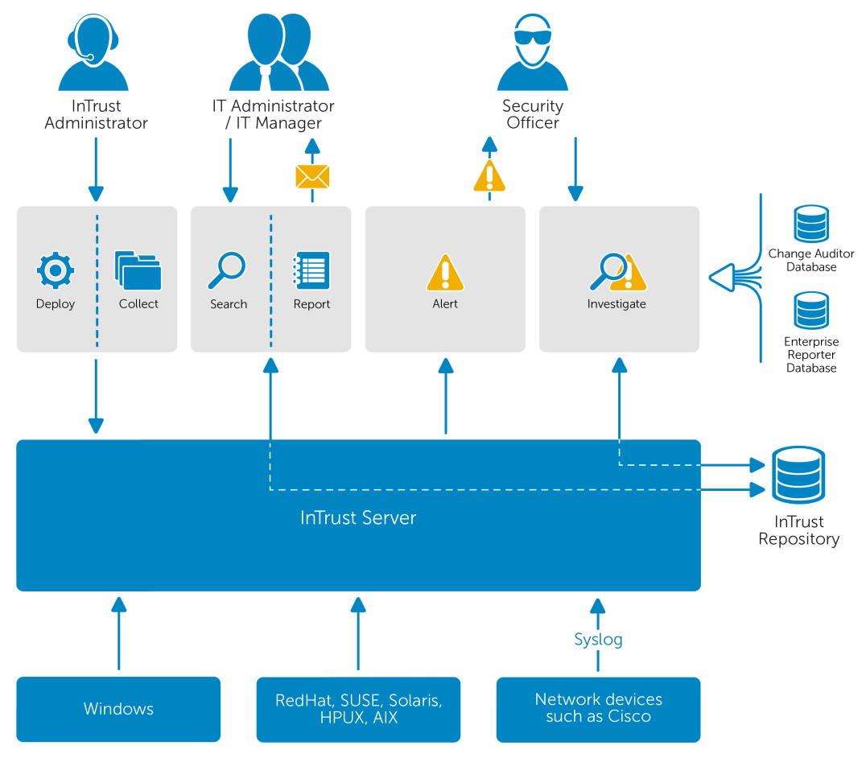
InTrust/IT Search
Consolidate, archive, search and analyze massive amounts of IT data
  Reduce the complexity of searching
  Search multiple sources in one UI
  Get real-time results
  Forensically investigate wide-spread incidents
  Comply with retention requirements, yet save on storage costs (40:1 compression)

Slide 32
Gain IT insights with on-the-fly investigations
Correlate disparate IT data
Review incidents quickly
Investigate Dynamically

Slide 33
Automate, archive and secure event logs
Real-time log collection
Archive, normalize and categorize
Secure events before they’re sent

Slide 34
Improve IT data analytics
Single pane of glass
SIEM integration
Diverse systems support

Slide 35
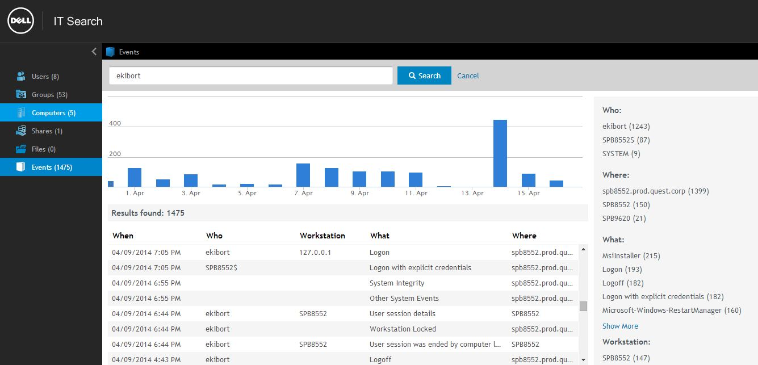
Make sense of your IT data with IT Search

Slide 36
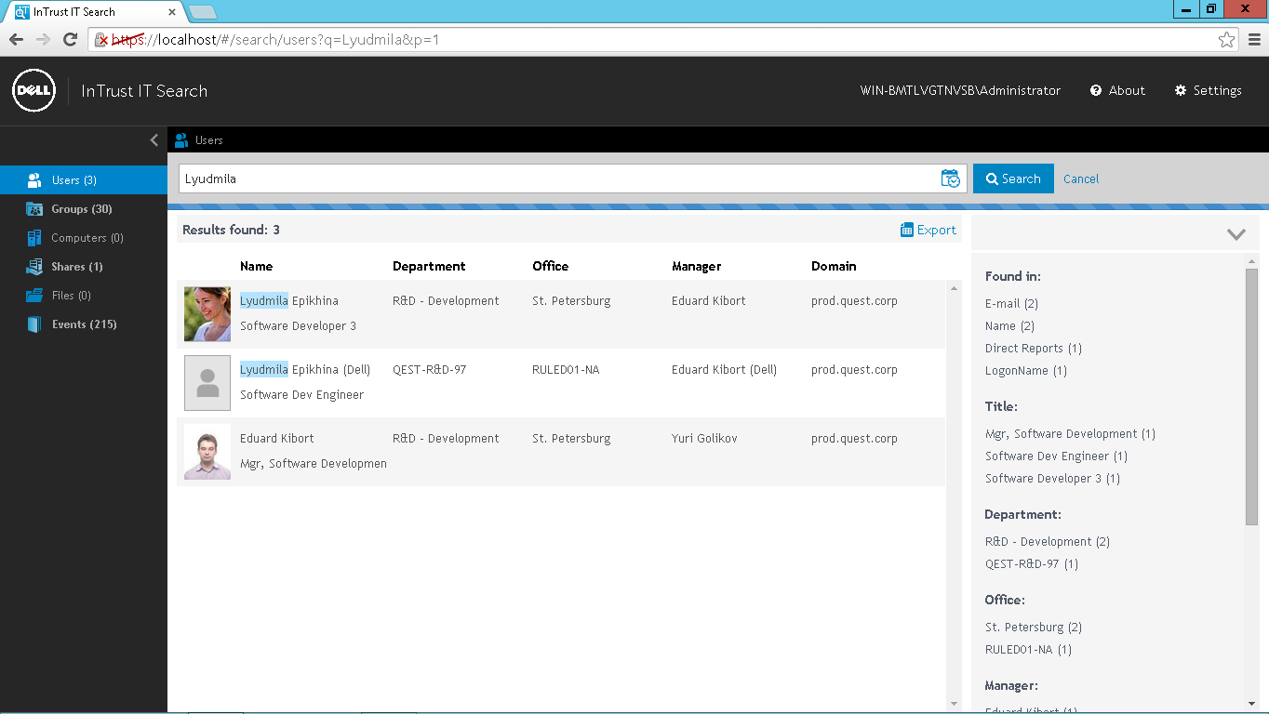
Search all IT assets in one place

Slide 37
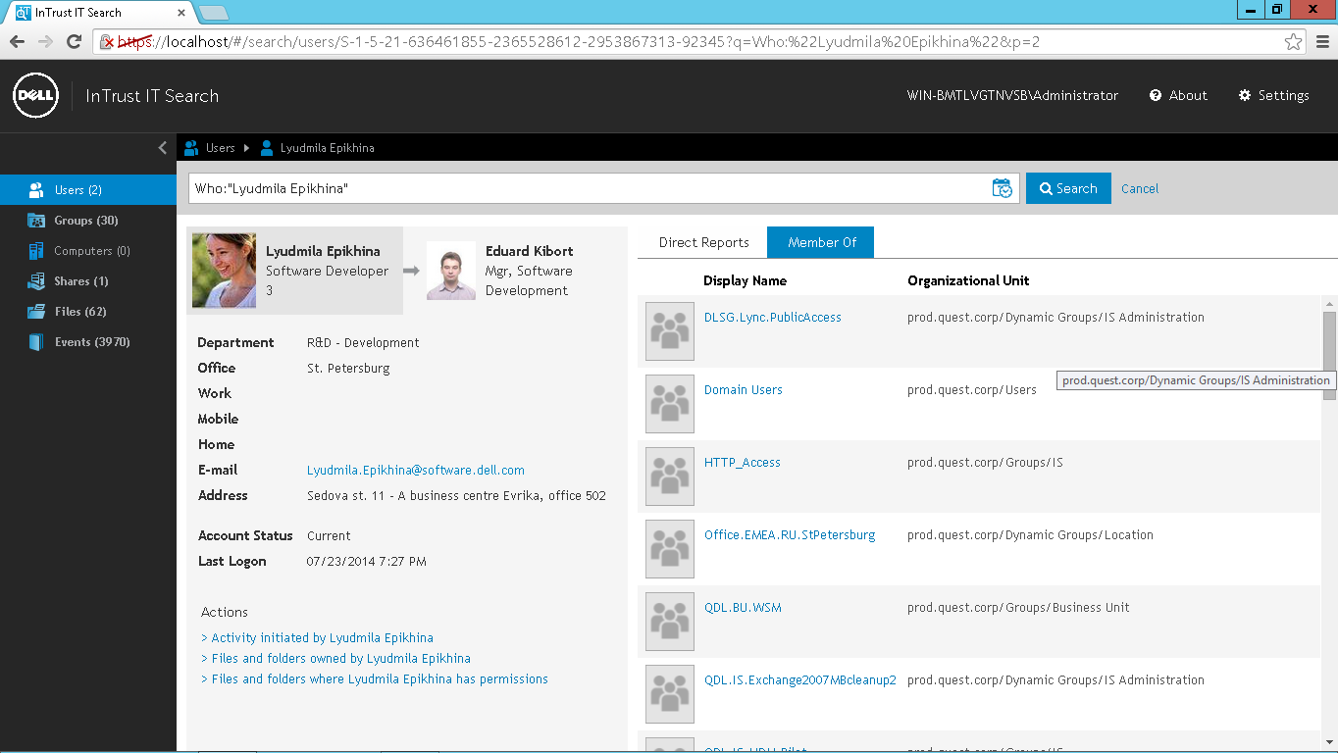
Exploit relationships between events and state-based data

Slide 38
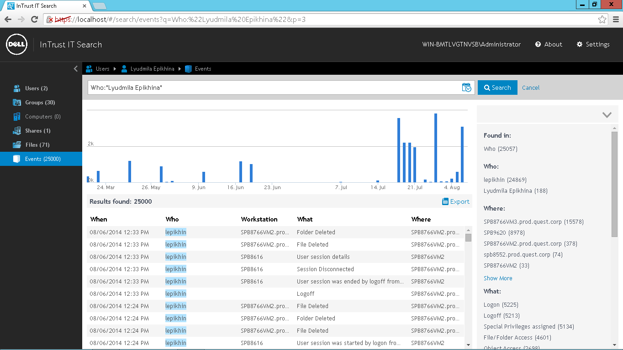
See what resources users had accessed

Slide 39
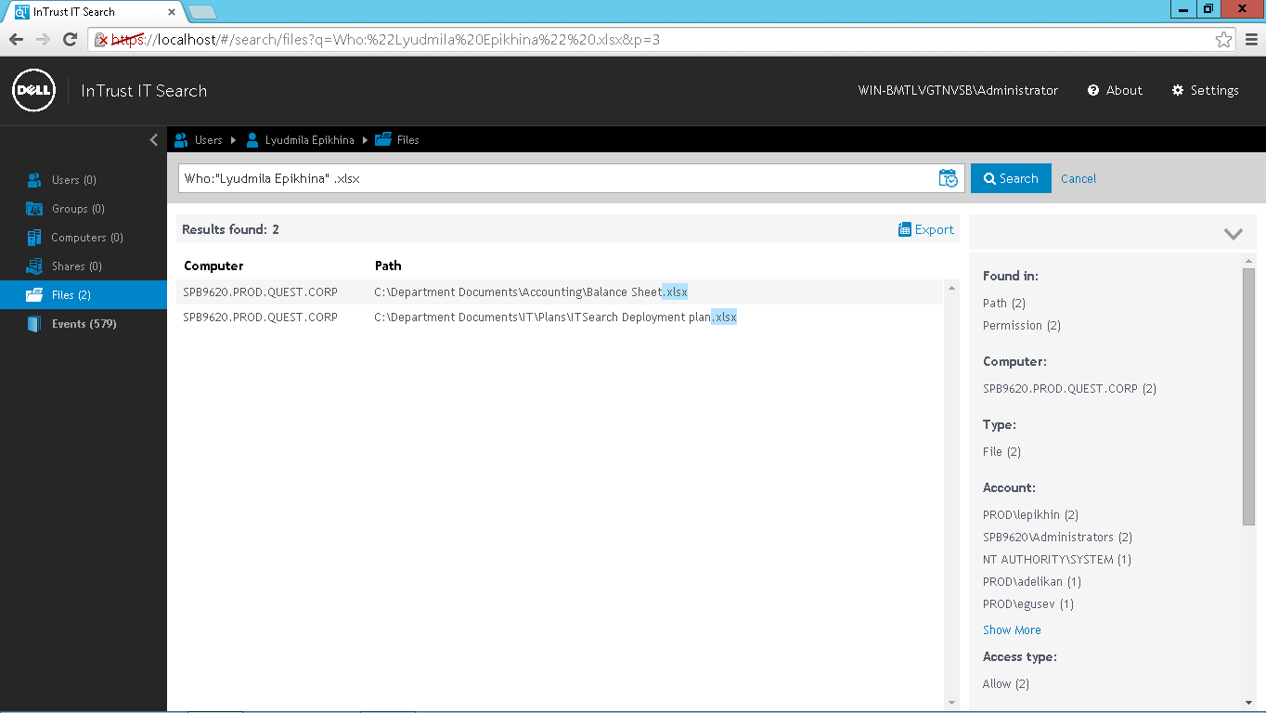
See where users have access

Slide 40
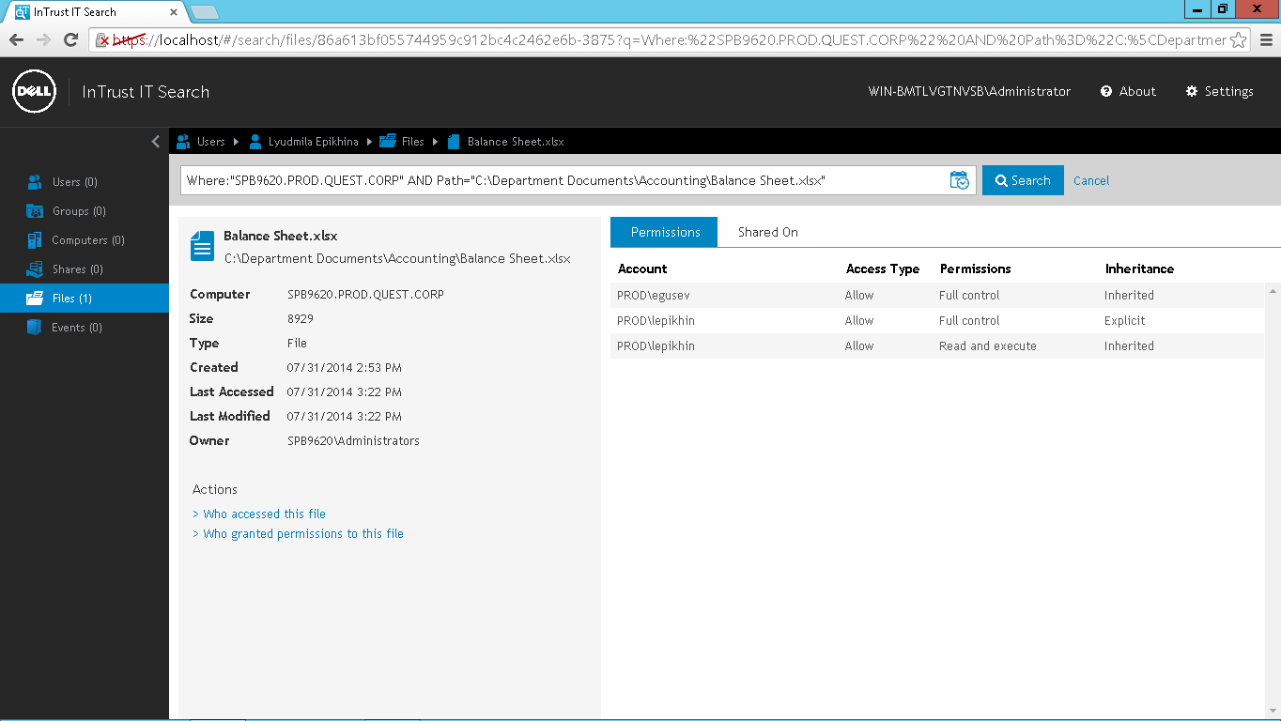
See how access was obtained

Slide 41

Dell: One place for end-to-end solutions
Comprehensive portfolio built with the industry’s most innovative IP
Optimized enterprise
Business-class connected solutions
Flexible,
next-gen services
Value-added software
Servers
Storage
Networking
Applications/workloads
Data center solutions
Tablets
Laptops
Desktops
Workstations
Printers
Proactive support
Consulting/deployment
App/cloud/managed
BPO
Security
Data center/cloud
Data protection
Information mgmt
Mobile workforce mgmt
Security
Engineered to work better together—and work with what you already have

Slide 42




Dell Software solutions capabilities
Data center & cloud management
Information management
Mobile workforce management
Endpoint management
Performance management
Virtualization & cloud mgmt
Windows server mgmt
Application & data integration
Big data analytics
Business intelligence/analytics
Database management
Application enablement/delivery
Desktop virtualization
Mobile device mgmt
Mobile security
Security
Data protection
Email security
Endpoint security
Identity & access management
Network security
Application protection
Disaster recovery
Enterprise backup/recovery
Virtual protection

Slide 43






Windows Server Management
Giving our customers the power to do more.
ZeroIMPACT Migration
Dell helps customers maximize their investment across the entire Microsoft stack.
IT Governance, Risk & Compliance
Increase IT efficiency & shift resources to innovation
Control risk everywhere, from migration to operations to compliance
Keep pace with the changing needs of the business
Maintain the availability and performance of Microsoft platforms and meet SLAs
Modernize your infrastructure to meet business demands
Administration & Recovery

Slide 44
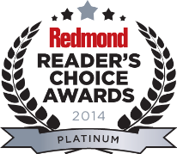
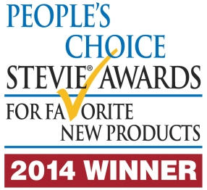

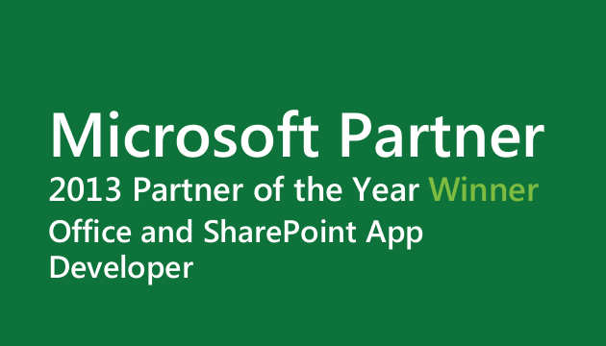
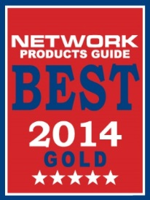
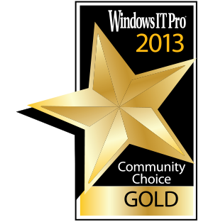
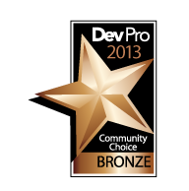

Awards
Dell Software Windows Migration & Management Portfolio
Network Product Guide – Product Portfolio Expansion (IT Software) of the Year – Gold
Active Administrator
WindowSecurity.com Readers’ Choice Winner
Redmond Reader’s Choice Awards – Silver
Change Auditor
People’s Choice STEVIE Award - Winner
Redmond Reader’s Choice Awards – Platinum
New Product of the Year STEVIE Winner – Bronze
Network Product Guide – Compliance Data Center Gold Winner
Info Security Compliance Award - Bronze
Migration Manager
Redmond Reader’s Choice Awards – Platinum
Migration Manager for PSTs
New Product of the Year STEVIE Winner – Bronze
Mobile IT
Windows IT Pro Community Choice – Gold
On Demand Migration for Email
New Product of the Year STEVIE Winner – Gold
Quick Apps for SharePoint
Dev Pro Community Choice – Bronze
Network Products Guide – IT Products and Services for Enterprise (Large) - Bronze
Recovery Manager for AD Forest Edition
People’s Choice STEVIE Award - Winner
New Product of the Year STEVIE Winner – Bronze
Recovery Manager for SharePoint
Windows IT Pro Community Choice - Silver
Security Explorer
Redmond Reader’s Choice Awards – Bronze
Site Administrator for SharePoint
Redmond Reader’s Choice Awards – Gold
Windows IT Pro Community Choice - Gold
Unified Communications Command Suite
UC Product of the Year - TMCNet
STEVIE WINNER – Bronze
Windows IT Pro Community Choice - Silver

Slide 45
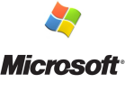
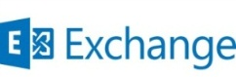

Windows management success and leadership
50+ Million
mailboxes migrated to Exchange
75+ Million
user accounts audited across 11 platforms
2X
Microsoft ISV Partner of the Year
128+ Million
Active Directory accounts managed
24x7
award-winning global support
36+ Million
Exchange mailboxes managed
65+ Million
Active Directory accounts migrated
Hundreds of TBs
of data migrated to SharePoint

Slide 46
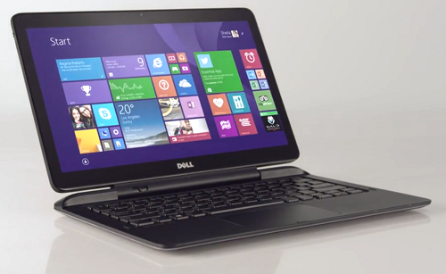
Next steps
See a demo in the Dell booth and get a daily raffle ticket for
a Dell Latitude 13 7000 2-in-1 Ultrabook/Tablet
Visit www.dellsoftware.com/cc
Email: thom_brainard@dell.com

Slide 47


Please evaluate this session
Your feedback is important to us!
Visit Myignite at http://myignite.microsoft.com
or download and use the Ignite Mobile App
with the QR code above.

