Slide 2
Microsoft Azure and its Competitors: The Big Picture
BRK1455
David Chappell, Chappell & Associates
www.davidchappell.com
@DChappellAssoc

Slide 3
The Three Most Important Events In enterprise IT in the last decade or so
Salesforce.com IPO, 2004
Launch of Amazon Web Services, 2006
Release of Apple iPhone, 2007
Showed that Software as a Service (SaaS) works
Introduced public cloud platforms
The birth of mobile platforms

Slide 4
Enterprise IT The traditional world
Packaged Applications
Custom
Applications
Datacenter Infrastructure
PCs/Laptops

Slide 5
Enterprise IT The new default
Custom
Applications
On-premises packaged applications are becoming SaaS applications
SaaS Applications
Cloud platforms are the new foundation for competitive advantage
Public Cloud Platform
This isn’t the post-PC era, but it is the PC+ era
PCs/Laptops
Tablets
Phones

Slide 6
Public Cloud Platforms: A Survey

Slide 7
Cloud Platform Technologies A simple summary
Compute
Data
Everything else
Run new applications
Might run existing packaged and custom applications
Store and access information
Analyze information
Identity, machine learning, VPNs, media services, integration, …
This category keeps on growing

Slide 8
Cloud Platform Technologies Compute services
Infrastructure as a Service (IaaS)
Platform as a Service
(PaaS)
Application
VM
VM
VM
VM
Create and use virtual machines
Provide applications
VM Images

Slide 9
Why IaaS is More Important Than PaaS An aside
IaaS
PaaS
Many think PaaS is much better for this
Support new
cloud-native apps
Yes
Yes
Run existing websites
Yes
Maybe
Run on-premises packaged or custom applications
Yes
No
Run a standard
DBMS, e.g., SQL Server
Yes
No
Provide VMs for dev/test
Yes
No
Support disaster recovery
Yes
No

Slide 10
Cloud Platform Technologies Data services
Also called
object storage
Blobs
Relational
NoSQL
100011010011110111110110
100011010011110111110110
100011010011110111110110
Can also run a relational or NoSQL DBMS in IaaS VMs

Slide 11
Cloud Platform Technologies Others
Identity
Machine Learning
Lots More
Data
Machine
Learning
Algorithms
SaaS and On-Premises
Applications
. . .
Directory
Service
Application
Model

Slide 12
Public Cloud Platforms Example vendors and technologies
Compute
Data
Others
Machine
Learning
IaaS
PaaS
Blobs
Relational
NoSQL
Identity
Microsoft
Azure
Amazon
Web Services
Google
Cloud Platform
OpenStack
Salesforce.com Force.com

Slide 13
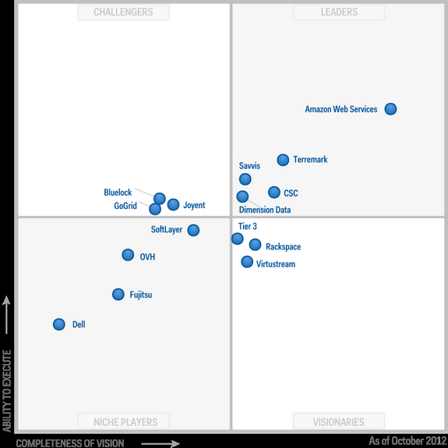
Gartner Public Cloud IaaS MQ October 2012
AWS is out in front
Microsoft and Google don’t yet offer IaaS
What?

Slide 14
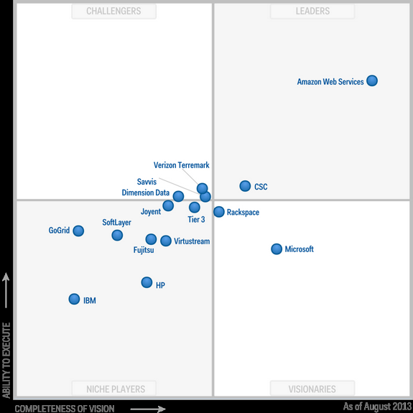
Gartner Public Cloud IaaS MQ August 2013
AWS is further out in front
Google doesn’t yet offer IaaS
Microsoft began offering IaaS two months earlier
The most visible OpenStack supporters
IBM is in real trouble

Slide 15
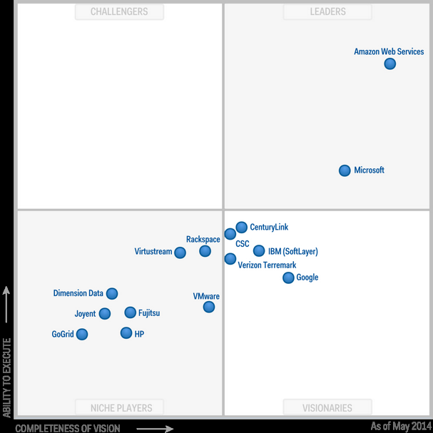
Gartner Public Cloud IaaS MQ May 2014
AWS is still in front
But it’s a two-horse race
Google has finally entered the market
Look where the other big enterprise vendors are

Slide 16
Public Cloud Platforms Microsoft
Compute
Data
Others
Machine
Learning
IaaS
PaaS
Blobs
Relational
NoSQL
Identity
Microsoft
Azure
Virtual Machines
Web Sites, Cloud Services
Blobs
SQL Database
DocumentDB, Tables
Azure Active Directory
Azure ML
Amazon
Web Services
Google
Cloud Platform
OpenStack
Salesforce.com Force.com

Slide 17
Azure Active Directory Premium Single sign-on for SaaS applications
Windows Server Active Directory
2
Login
On-Premises Application
ENTERPRISE
IT Admin
User
3
Access on-premises and SaaS applications
Including Google Apps, Salesforce, and lots more
1
Configure link
MICROSOFT AZURE
Azure
Active Directory
SaaS Application
SaaS Application
OTHER ENVIRONMENT

Slide 18
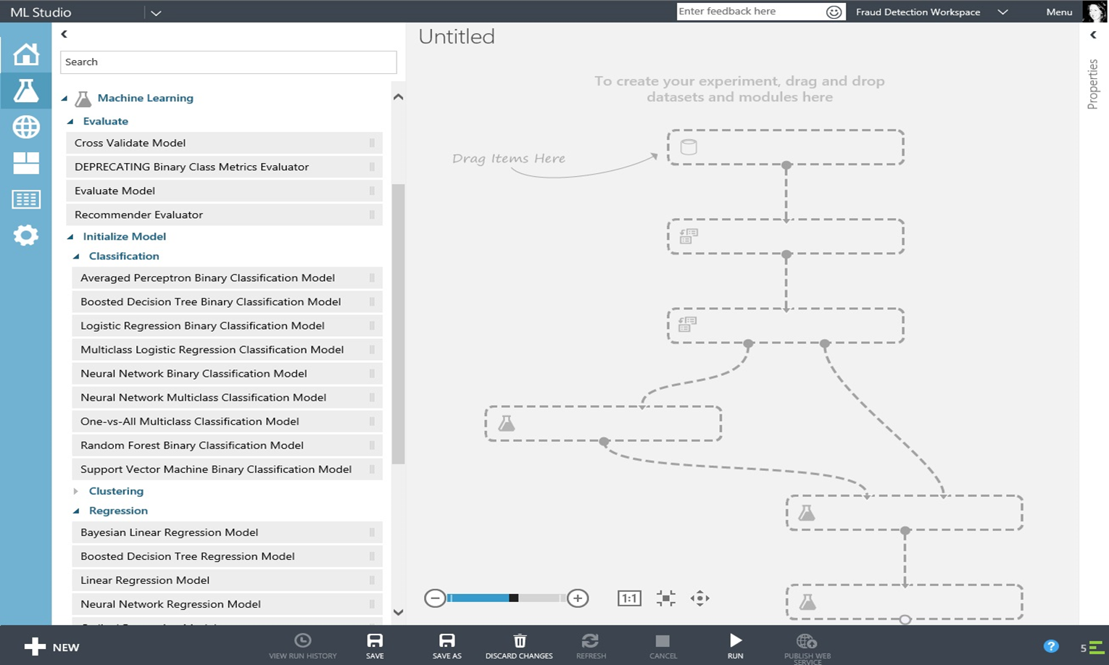
Azure ML
ML Studio
Raw Data
Prepared
Data
Apply learning algorithm
to data
Apply pre-processing to data
Deploy chosen model
Candidate
Model
Chosen
Model
Raw Data
Preprocessing Modules
Applications
Data Preprocessing Modules
Machine
Learning Algorithms

Slide 19
Microsoft An assessment
Microsoft was slow in offering IaaS
Microsoft has strong customer relationships
Microsoft emphasizes hybrid clouds
Although it’s recovering quickly from that delay
IT leaders commonly place a high value on these
Microsoft is already in most accounts
Given Microsoft’s large on-premises installed base, this isn’t surprising

Slide 20
Public Cloud Platforms Amazon
Compute
Data
Others
Machine
Learning
IaaS
PaaS
Blobs
Relational
NoSQL
Identity
Microsoft
Azure
Virtual Machines
Web Sites, Cloud Services
Blobs
SQL Database
DocumentDB, Tables
Azure Active Directory
Azure ML
Amazon
Web Services
Elastic Compute Cloud (EC2)
Elastic Beanstalk
Simple Storage Service (S3)
Relational Database Service (RDS)
DynamoDB
Amazon ML
Google
Cloud Platform
OpenStack
Salesforce.com Force.com

Slide 21
Amazon An assessment
AWS is a startup that got it right immediately
Amazon is viewed as a leader in this market
AWS is focused on the public cloud
Their first offerings were IaaS and blobs
These are still the two most widely used cloud platform technologies
They were the first mover in public cloud platforms
Amazon has called private cloud “false cloud”

Slide 22
Public Cloud Platforms Google
Compute
Data
Others
Machine
Learning
IaaS
PaaS
Blobs
Relational
NoSQL
Identity
Microsoft
Azure
Virtual Machines
Web Sites, Cloud Services
Blobs
SQL Database
DocumentDB, Tables
Azure Active Directory
Azure ML
Amazon
Web Services
Elastic Compute Cloud (EC2)
Elastic Beanstalk
Simple Storage Service (S3)
Relational Database Service (RDS)
DynamoDB
Amazon ML
Google
Cloud Platform
Compute Engine
App Engine
Cloud Storage
Cloud SQL
Cloud Datastore
Prediction API
OpenStack
Salesforce.com Force.com

Slide 23
Google An assessment
Google began with App Engine
Google appears serious about cloud platforms (finally)
Expect them to be a price leader
Like Microsoft, Google initially bet that the market wanted PaaS
Their IaaS offering is relatively new
They’ve announced support for Windows Server in Compute Engine
Initially for Windows Server 2008 R2; now includes Windows Server 2012 R2
They’ve said that cloud platform prices should follow Moore’s Law
They’ve innovated with pricing, e.g., reservation-like pricing once consumption hits a certain amount

Slide 24
Public Cloud Platforms OpenStack
Compute
Data
Others
Machine
Learning
IaaS
PaaS
Blobs
Relational
NoSQL
Identity
Microsoft
Azure
Virtual Machines
Web Sites, Cloud Services
Blobs
SQL Database
DocumentDB, Tables
Azure Active Directory
Azure ML
Amazon
Web Services
Elastic Compute Cloud (EC2)
Elastic Beanstalk
Simple Storage Service (S3)
Relational Database Service (RDS)
DynamoDB
Amazon ML
Google
Cloud Platform
Compute Engine
App Engine
Cloud Storage
Cloud SQL
Cloud Datastore
Prediction API
Compute
Object Storage
Database
OpenStack
Salesforce.com Force.com

Slide 25
OpenStack An assessment
It’s an open source project, but not really standard
Some firms offer public IaaS based on OpenStack
At most, one or two vendors will dominate OpenStack
Users love standards, so vendors claim to follow them
But they also add proprietary extensions
OpenStack gets more press attention than it deserves
And it’s unclear who they’ll be
HP’s Helion public cloud hasn’t gotten much traction
Rackspace has left the pure IaaS market

Slide 26
Cloud APIs An aside
Cloud Software
IaaS
Tools and Applications
Tools and Applications
Tools and Applications
IaaS: Start VM, Stop VM, …
Blobs: Get blob, put blob, …
VMs
VMs
VMs
Example APIs:
AWS
Azure
OpenStack
…
Blobs

Slide 27
Public Cloud Platforms Salesforce
Compute
Data
Others
Machine
Learning
IaaS
PaaS
Blobs
Relational
NoSQL
Identity
Microsoft
Azure
Virtual Machines
Web Sites, Cloud Services
Blobs
SQL Database
DocumentDB, Tables
Azure Active Directory
Azure ML
Amazon
Web Services
Elastic Compute Cloud (EC2)
Elastic Beanstalk
Simple Storage Service (S3)
Relational Database Service (RDS)
DynamoDB
Amazon ML
Google
Cloud Platform
Compute Engine
App Engine
Cloud Storage
Cloud SQL
Cloud Datastore
Prediction API
Compute
Object Storage
Database
OpenStack
Salesforce.com Force.com
Force.com App Logic
Force.com Database
Salesforce Identity

Slide 28
Salesforce An assessment
Force.com is typically sold as an adjunct to Salesforce CRM
Force.com is aimed at enterprise developers
Customer lock-in to Force.com is total
It’s PaaS, so it’s intended for new custom apps
Since your customer data is in the Salesforce cloud, why not build your apps there, too?
Some apps can be built solely with point-and-click tools
Developers can also use Apex, a Salesforce language
The platform, language, and tools are all proprietary
There’s no lock-in like cloud lock-in
Dynamics CRM includes xRM, a similar PaaS platform

Slide 29
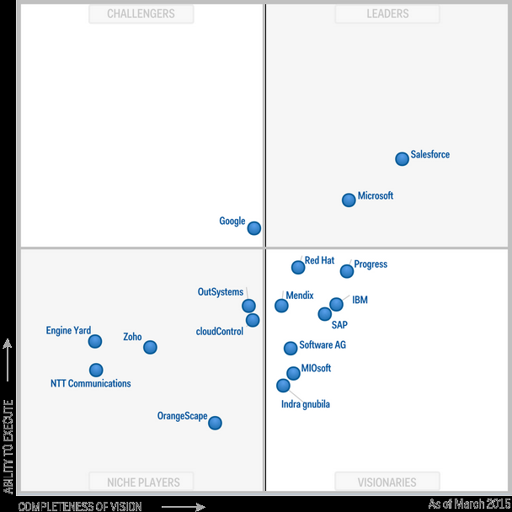
Gartner Enterprise Application PaaS MQ March 2015
In front because this MQ is focused on enterprise applications
Released before Azure, yet still a challenger
But it’s a two-horse race
The rest of the PaaS market is a crowded mess

Slide 30
IBM An assessment
IBM’s overall revenue has been steadily declining
IBM began with various half-hearted cloud initiatives
IBM bought SoftLayer for $2 billion in mid-2013
IBM announced a plan to spend $1.2 billion on cloud
None seemed serious
None got much traction with customers
SoftLayer was half hoster, half cloud provider
IBM highlights SoftLayer’s ability to provide both VMs and physical servers
But it’s spread across many datacenters
Microsoft spends this to build a single datacenter
“I think we’ve entered cloud at a perfect time.”
- Michael Rhodin, IBM Senior VP, Spring 2014

Slide 31
VMware An assessment
Formerly called vCloud Hybrid Service
Initially encouraged hosters to offer IaaS with vCloud
Currently offer vCloud Air themselves
vCloud Air isn’t a complete public cloud platform
Hosters didn’t much like this
Uptake was limited
It provides IaaS based on vSphere in VMware datacenters
It’s mostly VMs
Customers can also buy some Google Cloud Platform services through vCloud Air, e.g., blobs

Slide 32
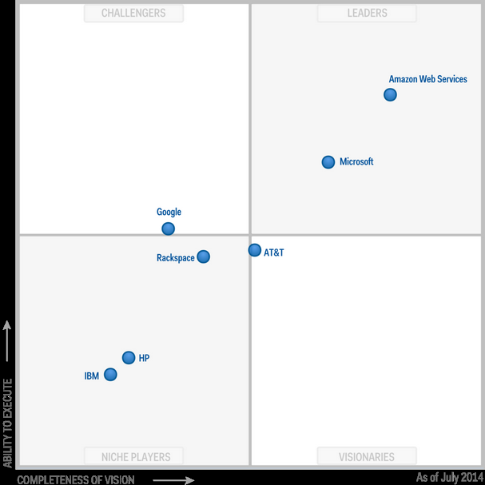
Gartner Public Cloud Storage MQ July 2014
AWS is in the Leaders Quadrant
So is Azure
Google is a ways behind
The traditional enterprise vendors

Slide 33
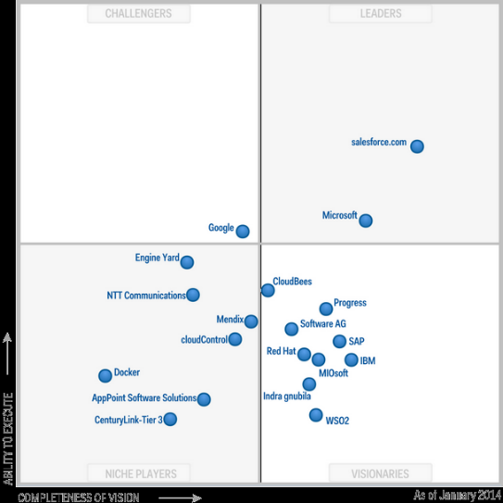
Summarizing the Public Cloud MQs
Microsoft
IaaS
PaaS
Storage

Slide 34
Public Cloud Platforms for Enterprises A summary
Amazon
Microsoft
Salesforce.com
Google
Cloud Strength
HP
IBM
VMware
Enterprise Strength

Slide 35
The Big Picture

Slide 36
IT Today: The New Default A more detailed look
Email
Custom
Applications
IaaS
NoSQL
SaaS Applications
Identity
Collaboration
PaaS
Public Cloud Platform
Productivity
Blobs
ML
CRM
. . .
Relational
. . .
PCs/Laptops
Clients
Tablets
Phones

Slide 37
IT Today: The New Default Microsoft
Exchange Online
Custom
Applications
Virtual
Machines
Tables,
DocumentDB
SaaS Applications
SharePoint Online
Web Sites,
Cloud Services
Azure
AD
Microsoft Azure
Office Online
Blobs
Machine
Learning
Dynamics
CRM
. . .
SQL
Database
. . .
Windows 8
Clients
Windows 8
Windows Phone 8

Slide 38
IT Today: The New Default Amazon
Workmail
Custom
Applications
EC2
DynamoDB
SaaS Applications
Collaboration
Elastic
Beanstalk
Identity
Amazon Web Services
Productivity
S3
Machine
Learning
CRM
. . .
RDS
. . .
PCs/Laptops
Clients
Kindle Fire
Fire Phone

Slide 39
IT Today: The New Default Google
Gmail
Custom
Applications
Compute
Engine
Cloud
Datastore
SaaS Applications
Collaboration
App
Engine
Identity
Google Cloud Platform
Google Docs
Cloud
Storage
Prediction
API
CRM
. . .
Cloud
SQL
. . .
Chrome
Clients
Android
Android

Slide 40
IT Today: The New Default OpenStack
Email
Custom
Applications
Compute
NoSQL
SaaS Applications
Identity
Collaboration
PaaS
OpenStack
Productivity
Object
Storage
ML
CRM
. . .
Database
. . .
PCs/Laptops
Clients
Tablets
Phones

Slide 41
IT Today: The New Default Salesforce.com
Email
Custom
Applications
IaaS
Database
SaaS Applications
Collaboration
App
Logic
Identity
Force.com
Productivity
Blobs
ML
CRM
. . .
Relational
. . .
PCs/Laptops
Clients
Tablets
Phones

Slide 42
IT Today: The New Default IBM
Email
Custom
Applications
Virtual
Servers
Cloudant
SaaS Applications
Collaboration
Bluemix
Identity
SoftLayer
Productivity
Object
Storage
ML
CRM
. . .
Relational
. . .
PCs/Laptops
Clients
Tablets
IBM is partnering with Apple here
Phones

Slide 43
IT Today: The New Default VMware
Email
Custom
Applications
IaaS
NoSQL
SaaS Applications
Identity
Collaboration
PaaS
vCloud Air
Productivity
Blobs
ML
CRM
. . .
Relational
. . .
PCs/Laptops
Clients
Tablets
Phones

Slide 44
Conclusion
We’re seeing a huge change in enterprise platforms
Everything’s changing at the same time
Everybody must choose their partners for this new world
Public cloud platforms are an important part of this
It’s a great time to be in technology

Slide 45
About the Speaker
David Chappell is Principal of Chappell & Associates (www.davidchappell.com) in San Francisco, California. Through his speaking, writing, and consulting, he helps people around the world understand, use, and make better decisions about new technology. David has been the keynote speaker for more than a hundred events and conferences on five continents, and his seminars have been attended by tens of thousands of IT leaders, architects, and developers in fifty countries. His books have been published in a dozen languages and used regularly in courses at MIT, ETH Zurich, and other universities. In his consulting practice, he has helped clients such as Hewlett-Packard, IBM, Microsoft, Stanford University, and Target Corporation adopt new technologies, market new products, and educate their customers and staff.

Slide 46
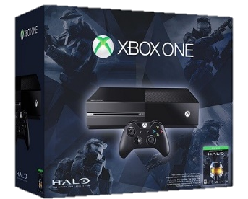
Ignite Azure Challenge Sweepstakes
Attend Azure sessions and activities, track your progress online, win raffle tickets for great prizes!
Aka.ms/MyAzureChallenge
Enter this session code online: BRK1455
NO PURCHASE NECESSARY. Open only to event attendees. Winners must be present to win. Game ends May 9th, 2015. For Official Rules, see The Cloud and Enterprise Lounge or myignite.com/challenge

Slide 47
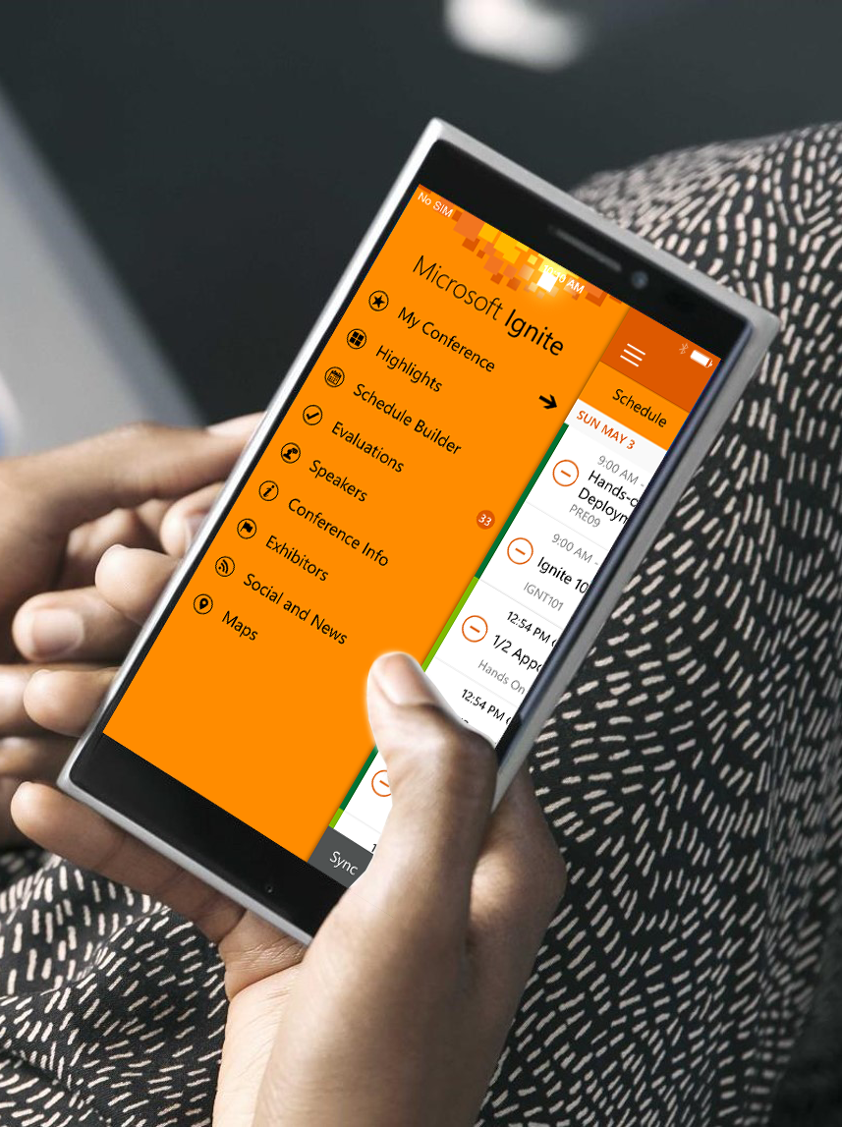
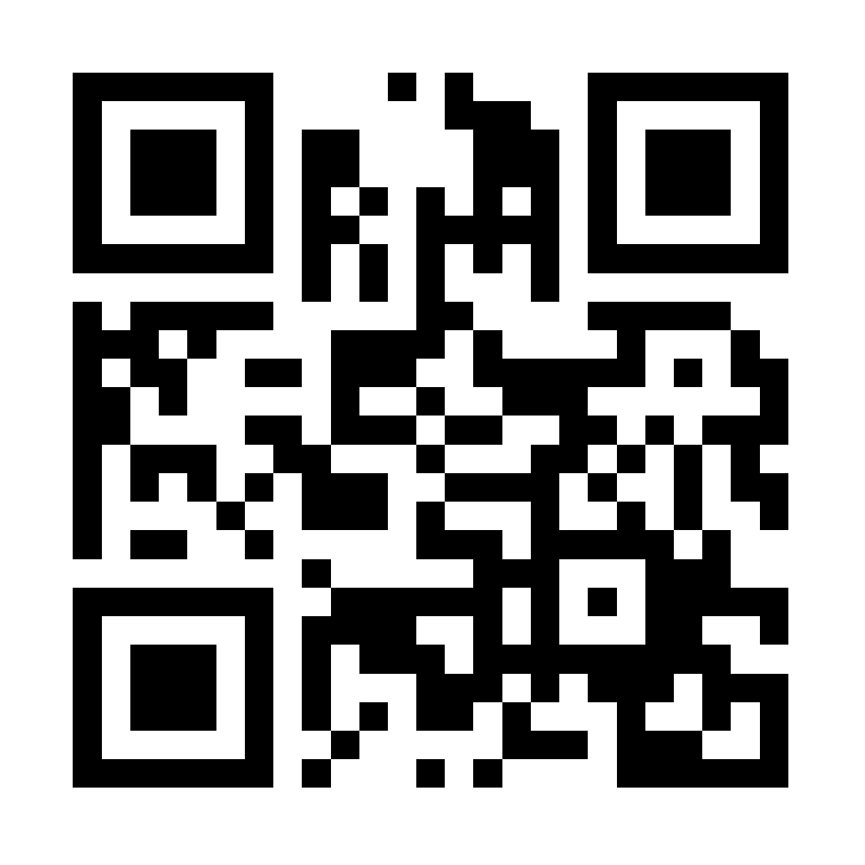
Please evaluate this session
Your feedback is important to us!
Visit Myignite at http://myignite.microsoft.com or download and use the Ignite Mobile App with the QR code above.

