Slide 2
How to Decide When to Use
SharePoint and Yammer and Office 365 Groups and Outlook and Skype
BRK2102
Richard Harbridge
Kanwal Khipple

Slide 3


Download the when to use what In Office 365 Enterprise User Guidance Whitepaper!
It goes into much greater depth and can be found at WhenToUseWhat.com

Slide 4



Richard
Harbridge
Speaker | Author | Super Friendly
My twitter handle is @RHarbridge, blog is http://RHarbridge.com, and I work at

Slide 5

Kanwal
Khipple
Speaker | Author | SUPER GOOD LOOKING
My twitter handle is @KKhipple, and I work at .

Slide 6
Answering The
“When To Use What”
Question

Slide 7


What People Often Think Of…
Find people
Share my stuff
Build internal communities
Stay connected
Get answers (general)
Get answers (moderated)
Collaborate on docs internally
Collaborate on docs externally
Build external communities
5 Reasons This Is Much More Complex
It’s not as simple as comparing and selecting one tool over another…

Slide 8
1. The Technology Works Best Together…
vs
= Decision
Thinking about this from a versus perspective is the wrong approach.

Slide 9





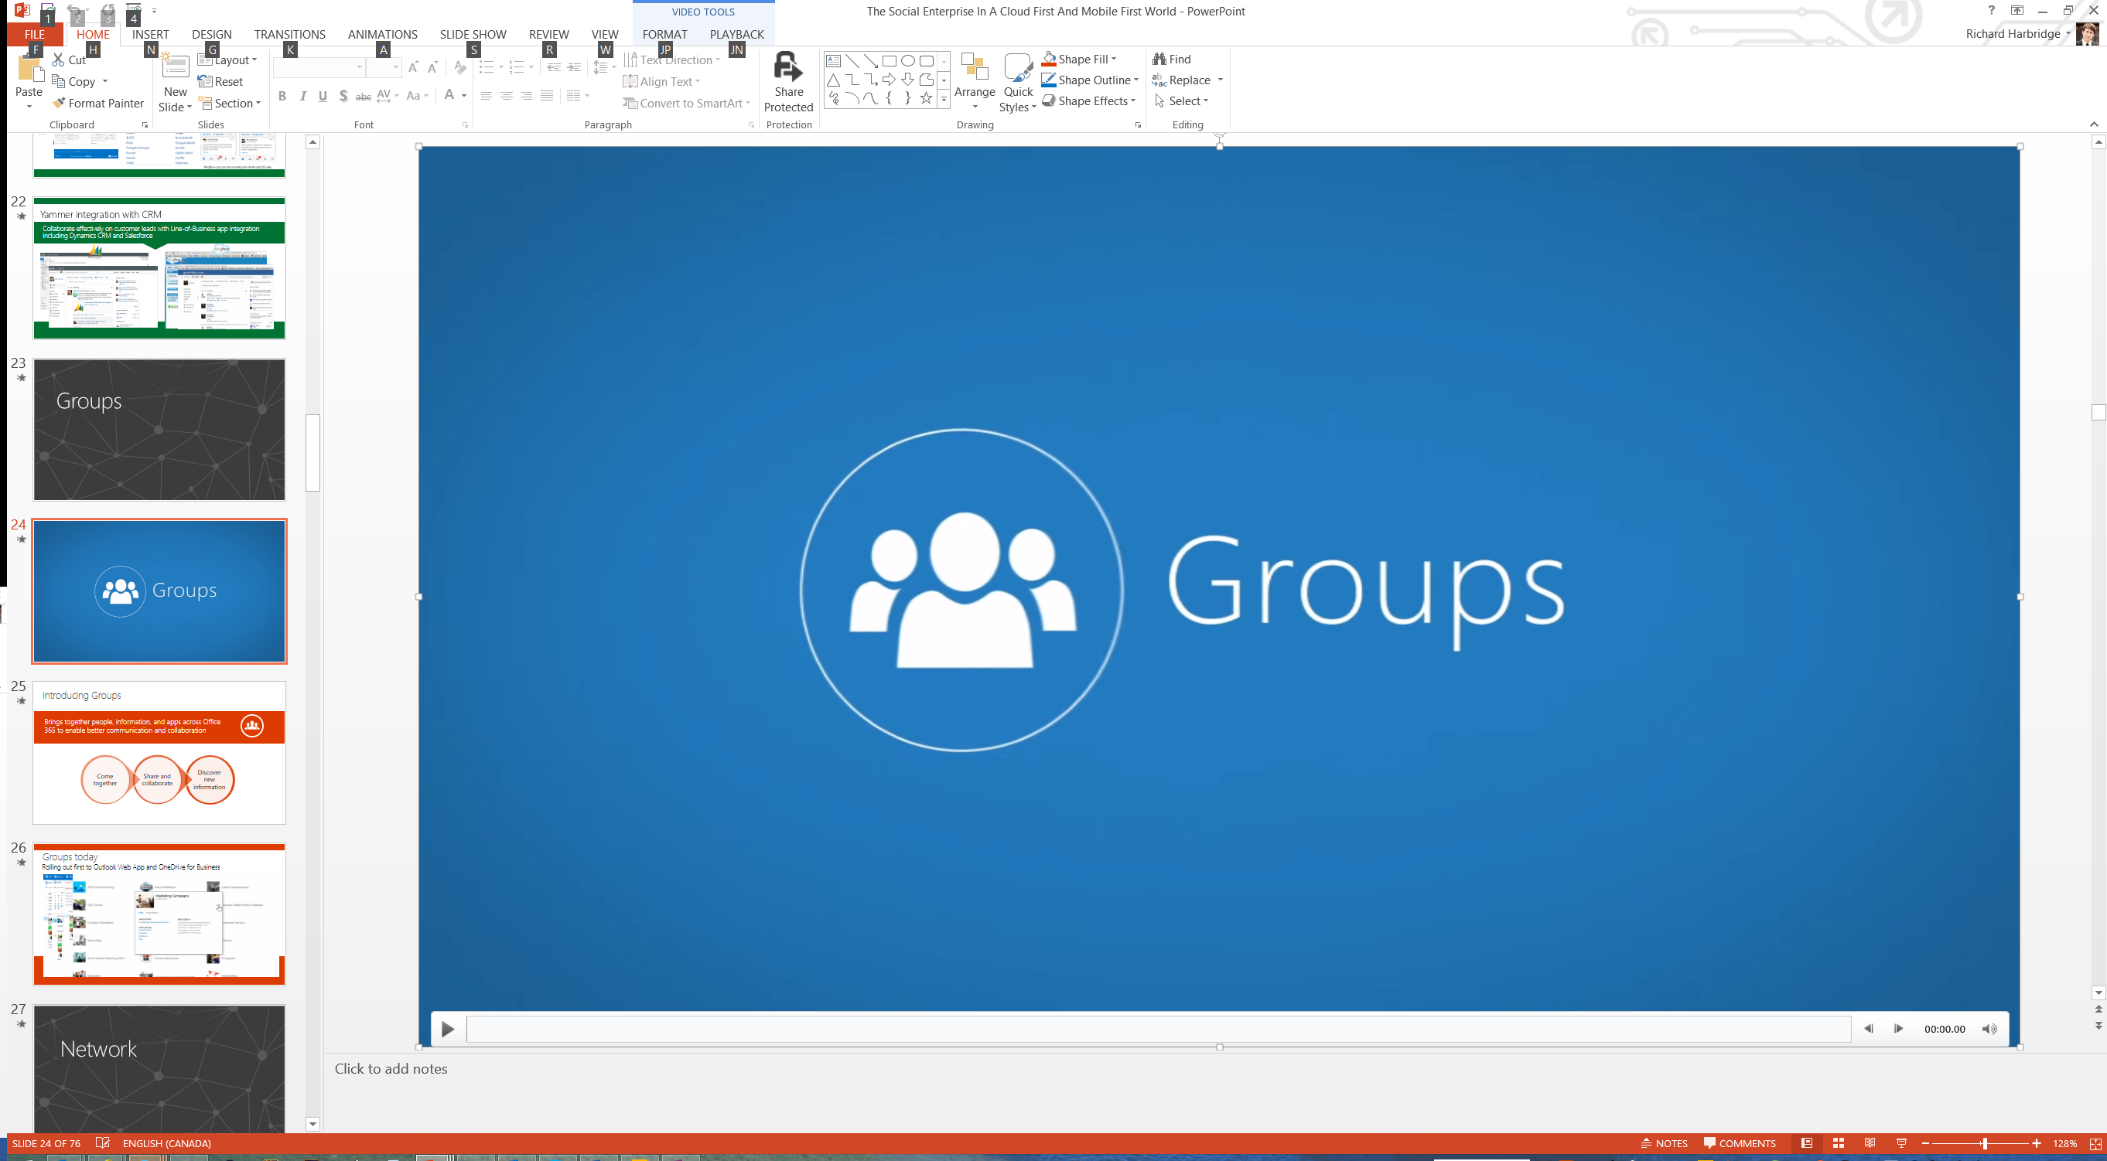



1. The Technology Works Best Together…
“I want to run an event for our launch of Office 365.”
We just leveraged at least 8 ‘products’!
The right approach is an AND approach where the technologies work together.

Slide 10



1. The Technology Works Best Together…
and
= Maximum Value
To maximize the value Office 365 provides we need to use as much of it as we can.

Slide 11
2. When To Use What Has Multiple Levels…
Organizational
Group
Individual
So you need to answer it in different ways.

Slide 12
2. When To Use What Has Multiple Levels…
Organizational
Social Collaboration Platform (Yammer)
Purpose: Corporate social networking and social collaboration solution.
Best for: Exchanging ideas, news and thoughts. It is also great at engaging others and sparking a conversation around a specific topic.
Example of high level guidance: Dialogue, social collaboration and networking take place on Yammer. It is used to share network with colleagues to develop greater belonging and connection.
• Ask questions and exchange ideas • Internal contests
• Brainstorm w/ virtual/cross-segment teams • Recognize performance w/ praise
• Place where employees can practice building online reputation with quality contributions
Think twice before using for: Extremely confidential or private information (while you can do this within Yammer safely there may be better options for you to leverage).
Messaging & Calendaring Platform (Outlook & Exchange)
Purpose: This is our corporate e-mail and calendaring solution.
Best for: Corporate email communications (both internal and external) and to manage calendars.
Example of high level guidance: Dialogue and decision making with small groups, where information is sensitive and should not be shared broadly.
Requests for approval or funding for an initiative
Discussions about the direction of a project
Reminders for deadlines
Calendar management
Think twice before using for: Personal email communication
Group
Remember that your enterprise strategy should indicate purpose and guidance.
Individual

Slide 13
2. When To Use What Has Multiple Levels…
Individual
Organizational
Group
Group
Individual
Organizational
If you don’t have clear organizational technology guidance, it will be much harder.

Slide 14
2. When To Use What Has Multiple Levels…
Individual
Individual
Group
Group
Organizational
Organizational
Spend the majority of your efforts providing individual and group guidance.

Slide 15
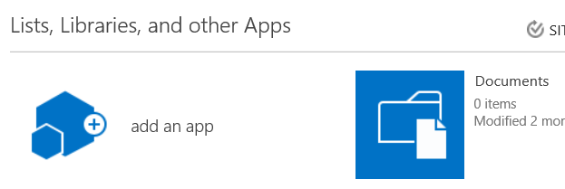
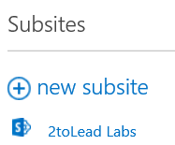
OR
3. Knowing What product to use isn’t enough…
Even if you have decided on the technology what about which features?

Slide 16
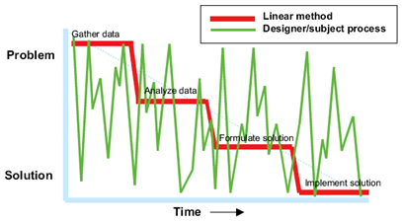
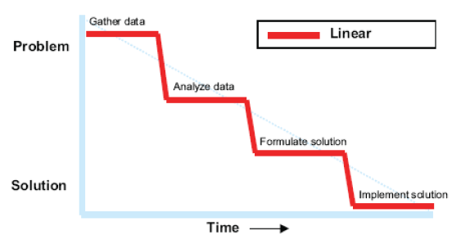
4. People Aren’t Making One Decision…
Users often wont use a matrix. They are trying to do more than make a decision.

Slide 17


5. Getting Sustained Commitment…
When users can't decide they use what they know,; even if better options exist.

Slide 18
The five Reasons When to use what is a hard question…
When To Use What Has Multiple Levels
Technology Works Best Together
Knowing Which Product Isn’t Enough
People Aren’t Making A One Time Decision
Sustained Commitment Is Critical
So how can we help arm all of you to better achieve sustained commitment?

Slide 19
The Formula For Commitment
Value
Understanding
Interest
Commitment

Slide 20
The Formula For Commitment
Value
Understanding
Interest
Commitment

Slide 21
Drive User Interest

Slide 22

Users work Anywhere…
By 2016 40% of the workforce will be mobile - Gartner

Slide 23

Users work Anytime…
Work
Life
Flexible work is prevalent – rethink your definition of a mobile worker.

Slide 24


Users work On Any device…
By 2015 at least 60% of information workers will interact with content applications
via a mobile device - Gartner

Slide 25




Users Work With More people…
60% of employees report working with 10 or more people on a day-to-day basis.
Half of these employees work with more than 20.
We work with more people on a day-to-day basis today than ever before.

Slide 26
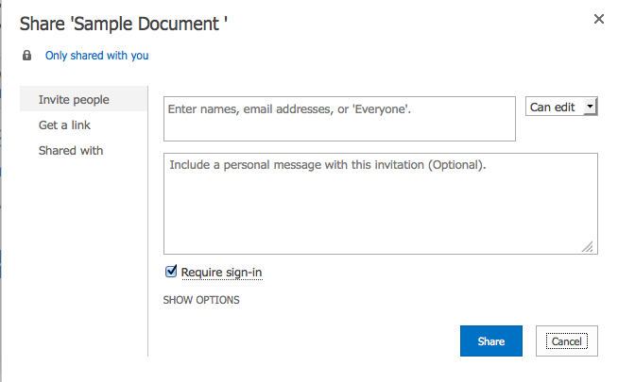
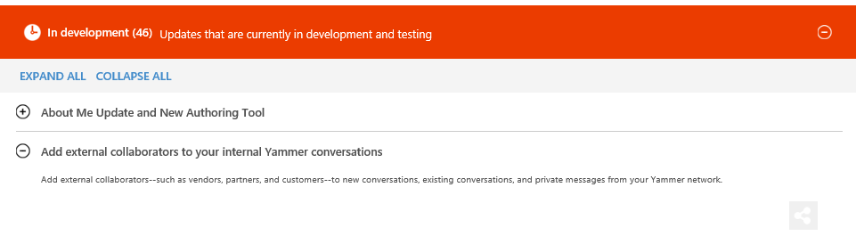
Users Work Inside & Outside of the organization…
We also work with contractors, customers or partners more…

Slide 27
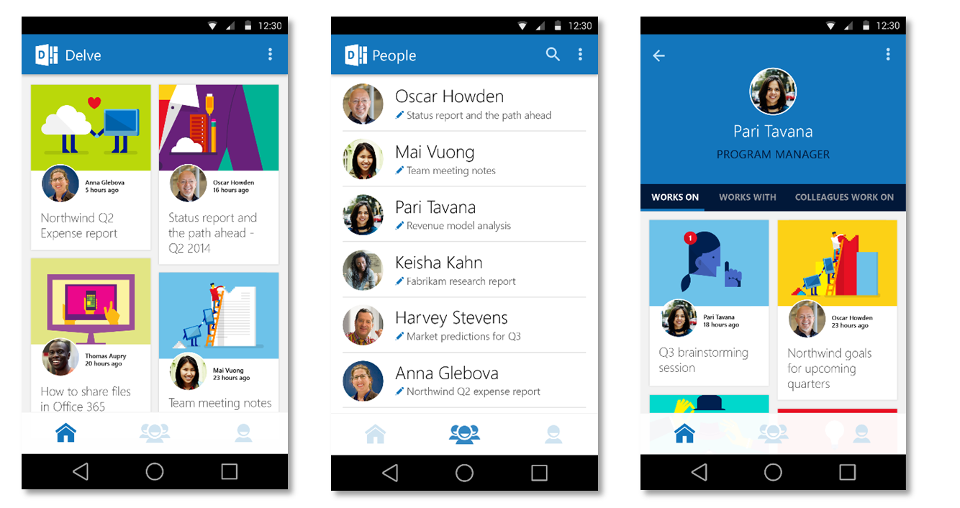
Are users aware of app experiences?
Are you actively providing awareness of ways people can work at on any device?

Slide 28
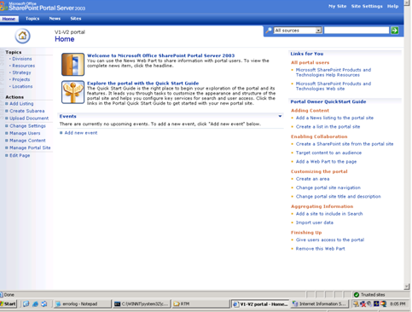
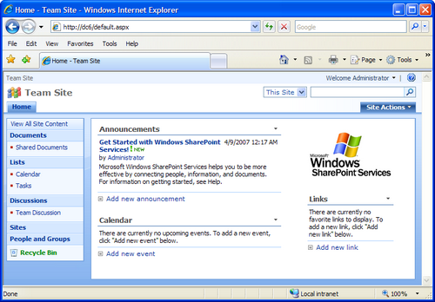
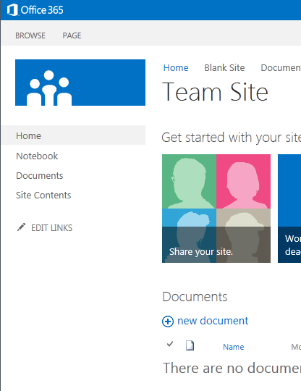
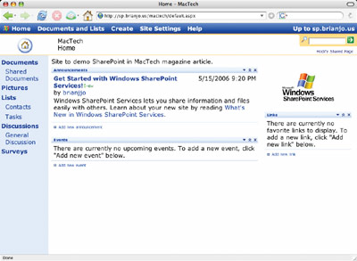
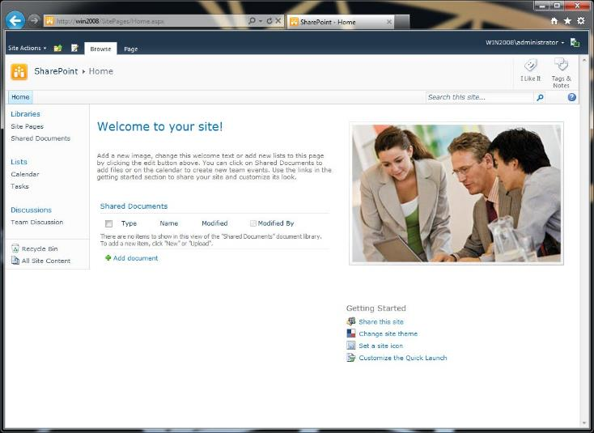
Don’t fall behind…
It will be more and more challenging to meet expectations on legacy technology.

Slide 29
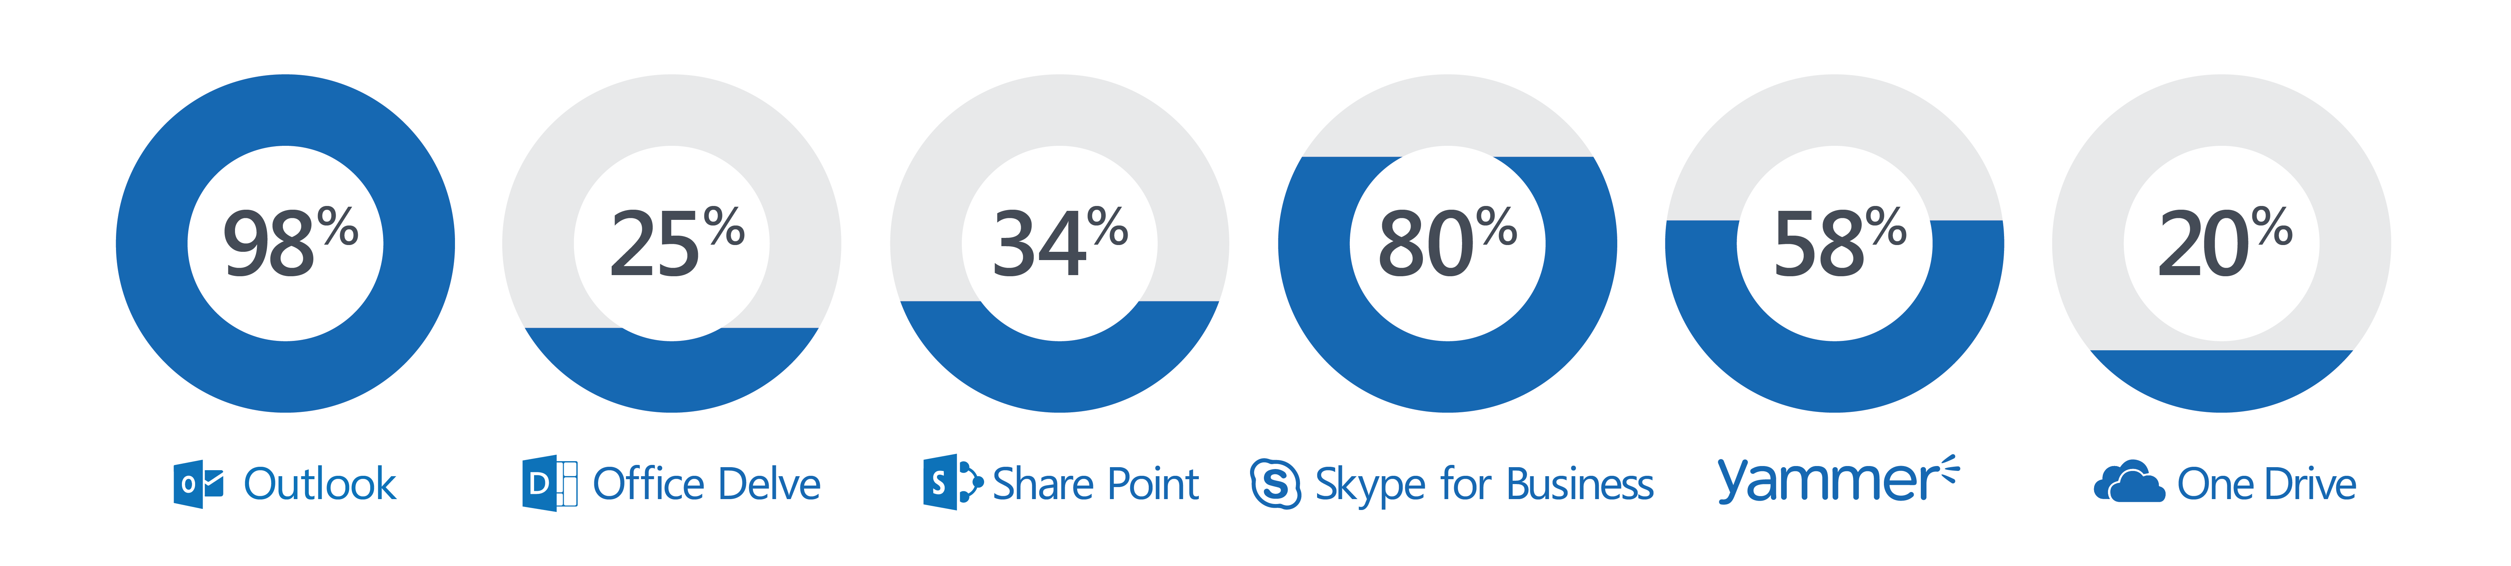
Getting more people to use the technology is important…
Often getting people to use more of the technology is just as important.

Slide 30
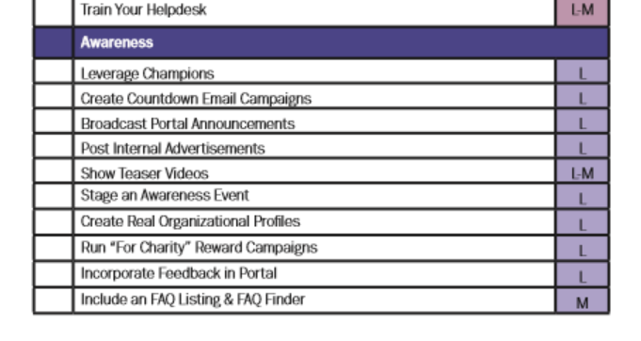

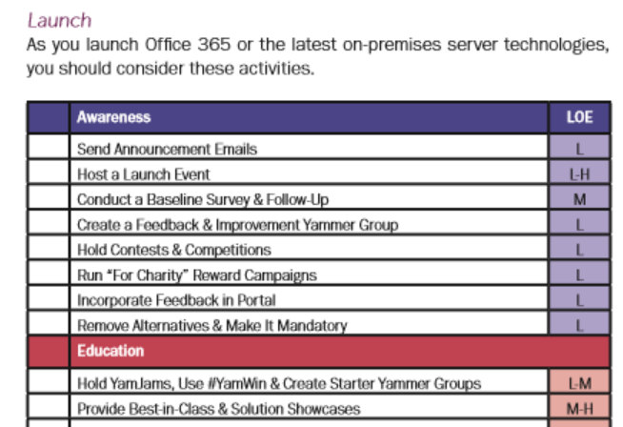
Real World Adoption Activities & More…
Find great ideas for driving adoption in our latest book http://improveit.how/book

Slide 31

The Formula For Commitment
Understanding
Interest
Value
Commitment

Slide 32
The Formula For Commitment
Understanding
Interest
Value
Commitment

Slide 33
Guiding Understanding

Slide 34
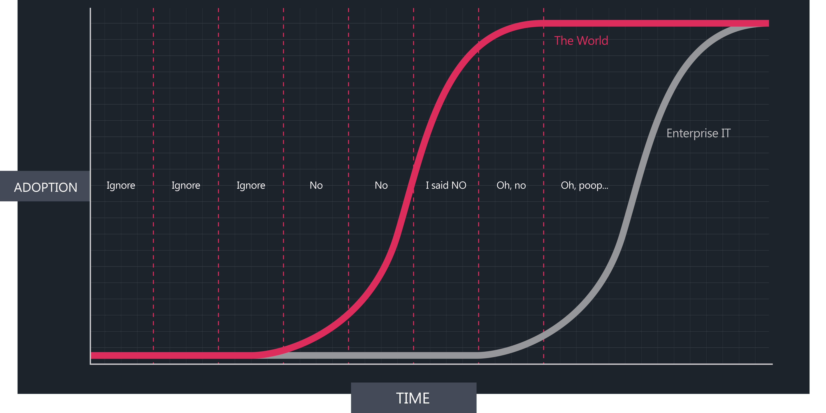
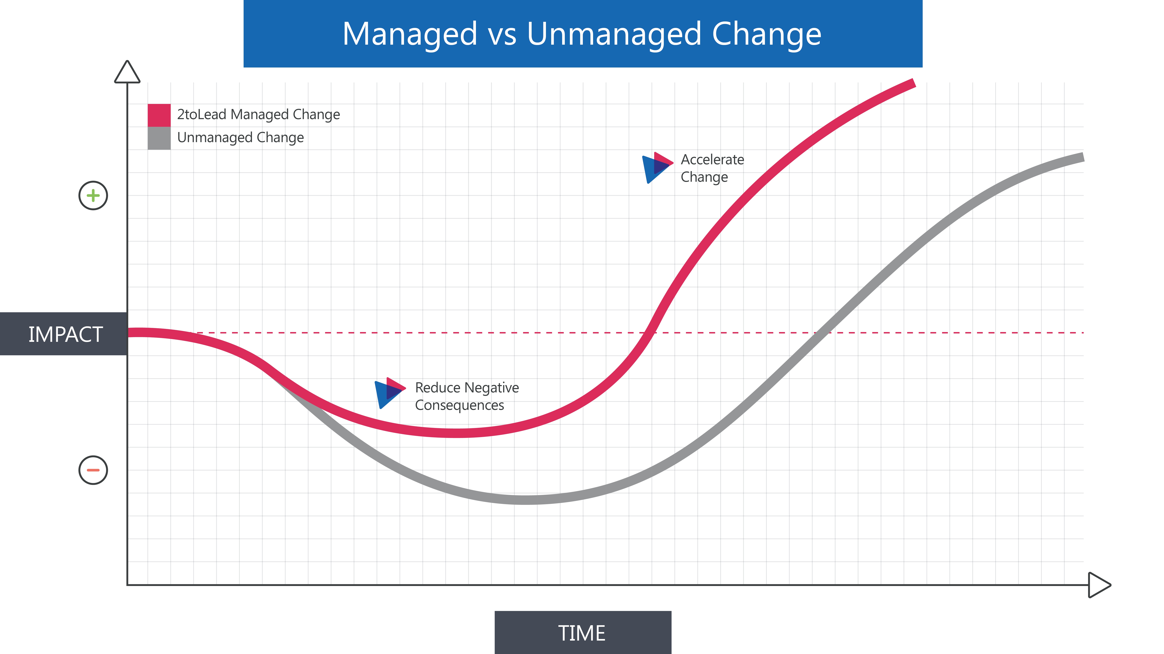
At the organizational level…
Always an impact to productivity. We can accelerate to get positive results sooner.

Slide 35
Use The Best Tool For The Job…
Skype For Business Call
Skype for Business Online Meetings
Yammer Company Communications
Urgent / High
IM
Skype Presence
Urgency / Time Sensitivity
Outlook
E-Mail
Office 365 Groups
Yammer Groups
OneDrive for Business
SharePoint Team Sites
SharePoint Intranet
Ad-hoc / Low
Delve Boards
Office Video
Individual
Group
Organizational
Audience (Internal or External)
How can you optimize how you work? Would Yammer or Lync be better?

Slide 36
What about more targeted purposes?
Skype For Business Call
Skype For Business Call
Skype for Business Online Meetings
Skype for Business Online Meeting
Yammer Company Communications
Yammer Company Communications
Urgent / High
Urgent / High
IM
Skype Presence
IM
Skype Presence
Skype Broadcast
Urgency / Time Sensitivity
Urgency / Time Sensitivity
Yammer Groups
Office 365 Groups
Yammer Groups
Outlook
E-Mail
Office 365 Groups
Outlook
E-Mail
OneDrive for Business
SharePoint Publishing Sites
OneDrive for Business
SharePoint Intranet
SharePoint Team Sites
SharePoint Intranet
Ad-hoc / Low
Ad-hoc / Low
Delve Boards
Office Video
Office Video
Organizational
Group
Organizational
Individual
Group
Individual
Audience (Internal or External)
Audience (Internal or External)
Think of the matrix as something that dynamically should adjust. Not static.

Slide 37
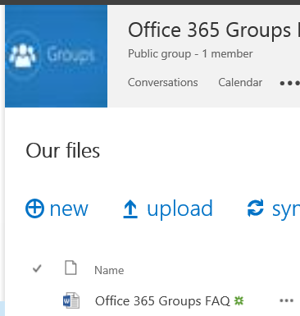
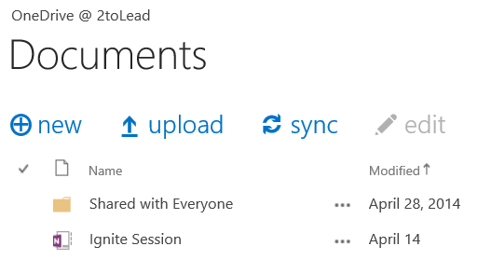
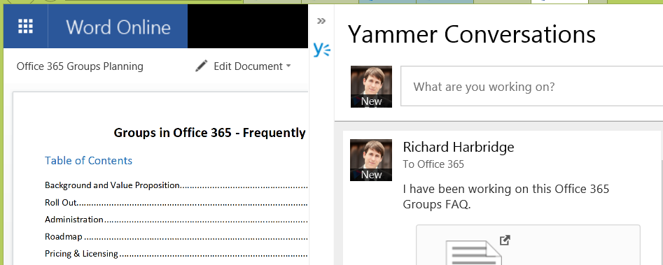

Transparency, Visibility & Openness…
Skype For Business Call
Skype for Business Online Meetings
Yammer Company Communications
Urgent / High
IM
Skype Presence
Urgency / Time Sensitivity
Outlook
E-Mail
Office 365 Groups
Yammer Groups
OneDrive for Business
SharePoint Team Sites
SharePoint Intranet
Ad-hoc / Low
Delve Boards
Office Video
Individual
Group
Organizational
Audience (Internal or External)
How can we help users change behavior and understanding?

Slide 38
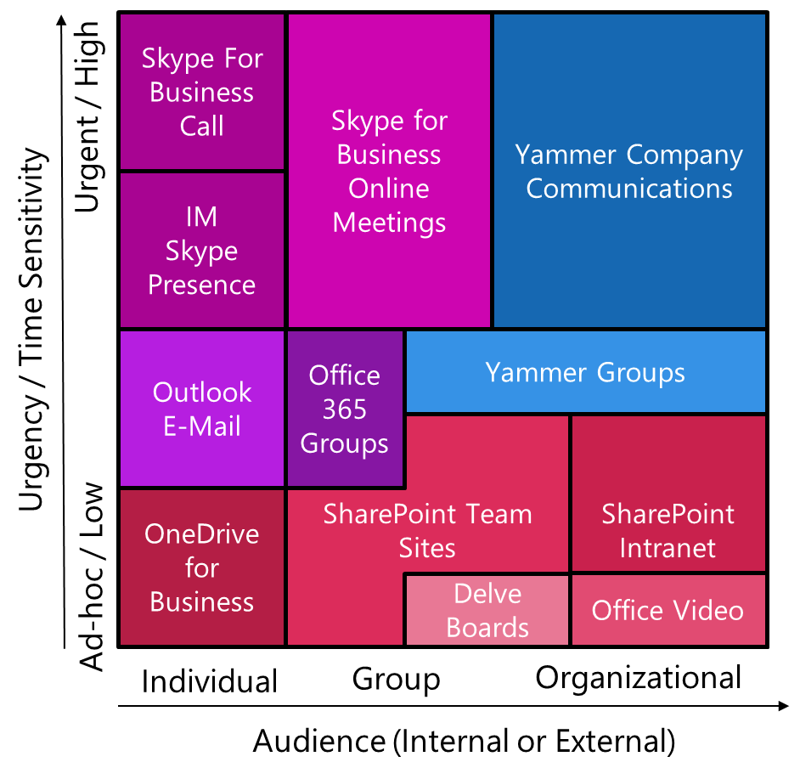
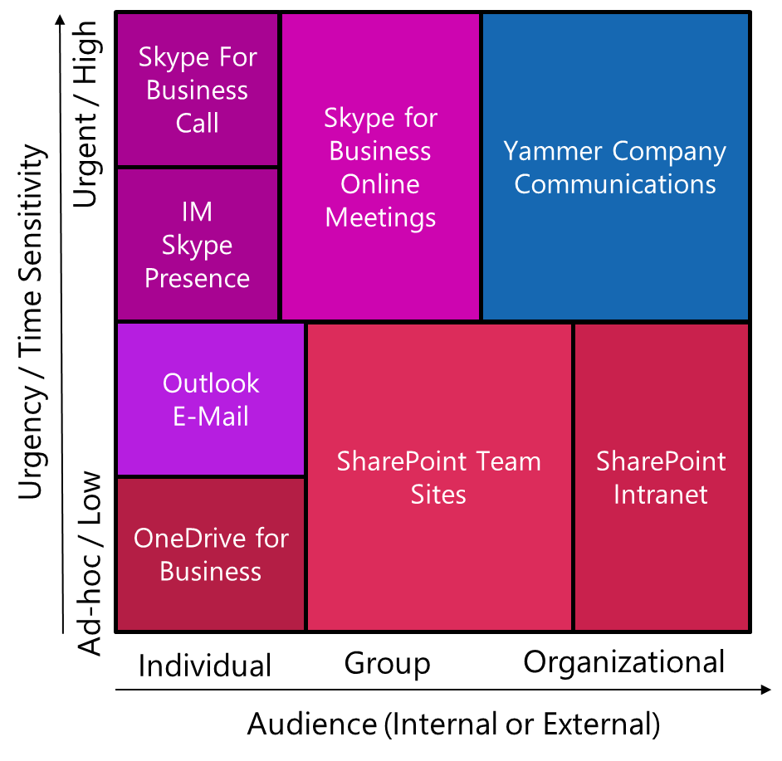
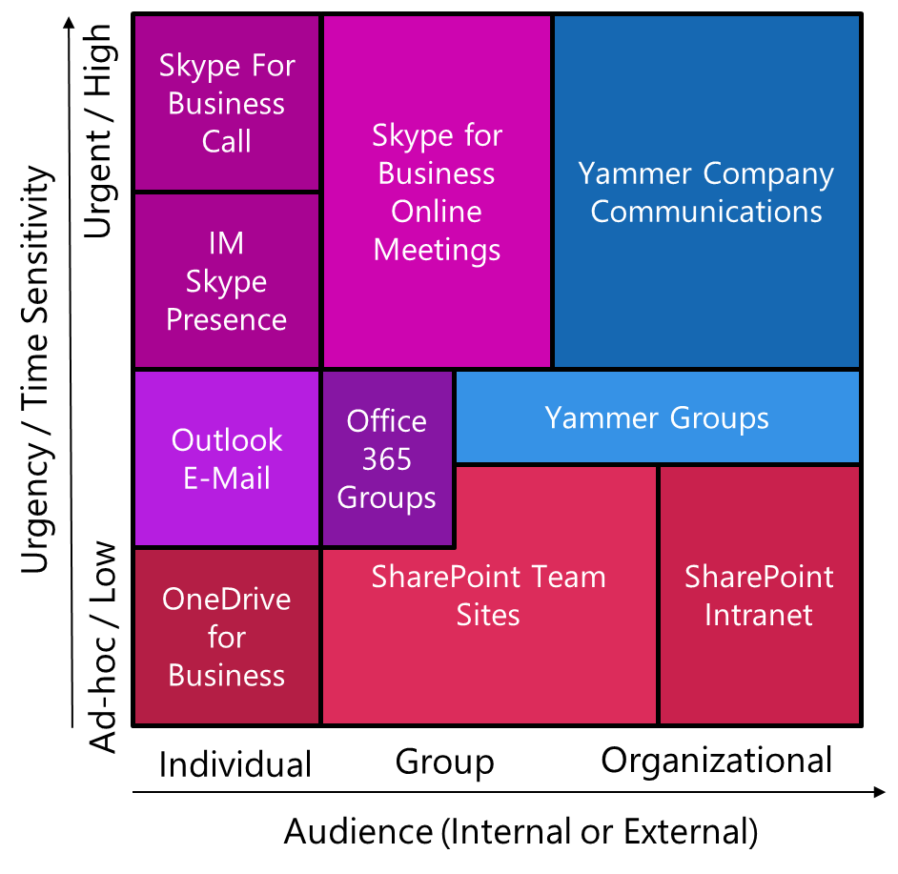
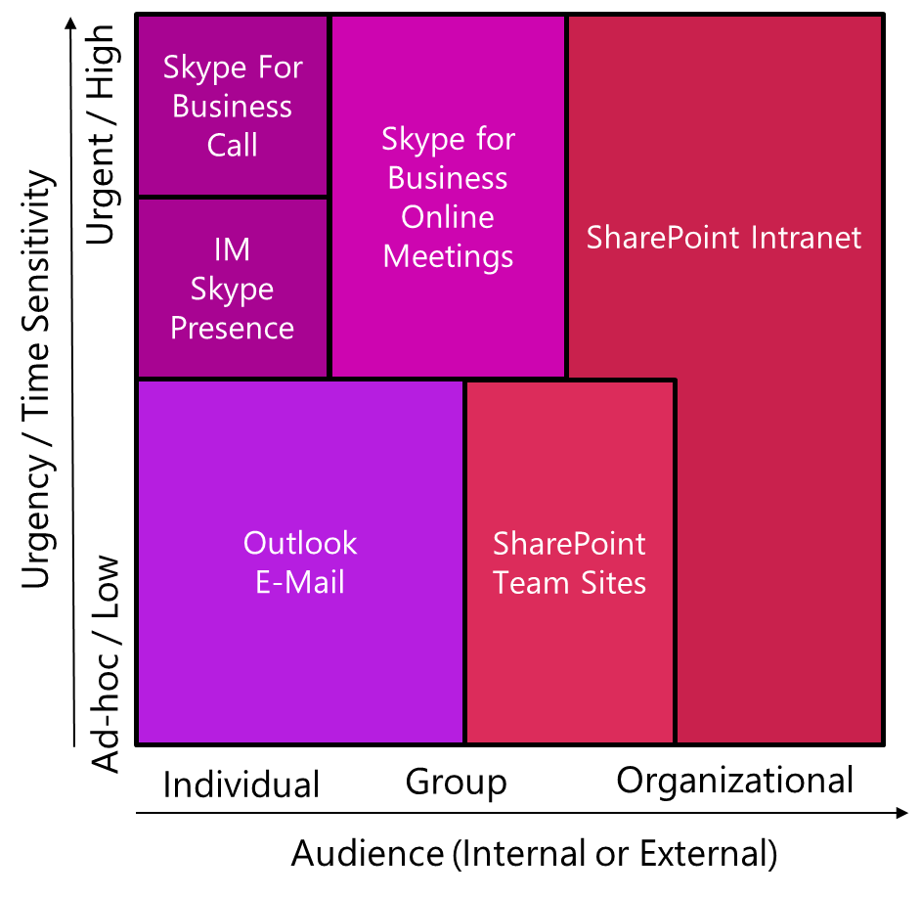
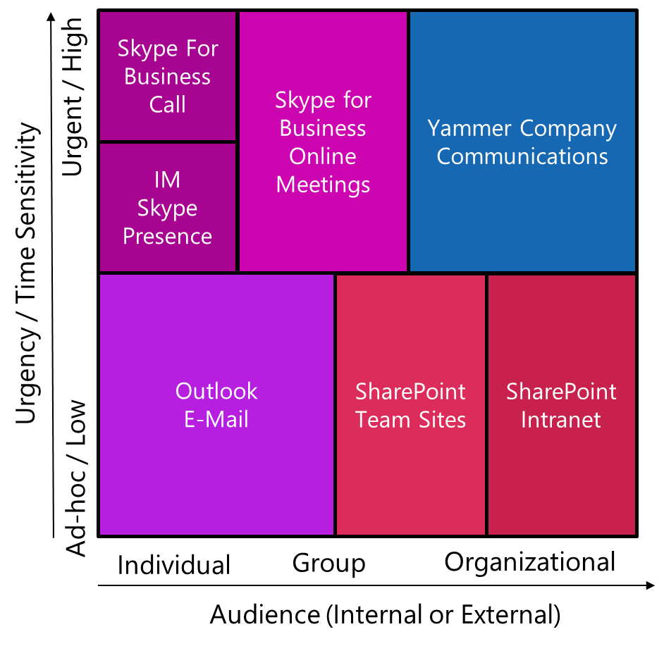
guide users From where they are…
Month 5
Month 1
Month 2
Month 3
Month 4
Target
Skype For Business Call
Skype for Business Online Meetings
Yammer Company Communications
Urgent / High
IM
Skype Presence
Urgency / Time Sensitivity
Outlook
E-Mail
Office 365 Groups
Yammer Groups
OneDrive for Business
SharePoint Team Sites
SharePoint Intranet
Ad-hoc / Low
Delve Boards
Office Video
Individual
Group
Organizational
Audience (Internal or External)
Personalize or base the matrixes you leverage on personas that change over time.

Slide 39
Let’s walk through some scenarios…
1. Where Should I Put & Share Documents
2. Finding Someone With A Certain Expertise
3. Provide A Note Of Congratulations/Praise
It’s important for the guidance to be understandable by an individual user.

Slide 40
Let’s walk through some scenarios…
1. Where Should I Put & Share Documents
2. Finding Someone With A Certain Expertise
3. Provide A Note Of Congratulations/Praise
It’s important for the guidance to be understandable by an individual user.

Slide 41
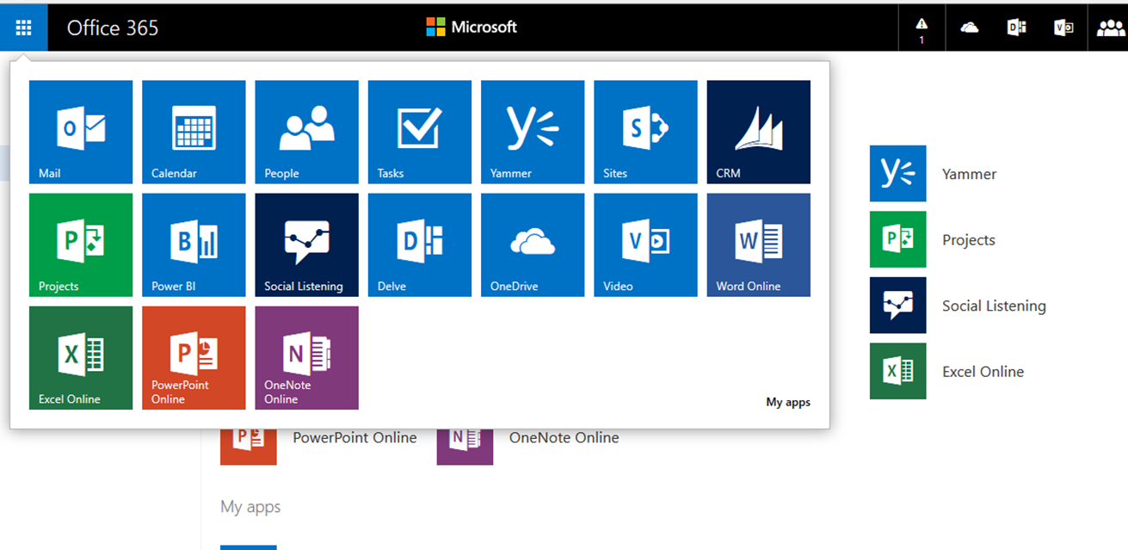
Where Should I put & Share Documents?
During our daily work we create documents or receive documents from partners &
customers. When we have a new document where should we store it?

Slide 42
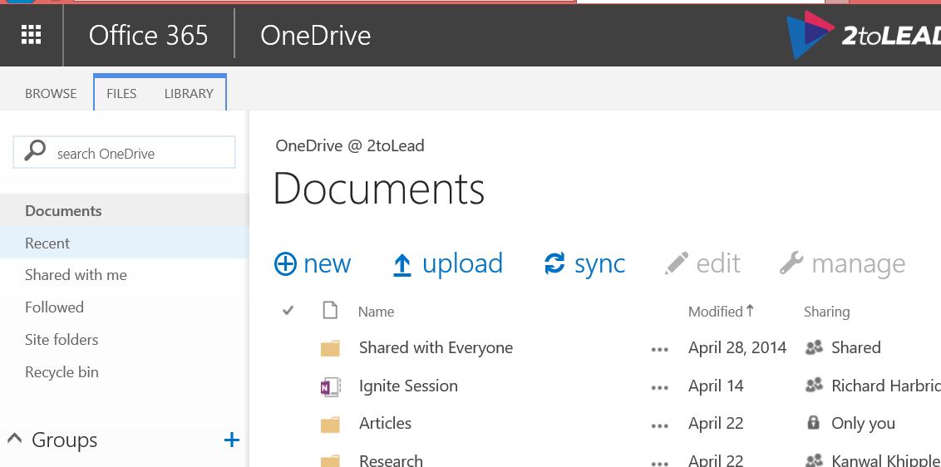
Where Should I put & Share Documents?
If this is a document I own, that is just for me, or I need a temporary place for it…

Slide 43
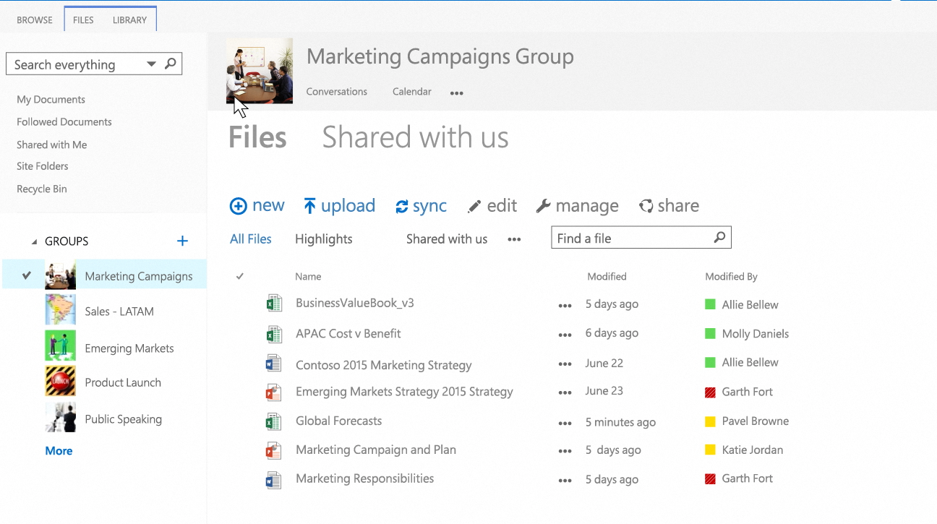
Where Should I put & Share Documents?
I need to share the document with others, I am not the only owner.

Slide 44
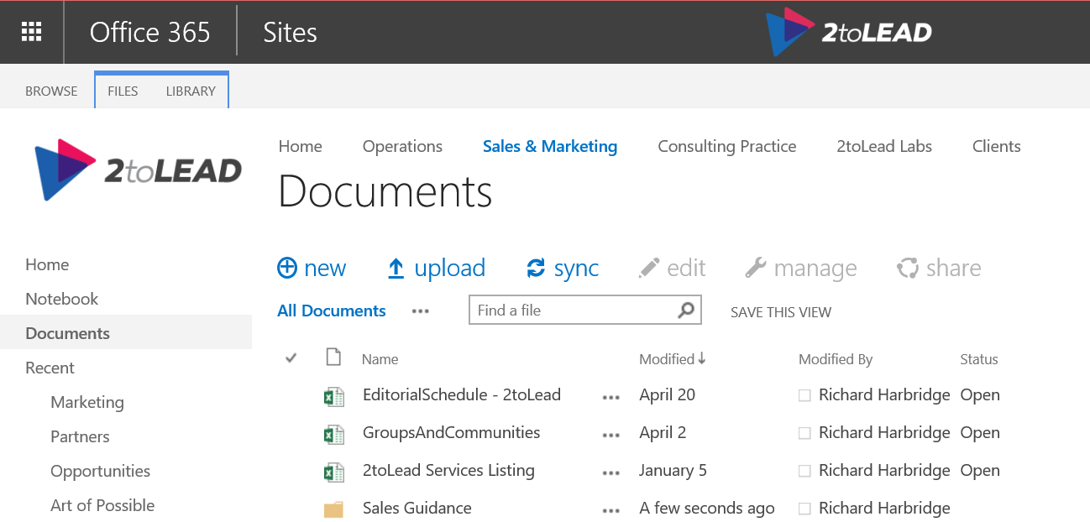
Where Should I put & Share Documents?
I need to share the document with others, I am not the only owner.

Slide 45
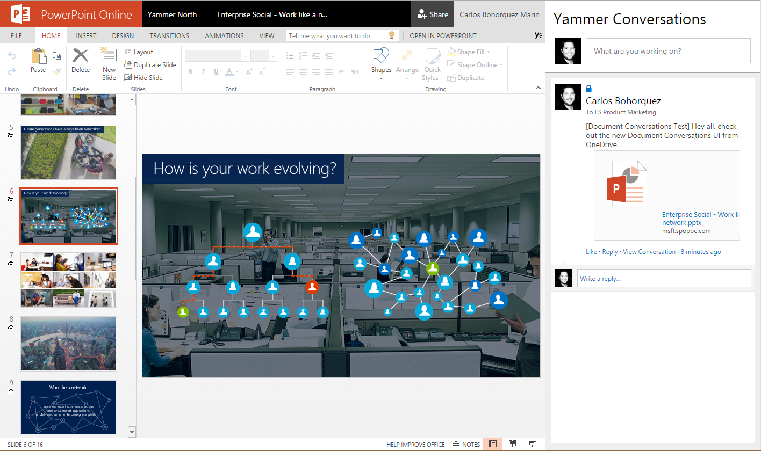


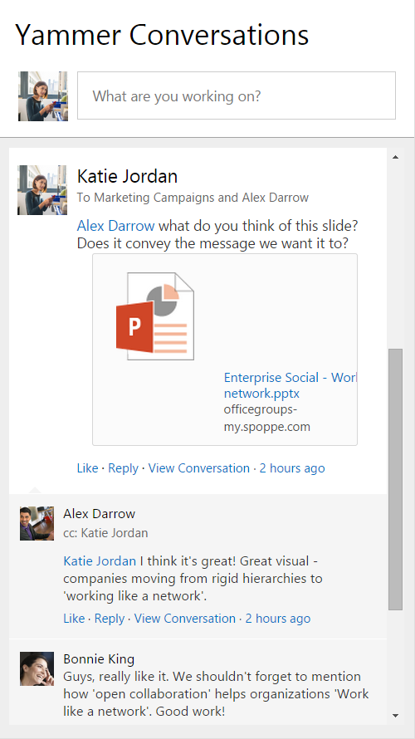


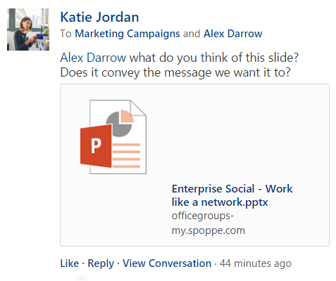
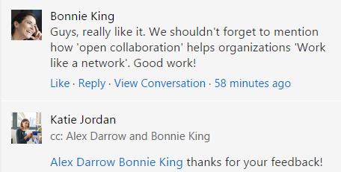

Where Should I put & Share Documents?
I need to share the document with others, so I can use yammer to amplify…

Slide 46
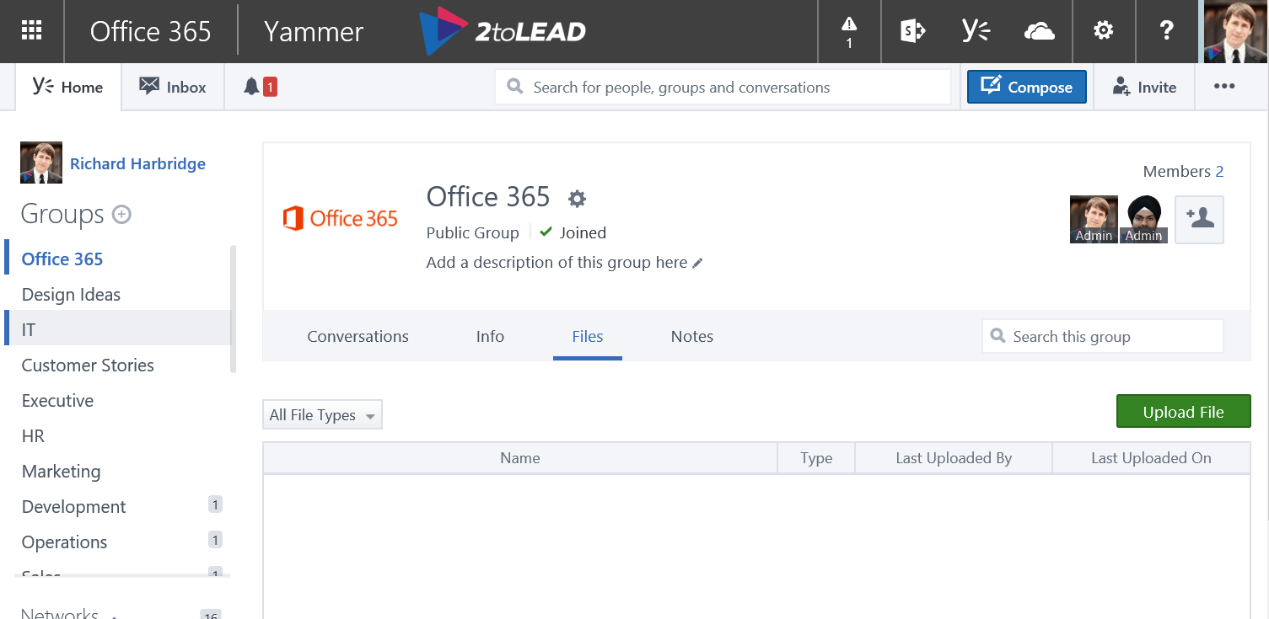
Where Should I put & Share Documents?
I need to share the document with others, to support an event…

Slide 47
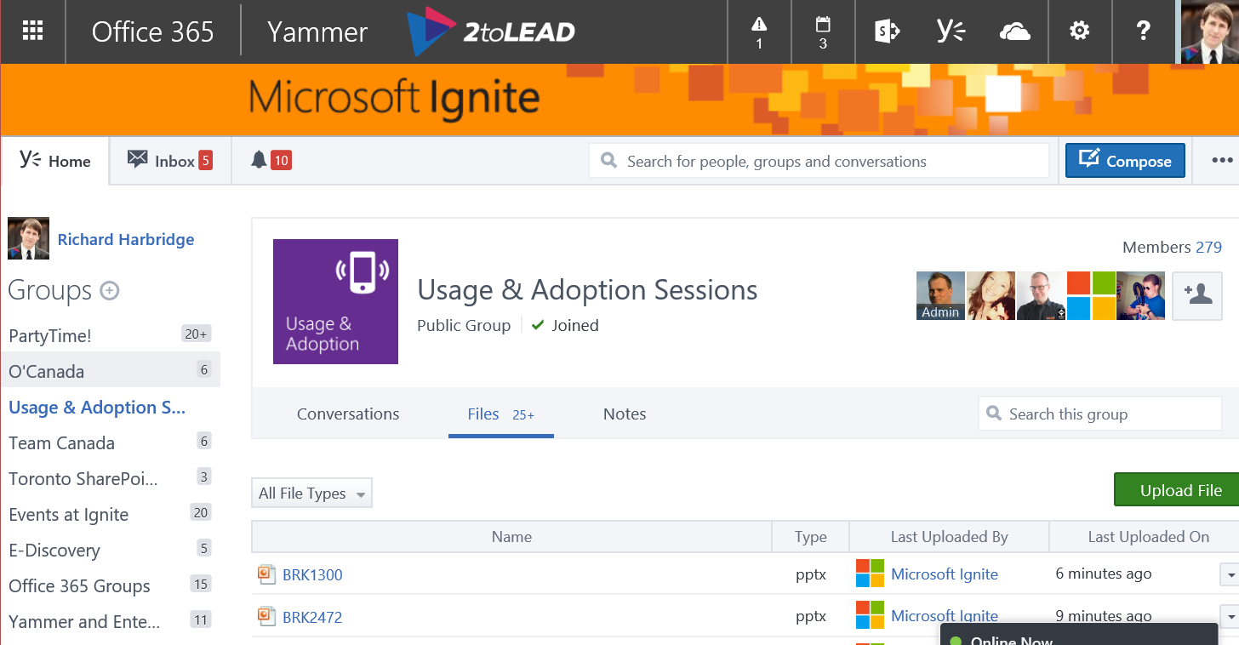
Where Should I put & Share Documents?
I need to share the document with others, to support an event…

Slide 48
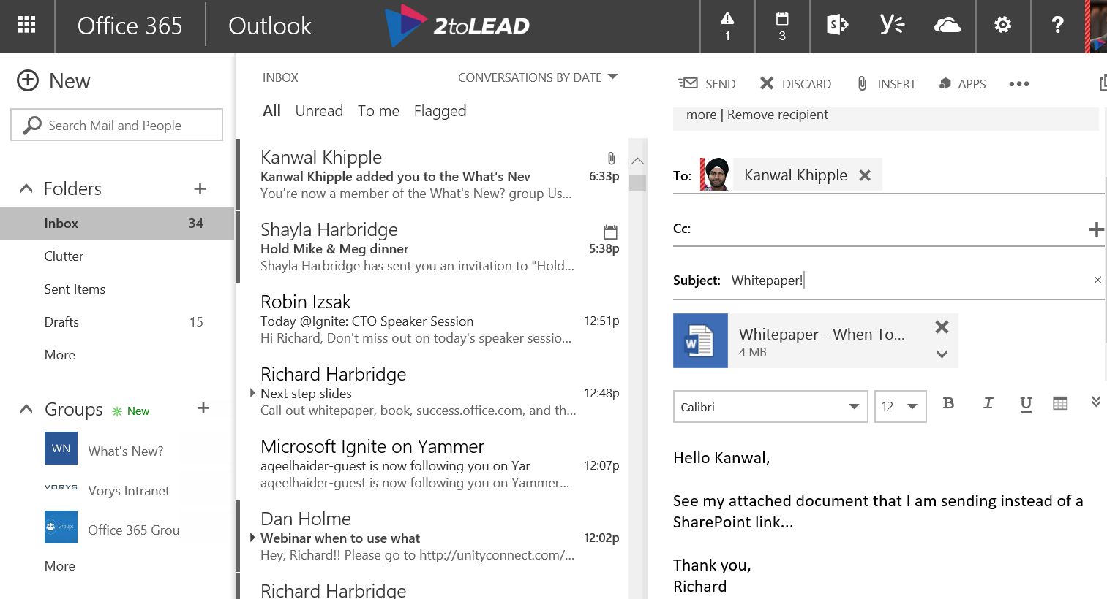
Where Should I put & Share Documents?
I need to share my document with others, so I can share a link…

Slide 49
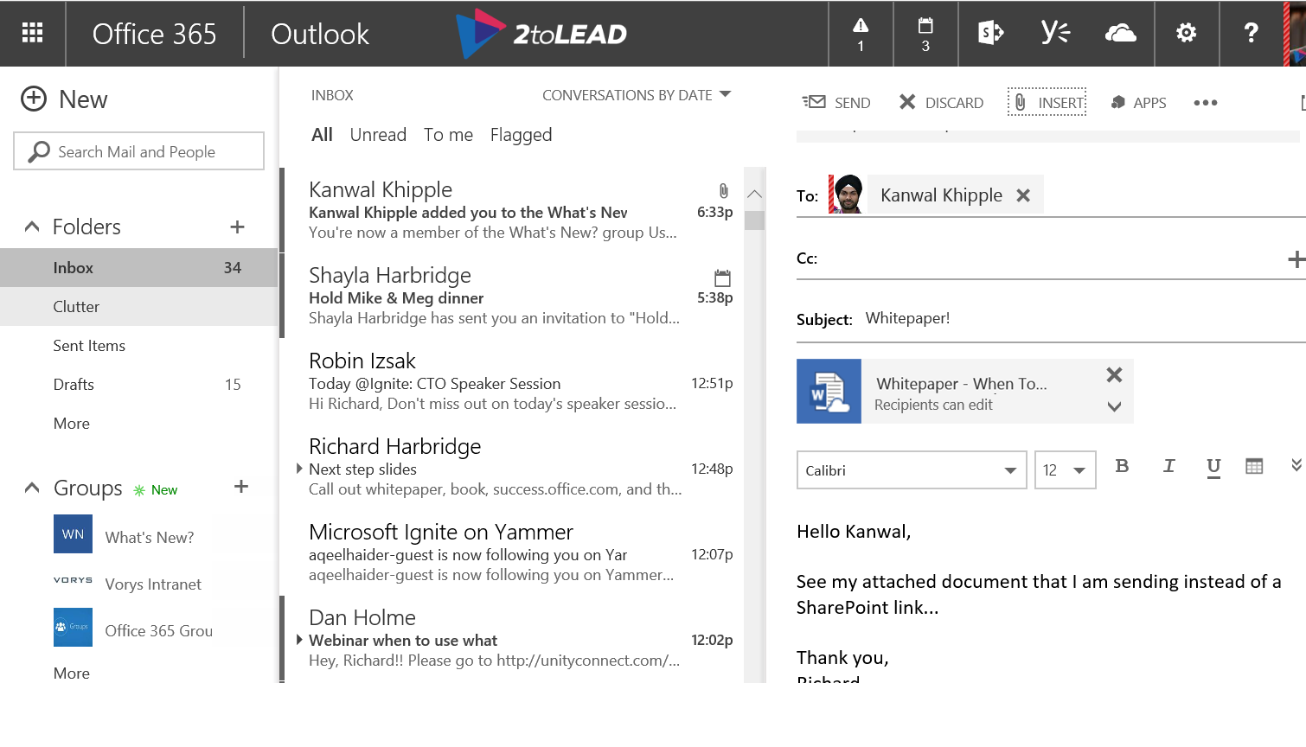
Where Should I put & Share Documents?
I need to share my document with others, so I can share a link…

Slide 50







Where Should I put Documents?
How might users accomplish this today in Office 365?

Slide 51
Let’s walk through some scenarios…
1. Where Should I Put & Share Documents
2. Finding Someone With A Certain Expertise
3. Provide A Note Of Congratulations/Praise
It’s important for the guidance to be understandable by an individual user.

Slide 52
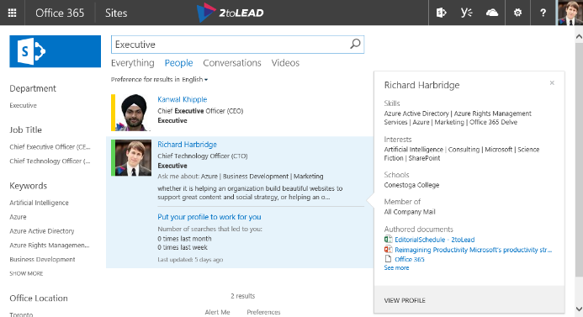

How to Find someone with a certain expertise…
SharePoint Search provides both discovery from content and profiles data.

Slide 53
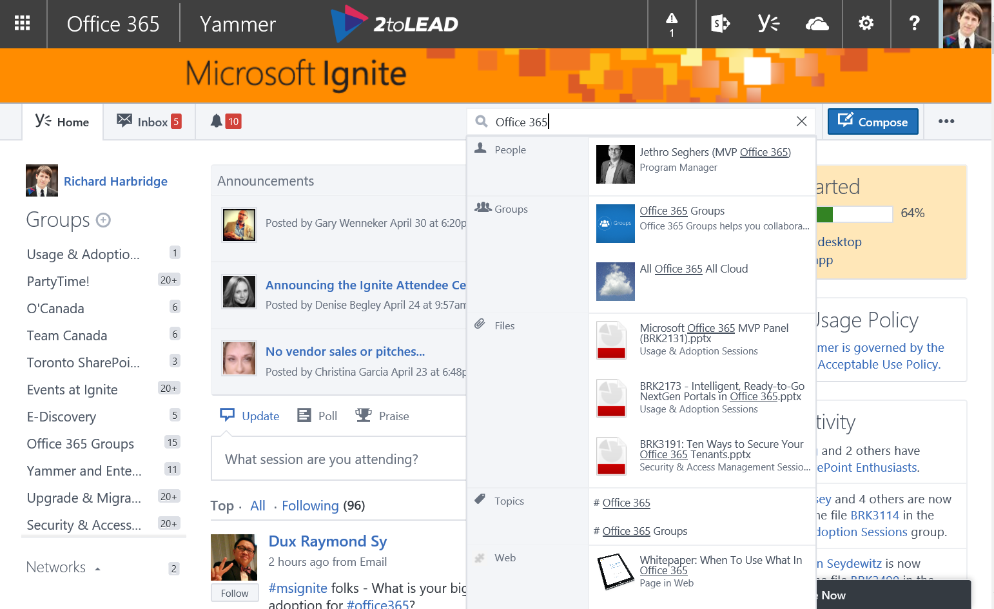
How to Find someone with a certain expertise…
How might users accomplish this today in Office 365?

Slide 54
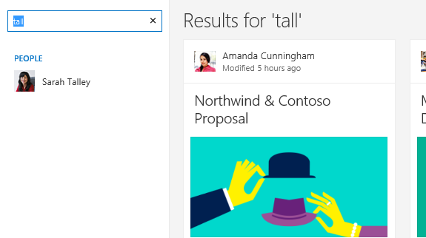
How to Find someone with a certain expertise…
How might users accomplish this today in Office 365?

Slide 55
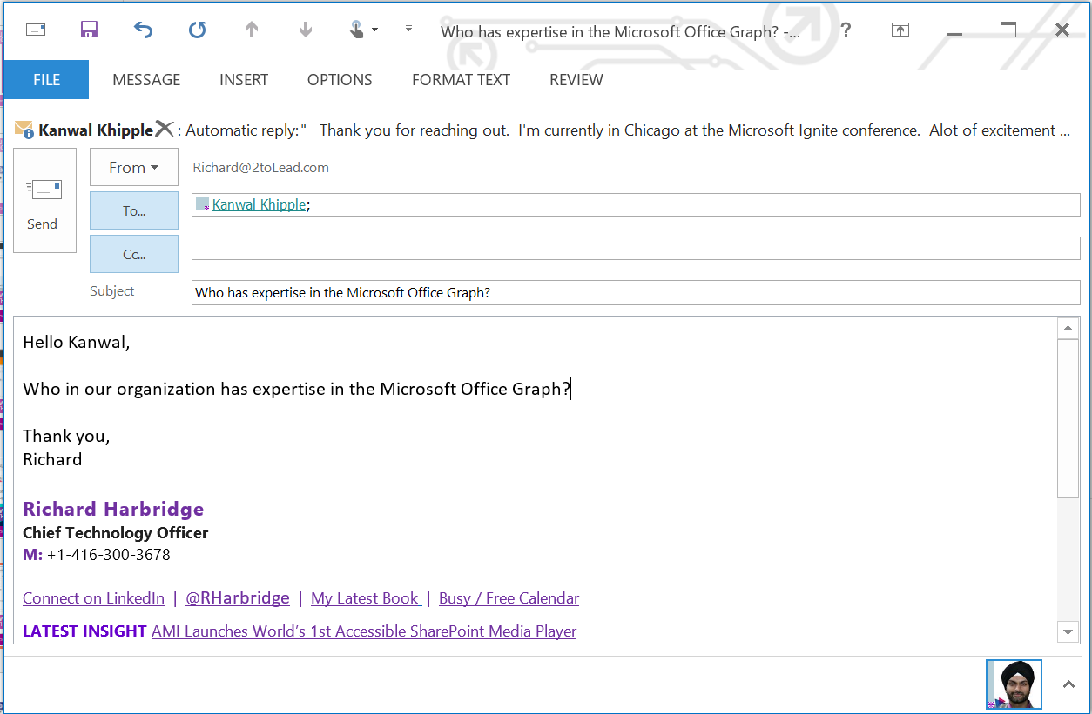
How to Find someone with a certain expertise…
How might users accomplish this today in Office 365?

Slide 56
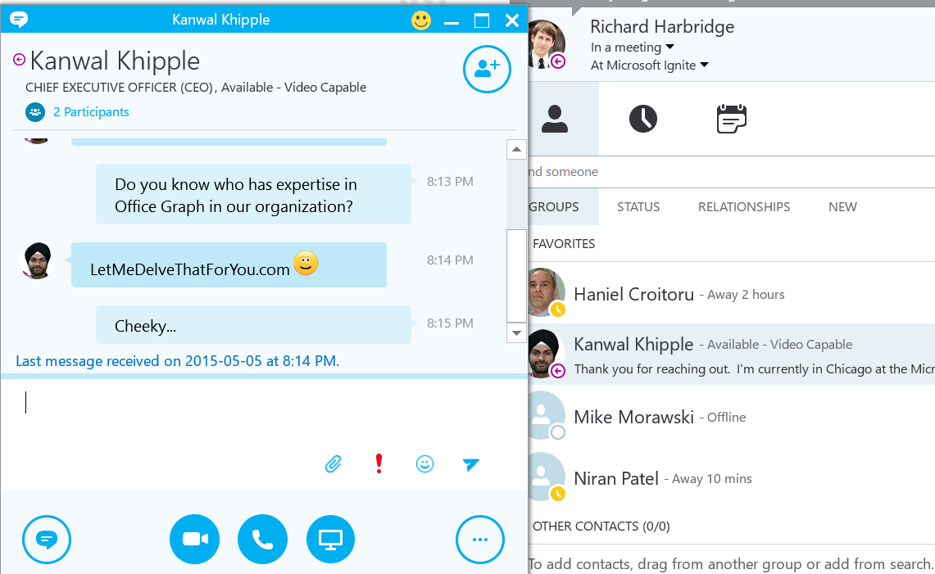
How to Find someone with a certain expertise…
How might users accomplish this today in Office 365?

Slide 57
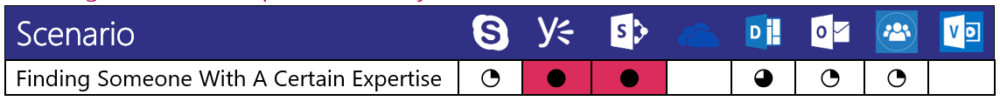
How to Find someone with a certain expertise…
How might users accomplish this today in Office 365?

Slide 58
Let’s walk through some scenarios…
1. Where Should I Put & Share Documents
2. Finding Someone With A Certain Expertise
3. Provide A Note Of Congratulations/Praise
It’s important for the guidance to be understandable by an individual user.

Slide 59
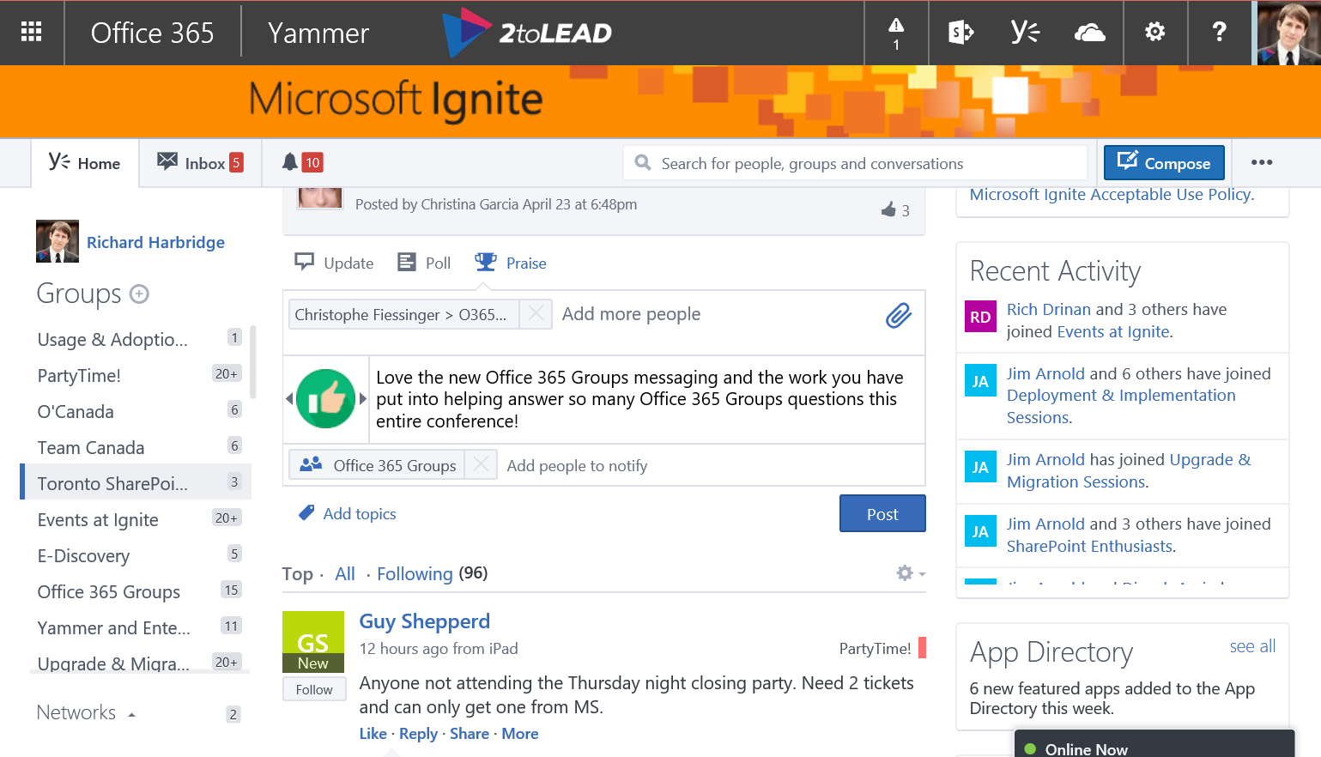
Provide A Note Of Congratulations…
How might users accomplish this today in Office 365?

Slide 60
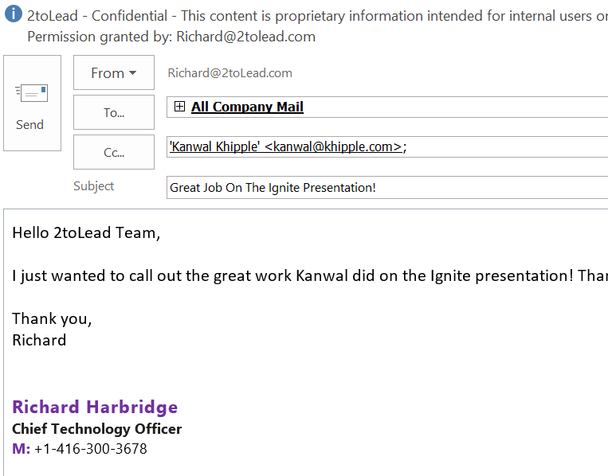
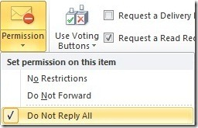
Provide A Note Of Congratulations…
How might users accomplish this today in Office 365?

Slide 61
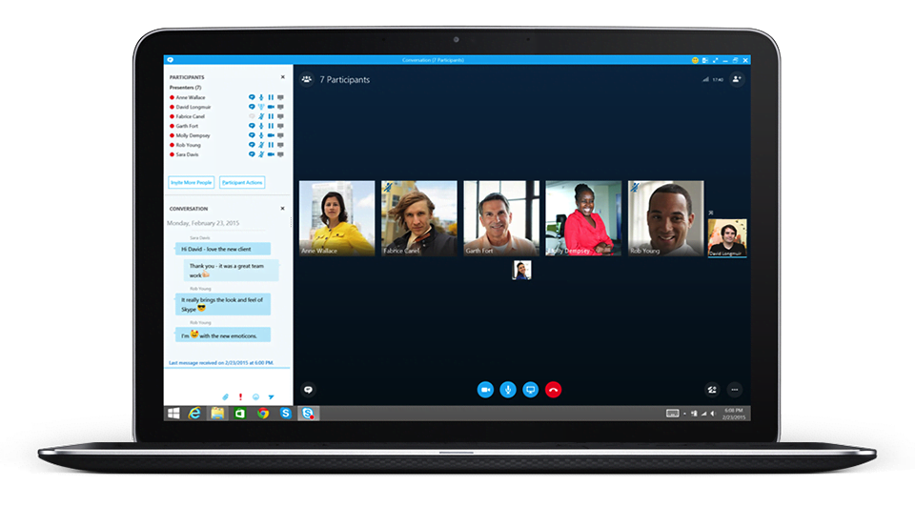
Provide A Note Of Congratulations…
How might users accomplish this today in Office 365?

Slide 62
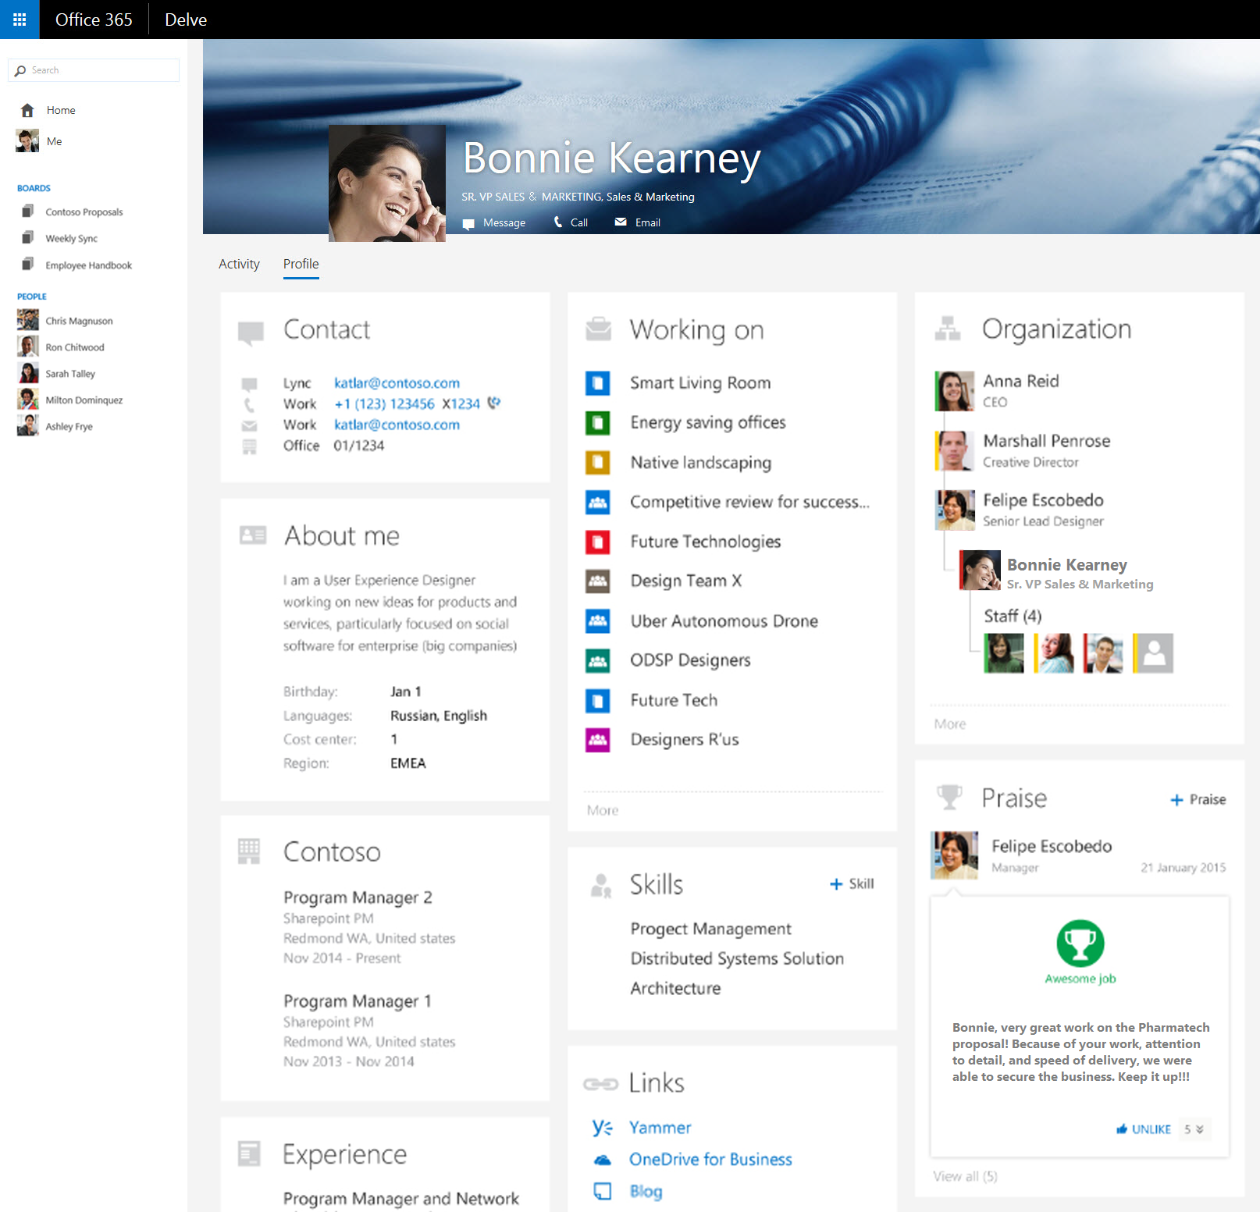
Provide A Note Of Congratulations…
How might users accomplish this today in Office 365?

Slide 63
Provide A Note Of Congratulations…
How might users accomplish this today in Office 365?

Slide 64
Want More Scenario Guidance?
Within the whitepaper we have provided guidance on 13 common scenarios…

Slide 65
The Formula For Commitment
Understanding
Interest
Value
Commitment

Slide 66
The Formula For Commitment
Understanding
Interest
Value
Commitment

Slide 67
Maximizing Realized Value

Slide 68
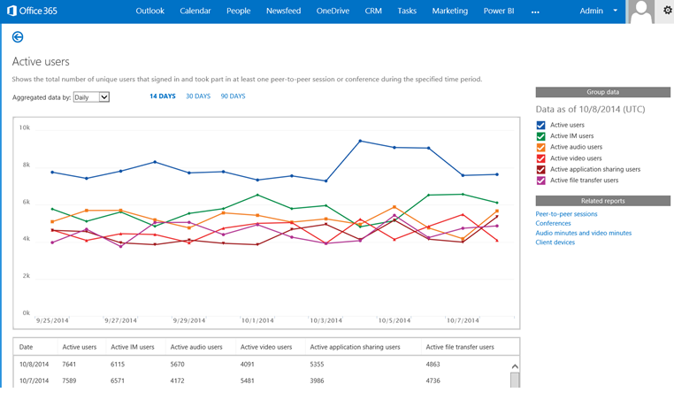


Value Is Realized Through Usage & Adoption
Even when people have the tools, vision, and an understanding of the risks.

Slide 69

It Doesn’t Happen On it’s Own…
Even when people have the tools, vision, and an understanding of the risks.

Slide 70

This is Important For All Of Us…
The more people use the platform the more value the technology provides.

Slide 71

Coach Others & Find Champions…
Learning via Co-Workers is among the most effective and most used methods.

Slide 72










Office 365 Customer
Success Center
  Scenarios
Build an adoption plan…
  Scenarios inspire people to work in new ways using Office 365, along with related communication kits to support adoption.
  Learn how to get the most out of Office 365, quickly get your team onboard, and drive adoption.
  Methodology
  success.office.com 
  A four-step approach to drive adoption supported by downloadable templates and best practices.
  Communities
  Featured adoption communities where you can learn from your peers and adoption experts.
  Resources
  Helpful resources to learn about other customer stories and special offers to make it easier to get started.

Slide 73

Adoption Advice & More…
Find great ideas for driving adoption in our latest book http://improveit.how/book

Slide 74
The Formula For Commitment
Understanding
Interest
Value
Commitment

Slide 75
The Formula For Commitment
Understanding
Interest
Value
Commitment

Slide 76
Sustaining Commitment

Slide 77



Shared Commitment…
Shared
Responsibility
Commitment
Realization Of Value
Understanding
Interest
It’s up to you AND Microsoft to help sustain commitment.

Slide 78

New Capabilities Must Be Introduced…
The technology itself should help users get acquainted with new capabilities.

Slide 79

Microsoft Is Listening & Improving…
Technology must adapt based on user needs/feedback.

Slide 80


Office 365 Groups & Delve Connect Experiences Across Office 365…
Based on what the user does put the best technology together to improve that.

Slide 81
The Formula For Commitment
Understanding
Interest
Value
Commitment

Slide 82
Next Steps
DEVELOP ORGANIZATIONAL, GROUP AND INDIVIDUAL GUIDANCE
LEVERAGE WHENTOUSEWHAT.COM WHITEPAPER, SUCCESS.OFFICE.COM AND IMPROVEIT.HOW/BOOK
GIVE US FEEDBACK & SHARE WHAT’S WORKING

Slide 83
Resources to help you be successful…
Get started today with:
FastTrack Content, Labs & Guidance: http://aka.ms/getfasttrack
Office 365 Success Center: http://success.office.com
Office 365 Training App: http://aka.ms/officetraining
Office 365 for Business Learning Center: http://aka.ms/o365learning
Join the “Driving Adoption” Group in: www.yammer.com/itpronetwork
Lync 2013 Rollout & Adoption Success Kit: http://aka.ms/lyncrask
Yammer Success Center: https://about.yammer.com/success/
Purchase & Provide Sweet 365 Gear: http://www.co-store.com/iw
Leverage Popular Use Cases: http://www.discoversharepoint.com/
Discover SharePoint App: http://aka.ms/dspapp
OnRamp (Automated Deployment Assistance): https://onramp.office365.com/onramp/
Office 365 Roadmap: http://office.com/roadmap
These are a few of the resources you should check out.

Slide 84
More Resources to help you be successful…
Available Programs (Applicability Varies):
Customer Immersion Experience: http://aka.ms/TryImmersion
The Microsoft Experience Center provides you a facilitated hands-on environment to experience Microsoft’s productivity solutions through a series of simulated, every day scenarios.
Adoption Offer (New 150+ Seat): https://deploy.office.com/email-migration-offer
Software Assurance Deployment Planning Services: https://deploy.office.com/deployment-planning-services
Software Assurance Training Vouchers: https://www.microsoft.com/learning/en-us/software-assurance-benefits.aspx
Onboarding Center: https://deploy.office.com/onboarding-center
100+ PowerPoint Presentations on SlideShare: http://www.SlidesShare.net/RHarbridge
Richard Harbridge & Kanwal Khipple via LinkedIn or 2toLead.com
These are a few of the resources you should check out.

Slide 85
Related Sessions…
Office 365 Groups
  Microsoft Office 365 Groups Overview and Roadmap (BRK2114)
  Microsoft Office 365 Groups Deep Dive (BRK3114)
  Evolving Distribution Lists with Office 365 Groups (BRK3103)
  Collaborate on Files and Information within Office 365 Groups (BRK2113)
Adoption
  Driving User Adoption from a Technical Standpoint for SharePoint, Exchange and Office 365 (BRK2113)
  Beyond Deployment: How IT Can Inspire, Motivate, and Drive Sustainable Adoption (BRK2157)
  Yammer
  Yammer Roadmap (BRK2103)
Office 365 Delve
  Office Delve & Office Graph Roadmap (BRK1105)
  A New People Experience In Delve (BRK2176)
  Search Channel9 Using (Session Codes)
Be sure to check out these sessions online if you haven’t seen them!

Slide 86
Join the conversation!
Share tips and best practices
with other Office 365 experts
http://aka.ms/office365network

Slide 87


Please evaluate this session
Your feedback is important to us!
Visit Myignite at http://myignite.microsoft.com
or download and use the Ignite Mobile App
with the QR code above.

Slide 88
Thank You!
Kanwal Khipple | Kanwal@2toLead.com | @KKhipple
Richard Harbridge | Richard.Harbridge@Microsoft.com | @RHarbridge
Richard@2toLead.com

Slide 89
Download the when to use what In Office 365 Enterprise User Guidance Whitepaper!
It goes into much greater depth and can be found at WhenToUseWhat.com

Slide 90

When To Use Video & When Not To Use Video
Beyond Office 365, when does it make sense to use Video in the enterprise?

