Slide 2
Become a Productivity Ninja
BRK2105
Angus Florance | @angusflorance
Steve Nguyen | @espnguyen
Steve Somers | @ricksteve

Slide 3
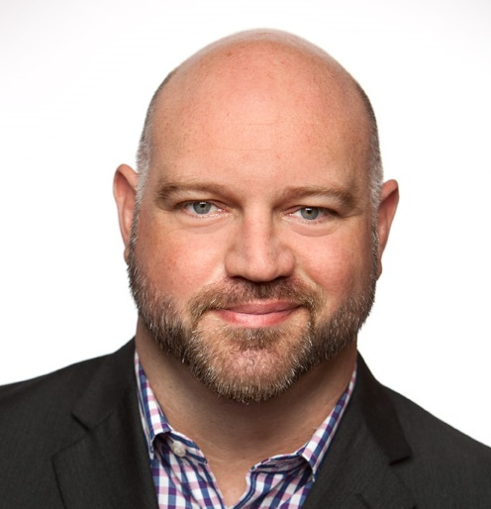
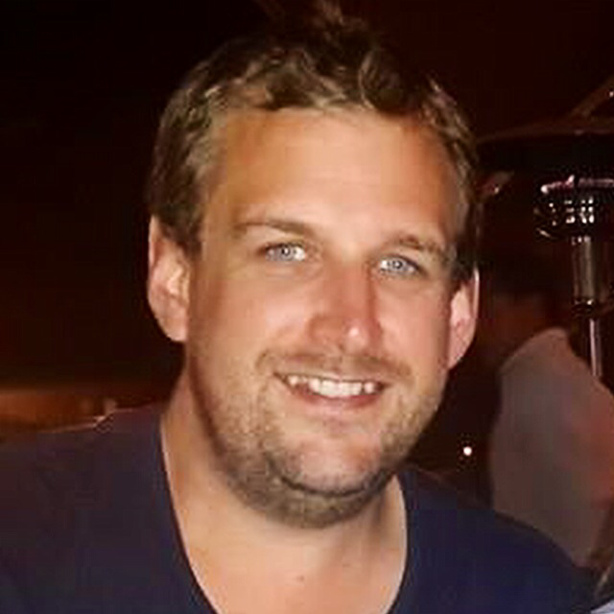
Introducing your Senseis…
Steve S.
Steve N.
Gus
“The Desk Jockey”
“The Home Worker”
“On the Go”

Slide 4
Getting Things Done by David Allen

Slide 5
Culture of Busy vs. Culture of Productive

Slide 6
Components of a Habit
CUE
ROUTINE
REWARD

Slide 7
Last chance to eject…
Planning your day
Manage and triage messages
Scheduling a meeting
Running a meeting
Expense reports

Slide 8
Let’s begin…

Slide 9
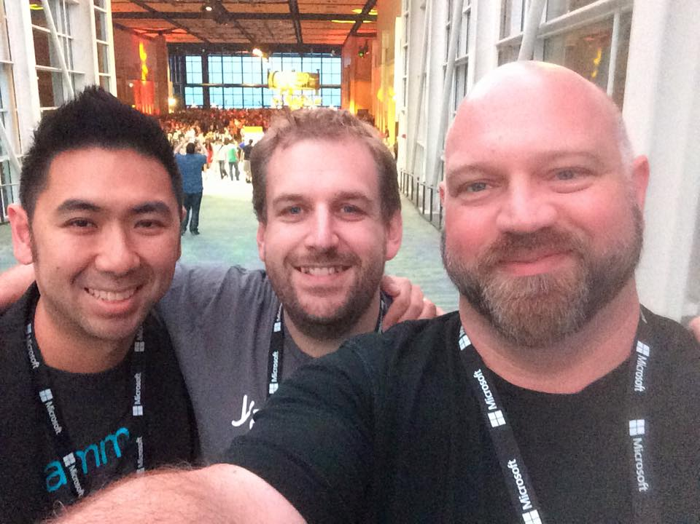
#ninjas #fourscreens

Slide 10
Resources
“Getting Things Done” by David Allen
“Power of Habit” by Charles Duhigg
“Procrastinate on Purpose” by Rory Vaden
Tools and Applications
Office 365
Pocket (getpocket.com)
Do.com
Remember the Milk
Fantastical

Slide 11
Questions?

Slide 12
Yammer Related Content and Resources
Breakout Sessions
Session | Code | Time | Room
Team Collaboration in the Connected Workplace | BRK1106 | Mon May 4, 1:30pm | S104
Yammer Enterprise Administration | BRK3111 | Tue May 5, 10:45pm | S103
Yammer Roadmap | BRK2103 | Tue May 5, 1:30am | S501
Yammer Identity and User Management | BRK3132 | Tue May 5, 3:15pm | E350
Yammer of Team Collaboration | BRK2190 | Wed May 6, 9:00am | S401
Yammer IT Mythbusters | BRK2201 | Wed May 6, 5:00pm | S103
The Social Journey: The Customers' Perspective | BRK2101 | Thu May 7, 9:00am | S503
Designing for innovation at Yammer | BRK2199 | Thu. May 7, 10:45am | N426
The Social Intranet: Integrate Yammer into Your Microsoft SharePoint Experience | BRK3201 | Thu. May 7, 1:30pm | N427
Gain Organizational Insights with Yammer Data Mining and Analytics | BRK2119 | Thu. May 7, 3:15pm | S501
Enterprise Social, from “Ooh, Shiny” to Business Success | BRK1103 | Thu. May 7, 5:00pm | S102
Yammer Mining: Dig in and "Listen" to What Your Big *Social* Data Is Saying | BRK4127 | Fri. May 8, 9:00am | N227
Become a Yammer Power User: From Zero to Hero in 75 minutes | BRK2171 | Fri. May 8, 9:00am | N427
Developing with Yammer: Extensibility and API Overview | BRK4109 | Fri. May 8, 9:00am | N228
The Microsoft Enterprise Social Journey: How We Did It | BRK2187 | Fri. May 8, 10:45am | S104
Become a Productivity Ninja: Enter the Productivity Dojo | BRK2105 | Fri. May 8, 12:30pm | E353
Resources
Office 365 Success Center Office 365 Public Roadmap Yammer admin center Office 365 Network: Yammer Service Updates
Drop by the Yammer booth!

