Slide 2
Compliance Made Easier in the Cloud
BRK2110
Shawn Veney, Principal GRC Architect
Vijay Kumar, Senior Product Marketing Manager

Slide 3
Trust Principles
It’s your data
You own it, you control it
We run the service for you
We are accountable to you
Built in
Security
Privacy
by design
Continuous
Compliance
Transparency and Control

Slide 4
Continuous Compliance in Office 365
Built-in capabilities for
compliance with standards
Enable customers to meet global compliance standards in ISO 27001, EUMC, HIPAA, FISMA
Contractually commit to privacy, security and handling of customer data through Data Processing Agreements
Customer controls for compliance with internal policies
Admin Controls like Data Loss Prevention, Archiving, E-Discovery to enable organizational compliance

Slide 5
Compliance with Standards & Regulations

Slide 6
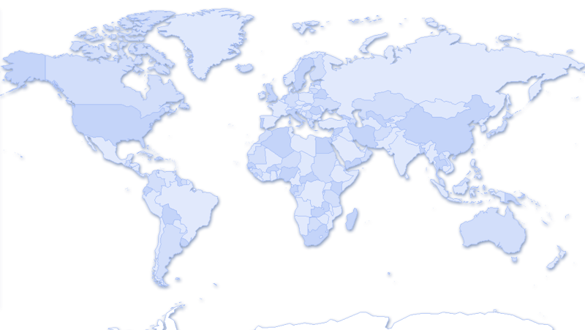
Standards & Certifications
Standards Certifications
Market
Region
SSAE/SOC
ISO27001
EUMC
FERPA
FISMA/FedRAMP
HIPAA
HITECH
ITAR
HMG IL2
CJIS
Article 29 ⁺
SOC 2
Finance
Global
Europe
Education
Government
Healthcare
Healthcare
Defense
Government
Law Enforcement
Europe
Global
Global
Global
Europe
U.S.
U.S.
U.S.
U.S.
U.S.
UK
U.S.
Europe
Global
⁺EU Data Protection Authorities validate Microsoft’s approach to privacy

Slide 7

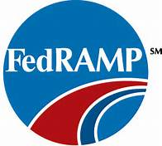


How Office 365 does Compliance
Office 365 Service | Control Sets | Certifications
Built-in Capabilities
Physical Security
Security Best Practices
Secure Network Layer
Access Control
Data Encryption
Data Minimization & Retention
Customer Controls
Account Mgmt.
DLP
Incident Monitoring
AUDITS
OME
Data Encryption
SMIME
Encryption of stored data and more…
RBAC
New Cert’s and more…
RMS

Slide 8
Building a comprehensive set of controls

Slide 9
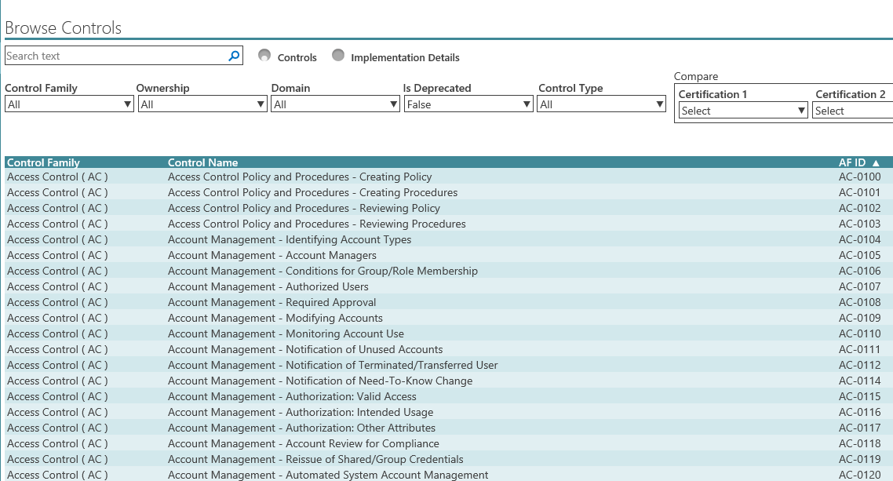
Control set – over 1,050 controls

Slide 10
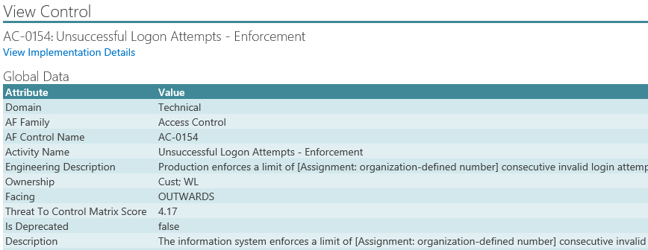
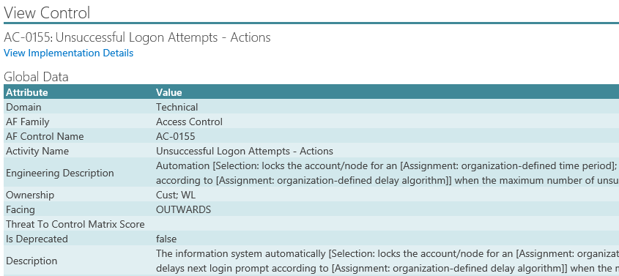
Specific control

Slide 11
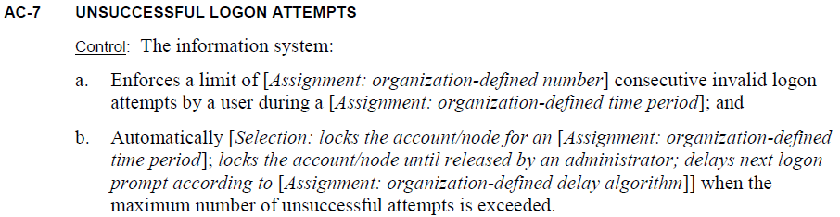
Controls based on NIST
Based on NIST Special Publication 800-53
Internationally recognized security and privacy controls
Specific and adaptable
Example:

Slide 12
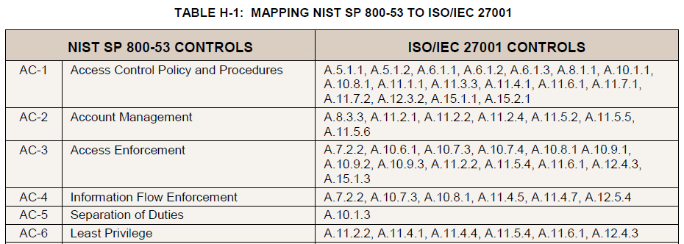
Mapping to other standards
NIST provides a mapping to ISO27001
We map other standards like SOC 1, SOC 2 and EU Model Clauses

Slide 13

Why Compliance?
Independent verification
Regulatory compliance
Increased control through compliance
Reduction in risk

Slide 14
Risk
  Organizations face risk every day.
  What can you do about a risk?
  Mitigate
  Transfer
  Accept
  Avoid
  With Office 365, a number of risks can be mitigated by Microsoft

Slide 15
Risk Management in the Cloud
Risk | Confidentiality |  | Integrity |  | Availability
 | On Premises | Cloud | On Premises | Cloud | On Premises | Cloud
Mitigate | Customer | Shared | Customer | Microsoft | Customer | Microsoft
Accept | Customer | Shared | Customer | Shared | Customer | Shared
Transfer | - | Microsoft (Contracts & Compliance) | - | Microsoft (Contracts & Compliance) | - | Microsoft (SLA)

Slide 16
Real story is how we manage these controls

Slide 17
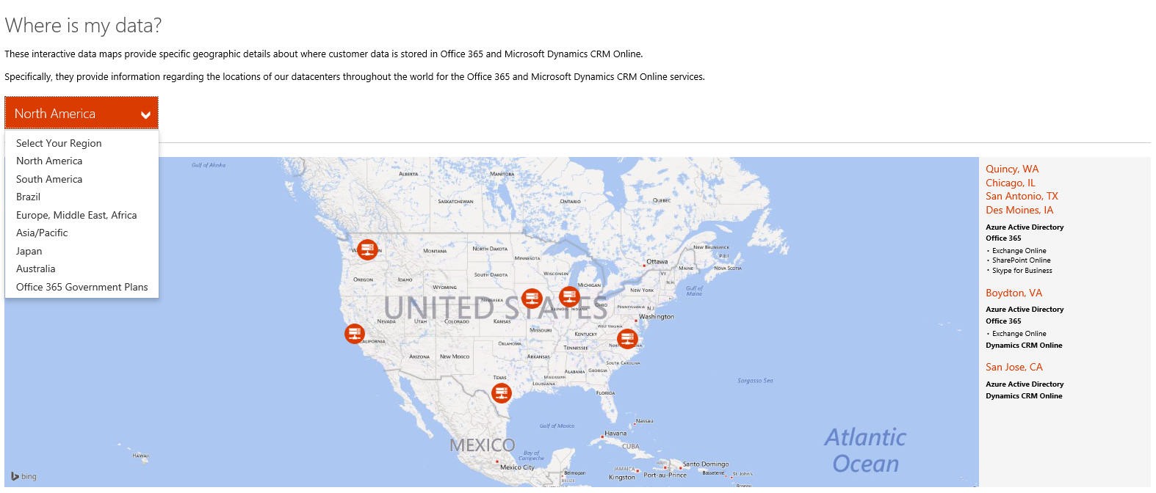
Transparency - data residency
We tell you where your data resides
http://trust.office365.com – direct link at Data Maps

Slide 18
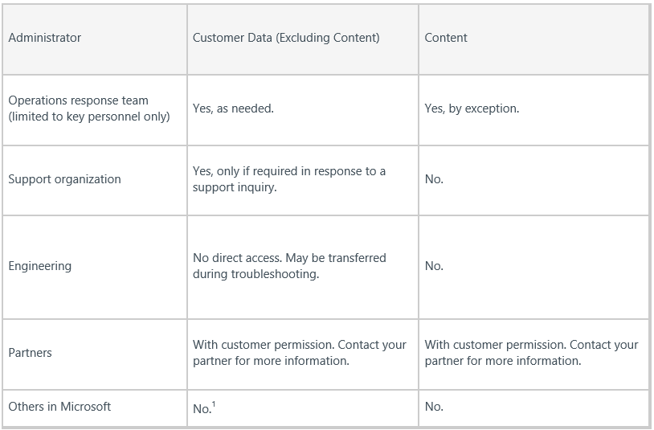
Access to your data in the service
We tell you who is involved in operating the service
http://trust.office365.com – direct link at Who has access to your data

Slide 19
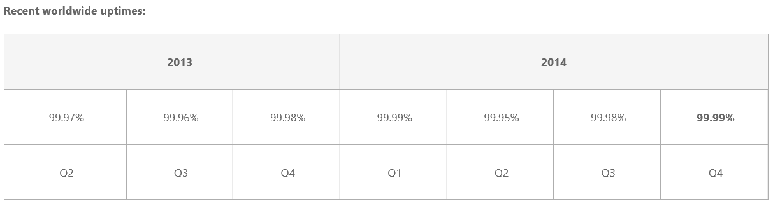
How reliable is the service
We tell you what the reliability numbers are every quarters and we offer a financially backed SLA
99.9% financially backed SLA

Slide 20
Other commitments
You can take your data with you when you leave the service
We notify you if there are any changes to the service compliance
We do not mine your data for advertising purposes
We allow you to turn off and on privacy impacting features
We contractually commit to promises we make to keep your data safe

Slide 21
Ever Evolving Approach to Compliance
Market & Competitive Intelligence
Regulatory Impact Analysis (RSIA)
Remediation
Prioritize
Compliance Management Framework
Define Security, and Privacy controls
Independent verification (Audits)
Continuous Monitoring
Determine Implementation Requirements
Document Implementation
Implement Controls

Slide 22
Examples of Compliance with deeper standards

Slide 23
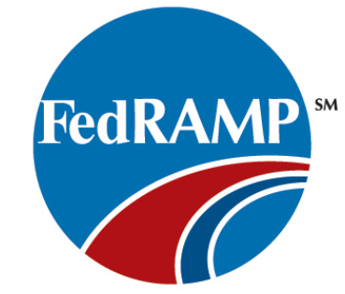
FedRAMP ATO
Department of Health & Human Services Office of the Inspector General recently issued Office 365 the Authority to Operate (ATO)
DoD Approves 23 Commercial Cloud Service Offerings that Meet FedRAMP Moderate Baseline
http://disa.mil/News/PressResources/2015/Commercial-Cloud-Service
May 4, 2015

Slide 24
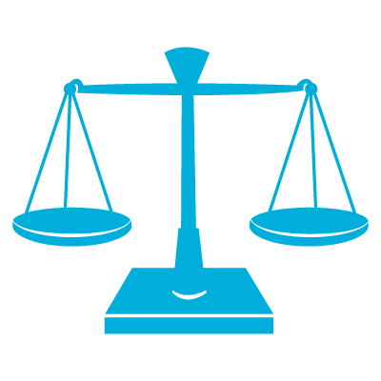
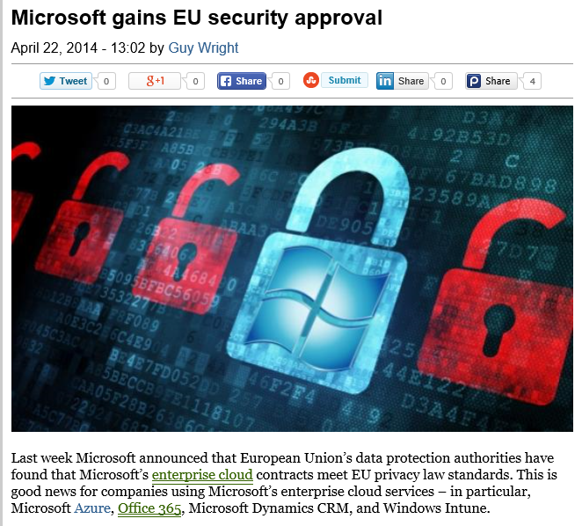
Article 29 Working Group Approval
Article 29 Working Party - collection of data protection authorities in Europe regulating world’s toughest privacy laws
Validation by EU Data Protection Authorities for Microsoft’s commercial commitments for DPA/EU Model Clauses. (covering Office 365, Azure, CRM Online, and Intune)
  Microsoft is the only provider to have received this validation
  Standard part of contracts as of July 1st
http://www.tgdaily.com/enterprise/100136-microsoft-gains-eu-security-approval

Slide 25

ISO 27018
Key Principles - Cloud providers must:
Not use data for advertising or marketing unless express consent is obtained
Be accountable to determine if customer data was impacted by a breach of information security
Be transparent about data location and how data is handled
Communicate to customers and regulators in the event of a breach
Provide customers with control over how their data is used
Have services independently audited for compliance with this standard

Slide 26
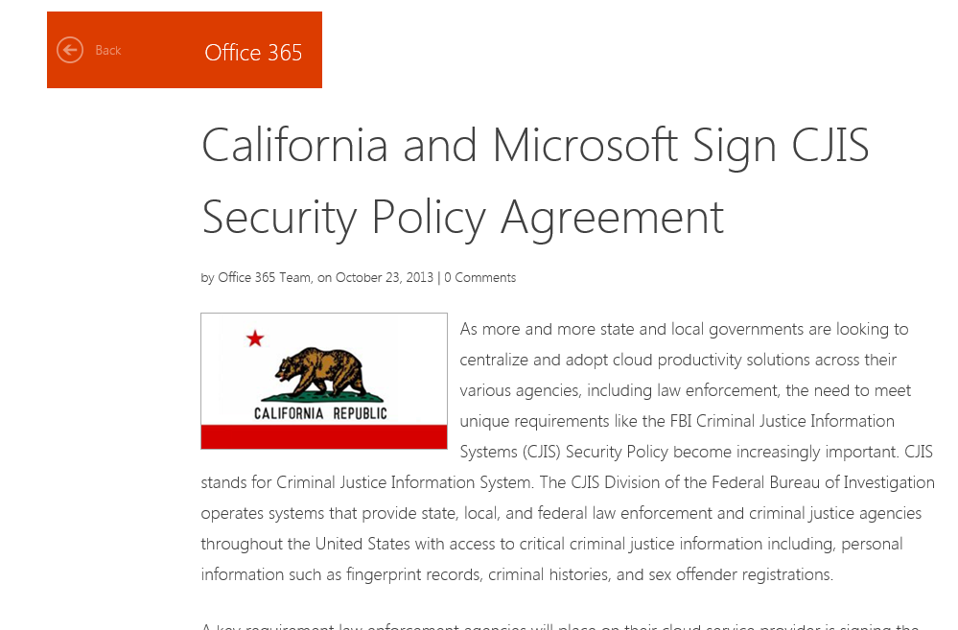
CJIS - Criminal Justice Information Systems
Office 365 has a comprehensive approach towards CJIS compliance
11 States in the US

Slide 27
Audits

Slide 28
How Office 365 does Compliance
Office 365 Service | Control Sets | Certifications
Built-in Capabilities
Physical Security
Security Best Practices
Secure Network Layer
Access Control
Data Encryption
Data Minimization & Retention
Customer Controls
Account Mgmt.
DLP
Incident Monitoring
AUDITS
OME
Data Encryption
SMIME
Encryption of stored data and more…
RBAC
New Cert’s and more…
RMS

Slide 29


Audit cadence
We audit control effectiveness using 3rd party independent auditors.
Control Effectiveness Assessment (Audit) Schedule
Nov 2014 | Dec 2015 | Jan 2015 | Feb 2015 | Mar 2015 | Apr 2015 | May 2015 | Jun 2015 | Jul 2015 | Aug 2015 | Sep 2015 | Oct 2015 | Nov 2015
ISO |  | FedRAMP MT |  | ISAE3402/SOC |  |  |  | ITAR |  |  |  | ISO
Control Effectiveness Assessment (Audit) Schedule
Nov 2014 | Dec 2015 | Jan 2015 | Feb 2015 | Mar 2015 | Apr 2015 | May 2015 | Jun 2015 | Jul 2015 | Aug 2015 | Sep 2015 | Oct 2015 | Nov 2015
ISO |  | FedRAMP MT |  | ISAE3402/SOC |  |  |  |  |  |  |  | ISO

Slide 30
Trust but verify
Share latest audit reports
(Third-party verification)
Compliance Program
(Right to Examine*)
Transparency and Control through Continuous monitoring
* For larger highly regulated customers

Slide 31
Managing Risk
Office 365 supports a high degree of customer configuration
  Part of the responsibility for the secure management of the service lies with each customer.
Customers must put the following controls in place to ensure the security of their data
  Account Management
  Access control
  Segregation of duties
  Awareness and training
  Support requests
  Use flexible customer controls in Office 365

Slide 32
Compliance customer controls

Slide 33




Compliance controls
Identify
Monitor
Helps to
  Identify monitor protect
Sensitive data through deep content analysis
Protect
End user education

Slide 34


DLP Policy Enforcement
APPEND
OVERRIDE
Flexible tools for policy enforcement that provide the right level of control
  Transport Rules
  Rights Management
  Data Loss Prevention
REVIEW
ENCRYPT
CLASSIFY
REDIRECT
ALERT
BLOCK

Slide 35

Email archiving and retention
Preserve
Search
In-Place Archive
Governance
Hold
eDiscovery
Secondary mailbox with separate quota
Managed through EAC or PowerShell
Available on-premises, online, or through EOA
Automated and time-based criteria
Set policies at item or folder level
Expiration date shown in email message
Capture deleted and edited email messages
Time-Based In-Place Hold
Granular Query-Based In-Place Hold
Optional notification
Web-based eDiscovery Center and multi-mailbox search
Search primary, In-Place Archive, and recoverable items
Delegate through roles-based administration
De-duplication after discovery
Auditing to ensure controls
are met

Slide 36

















Activity Logs
ISVs
Security
Users
Report/Dashboards
Engagement
Admins
Activity
API
Compliance
Operations
Microsoft

Slide 37

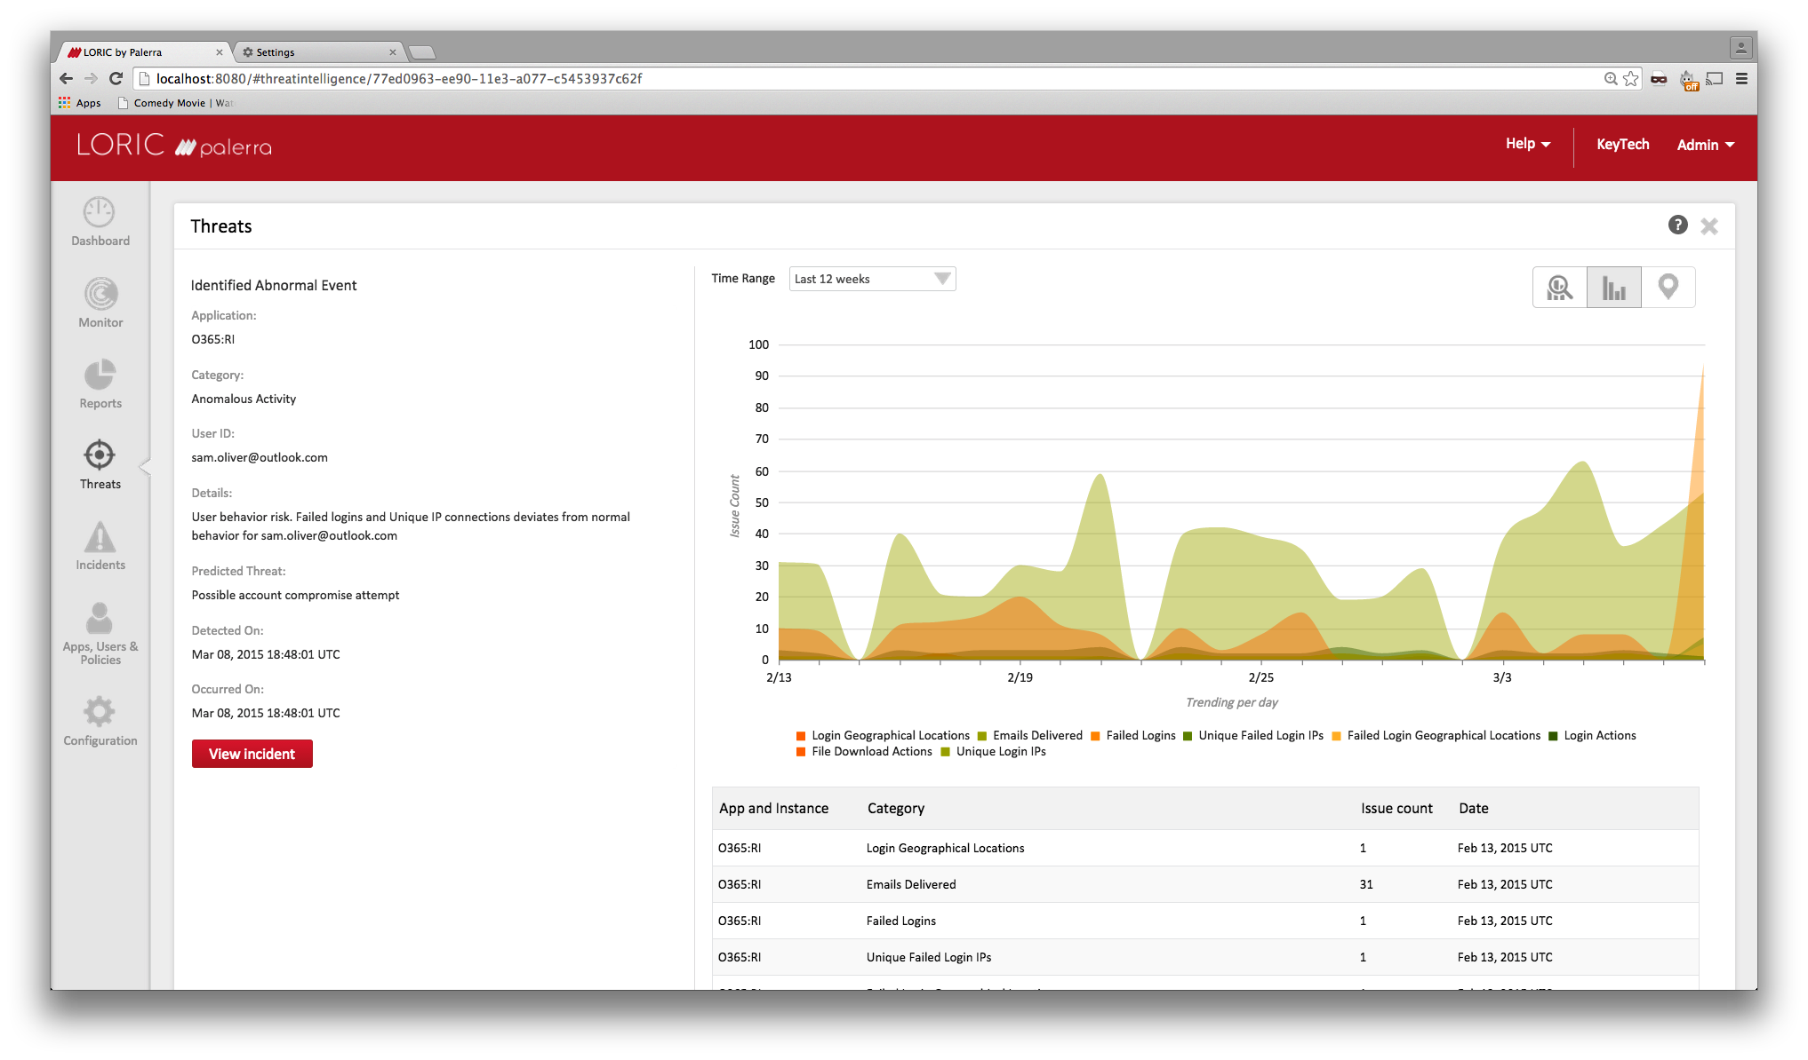
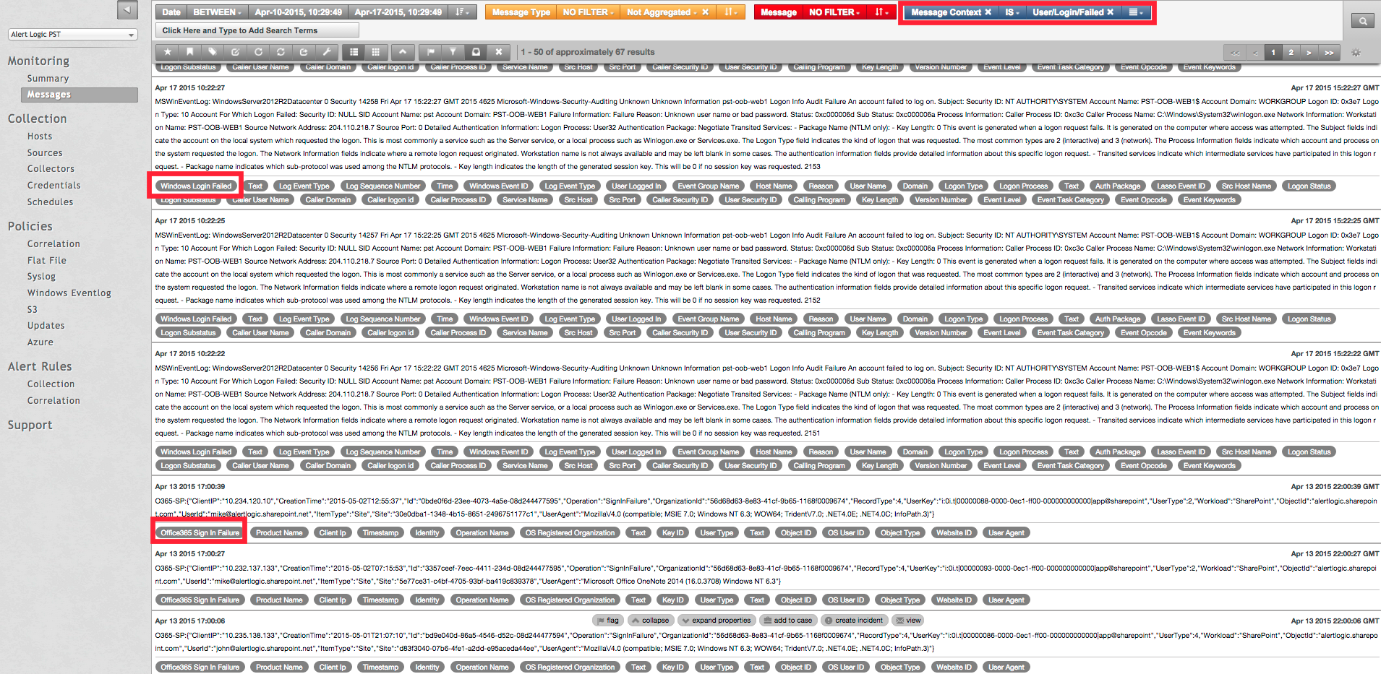
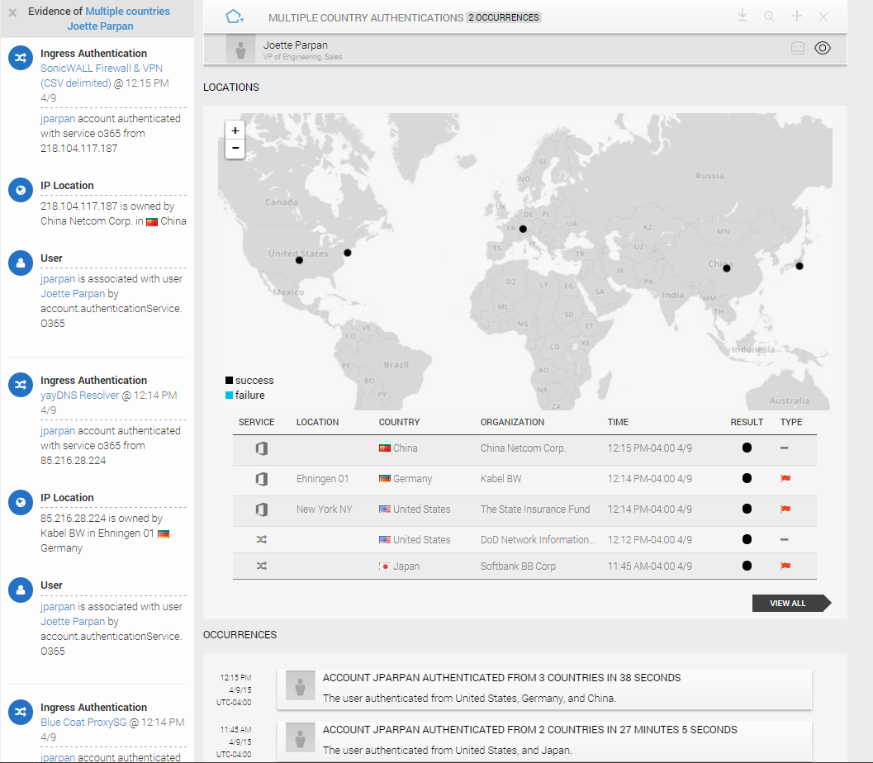
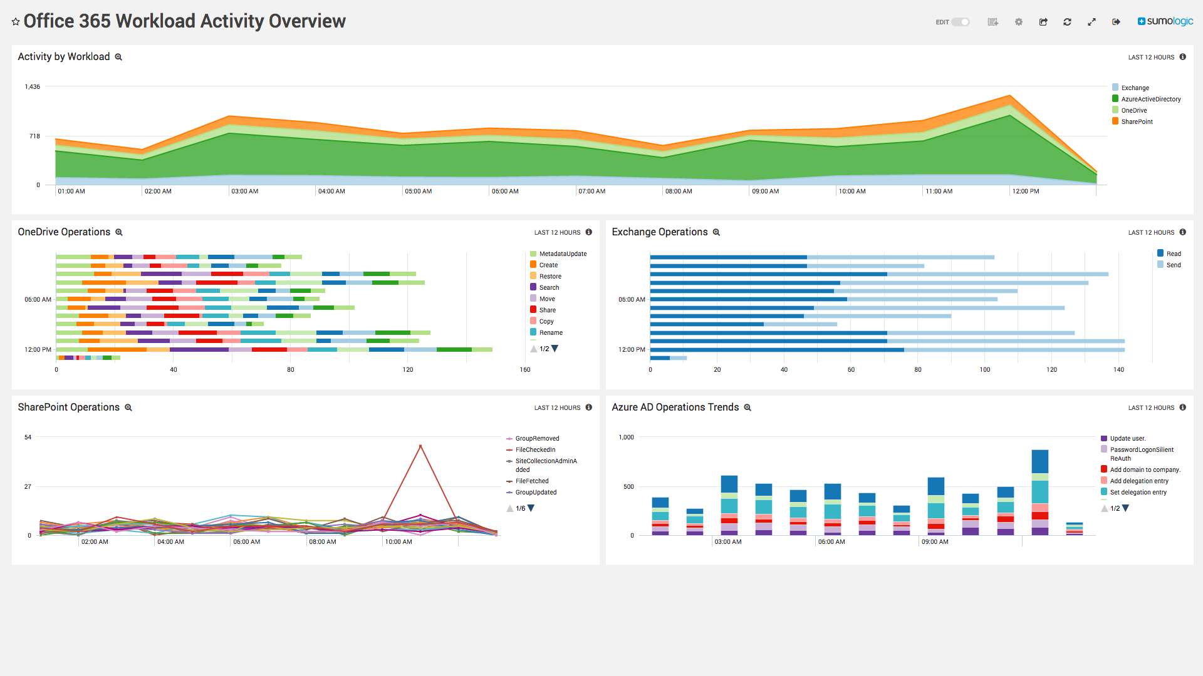
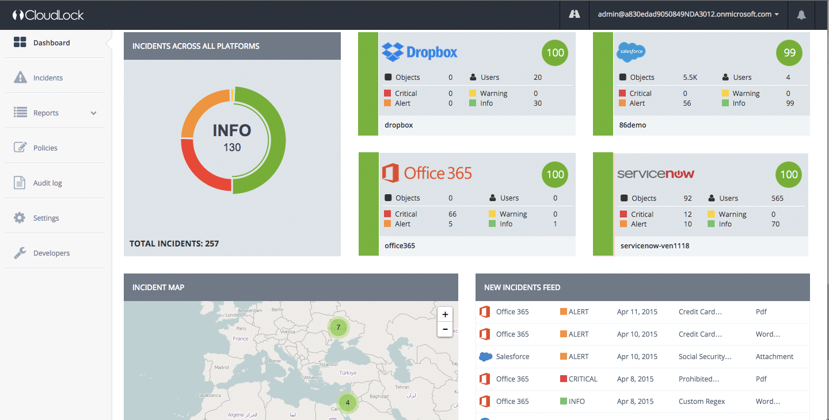




Activity Logs: ISV Integrations

Slide 38
Privacy

Slide 39



Privacy
Privacy by design means that we do not use your information for anything
other than providing you services
No Advertising
Transparency
Privacy controls
No advertising products out
of Customer Data
No scanning of email or documents to build analytics or mine data
Access to information about geographical location of data, who has access and when
Notification to customers about changes in security, privacy and audit information
  Various customer controls at admin and user level to enable or regulate sharing
  If the customer decides to leave the service, they get to take to take their data and delete it in the service

Slide 40
On government snooping…
To be clear, here’s what we do, and what we don’t do:
We don’t provide any government with direct, unfettered access to your data.
We don’t assist any government’s efforts to break our encryption or provide any government with encryption keys.
We don’t engineer back doors into our products and we take steps to ensure governments can independently verify this.
If as reports suggest there is a bigger surveillance program we aren’t involved

Slide 41
Response to data requests
If we receive a government demand for any enterprise customer’s data:
We will only disclose customer data when legally required, and only after attempting to redirect the request to the customer.
We will notify the customer and provide a copy of the demand unless legally prohibited from doing so.
We will resist government demands that are invalid.
We back up these commitments in our contracts, and will go to court if necessary when government orders seeking customer data do not comply with applicable laws.

Slide 42
Resources

Slide 43
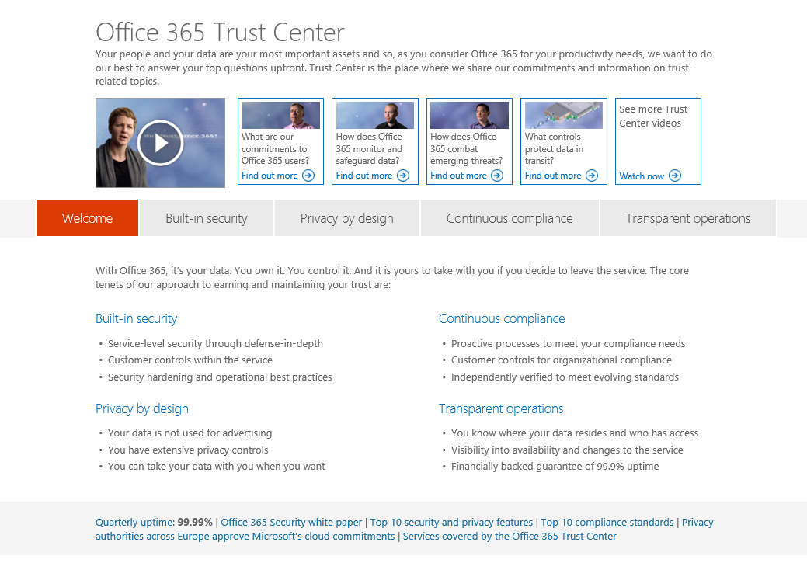
Resources
Office 365 Trust Center http://trust.office365.com
Office 365 Blog http://blogs.office.com/
Enabling transparency and control
Enhancing transparency and control for Office 365 customers
Customer Lockbox
Office 365 management activity API for security and compliance monitoring
Whitepapers
Overview of Security
http://aka.ms/securitywhitepaper
Overview of Security and Compliance in Office 365
Customer controls for Information Protection
http://aka.ms/customercontrolsm
Law Enforcement Requests Report
http://www.microsoft.com/about/corporatecitizenship/en-us/reporting/transparency/

Slide 44
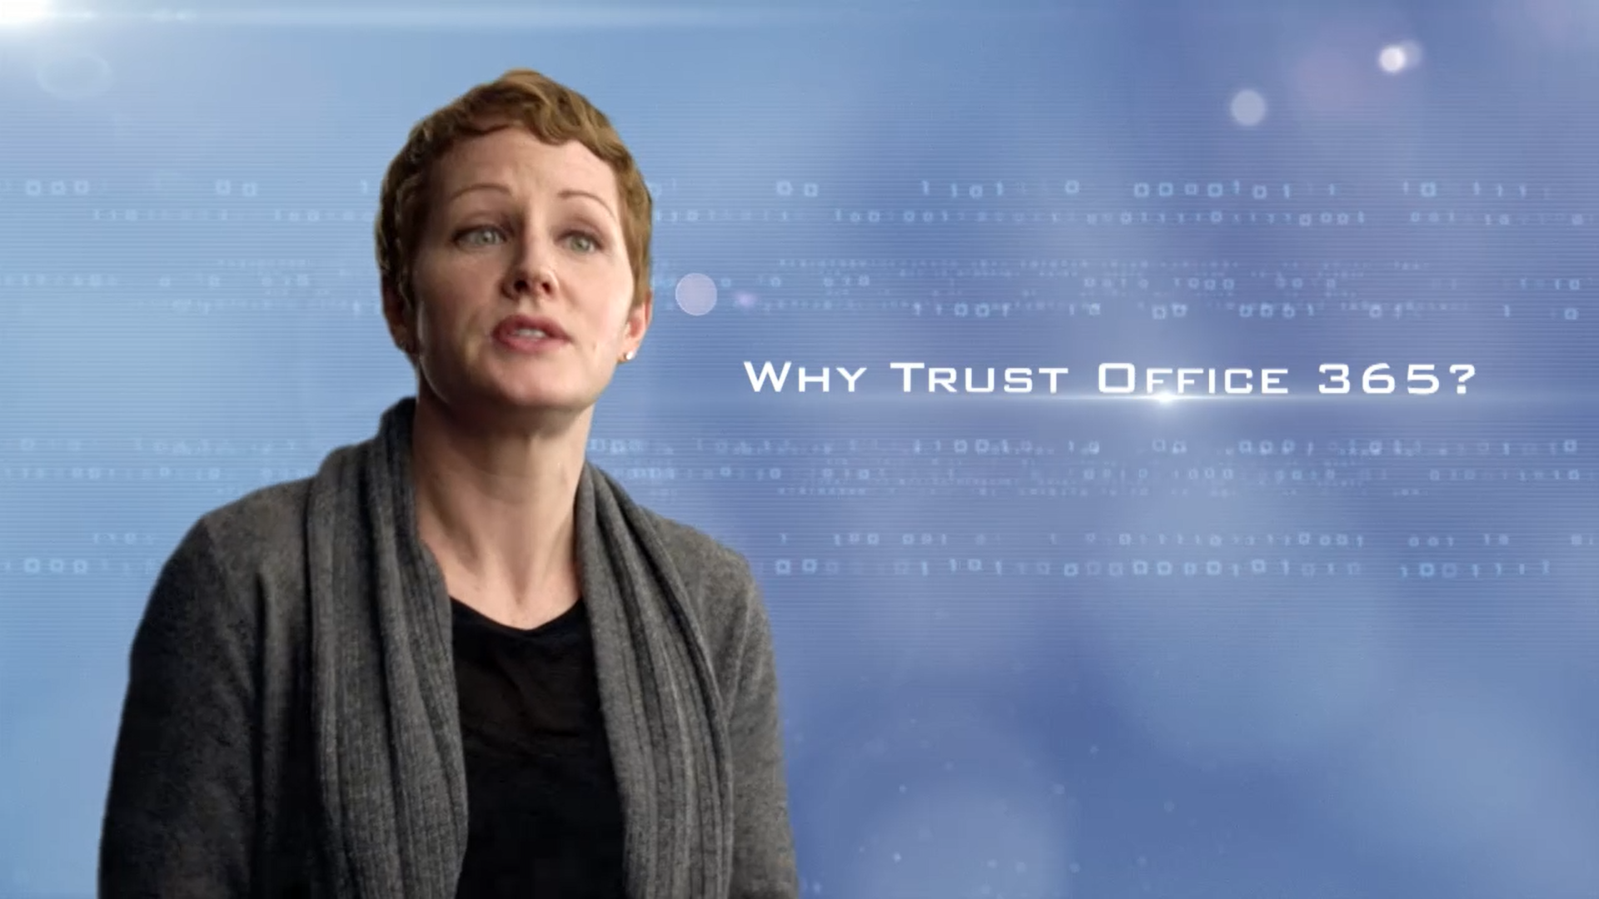



From Inside the Cloud
Commentary from people who design, build and manage the service
http://aka.ms/fitc

Slide 45
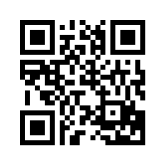
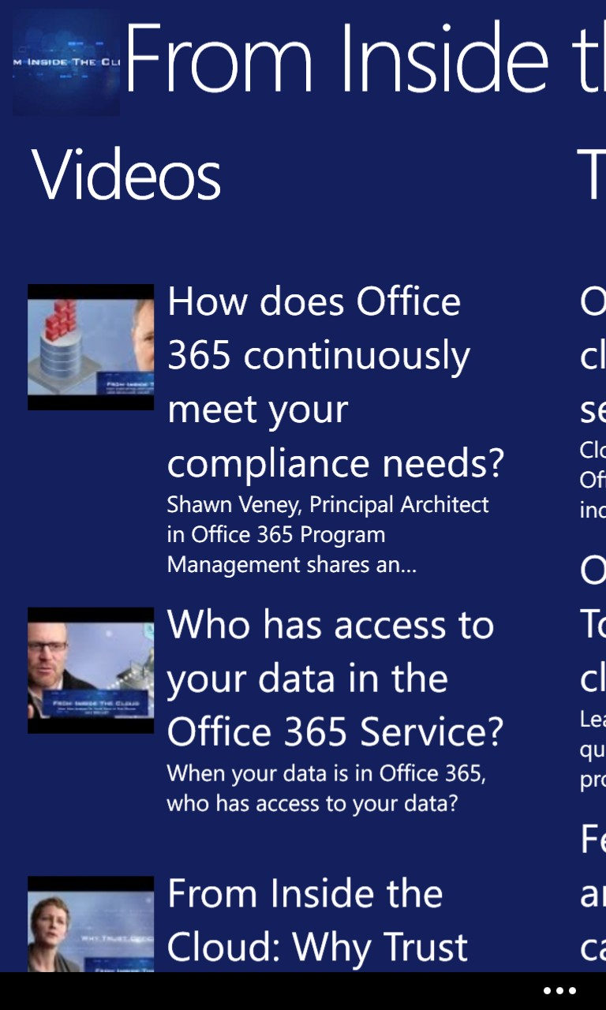
Download “From Inside the Cloud” WP app
http://aka.ms/fitc4wp

Slide 46

Q&A

Slide 47


Please evaluate this session
Your feedback is important to us!
Visit Myignite at http://myignite.microsoft.com
or download and use the Ignite Mobile App
with the QR code above.

Slide 49
Backed up by contractual commitments
Privacy terms
Security terms
EU Model Clauses
Response to government demands
Core service features and simpler, stable terms during a subscription
Standard Online Service Terms apply to every cloud customer—no amendments or negotiations required.

Slide 50
Putting our commitments into action
Microsoft is demonstrating our commitment to protect customer data from government demands in court actions.
U.S. Warrant Case. Microsoft is in litigation with the U.S. government to resist a criminal search warrant seeking customer data stored outside the United States. The case is on appeal. It raises important questions about the ability of the U.S. government to issue search warrants for data outside the U.S., given that the government clearly cannot search homes or business premises abroad.
National Security Letters. Microsoft resisted a National Security Letter non-disclosure order, which prohibited Microsoft from notifying the customer of a government demand to disclose its data. The FBI withdrew the demand.
Government Requests Transparency. Microsoft filed a lawsuit against the U.S. government to permit greater disclosure about government demands for customer data. The U.S. government settled, allowing Microsoft and others to share broader information with customers.

