Slide 2
Microsoft Office 365 MVP Panel
BRK2131
Darrell Webster, Jethro Seghers, Sean McNeill, Brett Hill, Martina Grom, J. Peter Bruzzese.

Slide 3
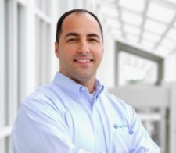
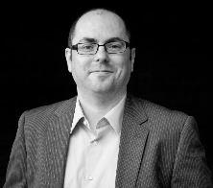


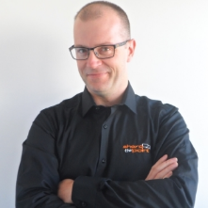
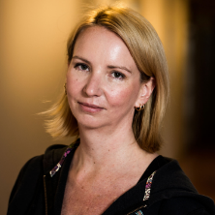
Experts Unplugged:
Office 365 MVP Panel
 | J. Peter Bruzzese | @JPBruzzese Technical Consultant, Clip Training All about Exchange |  |  | Jethro Seghers | @jseghers Program Manager, BitTitan Migrations
 | Sean McNeill | @S_McNeill Director of Enterprise, SkyKick Migrations |  |  | Brett Hill | @bretthill Manager Technical Marketing, Riverbed Network Optimization
 | Darrell Webster | @DarrellCWebster Office 365 Trainer Adoption |  |  | Martina Grom | @magrom Cloud Architect, atwork All about Office 365

Slide 4
Join the conversation!
Share tips and best practices
with other Office 365 experts
http://aka.ms/office365network

Slide 5


Please evaluate this session
Your feedback is important to us!
Visit Myignite at http://myignite.microsoft.com
or download and use the Ignite Mobile App
with the QR code above.

