Slide 2
Keeping Your Data in Place with Office 365 Archiving and Retention
BRK2144
Dheepak Ramaswamy, Sanjay Ramaswamy

Slide 3
About me

Slide 4


Slide 5


Slide 6


Slide 7
Program Manager
Office 365 Information Protection
Exchange, SharePoint, OneDrive, Lync, Yammer
And more…

Slide 8

REDUCE RISK

Slide 9

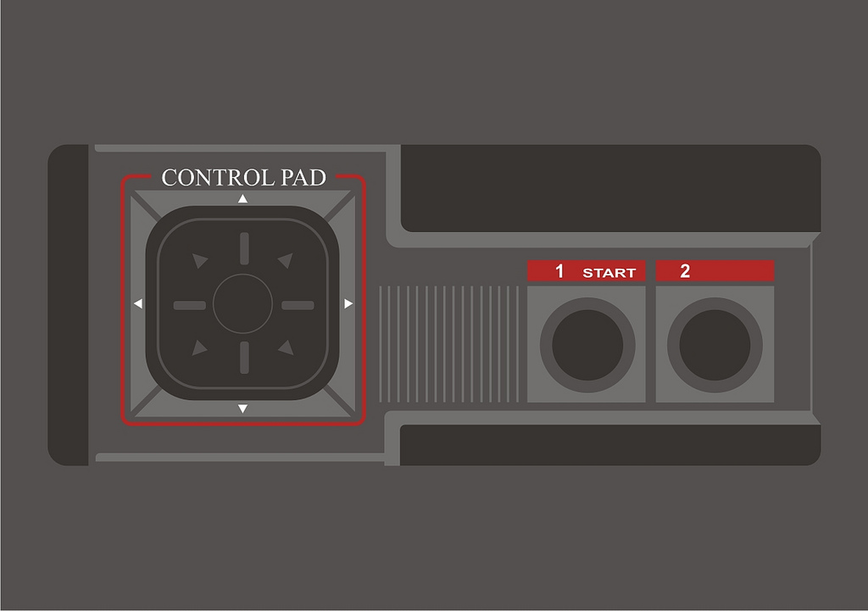
SIMPLIFY

Slide 10

SAVE MONEY

Slide 11




Archiving
Integrated tools to help you import, store, preserve and expire data
Import
Storage
Retention
Bring your data to Office 365
Unlimited archive
Preserve the data you need to keep, delete the data you don’t need
One retention policy for Exchange, SP, OneDrive, Lync and Public Folders
Time based policy
Delete policies at item or folder level for email, site level for SP, OneDrive
Import TB of data quickly and easily
Ship data on hard drives or upload over network
Partner support
All data that matters to you
Full fidelity end user client experience
No add-ons, plug-ins for the end user
No need to maintain separate duplicate store
No configuring separate AD connectors or passwords or journal rules

Slide 12
Import

Slide 13
Data ecosystem
On-premises Microsoft Workloads
Exchange
SharePoint/OneDrive
Lync
File Shares
3rd party archives
Public Web Sites
3rd party messaging
Financial
IM
SMS
On-premises 3rd Party workloads
Email
ECM
Social Media (consumer, business)

Slide 14
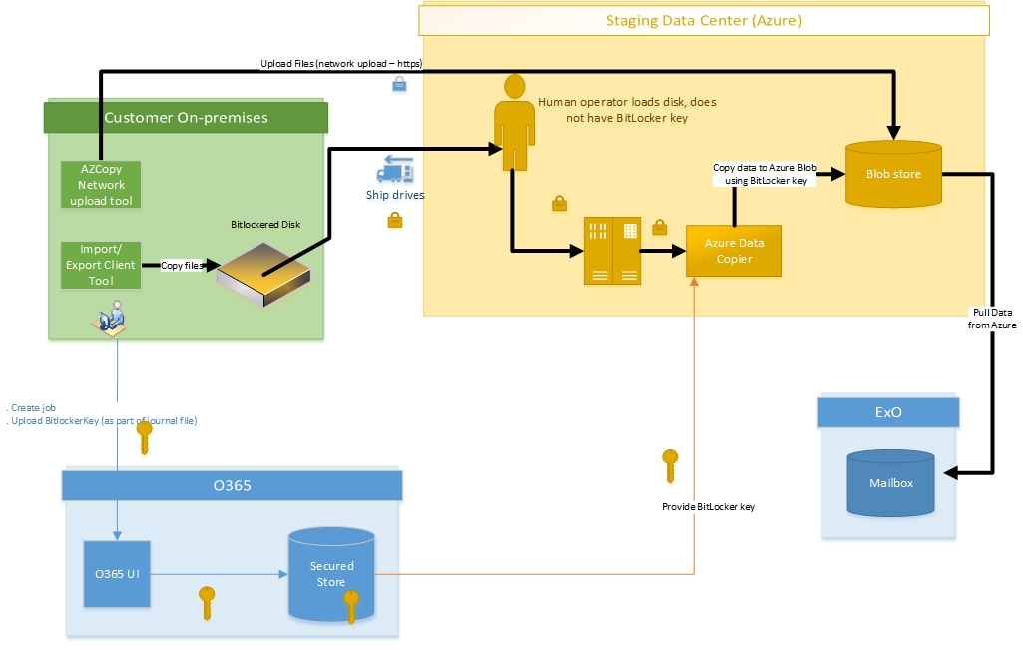
O365 Import Service – Drive shipping

Slide 15
Demo – PST Import
Dheepak Ramaswamy

Slide 16
Demo – SharePoint/OneDrive Import
Simon Bourdages

Slide 17
O365 Import – more features
Encryption at the client
Auto create destination mailbox
Import into Inactive mailbox
Auto detect if PST to mailbox mapping is correct
Additional work for GOV/ITAR/Dedicated customers
Chain of custody

Slide 18
Demo – 3rd party data import
Dheepak Ramaswamy

Slide 19
Import partners

Slide 20
Storage

Slide 21
Storage
Unlimited archive – Exchange Online/Lync
1 TB site collection limit for OneDrive for Business and team sites, groups storage
Infinite tenant storage scale

Slide 22
Personal Archive - Email

Slide 23

The personal archive is simply an overflow container.

Slide 24




Benefits of large mailbox with archiving
Access to all
email from
most clients
No time spent managing
mailbox quota
Eliminate lost
or corrupted
.PST files
Simplify email discovery and retention mgmt.

Slide 25


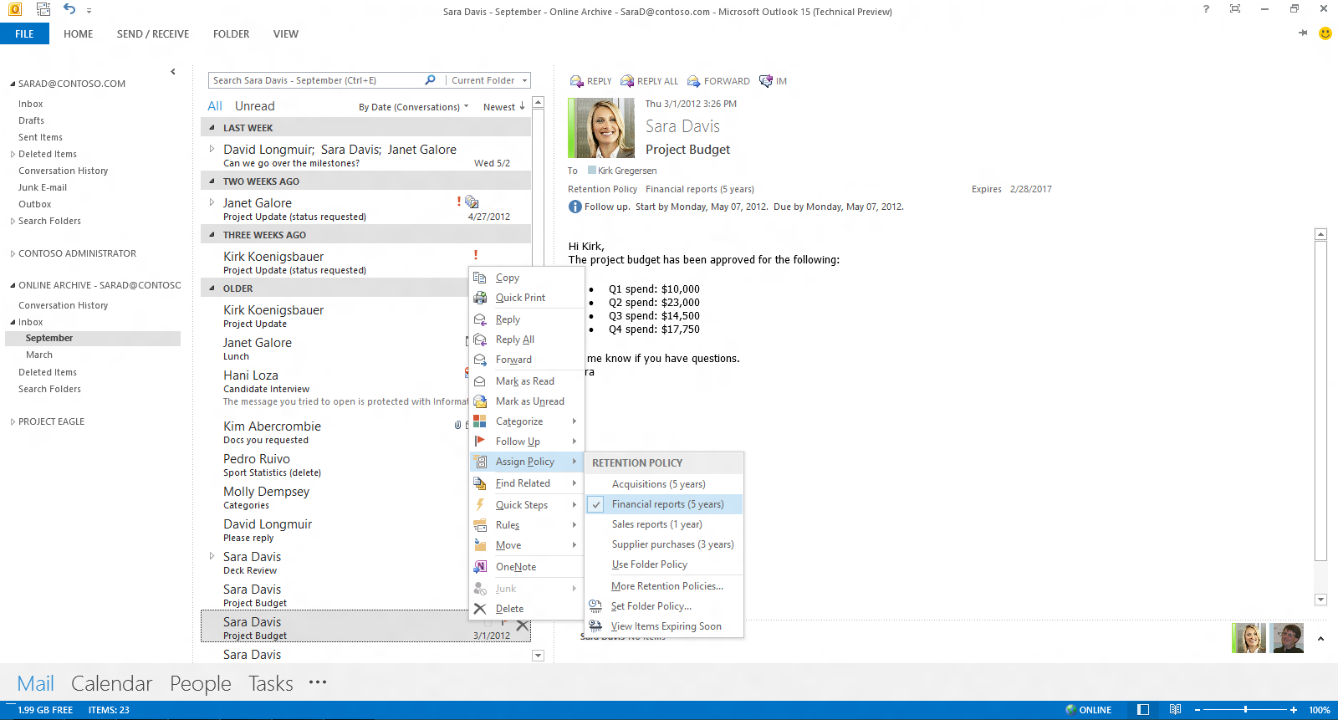
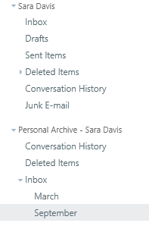
Today: Data storage
Exchange In-Place Archive
User A
Outlook
OWA
Primary
Archive
Inbox
“Inbox”
…
…
Deleted Items
Immutable
Immutable
Deletions
Deletions
Versions
Versions
Purges
Purges
DiscoveryHolds
DiscoveryHolds
…
…
  Retain folder hierarchy

Slide 26
Demo – Create an archive and Outlook experience
Dheepak Ramaswamy

Slide 27
Inactive users

Slide 28


How does archiving work for inactive users?
  User is placed on hold
  User leaves company, AD object is deleted
  The license will be released, and the In-Place Hold remains enabled
  The hold is removed or reaches its specified end date. The data is then deleted
  Inactive data can now be searched and accessed only through eDiscovery

Slide 29
Retention

Slide 30
Why do you need Retention?
Legal obligations
Corporate governance standards
Industry regulations
    HIPAA
    OSHA
    Sarbanes-Oxley
    SEC 17a-4
    21 CFR part 11
    UK Public Records
    Data Protection Act

Slide 31
Retention in O365
In-Place retention
Unified Policy across all workloads
Preserve for X years, Delete once X years are up
Automated policy enforcement
DL/BCC information preserved – no need for journal based archiving
Different from eDiscovery and Legal Holds

Slide 32
Demo – Retention in the Compliance Center
Dheepak Ramaswamy

Slide 33
Demo – Public Folder Retention
Dheepak Ramaswamy

Slide 34
Data Governance (MRM)

Slide 35
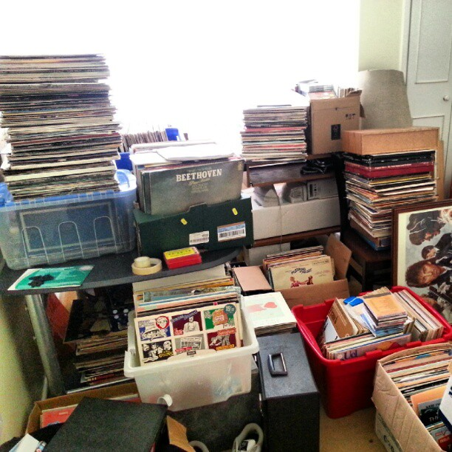
Deletion policy
Junk email
OneDrive
Team sharing site
Limit user access to risky data

Slide 36
Demo – Site deletion policy
Dheepak Ramaswamy

Slide 37
Roadmap

Slide 38
Roadmap
Groups
WORM Storage – Immutable retention policy
Supervisory review

Slide 39


Archiving Roadmap
In-Place Archiving
Unified Experience
Extensible Platform
Built in (not bolt on) Compliance for Office
eDiscovery and Compliance
eDiscovery and Compliance
Audit
Archive
Discover
Encrypt
DLP
Preserve
Delete
Exchange
Exchange
Lync
Immutable
Lync
Immutable
IM
SharePoint
SharePoint
3rd Party Archives
eDiscovery and Compliance
eDiscovery and Compliance
File shares
Immutable
Immutable
File Shares
Audit
Archive
Discover
Encrypt
DLP
Preserve
Audit
Archive
Discover
Encrypt
DLP
Preserve
Exchange
SharePoint
Immutable
Immutable
Go Big, Go Fast, Unify
One Compliance Centre, Scale
Bring the data home
Import
Migrations from third party stores, more formats
In-Place
Immutability and in-place search, preservation, deletion

Slide 40
How we plan to get there
Exchange
eDiscovery and Compliance
eDiscovery and Compliance
SharePoint
Traditional Archive
Audit
Archive
Discover
Encrypt
DLP
Preserve
Delete
Others
Exchange
Build compliance into
Exchange, SharePoint and OneDrive
Index or Import to extend beyond these workloads
Unify compliance experience and configuration across the suite
Lync
Immutable
IM
SharePoint
3rd Party Archives
Immutable
File shares

Slide 41
Questions?

Slide 42
Join the conversation!
Share tips and best practices
with other Office 365 experts
http://aka.ms/office365network

Slide 43


Please evaluate this session
Your feedback is important to us!
Visit Myignite at http://myignite.microsoft.com
or download and use the Ignite Mobile App
with the QR code above.

