Slide 2
A Lync Customer Story—Intermountain Healthcare
BRK2147
Lonnie Buchanan and Tee Jay Harrison

Slide 3
Changing the Face of Healthcare

Slide 4
Neonatal Resuscitation

Slide 5
Decrease in Infant Mortality Rates
Significant drops in rates around mid century.
In 1900 up to 30% of infants in some cities died before reaching their first birthday
If turn-of-the-century infant death rates had continued, then an estimated 500,000 live-born infants during 1997 would have died before age 1 year; instead, 28,045 infants died
Achievements in Public health, 1900-1999: Healthier Mothers and Babies; MMWR; Vol 48(38), October 1, 1999

Slide 6
Why?

Slide 7

Why?
Changes in the way we live
  Advances in Living Conditions
Advances in sanitation and the understanding it played in disease control

Slide 8
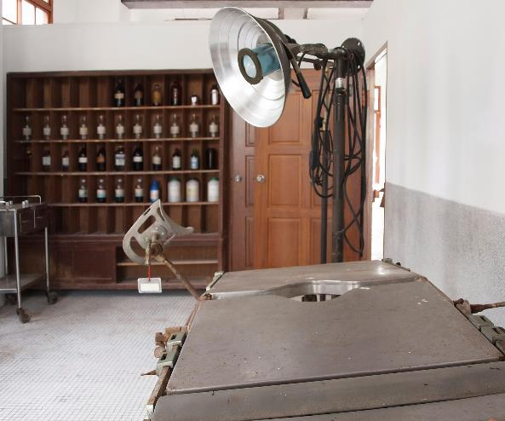
Why?
Changes in the way we live
  Advances in Living Conditions
Changes in how we treat diseases and conditions
  Advances in Treatment, Drugs and Vaccinations
Creation of sanatoriums to house sick patients and the creation of dispensaries and clinics to treat the sick.

Slide 9
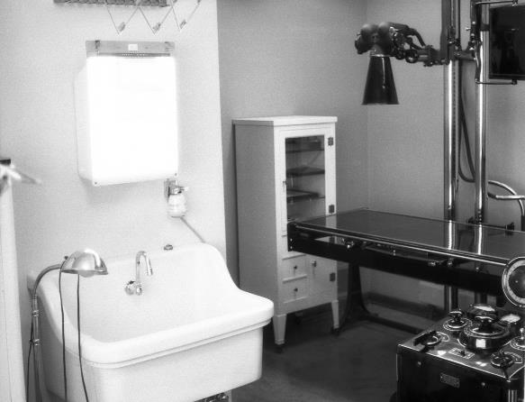
Why?
Changes in the way we live
  Advances in Living Conditions
Changes in how we treat diseases and conditions
  Advances in Treatment, Drugs and Vaccinations
Changes in how we use technology
  Advances in Technology and Science
Such as X-Rays

Slide 10
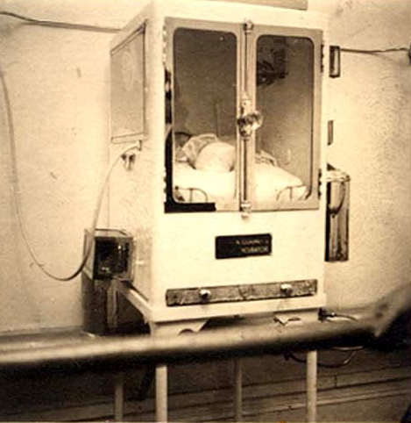
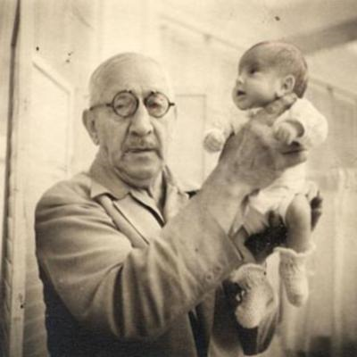
Baby Incubators

Slide 11
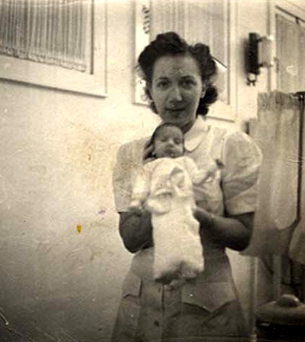
Premature Babies You May Know…

Slide 12
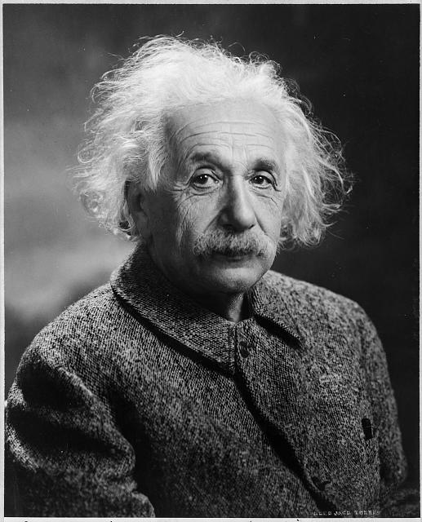
Albert Einstein

Slide 13

Sir Isaac Newton

Slide 14
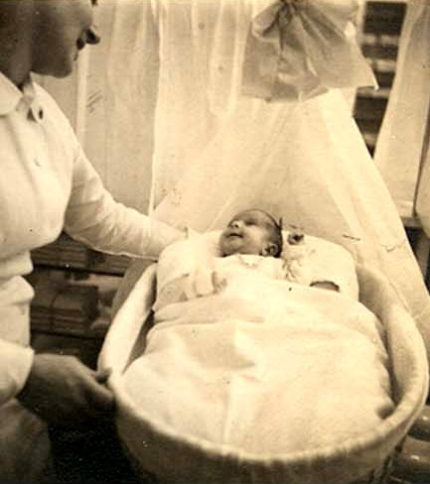
and Beth Allen

Slide 15
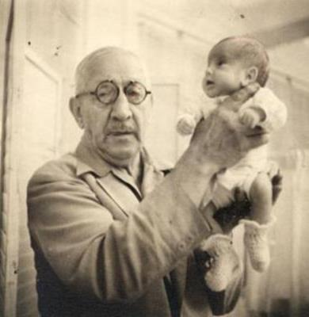
Martin Couney

Slide 16

Coney Island 1903

Slide 17
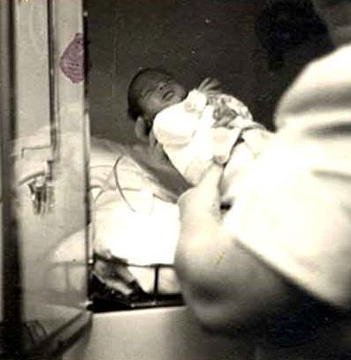
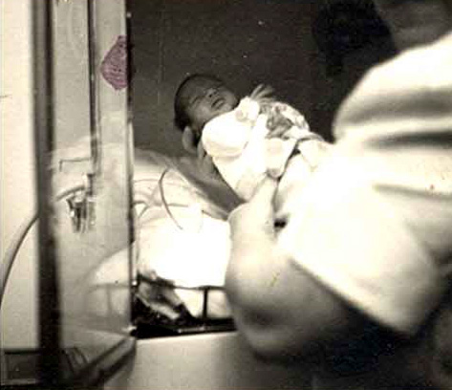
Beth Allen

Slide 18
What made the difference?
changes in the way we live,
treat diseases and conditions, and
how we use technology

Slide 19
What made the difference?
Desire to make changes

Slide 20
Next Phase of Healthcare…

Slide 21
The Vision
Intermountain Healthcare will be a nationally recognized leader in the use of TeleHealth to
improve clinical quality, improve health, and improve affordability.

Slide 22

Why?
Changes in the way we live
  Advances in Living Conditions

Slide 23
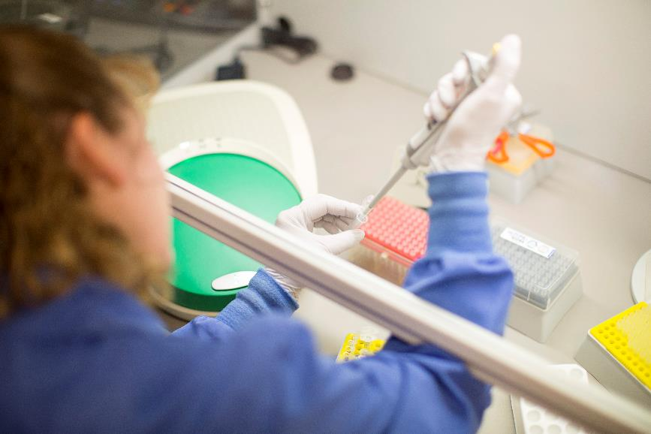
Why?
Changes in the way we live
  Advances in Living Conditions
Changes in how we treat diseases and conditions
  Advances in Treatment, Drugs and Vaccinations

Slide 24
Why?
Changes in the way we live
  Advances in Living Conditions
Changes in how we treat diseases and conditions
  Advances in Treatment, Drugs and Vaccinations
Changes in how we use technology
  Advances in Technology and Science

Slide 25
Why TeleHealth?
By 2018, 40% of primary care encounters in the U.S. will be delivered virtually.
Gartner, Predicts 2015: Healthcare Delivery Organizations Will Stand on IT to Climb Bigger Mountains , G00270789, 02 December 2014, Vi Shaffer, Thomas J. Handler, M.D., Laura Craft, Melanie A. Meyer, Barry Runyon, Zafar Chaudry, M.D.

Slide 26
Tommy’s Story

Slide 27
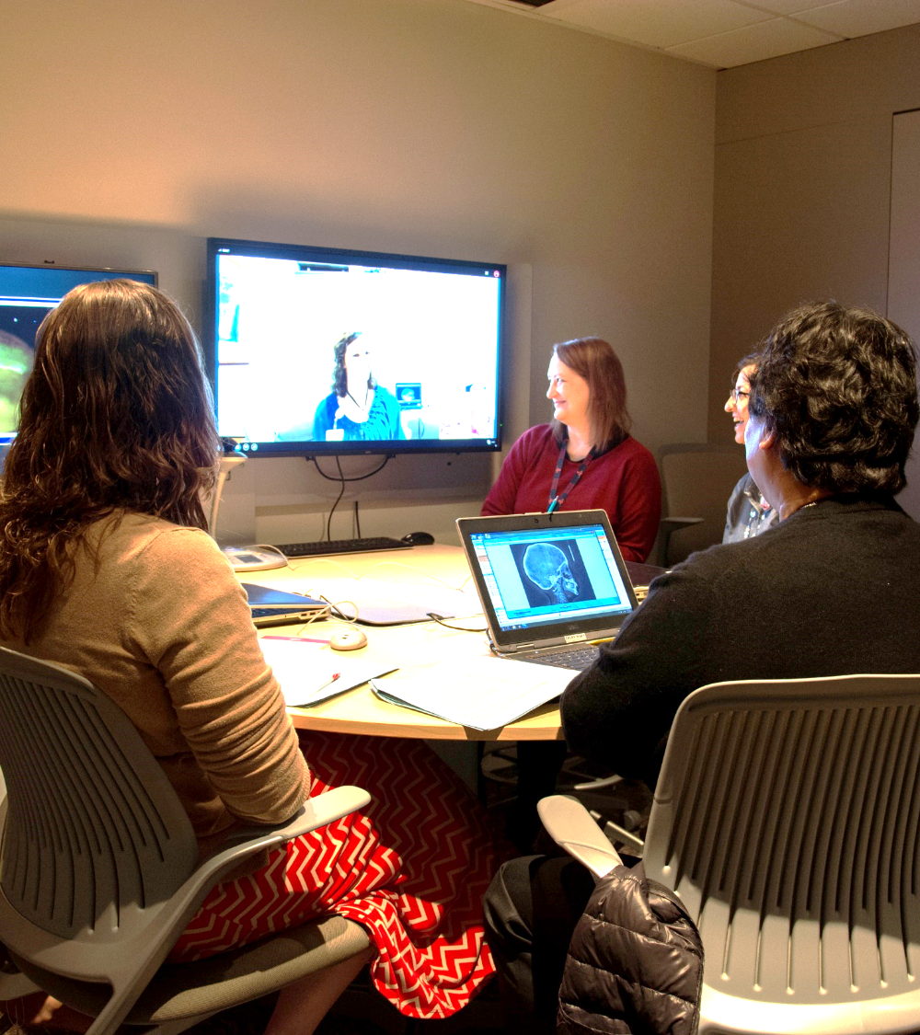
Craniofacial Clinics

Slide 28
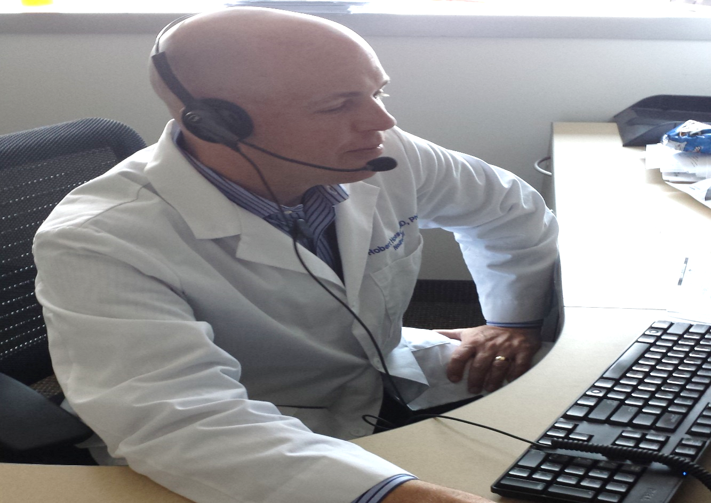
Telestroke

Slide 29
All about the numbers
795,000 strokes occur each year
Stroke is a leading cause of disability
Costs related to stroke in 2008 were $34.3 billion
Improved outcomes related to standardized care

Slide 30
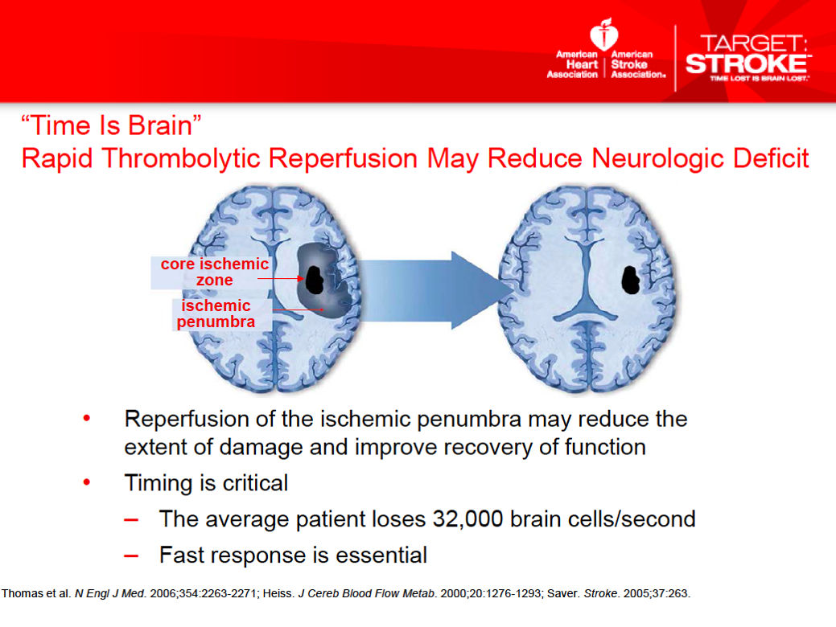

Slide 31
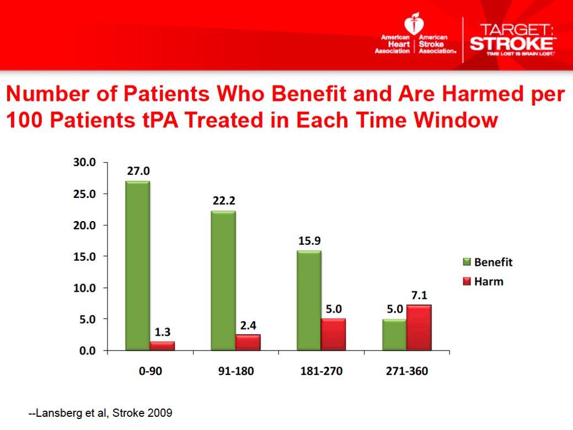

Slide 32
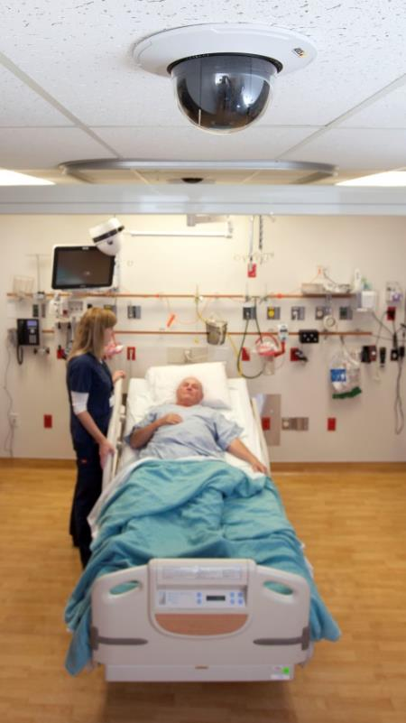
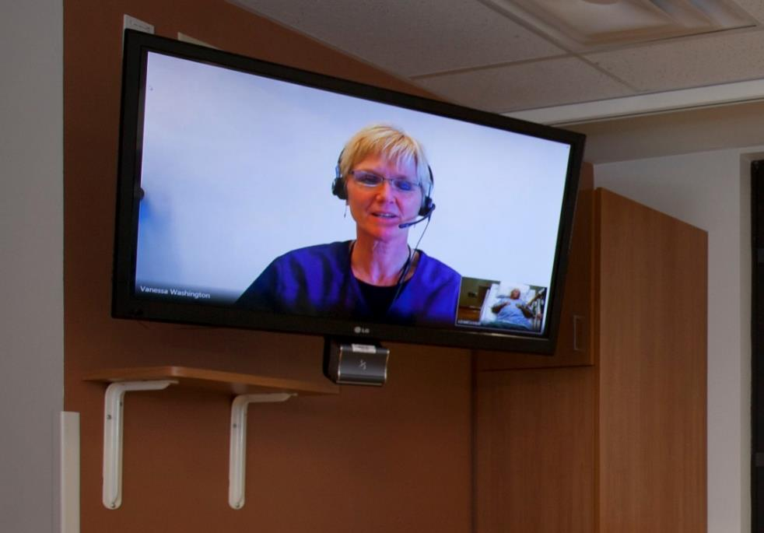
In Room Equipment

Slide 33
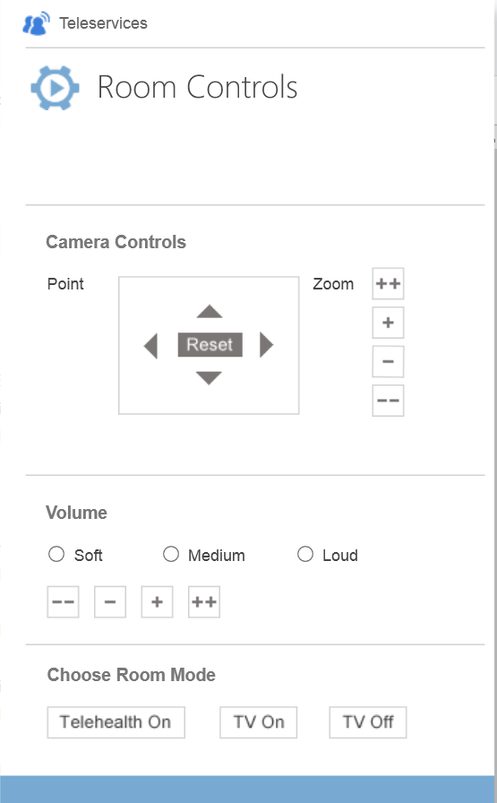

Provider Experience

Slide 34

Remote Patient Monitoring

Slide 35
The Dreaded Internet of Things
‘Things’
Interfaces
Event Processing
Compute
Storage
Business Interaction
Event Queuing System
Transformation
Long-term storage
Presentation and action
Machine Learning
Real Time Dash Boarding
Applications
Self Service Business Intelligence
Event Hubs
Real Time Compute
Big Data
Devices
Cloud gateways
(web APIs)
Natural Language Query
Message Brokers
Stream
processing
Sensors
Automatic Alerting
Data Warehouse
Storage Adapters
Procrastination Portals
Device
Hubs

Slide 36

Extending Access
Strengthening Teamwork
Improving Care

Slide 37
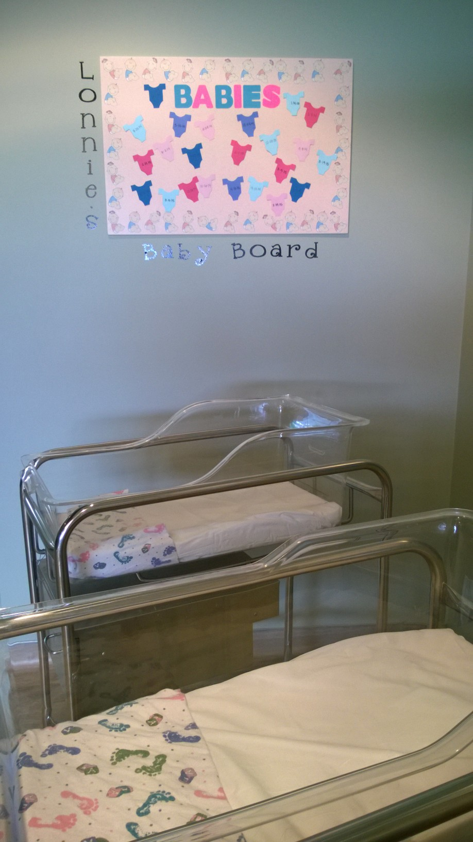

Microsoft Award and Baby Board

Slide 38
So Who is the Next Einstein or Newton?

Slide 39
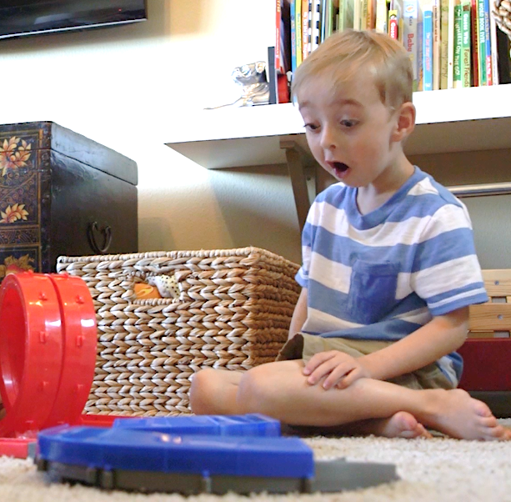



Slide 40
Portal
Tee Jay Harrison

Slide 41
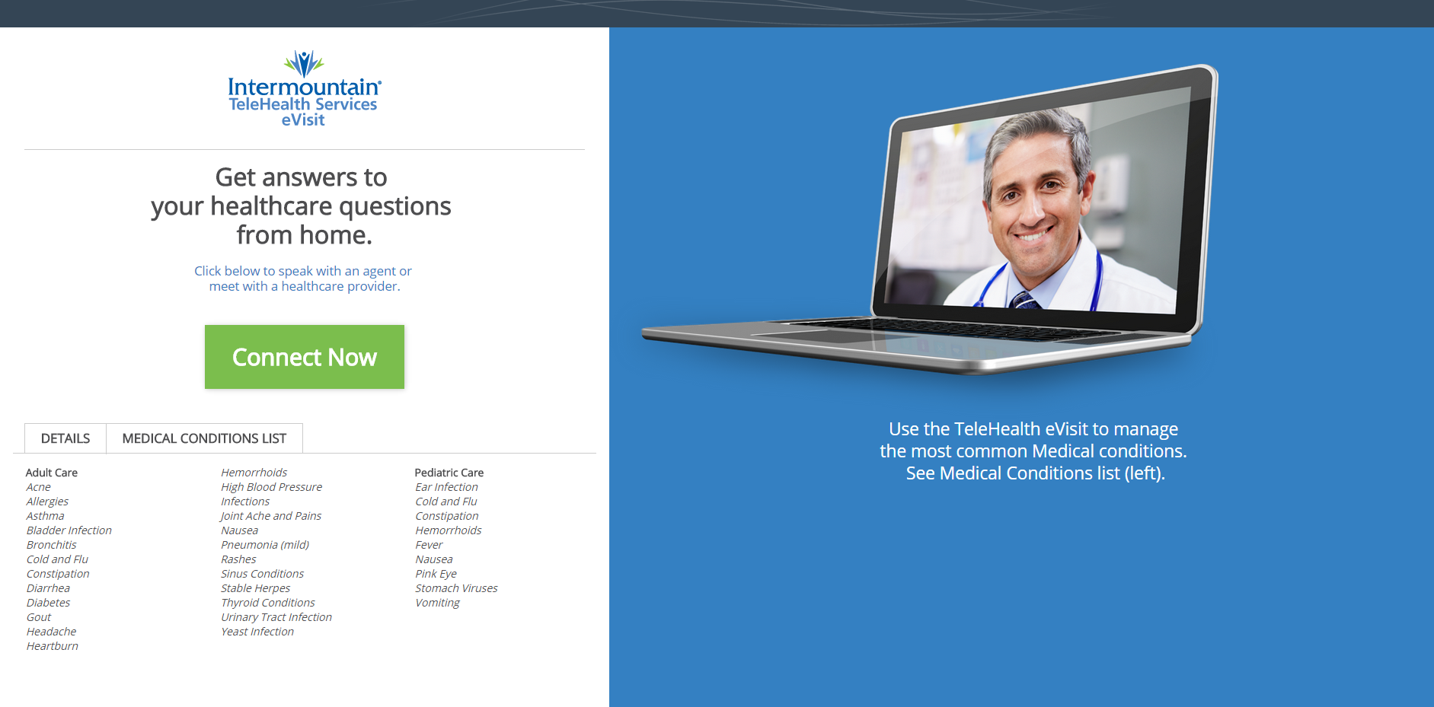
Patient Launch

Slide 42

Patient Test

Slide 43
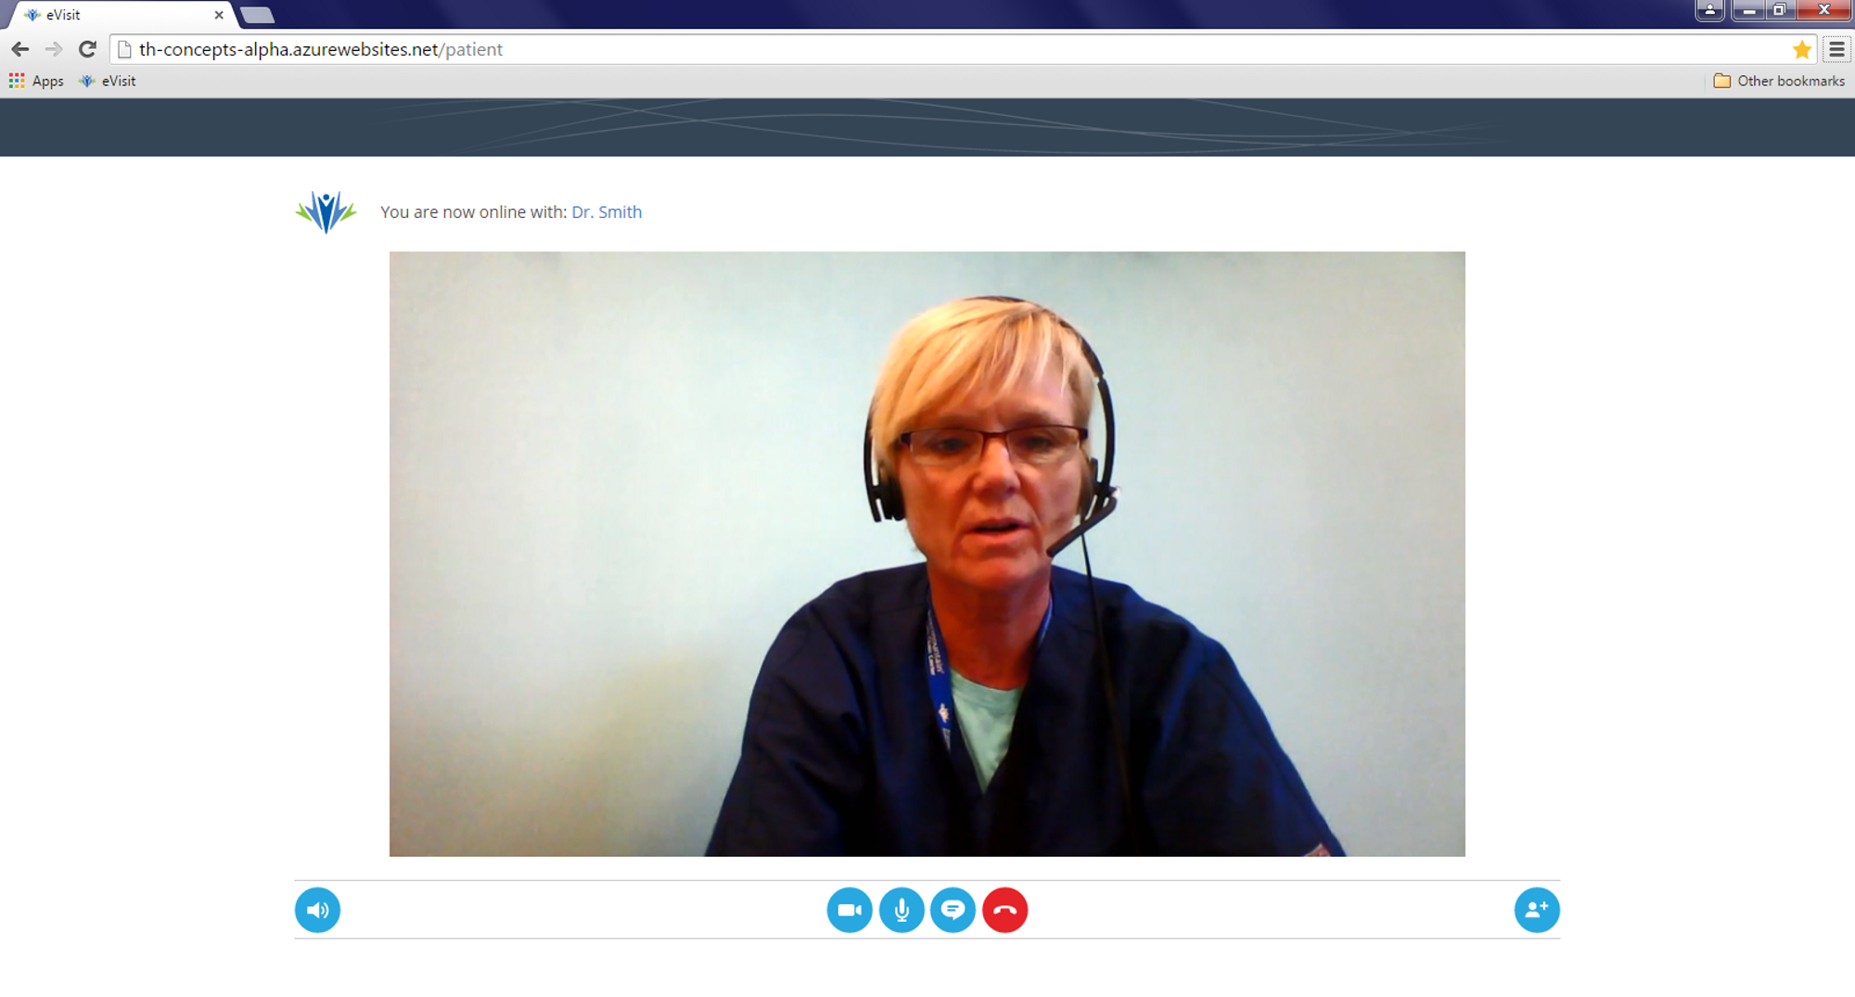
Clinician

Slide 44
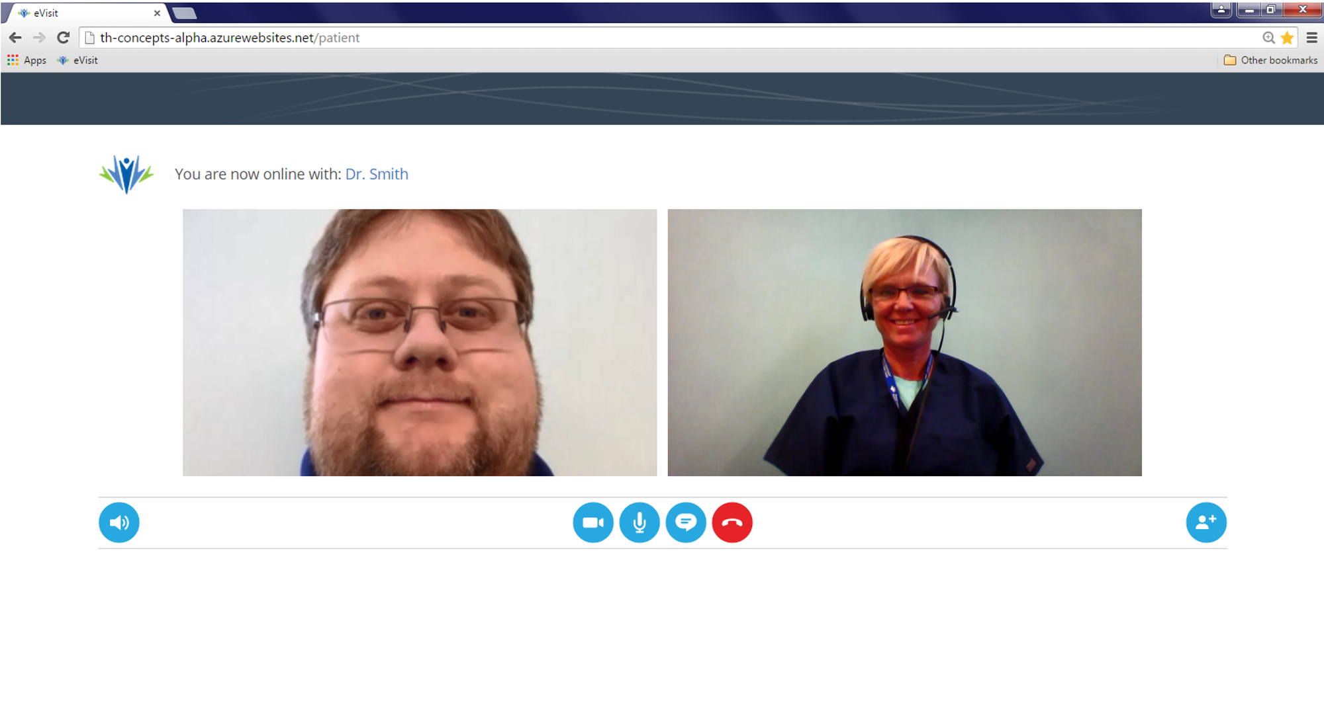

Multiple Physicians

Slide 45
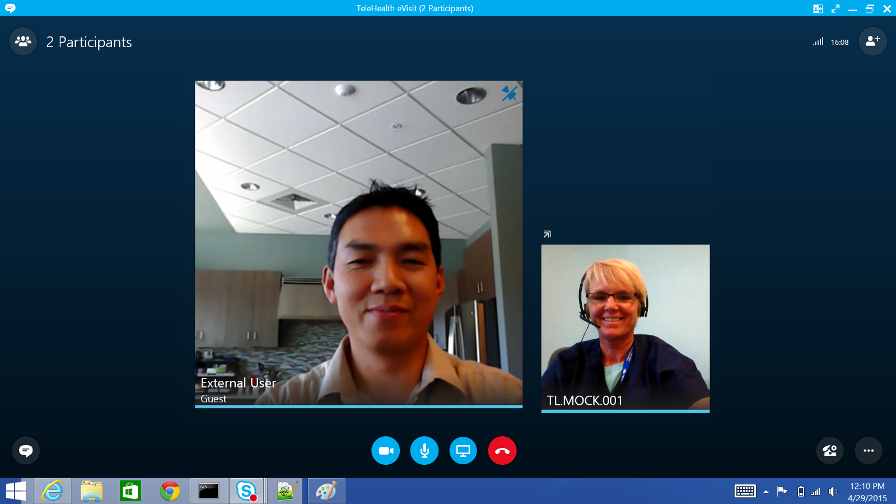
Provider view

Slide 46
Join the conversation!
Share tips and best practices
with other Office 365 experts
http://aka.ms/office365network

Slide 47


Please evaluate this session
Your feedback is important to us!
Visit Myignite at http://myignite.microsoft.com
or download and use the Ignite Mobile App
with the QR code above.

