Slide 2
Virtusa: Establishing SharePoint Hybrid for Social, Search and Personal Storage
BRK2156
Shehan Warusavithana
Sudesh Withanage

Slide 3
In this session we will discuss our experience of building a Social Enterprise using Sharepoint
Social Enterprise
Our strategy
Outcomes
How we did it

Slide 4
Social Enterprise

Slide 5
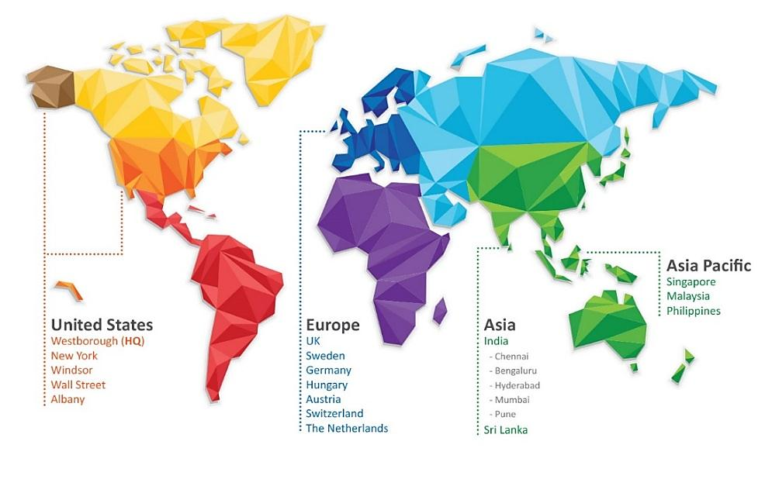
Virtusa - Global information technology services company providing IT consulting, technology and outsourcing services
Founded in 1996 focused on Innovation & Engineering
Listed on NASDAQ: VRTU
FY15 revenue $479m (midpoint guidance)
CAGR of 23% over the past 7 years
No debt, $215m cash
HQ in Westborough, MA.
Major Technology Centers in the US, Sri Lanka, Europe and India
~10,000 Employees globally
Majority of our customers have been with us for more than 7 years

Slide 6
Building a social enterprise is not a fad for us, it’s a business reality
Our workforce demography has changed, with 76% of global Virtusans being Millennials
Our client demands are increasingly focused on innovation, productivity and agility

Slide 7
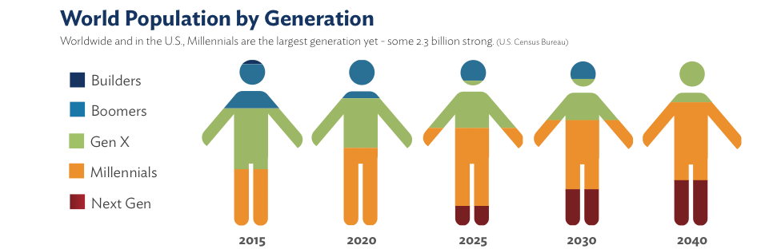
Millennials are taking over the workplace
Millennials are 95 million strong across the world today and will comprise 75% of the global workforce by 2025.
- Deloitte Millennial Survey, January 2014

Slide 8

97% own a computer
94% own a cellphone
76% use instant messaging
15% of IM users are logged on 24 hours a day/7 days a week
34% use websites as their primary source of news
28% author a blog and 44% read blogs
75% of college students have a Facebook account
60% own some type of portable music and/or video device such as an iPod
They are digitally savvy

Slide 9

…and different
Loyalty vs Quest
Meta-cultural Ease
Healing the Planet
45% want to stay with current employer
58% looking for new challenges
78% comfortable working with people with different cultural/ethnic backgrounds vs 27% for baby boomers
47% say it’s very important that they are able to give back through their work
Reward Mix
Born Networkers
Generation Jumpers
Changing values and new equations are in vogue
Having colleague they enjoys working with is a top motivator
48% Gen Ys says it’s very important to have a network of friends at work
On average have 220+ “friends”
37% speaks to their parents everyday
57% look to boomers for professional advice

Slide 10
We find that we deliver unparalleled Innovation, Agility and Productivity when we have engaged customers collaborating with engaged employees
Engaged Customer
Productivity
Innovation
Agility
Co-create
Engaged Employee

Slide 11
Our strategy

Slide 12
V+ Our Social Business Platform
The vision for V+ is to transform the way we work, learn, share and connect with each other.
We focused on three key areas that would drive our Millennial Employees to meet our changing project needs
1. Millennial User Experience
2. Social Enable Core Processes
3. Gamify Outcomes

Slide 13
1. Millennial User Experience
Create the Sunday night computing experience, Monday morning
Not just a ‘web site’ but a way of working…
Co-create the experience

Slide 14
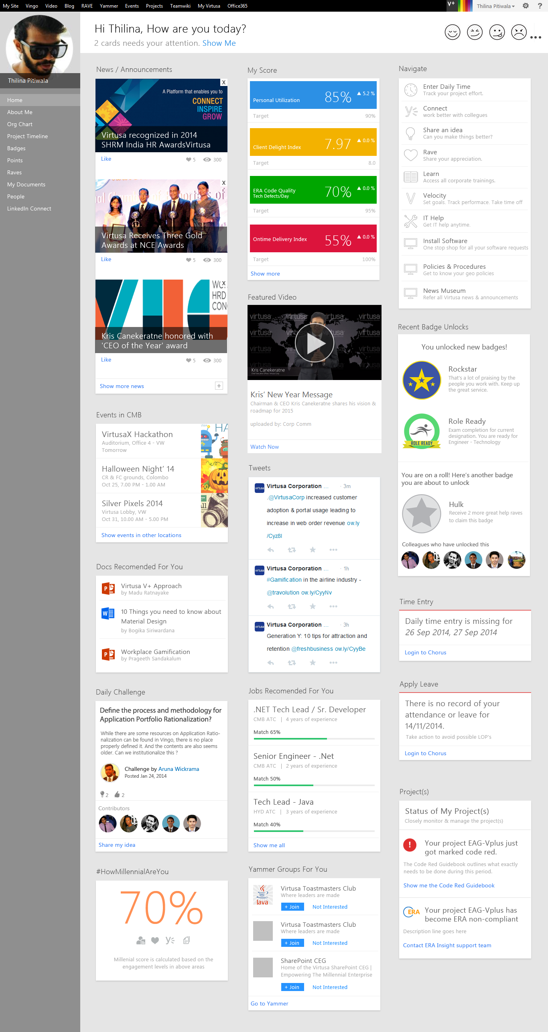

Slide 17
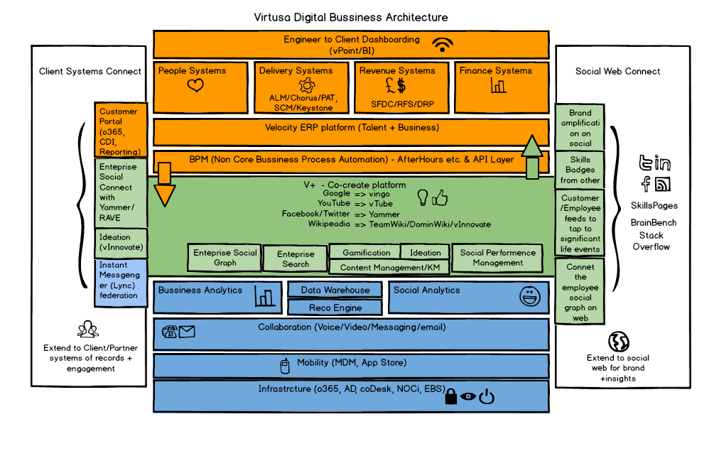
2. Social Enable Core Processes
Systems of Records
Integrate Systems of Records and Systems of Engagement
Single Social Graph
Collaborate around work
Generate insights
Clients & Partners
Social
Web
Systems of Engagement
Infrastructure

Slide 18
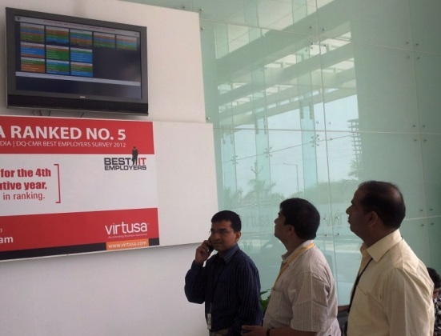
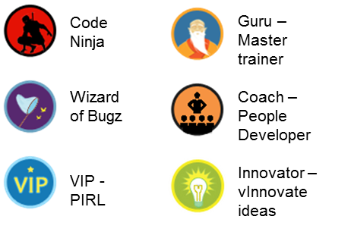


3. Gamify Outcomes
Gamification around core business outcomes to drive behavior
Driving Revenue
  Leaderboard/Contests on Revenue, DSO, New Deals, Quota achievement etc.
Driving Project Delivery
  Personal Dashboards, Leaderboard/Contest on Quality, Productivity, Client Delight, Innovation, KM etc.
Driving People Excellence
  Leaderboard/Contests on Coaching, Teaching, Living Values, Referrals etc.
Badges to recognize achievements & celebrate high performance

Slide 19
Outcomes

Slide 20












V+ adoption grew from 0 to 10000+ users in less than 3 years
Close to 100% of the company on social
Collaboration is growing
Content is growing
6,400+ Messages per month
68,000+ Documents
240+
Messages and Likes between top and the bottom of org per month
380+
Video Uploads
10,000+ views per month growing 7%
453
Blogs
836
TeamWiki’s and Yammer Groups
650+ Conversations per month growing 180%
37,000
Search queries per month
100,000+
RAVES
2100+
RAVEs per Month
219
Ideas

Slide 21

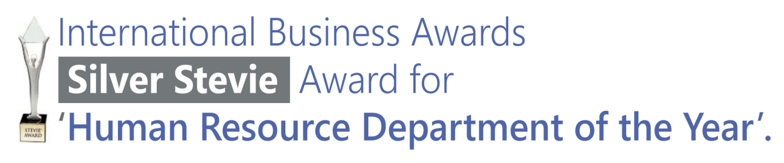



We are proud of the accolades we are getting for the innovative use of technology for Millennial Employee engagement at Virtusa

Slide 22
How we did it

Slide 23
We started our journey 3 years ago
Cloud makes absolute sense for us
  We have a significant number of employees working from client offices or home offices
  Geographically dispersed
  Share and collaborate on documents – stop emailing large documents!
  Tough to keep up with our growth and scale OnPremise
  Don’t want an army of people managing infrastructure
But, we are taking measured steps
  Some client policies prevent us from storing their data on the cloud
  Deployed Data Leak Prevention tools
  O365 Two-Factor didn’t work for us, so VPN required to login from outside our facilities

Slide 24
We adopted a hybrid strategy
Move to the cloud at our own pace
  No big bang migration to worry about
  Use a 3rd Party tool to migrate On Premise sites Online
Retain restricted content On Premise
  Comply with our client policies
Seamless search experience in a Hybrid environment
  We can’t expect our employees to know where the content resides – just like on the public internet
  Ability to search for content from either the On Premise or Cloud search center
  Ability to search content stored on shared drives (OneDrive)

Slide 25
Current Workload Distribution
We are currently running most services OnPremise
Mail/Calendar/Contacts/Tasks
Search | Yammer
OneDrive | OOB Intranet Portals
Mail/Calendar/Contacts/Tasks
Search | MySite
Intranet Portals | Team Collaboration Portals
Custom Portals (Applications) | Video
Reporting & Dashboarding | Blogs
Lync

Slide 26
How we decided which work loads to migrate online
SharePoint On Premise
Existing investments which needs to live longer
Server side code and LOB connectivity
Sensitive data & client requirements
Limitations with Online (Enterprise BI, FBA requirements and customizations)
SharePoint Online
External sharing & collaboration
OOB portals with no customizations
Stand alone applications with sandbox code

Slide 27
Roadmap Workload Distribution
We will retain the hybrid setup with customized and highly integrated components remaining OnPremise
Mail/Calendar/Contacts/Tasks
Search + Delve | Yammer
OneDrive | OOB Intranet Portals
Team Collaboration Portals (Groups) | Video
Analytics (Power BI) | Blogs
Skype
Search | MySite
Custom Portals (Applications) | Reporting & Dashboarding

Slide 28
What is SharePoint Hybrid
SharePoint Server 2013 On Premise +
SharePoint Online on O365
  Mutual trust & common identity management

Slide 29
Setting up Hybrid Search

Slide 30
Hybrid topologies
One way outbound
One way inbound
Two way

Slide 31
One way outbound

Slide 32
One way inbound

Slide 33
Two way

Slide 34
How to configure
1. Hybrid topology configuration
2. Reverse proxy configuration
3. Identity management configuration
4. Hybrid search configuration

Slide 35
1. Hybrid topology configuration
Domain configuration
SharePoint Server Configuration
  User profile service
  App managment service
Configure site collection Strategy
UPN Domain suffix
Synchronize User Profile
Configure oAuth over http

Slide 36
2. Reverse Proxy configuration

Slide 37
3. Identity Management

Slide 38
4. Hybrid Search Configuration
Display search results on Online Search Center
  Query rule creation
  Result source
Display search results on OnPrem Search Center
  Query rule creation
  Result source

Slide 39
Hybrid Search – On Premise and Online

Slide 40
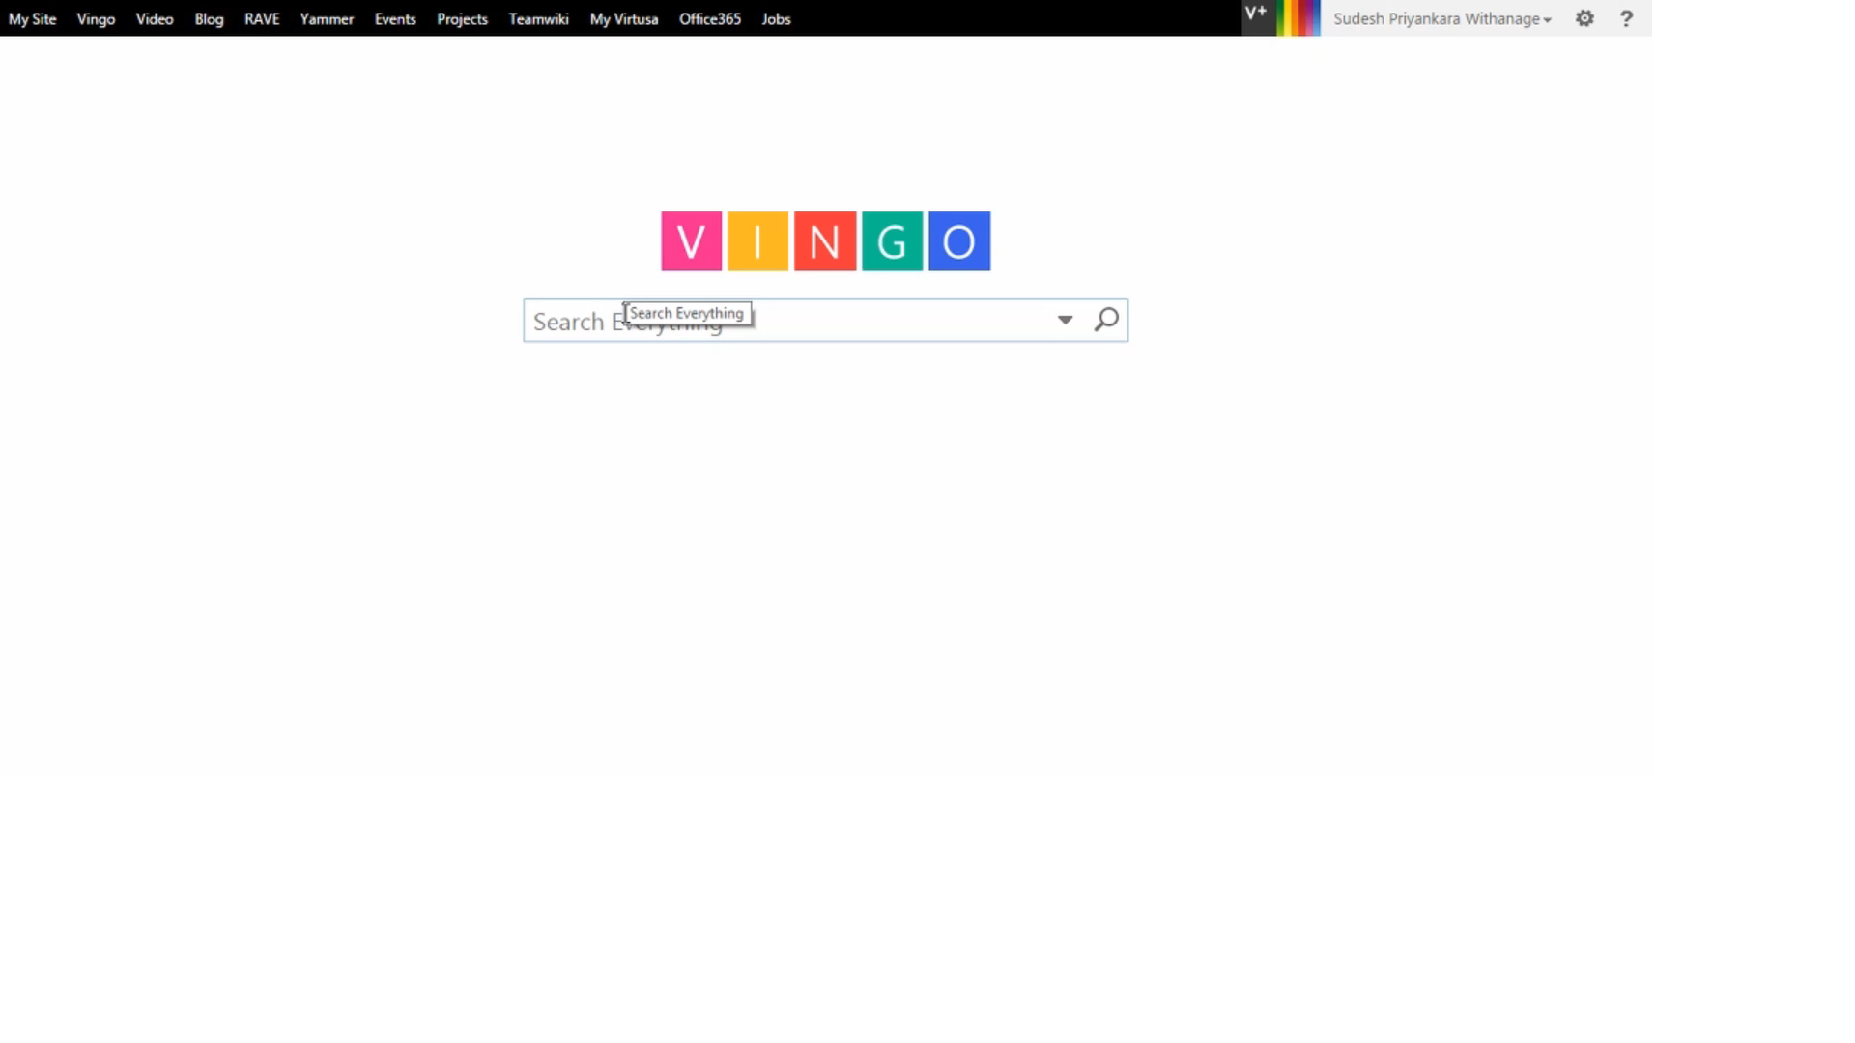
Searching from the OnPremise Search Center

Slide 41
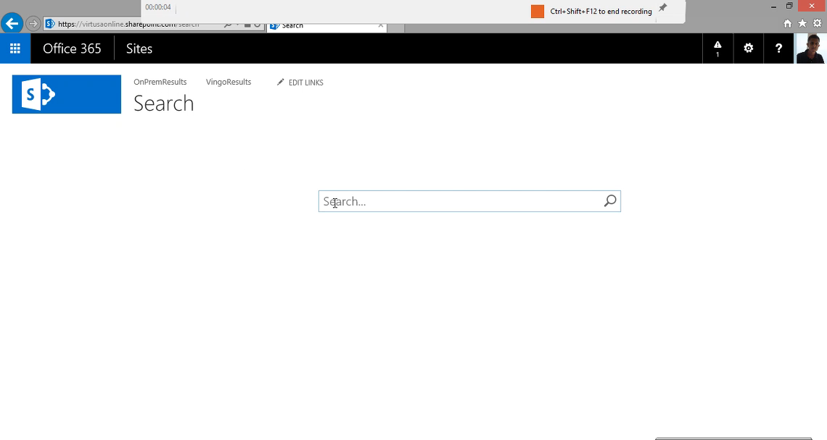
Searching from the Online Search Center

Slide 42
In conclusion, we have built a Social Business Platform using Sharepoint and Office365
Use the strengths of our millennial employees to deliver unparalleled innovation, productivity and agility to our clients
3-Pillar Strategy to transform the way we work, learn, share and connect with each other
  Millennial User Experience
  Social Enable Core Processes
  Gamify Outcomes
Selected an hybrid cloud and OnPremise solution
Getting fantastic outcomes from our Platform

Slide 43
Join the conversation!
Share tips and best practices
with other Office 365 experts
http://aka.ms/office365network

Slide 44


Please evaluate this session
Your feedback is important to us!
Visit Myignite at http://myignite.microsoft.com
or download and use the Ignite Mobile App
with the QR code above.

