Slide 2
ExpressRoute for Office 365 and other Network Connection Options
BRK2161
Paul Andrew Twitter @pndrw
Technical Product Manager
Office 365
Microsoft

Slide 3
Agenda
Microsoft datacenters and network
Connecting your network to Office 365
ExpressRoute for Office 365
Implementing ExpressRoute

Slide 4
Microsoft datacenters and network

Slide 5
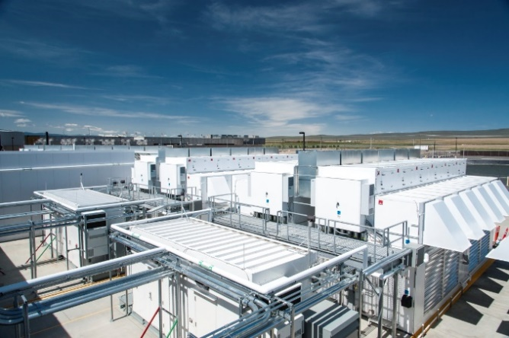


Huge Microsoft investments in infrastructure
Microsoft has invested $15 billion in infrastructure, building over 100 datacenters and we are constantly evaluating new locations
Our high-performing network is one of the top 3 in the world with public peering in 23 countries with 1,500 ISPs.
Our Datacenters support over 20 Million businesses and over 200 Online Services. Office 365 is sold in 140 markets, 43 languages, and 25 currencies.

Slide 6
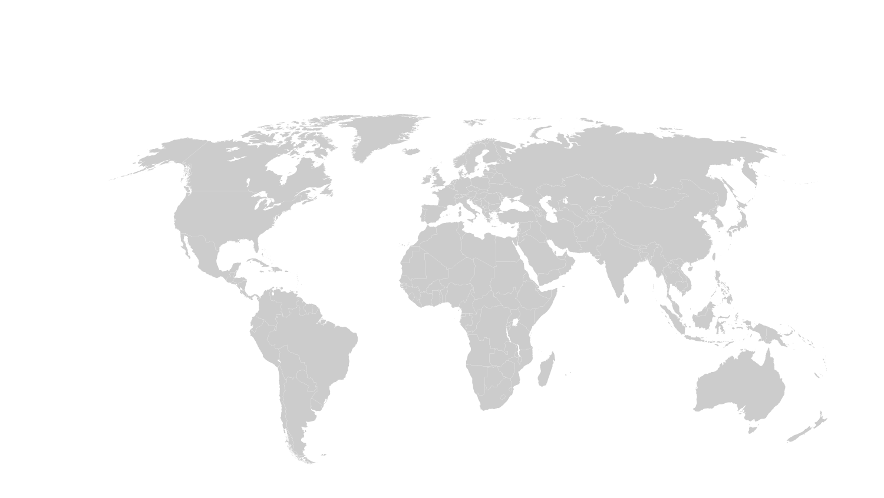
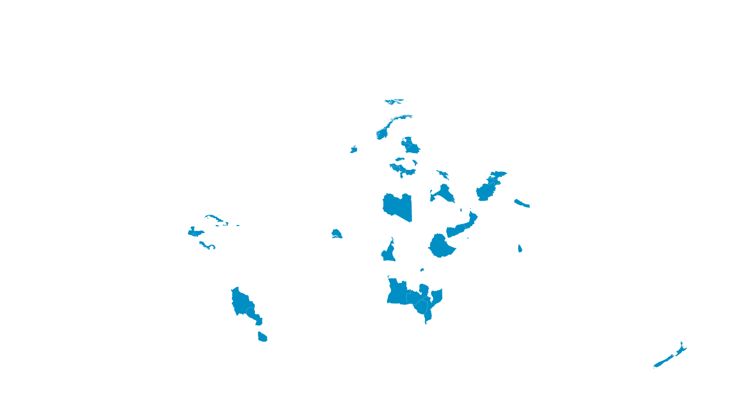
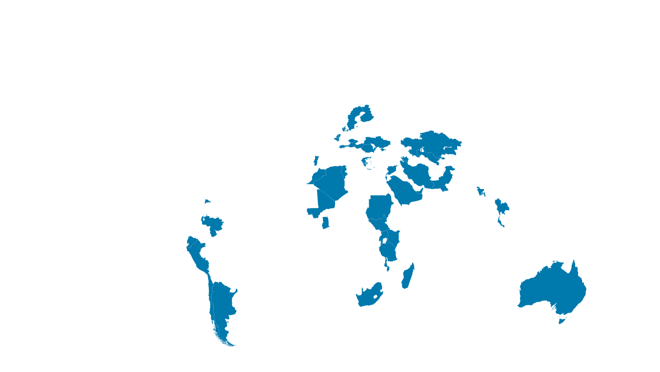
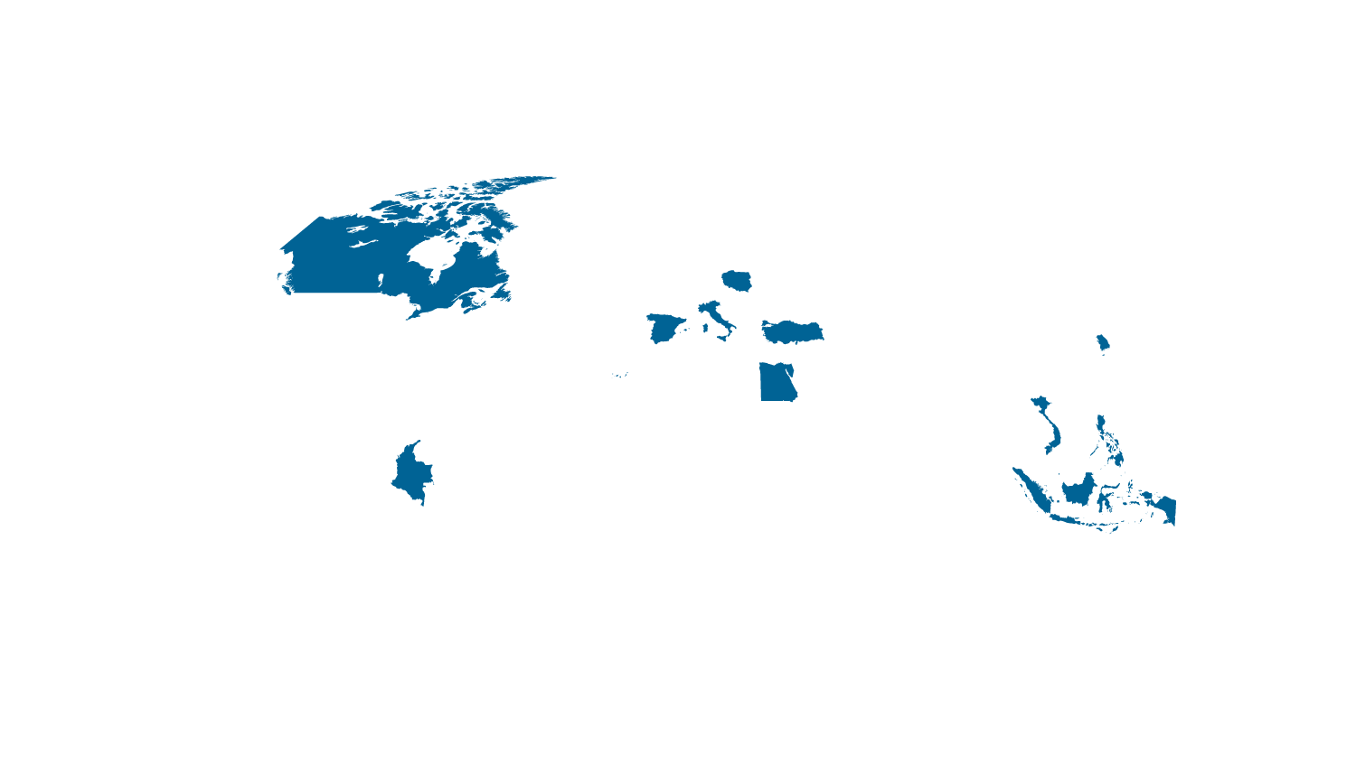
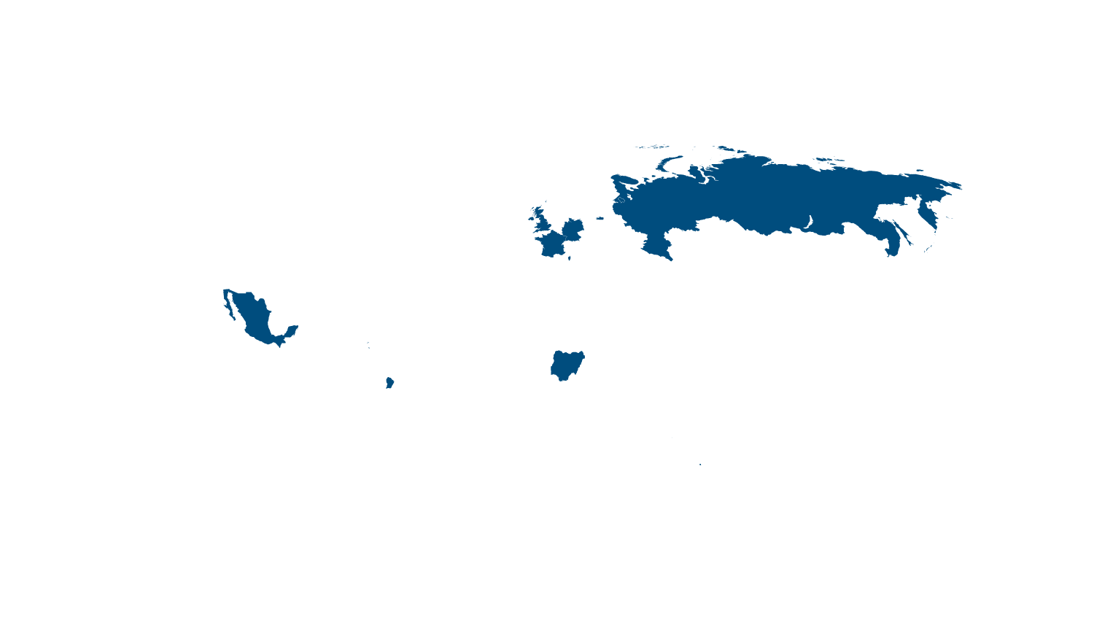
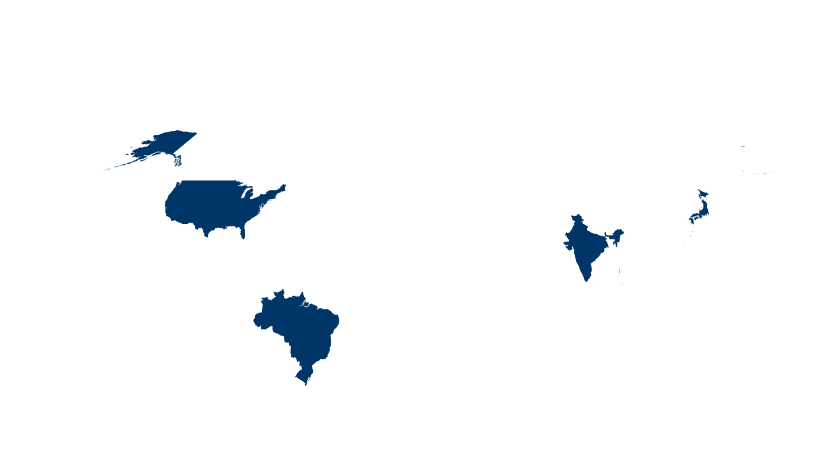

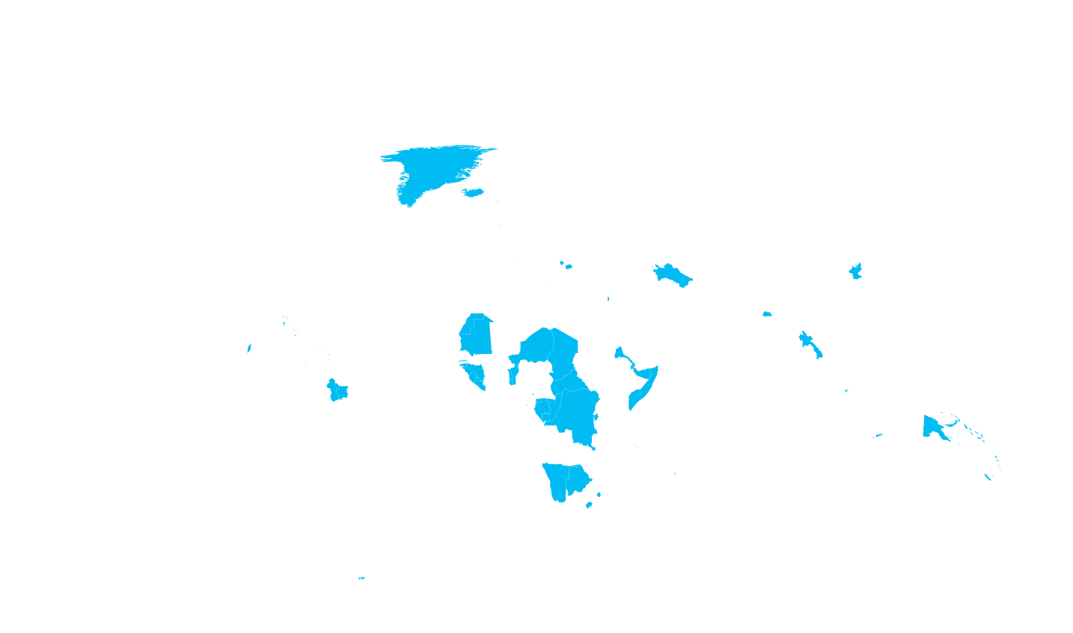


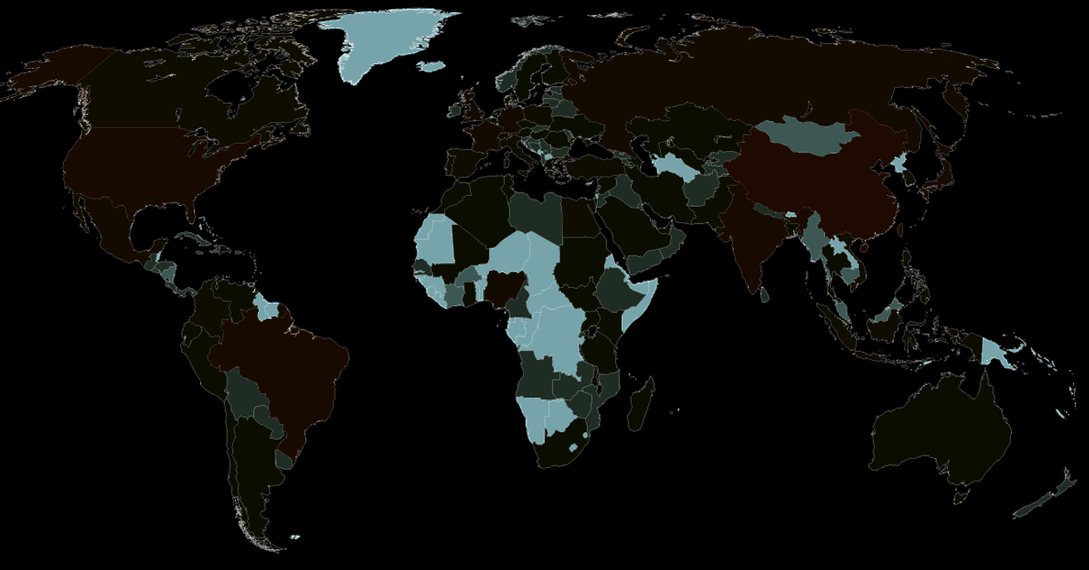
Microsoft’s global datacenter footprint
Microsoft’s network is one of the three largest in the world
FINLAND
AMSTERDAM
DES MOINES
QUINCY
CHICAGO
BEIJING
JAPAN
DUBLIN
AUSTRIA
INDIA
CHEYENNE
BOYDTON
SAN ANTONIO
SHANGHAI
HONG KONG
BRAZIL
SINGAPORE
AUSTRALIA
1 million+ servers • 100+ Datacenters in over 40 countries • 1,500 network agreements and 50 Internet connections
*Operated by 21Vianet

Slide 7
Office 365 datacenter regions
Datacenter region is selected based on the customers chosen country
Office 365 Region | Datacenter Locations¹ | Customers Chosen Country³ | Unique Characteristics
Europe | Dublin, Ireland; and Amsterdam, the Netherlands; Austria; Finland | Located in Europe, Middle East, and Africa | Contractual commitment for location of customer data at rest
North America | Quincy, WA, Chicago, IL, Boydton, VA, Des Moines, IA and San Antonio, TX | Located in North America countries | Contractual commitment for location of customer data at rest
South America | Quincy, WA, Chicago, IL, Boydton, VA, Des Moines, IA and San Antonio, TX | Located in South America countries except Brazil
Asia Pacific | Hong Kong and Singapore | Located in Asia Pacific countries except China, Japan, Australia, New Zealand, Fiji, and India (future)
US Government | Iowa and Virginia in the USA | U.S.A. for US Government agencies | Operated by US Citizen employees of Microsoft corp. Separated from Office 365 commercial servers. Only available to US government agencies.
Brazil² | Sao Paulo State and San Antonio | Brazil | Passive for data resiliency only in San Antonio
China | Shanghai (operated by 21 Vianet) | China
Japan | Saitama Prefecture and Osaka Prefecture | Japan
Australia | New South Wales and Victoria. | Australia, New Zealand, and Fiji
India (future) | India. Planned for 2015 | India
¹Not all datacenter locations are disclosed. Microsoft has 100+ world wide datacenter locations. All regions have multiple datacenter locations.
²Dynamics CRM Online services do not use datacenters located in Brazil.
³The customers chosen country is set when the customers administrator enters during the initial setup of Office 365 services. This selects the primary storage location for the customers data, the customers sales tax
treatment, and the specific services that are available.

Slide 8
Office 365 datacenter expansion plans
New Office 365 datacenter regions | Japan launched December 15, 2014 Australia March 31, 2015 India by end of 2015
New datacenters in existing regions | We do also add new datacenters to existing regions for resiliency and capacity planning purposes. Recently Austria and Finland datacenters were added to the Europe region.

Slide 9
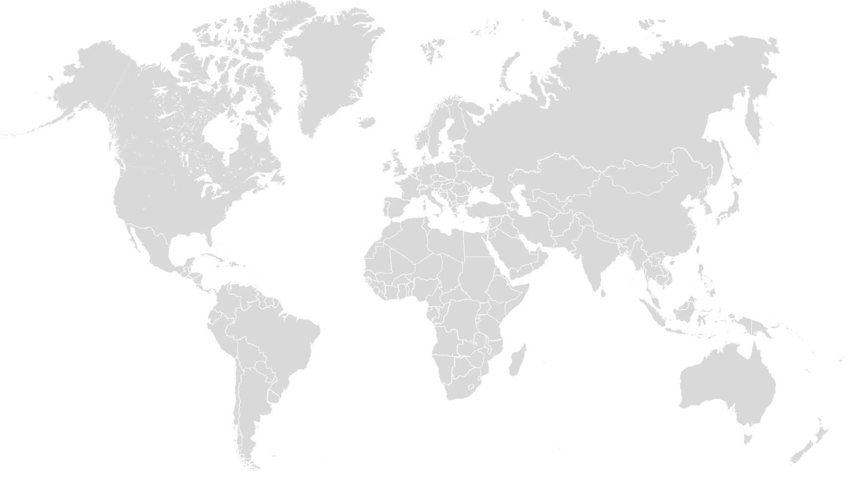
Office 365 Microsoft Edge is live in 22 locations
The green circles represent Microsoft Edge nodes live for the Office 365 Portal.
There are many other Microsoft edge nodes that are not yet compliant with Office 365.

Slide 10
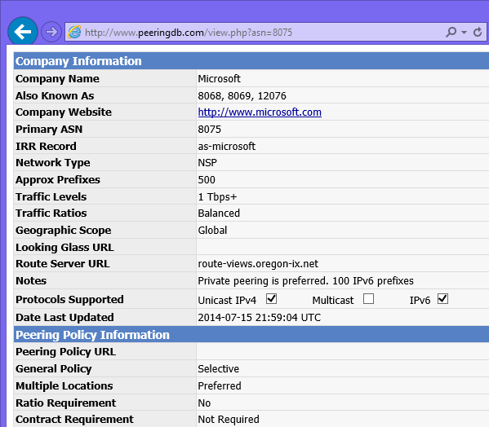
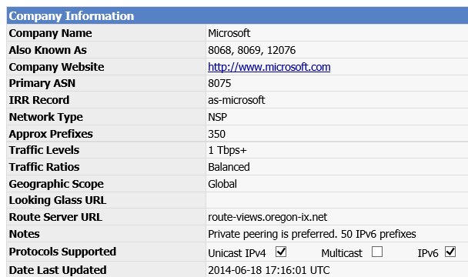
Internet Network Peering
Microsoft has more than 50 connection points to the Internet in 23 countries with peering agreements with over 1,500 ISPs
Peering points are listed at: http://www.peeringdb.com/view.php?asn=8075
ISPs and Network Operators are invited to peer for routing
http://microsoft.com/peering

Slide 11
Internet Network peering locations
Brisbane | Australia
Melbourne | Australia
Perth | Australia
Sydney | Australia
Vienna | Austria
Luxembourg | Luxembourg
Sao Paulo | Brazil
Montreal | Canada
Toronto | Canada
Prague | Czechoslovakia
Paris | France
Frankfurt | Germany
Hong Kong | Hong Kong
Dublin | Ireland
Milan | Italy
Turin | Italy
Tokyo | Japan
Seoul | Korea
Kuala Lumpur | Malaysia
Amsterdam | Netherlands
Auckland | New Zealand
Wellington | New Zealand
Moscow | Russia
Singapore | Singapore
Stockholm | Sweden
Zurich | Switzerland
Taipei | Taiwan
London | UK
Ashburn | USA
Atlanta | USA
Boston | USA
Chicago | USA
Dallas | USA
Denver | USA
Honolulu | USA
Las Vegas | USA
Los Angeles | USA
Miami | USA
New York | USA
Palo Alto | USA
San Jose | USA
Seattle | USA
Site data is published at http://www.peeringdb.com/view.php?asn=8075
Some cities have multiple peering points
Peering locations may be on-net or off-net
Peering may involve physical connection and/or routing advertisements
Data as of July 2014 is subject to change

Slide 12
Connecting your network to Office 365

Slide 13
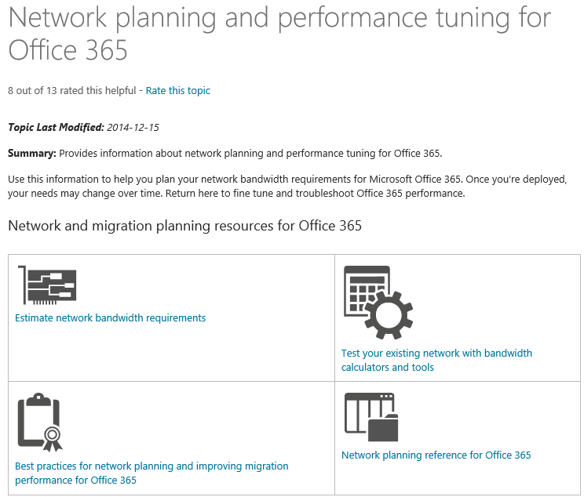
Network capacity planning for Office 365
Required for Internet or ExpressRoute connections
Know your Office 365 network connection | Network capacity planning steps
Commercial Internet ISPs How is the ISP connected to the Microsoft network? Bandwidth headroom available Multi office managed WAN (MPLS) Offsite datacenter on this WAN VPN Connection to head office Head office Internet connection | Plan Office 365 bandwidth before deployment Use our planning calculators for customers up to 25 users Don’t rely on these for larger customers Find existing Internet capacity headroom Measure baseline requirement for workloads Use pilot and extrapolate to full user base Planning help on TechNet http://aka.ms/tune

Slide 14
ExpressRoute for Office 365

Slide 15



ExpressRoute for Office 365 announcement timeline
ExpressRoute for Office 365 GA
March 17 2015
Q3 CY 2015
AT&T
British Telecom
Equinix
Other Azure ExpressRoute service provider partners will follow

Slide 16
Carrier Neutral Facility Locations
Network Service Providers
Exchange Provider
Dallas
Silicon Valley
Washington DC
Amsterdam
London
Silicon Valley
Washington DC
Amsterdam
Atlanta
Chicago
Dallas
Hong Kong
London
Los Angeles
New York
Sao Paulo
Seattle
Silicon Valley
Singapore
Sydney
Tokyo
Washington DC

Slide 17
What is ExpressRoute for Office 365?
Microsoft Datacenter
An alternative to the public Internet connection
Premium network connection to Microsoft datacenters
Private networking for primary Office 365 workloads
Predictable performance with managed connectivity
SLA of 99.9% for availability
Office 365
Services on
ExpressRoute
Customer Site 2
EXPRESSROUTE
Office 365
Services Require
Internet
Customer Site 1
MPLS VPN WAN
Azure services
Internet Co-lo
Customer
Datacenter
Public
internet
Alternate connection

Slide 18
How do networks connect?
Microsoft Datacenter
MPLSWAN
Office 365
Services on
ExpressRoute
ExpressRoute router
Using a network service provider you don’t use this.
Using an exchange provider you are responsible for the connection here.
Can also use an exchange provider and a regional network provider in combination.
AKA Meet Me Location or Co-location facility
Other Network Routers
Carrier Neutral
Facility
Customer
Datacenter

Slide 19


Premium network connection
Extend your existing managed network
  Your existing managed VPN WAN can be extended to Microsoft datacenters
One connection
  Connect both Office 365 and Azure workloads over a single ExpressRoute circuit
Customer
1

Slide 20
Private networking for primary workloads
Private circuits
  Traffic flows from your network to Microsoft’s network over private VLAN circuits maintained by service providers that you work with directly.
Avoiding the Internet
  Traffic from your network to Microsoft datacenters for most Office 365 workloads does not traverse Internet routers. Traffic doesn’t traverse any third party networks or the public Internet.
Privacy Considerations
Internet connectivity is still required and only specific Office 365 workloads can avoid the Internet when connecting from the ExpressRoute connected Office
The Office 365 tenant can still be accessed from the Internet. Learn more about Conditional Access to find out how to block users who are not connecting from an ExpressRoute connection
Public IP addresses are still used for Office 365 front end servers
EXPRESSROUTE
Unknown
Companies
Unknown
Companies
Unknown
Companies
Network
Operator
Network
Operator
Customer 1
Customer 2
Conditional Access talks BRK3113 and BRK3863
2

Slide 21

Predictable performance profile
Predictable performance
  With ExpressRoute you have dedicated bandwidth, traffic goes over managed infrastructure
  Control over network routing and number of routing hops, and by implication control over network latency
  No congestion with public Internet customers
Performance considerations
  Capacity planning is still required
  Depends on the network capacity you have from user locations to the Microsoft network
  Network distance, routing path and DNS must be carefully planned for ExpressRoute
Customer
3

Slide 22
SLA for premium availability
Guaranteed availability
  Uptime SLA of 99.9% for the Microsoft networking elements. Ask your service provider for information about their SLA
Multiple circuits for higher availability
  Two physical connections for each ExpressRoute circuit
  Our advanced networking enables multiple connections even from different network operators and in different locations
Flexibility
  You may rely on public Internet as a redundant path. Users can access Office 365 workloads from other Internet connected locations
Internet
Connection
Backup
Customer
4

Slide 23
High-Availability options with ExpressRoute
  ExpressRoute allows multiple customer configuration options to support high-availability
Internet
  Route traffic to the internet on-demand when needed for maintenance and failure conditions
Multiple geographically diverse links
  Utilize multiple links to continue to benefit from the advantages of ExpressRoute with the flexibility to failover as needed
Multiple ExpressRouteLinks for redundancy
Customer
Public
internet

Slide 24
Two connection models
 | Connecting via Exchange Provider | Connecting via Network Service Provider
Suitable for | Customer already using Exchange provider (co-location) Meet ExpressRoute at Exchange Provider location for a simple point to point connection Connect to ExpressRoute directly through a virtual cross connection Higher flexibility, Control over routing Install, configure, & manage your hardware in the Exchange Provider’s datacenter | Customer already getting managed WAN services (like MPLS VPN) from Network Service Provider (e.g. telco carrier) Connect to ExpressRoute through managed WAN provider leveraging existing network infrastructure Use your existing managed WAN to connect to ExpressRoute Access Office 365 from any site on the provider’s WAN
 | 200 Mbps, 500Mbps, 1Gbps, 10Gbps | 10 Mbps, 50 Mbps, 100 Mbps, 500 Mbps, 1 Gbps
Public
internet
Microsoft network
and datacenters
Customer Site 1
Microsoft network
and datacenters
Customer Site 2
Wan
Public
internet
Customer Site
ExpressRoute partner location
Customer Site 3

Slide 25
General Availability details
  Pre-requisites for deploying very soon after GA
  Azure qualification criteria from MSDN
  Azure ExpressRoute subscription is required, but no additional Microsoft subscription is required
  Service engagement with an ExpressRoute connectivity provider is required
  Customers should already have either a managed VPN WAN or co-located networking planned
Office 365 workloads on ExpressRoute | Office 365 workloads that require Internet
Exchange Online & Exchange Online Protection SharePoint Online, OneDrive for Business, Office 365 Video, Delve Skype for Business Online (formerly Lync Online) Office Online Azure AD & Azure AD Sync Power BI and Project Online | Yammer Office 365 ProPlus client downloads On-premises Identity Provider Sign-In Standard DNS and CDN lookups Office 365 (operated by 21 Vianet) service in China

Slide 26
Implementing ExpressRoute

Slide 27
Existing Azure ExpressRoute scenario
Existing customers of Azure ExpressRoute will be able to route traffic to Office 365 end points. There are no changes needed for the Azure subscription
Revise network capacity planning for additional traffic
Need to coordinate with your ExpressRoute network provider
Microsoft Datacenter
Customer

Slide 28
WAN with multiple sites scenario
You have multiple offices connected by a private managed WAN using MPLS
ExpressRoute connects that WAN to Microsoft datacenters
This avoids a separate Internet connection for most Office 365 traffic
Customer Site 2
Office 365
Customer Site 1
WAN
Public
internet
Customer Datacenter

Slide 29
Direct high bandwidth connection private connection scenario
Office 365 customers with network presence in existing ExpressRoute enabled co-location facilities
Carrier
Neutral
Facility
EXPRESSROUTE
Customer

Slide 30

Offices in Multiple regions advanced scenario
Multiple ExpressRoute connections with multiple operators
Must connect in the same region as the Office 365 target end points
  SharePoint Online and Skype for Business Online connections within the region for the datacenter
  Exchange Online connections from anywhere
  New Azure ExpressRoute premium SKU removes this requirement
Routing Office 365 workloads separately
  Not expecting to be ready to support this by GA, but work is in progress to allow separate routing
Internet
egress point
Microsoft datacenter
Customer network
Data transfer

Slide 31
ExpressRoute geopolitical regions
GEOPOLITICAL REGION | Office 365 REGION | EXPRESSROUTE LOCATIONS
US | North America, US Government | Atlanta, Chicago, Dallas, Los Angeles, New York, Seattle, Silicon Valley, Washington DC
South America | Brazil, South America | Sao Paulo
Europe | Europe Middle East and Africa | Amsterdam, London, Dublin (coming soon)
Asia | Asia Pacific | Hong Kong, Singapore
Japan | Japan | Tokyo, Osaka (coming soon)
Australia | Australia | Sydney, Melbourne (coming soon)
India | India (coming soon) | TBD
Connectivity across geopolitical regions is not supported unless you have the premium SKU. You can work with your connectivity provider to extend connectivity across geopolitical regions using their network.

Slide 32
ExpressRoute for Office 365 prerequisites
An Azure subscription
The latest version of Azure PowerShell
A network service provider or an exchange provider
  Either you must be a VPN customer of the network service provider with one on-premises site connected
  Or you must have network infrastructure in the exchange providers datacenter for cross connect
  Or you must have Ethernet connectivity via a third party network provider to the exchange providers Ethernet exchange
Virtual network requirements
  A set of IP prefixes for on-premises use
  A /28 subnet for configuring routes
  Your own public Autonomous System number for routing
Additional network requirements for exchange providers
  MD5 hash if you need an authenticated BGP session
  Two VLAN IDs on which traffic will be sent

Slide 33
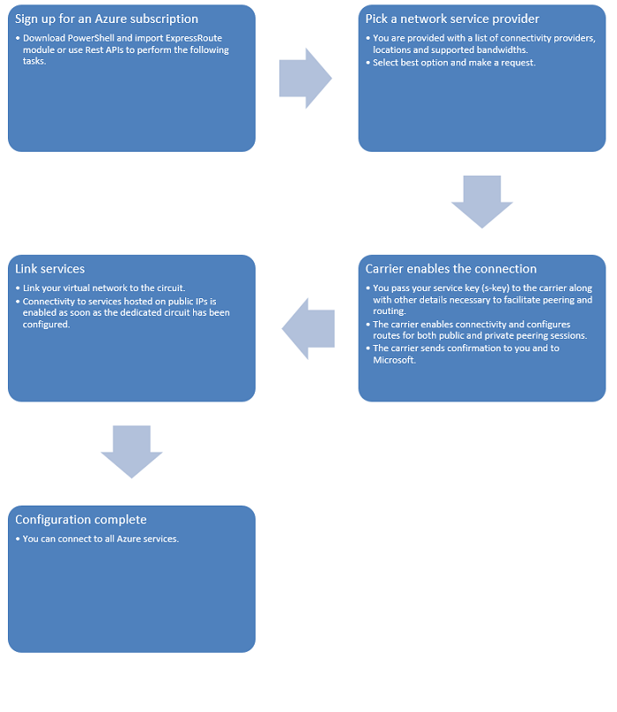
Create a new circuit in PowerShell for NSP
## import powershell modules
Import-Module 'C:\Program Files (x86)\Microsoft SDKs\Azure\PowerShell\ServiceManagement\Azure\Azure.psd1'
Import-Module 'C:\Program Files (x86)\Microsoft SDKs\Azure\PowerShell\ServiceManagement\Azure\ExpressRoute\ExpressRoute.psd1'
## Request a service key and send to your provider
New-AzureDedicatedCircuit -CircuitName $CircuitName -ServiceProviderName $ServiceProvider -Bandwidth $Bandwidth -Location $Location
## Configure your Virtual Network and Gateway
## This is done in the Azure Management Portal
## Link your network to s circuit
New-AzureDedicatedCircuitLink -ServiceKey $ServiceKey -VNetName $Vnet

Slide 34
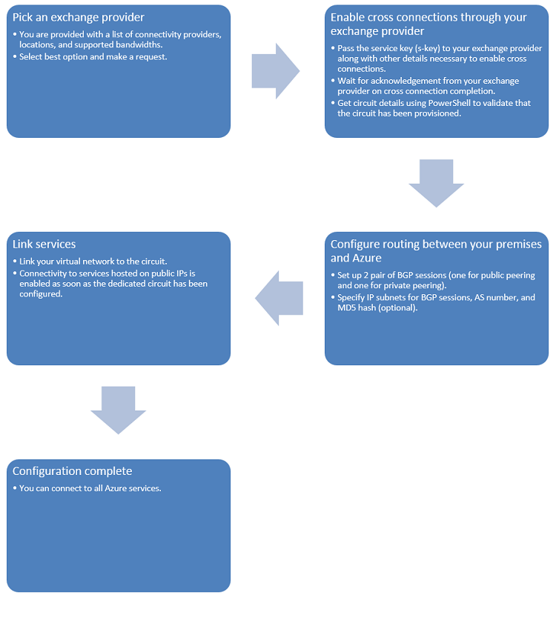
Create a new circuit in PowerShell for EXP
## import powershell modules
Import-Module 'C:\Program Files (x86)\Microsoft SDKs\Azure\PowerShell\ServiceManagement\Azure\Azure.psd1'
Import-Module 'C:\Program Files (x86)\Microsoft SDKs\Azure\PowerShell\ServiceManagement\Azure\ExpressRoute\ExpressRoute.psd1'
## Request a service key and send to your provider
New-AzureDedicatedCircuit -CircuitName $CircuitName -ServiceProviderName $ServiceProvider -Bandwidth $Bandwidth -Location $Location
#Create a new bgp peering session
New-AzureBGPPeering -ServiceKey $ServiceKey -PrimaryPeerSubnet $PriSN -SecondaryPeerSubnet $SecSN -PeerAsn $ASN -VlanId $VLAN –AccessType Private
## Configure your Virtual Network and Gateway
## This is done in the Azure Management Portal
## Link your network to s circuit
New-AzureDedicatedCircuitLink -ServiceKey $ServiceKey -VNetName $Vnet

Slide 35
LAN routing implementation
Internal LAN routing
  Either edge router receives BGP and broadcasts RIP or OSPF
  Or default route to proxy server
  Bypass proxy servers for Office 365 traffic if possible
    PAC files
  Office 365 front end will be ACL’d public IP addresses
Block tenant access from Internet
  Block ADFS from Internet connectivity so that users cannot login from outside of the corporate network

Slide 36
Using a PAC file to route Office 365 requests
Function FindProxyForURL(url, host) {
// local machines don’t need a proxy
if (shExpMatch(host, “(*.mycompany.com|mycompany.com)”))
{
return “DIRECT”;
}
// URLs for Office 365 go direct bypassing the proxy
if (shExpMatch(host, “*.office.com”) ||
isInNet(dnsResolve(host), “23.103.160.0”, “255.255.240.0”))
{
return “DIRECT”;
}
// All other requests go through the company proxy server
// If that fails then go direct
return “PROXY proxy.mycompany.com:8080; DIRECT”;
}

Slide 37
Next Steps
Read about Azure ExpressRoute at
  Overview page: http://aka.ms/expressrouteoffice365
  Available locations: https://msdn.microsoft.com/en-us/library/azure/dn957919.aspx
Meet qualification criteria
  Please read qualification criteria at http://azure.microsoft.com/en-us/documentation/articles/expressroute-prerequisites/
Start onboarding to Azure ExpressRoute today
  Please contact us using the “Request Information” button at http://aka.ms/ert
  ExpressRoute for Office 365 general availability is coming in Q3 CY2015

Slide 38


Please evaluate this session
Your feedback is important to us!
Visit Myignite at http://myignite.microsoft.com
or download and use the Ignite Mobile App
with the QR code above.

