Slide 2
Meet Office 365 Compliance Center: Your One Stop Shop for Everything Compliance
Kamal Janardhan, Group Program Manager
Ben Appleby , Lead Program Manager
Information Protection

Slide 3
Compliance & Governance
Organizations are under attack
Change is the only constant
You are required to prove compliance
You want insights and alerting
How we can help

Slide 4
You own your data,
we are the guardians of it.
Pervasive to protect
Transparent to enable and extend
People Centric for productivity

Slide 5
What you may be doing today….
SP/OneDrive
Data duplication
Non native end user experience
Incomplete information
Higher cost
Fragmented policy and experience
Exchange
Compliance and Governance
Solutions
Skype for Business
Social, IM (FB, Twitter, etc.
Third Party Archives

Slide 6
O365 Compliance…your peace of mind
SP/OneDrive
Office 365
Exchange
Compliance Center
Skype for Business
Archiving
eDiscovery
DLP
Auditing
Device Protection
and more…
And more…
EXO
SPO/OneDrive
Skype
Yammer
Social, IM (FB, Twitter, etc.
Partner Ecosystem (APIs, Experiences)
Third Party Archives
Ingestion
Review
Auditing
Alerting
and more…
And more…

Slide 7
Compliance Center
One experience across all workloads (EXO, SPO, Skype for Business, etc.)
Consistent Governance
(Preservation, Delete, Device Protection, DLP)
Insights and Alerts for Security and Compliance

Slide 8
…and not just for data in the cloud.
Cloud Connect
On-premises can still have compliance features in the cloud
Cloud based Compliance Center, Auditing, Analyze with Equivio, DLP and more…
Pure On-Premises
Exchange | SharePoint
O365 Archives grow with your data Public Folder Search and Preservation Search Permissions Scoping Search with Infix and Suffix wildcards Audit Reporting Export to Analyze with Equivio | Document Deletion Audit Reporting Search with Infix and Suffix wildcards Unlimited Concurrent Searches Export to Analyze with Equivio

Slide 9
Archiving

Slide 10
Archiving
Easy to ingest
All the storage you need, the best IW experience, none of the management
Granular and Flexible Retention for end users, Compliance Officers and Admins

Slide 11
O365 Archiving Features
Ingest
Store and Retain
Ingest into Office 365
Store and Access
Preserve what you need, Delete what you don’t
Network Ingestion for email
Drive Shipping for your Email!
3rd Party data Ingestion in Preview
Social – Twitter, FB etc.
IM Yahoo, Bloomberg, etc.
Rehydration from archives
Drives for documents coming soon.
Inactive and Active data with immutability built into the service
Preserve for Exchange, SharePoint/One Drive and Lync
Delete for Exchange and Lync
End user Access with Outlook, OWA, OneDrive, SharePoint and Lync
O365 Archives grow with your data (1 TB SPO/OD, unlimited EXO)
Public Folder Preservation
Document Deletion in SharePoint
Compliance for Modern Groups, Yammer on its way.

Slide 12
Drive Shipping

Slide 13
eDiscovery

Slide 14
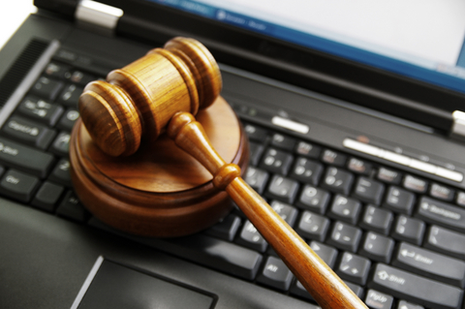
eDiscovery
Scalable, complete, built in search
Search and Refine with Compliance Search
One search for all data types
Analyze using Zoom
Welcome to the Equivio team!
Export to Review and Legal Partners

Slide 15
eDiscovery Features
Query and Hold
Analyze
Export
Search and Preserve
Equivio enabled insights
Export the smallest amount of data
Download results of a search from SharePoint, OneDrive, Exchange, and file shares whether on premises or in Office 365.
EDRM XML supported formats
Can export to legal or review partners
Unlimited, Concurrent searches
Proximity search, rich query syntax, hit highlighting, infix and suffix wildcards
Granular Search Permissions
Hold mailboxes, sites and queries with no impact to end users
Indexing is immediate and full fidelity with built in search
Themes to understand what you’re looking for
Pivots and grouping to enable complex and powerful searches
Predictive coding to cull large amounts of data
O635 + Equivio in Preview

Slide 16
eDiscovery + Equivio

Slide 17
DLP

Slide 18
DLP
Sensitive data analyzed using built in search
Define policies for sensitive data
Unified policies for all data types
End users empowered with Policy Tips, contextual experiences that ensure productivity
All activity is audited and reported

Slide 19
O365 DLP Features
Identity and Monitor
Protect and Educate
Policies govern to flow sensitive data
Policy Tips to educate end users
Index sensitive content as it arrives in the service
Contextual classification based on Windows FCI system or 3rd party system
Select DLP policies from a template
Create or extend custom policies to integrate with incident management or alerting systems
Policy Tips in OWA, Outlook, SharePoint and OneDrive and Office Clients (Word, Powerpoint, Excel)
Malicious users are audited and good users are protected
Auditing and Reporting of all DLP activity

Slide 20
Policy Tips across Office experiences
New DLP sensitive information types added to Exchange
PolicyTips added to Excel and other Office applications
Extension of DLP capabilities to SharePoint

Slide 21
Device Protection

Slide 22
Device Protection
Compliance is determined using built in authentication flow with Active Directory conditional access
Policies are defined for corporate data access
Unified policies for different devices and apps
End users and data is protected by contextual actions within the application
All activity is audited and reported

Slide 23
DLP and Device Protection

Slide 24
Auditing

Slide 25
Auditing
New Audit pipeline to capture all O365 activity
Correlation and search across content that is person and content centric
Search, Stream and Export using the new O365 Management Activity API.

Slide 26
O365 Auditing Features
Capture and Store
Extend
Consistent logging and Compliant Storage
O365 Management API
Compliance Center experience
Consistent and Complete logging
90 days of events by default, can be extended for as long as you need.
Immutability and freshness
Single API
Consistent Schema
150+ events and growing including Exchange, SharePoint, OneDrive, Azure AD and O365 Datacenter Admin
100+ partners and growing

Slide 27
Auditing

Slide 28
Futures
Supervisory Review
Drive Shipping for Documents and other data types (+Partners)
Ingestion for Social, IM, Financials etc. (+Partners)
Analyze with O365 search + Equivio
Compliance Center Experiences
Audit Reporting experiences
Alerting and Anomaly Detection (+Partners)
Device Protection for Windows 10, Lync, OneNote, Outlook, etc.
And more…

Slide 29
Next Generation Compliance Experiences

Slide 30
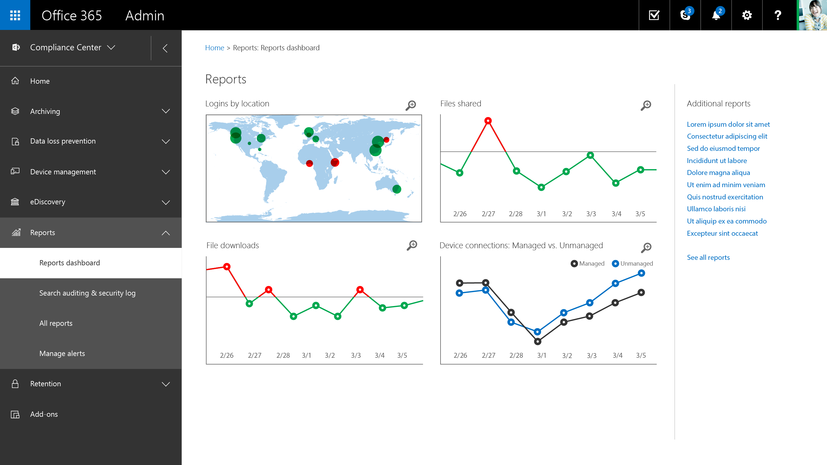

Slide 31
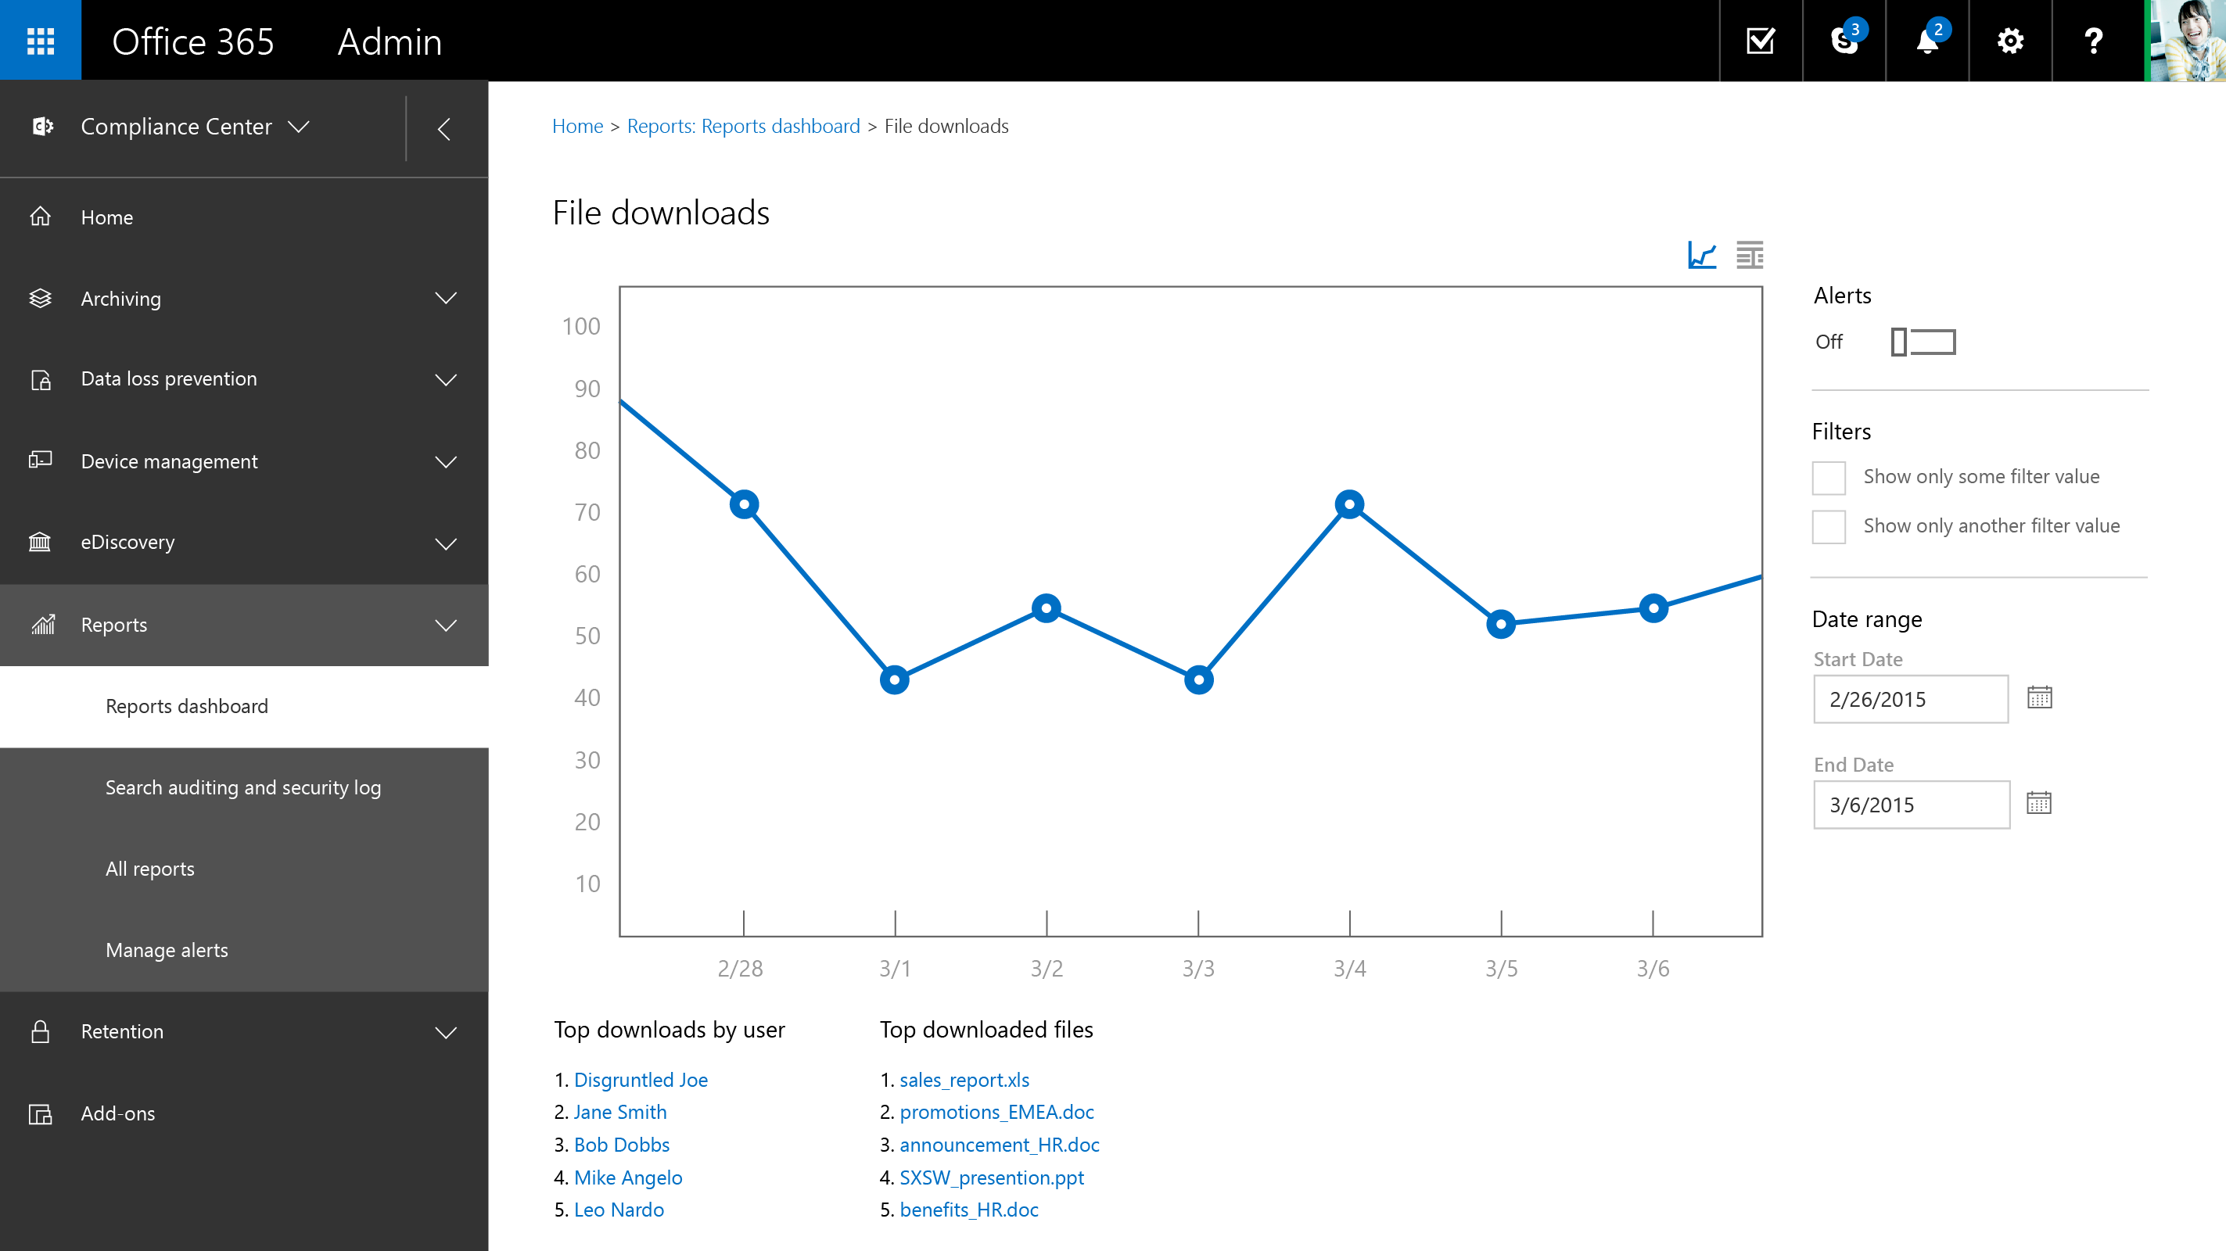

Slide 32
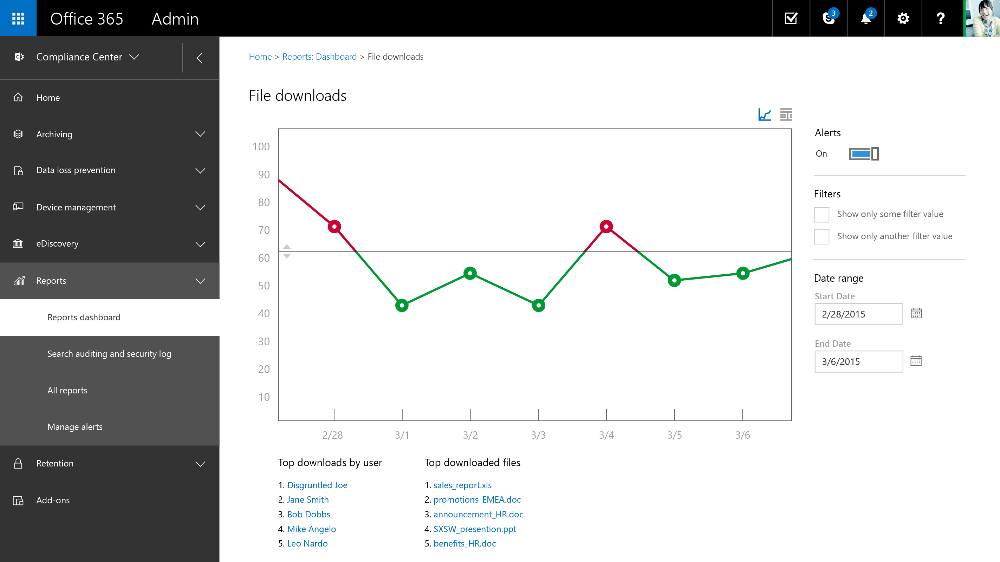

Slide 33
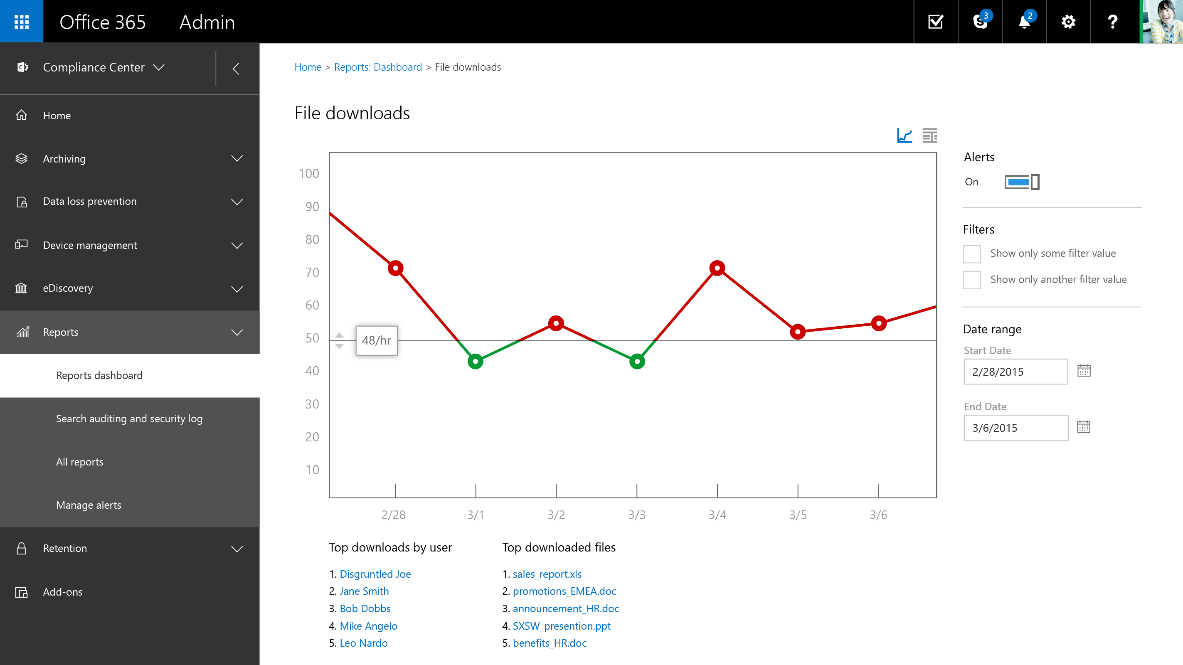

Slide 34
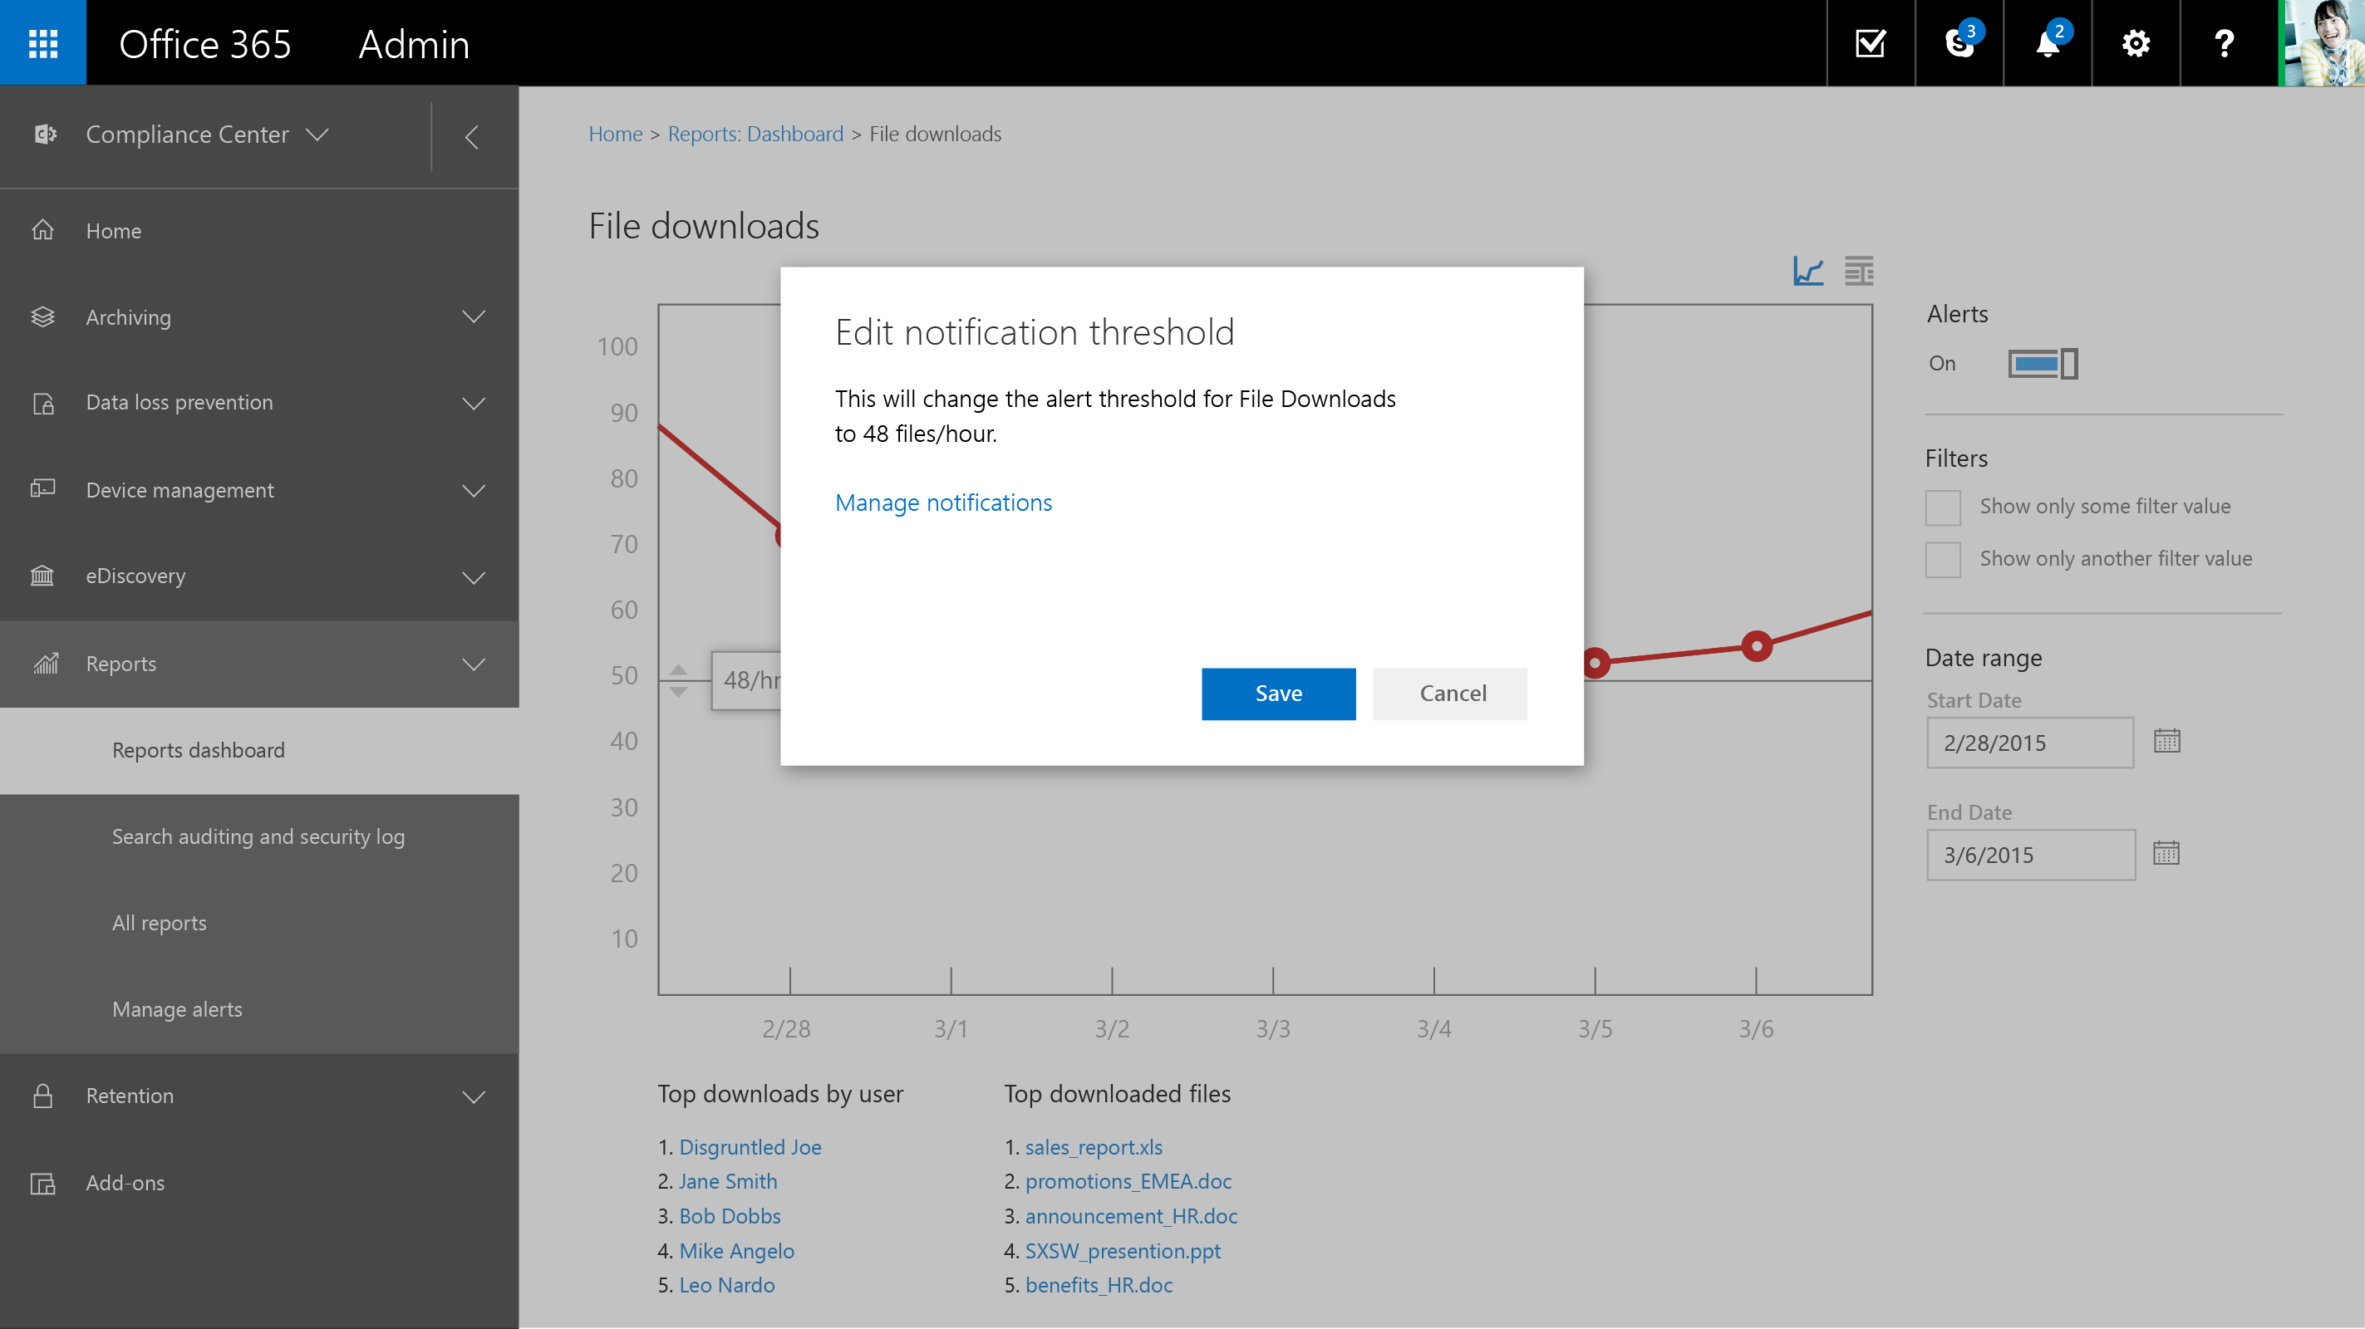

Slide 35
Related Sessions
BRK2159 - Enterprise Grade Data Protection and Compliance with Office 365: Today and Beyond
BRK2180 - Extending Microsoft Office 365 Visibility, Security and Compliance: Office 365 Management APIs
BRK2144 - Keeping Your Data in Place with Office 365 Archiving and Retention
BRK3113 - Device and Data Protection with Mobile Device Management in Office 365
BRK3121 - eDiscovery Redefined: Real Time and In-Place
BRK3181 - End to End Data Loss Prevention
BRK3172 – Encryption in Office 365
BRK2193 - Experts Unplugged: Office 365 Security
BRK2145 - Experts Unplugged: Office 365 Compliance
BRK2142 - Microsoft SharePoint Data Security and Compliance
BRK3126 - Auditing for Office 365

Slide 36
Questions?

