Slide 2
Office 365 and Microsoft Dynamics CRM Online: What’s New?
BRK2166
Luis Camino
Technical Product Marketing Manager
Girish Raja
Technical Product Marketing Manager
Interact with us!
Use Twitter Hashtag
#MSIgnite #BRK2166

Slide 3
Agenda
Overview
Microsoft Dynamics
Demo
UX Tour, Admin Experience
Demo
CRM App for Outlook, Exchange and Folder Sync, Office 365 Groups
Demo
Microsoft Dynamics CRM with SharePoint, Excel, OneNote, and PowerBI
Q&A
Submit your questions on Twitter #MSIgnite #BRK2166

Slide 4
Key Takeaways
Simple
Familiar
Immersive
Powerful

Slide 5
Overview
Microsoft Dynamics

Slide 6
In a mobile-first, cloud-first era, Microsoft delivers the Cloud for Business
Individual Productivity
Microsoft Dynamics
Business Solutions
Microsoft Azure
Flexible Cloud Platform
GLOBAL-CLASS
|
FLEXIBLE BY DESIGN
|
PEOPLE-FOCUSED

Slide 7
Business Solutions
ERP
SALES
SERVICE
MARKETING
SOCIAL
PLATFORM (xRM)
CUSTOMER ENGAGEMENT

Slide 8
What we’ll cover in this demo segment
UX Tour
Simple-to-use, Modern UI, Process-centric
CRM Online Admin Experience
Unified administration and Identity experience
Manage users across the Microsoft Cloud
You are in Control!
Customer-driven updates
On-demand backups
Azure storage and more
Simple
Familiar
Immersive
Powerful

Slide 9
Demo
Girish Raja

Slide 10
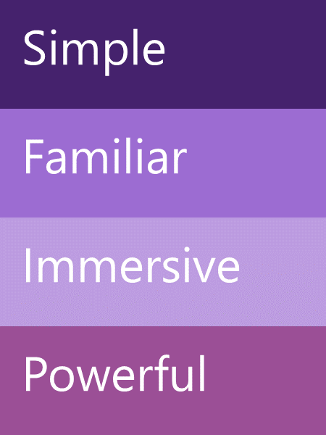
CRM & Office Ecosystem
Office 365 Admin
Dynamics CRM
Skype for Business
Email
Skype
Excel
O365 Groups
Power BI
Yammer
OneNote
SharePoint
OneDrive for Business

Slide 11
What we’ll cover in this demo segment
Folder based Email Sync
Seamlessly sync email to CRM from any device!
Dynamics CRM app for Outlook
Track emails, appointments, contacts including contextual information with just a few taps
Office 365 Groups
Shared documents, calendar, notebook and more for effective team collaboration
Simple
Familiar
Immersive
Powerful

Slide 12
Demo
Girish Raja

Slide 13
What we’ll cover in this demo segment
SharePoint
Documents in context of Dynamics CRM records
Excel
Immersive Excel for data analysis and record updates
OneNote
Note taking and sharing in context of Dynamics CRM records
Power BI
Bring your data together and discover powerful insight
Simple
Familiar
Immersive
Powerful

Slide 14
Demo
Luis Camino

Slide 15
What’s Next?
Luis Camino

Slide 16
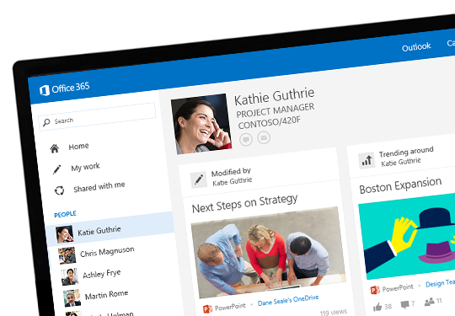
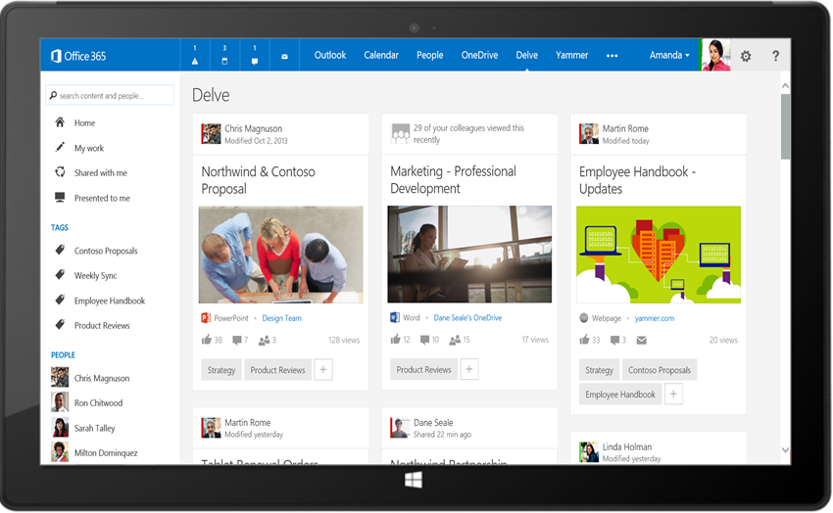
Microsoft Office Delve
Stay In the Know
Find What you Need
Discover New Connections
Discover new information tailored to you from your network
Find just the right results from any source and take action
Connect with the right people and learn more about their content.
Powered by Office Graph

Slide 17
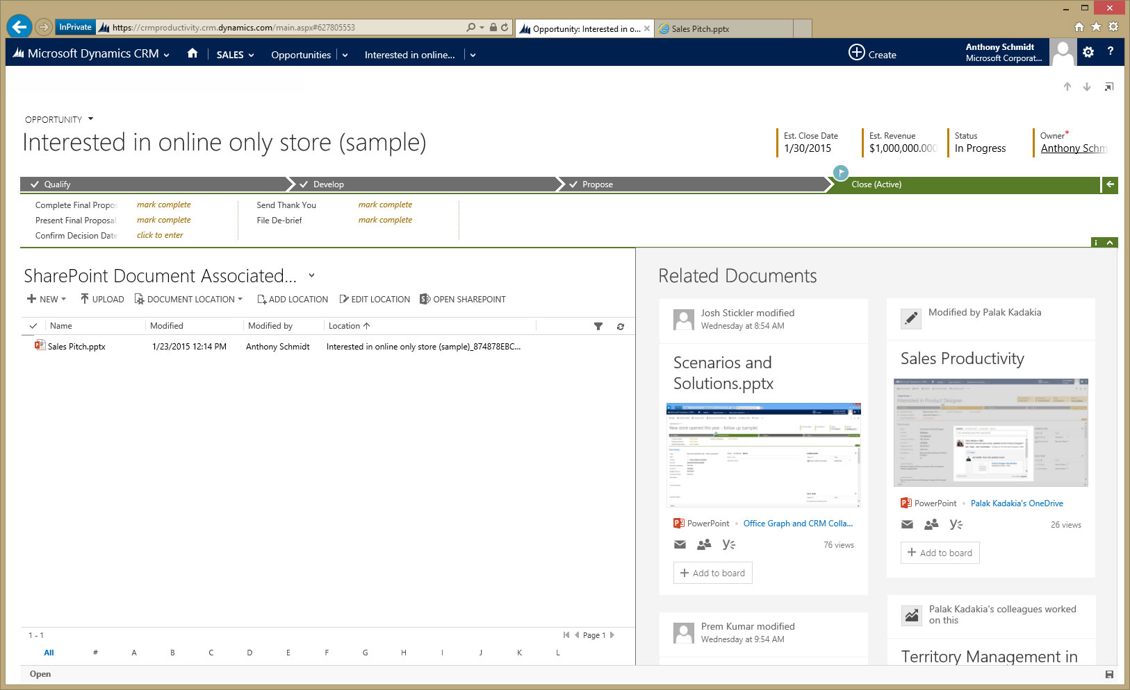
Office Delve in Microsoft Dynamics CRM (Post Spring Release)

Slide 18
Key Takeaways
Simple
Familiar
Immersive
Powerful

Slide 19
Thank you! Submit Questions on Twitter #MSIgnite #BRK2166

Slide 20
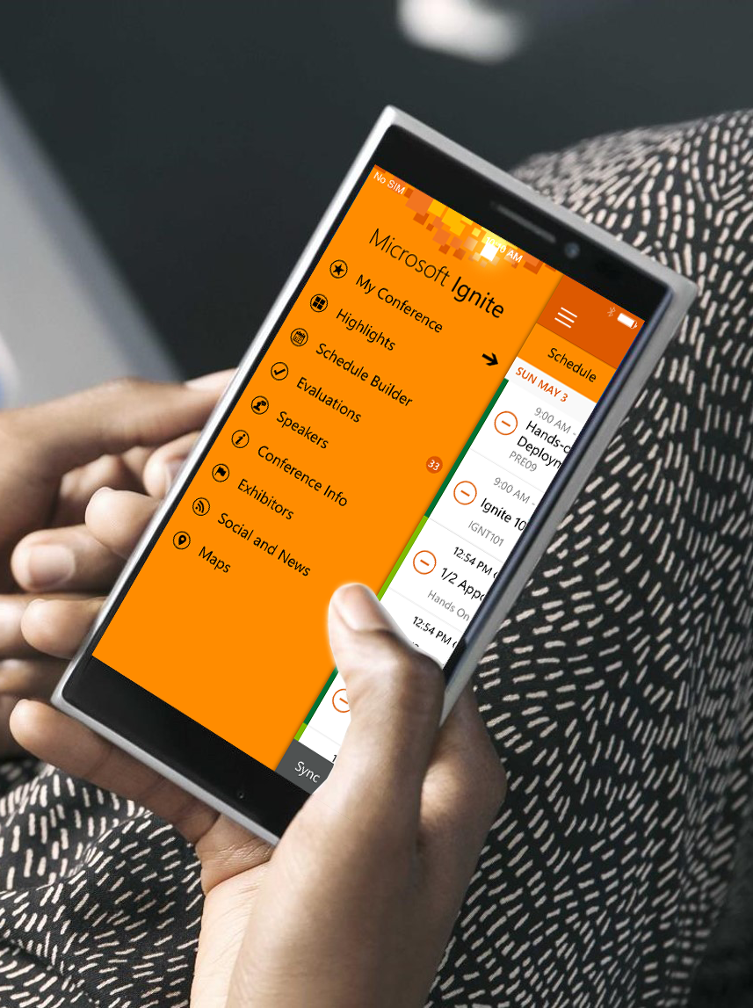
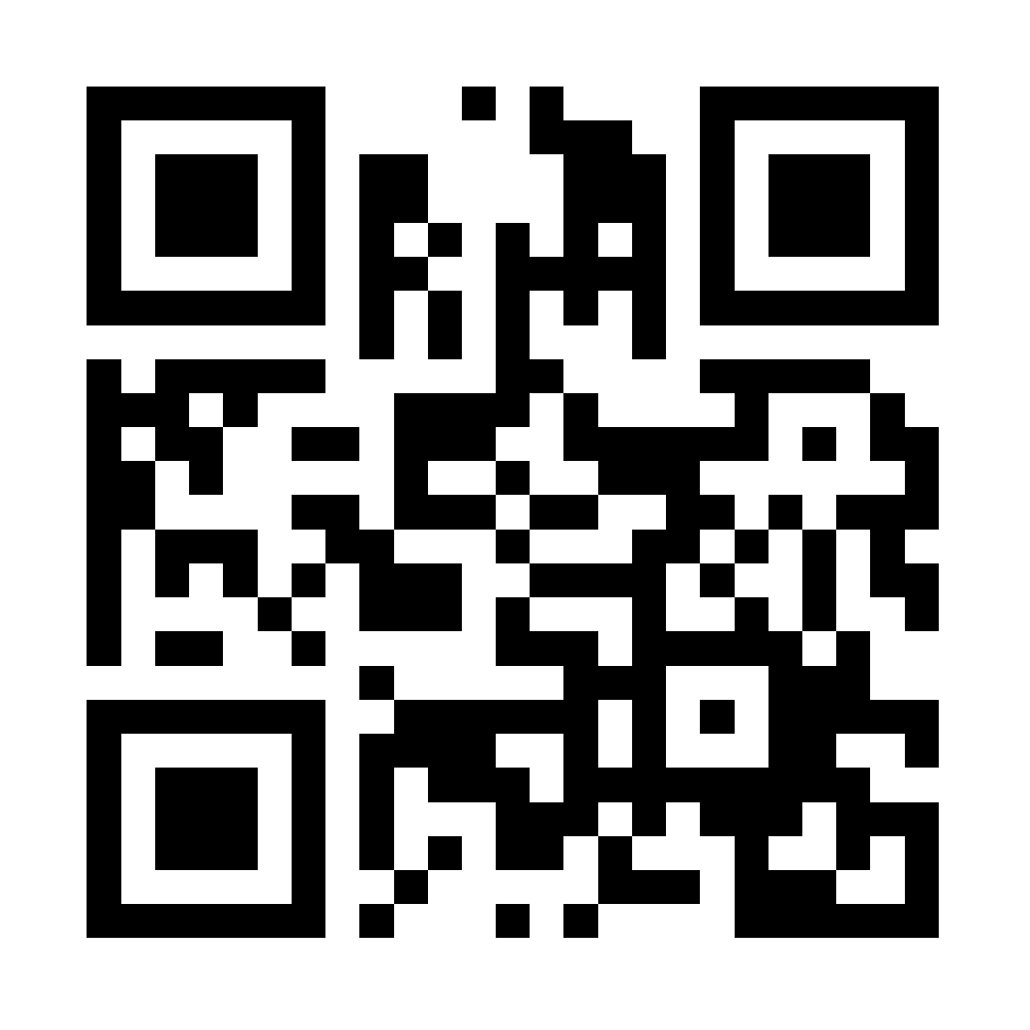
Please evaluate this session
Your feedback is important to us!
Visit Myignite at http://myignite.microsoft.com or download and use the Ignite Mobile App with the QR code above.

