Slide 2
Best Practices for Design and Performance in SharePoint Online
BRK2169
John Ross & Randy Drisgill
Rackspace
Shyam Narayan
Microsoft

Slide 3
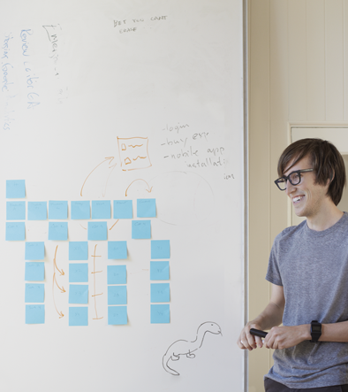
Guidance for successfully building portals on SharePoint Online
SharePoint Online’s scale out and capacity management strategy
Share real world experiences from large portal launches

Slide 4


John Ross
Product Manager – Rackspace
MVP SharePoint Server
Author
  SharePoint 2013 Branding & UI Design
    http://bit.ly/SP2013Branding
  Professional SharePoint 2010 Branding
    http://bit.ly/sp2010-brandingbook
Blog:
  http://johnrossjr.wordpress.com/
Twitter:
  http://twitter.com/johnrossjr
Orlando, FL

Slide 5

Randy Drisgill
Manager and UI Guy – Rackspace
MVP SharePoint Server
Author
  SharePoint 2013 Branding & UI Design
    http://bit.ly/SP2013Branding
  Professional SharePoint 2010 Branding
    http://bit.ly/sp2010-brandingbook
Blog:
  http://blog.drisgill.com
Twitter:
  http://twitter.com/Drisgill
Orlando, FL

Slide 6

Shyam Narayan
Program Manager – Microsoft
Responsible for SharePoint Online
  Performance
  Scalability
  Storage
Blog
  http://blogs.msdn.com/b/shyam/
Twitter
  http://twitter.com/dotnetbounce
Seattle, WA

Slide 7
Platform Decisions
Cloud? On-Prem(ises)
There’s many different types of clouds
  SharePoint Online is a Software as a Service (SaaS) solution
  Azure is an Infrastructure as a Service (IaaS) solution
  Both are considered Cloud
  Any SharePoint version not SharePoint Online is considered “On-Prem”
Which cloud is the right fit for you?

Slide 8

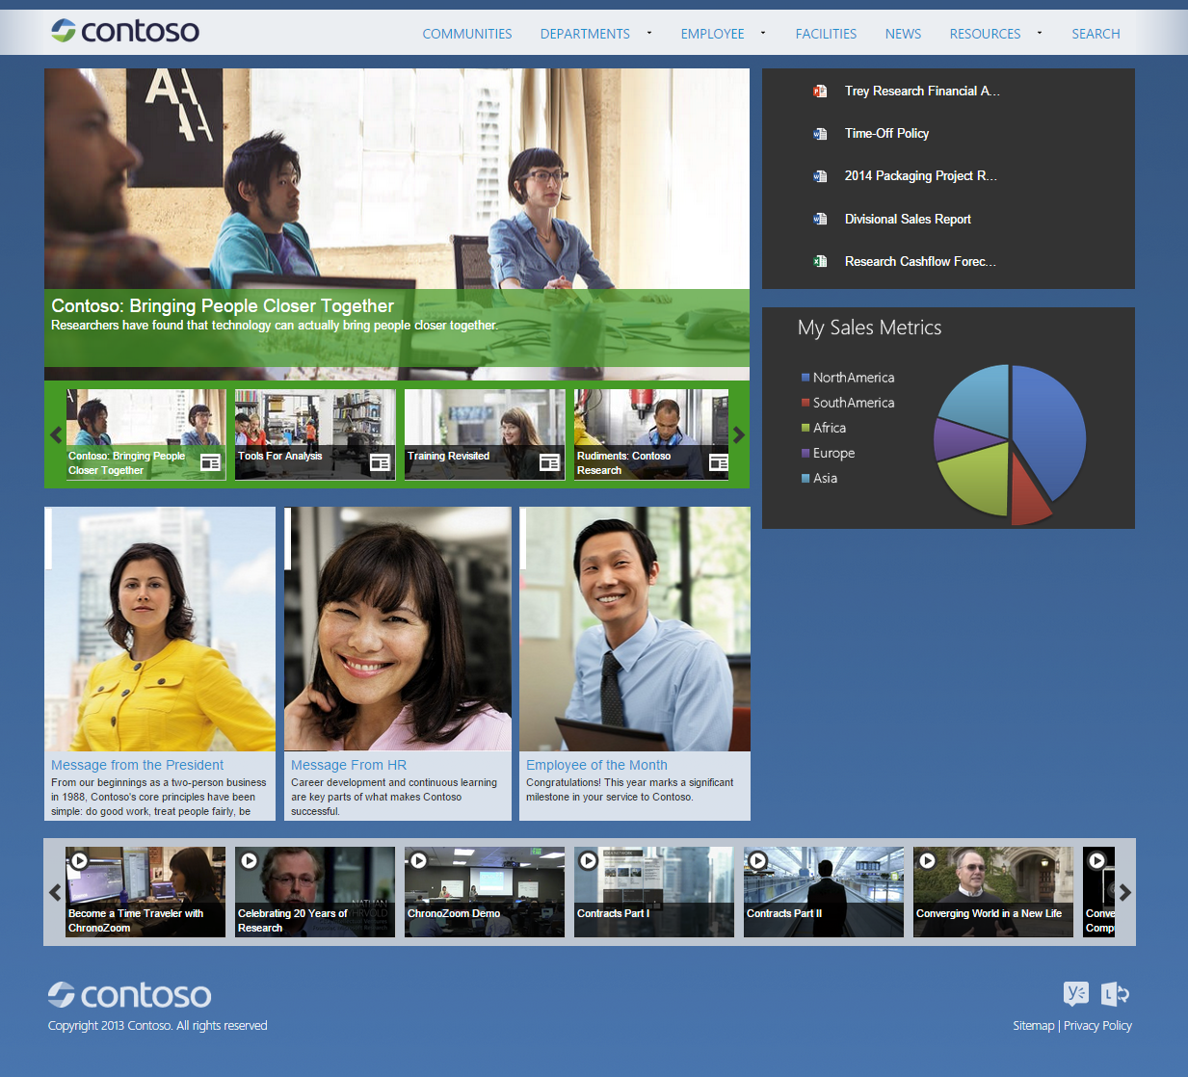
Why is it different?
Server
CDN
Browser
Network
Server
Network
Microsoft
Network
ISP
Internet
Complex pages
Too many web parts
Large payload
Too many files
Large distance to server
Complex pages
Busy computer
Small cache
Expensive server interactions
Front end cache misses

Slide 9
SharePoint Online – Where do you start?
Make a new Portal – “Green fields”
  Provides maximum flexibility
  Avoid applying on-premises guidance to the cloud
Migrating from SharePoint on-premises
  Do not lift and shift
  Re-architect for SharePoint Online capabilities
  Suggested approach for publishing portals

Slide 10
Building on SharePoint Online
Planning
Branding
Site Build/Configure
Other
Rollout

Slide 11



Things to factor into your design
Cloud Parity
Devices
Connectivity
  Feature parity not guaranteed
  Feature behavior and performance not same
  BYOD
  x-cross platform
  Mobile devices and tablets
  Corporate network
  Home, on the go..
  Remote offices and across geographies

Slide 12
Building portals on SharePoint Online

Slide 13
What do we mean by “branding”
In Marketing:
  Creating names, logos, symbols, designs, etc. that differentiates products in the marketplace
Branding for SharePoint:
  Generic term used for SharePoint UI Customization
  Master Pages, Page Layouts, CSS, Web Parts, images, fonts, etc.

Slide 14
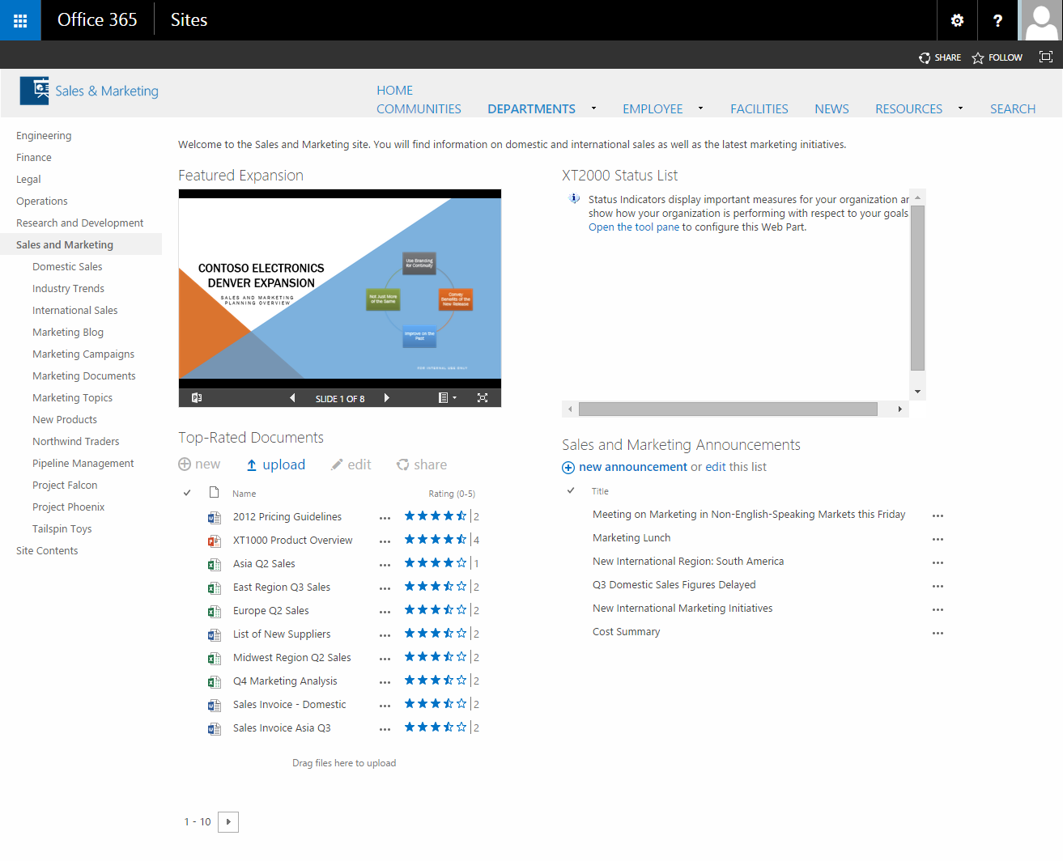
Portals vs Collaboration Sites
Portals:
  Corporate Intranet Home Page
  Often features heavy branding / styling
  Communicative – Few Authors / Many Consumers
  Often controlled by Corp Communications
Collaboration Sites
  Team / Project Sites
  Often not as stylized
  All about team productivity
  Teams own their sites

Slide 15

Approaches to Branding in SharePoint Online
Full Effort - Extend
Custom Master Pages, Page Layouts, Display Templates
Medium Effort – Configure/Extend
Design Manger for Publishing Sites
Custom CSS
Low Effort – Out of the box
Page Editing & Composed Looks

Slide 16
Branding Impact on SharePoint Online
Low Impact
Higher Impact
Composed Looks
  Simple layout / color / font options
  Upload your logo and a background image to complete the look
Design Manager
  Convert standard HTML / CSS to SharePoint Master Page & Page Layouts
  Snippets to help you build out SP functionality
  Publishing Sites Only
Full SharePoint branding
  Custom Master Page & Page Layouts created by you
  Steep learning curve – You add SP functionality manually

Slide 17
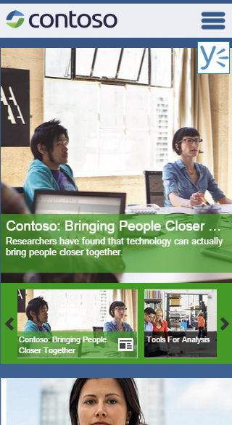
Responsive Web Design
Why RWD?
  Create one design that adapts to many screen resolutions
  Great experience across devices
  Maintain one codebase
Considerations
  Better for Portals that Collaboration / Team Sites
  More planning / Testing – How will site react at different sizes with different devices
  Content Authors – May need to understand how to create content that is responsive
Example:
  Heather Solomon – Making Seattle.master responsive:
    blog.sharepointexperience.com/2015/03/making-seattle-master-responsive/

Slide 18
SharePoint Branding Options

Slide 19
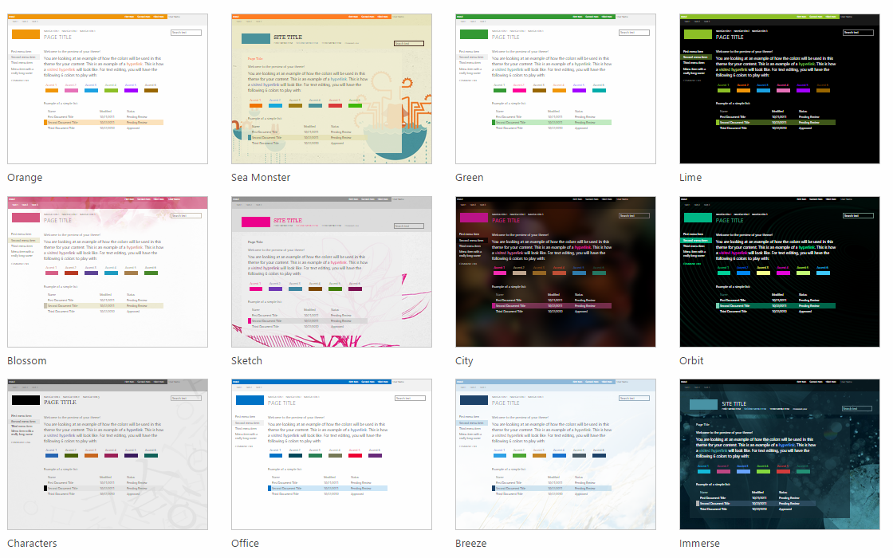
Composed Looks
Also called Themes
Pick from predefined Composed Looks
Configure:
  Background Image
  Colors
  Site Layout (Master Page)
    Seattle
    Oslo
  Fonts

Slide 20
Master Pages
They can be thought of as the outer shell of a site design
Custom master pages give you control over much of the SharePoint Page
  Full HTML Control
  Add JavaScript / jQuery
  Add Custom CSS
  Content layout
  Hide and show parts of SharePoint
  SharePoint Controls

Slide 21
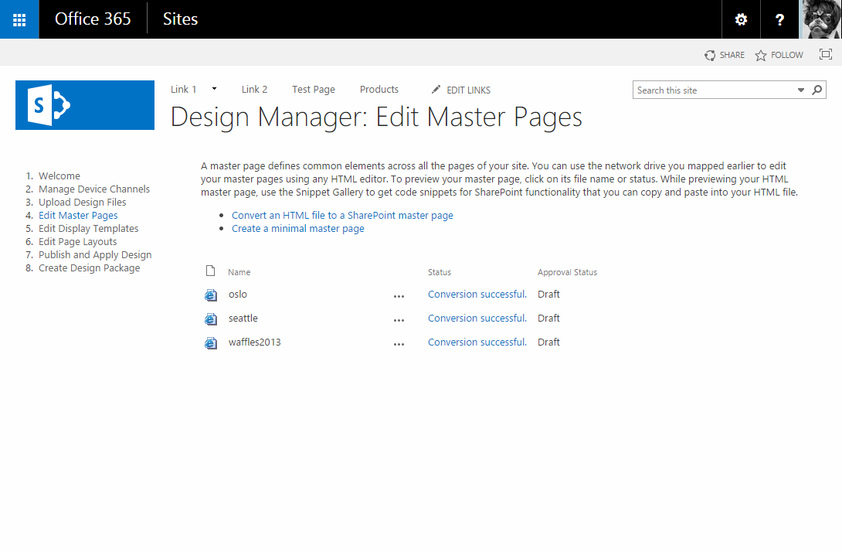
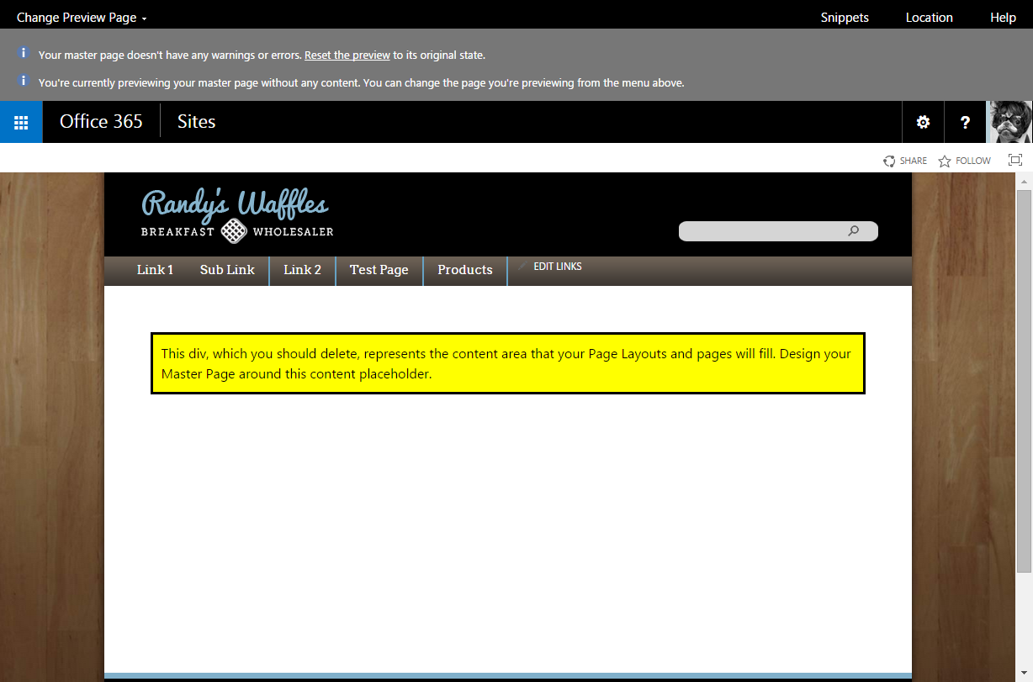
Design Manager
Easily convert HTML design into SharePoint
  Available only in Publishing Sites
    Site Settings > Design Manager
  Master Pages for shell of your design
  Page Layouts for page content formatting

Slide 22
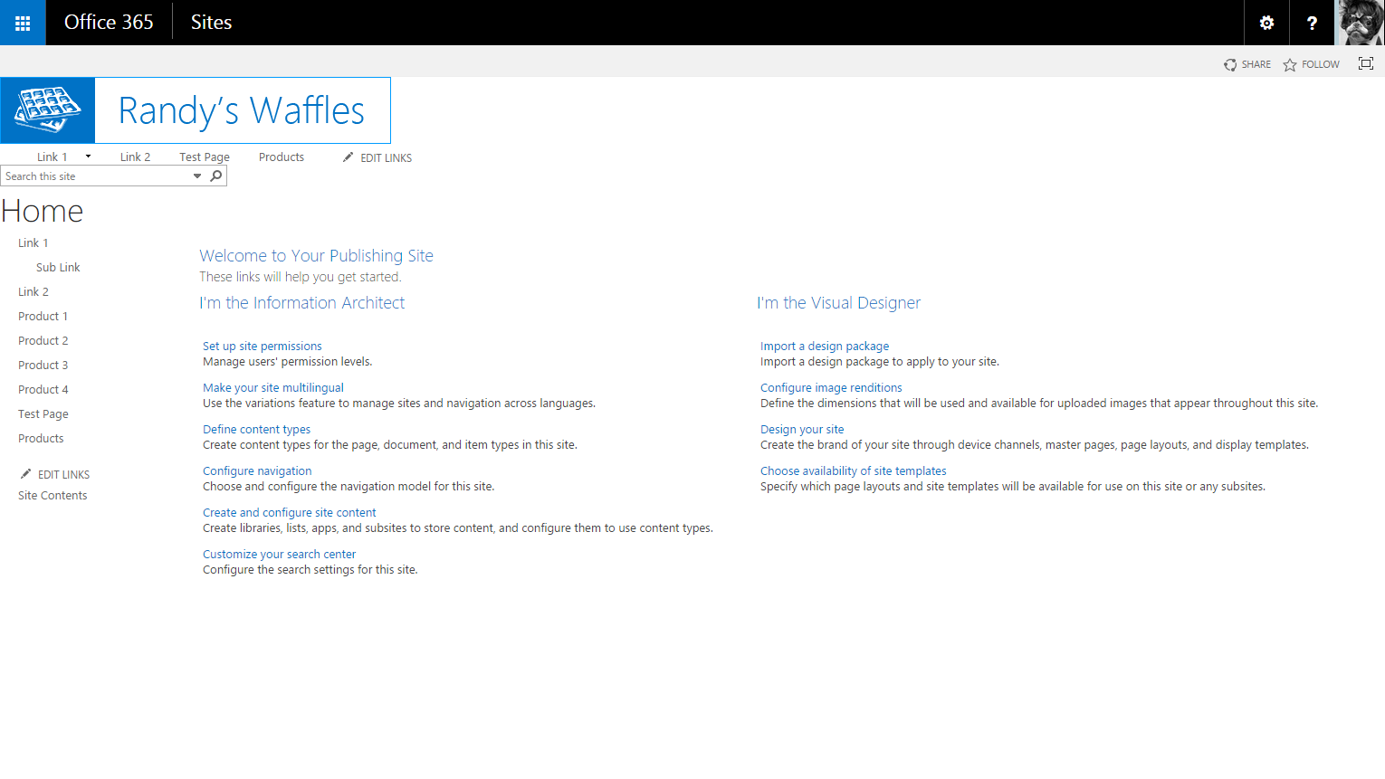
Custom Branding
Create Master Pages and Page Layouts by hand
  Use a Starter Master Page - StarterMasterPages.CodePlex.Com
  Layout with HTML, CSS, & images
  Add SP Controls + Move / Hide Content Placeholders
  Customize CSS + add JavaScript as needed

Slide 23
Design Manager vs. Custom Branding
 | Design Manager | Custom Branding
You have Foundation or non-Publishing site
You are experienced with Pre-SP 2013 branding
Need quick nice looking branding
Need highly stylized / complex branding
Updating Existing SharePoint Branding
You are experienced with HTML and CSS

Slide 24
SharePoint Branding Options
Demo

Slide 25
Optimizing Performance

Slide 26


Top 5 causes of slow perf in SharePoint Online
Structural navigation
Deep navigation
Content rollup
Expensive queries
Large files
Images and videos
Lots of requests
.js, .css, images
Lots of web parts

Slide 27
Performance Optimizations
Demo: 30 seconds to 2 seconds

Slide 28
30 seconds to 2 seconds
30s
Structural to search or managed navigation
20s
Content by query to content by search
Image optimization, delay loading and custom apps
5s
Optimizing HTTP traffic via CDN’s, bundling and minification
2s

Slide 29
Performance Optimization Techniques http://aka.ms/tune

Slide 30
How SharePoint Online manages capacity

Slide 31
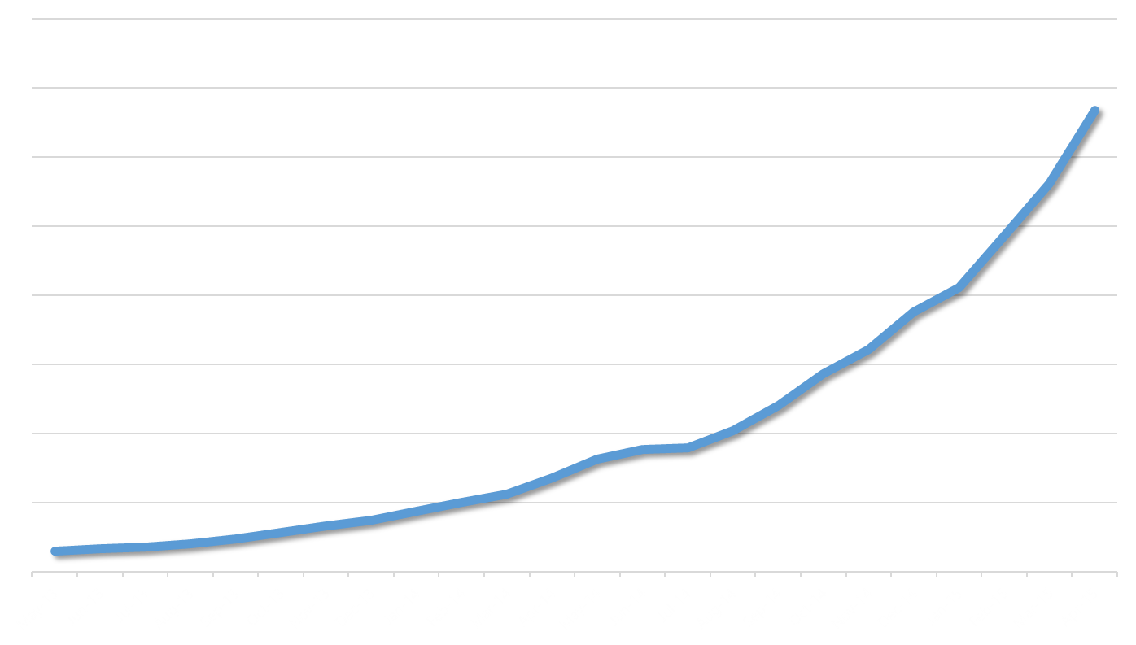
Lots of content….
Today
500% Growth
12 Months

Slide 32
Predictive capacity: forecasting
SharePoint Online forecasts future growth by trending historical load
Requests in zone

Slide 33
Predictive capacity: forecasting
Forecasts are for groups of farms in a zone
Requests in zone
Requests per farm

Slide 34
Predictive capacity: managing farms
Average front end CPU load
85 to 100 % - Danger Zone
Front ends in content farms run at 40% CPU
As load increases, we
add capacity
40% to 85 % - Buffer
% CPU
0% to 40 % - Operating zone
Monday Tuesday Wednesday Thursday Friday

Slide 35
Launching on SharePoint Online

Slide 36
Launching a new site to > 10k users
Waves
Pilot
1
2
3
4
Invited users
Active users

Slide 37
…but sometimes slow rollouts isn’t an option

Slide 38
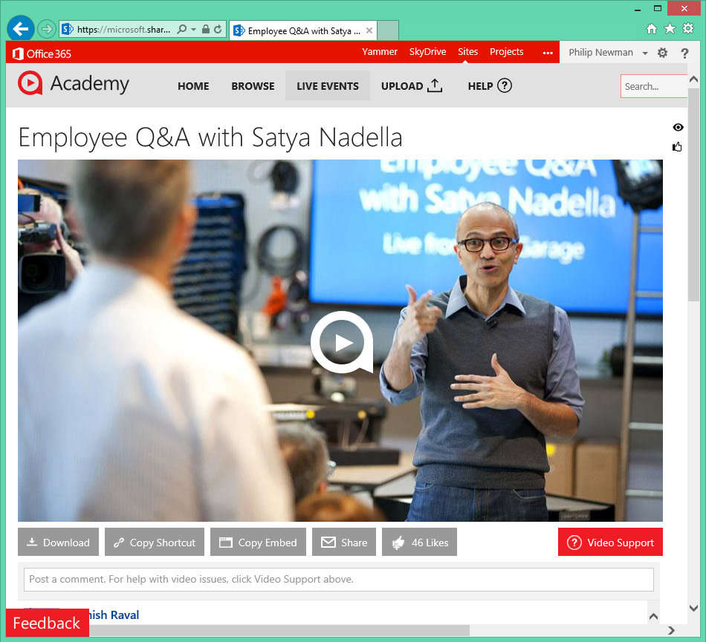
Scenario: Company-wide webcast
Microsoft’s “Academy” site hosts training videos and live broadcasts
Recent live company-wide events:
Company meeting
New CEO announcement
Optimizations:
Load jQuery from CDN
Move images to asset library

Slide 39
Microsoft farm & Satya webcast
Webcast requests
Non-webcast requests
Monday Tuesday Wednesday Thursday Friday

Slide 40
Key takeaways..
Visually Stunning
Highly Performant
Extreme Scale

Slide 41
Suggested Sessions
BRK3164: Deep Dive into Safe SharePoint Branding (Monday, 5/4 @ 3:15pm)
BRK2205: Behind the Scenes: Engineering NextGen Portals (Thursday, 5/7 @ 9am)

Slide 42


Please evaluate this session
Your feedback is important to us!
Visit Myignite at http://myignite.microsoft.com
or download and use the Ignite Mobile App
with the QR code above.

