Slide 2
The New Knowledge Management Portal in O365
BRK2174
Victor Poznanski and Christopher Kehler
Microsoft

Slide 3
The Sea of Data
O365 is great for acquiring data spreadsheets, videos, PowerPoints, etc
The result is a sea of undifferentiated data in team sites, mail, OneDrive, group folders
We need to organize and find definitive information no matter where it’s siloed Codename Infopedia is our vision for ready-to-go curation, browsing, finding and communication of definitive knowledge across organizations

Slide 4
Imagine if…
Everyone had a beautiful, easy way of showcasing and sharing their most important company knowledge
…mobile, fast, social and powered by the Office Graph and analytics
There was one place to find definitive answers to all your questions, explore and stay up-to-date on critical business topics
It was inclusive, working well from the get-go, but became even better organized for your business with the right stewardship
…that’s the Codename Infopedia ready-to-go KM portal

Slide 5
Knowledge Management
Making your information actionable
Getting the right information to the right people at the right time
Organizing
Relating
Collecting
Explaining
Highlighting
Finding
Sharing
Discovering
Connecting
Notifying
Mobile

Slide 6
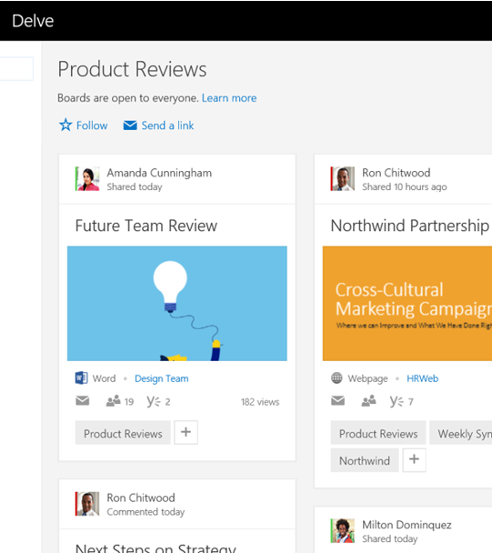
SharePoint Portals vs Ready-to-go Experiences
SharePoint Portals: Toolkit
CBS, search-driven publishing, taxonomy, navigation providers, master pages, layouts, web parts, workflow, versioning, checkin/out, perms…
Ready-to-go KM
Boards, microsites surfaced in Codename Infopedia

Slide 7
NextGen Portals: Meet the Family
O365 Video
Delve
O365 “InfoPedia”
Build Your Own
Video
Delve
“InfoPedia”
Your Portal
Intelligent
Social
Mobile
“Ready to go”
Enhanced by key Office 365 Capabilities
Office Graph
Office Add-Ins
OneDrive
Skype
Outlook
Compliance Center
Yammer
SharePoint Content Management
Azure Media & other Azure PaaS Services

Slide 8
KM Strategy
Boards
lightweight collection and sharing
Microsites
organized, contextualized information
Codename
Infopedia
personalized knowledge gateway
Bottom-up
(Usage)
Top-down
(Value)

Slide 9
Lightweight Knowledge Management with Boards

Slide 10
Collecting with Boards
Problem: Information gets fragmented and scattered
Boards are an easy way to collect and share fresh content
Collaborative: anyone can contribute and mail links
“add to board” is integrated into Delve

Slide 11
Boards in Action
Christopher Kehler

Slide 12
What does the Graph give you?
Me
related to
contributed
The Office Graph records relationships between people and O365 objects
It’s available throughout O365
You will be able to add to board from anywhere
We can derive great insights for you:
Who has contributed to this board?
Is anything happening on boards you care about?
Is there a board you should know about, because people close to you interact with it?
following
Sales Research
Fabrikam
added to
added to
trending around
modified

Slide 13
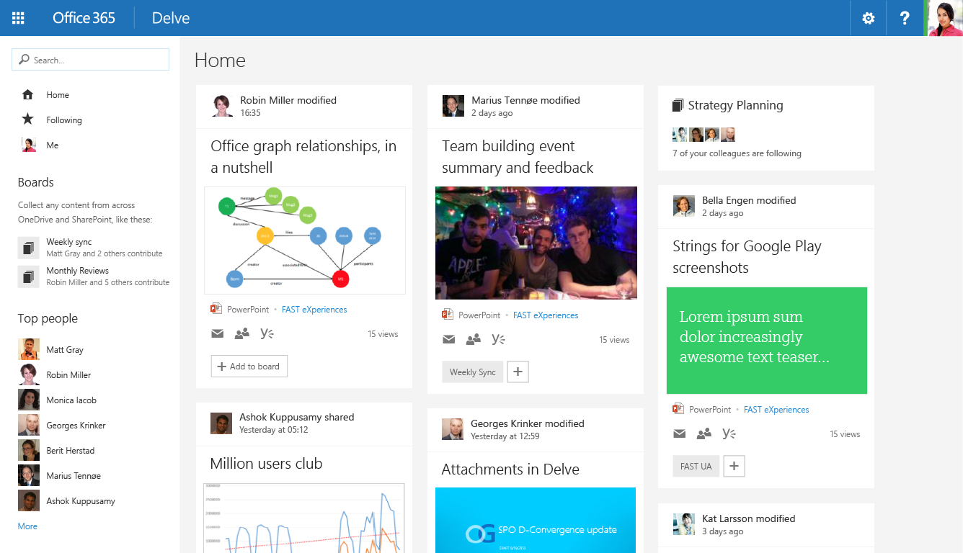
Drawing Attention to Boards
Ideas in the pipeline

Slide 14
Attention/Notifications on Boards
Ideas in the pipeline
Changes to items on boards are ranked higher
Users receive digests mails of updates to boards

Slide 15
Boards Available Anywhere
The Ultimate Vision
You can add to a board anywhere in O365
Email
Onedrive for Business
Video, …
Add to Board
Abraham Beardsley

Slide 16
When should I use Boards?
When you want to pull together fresh information from different places and different people
When you want to focus attention on a subset of documents
When you want to re-use and build upon existing knowledge
Eg. All powerpoints for an offsite sitting on different Onedrives
Eg. The must-see documents in my group folder
Eg. Contributing to a company-wide topic

Slide 17
What if I want more control over curation?
…manage exactly who can add content
…order the content
…annotate, explain or provide context
...highlight or crack open certain content
…show related content
Microsites

Slide 18
Collecting and Contextualizing using Microsites

Slide 19
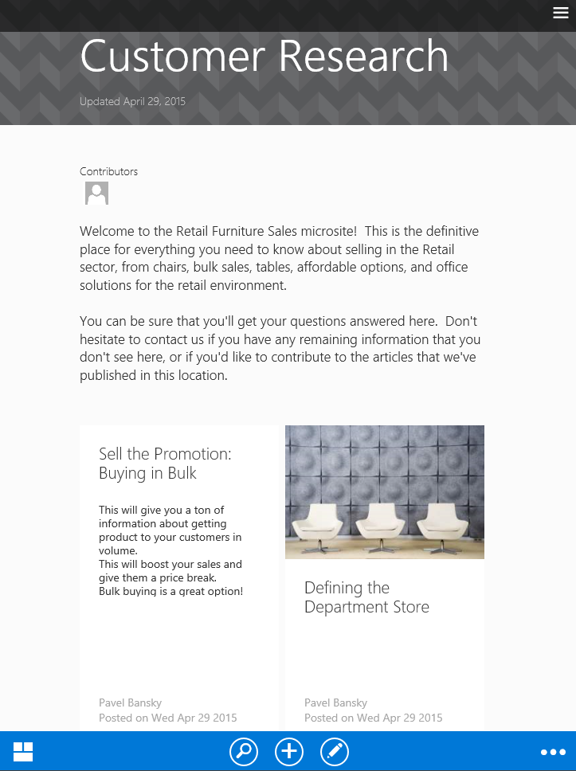
Microsites
Microsites provide more control and context around a collection
Provide narrative and explanation:
an ordered collection of articles stapled together
with a convenient front page and navigation
Microsites also introduce a simple permissions system control who can contribute scope your readership
They help you understand the impact of your work
instrumented social features

Slide 20
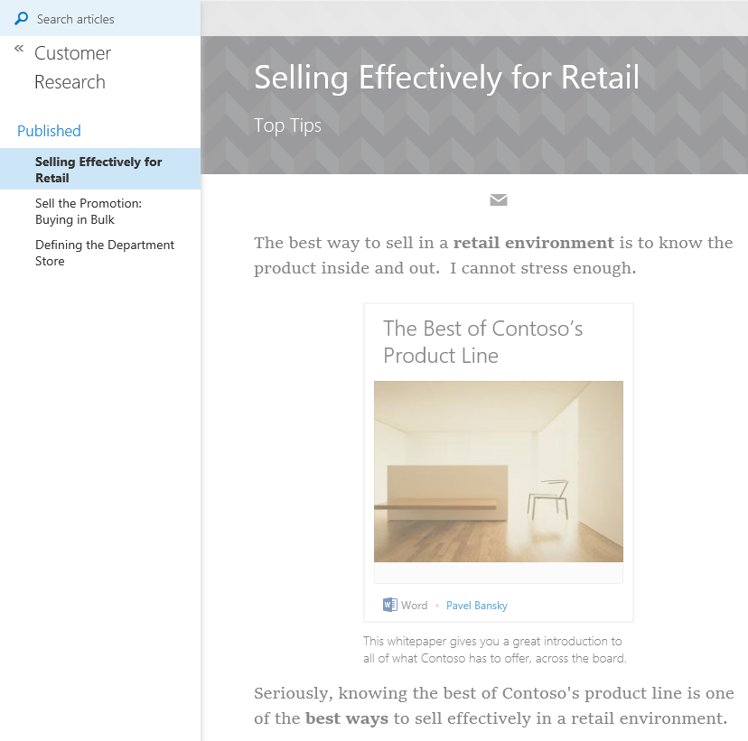
Articles
Articles let you organize information on a page
Explain and showcase O365 assets
Connect and relate your information through graph insights and curation
Communicate to your audience and understand your impact

Slide 21
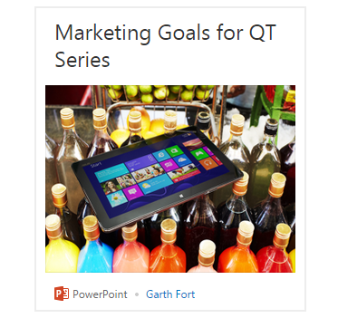
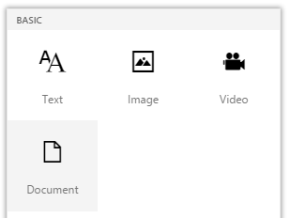
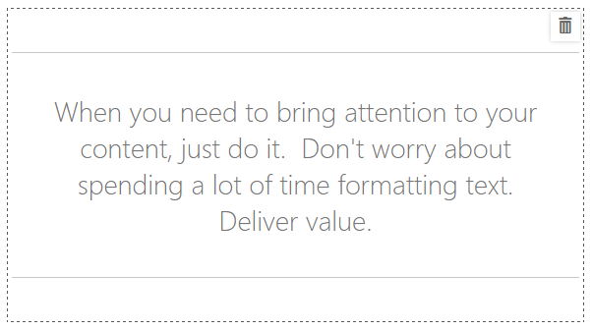
Articles at a Glance
Content-first you focus on content; we format on any device
Rich documents show off the most important content in your Office docs
Rich text as easy as Word or email with toolbox and hinting system
Social have conversations about them; like them; see view counts
Dynamic & Beautiful anything you write just looks great
Integrated with email mail out rich articles and attract readers to your microsite

Slide 22
Microsites in Action
Christopher Kehler

Slide 23
Graph-driven Insights
Your articles can rapidly become obsolete It can be expensive to keep them fresh Graph insights can help you out By mining documents around you and your users, we can keep them relevant

Slide 24
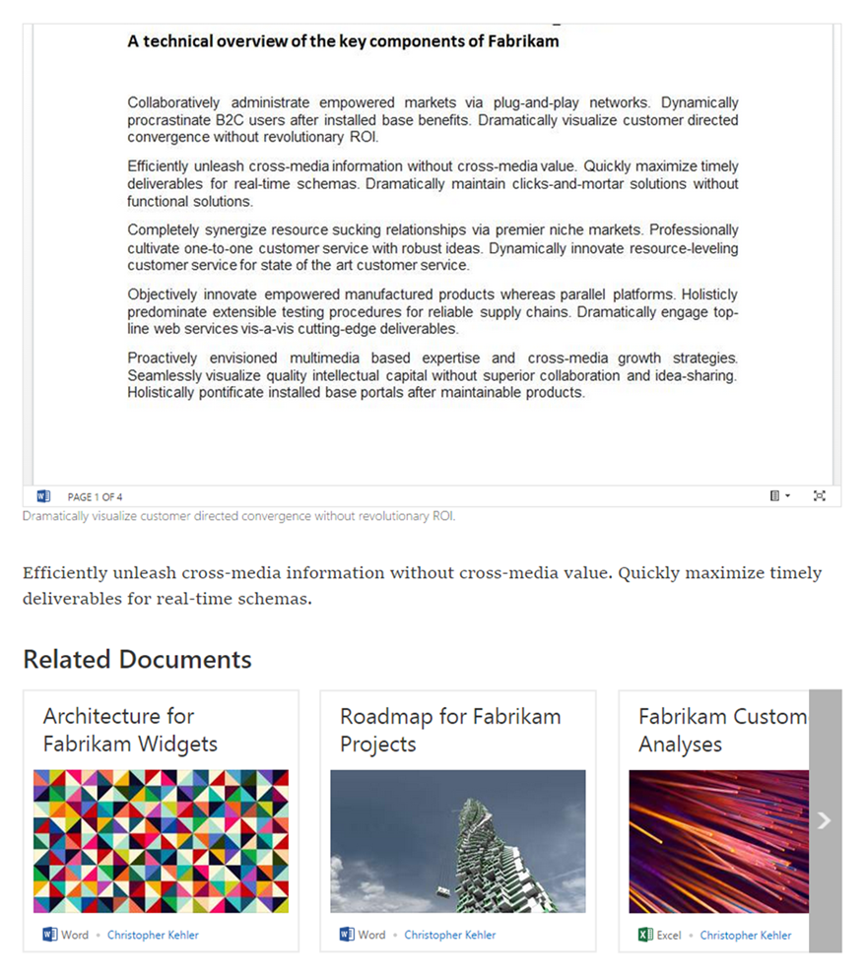
Related Documents
When you embed documents in an article, we predict related documents for you
Shopping-site-like recommendation:
people who used these documents went on to use the following
Doc2Doc Recommendation
$$P\left(D_{2, u, t+n}|D_{1, u, t}\right)$$

Slide 25
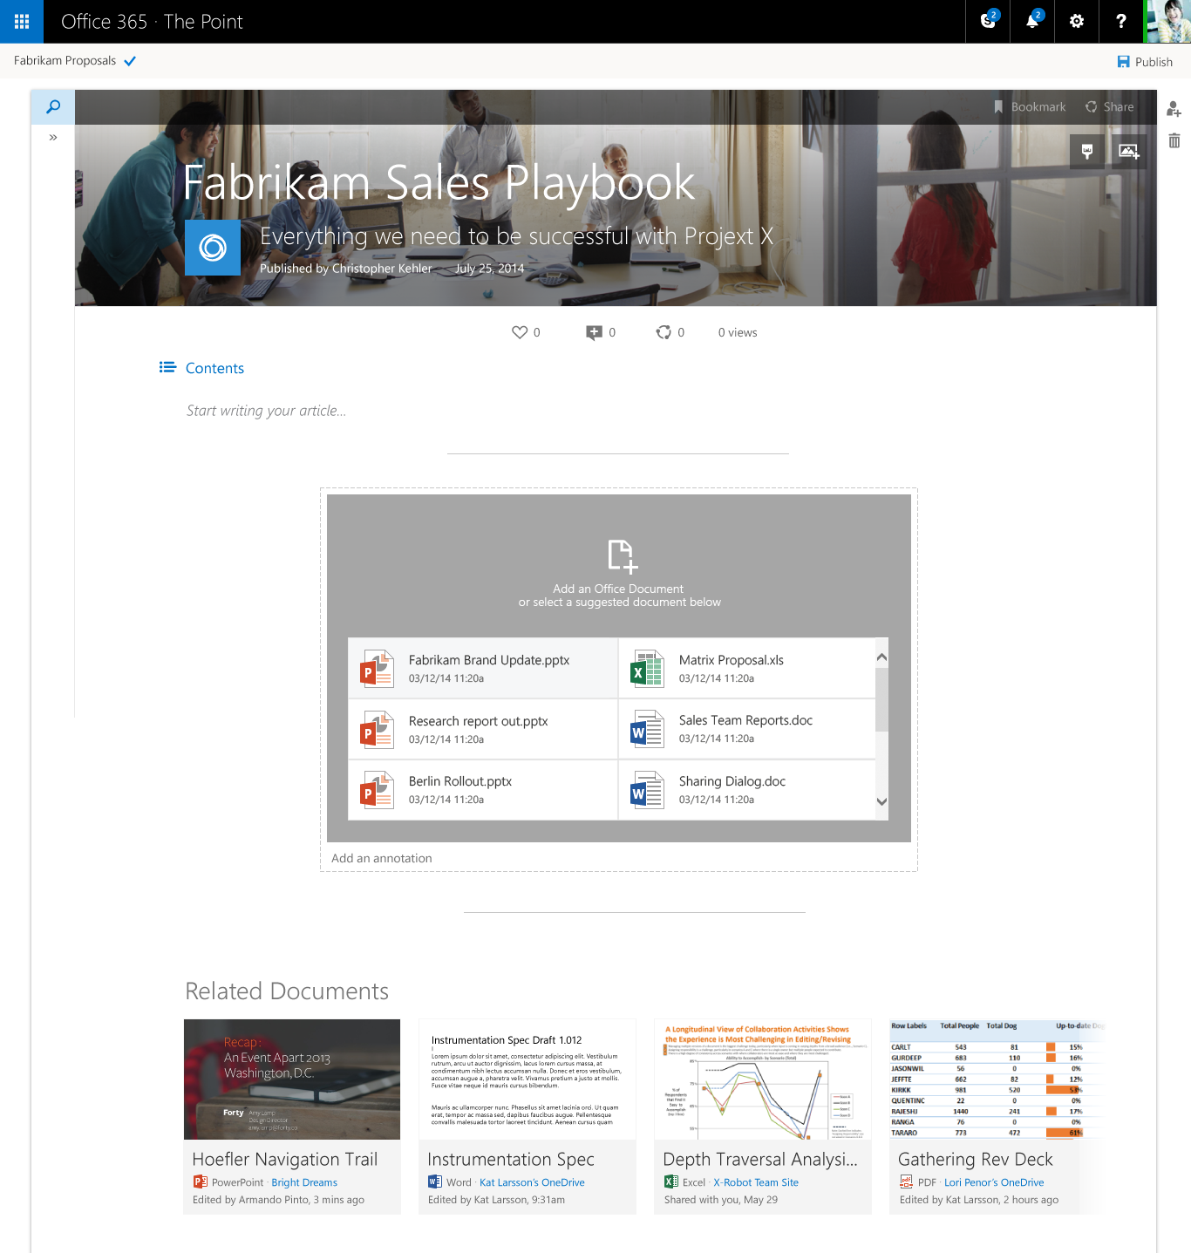
Predicted Documents
We encourage users to add document references with an inline-file picker
It predicts what you most want to add from your recent activity

Slide 26
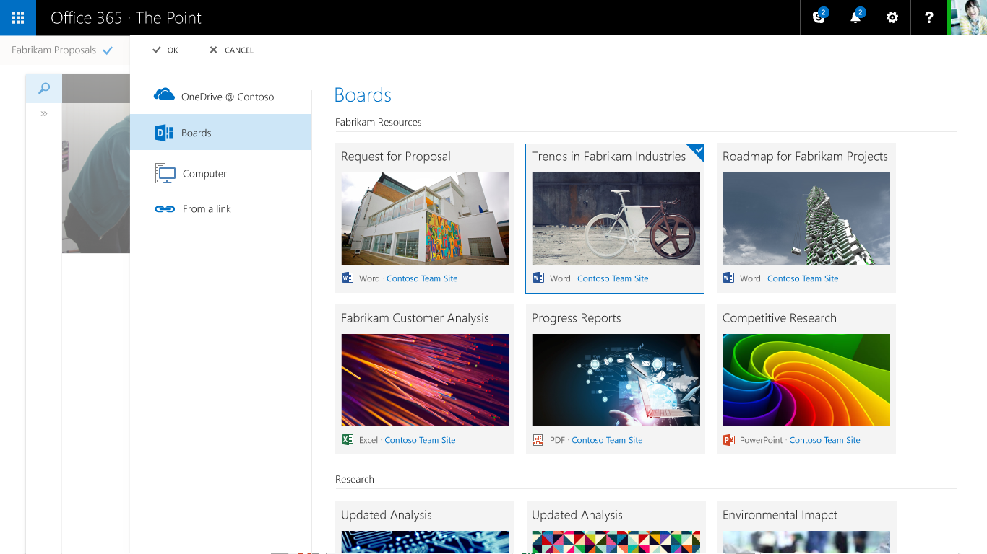
From Boards to Articles
Ideas in the pipeline

Slide 27
Code-name Infopedia
A Vision

Slide 28
Table of Contents

Slide 29
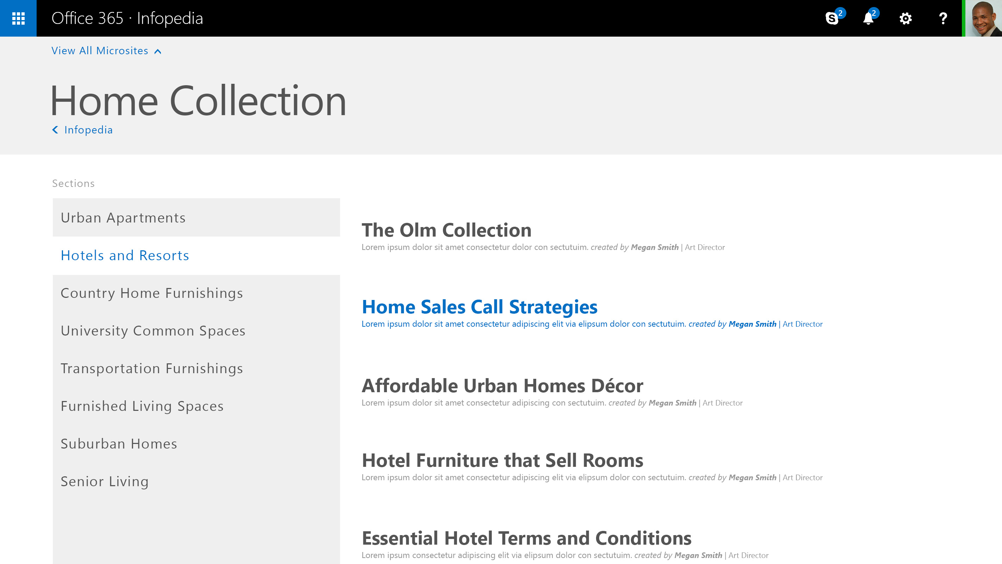
A Table of Contents with Sections

Slide 33
Infopedia Mock-up
An online knowledge shop:
…with personalized recommendations
…organized around your company
…with great search
Victor
Poznanski

Slide 34
Summary: the Infopedia Promise
Knowledge seekers, you be able to:
easily shop for definitive knowledge in O365 through Infopedia
Knowledge workers will be able to:
easily curate and showcase your collections (boards and microsites)
assess and improve your impact (social features, simple analytics)
Organizational content stewards, you’ll be able to:
market your knowledge intuitively (setup UX, analytics)
establish trust and authority in your content (badging, hubs)
keep knowledge fresh by reducing author friction (data mining)

Slide 35
Recommended Sessions
Tuesday (5/5/2015)
BRK2173 | Intelligent, Ready-to-Go NextGen Portals in Office 365 |  | Adam Harmetz; Mark Kashman | 9:00AM | S100
Wednesday (5/6/2015)
BRK2176 | A New People Experience in Delve: Discover People Through Content, and Content Through People | Stefan Debald; Welly Lee |  | 10:45AM | E353
BRK2174 | The New Knowledge Management Portal in Office 365 | Christopher Kehler; Victor Poznanski |  | 1:30PM | S104
BRK2113 | Collaborate on Files and Information within Office 365 Groups | Andrew Haon; Eric Zenz |  | 3:15PM | S100
Thursday (5/7/2015)
BRK3155 | Office 365 Video and Custom Solutions Built on Azure Media Services | Ashish Chawla; Marc Mroz |  | 9:00AM | S105d
BRK3175 | Behind the scenes: Engineering NextGen Portals | Daniel Kogan; Jeremy Kelley |  | 9:00AM | E350

Slide 36
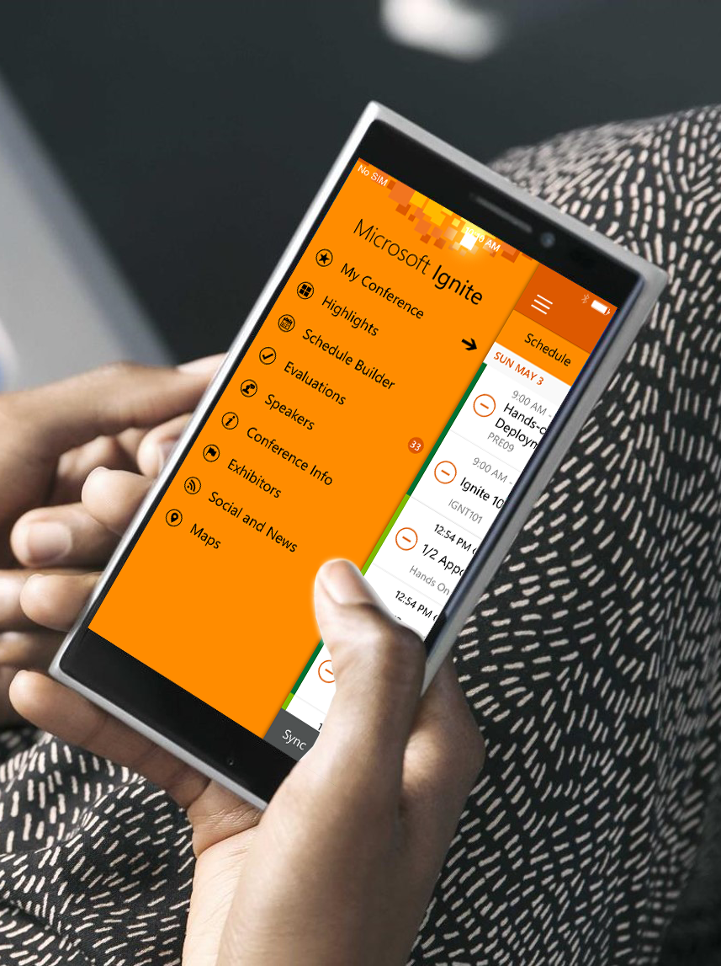
Please evaluate this session
Your feedback is important to us!
Visit Myignite at http://myignite.microsoft.com or download and use the Ignite Mobile App with the QR code above.

