Slide 2
Microsoft Office: The Next Chapter on Windows 10
BRK2185
Ben Walters | Sr. Product Marketing Manager
Dan Parish | Sr. PM Manager

Slide 3

Office Everywhere
Office for Android tablet
Office 2016 for Mac Preview
Outlook for iOS and Android
Sway for iPhone
Office for iPad
OneNote for Mac
Office Lens
Office for iPhone
Outlook for Mac
Sway Preview
Office 2016 Preview
Office Universal Preview
Office Lens, iPhone and Android
Spring 2014
Fall 2014
Winter 2015
Spring 2015

Slide 4

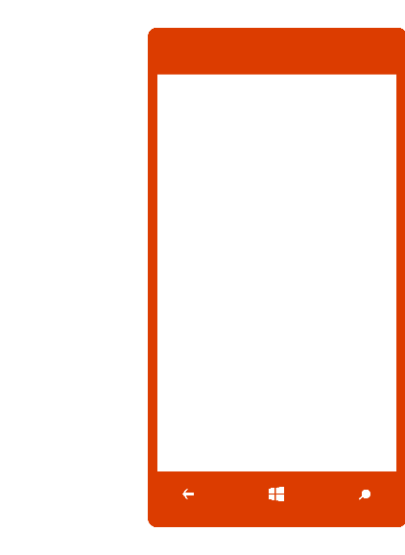


The Modern Workplace
Office “Universal”
Office 2016
Optimized for Mouse & Keyboard
Desktop Office applications and features
Professional Productivity
  Document authoring, revisions, versioning
  Pro layouts and presentations
  Data analysis and visualization

Slide 5
Office Desktop
Office Touch
Desktop
&
Mobile
Richest feature set for professional content creation
Designed for the precision of the keyboard and mouse
Sophisticated authoring, pixel-perfect design, deep analysis and visualization
Flexible deployment options
tuned for the Enterprise
On-the-go productivity
Touch-first, built for
tablets and phones
Viewing, quick edits, review, mark-up, and comments
Delivered and serviced thru the Windows App Store
Viewing and basic editing free for consumers below 10.1”

Slide 6

Office Universal
Content fidelity and document integrity
Familiar interface
Cloud connected
New common architecture
Improvements at a quick pace

Slide 7
Demo:
Office Universal

Slide 8

Office 2016
Modern collaboration
Personal insights
People-centric compliance
Modern experience
Office 365 ProPlus update management

Slide 9
Demo:
Office 2016

Slide 10
Takeaways
Platform appropriate, but undeniably Office on all of your devices
Shared codebases guarantee cross-platform fidelity and user experiences
We are deeply invested in bringing the best of Office to everyone, everywhere
Visit the Loading Station to get Office 2016 on your device
Get the preview at home: http://aka.ms/2016preview

Slide 11
Questions?

Slide 12
Join the conversation!
Share tips and best practices
with other Office 365 experts
http://aka.ms/office365network

Slide 13


Please evaluate this session
Your feedback is important to us!
Visit Myignite at http://myignite.microsoft.com
or download and use the Ignite Mobile App
with the QR code above.

