Slide 3

SharePoint 2016 for IT Professionals
Bill Baer
Senior Technical Product Manager (SharePoint)
Microsoft

Slide 4
Introduction
Bill Baer (ˈbɛər)
Senior Product Marketing Manager
SharePoint Microsoft Corporation
Bill Baer is a Senior Technical Product Manager
and Microsoft Certified Master for SharePoint
in the SharePoint product group in Redmond, Washington; having previously worked at
Hewlett-Packard Bill Baer has a proven background in infrastructure engineering and enterprise deployments of SharePoint Products and Technologies. While at Hewlett-Packard
Bill Baer was awarded the MVP award for his contributions in the Technology Solutions Group, now known as HP Enterprise Business, which encompasses server and storage hardware, technology consulting, and software sales.
Twitter
@williambaer
LinkedIn
/billbaer
TechNet
/b/wbaer

Slide 5
Agenda
Management
Reliability, Performance, and Scale
Insights and Data
Cloud Accelerated Experiences

Slide 6

RTW
Q2 CY 2016
SharePoint 2016
Build
16.0.4021.1201
build\ˈbild\
1) Noun: a compiled version of a program
2) Verb: (compile) a program, database, index, etc.
1.21 GB
(1,307,219,231 bytes)

Slide 7
Convergence
Converged code base
  Cloud-down codebase based on SharePoint Online
  Backported capabilities for on-premises differentiators
GUx
GUy
DevMain
SPORel
O15

Slide 8

Management

Slide 9

Hardware Requirements
MEM
PROC
DISK
Single Server
16-24
X64
1x4
80 GB
Farm Server
12-16
X64
1x4
80 GB

Slide 10
Prerequisites
Provides support
for Windows PowerShell 3.0
Provides support
for Windows PowerShell 3.0
.NET Framework 4.0
Windows Server 2012 R2
.NET Framework 4.5.2
Windows Server 10
Prerequisites
  Windows Management Framework 3.0
  Application Server Role
  Web Server (IIS) Role
  Microsoft .NET Framework 4.5.2
  Update for the .NET Framework 4 (KB2898850)
  Microsoft SQL Server 2012 Native Client
  Microsoft Identity Extensions
  Microsoft Sync Framework Runtime v1.0 SP1 (x64)
  Windows Server AppFabric 1.1
  Windows Identity Foundation v1.1
  Microsoft Information Protection and Control Client
  Microsoft WCF Data Services
Provides in memory distributed caching
Provides in memory distributed caching
Provides support for information protection
  Windows Management Framework 3.0
Provides support for information protection
  Microsoft .NET Framework 4.5.2
  Update for the .NET Framework 4 (KB2898850)
Enables the creation
& consumption
of OData services
  Windows Server AppFabric 1.1
  Microsoft Information Protection and Control Client
  Microsoft WCF Data Services

Slide 11
Software Requirements
64-bit edition of Microsoft SQL Server 2014
Service Pack 1
Database Servers
64-bit edition of SQL Server 201x

Slide 12
Deployment Scenarios
SharePoint 2013
SharePoint 2016
Workgroup
Unsupported
Unsupported
Domain Controller
Developer
Developer
Client OS
Unsupported
Unsupported
Dynamic Memory
Unsupported
Unsupported
Windows Web Server
Unsupported
Unsupported

Slide 13
Upgrade & Migration
Upgrade
Migration
Upgrade 14.5 mode site collections to 15 mode
Attach SharePoint 2013 databases to SharePoint 2016
Migrate content to SharePoint 2016

Slide 14
Auth N-Z
Windows identity over SAML claims
Normalizes on OAuth and JWT/SAML with WSFED
IdP
Request
3
4
Approved
Important resources
File Servers
OneDrive
5
Here is my proof
2
Email
Wireless
Prove to me who you are
1
Access please

Slide 15
SMTP Connection Encryption
Connection Encryption
Supports sending mail to SMTP servers using STARTTLS connection encryption
Provides improved messaging security
No fallback support for unencrypted connections
SMTP can use non-default ports

Slide 16

Performance and Reliability

Slide 17







Roles & Services
2016
2013
MinRole
[…..] Distributed Cache and Request Management
User services
sync client
onenote
user profile
page
rendering
Distributed Cache, Request Management, SharePoint Foundation Web Application
excel
services
sandbox
code
project
subscription
settings
[…..] Web Servers
Access Services, Business Data Connectivity, Central Administration, Managed Metadata,
SharePoint Foundation Web Application, Secure Store Service, State, Subscription Settings, User Code,
User Profile, Visio Graphics
Robot services
[…..] Batch Processing
provisioning
timer jobs
search
Crawl Target, Machine Translation, SharePoint Foundation Web Application, PowerPoint Conversion,
User Profile Synchronization, Word Automation, Work Management, Workflow Timer Service
[…..] Specialized Workloads
SharePoint logic consolidated into one single machine reducing the number of discrete roles
Caching services
Excel Calculation, PerformancePoint, Project, Search, SharePoint Foundation Web Application
caching

Slide 18
Demo
MinRole Provisioning

Slide 19
MinRole Roles and Services
Description
WebFrontEnd
Services end user requests. Servers assigned to this role are optimized for low latency.
Application
Services backend jobs or the requests triggered by backend jobs. Servers assigned to this role are optimized for high throughput.
Specialized Load
Reserved for services that needed to be isolated from other services. 3rd party applications, etc.
DistributedCache
Serves distributed cache for the farm. Servers assigned to this role can load balance end user requests among the web front ends.

Slide 20
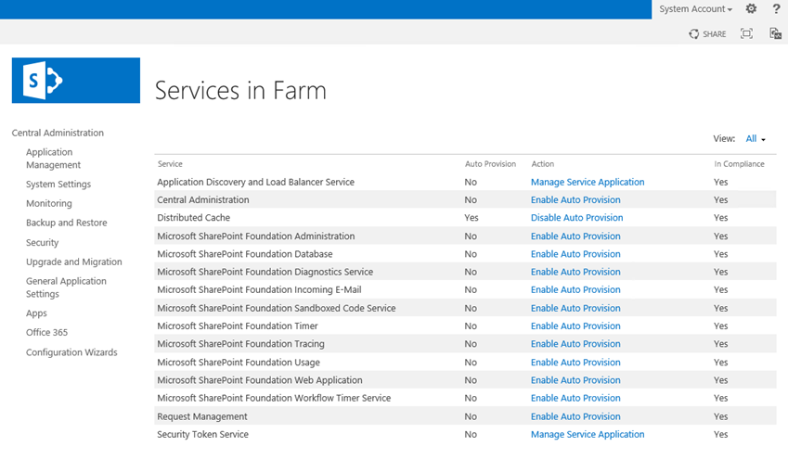
Role Enforcement and Health
SharePoint Health Analyzer for MinRole enforcement
Health rule will scan each server in the farm daily
Scans all roles except for SpecialLoad
Compares Service Instances on server to expected configuration

Slide 21
Demo
MinRole Health

Slide 22
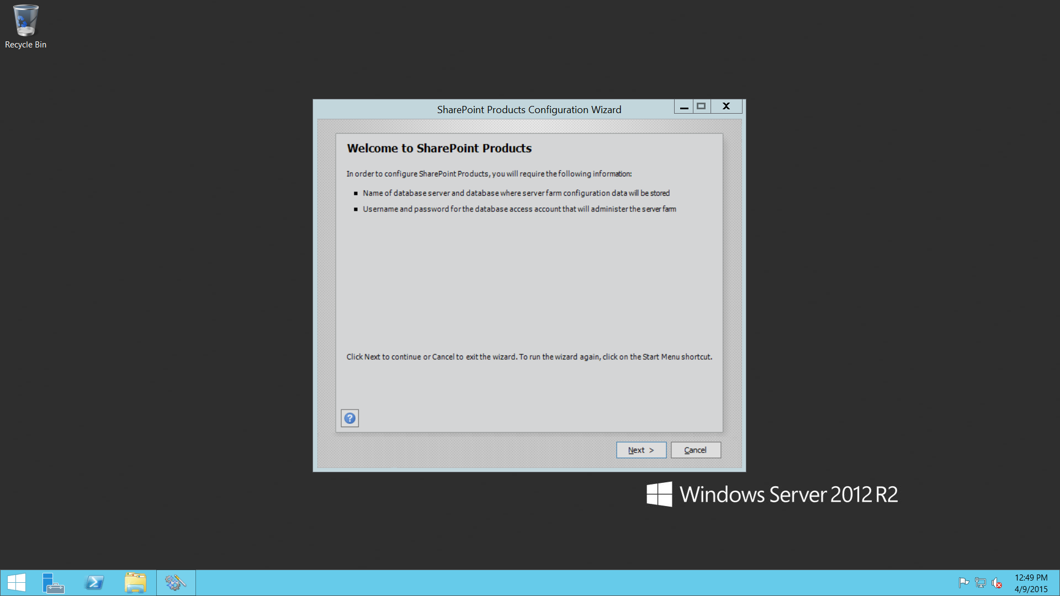
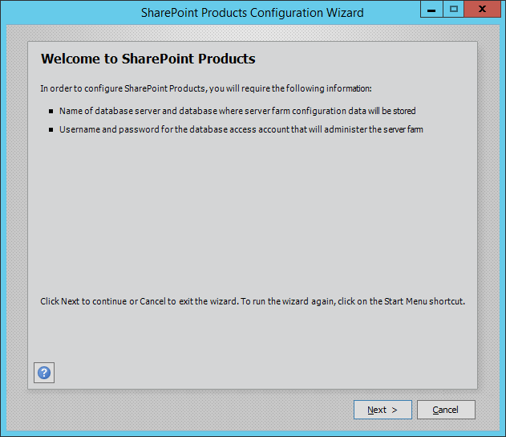
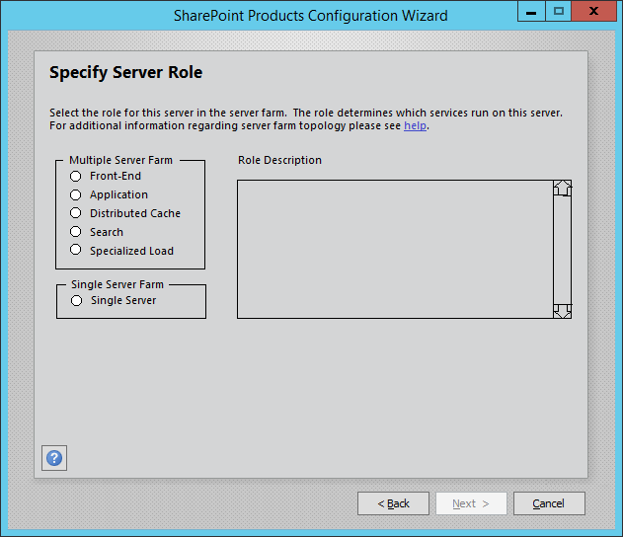
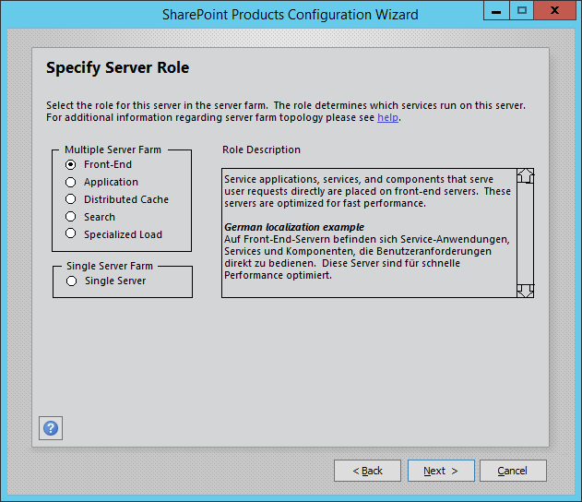
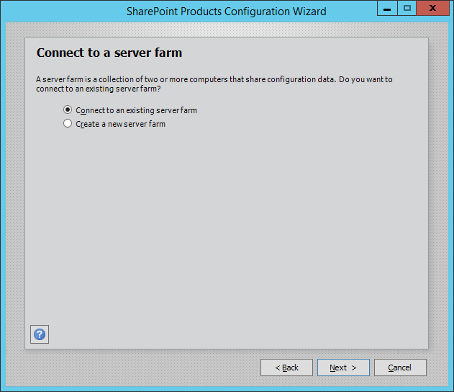
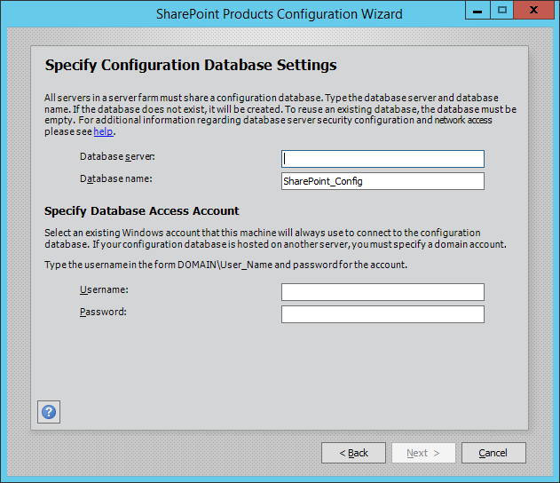
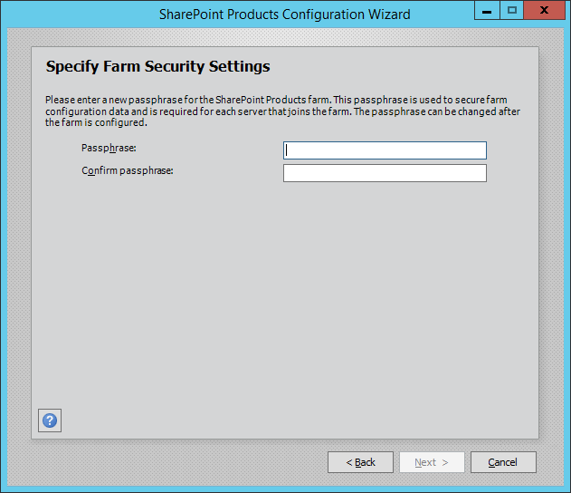
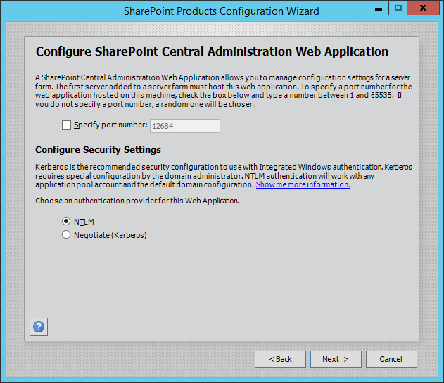
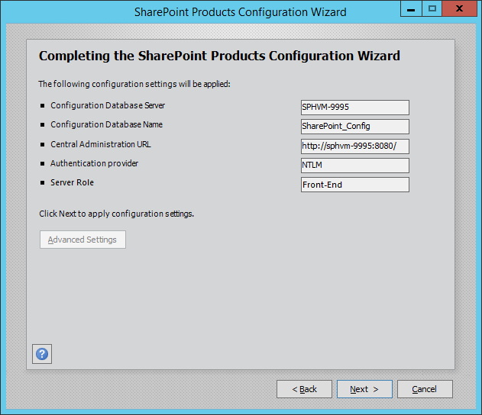
MinRole Walkthrough

Slide 23


Patching
MSI
MSP
Smaller update footprint
  Reduced number of MSI and MSP
  In-place, online, installation

Slide 24
Distributed Cache
SharePoint
Improved performance and reliability
  Support for 4x 9
  More connections
{Transform}
@
How?
speed
Cache Cluster

Slide 25
Boundaries and limits
Content Database Size
Site Collections per Content Database
List Threshold
MaxFile Size
Indexed Items
Content database sizing into TB’s
100,000 site collections per content database
Increased List Threshold >5000
MaxFile Size increases to 10GB and removed character restrictions
2x increase in Search scale to 500 million items

Slide 26
Files Performance
BITS Protocol support
Data
Application
Download
  Byte-range HTTP GETs
Upload
  BITS specific block-based upload protocol
Data
Presentation
HOST LAYERS
Data
Session
Segments
Transport
Packets
Network
MEDIA LAYERS
Frames
Data Link
Bits
Physical

Slide 27
Fast Site Creation
New Logic
Copies Site Collections using SPSite.Copy at Content Database level
Improves site collection creation performance
Implements master copies of Site Collections
Mitigates Feature Activation overhead

Slide 28
Traffic Management
New endpoint running on web servers
Platform Resiliency
Establishes affinity between web servers and load balancers
Improves reliability to allow 4x9’s availability
Isolates requests and provides intelligent routing based on variables (health, servicing, etc.)
Provable health remotely verifies health, can initialize remediation, and provides services for conditional access scenarios

Slide 29
User Profile Service
FIM SYNCHRONIZATION SERVICE
Improved bidirectional synchronization
  Removed built-in FIM Service
  Supports external FIM Service
Unidirectional synchronization provided through native AD synchronization
SharePoint
Auth
AD
Synchronization
FIM Synchronization Service and FIMSyncDB

Slide 30
Project Server
SharePoint Server
PWA
Project Server
WCF Services
Integrated Project Server
  Controlled through server/user licensing
Project Server Interface (PSI)
Project Server Eventing System
Local Event Handlers
Project Server Queuing System
Business Objects
Project Calculation Service
Project Server
Workflow System
Project Database
Content (+Project) Database
Content
Database
Configuration Database

Slide 31



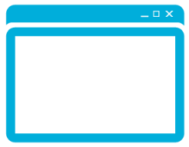
Durable Links
Resource Id based Urls
  Url remains intact with rename and move
  Enables discrete Url on visibility
Cobalt endpoint for getting file for client
Redirect manager: based on this docID, provide the right way to get a doc
URL with SiteID & DocID to WOPI
  …
User clicks docID-based durable URL
GuestAccess.aspx URL for WOPI

Slide 32

Insights and Data

Slide 33
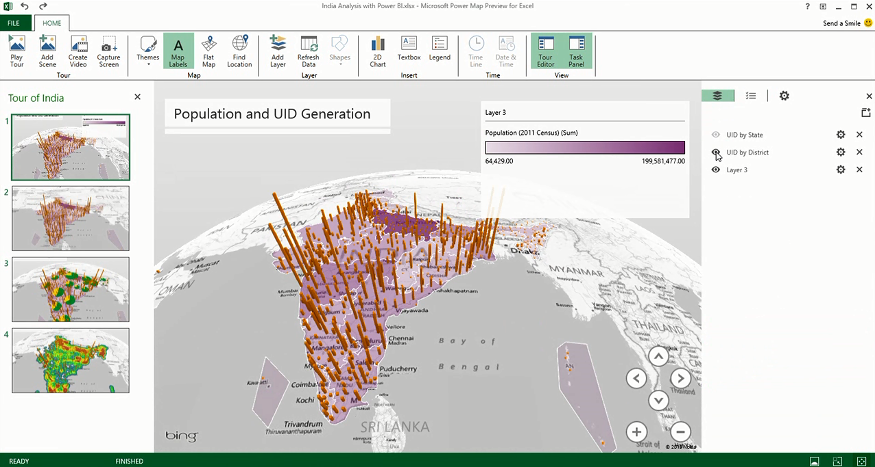

Operations
Real-time telemetry
  Advanced data analysis and reporting
  Real user monitoring
Services
Actions
Usage
Engagement
Diagnostics

Slide 34
Demo
Insights

Slide 35
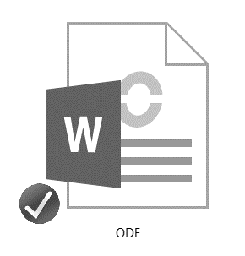
ODF in Document Libraries
Allows creating new files in Doc Libraries and saving as ODF
  Can edit new file with program of choice

Slide 36

Cloud Accelerated
Experiences

Slide 37
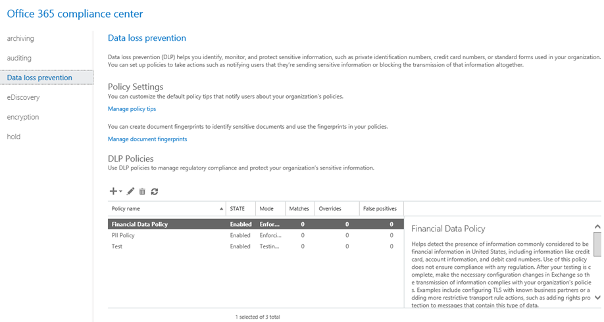
Compliance
Compliance across cloud and on-premises
Identify, monitor & protect sensitive data through deep content analysis
Discover and preserve with eDiscovery
Investigate and prove with auditing

Slide 38
Cloud Search Service Application
Metadata extraction
and processing
Search Service Application for cloud storage
  Unifies on-premises and cloud indexes
  Provides support for Office Graph/Delve experiences on-premises
  Supports Search as a Service / reduces search crawl footprint
Audio text
And search
index
signals
properties

Slide 39
Demo
Cloud Search Service
Application

Slide 40
Extranet
Site publishing
  Publish internal sites to Internet
  Leverages Office 365 identity federation services

Slide 41
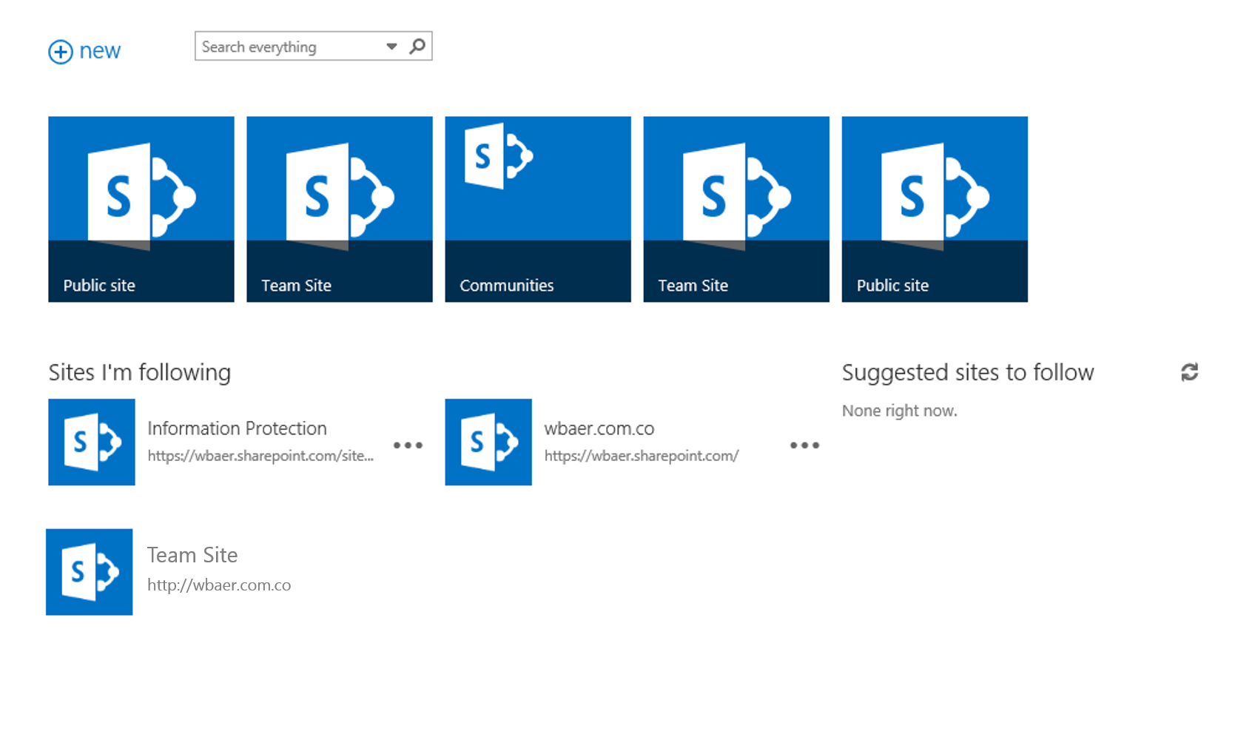
Team Sites
SharePoint 2016 and Office 365 distributed sites
Follow Sites, Documents, and People across on-premises and cloud (documents are mastered in Office 365)
Managed Metadata
Promoted Sites
Self-service site creation across on-premises and cloud

Slide 42
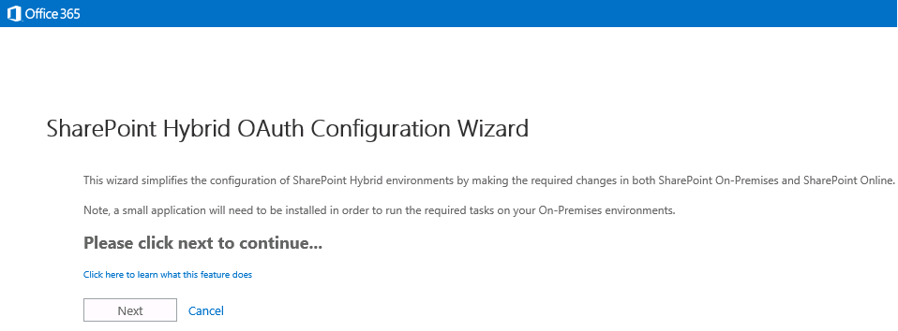
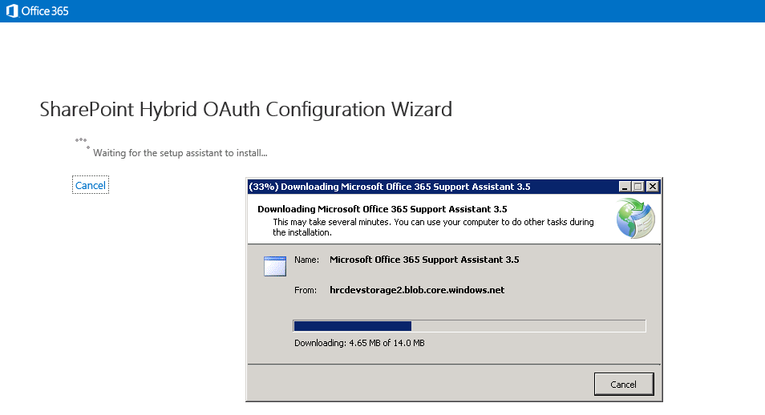
Scenario Picker
Hybrid deployment automation
Enables scenario selection (I.e. Search, OneDrive for Business, etc.)
Automated configuration of prerequisites and core infrastructure
UI-based configuration

Slide 43
Summary
SharePoint Server 2016 is:
a comprehensive solution for connected information work
that preserves structured processes, compliance, IT investment
optimized for the way people work
through an easily-managed and integrated platform

Slide 44
Q & A

