Slide 2
Yammer for Team Collaboration
Lindsay Matthews, Senior Product Manager
Jay Sethna, Product Marketing Manager

Slide 3
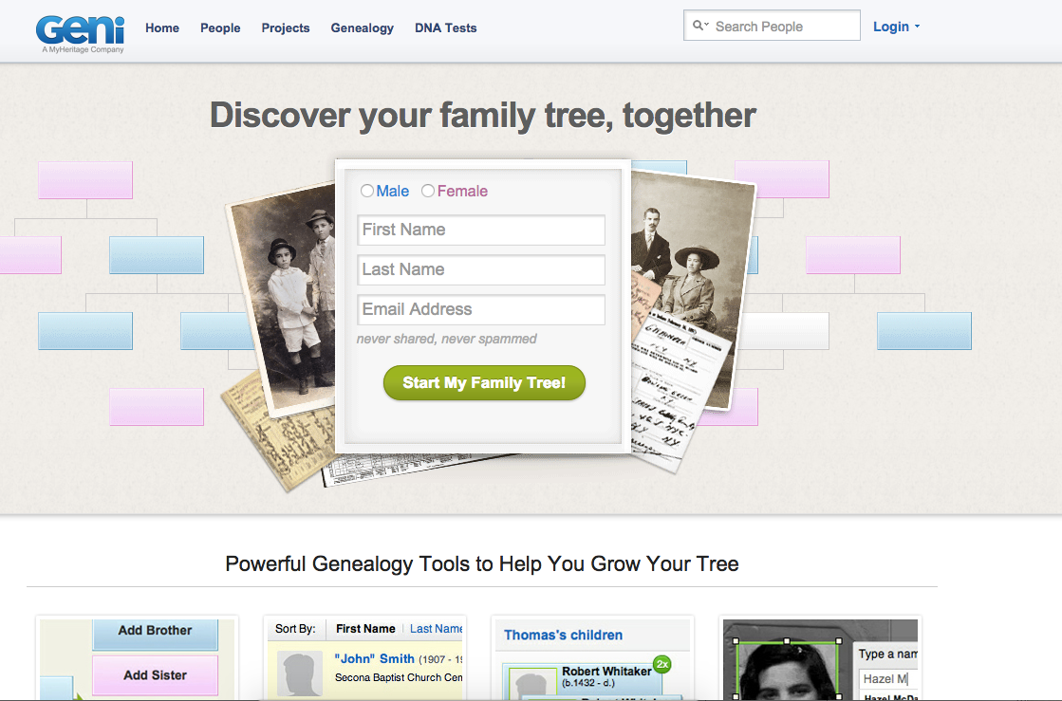

Slide 4
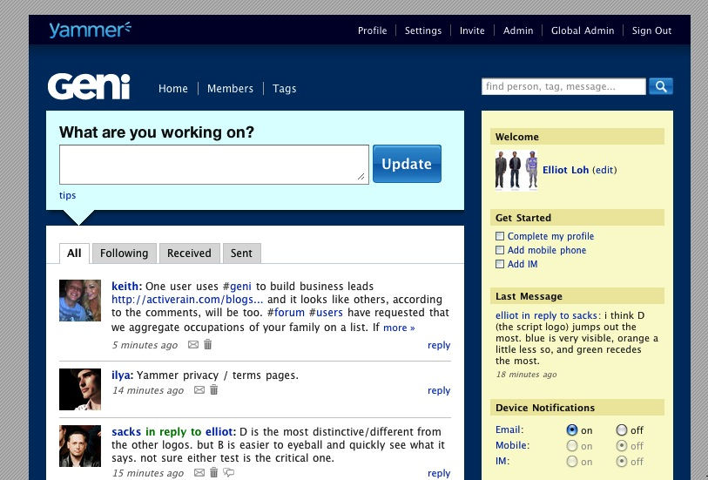

Slide 5
What is a team?

Slide 6
Create teams for any and every reason

Slide 9
Yammer for teamwork
Bring your team together
Work smarter & faster
Scale your impact

Slide 10
Demo

Slide 11
Yammer for teamwork
Bring your team together
Work smarter & faster
Scale your impact
Connect with others in your organization
Create a group within seconds
Stay connected across time zones and devices
Centralize conversations, collaborate on files, and more

Slide 12
Demo

Slide 13
Yammer for teamwork
Bring your team together
Work smarter & faster
Scale your impact
Keep everyone on the same page
Extend conversations beyond your organization
A destination to work. One place to find answers and experts

Slide 14
Demo

Slide 15
Yammer for teamwork
Bring your team together
Work smarter & faster
Scale your impact
Share your knowledge across your company
Make your work go further
Discover information to help me make better decisions

Slide 16
Bring your team together

Slide 17
Work smarter and faster in teams

Slide 18
The Social Journey
Define Your Vision & Priorities
Evaluate, Adapt, & Iterate
Identify Business Outcomes
Launch and Drive Success
Plan to Work Social

Slide 19
Next Steps
1
Sign up for Yammer at www.yammer.com
2
Start a group based off a topic, project, or locality
3
Connect with customers and hear the latest updated in the O365 Network

Slide 20
Any questions?

Slide 21
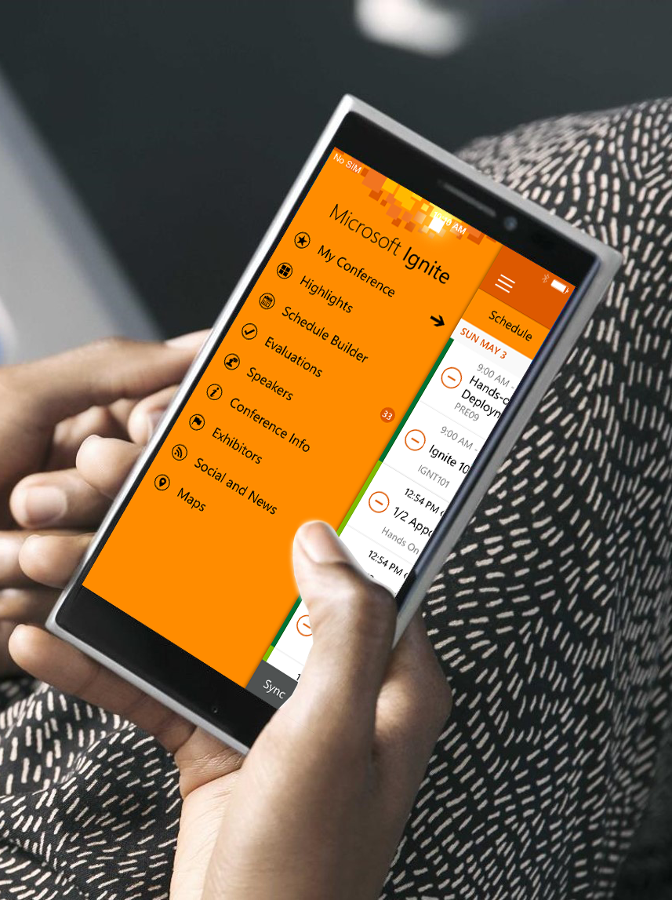
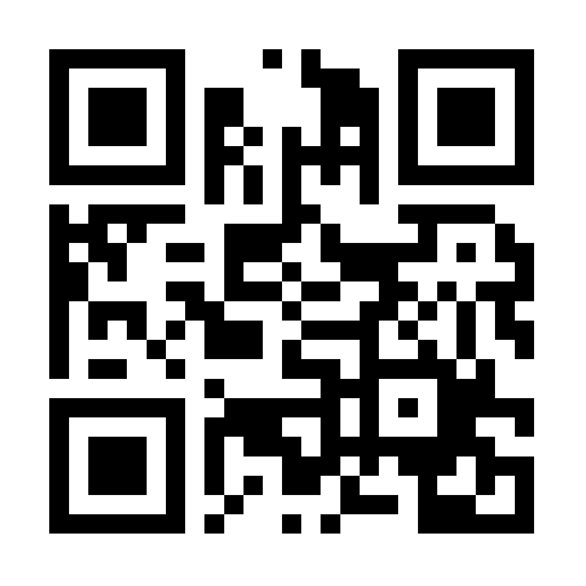
Please evaluate this session
Your feedback is important to us!
Visit Myignite at http://myignite.microsoft.com or download and use the Ignite Mobile App with the QR code above.

Slide 23
Appendix

Slide 24
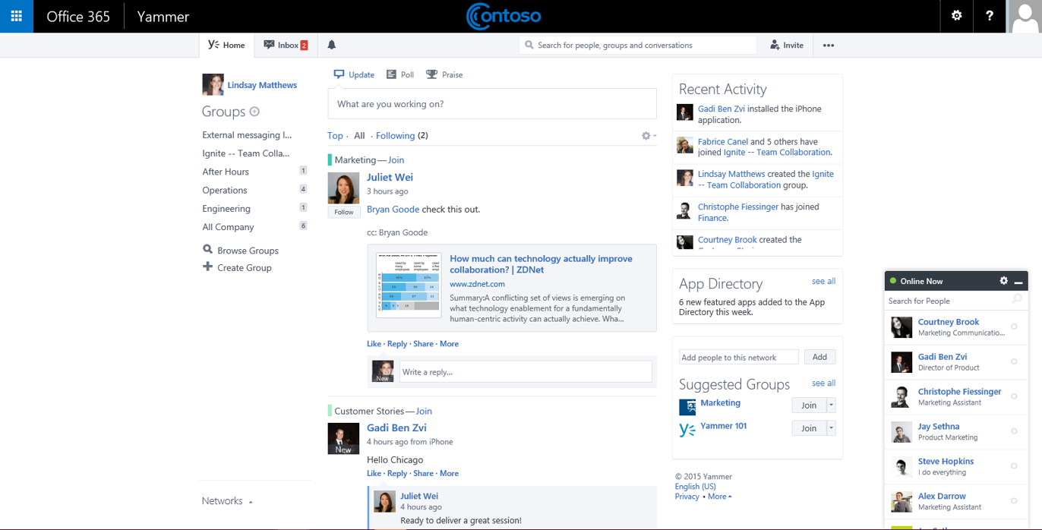

Slide 25
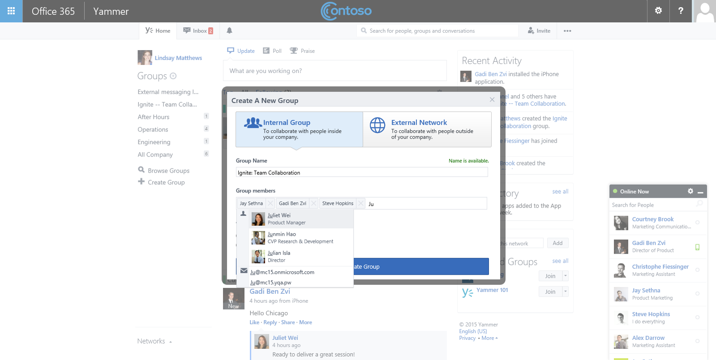

Slide 26
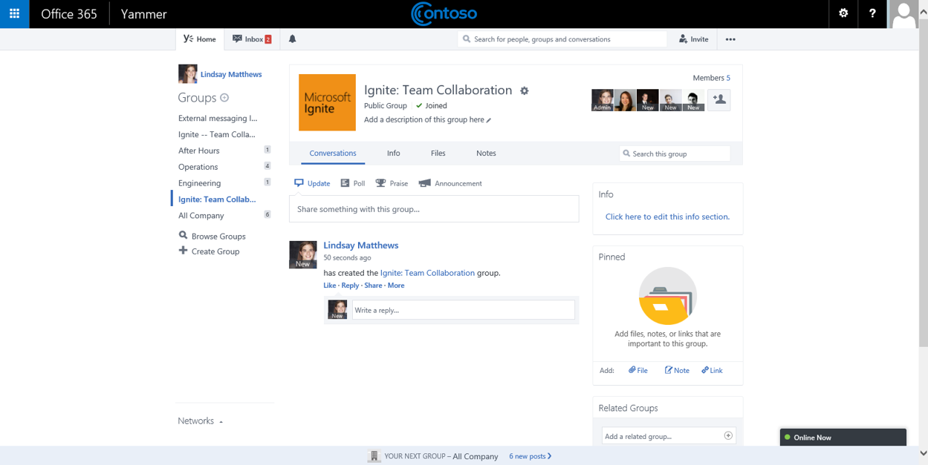

Slide 27
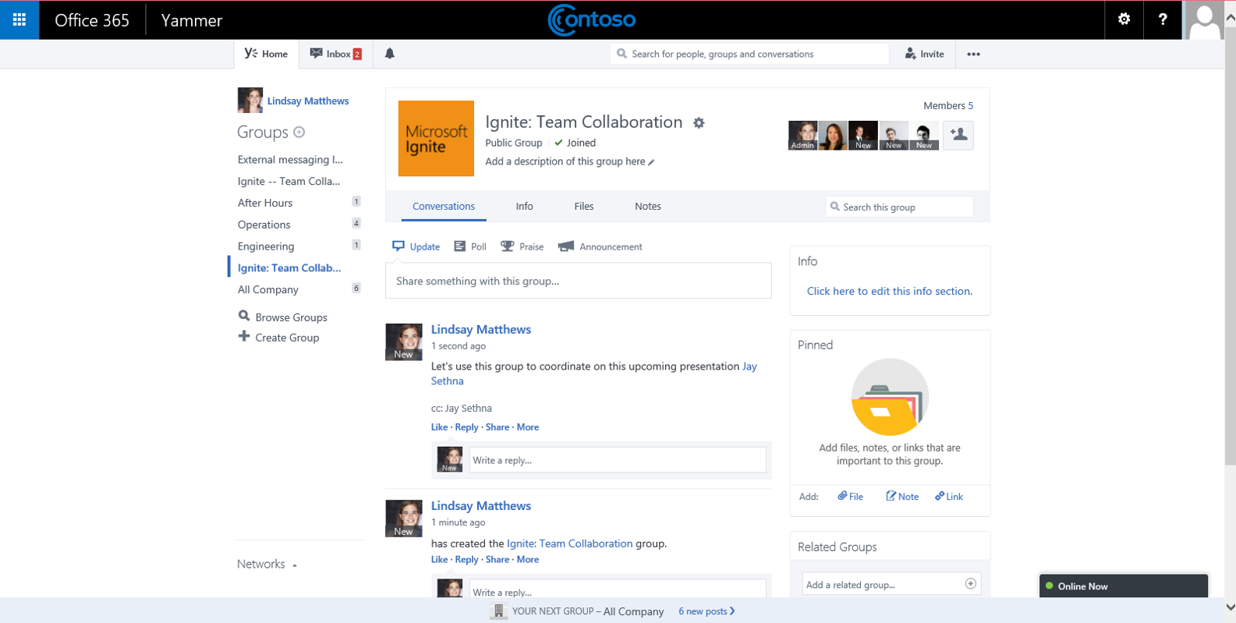

Slide 28
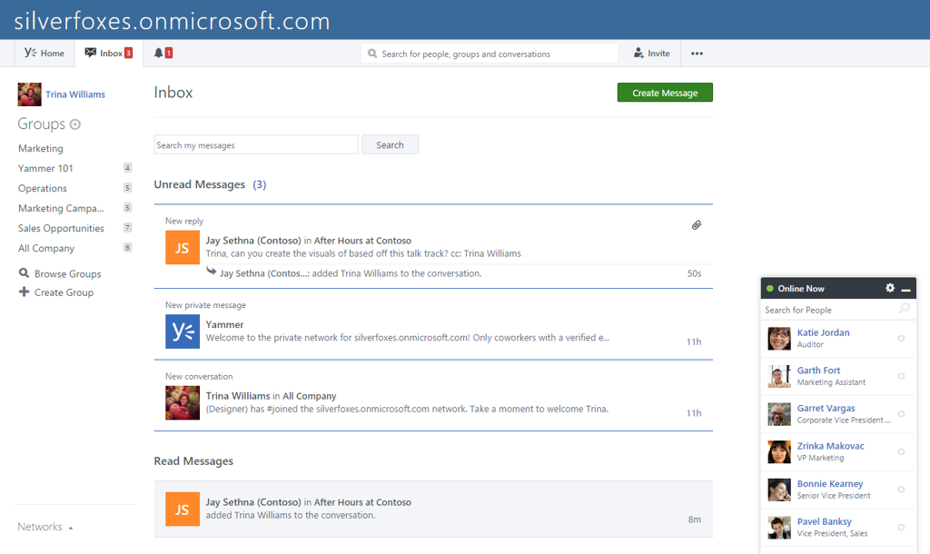
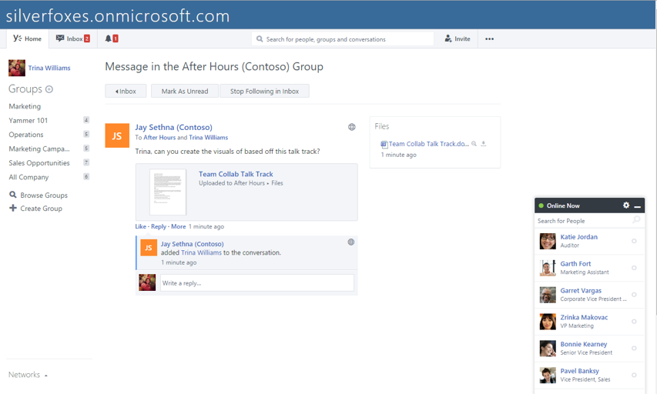
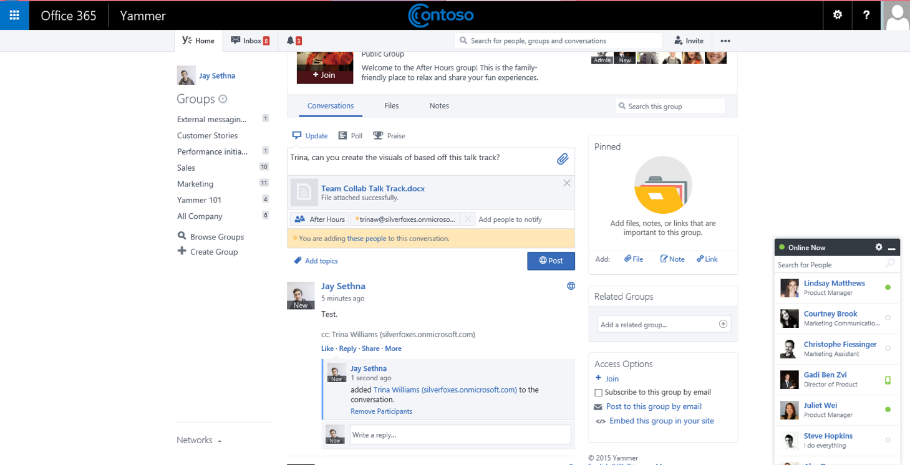
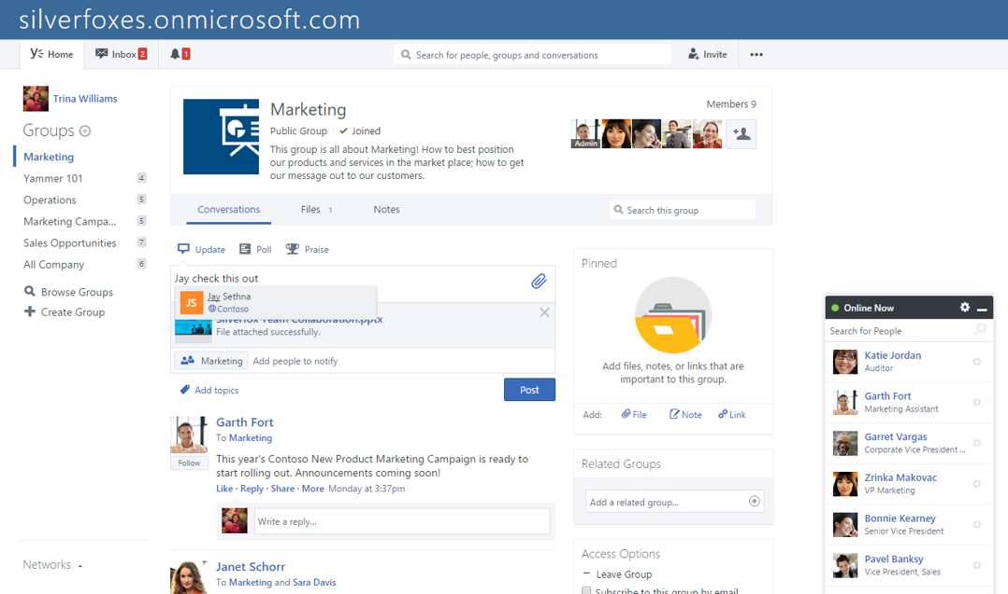

Slide 29
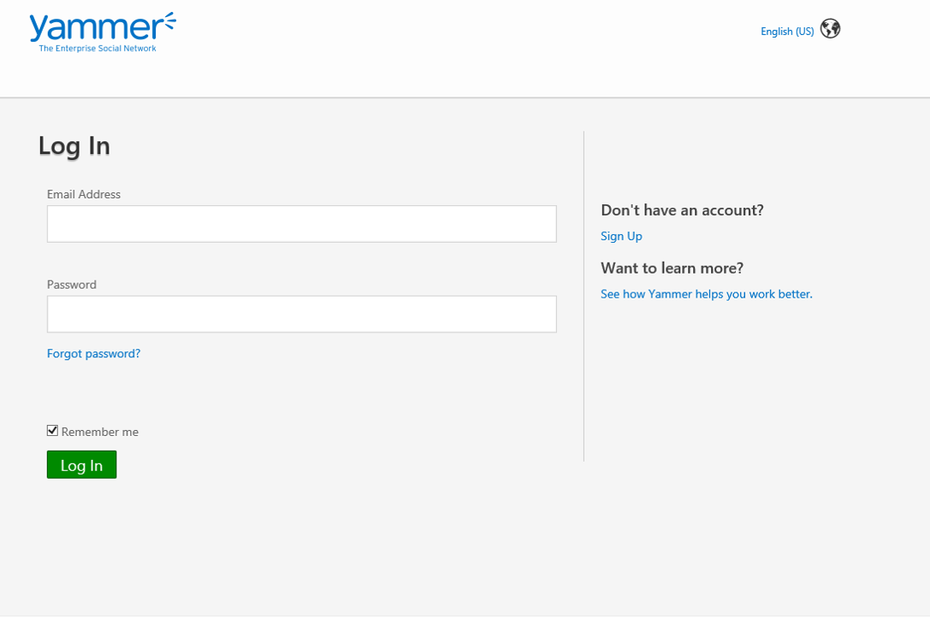
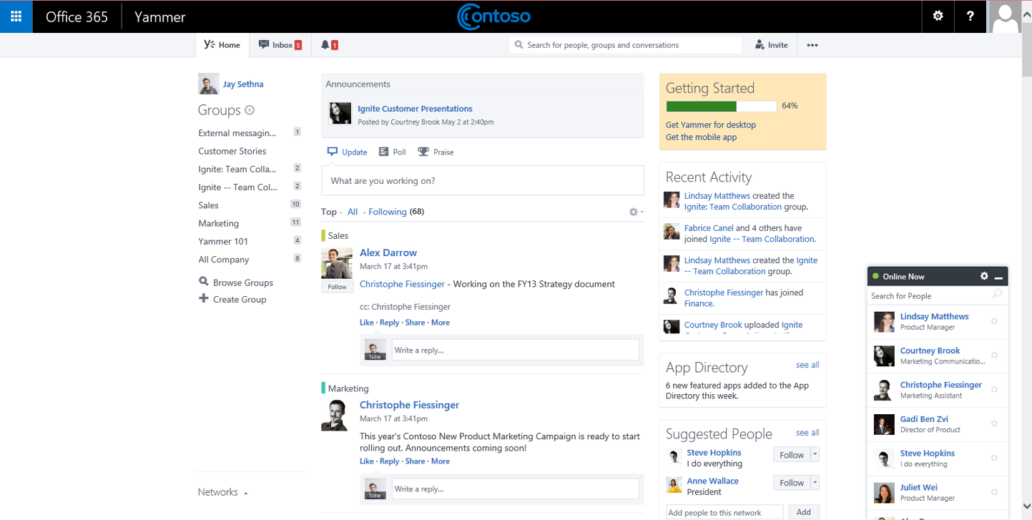
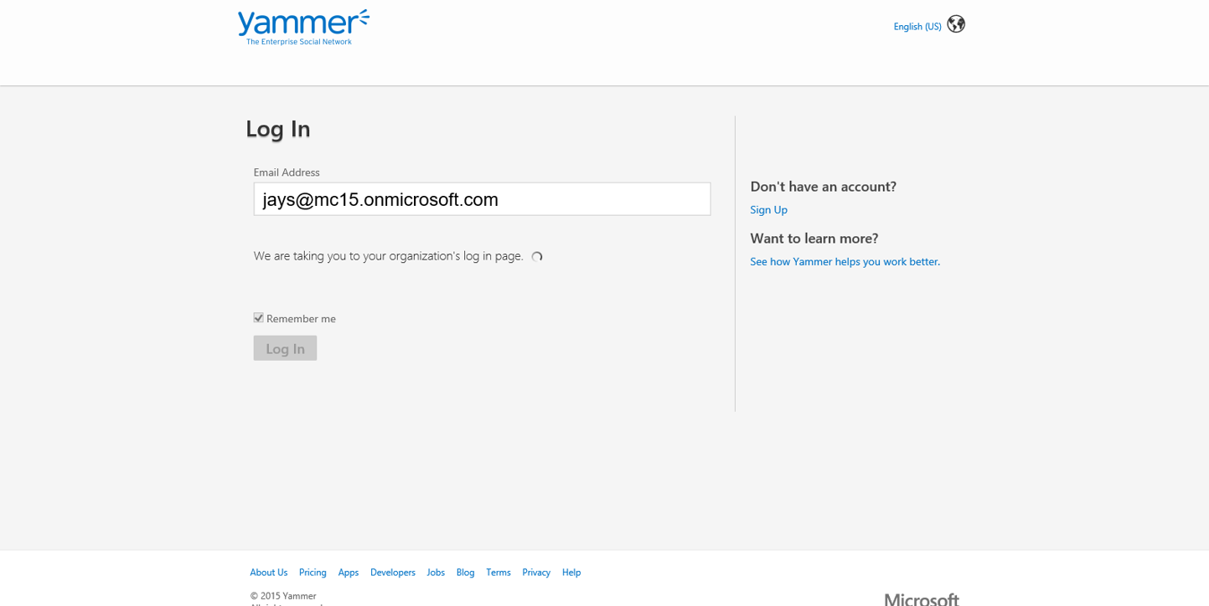
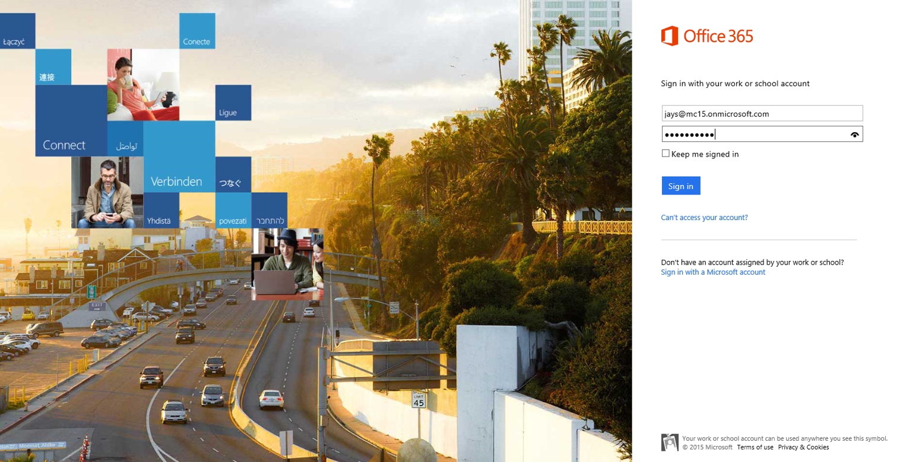

Slide 30
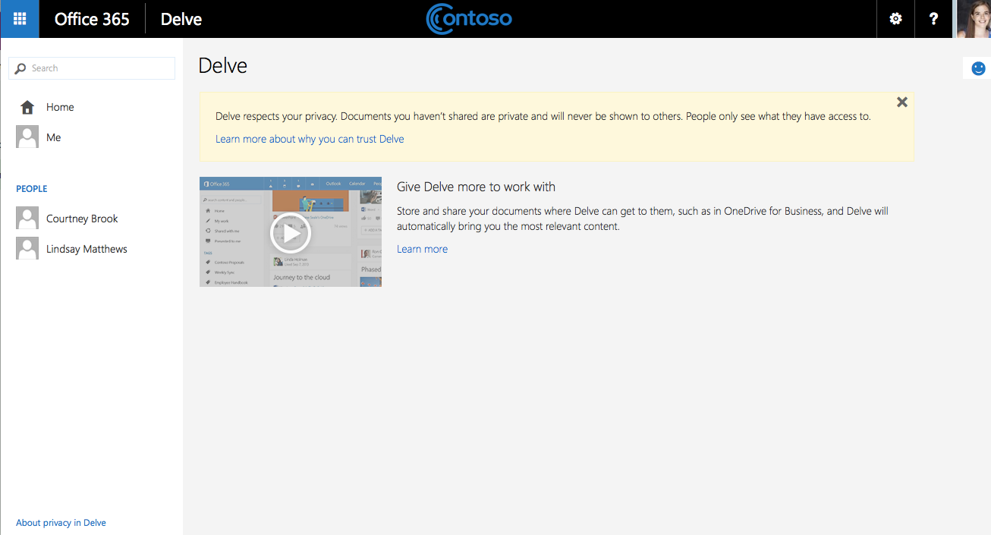

Slide 31
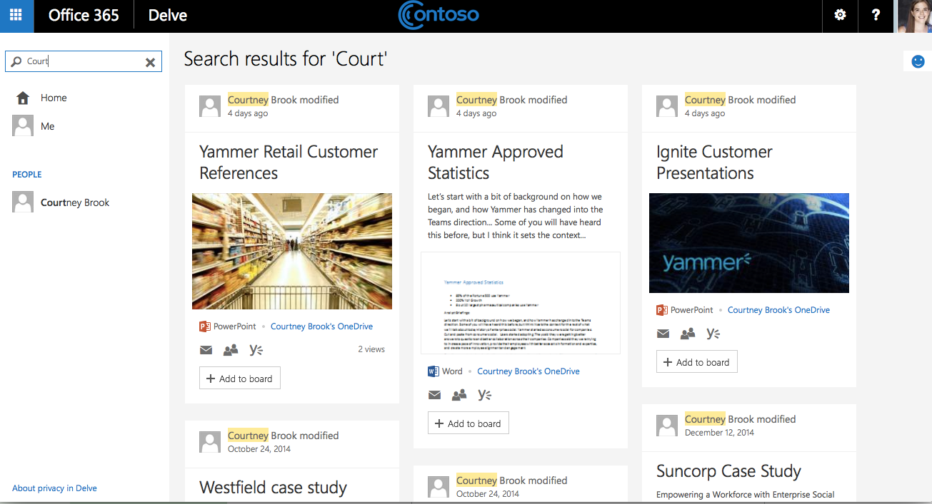

Slide 32
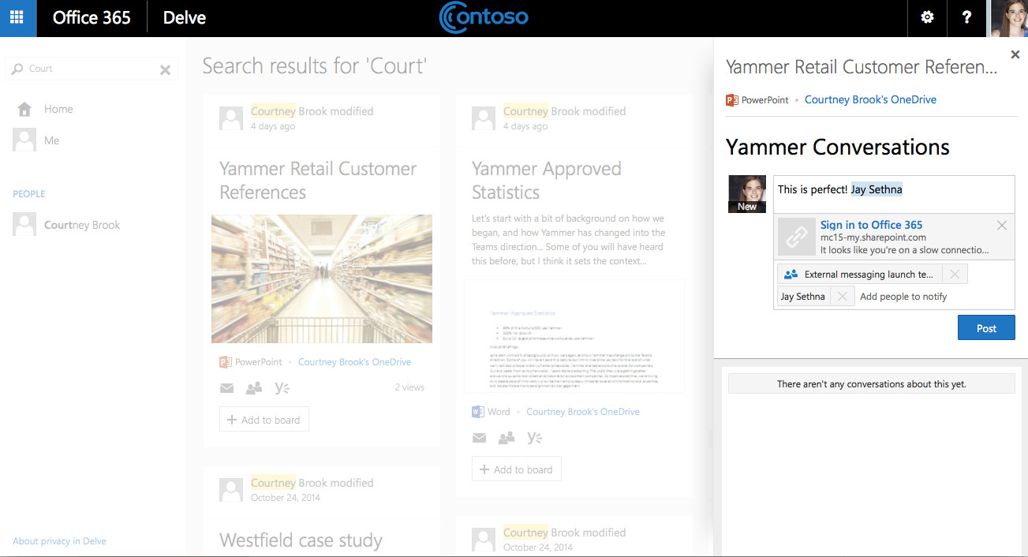

Slide 33
