Slide 2
Office 365 ProPlus Deployment and Management Update
BRK2207
Amesh Mansukhani
The Office for Enterprise Deployment Guy
@ameshm

Slide 3




MODERN PRODUCTIVITY

Slide 4




OFFICE
AT THE CENTER OF PRODUCTIVITY
Email and calendaring
File storage and sharing, sites and workflows
Messaging,
voice, presence and meetings
Social collaboration
ProPlus

Slide 5

What we are hearing from you about adoption
CHALLENGES
We:
are concerned upgrades may break critical line-of-business apps
need sufficient time to test
need more notification to plan
need better update & activation management tools
need better network traffic management
Our:
deployments are complex and expensive
key software vendors need time to test & issue statements of support

Slide 6
What we are hearing from you about adoption
Coming soon…
Better network traffic management
Enhanced distribution management
Flexible update management
Simplified activation management

Slide 7
Better network traffic management

Slide 8
What we are hearing from you about adoption
CHALLENGES
We:
are concerned upgrades may break critical line-of-business apps
need sufficient time to test
need more notification to plan
need better update & activation management tools
need better network traffic management
Our:
deployments are complex and expensive
key software vendors need time to test & issue statements of support

Slide 9

Better network traffic management
Announcing (BITS) integration
Lowers download priority for Office updates when other
protocols are being used on the desktop
Enabled from the any source locations (e.g., Office CDN,
distribution points or file share)

Slide 10
Enhanced distribution management

Slide 11
What we are hearing from you about adoption
CHALLENGES
We:
are concerned upgrades may break critical line-of-business apps
need sufficient time to test
need more notification to plan
need better update & activation management tools
need better network traffic management
Our:
deployments are complex and expensive
key software vendors need time to test & issue statements of support

Slide 12
Enhanced Distribution through Better Integration with SCCM
 | SCCM 2016 | SCCM 2012 | SCCM 2007
Support for Applications Mode | ✓ | ✓ | ✗
Maintenance Windows | ✓ | ✓ | ✗
Maximum run time | ✓ | ✓ | ✗
Installation deadline | ✓ | ✓ | ✗
Software available times | ✓ | ✓ | ✗
Support for Distribution Mode | ✓ | ✗* | ✗
Download from Distribution Point | ✓ | ✗* | ✗
Find nearest Distribution Points | ✓ | ✗* | ✗
WSUS notifications | ✓ | ✗ | ✗
Support for Packages & Programs | ✗ | ✗ | ✗
* Current under investigation

Slide 13
Flexible update management

Slide 14
What we are hearing from you about adoption
CHALLENGES
We:
are concerned upgrades may break critical line-of-business apps
need sufficient time to test
need more notification to plan
need better update & activation management tools
need better network traffic management
Our:
deployments are complex and expensive
key software vendors need time to test & issue statements of support

Slide 15

Introducing Office Deferred Updates
Feature updates consolidated and delivered 3 time/year
Preview and validate feature updates up to 4 months prior to delivery
Continuous Security updates delivered monthly

Slide 16
Market driven quality
Early Adopters
Current Branch
Deferred Branch
Your Users
100’s
of millions
Ensures insight into upcoming features
10’s
of millions
Build vetted through market adoption and feedback
100’s of thousands
Enables IT and ISVs to have early access and validate builds against LOB apps
Builds deployed using existing software deployment solutions
Time

Slide 17
Current Branch
Customer experience
Features are released to broad market
Customers are up to date with features as they are released after broad early adopter validation
Opportunity for enterprises to test and validate new features
Security updates and fixes
are delivered regularly
jan
feb
mar
apr
may
jun
jul
aug
sep
oct
nov
dec
Time
Dates are for illustration purposes only

Slide 18
Deferred Branch
Customer experience
Features are delivered 3 time/year
Security updates are delivered regularly for 4 months
Business customers on auto-update will be moved to a new branch
Business customers can wait to receive feature updates for an additional 4 months, providing access to two branches
Validation builds are stabilized and available for testing 4 months prior to declaring as deferred branch
DB3
DB2
DB1
jan
feb
mar
apr
may
jun
jul
aug
sep
oct
nov
dec
Time
Feature update
Security update
Extended support
Dates are for illustration purposes only

Slide 19
Aligning Office & Windows 10
Better together
 | “Current Branch” |  | “Deferred Branch”
Features | 1 branch in market at a time Monthly features, bug fixes and security patches |  | 2 branches available (subsequent branch overlaps availability of preceding branch) Regular security updates
Availability | 2-3 times a year | monthly | 2-3 times a year | 3 times a year
Serviceability | ~4 months | 12 months | 4 months | 4-8 months
Deployment Technology | Windows Update Windows Update for Business WSUS | System Center Configuration Manager Microsoft Intune 3rd party software deployment tools | Windows Update for Business WSUS | System Center Configuration Manager Microsoft Intune 3rd party software deployment tools

Slide 20

What about Special Systems?
Office Volume Licensing
No new functionality due to environmental challenges
But security updates are a must
Deployed and updated via traditional MSI packages
Examples:
Air Traffic Control,
Emergency Rooms
Oil Refineries

Slide 21
Office as a Service Lifecycle
Branch
Features
Scenarios
Serviceability
Support
Current Branch
Sales force
BYOD
Test systems
Available monthly
Regular security updates & bug fixes
1 branch in market at a time
Consume via Office CDN or existing software distribution method (e.g. SCCM, File share, etc.)
30 days
security and bug fixes
12 months
Deferred Branch
Feature available 3 time /year
Regular security updates
2 branches available simultaneously
Consume via Office CDN or existing software distribution method (e.g. SCCM, File share, etc.)
Knowledge Workers
Salesforce
Road warriors
4 months mainstream support
4 months extended support
Security only updates
8 months
Office Volume Licensing*
Factory floor machines
Air Traffic Controllers
Emergency Room devices
No new features available during lifecycle
Regular security updates
Consume via Volume Licensing
5 years for mainstream support
5 years for extended support
5 years for mainstream support
5 years for extended support
*available through perpetual purchase

Slide 22
Simplified activation management

Slide 23
What we are hearing from you about adoption
CHALLENGES
We:
are concerned upgrades may break critical line-of-business apps
need sufficient time to test
need more notification to plan
need better update & activation management tools
need better network traffic management
Our:
deployments are complex and expensive
key software vendors need time to test & issue statements of support

Slide 24
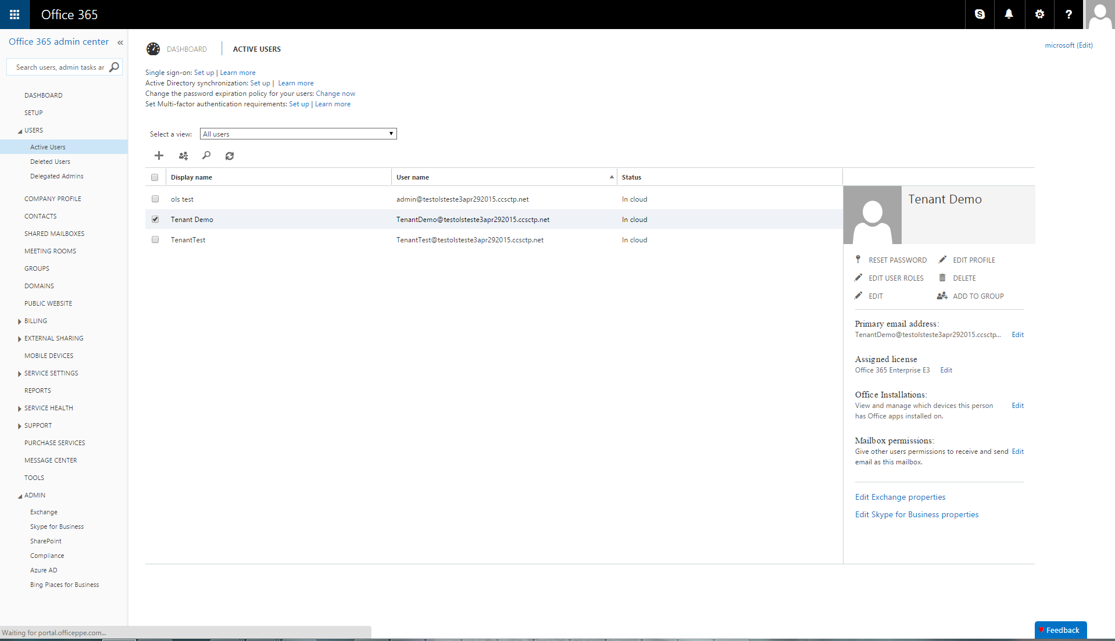

Slide 25
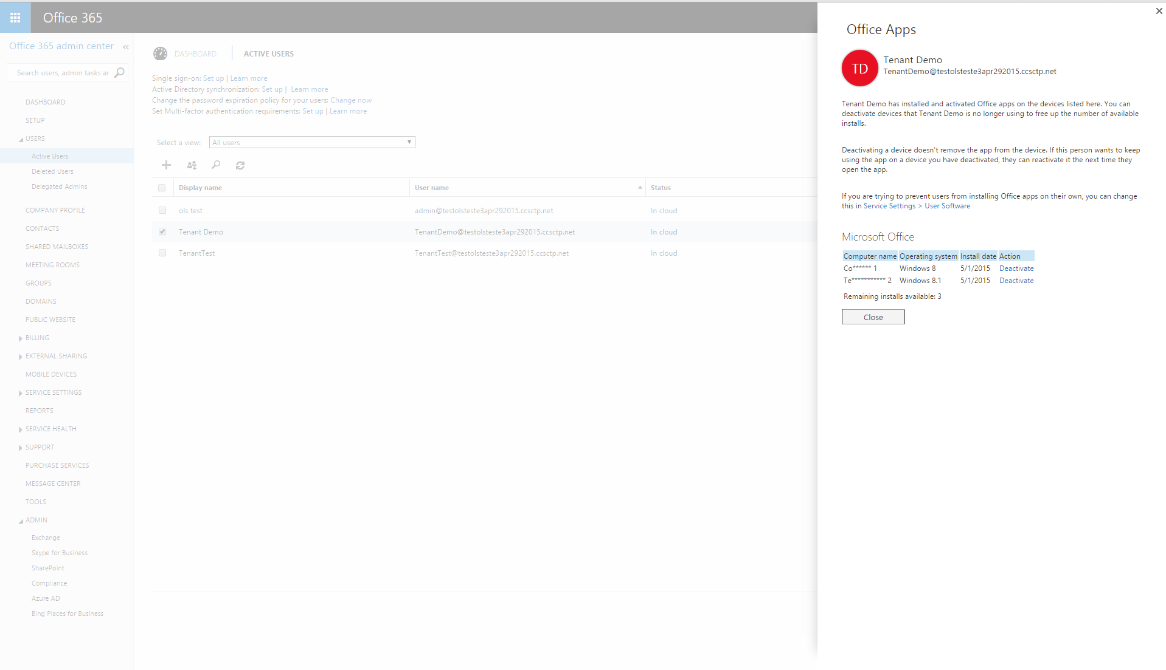
TD
Computer Names are obfuscated for privacy
Operating system and installation dates are displayed
Remaining activations are shown
Information is provided for Office, Visio & Project Online

Slide 26
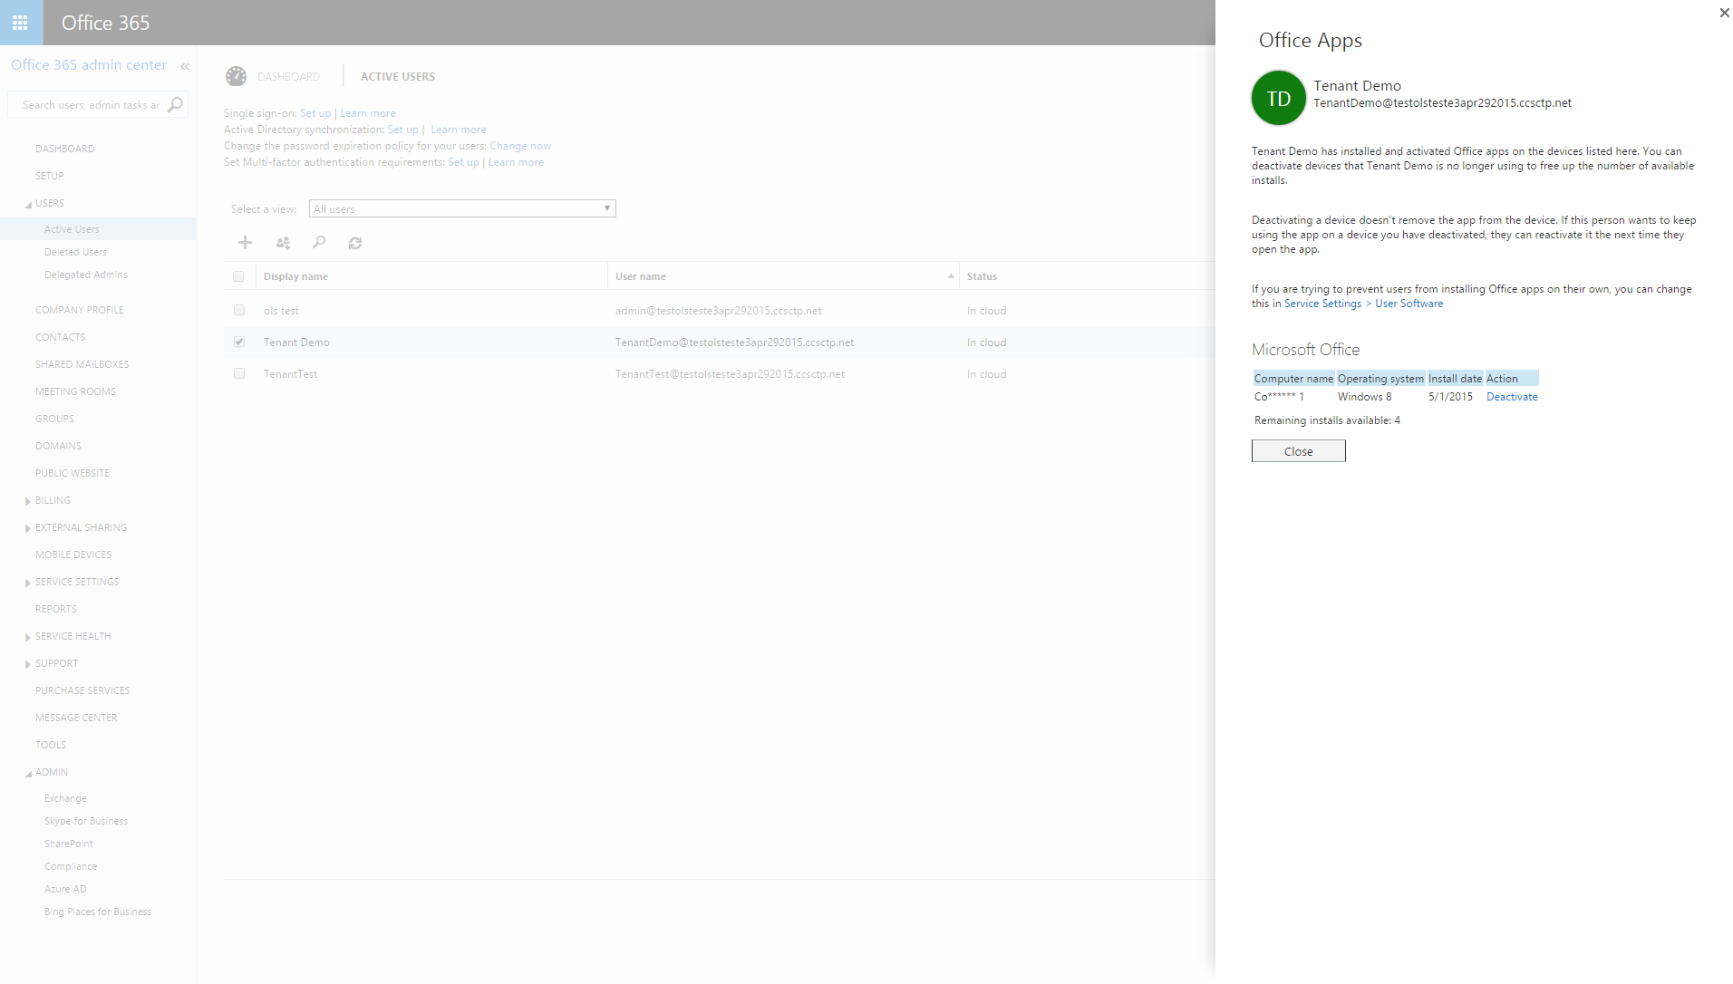

Slide 27

Next Steps
Download the Office 2016 Preview
  Test your update strategy
  Test your LOB apps for compatibility

Slide 28


Please evaluate this session
Your feedback is important to us!
Visit Myignite at http://myignite.microsoft.com
or download and use the Ignite Mobile App
with the QR code above.

