Slide 2
Build Line of Business Applications with Microsoft Dynamics
BRK2309
Luis Camino
Technical Product Marketing Manager
Mike Carter
Sr. Program Manager
Interact with us!
Real-Time Pulse Voting
https://pulse.bing.com/app/Dynamics/BRK2309

Slide 3
Build Line of Business Applications with Microsoft Dynamics
Luis Camino
Technical Product Marketing Manager
Mike Carter
Sr. Program Manager
Interact with us!
Real-Time Pulse Voting
http://aka.ms/BRK2309

Slide 4
Agenda
Poll
Interact with us! Real-Time Pulse Voting
https://pulse.bing.com/app/Dynamics/BRK2309
Overview
Microsoft Dynamics
Demo
Giving Campaign Management App Overview
Demo
Giving Campaign Management App Deconstruction
Future
What’s Next?
Q&A
Submit your questions on Twitter #MSIgnite #BRK2309

Slide 5
Key Takeaways
Simple
Familiar
Immersive
Powerful

Slide 6
Overview
Microsoft Dynamics

Slide 7
In a mobile-first, cloud-first era, Microsoft delivers the Cloud for Business
Individual Productivity
Microsoft Dynamics
Business Solutions
Microsoft Azure
Flexible Cloud Platform
GLOBAL-CLASS
|
FLEXIBLE BY DESIGN
|
PEOPLE-FOCUSED

Slide 8
Business Solutions
ERP
SALES
SERVICE
MARKETING
SOCIAL
PLATFORM (xRM)
CUSTOMER ENGAGEMENT

Slide 9
Business Activities of Companies Today
Marketing
Human Resources
Sales
Finance
Customer Service
Engineering
Operations

Slide 10
Line of Business Activities of Companies Today
Customer
Constituent
Donor
Associate
Member
Partner
Vendor
Distributor
Agent
Volunteer
Dealer
Alumni
Tenant
Client
Fan
…
RELATIONSHIP MANAGEMENT
PROCESS AUTOMATION
Appointments
Tasks
Touch Points
Requests
Profile Updates
Reminders
Notifications
…
INTERACTION TRACKING
Events
Facilities
Grants
Property
Products
Services
…
LOB MANAGEMENT

Slide 11
Giving Campaign Application Needs
Themed
Personalized
Configurable
Social & Collaborative
Mobile Ready
Customizable Search
Secured
Analytical
Simple
Familiar
Immersive
Powerful

Slide 12
What we’ll cover in this demo segment
Theming
Customize theme to your company’s brand; have multiple themes
Personalization
Profile, Picture, My Stuff, My Data
Navigation & Visualizations
Quick Create, Menu Navigation, Hierarchical Visualizations
Search
Click and Configure data to be searched.
Office 365 Integration
Increase productivity of your app with immersive Excel, OneNote, and Office 365 Groups for sharing and collaboration.
Mobility
No limits! Offline, OneNote
Integrations
UI Mashups, Social Collaboration
Simple
Familiar
Immersive
Powerful

Slide 13
Demo Giving Campaign
Luis Camino

Slide 14
Key Capabilities
Model Driven Design
Robust Security
Business Rules Designer
Processes & Workflow Automation Designer
Access Anywhere
Multi-Language
⬥
MANAGE
Collaboration & Communication Ready
Hierarchy Visualizations
Calculated Fields, Rollup Fields
Search
Offline Capabilities
Localization
❖
INTEGRATE
Mobile
Social
Insight
◆
BUILD
xRM Platform

Slide 15
Key Capabilities
⬥
MANAGE
Standards Based - oData REST API
Mashup Ready
Standards Based – Authentication (oAuth)
Bulk Data API - Import
Mobile SDK
❖
INTEGRATE
◆
BUILD
Mobile
Social
Insight
xRM Platform

Slide 16
Key Capabilities
Central Management Portal
Solution Versioning
Sandbox Environments
Deployment Choices
Data Access and Management API
Scalable
Maintainable
Upgradeable on your terms
⬥
MANAGE
❖
INTEGRATE
◆
BUILD
Mobile
Social
Insight
xRM Platform

Slide 17
Demo xRM Customization
Mike Carter

Slide 18
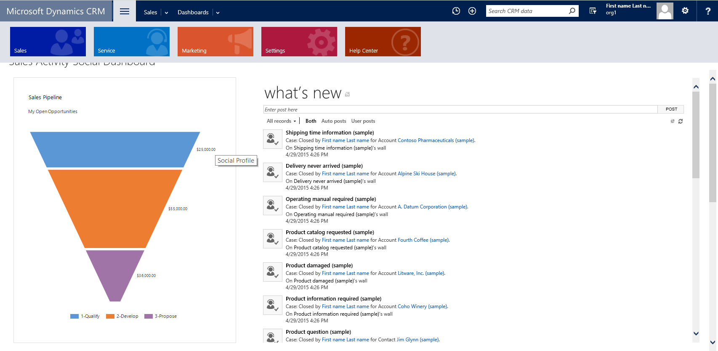
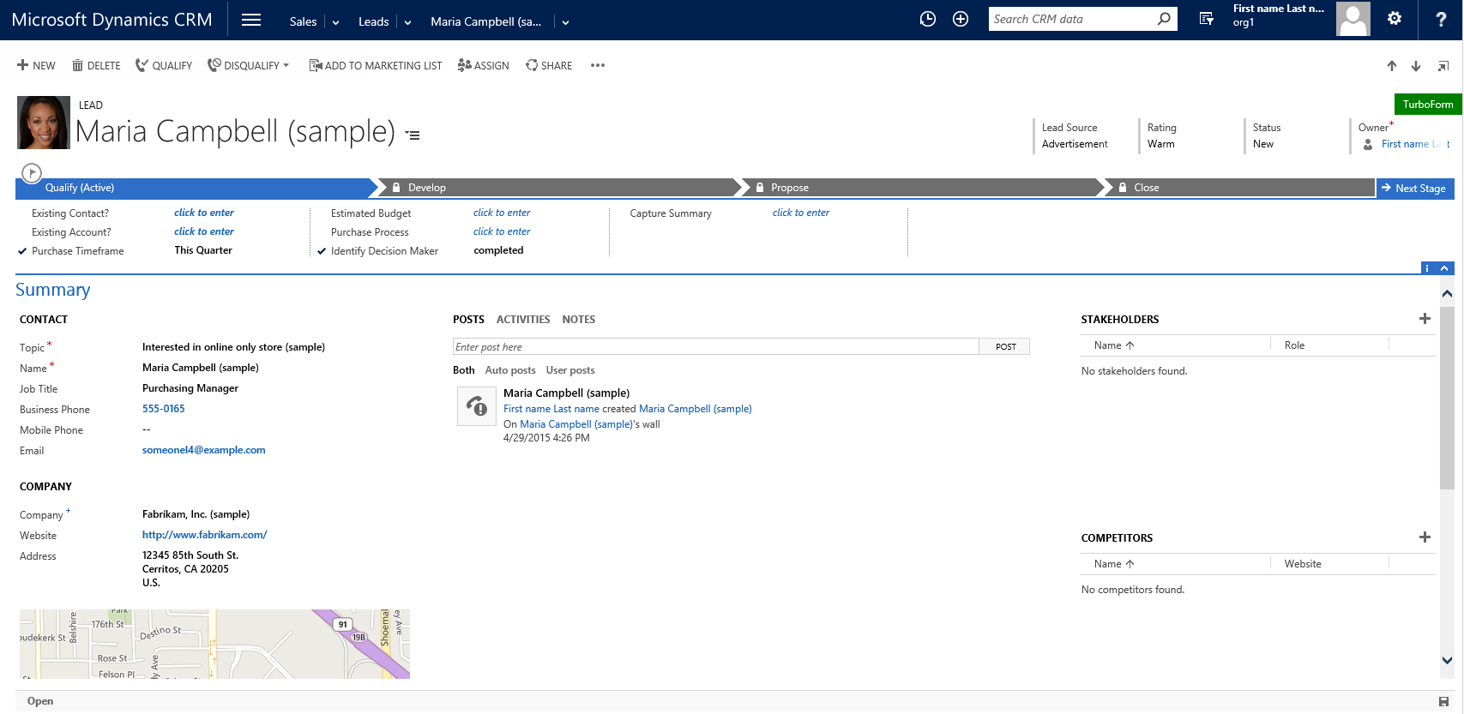
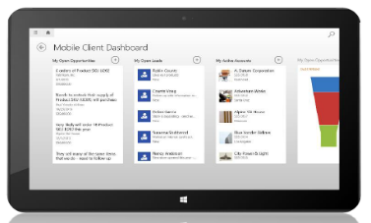
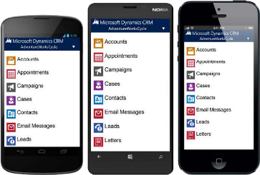
xRM Highlights
Entity, Fields & Relationships
Processes
Business Rules
Workflow
Custom Code
Forms
Finished Application
Model-driven Extensible Rapid Application Development Platform for the Business User
Open .NET based coding extensions for Increased Developer effectiveness with the power of all MS Tools
Backed by a Scalable, Secure Microsoft Cloud
Low TCO

Slide 19
The road ahead…
xRM
Search
Solutions

Slide 20
Thank you! Submit Questions on Twitter #MSIgnite #BRK2309

Slide 21
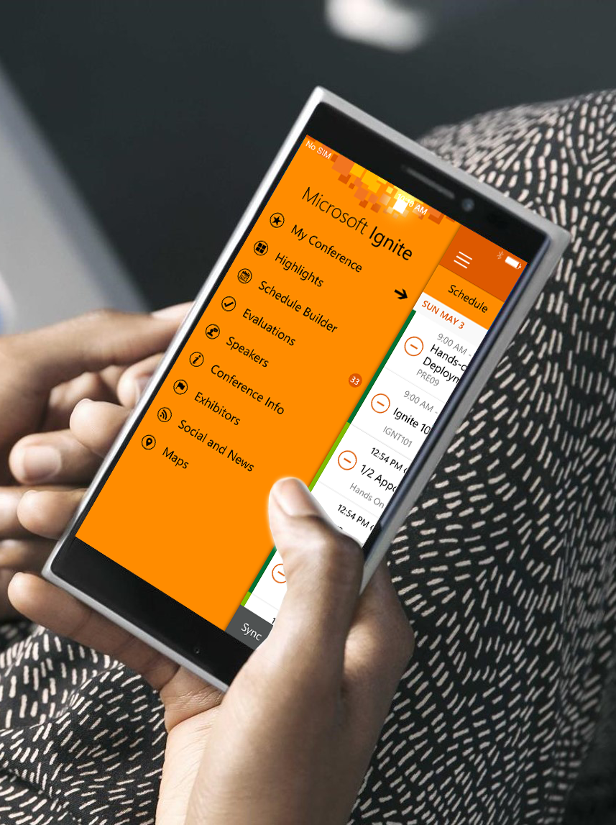
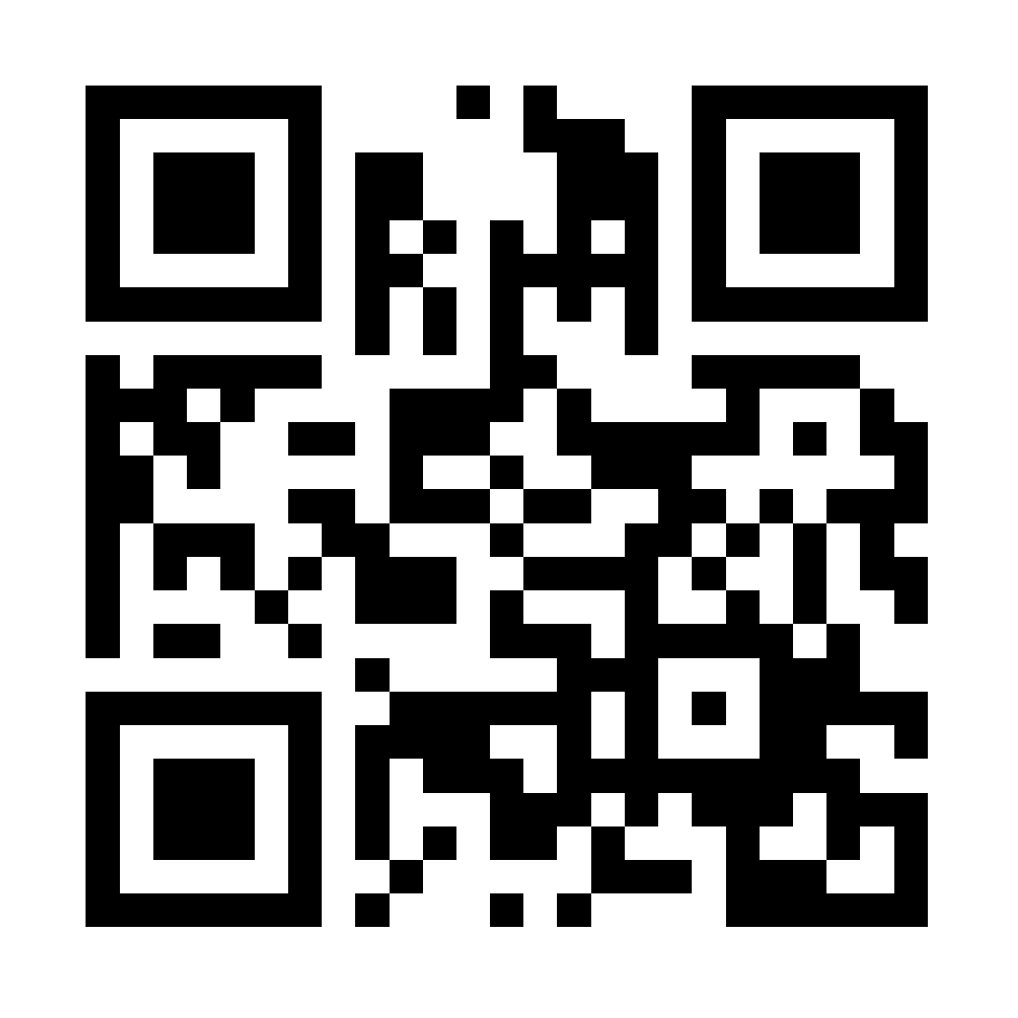
Please evaluate this session
Your feedback is important to us!
Visit Myignite at http://myignite.microsoft.com or download and use the Ignite Mobile App with the QR code above.

