Slide 2
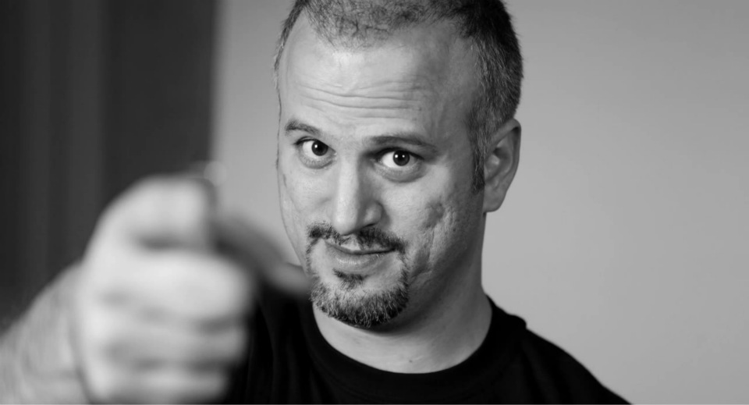
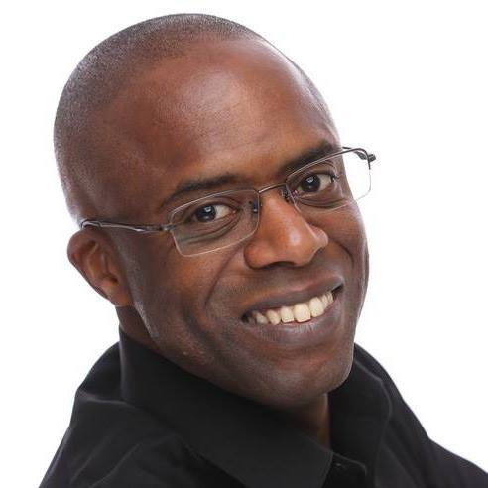
Zombies in Social Networks
BRK2315
Erdal Ozkaya
emt Holding
eo@emtdist.com
Raymond Comvalius
NEXTXPERT
raymond.comvalius@nextxpert.nl

Slide 3
Erdal Ozkaya
www.ErdalOzkaya.com
About Me
Erdal.Ozkaya@emtdist.com
Master of Information Systems Security (M.I.S), Bachelor of Information Technology (B.I.T.), ISO27001 Consultant, Certified Ethical Hacker and Licenced Penetration Tester.
Lecturer at Charles Sturt University and is also completing his Doctor of Philosophy (Ph.D.) in IT Security.
Advising and creating content to Government departments, Fortune 500 companies and Information Security Professionals to ensure they are getting prepared against latest "Cyber Crime" and being able to defend their organizations against any security breaches. I’m involved in the complex IT security solutions and enforcing regulatory requirements to the organizations, to protect their digital assets.

Slide 4
Raymond Comvalius - www.nextxpert.com
About Me
Independent trainer/architect since 1998
Most Valued Professional
Microsoft Certified Trainer
Author of “Windows 7 for XP Professionals”

Slide 5
Everyone who tweets will win
@Erdal_Ozkaya
@nextxpert ·
Channel 9 viewers included please refer to www.ErdalOzkaya.com

Slide 6
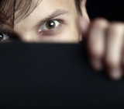
Warning! This Presentation Contains Occasional Bad Language & Subject Matter that some May find Disturbing

Slide 7
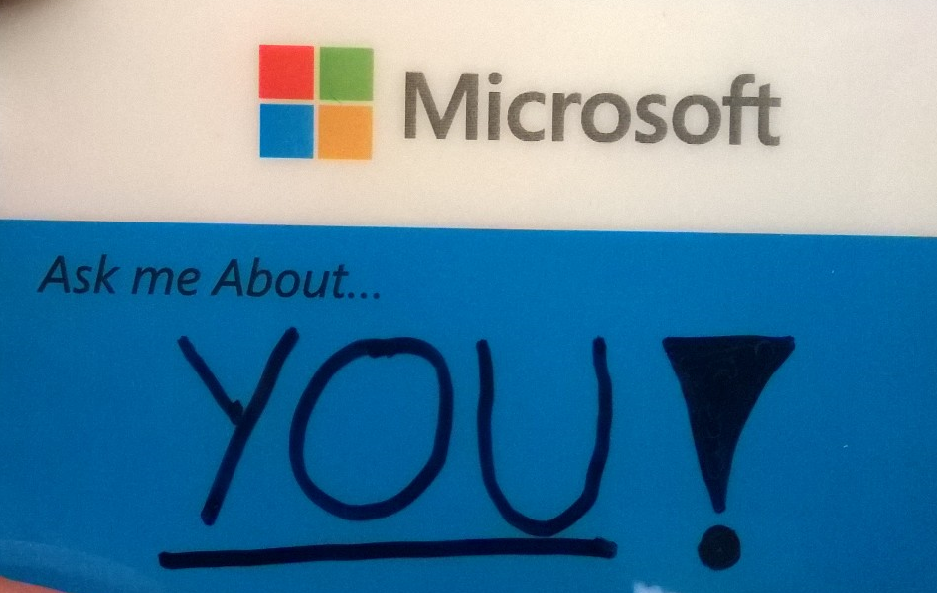

Slide 8
Source: Flicker

Slide 9
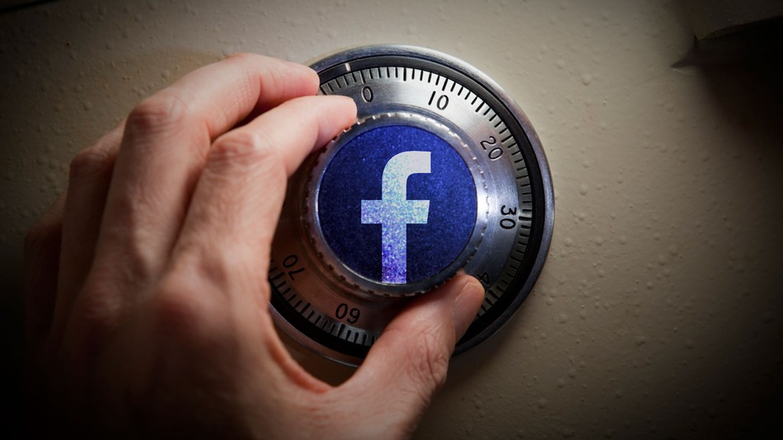
What is a Social Network?
A social network is a social structure made up of a set of actors (such as individuals or organizations) and the dyadic ties between these actors (such as relationships, connections, or interactions)

Slide 13
Guess What ?
Many of your friends are “bots”
Thousands of malware is delivered daily trough Social Media
Your private data should not be “online”
Zuckerberg is now a billionaire
Cyberbullying is a big issue in high schools

Slide 14
But…

Slide 15
Source: Flicker

Slide 16
Video

Slide 19
Don’t we share bit much ?

Slide 20
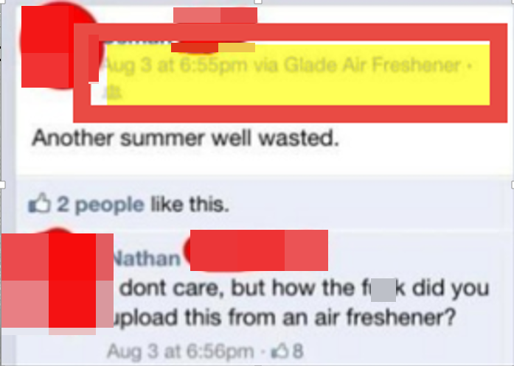

Slide 22
Keep in mind of those…
Stalkers
Burglaries
Cyber Bullying
Competitors

Slide 23
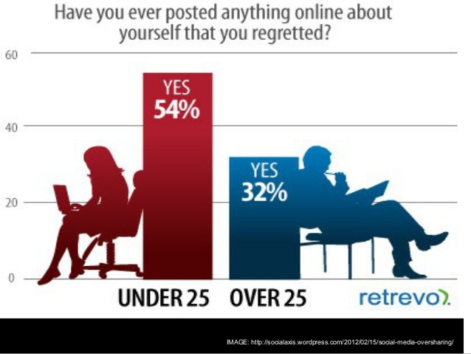

Slide 24
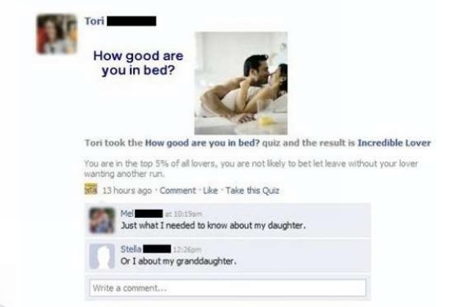

Slide 25
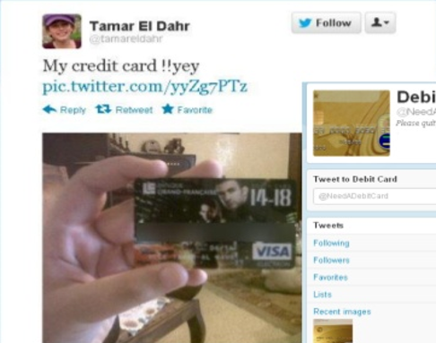
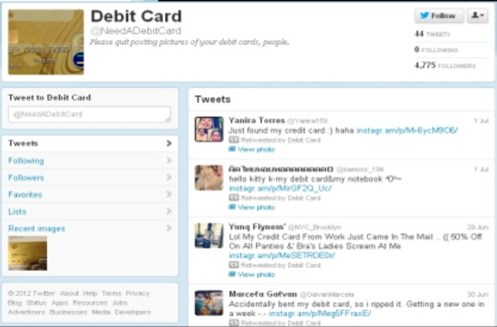
Are they serious ?

Slide 26
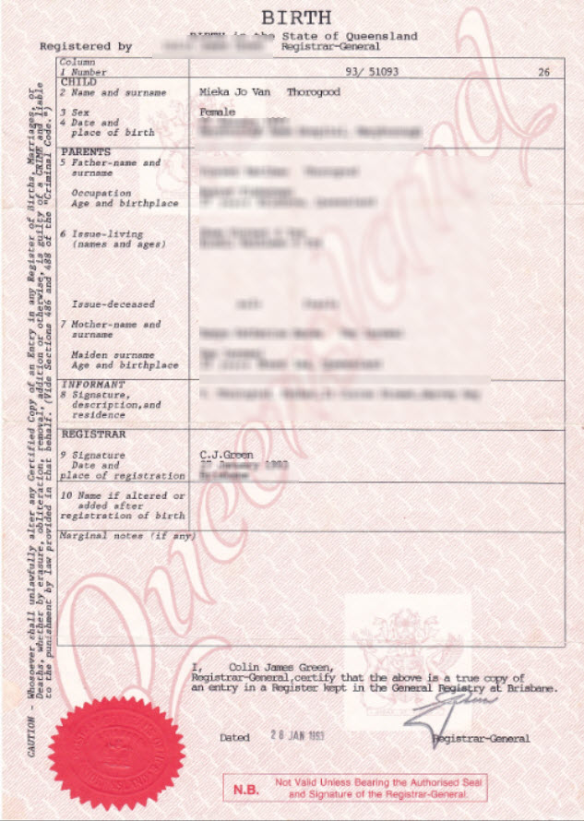
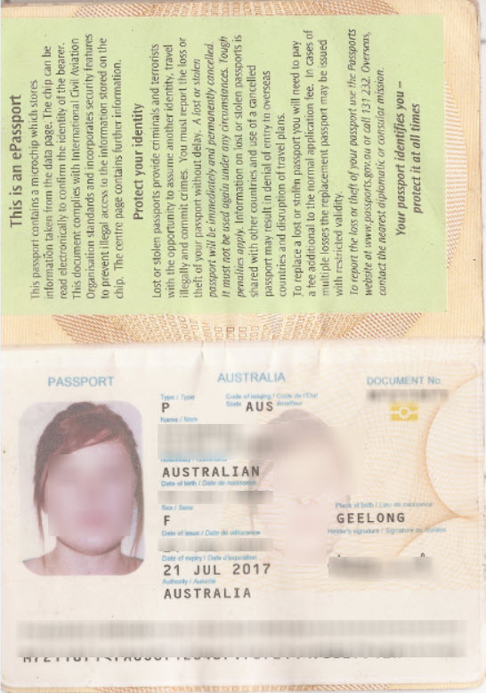
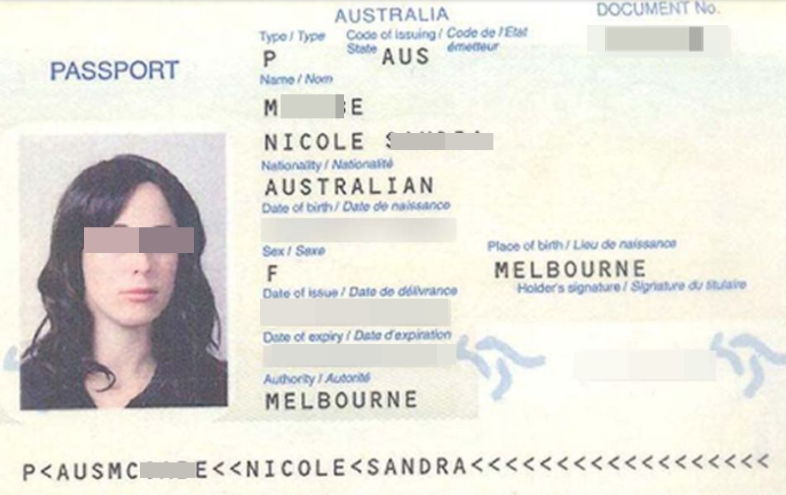
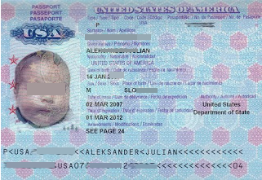

Slide 27
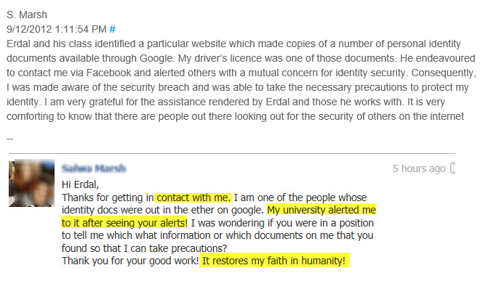
http://www.erdalozkaya.com/index.php/security/110-australian-passports-in-google

Slide 28
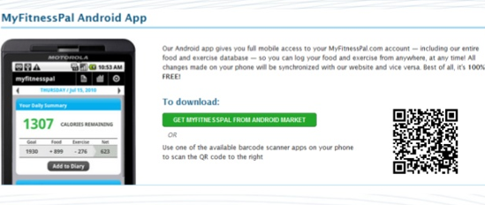
This looks “harmless “

Slide 29
Now look again, but carefully!

Slide 30
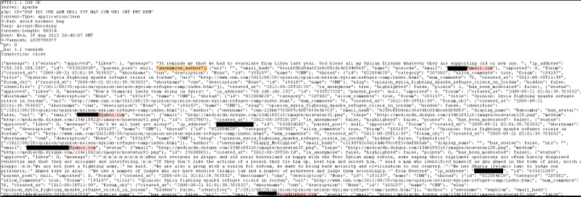
CNN app
Sometimes the server response tells you interesting details
Email and IP address

Slide 31
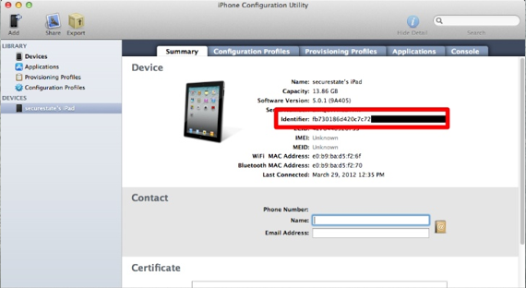
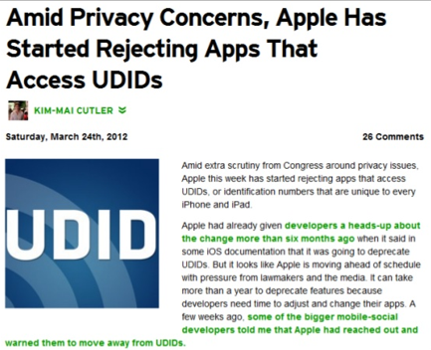
Your Unique Device Identifier

Slide 33
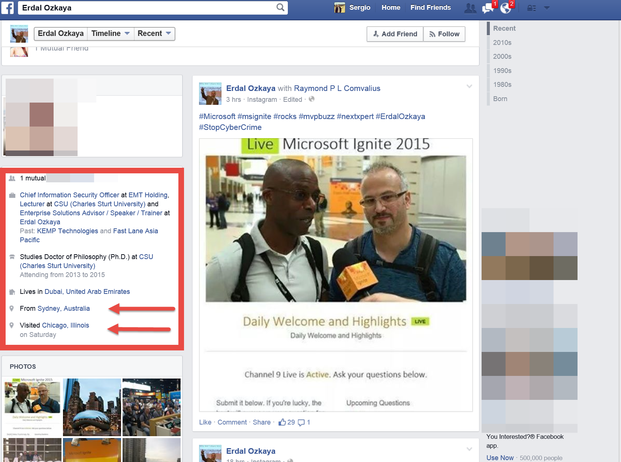
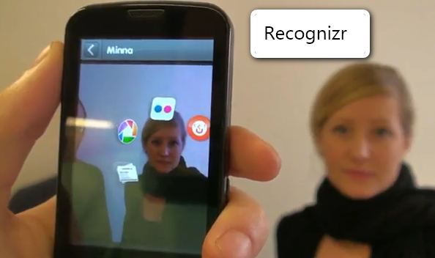

Slide 34
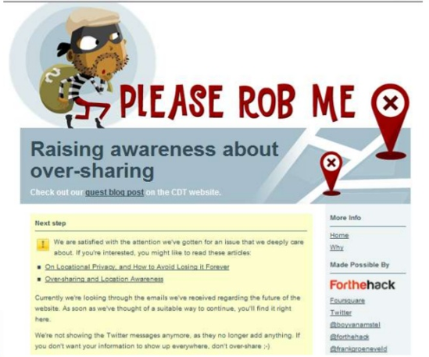

Slide 35
Geotagging Creepy or What!
More and more cameras have GPS built right into them
The moment you take a photo, your camera records exactly where you took it
You can then locate the co-ordinates in you favourite mapping tool
Then I can Find You…

Slide 36
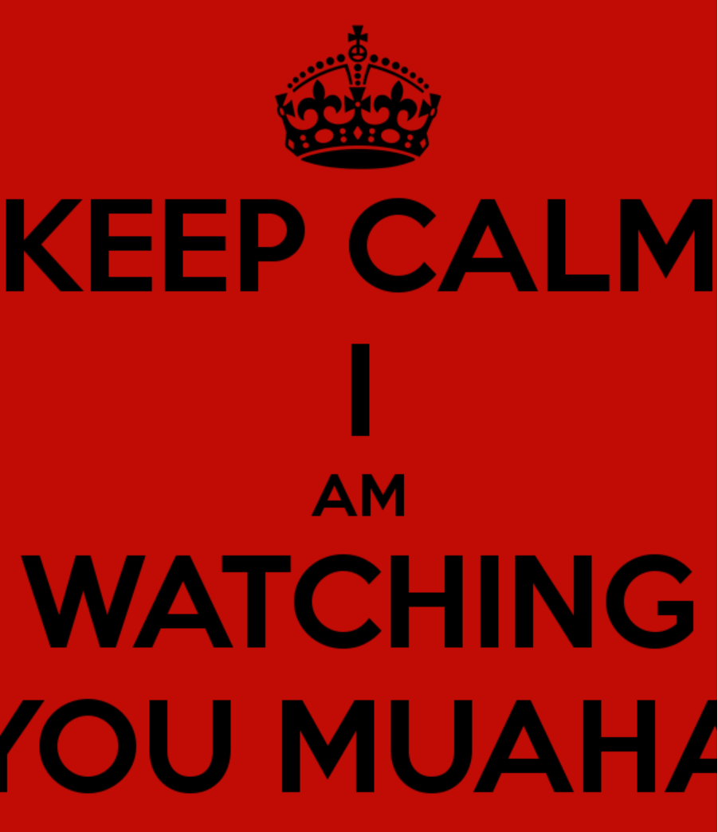
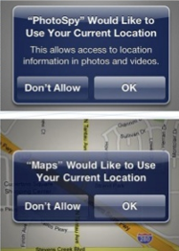
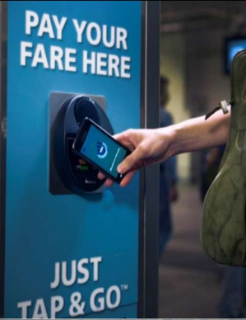
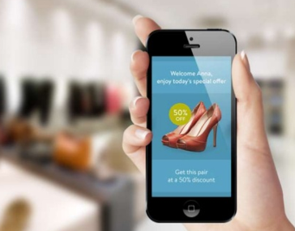
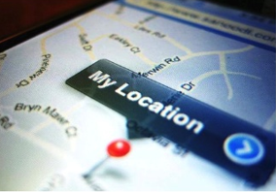
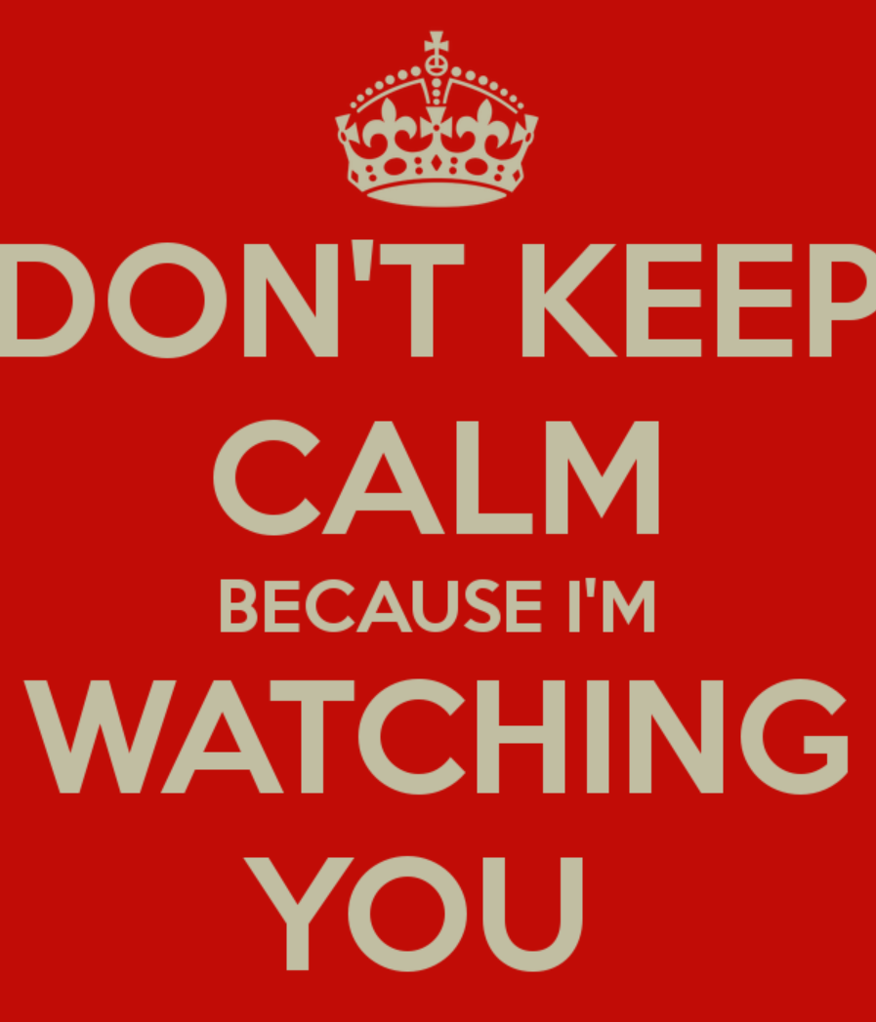

Slide 37
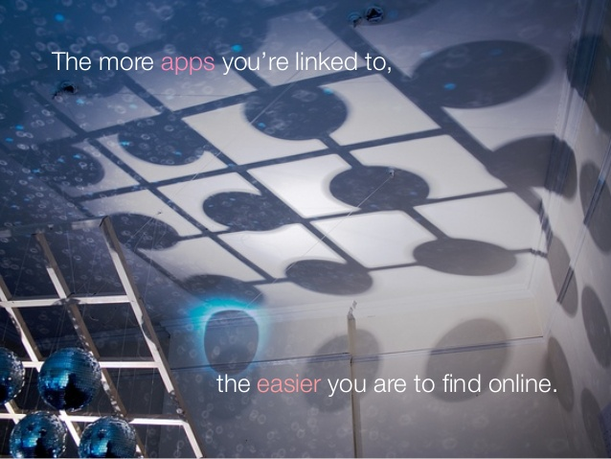

Slide 42
Social Media has become a HUGE part of our lives.

Slide 43
Demo
Speaker name

Slide 44
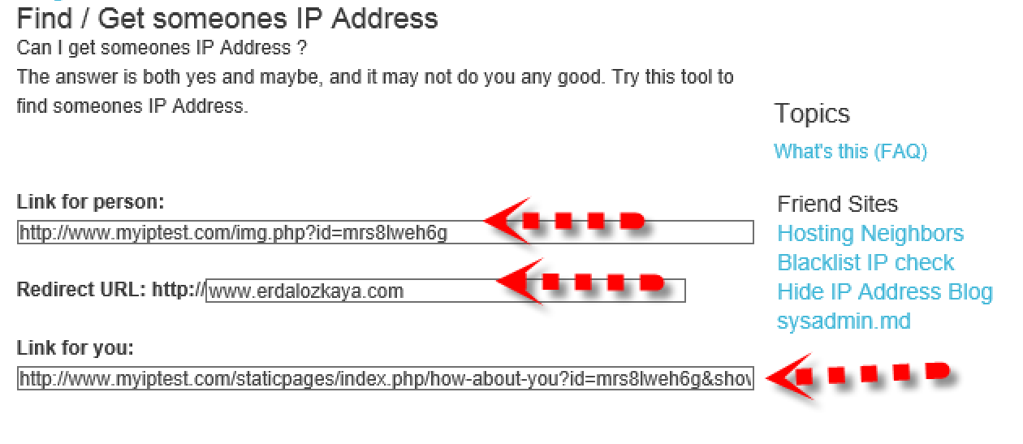

Slide 45
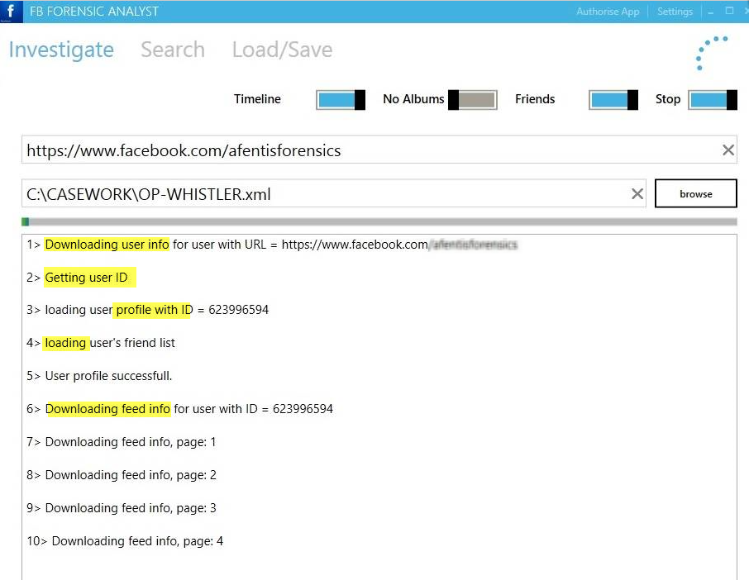

Slide 46
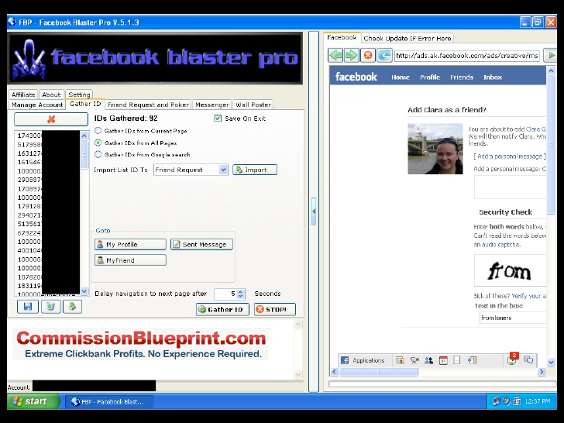

Slide 47
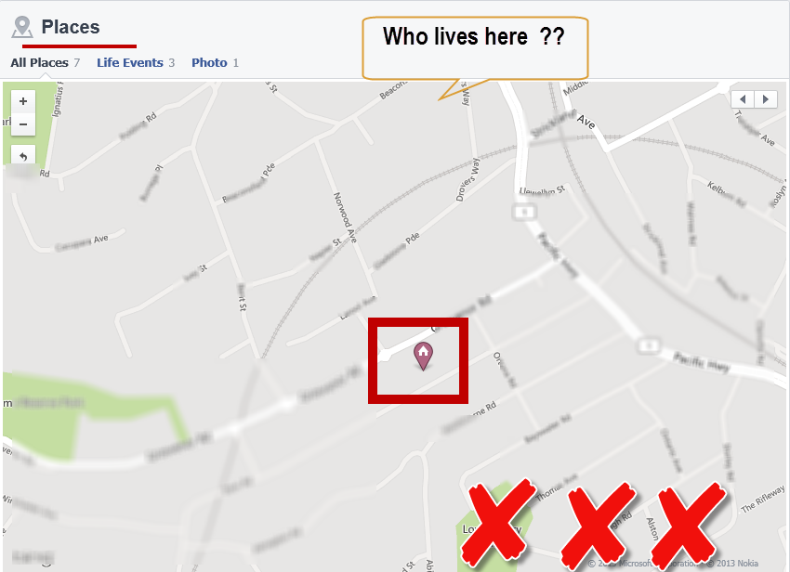

Slide 48
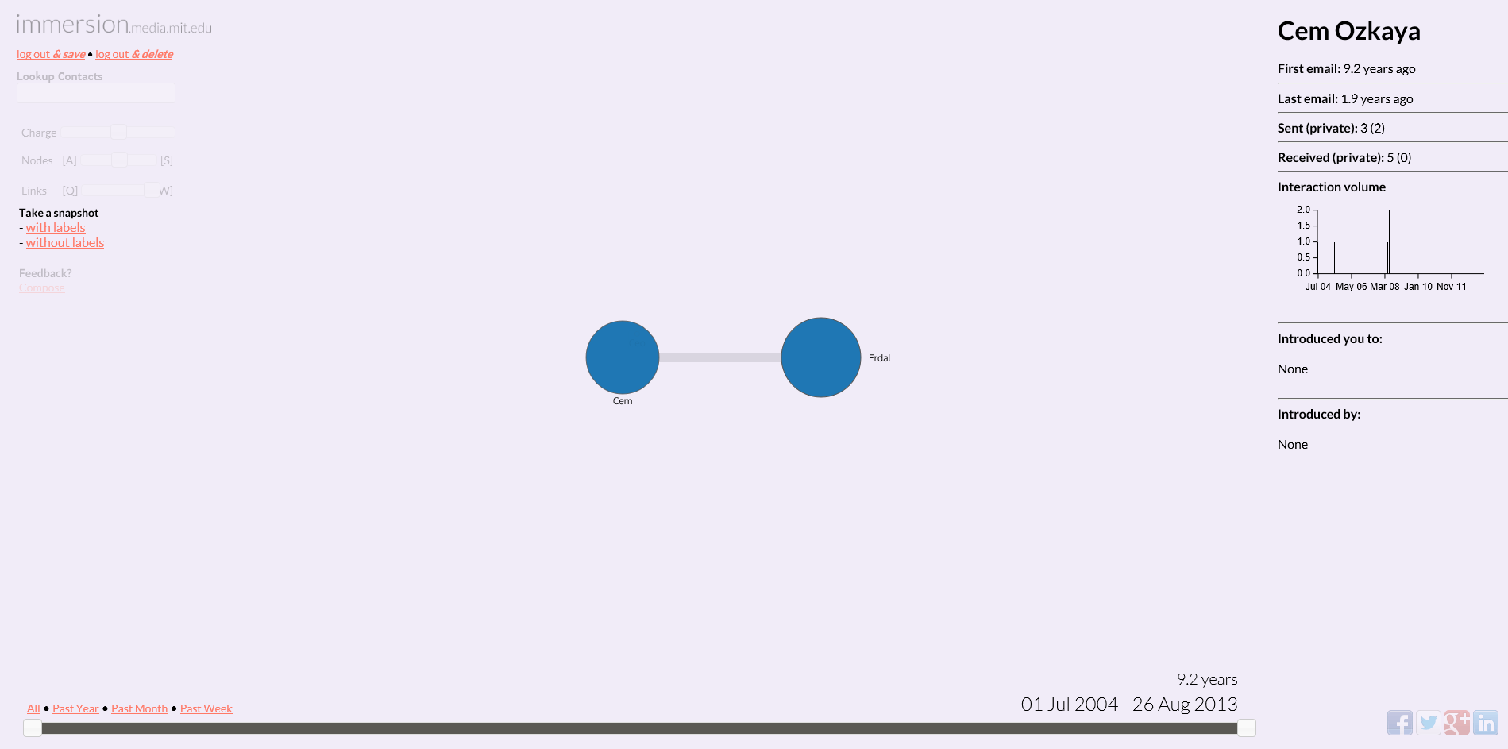

Slide 49
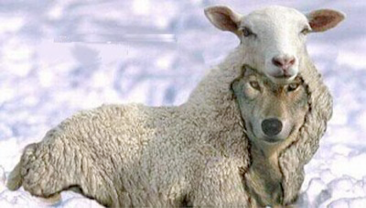

Slide 52
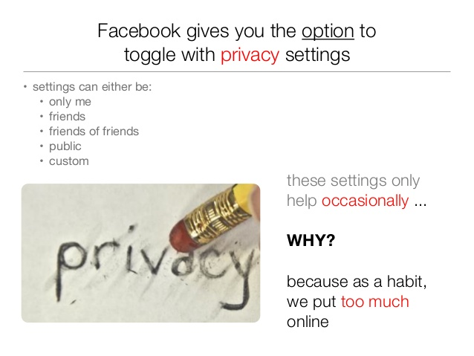

Slide 54
Even him…

Slide 55
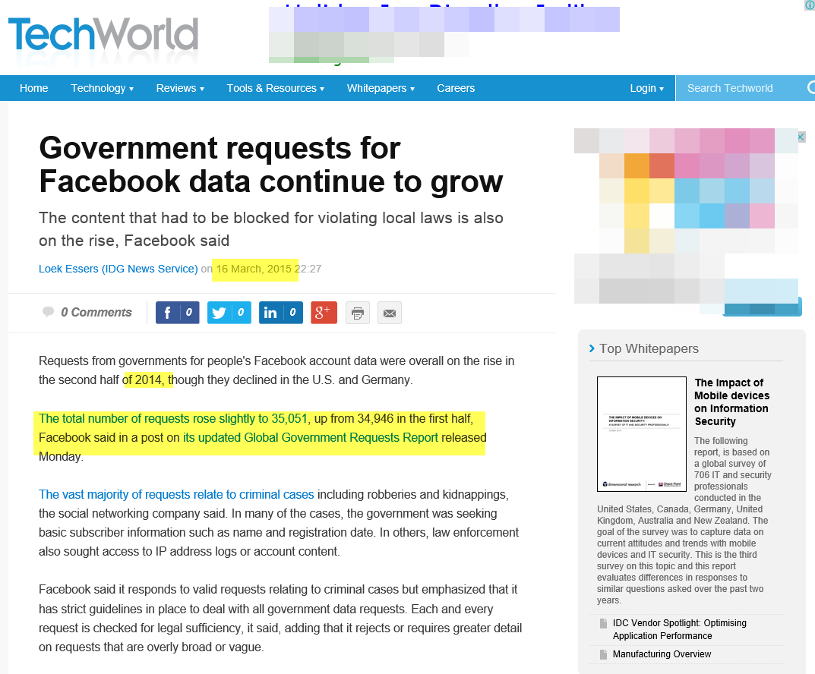

Slide 56
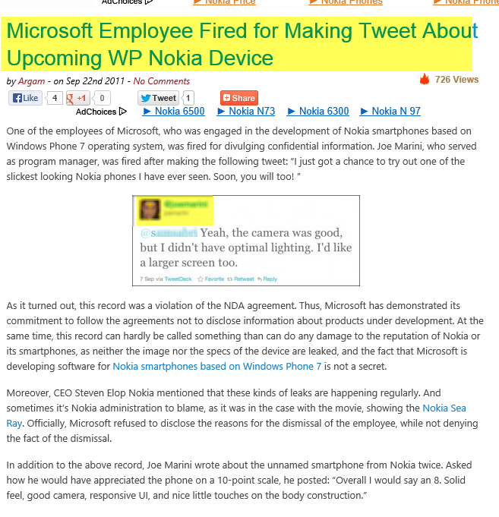
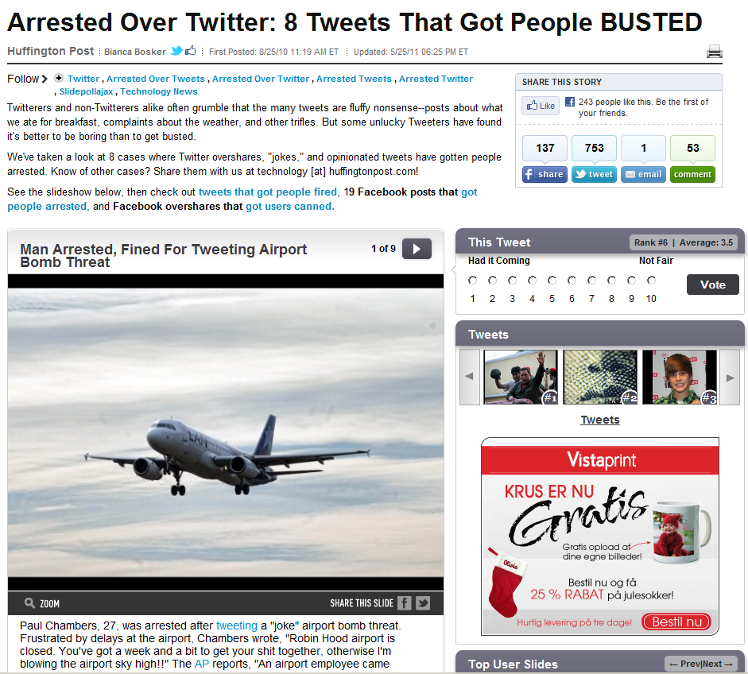
You’re liable on what you post!

Slide 58
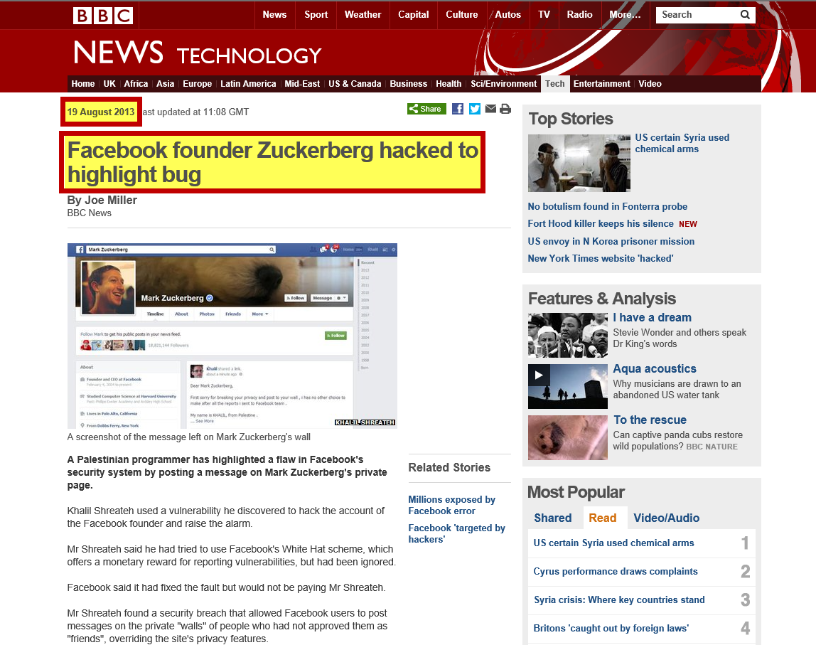
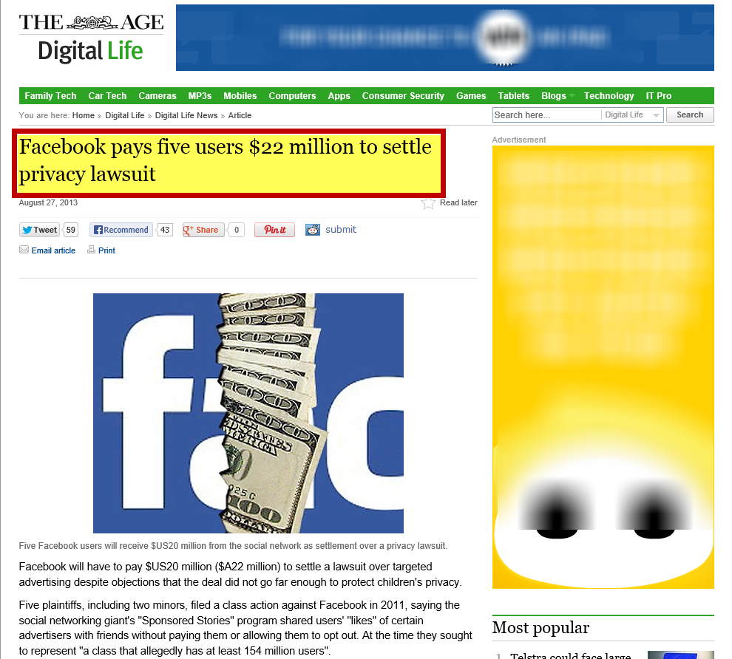
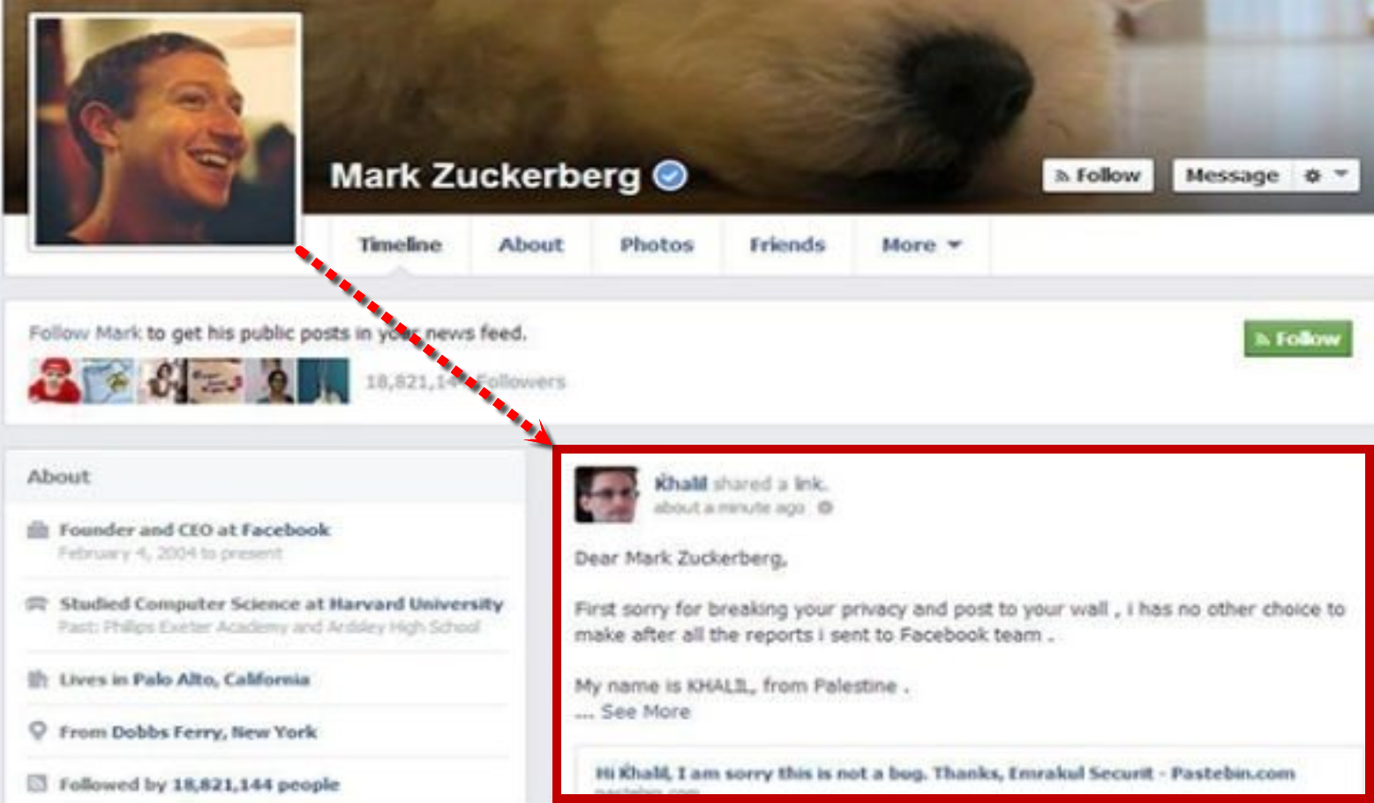

Slide 59
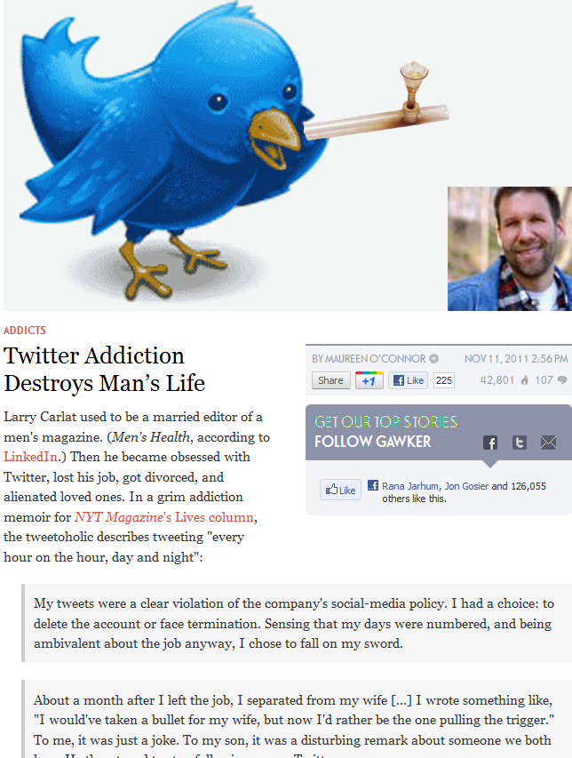
Social Network Addiction is No Joke!

Slide 60
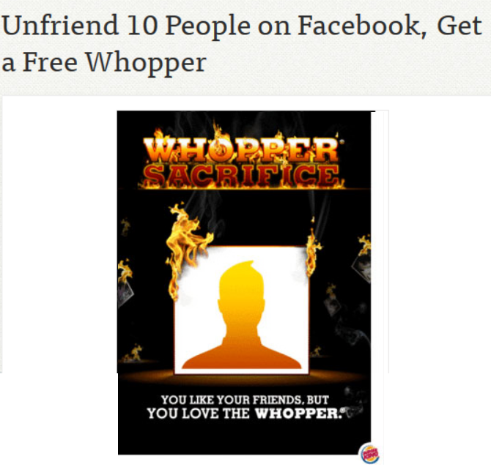

Slide 61
THE END !!!

Slide 62
Please don’t forget to like us ☺

Slide 63
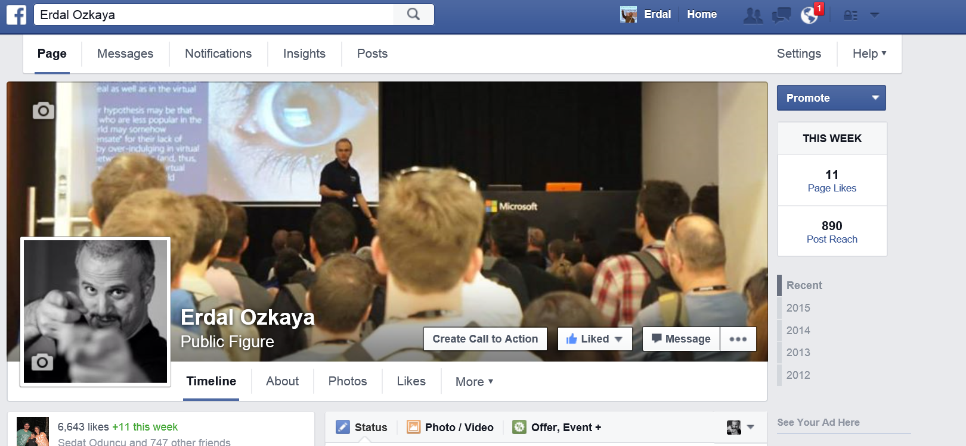
www.facebook.com/YourMCT

Slide 64
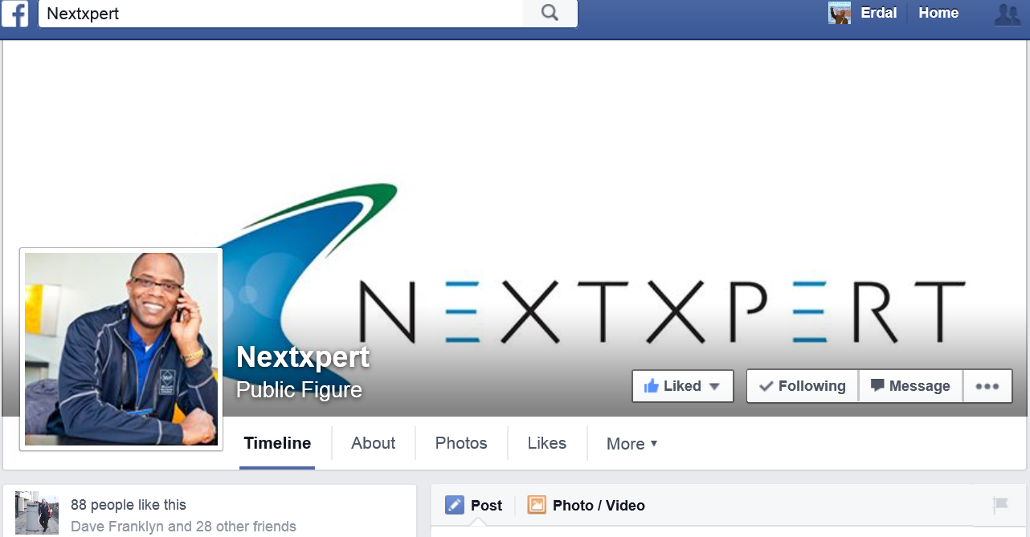
www.facebook.com/nextxpert

Slide 65
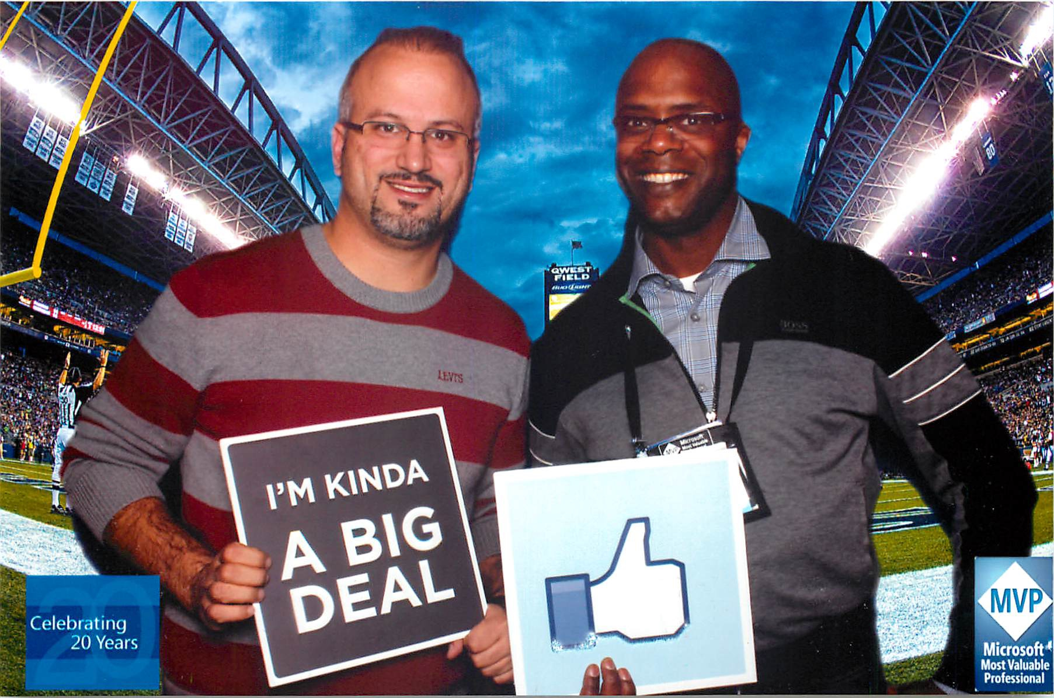
THANK YOU

Slide 66
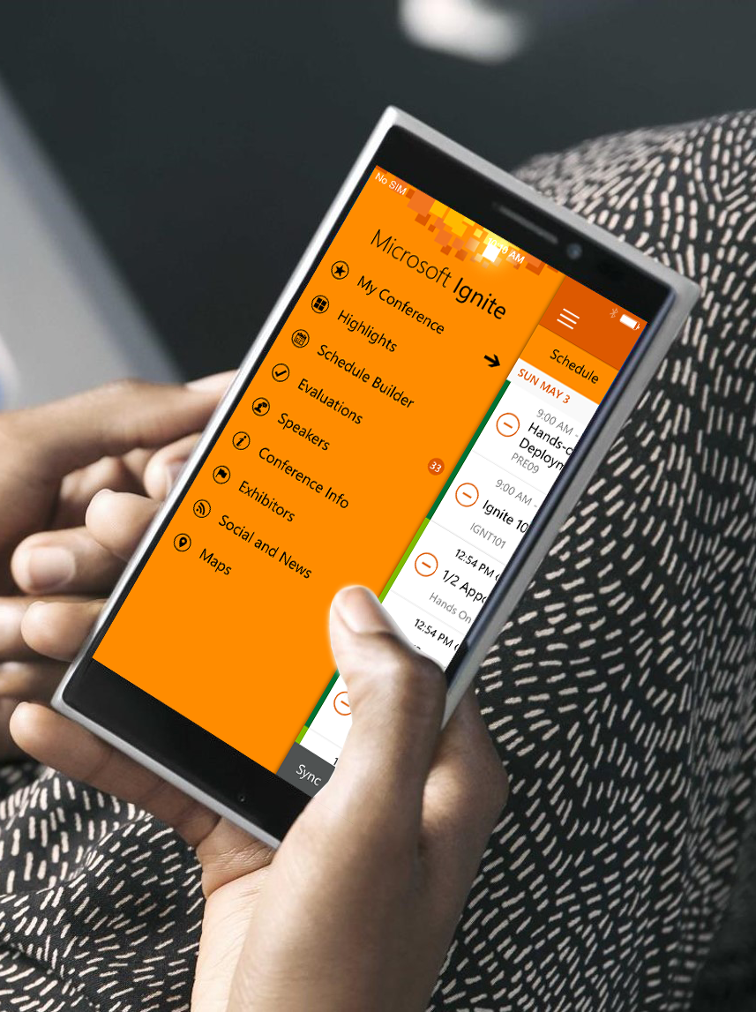
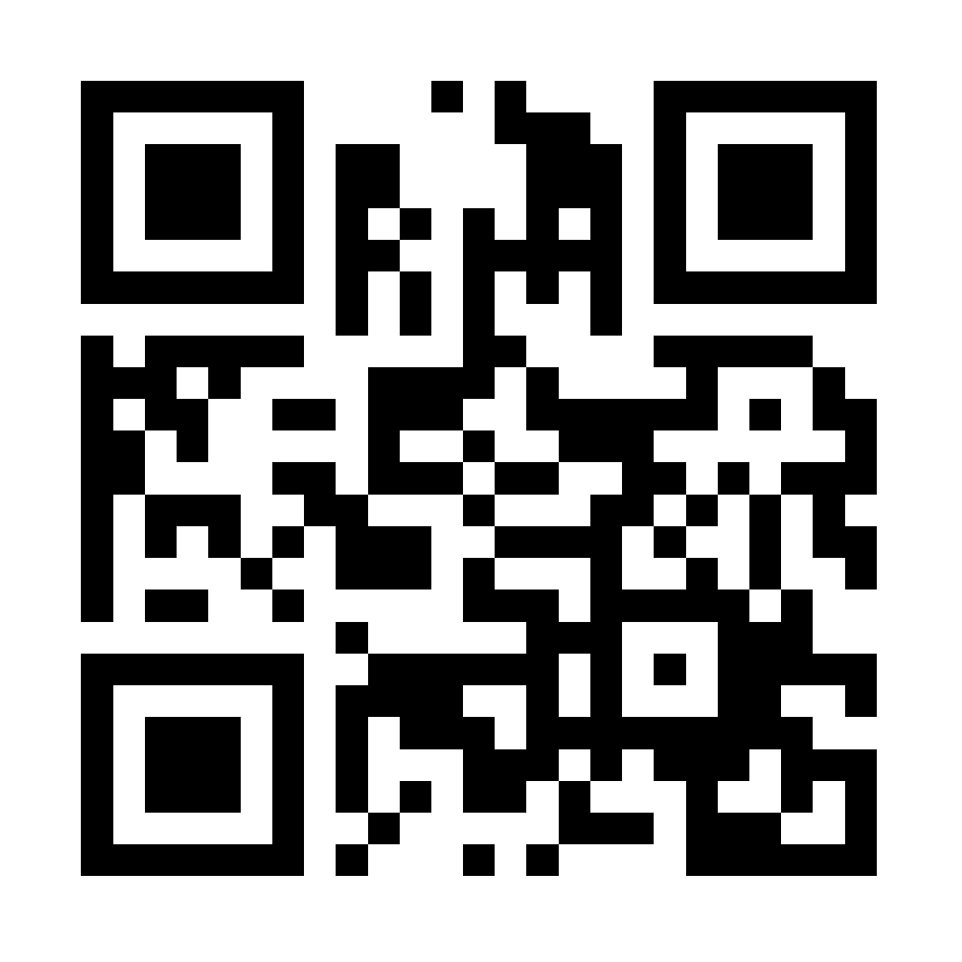
Please evaluate this session
Your feedback is important to us!
Visit Myignite at http://myignite.microsoft.com or download and use the Ignite Mobile App with the QR code above.

