Slide 2
Deploying Mobile Industry Devices for the Masses with Windows 10
BRK2318
Scott Culbertson, Architect, Microsoft
Eric Moe, Senior Consultant, Microsoft

Slide 3
Introduction

Slide 4
Who We Are….
Scott “The Man With the Plan” Culbertson
Eric “Hands on the Keyboard” Moe

Slide 5
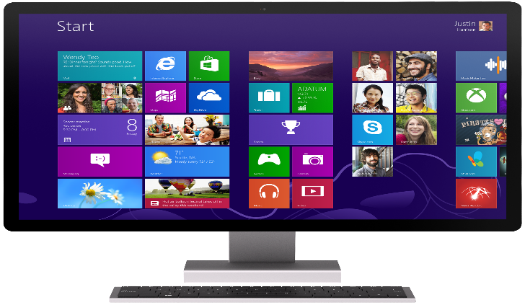
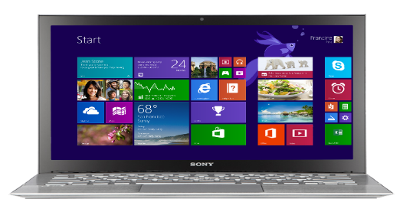
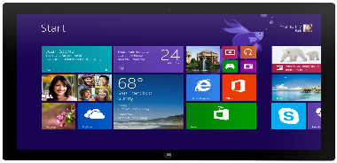
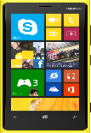
Windows Embedded 8.1
Transforming Windows for Specialized Devices
Provides a standards-ready platform to develop and deploy system quickly and easily
Enable enterprise scenarios by adding industry capabilities

Slide 6
Field Experience
Microsoft Early Adaptor Program “TAP+ ”
Combined effort / joint funding
Early access to products and capabilities
Public Relations for both Customer and Microsoft
Windows Embedded 8.1 Handheld Customer Scenario
Retail Customer
Multiple locations across the United States
Seeking to replace aging hardware with newer (and fewer) devices

Slide 7
But Before We Get Started…
Windows Embedded Handheld has a lot of commonality with Windows Phone
Let’s start with a level-set on Windows Phone capabilities

Slide 8
Windows Phone

Slide 9
Windows Phone release
Built-in Office Collaboration Apps
Enterprise VPN and Wi-Fi
S/MIME Support for Secure, Encrypted Email
Cortana, your more personal, personal assistant
Business users
Anywhere productivity
Enhanced Device and App Management
Windows App Platform Convergence
Certificate Management
Enterprise Wipe
Enhanced Asset Management and User Assistance
Assigned Access
IT professionals
Putting IT in control

Slide 10
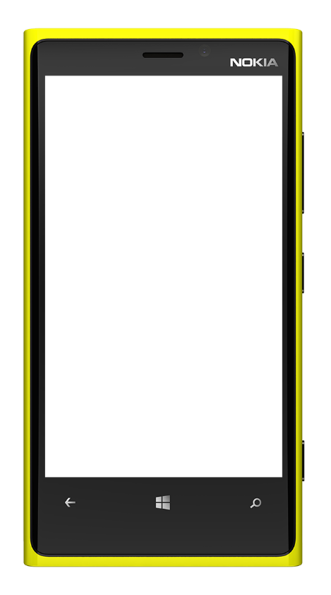
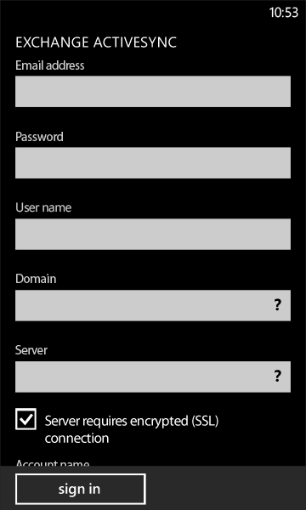
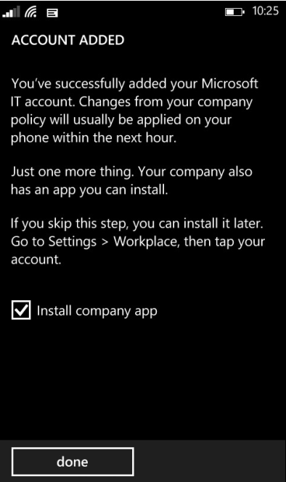
Putting IT in control with MDM
Easy enrollment to access corporate resources from anywhere
IT pushes enterprise collection and configures accounts, VPN, Wi-Fi, certificates, apps, and restrictions with an extensive set of policies
IT monitors assets and assists user
Enterprise Wipe removes all company data but preserves consumer data
MDM support by Microsoft Intune and 3rd party vendors

Slide 11
Uncompromising security and encryption
System integrity with secure hardware and trusted boot
Malware protection with application sandboxing and certification
Keep data safe with full device encryption
Secure Access with Wi-Fi EAP-TLS and auto triggered app specific IPsec or SSL VPN

Slide 12
Windows Embedded 8.1 Handheld

Slide 13
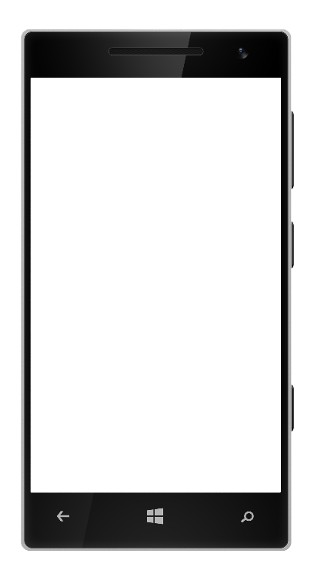
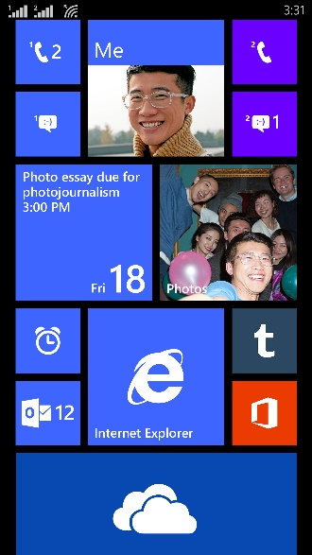
Industry Device Features
Multi-User Lockdown
Device Management
Industry Standard API’s for peripherals
Extended Hardware and Peripheral Support
Windows Phone
Windows Embedded 8.1 Handheld
No modification to WP Core OS
Major and GDR release schedules are the same
100% Application compatibility with Windows Phone [WEH apps on may not always run on Phone]
Support lifecycle – 3+2 years
… additional packages for industry devices are added to WP to make WEH

Slide 14
Microsoft Vision - One Standard Enterprise Handheld
Consumer
Microsoft Windows Embedded Handheld
Rugged Industrial
Good
End user Familiarity
Rapid technology cadence
Low cost
Bad
Malware
Fragmentation
Not enterprise focused
Peripheral
support
Bad
Old
Not as easy to use
Not easy to develop for anymore
Modern app
compatibility
Good
Proven
Enterprise applications
Peripheral Support
Developer knowledge
Long life
cycle
Bad
Android malware
Android fragmentation
Not enterprise focused
Peripheral
support
Bad
Old
Not as easy to use
Not easy to develop for anymore
Modern app
compatability.
for
Handheld Devices

Slide 15
Handheld Device Partners

Slide 16
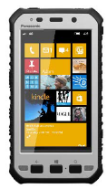
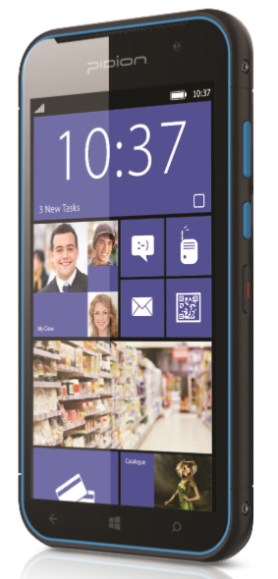
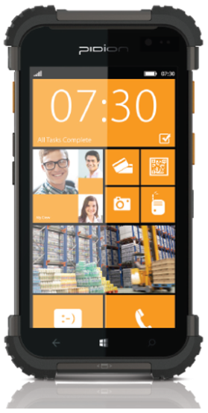
Multiple device types and functionality
5” HD Multi touch Display
Semi-rugged (IP-65)
Option MSR & Support for Contactless Smart Cards
Integrated Barcode Imager
WAN & Wi-Fi versions available
4.3” HD Multi touch Display
Integrated Barcode Imager
Durable Compact design
5” HD Outdoor Touch Display
Ruggedized (IP-68), 3m drop test & waterproof
Quick charge plus hot swap battery
Integrated barcode Imager
WAN & Wi-Fi versions available

Slide 17
Handheld OEM Role
Configuring, Packaging, Signing and Releasing all OS Images (firmware) for the devices including OS Updates and device drivers
Configuring device defaults (volume, brightness, WiFi Roaming and Signal strength, etc.)
Responsible for developing QR Code Plugin for OOBE as well as the utility customers would use to produce QR code with encryption since Prov.xml include sensitive material
First point of contact for technical support with OS or device functionality, reliability, security, etc. OEM then may escalate to Microsoft if needed.

Slide 18
Assigned Access: Enterprise Defined Profile
App / Settings Allow List
Kiosk Mode Support¹,
Suppress App Search¹
Start Screen Configuration [tiles, accent colors]
Prevent Tile Manipulation¹
Button Disable / Remapping
Disable Navigation Buttons¹
Bulk Provisioning Enhancements (NFC, SD Card)
Auto Wi-Fi Connectivity (EAP-TLS¹)
Auto MDM Enrollment
Barcode provisioning via plugin
Prevent OEM or store app install during OOBE²
Defined Enterprise Time Source (NTP)¹
Assigned Access: Multi-Profile Support
Define Multiple Profiles
API Support for Profile Switching
Dynamic Policy Updating
Associate role to defined Wi-Fi network ²
Device Management Enhancements
Enterprise Cert Validation Opt out¹
OS Update Management
Controlled Updates
Mandatory Maintenance Window¹
Configure brightness setting via MDM²
Optional PIN when set screen timeout²
Friendly Device ID²
Best in Class Hardware Support
Wi-Fi Only Options
USB Host
Extended OEM Peripheral Support
Magnetic Stripe Reader
Barcode Scanner, Software Trigger API¹
Physical Keyboard
Enhanced Platform Support and Security
Enterprise Wi-Fi connectivity (EAP-TLS)
Wired Ethernet connection²
Programmatically switch between cellular radios²
Controllable LED and Audible alerts²
¹ WEH GDR1 Features
² WEH GDR2 Features

Slide 19
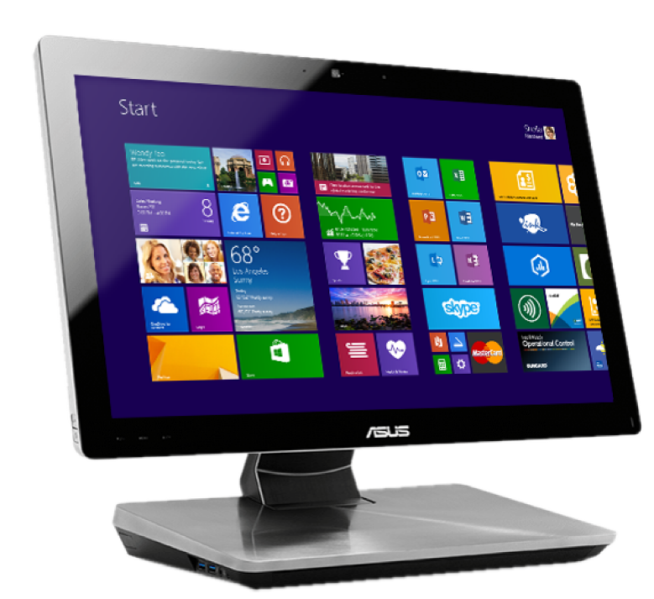
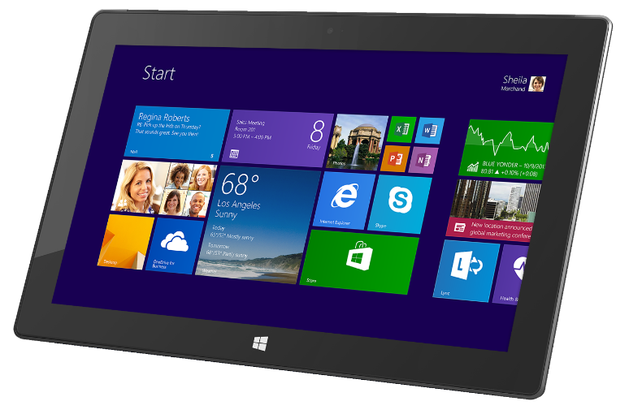
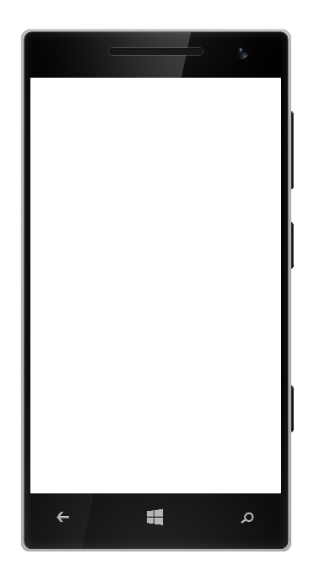
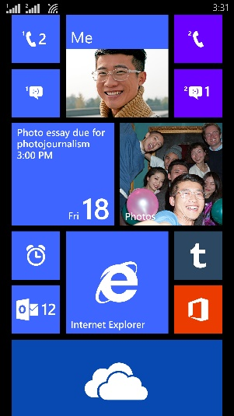
Windows app platform convergence
Shared API set across Windows devices
Unified app model and services
Familiar developer tools
Private app distribution and management

Slide 20
Windows 10 for IoT Roadmap

Slide 21
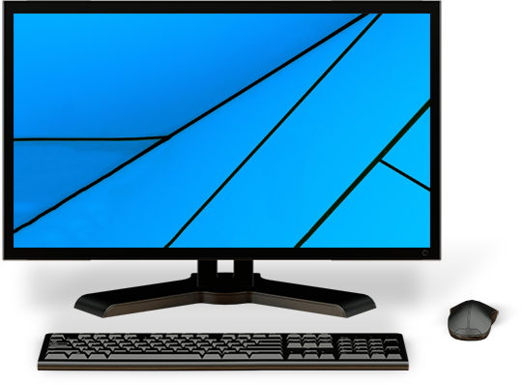
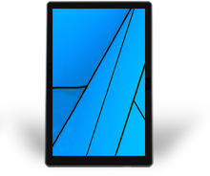
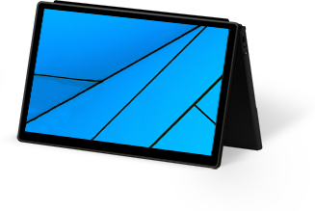
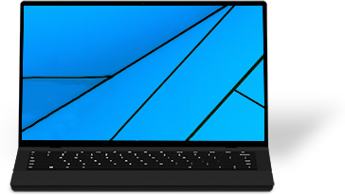
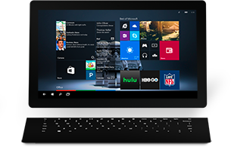
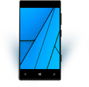
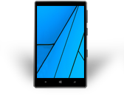
ONE WINDOWS
Phone
Handheld
Small Tablet
Large Tablet
2-in-1s (Tablet or Laptop)
Classic Laptop
Desktops & All-in-Ones

Slide 22
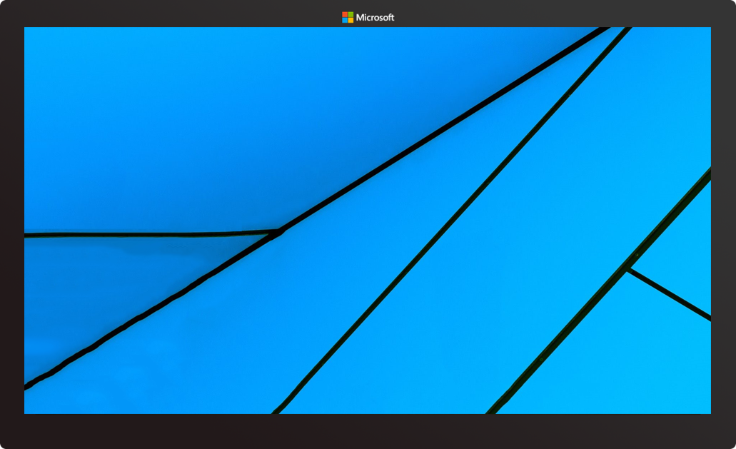
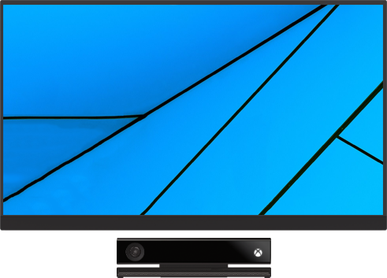
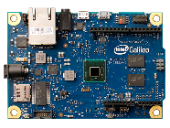
ONE WINDOWS
Internet of Things
Xbox
PPI

Slide 23
PLATFORM CONVERGENCE JOURNEY
Xbox 360
Xbox One
Converged
OS kernel
Windows 8
Windows 8.1
Converged
app model
Windows 10
Windows Phone 8.1
Windows Phone 8
Windows Phone 7.5
Windows on Devices

Slide 24
INDUSTRY READY ON ANY WINDOWS 10 DEVICE
Commercial and consumer devices
Converted industry and ruggedized devices
Purpose-built industry solutions

Slide 25
Window 10 IoT for Industry Specific Devices
Windows 10 IoT for industry devices
Desktop Shell, Win32 apps, Universal Apps and Drivers
1 GB RAM, 16 GB Storage
X86
$
Premium
Windows 10 IoT for mobile devices
Modern Shell, Universal Apps and Drivers
512 MB RAM, 4 GB storage
ARM
Windows 10 IoT Core
No Shell, Universal Apps and Drivers
256MB RAM, 2GB storage
X86 or ARM
Entry
Device Capabilities

Slide 26
Advance Device Lockdown
Write Filters and Overlays
USB Filter
Dialog and Notification Filters
Input Filters
AppLocker and Layout Control
Shell and App Launcher
Easily create read only devices. Improve system uptime
Only allow approved USB peripherals
Block Pop-up Dialog Boxes and system notifications
Block hotkeys and edge gestures to prevent system access
Control which apps are visible and can run
Enable single Win32 or Modern app experience on device
Consistent and predictable device experience for industry line of business apps

Slide 27
Capabilities and Features
Lockdown Capability | Windows 10 IoT Core | Windows 10 IoT for mobile devices | Windows 10 IoT for industry devices
Write Filters and Overlays | - | - | √
USB Filter | √ | √ | √
Dialog and Notification Filters | n/a | √ | √
Input Filters | n/a | √ | √
AppLocker and Layout Control | n/a | √ | √
Shell and App Launcher | √ | √ | √

Slide 28
Application Development In Windows 10

Slide 29
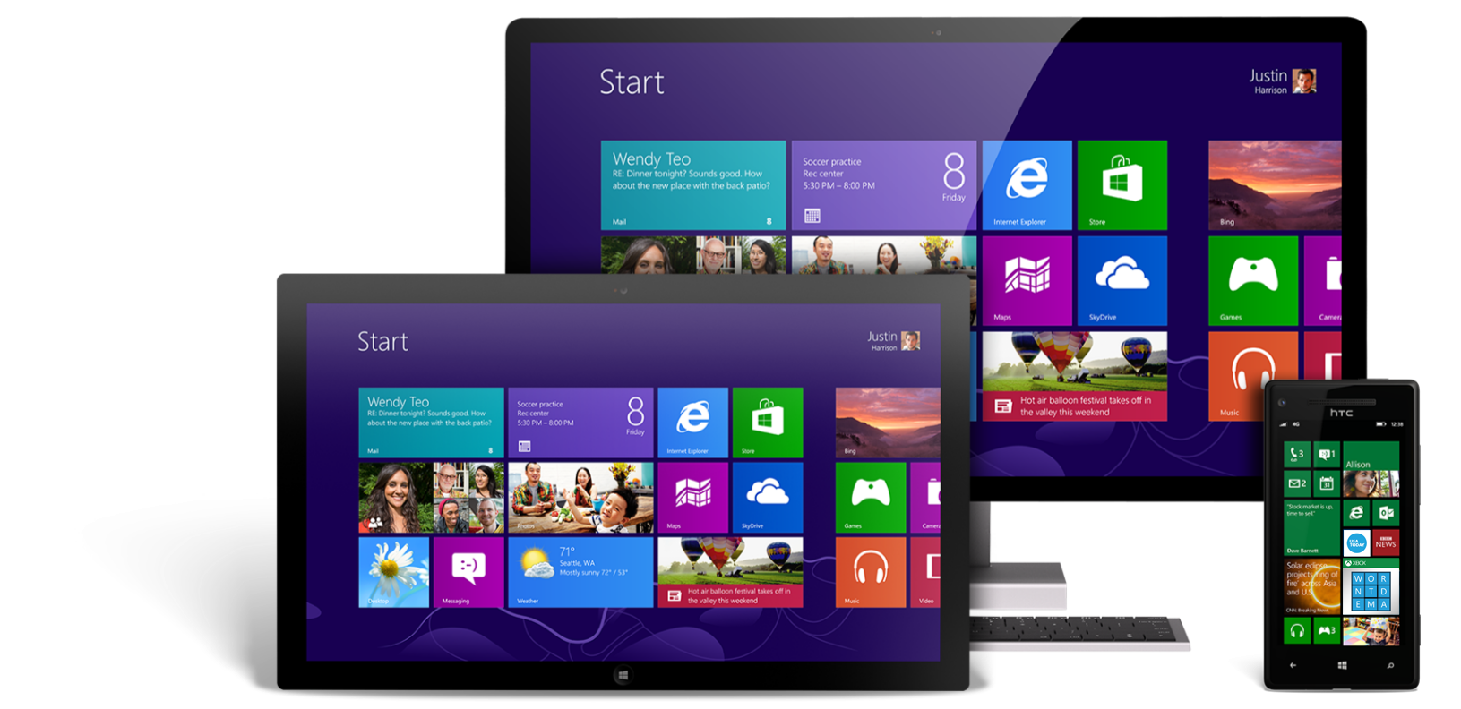
One Windows for App Developers
Shared Developer Platform
Windows XAML apps
Shared API set
Windows 8.1 Pro and Embedded Handheld uses same POS APIs
Shared app model
Shared Live Tiles
Shared App distribution format
Converged Controls + Performance Gains
Shared App Services
Shared developer Store registration
Unified Push Services (WNS)
Unified App Data Roaming and backup
Shared app identities + entitlement

Slide 30
Windows Runtime (WinRT) convergence
Namespace Convergence: Windows 8 & Windows Phone 8
Phone
33%
Common
27%
Windows
40%
Namespace Convergence: Windows 8.1 & Windows Phone 8.1
Phone
10%
Common
77%
Windows
13%

Slide 31
Universal Windows XAML Apps
Developers can create a single app that targets Windows Phone and Windows
One Visual Studio ‘Universal Project’ template for your app
Shared dev and test tooling for both platforms

Slide 32
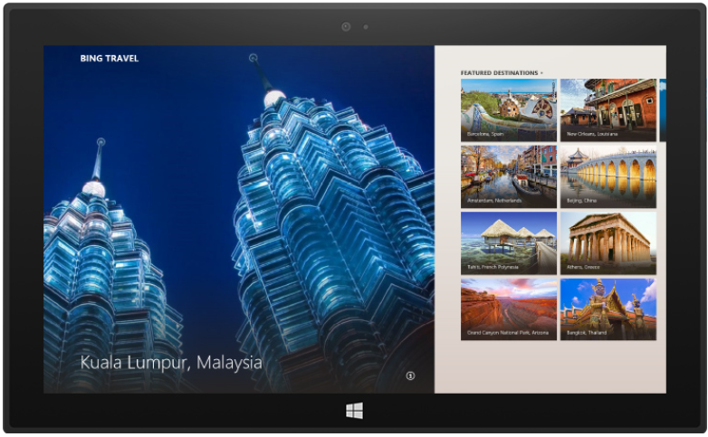
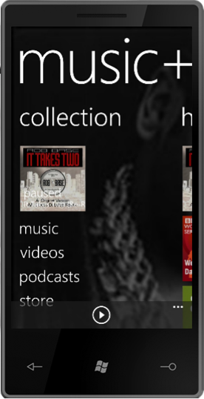
Controls that adjust for form factor
On Windows Mobile
… and on Windows

Slide 33
Windows Embedded 6.5 app migration
Not a minor re-write/re-compile
“File/New/Project”
Business logic may be reusable, but UI must be recreated
Developers get new capabilities beyond CE5 & VS2008
Web & Streamed apps may be OK

Slide 34
Device Management

Slide 35
Typical Management Activities
Configuration Baselines (Dev/Staging/Prod)
Application Deployment (Dev/Staging/Prod)
Inventory / Lifecycle Management
OTA Updates
Device retirement/wipe/re-enroll/exchange
“Reimaging a device” (sdcard, USB, OTA, Re-enrollment in the field)
Geofencing (pros and cons)

Slide 36
Enterprise provisioning
Key point: Post deployment support of devices
Needs for update example GDR1 to GDR2 with Over the Air updates. 1 gig plus in data
Need to limit impact to network so controlled workflow required
System Center vNext enables this control via policies
Distributed shared storage
Segmentation of devices by lan segments with storage pointers for OTA update source control

Slide 37
MDM - Policies
Remote Management and configuration
Extends management capabilities to enable critical Enterprise scenarios (many steps beyond BYOD)
Device bulk enrollment and provisioning - reduces deployment time, expense
Multiple sources: NFC, SD Card, Barcode
Open protocol + deep engagement with top MDM providers
Lock down devices with multiple profiles
Microsoft confidential – Shared under NDA

Slide 38
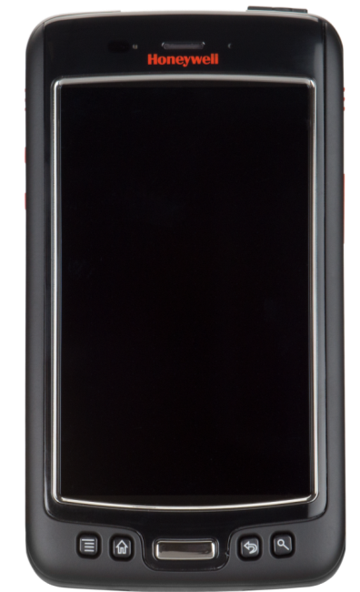
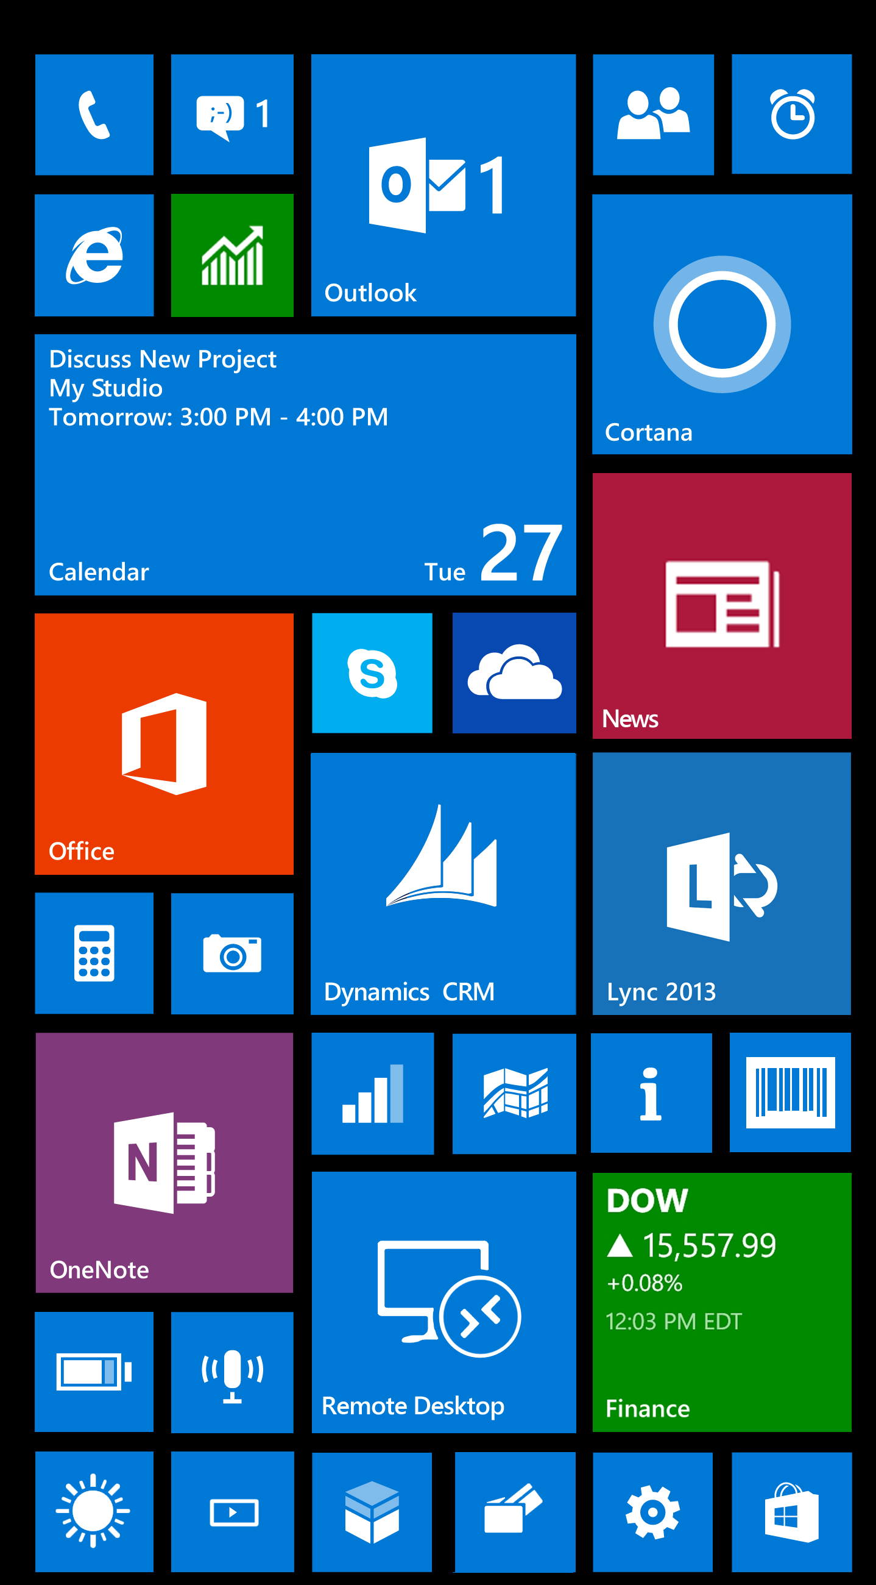
Putting IT in control with MDM
Bulk enrollment to access corporate resources from anywhere
IT pushes configuration: accounts, VPN, Wi-Fi, certificates, apps, policies and restrictions with an extensive set of policies
IT monitors assets and controls updates of OS and apps
Enterprise Wipe removes all company data

Slide 39
OOBE Provisioning
Bulk Provisioning
Configure Enterprise settings during OOBE
ASSIGNED ACCESS
Set up your Handheld
Available configuration sources
Scan Barcode
Barcode
Tap NFC
scan barcode to get configuration
NFC
tap NFC to get configuration
SD Card
Insert SD Card
insert SD card to get configuration
More Options
Prov.xml
Previous
Next

Slide 40
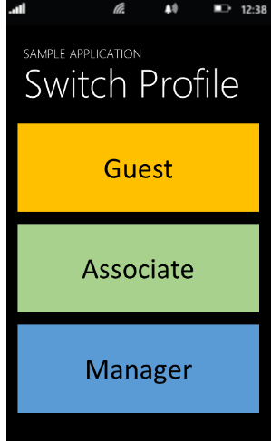
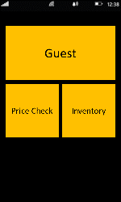
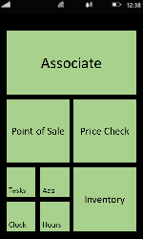
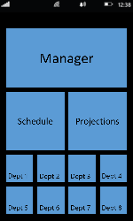
Assigned Access
Multi User Profiles
namespace
Windows.Embedded.DeviceLockdown
Clasas
DeviceLockDownProfile
Methods
ApplyLockdownProfileAsync
GetCurrentLockdownProfile
GetLockdownProfileInformation
GetSupportedLockdownProfiles
Increase device utilization

Slide 41
Update Improvements
Change pic
Enhancements to the Enterprise Device Update
Controllable OS update install
Ability to locally host updates
Designated device maintenance time
Ability to re-flash devices
Unattended OS Update installations

Slide 42
Prov.XML
Bulk Enrollment Configuration File containing:
Root & Issuing CA Certificate
WLAN Profiles including proxy, certs, PSK, Proxy, etc.
MDM Enrollment Server Connection Point
Internal Time Server
OS Configuration Options (Time Zone, OS Update)
Assigned Access (Profiles, app / settings)

Slide 43
Demo - Provisioning
Eric Moe

Slide 44
Demo – Multi User Profiles
Eric Moe

Slide 45
Device Security

Slide 46
Security by Design
Secure Boot using UEFI
TPM for BitLocker, Virtual Smartcards & certificates
Chambered Security Model
- AppContainer sandbox
- Applications must be signed and capabilities defined by certificates
Removable storage encryption
S/MIME & IRM
EAP-TLS, SSL, VPN & App specific VPN
Network World 11/16/2014

Slide 47
Conclusion

Slide 48
Window 10 IoT for Industry Specific Devices
Windows 10 IoT for industry devices
Desktop Shell, Win32 apps, Universal Apps and Drivers
1 GB RAM, 16 GB Storage
X86, x64
$
Premium
Windows 10 IoT for mobile devices
Modern Shell, Universal Apps and Drivers
512 MB RAM, 4 GB storage
ARM
Windows 10 IoT Core
No Shell, Universal Apps and Drivers
256MB RAM, 2GB storage
X86 or ARM
Entry
Device Capabilities

Slide 49
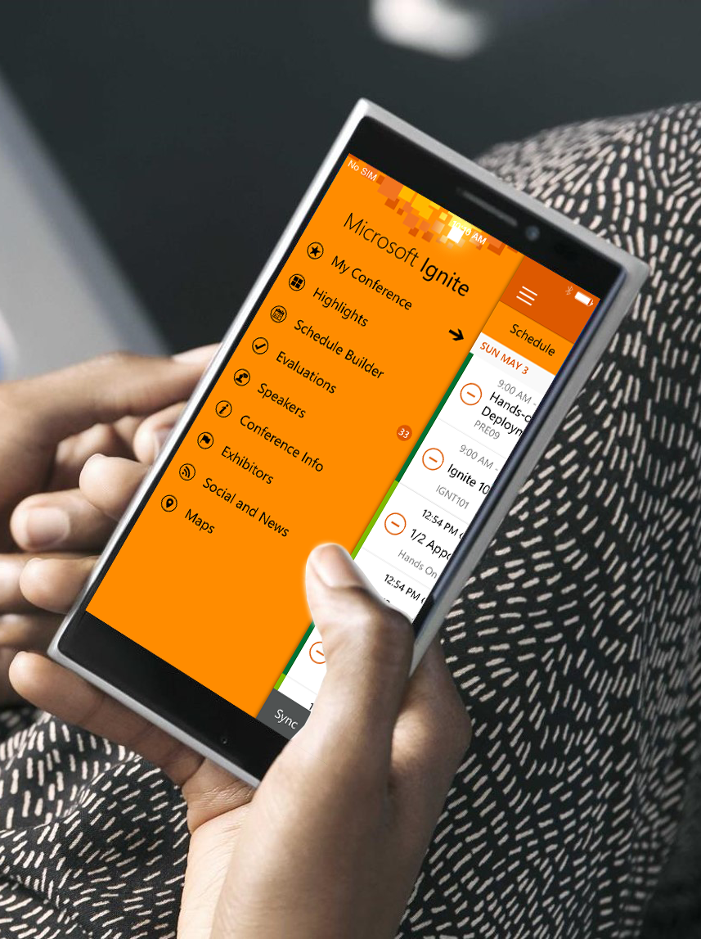
Please evaluate this session
Your feedback is important to us!
Visit Myignite at http://myignite.microsoft.com or download and use the Ignite Mobile App with the QR code above.

