Slide 2
Browser Security Overview
BRK2319
Fred Pullen

Slide 3
Browser Breakout Sessions at Microsoft Ignite
CR
Topic | Session | Topic | Speaker
Enterprise Guidance | BRK2338 | Enterprise Web Browsing | Fred Pullen
How do I upgrade to Internet Explorer 11? | BRK2307 | Enterprise Mode for Internet Explorer 11 Deep Dive | Deen King-Smith
 | BRK2312 | Web App Compat & Modernization for Nerds | Chris Jackson
Tell me about Microsoft Edge | BRK1301 | Microsoft Edge Overview | Fred Pullen
 | BRK2347 | Windows 10 Browser Management | Deen King-Smith
What about security? | BRK2319 | Browser Security Overview | Fred Pullen

Slide 4
Security Concepts

Slide 5
Important Security Concepts
Defense-in-depth | Provide multiple layers of protection against threats
Least privilege | Grant the least amount of privileges required for a user or resource to perform a task
Minimized attack surface | Reduce vulnerable points as much as is practical
Vulnerabilities | A flaw or weakness in a system’s design, implementation, or operation and management that could be exploited
Exploits | Software, data, or commands that take advantage of a vulnerability

Slide 6
Defense-in-Depth Security Strategy
Data
Policies,
Procedures,
Awareness
Application
Host
Internal Network
Perimeter
Physical

Slide 7
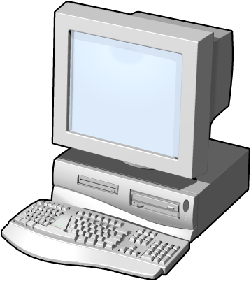
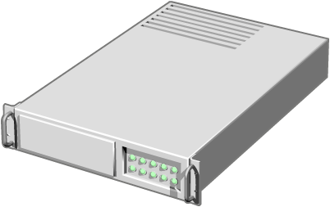
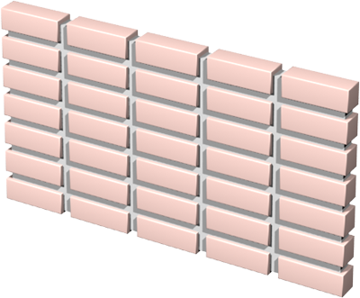
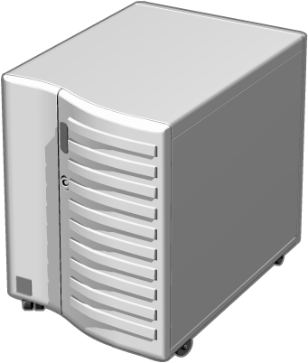

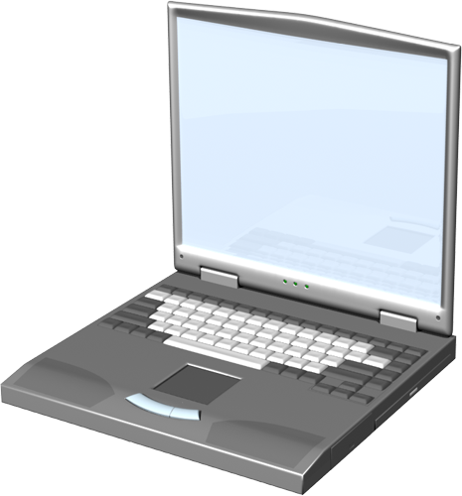

Least Privileged Security Strategy
Branch Office
Corporate Headquarters
LAN
LAN
Web
Server
Server
Remote
User
Internet
Wireless User

Slide 8
Minimized Attack Surface Security Strategy
Open
Closed
Security Continuum

Slide 9
Vulnerability Examples
  Physical
    Unlocked doors
    Unguarded access to computing facilities
    Insufficient fire suppression systems
  Natural
    Facility located on a fault line
    Facility located in a flood zone
    Facility located in an avalanche area
  Hardware
    Outdated firmware
    Systems not physically secured
    Misconfigured systems
  Software
    Out-of-date antivirus software
    Missing patches
    Complex applications
  Communications
    Unencrypted network protocols
    No filtering between network segments
  Human
    Poorly defined procedures
    Easy-to-guess passwords
  Media
    Electrical interference

Slide 10
Exploit Examples
  Tampering with data
    Causing a trusted entity to modify data improperly
    Creating an elevation-of-privilege attack
  Repudiation
    Circumventing security event logging
    Tampering with the security log to conceal the identity of an attacker
  Information disclosure
    Gaining access to data that is considered private and protected
    Data sniffing on a network
  Denial of Service
    Consuming CPU cycles by infinite programmatic looping
    Consuming excessive memory or file quotas
    Causing a crash, restart, or error
  Elevation of privilege
    Improperly gaining unrestricted rights
    Running untrusted data as native code in a trusted process
  Spoofing
    Changing the identity
    Subverting a secure logon mechanism
  Social engineering
    Coax a fellow worker into revealing their password
    Befriend someone to gain physical access
    Getting a user to click on an email link

Slide 11
Vulnerability Trends

Slide 12
Industry-wide vulnerability disclosures
Vulnerability disclosures across the industry in 1H14 were down 0.6 percent from 2H13, and up 4.7 percent from 1H13.

Slide 13
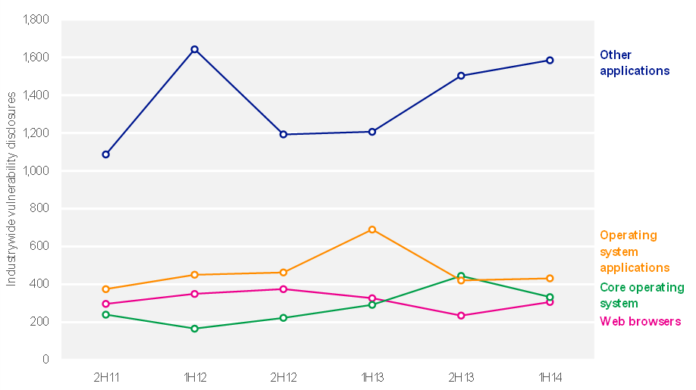
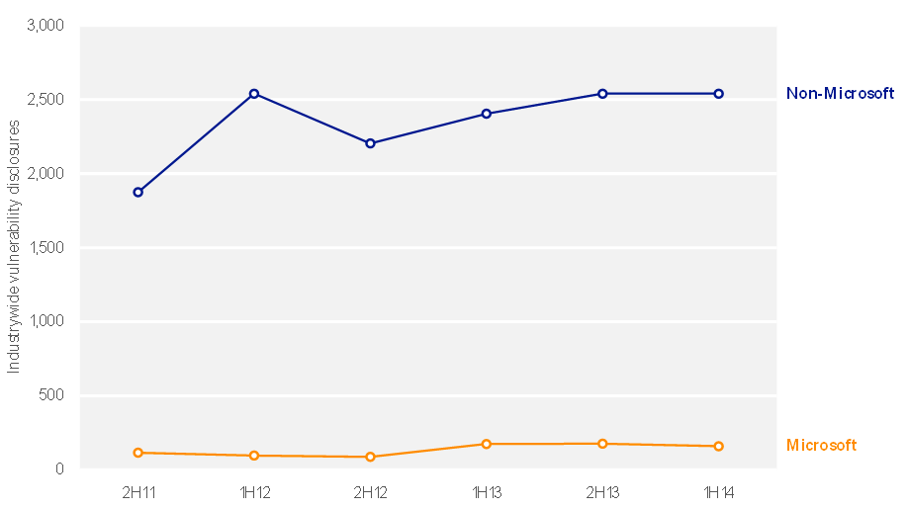
Industry-wide vulnerability disclosures
By severity
By access complexity
OS, browser, and application vulnerabilities
Industry-wide vulnerability disclosures

Slide 14
Exploit Trends

Slide 15
Exploit trends
Encounters with exploit kits and other HTML and JavaScript threats nearly doubled between 4Q13 and 2Q14, becoming the most commonly encountered type of exploit in the first half of the year.

Slide 16
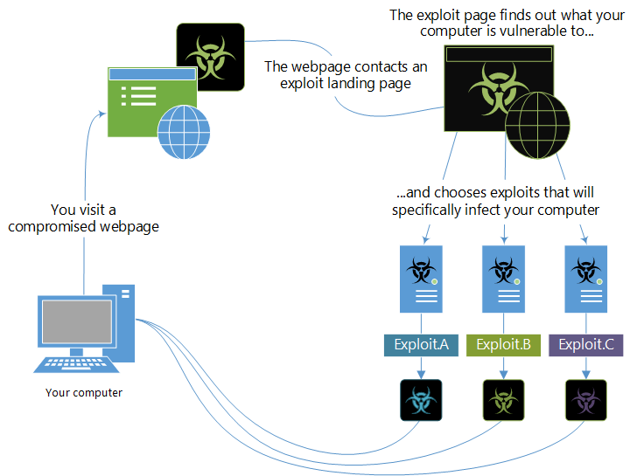
How exploit kits work

Slide 17
Exploit kits, HTML and JavaScript exploits
Although down considerably from its 2Q13 peak, HTML/IframeRef remained the top HTML/JavaScript exploit encountered in the second half of the year because of its popularity among attackers who use it to redirect browsers to websites containing malicious content.

Slide 18
Java exploits
Overall, encounters with Java exploits decreased significantly in 1H14
A new feature in Internet Explorer 11 provides an interface for security software to validate that a webpage is safe before allowing instantiation of ActiveX controls, such as the control that hosts embedded Java applets.

Slide 19
Adobe Flash Player exploits
Two of the most commonly encountered Adobe Flash Player exploit families in 2Q14, HTML/Fashack and HTML/Meadgive, are detections for exploit kits that target vulnerabilities in a number of popular browsers and add-ons.

Slide 20
Malware

Slide 21
Worldwide encounter and infection rates
Malware encounters are much more common than malware infections. On average, about 21.5 percent of reporting computers worldwide encountered malware over the past four quarters. At the same time, the MSRT removed malware from about 8.8 out of every 1,000 computers, or 0.88 percent.

Slide 22
Malware encounter rate trends by location
 | Country/Region | 3Q13 | 4Q13 | 1Q14 | 2Q14
1 | United States | 16.7 % | 13.0 % | 13.0 % | 12.3 %
2 | Brazil | 43.1 % | 36.8 % | 34.0 % | 30.5 %
3 | Russia | 31.7 % | 28.9 % | 28.7 % | 26.4 %
4 | Turkey | 41.3 % | 45.5 % | 45.7 % | 40.5 %
5 | France | 24.2 % | 23.0 % | 20.2 % | 16.8 %
6 | India | 51.0 % | 47.1 % | 50.5 % | 41.7 %
7 | Mexico | 39.8 % | 36.7 % | 38.6 % | 32.1 %
8 | Germany | 18.1 % | 14.8 % | 13.6 % | 13.5 %
9 | Italy | 28.3 % | 26.1 % | 25.5 % | 20.4 %
10 | United Kingdom | 18.2 % | 14.5 % | 13.5 % | 13.3 %

Slide 23
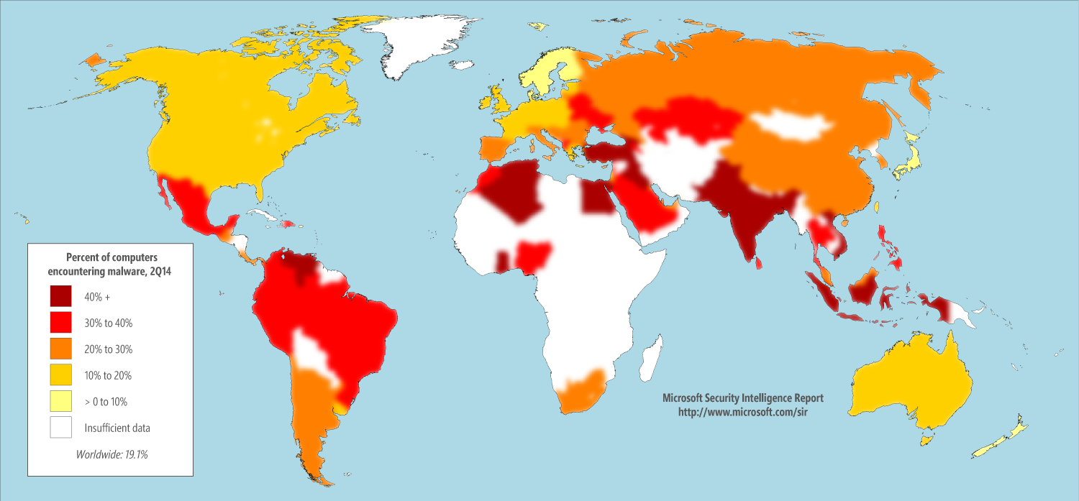
Encounter Rates
2Q14

Slide 24
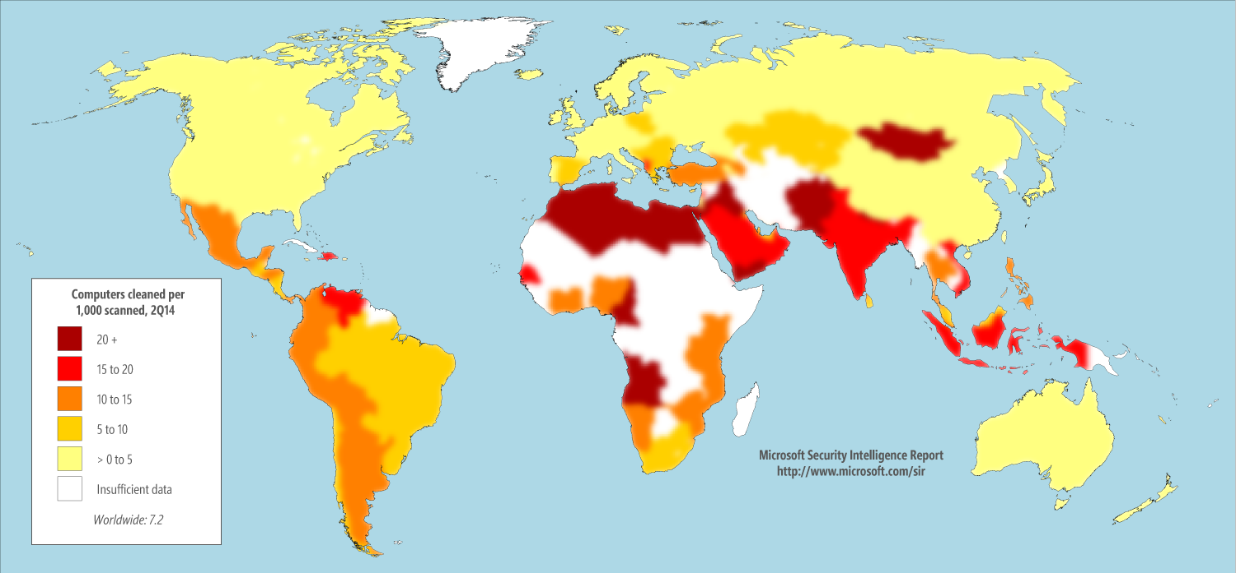
Computers Cleaned per Thousand
2Q14

Slide 25
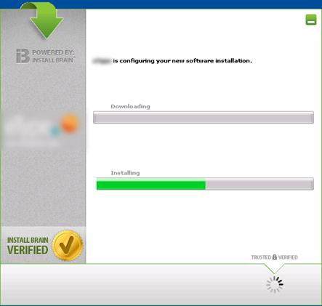
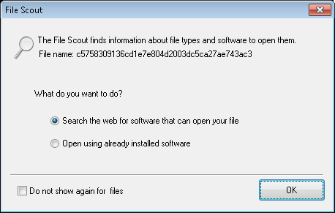
InstallBrain, File Scout, and Browser Protector

Slide 26
Computers Cleaned per Thousand
This data is normalized; that is, the infection rate for each version of Windows is calculated by comparing an equal number of computers
per version.

Slide 27
Encounter rate trends by threat category
Encounters with most categories of malware decreased or were mostly stable between 1Q14 and 2Q14. Exploits was the only category to show a significant increase, led by JS/Axpergle and JS/Neclu.

Slide 28
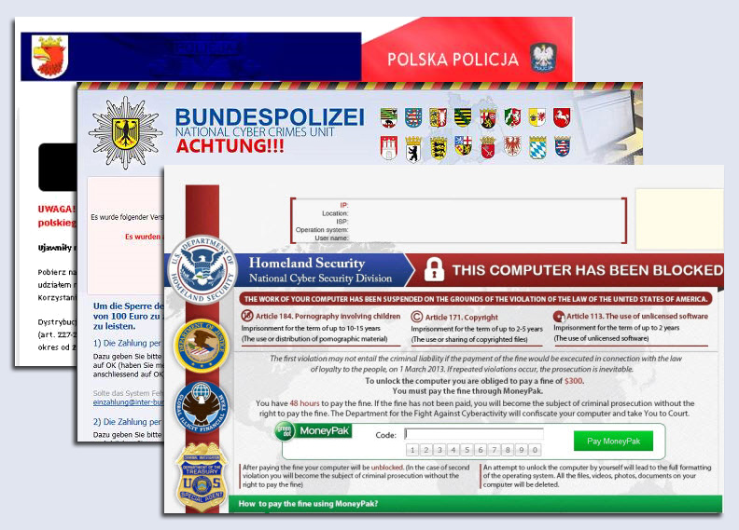
Ransomware

Slide 29
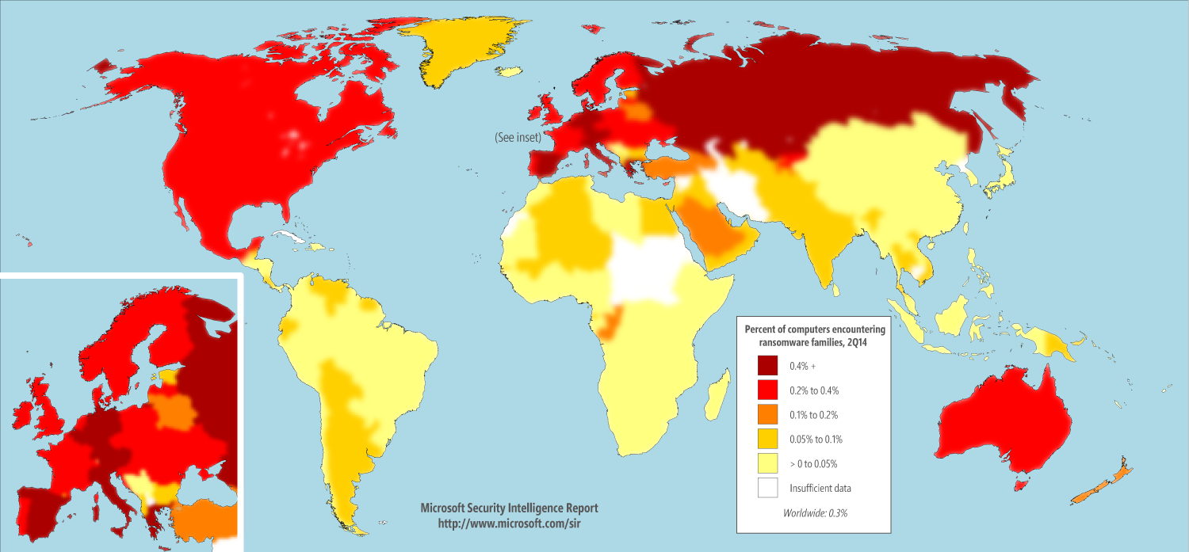
Ransomware by country or region
2Q14

Slide 30
Trends for ransomware families

Slide 31
Encounter rates, enterprise versus consumer
Consumer PCs tend to encounter malware at a higher rate than enterprise PCs. The encounter rate for consumer PCs was 2.4 times as high as that of enterprise PCs in 2Q14.

Slide 32
Malware categories, enterprise vs consumer

Slide 33
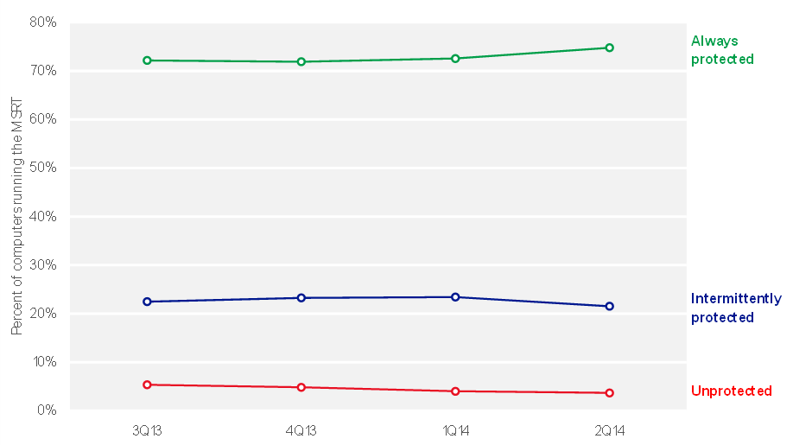
Security software use
Three-quarters of computers worldwide were found to be running real-time security software during every monthly MSRT execution in each of the past four quarters.

Slide 34
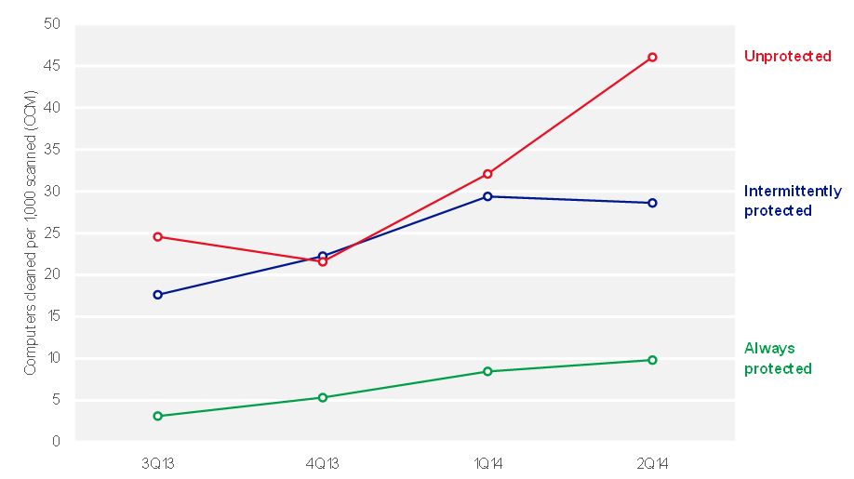
Computers Cleaned per Thousand
Computers that were never found to be running real-time security software during 1H14 were about 4 times as likely to be infected with malware as computers that were always found to be protected.

Slide 35
Malicious Websites

Slide 36
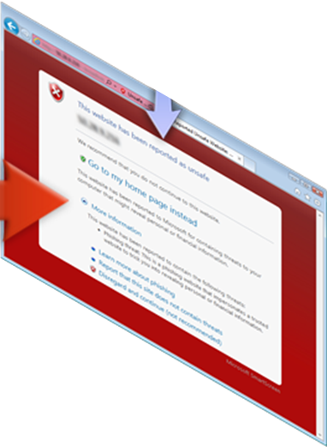
How Microsoft tracks Phishing impressions
1. The user views a phishing
message, in email or elsewhere, and is tricked
into clicking a link that leads to a malicious website.
2. SmartScreen Filter in Internet Explorer checks the Microsoft URL Reputation Service, determines that the web site is malicious, and blocks it.
3. The URL Reputation Service
records the anonymized
details of the incident
as a phishing impression.
Your Bank
Click here
USER
Microsoft Malware Protection Center
http://www.microsoft.com/security/portal

Slide 37
Phishing impression by type

Slide 38
Phishing URLs by type

Slide 39
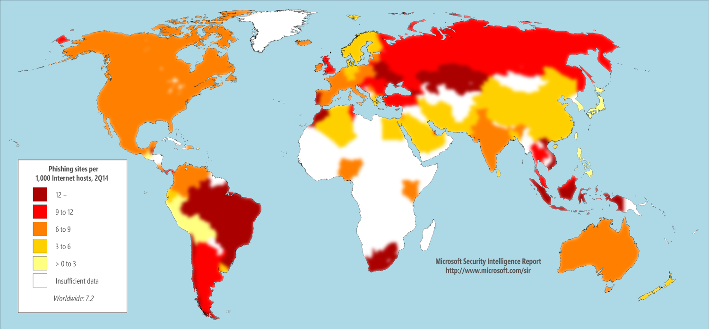
Phishing sites by country or region
2Q14

Slide 40
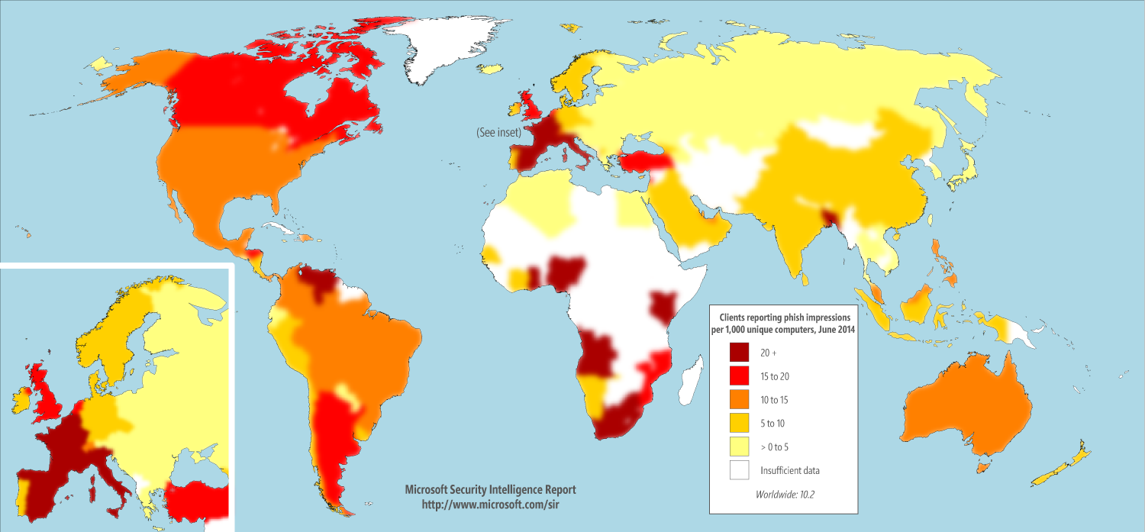
Phishing clients by country or region
2Q14

Slide 41
Threat types blocked by SmartScreen

Slide 42
Top malware families blocked by SmartScreen
 | Family | Most significant category | % of malware impressions
1 | Win32/Bdaejec | Backdoors | 14.84%
2 | Win32/Dowque | Downloaders & Droppers | 14.66%
3 | Win32/Microjoin | Downloaders & Droppers | 14.33%
4 | Win32/DelfInject | Obfuscators & Injectors | 13.28%
5 | Win32/Obfuscator | Obfuscators & Injectors | 2.94%
6 | Win32/Oceanmug | Downloaders & Droppers | 2.86%
7 | Win32/VB | Worms & Viruses | 2.82%
8 | Win32/Dynamer | Trojans | 2.50%
9 | Win32/Sisproc | Trojans | 1.44%
10 | Win32/Meredrop | Trojans | 1.15%
11 | Win32/Startpage | Trojans | 1.10%
12 | Win32/Bumat | Trojans | 1.04%
13 | Win32/Zegost | Backdoors | 0.99%
14 | Win32/Orsam | Trojans | 0.96%
15 | Win32/Banload | Downloaders & Droppers | 0.90%

Slide 43
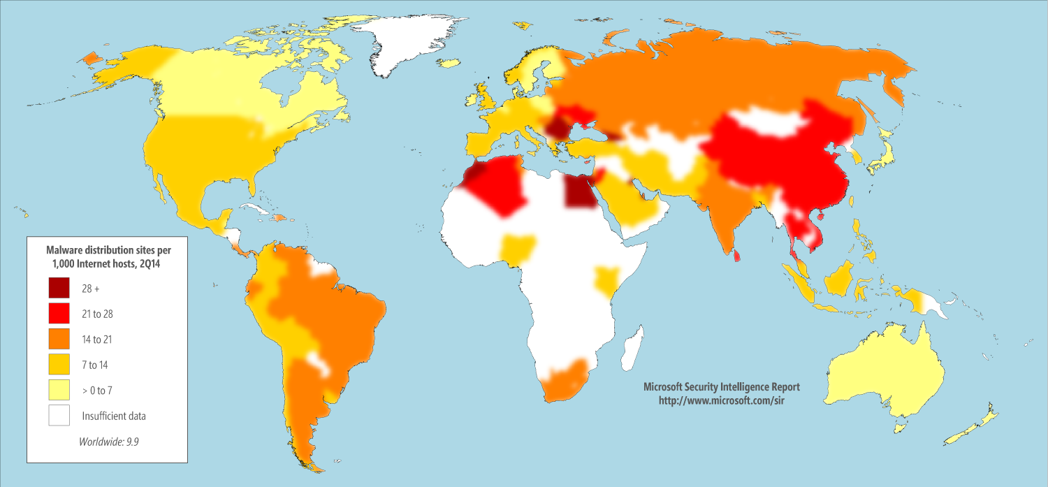
Malware distribution sites by country or region
2Q14

Slide 44
Browser Protections

Slide 45
Threat Focus Areas
Attacks on Users
Attacks on Browsers
Attacks on Websites
Isolation Model
64-bit memory protection
Block binary extensions
Out-of-date ActiveX control blocking
CFG
DEP/NX + ASLR
ForceASLR + HEASLR
Enhanced /GS
SEHOP
Protected Mode/Enhanced Protected Mode
Content Security Policy
Enhanced cert rep
HTML 5 Sandbox
XSS Filter
toStaticHTML
postMessage
Native JSON support
XDomainRequest / CORS XHR
Address Bar paste protection
HSTS
Next Generation Credentials
SmartScreen-Filter
Address Bar UI
EV Certificates
Tracking Protection
Social Engineering constitutes around 45% of all online threats

Slide 46
Internet Explorer Browser Architecture
User Interface
Page
Rendering
IEFrame
Browser Helper Objects
ActiveX
Toolbars
MSHTML
Script Engine
Binary
Behaviors
Mimefilters
URLMon
Network Request Layer
WinINet

Slide 47
Evolution of security in Internet Explorer
IE6
8/25/2004
Local Machine Zone Lockdown
Manage Add-Ons
Pop-Up Blocker
Information Bar (aka goldbar)
Mark of the Web
Attachment Execution Services (AES)

Slide 48
Evolution of security in Internet Explorer
IE6
8/25/2004
IE7
10/18/2006
Low Rights IE (LoRIE)
    Huge architectural change
  Protected Mode = low-IL + UIPI + brokers
Phishing Filter
Active X opt-in
No Add-Ons mode
IDN anti-spoofing
EV Certificates
Secure SSL enhancements

Slide 49
Evolution of security in Internet Explorer
IE6
8/25/2004
IE7
10/18/2006
IE8
3/19/2009
Loosely Coupled IE (LCIE)
DEP/NX
SmartScreen Filter
Per site and per-user ActiveX
Cross-site Scripting (XSS) Filter
tostaticHTML
Native JSON
CSS Expressions deprecated in standards mode
X-FRAME-OPTIONS

Slide 50
Evolution of security in Internet Explorer
IE6 8/25/2004
IE7
10/18/2006
IE8
3/19/2009
IE9
3/14/2011
Memory Protection Improvements
  SafeSEH
  SEHOP
  Enhanced GS
Application Reputation
Enhanced XSS Filter Performance
Download manager
Site Pinning
ActiveX Filtering

Slide 51
Evolution of security in Internet Explorer
IE6 8/25/2004
IE7
10/18/2006
IE8
3/19/2009
IE9
3/14/2011
IE10
10/26/2012
Enhanced Protected Mode
  AppContainer
  64-bit content process
Memory Protection Improvements
  ForceASLR
  HEASLR
  VTGuard
HTML5 Sandbox
Native Flash Support

Slide 52
Evolution of security in Internet Explorer
IE6 8/25/2004
IE7
10/18/2006
IE8
3/19/2009
IE9
3/14/2011
IE10
10/26/2012
IE11
10/17/13
Enhanced Protected Mode improvements
More granular feature options
IExtensionValidation anti-virus API
TLS 1.2 enabled by default
SmartScreen telemetry enhancements
WTD_MOTW flag for WinVerifyTrust calls
Password manager enhancements
Error message improvements
New: Memory protection improvements
New: SSL3.0 protocol & fallback disabled
Enhanced Mitigation Experience Toolkit (EMET)

Slide 53
64-bit Processes, ForceASLR, HEASLR
Top-down allocations
(PEBs, TEBs, MEM_TOP_DOWN)
Windows 7
Heaps, stacks, and PEBs/TEBs are randomized
Address space
Windows 8.1 / Windows 10
All bottom-up/top-down allocations are randomized
Accomplished by biasing start address of allocations
8 bits of entropy
Bottom-up allocations
(stacks, heaps, mapped files, VirtualAlloc, etc)

Slide 54
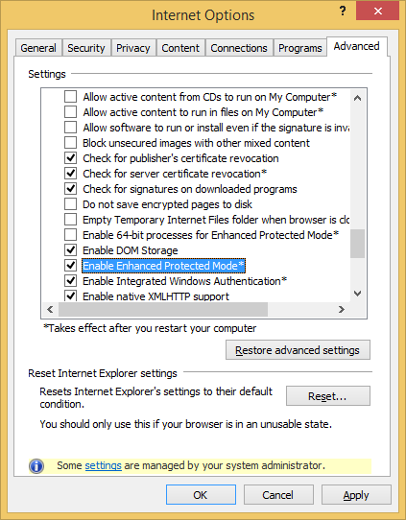
Enhanced Protected Mode
Enables AppContainer technology in Windows 8.1 / Windows 10
Can be used with 64-bit processes for even better security
EPM incompatible add-ons aren’t loaded by default

Slide 55
AppContainer
MostRestrictedAC | LeastRestrictedAC | LowIL Not AC (LILNAC)
documentsLibrary | documentsLibrary | documentsLibrary
enterpriseAuthentication | enterpriseAuthentication | enterpriseAuthentication
internetClient | internetClient | internetClient
internetClientServer | internetClientServer | internetClientServer
location | location | location
microphone | microphone | microphone
musicLibrary | musicLibrary | musicLibrary
picturesLibrary | picturesLibrary | picturesLibrary
privateNetworkClientServer | privateNetworkClientServer | privateNetworkClientServer
proximity | proximity | proximity
removableStorage | removableStorage | removableStorage
sharedUserCertificates | sharedUserCertificates | sharedUserCertificates
videosLibrary | videosLibrary | videosLibrary
webcam | webcam | webcam
Key
Available
Subscribed

Slide 56
Enhanced Protected Mode Process Model
High-IL
Ieinstal.exe
Medium-IL
Intranet
Manager
Broker
Browser
Input
Low-IL
Compat
Enabled for Protected mode
windows_ie_ac_122
Partner
windows_ie_ac_001
Internet

Slide 57
IE Sandbox Security Surface Area
Elevation Broker
Manager
Elevation APIs
(130+)
Wininet APIs
(5)
Local APIs
(50+)
Browser APIs
(100+)
Wininet APIs
(8)
Hardened COM
Kernel Objects
File/Registry
Iso
Unhardened COM
Security Proxies
APIs to secure:
  Elevation APIs
  Browser APIs
  Wininet APIs
  Local APIs

Slide 58
Microsoft Edge

Slide 59

Microsoft Edge
Microsoft Edge is a modern app
  Always up-to-date
  Execution state management
  AppContainer isolation
  Store deployment
  EdgeHTML is a new browser engine
  Evergreen rendering engine
  Updated through Windows Update
Microsoft Edge is a browser re-imagined
  Prioritizes security and interoperability over legacy compatibility

Slide 60
Microsoft Edge Process Model
High-IL
Medium-IL
Elevation Consent
Broker
Smaller security surface than IE
Package-AC
Manager
Browser
Input
Microsoft Edge_rac_121
ServiceUI
Microsoft Edge_rac_120
Intranet
Microsoft Edge_rac_001
Internet

Slide 61
Microsoft Edge Manager Security Surface
Manager
Local APIs
(50+)
Browser APIs
(100+)
Wininet APIs
(8)
Kernel Objects
File/Registry
Iso
Unhardened COM
Security Proxies
Microsoft Edge manager is isolated from untrusted content

Slide 62
Microsoft Edge Elevation Broker Security Surface
Elevation Broker
Elevation APIs
(6)
Wininet APIs
(5)
Download APIs
(7)
Hardened COM
Unsecure COM
Elevation Broker surface is smaller and safer than IE/Manager
  Elevation APIs
  Wininet APIs

Slide 63
HTTP Strict Transport Security
Threat: Initial contact to http://contoso.com/ is plaintext, and vulnerable to MitM attacks
HSTS: Pins self-selected sites into the browser, says “initial contact to this origin should be HTTPS”
Value prop: Block wifi, nation-state attacks against naïve initial contact

Slide 64
CSP: Content Security Policy 1.0
Threat: XSS (Cross-Site Scripting) because the web is inherently vulnerable to injection attacks
  Code mixed with data → injection attacks
Mitigation: declarative policy web site can deploy that specifies where JS can come from
Limit: needs to be supported both by the browser and the web site
  … and it is a lot of work for the web site, so most have not done it

Slide 65
Enhanced Certificate Reputation
http://blogs.msdn.com/b/ie/archive/2015/03/10/certificate-reputation-for-website-owners.aspx
Threat: fraudsters, nation state attackers—or just bad CAs—impersonate your cert
Mitigation: allows web site operators to observe stuff about their certs, so they can call “shenanigans!”

Slide 66
NGC: Next Generation Creds
Threat: cookies are “bearer authN”, attacker can steal your cookies and use them to authN to a server from anywhere
Mitigation: crypto pins your cookies to your box

Slide 67
Microsoft Edge is 64-bit Only
IE can run in 64-bit processes
  But this is not the default
  Many extensions drag it back to 32-bit
Microsoft Edge is 64-bit all the time
  Only setting on 64-bit Windows
  No binary extensions, so nothing that needs 32-bit

Slide 68
No “3rd Party” Binary Extensions
IE Binary extensions are in-proc COM objects
  Each one adds attack surface area
  Vulnerable add-on surface area is additive
  ActiveX install broker surface area
Mitigation: no binary extensions in Microsoft Edge
  Flash in-box, maintained by Windows Update
  Some additional 1st party components
  JS/HTML extension model

Slide 69
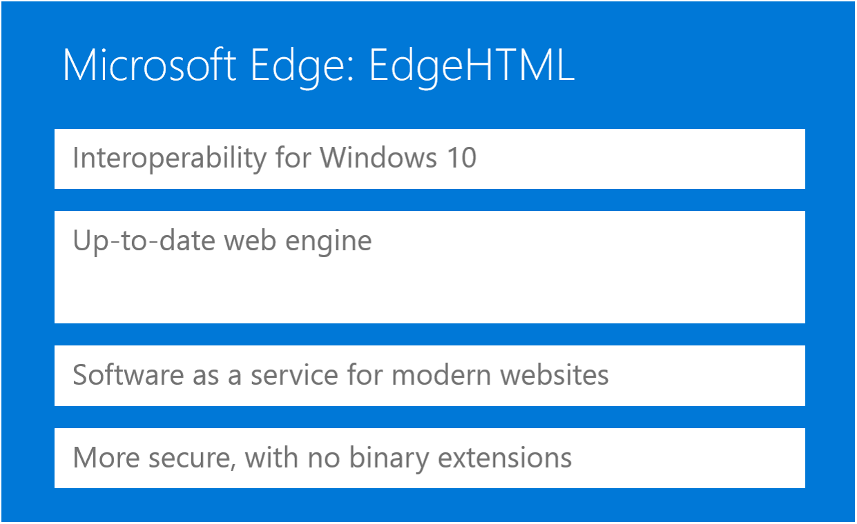
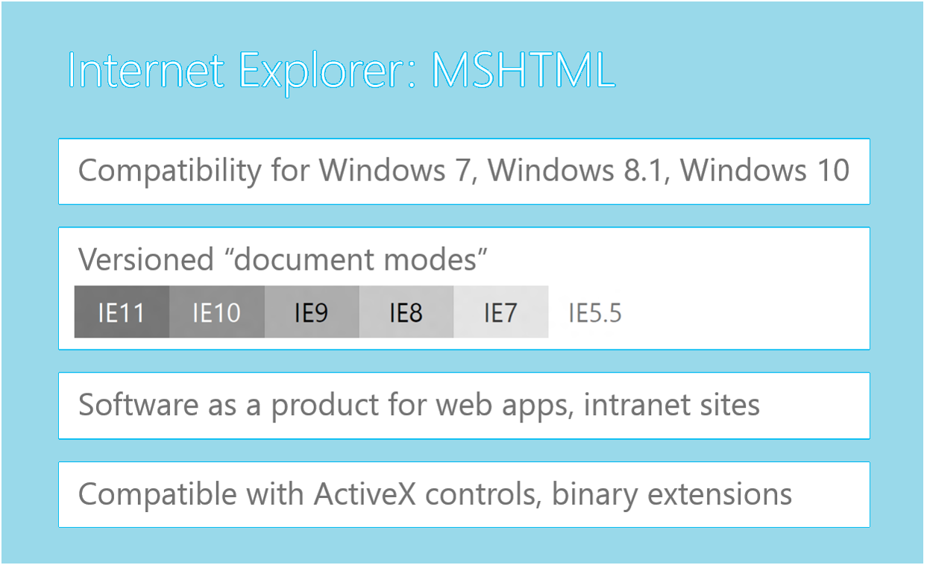
Windows 10 Browsing Engines
Internet Explorer: MSHTML
Internet Explorer 11: MSHTML
Interoperability & Compatibility
Versioned “document modes”
For modern HTML websites, intranet & Enterprise Mode
Compatible with ActiveX controls, binary extensions

Slide 70
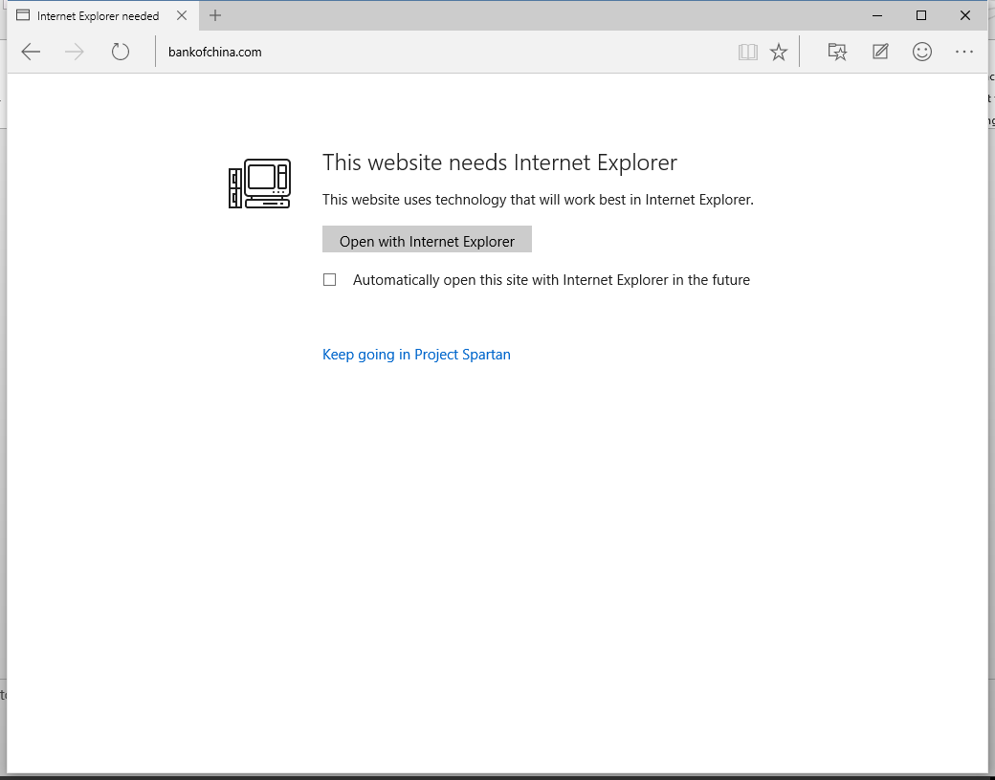
Microsoft Edge is default, but IE is still available
Why do you need Internet Explorer?
  Sites that require older Document Modes or Enterprise Mode
  Web apps that depend on BHOs or toolbars
  Sites that depend on ActiveX controls other than Flash
  Enterprises that have apps that are only certified for use with Internet Explorer
You can configure Microsoft Edge to fall back to IE11
only for sites that need it, to minimize security risks.

Slide 71
Guidance & Resources

Slide 72


Browser Security Guidance
IT Guidance
User Guidance
Keep all your software updated—not just antimalware
Upgrade to Internet Explorer 11 to continue receiving security updates after January 12, 2016
Stay current on the latest threat and mitigation information, such as security bulletins and the Microsoft SIR
Use least privileged and defense in depth security strategies – investigate EMET for even better Internet Explorer security
Security means tradeoffs – Microsoft Edge is more secure than Internet Explorer, but not as compatible
Use caution when clicking on links and logging into web pages – use site pinning instead
Use caution with attachments and file transfers
Avoid downloading suspicious software
Protect yourself from social engineering attacks
Use caution when clicking on links to Web pages
Use caution with attachments and file transfers
Avoid downloading pirated software
Protect yourself from social engineering attacks

Slide 73
Browser Security Resources
CR
Microsoft Security Intelligence Report: www.microsoft.com/sir
Microsoft Trustworthy Computing: www.microsoft.com/twc
Microsoft Security Blog: blogs.microsoft.com/cybertrust

Slide 74
The Ten Immutable Laws of Security (2011)
If a bad guy can persuade you to run a program on your computer, it’s not solely your computer anymore.
If a bad guy can alter the operating system on your computer, it’s not your computer anymore.
If a bad guy has unrestricted physical access to your computer, it’s not your computer anymore.
If you allow a bad guy to run active content in your website, it’s not your website any more.
Weak passwords trump strong security.
A computer is only as secure as the administrator is trustworthy.
Encrypted data is only as secure as its decryption key.
An out-of-date antimalware scanner is only marginally better than no scanner at all.
Absolute anonymity isn’t practically achievable, online or offline.
Technology is not a panacea.

Slide 75
Browser Session Schedule at Microsoft Ignite
CR
Day | Time | Location | Topic | Speaker
Monday | 1:30pm | E253 | Microsoft Edge Overview | Fred Pullen
 | 6:00pm | Hall A1/A2 | Ask the Experts
Tuesday | 9:00am | S401 | Enterprise Web Browsing | Fred Pullen
Wednesday | 9:00am | E451b | Windows 10 Browser Management | Deen King-Smith
 | 3:15pm | E451b | Browser Security Overview | Fred Pullen
Thursday | 9:00am | N427 | Enterprise Mode for Internet Explorer 11 Deep Dive | Deen King-Smith
 | 3:15pm | S502 | Web App Compat & Modernization for Nerds | Chris Jackson
 | 11am-5pm | N135 | Drop-In App Compat Troubleshooting Workshop

Slide 76


Please evaluate this session
Your feedback is important to us!
Visit Myignite at http://myignite.microsoft.com
or download and use the Ignite Mobile App
with the QR code above.

