Slide 2
Secure Authentication with Windows Hello
BRK2324
Nelly Porter
Principal Program Manager Lead
OS Security

Slide 3
shhh!
Shared secrets
Easily breached, stolen, or phished

Slide 4
Replace passwords with a private key made available solely through a “user gesture” (PIN, Windows Hello, remote device, etc.)
introducing
Microsoft "Passport"
Support both local Passport and Passport2Go (phone, USB dongle, etc.)
Introduce MSFT Passport because of its convenience first and security first,
UX must be at least as good as with passwords
GOALS:

Slide 5
To IT it’s familiar as it’s based on certificate or asymmetrical key pair
using
Microsoft "Passport"
To the user, it’s familiar, Windows Hello or PIN user gesture
Proof-able with OTP, Code and PhoneFactor …
Public key of Passport is mapped to an user account
THE CREDENTIAL

Slide 6
Keys are ideally generated in hardware (TPM) first, software as a last resort
using
Microsoft "Passport"
Hardware-bound keys can be attested
Single “unlock gesture” provides access to multiple credentials origin isolated
THE USAGE
Browser support via JS/Webcrypto apis to create and use Passport for users

Slide 7
Authentication For Orgs & Consumers
Create Account or
Proves Identity
1
Create and trust my unique key or
Authenticate me by validating this signed request
User Unlock Windows identity container w/ PIN or Bio
2
IDP
Active Directory
Azure Active Directory
Microsoft Account
Other IDP’s
User
Here is your authentication token
I trust tokens from IDP
A NEW APPROACH: KEY BASED
Intranet
Resource
4
3
So do I
Windows 10
Intranet
Resource
4

Slide 8
Authentication For Orgs & Consumers
Hardware Secured Keys
Default Container
Enterprise Container
Microsoft Account
Enterprise IDP
Consumer IDP 1
Consumer IDP 2
TPM

Slide 9
Why Windows Hello?
A baby can identify its mother by the time it's a month old
Our devices could not do it
None of our senses operated in the digital world
until recently

Slide 10
Biometric Authentication in Windows 10
Windows 10 is moving the world to a more secure, password-free experience, powered by Microsoft Passport and Biometrics……
Windows Hello introduces system support for biometric authentication – using your face, iris, or fingerprint to unlock your devices
Convenient device logon and strong user authentication
Enterprise level security and access to High Business Impact data and resources via Microsoft Passport
Consistent inbox user enrolment and usage across Windows enabled biometric devices

Slide 11
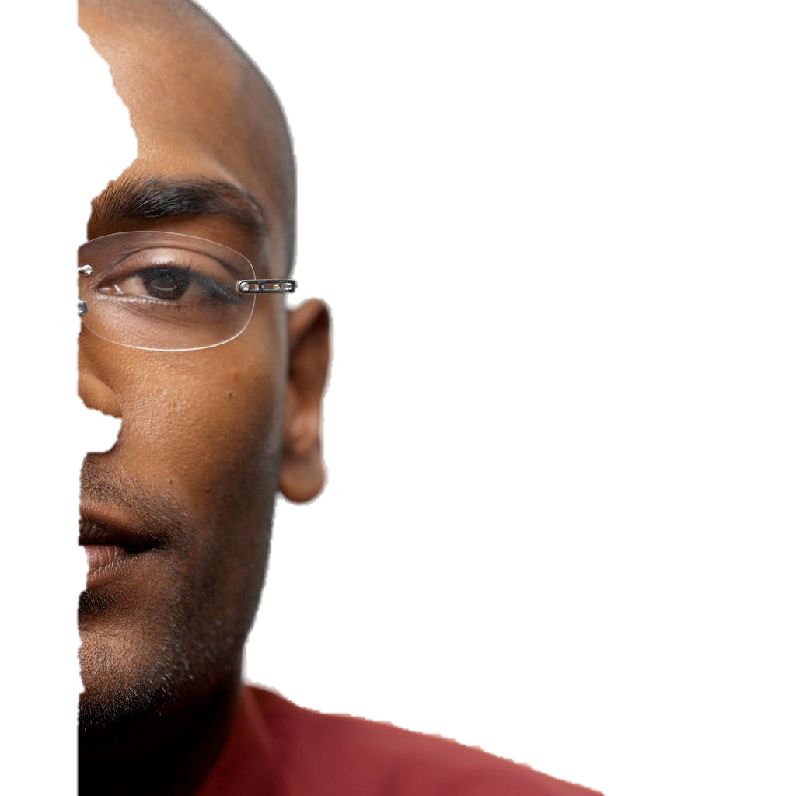
Biometrics Steps
Face, iris and fingerprint share the same design language for enrollment, usage, and recovery with Windows Hello
Enrollment
Usage
authentication and presence monitoring
Recovery

Slide 12
Enrollment
:)
Discover Landmarks
Detect Head
Orientation
Build & Secure
Vector based Template
Find a Face

Slide 13
Usage
:)
Detect head
Orientation
Build Vector based Representation
Does it match a Template?
Find a Face
Discover Landmarks

Slide 14
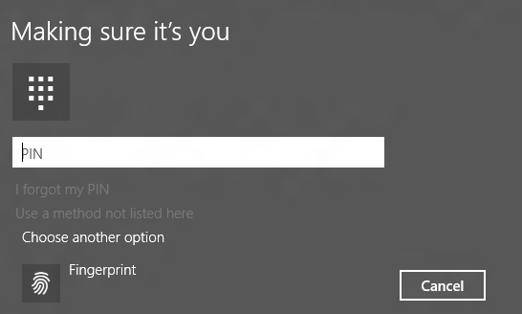
Recovery
:)
Type a PIN to verify your identity
Find a Face
Does not Match Template

Slide 15
Authentication vs. Identification
Not every biometric modality is created equal
False Acceptance rate (FAR)
False Rejection Rate (FRR)
“Liveness” and anti-spoofing

Slide 16
Windows Hello Security Requirements
Demonstrate False Acceptance Rate (FAR): 1/100,000
With False Rejection Rate: 2-4%,
Provide live-ness measures
Enable anti-spoofing detection
Integrated with Windows Biometric Framework

Slide 17
False Acceptance Rate, What is that?

Slide 18
The Face Authentication
Machine learned 1/100,000 False Accept Rate Threshold
Over 4.3 million test combinations
Machine learning based accuracy threshold
Validated against ~2,000 unique faces
Large representative sample
over 13,000 unique faces captured so far (Target 30k)
Mix of ethnicities, height, weight, skin color, glasses, etc.
Variety of possible angles and lighting conditions
Captured on reference hardware

Slide 19
False Rejection Rate, What is that?

Slide 20
Live-ness and Anti-spoofing?

Slide 21
Biometric as a second factor
System will only authorize use of Microsoft Passport keys when
User submits a matching biometric sample at the moment of authorization, and
The system determines that the sample is “live”
Our goal is to make Biometrics non-susceptible to
Spoofing and replay attacks
Attacks by privileged code on a compromised system
Offline attacks

Slide 22
Windows Biometrics Framework, What is that?

Slide 23
Windows Biometric Framework
Enrollment
Biometric
Credential
Provider
Win32
Apps
UAP apps
Windows Runtime (WinRT)
Windows Biometric Client API (WinBio.DLL)
Windows Biometric Service
Storage Adapter
(inbox but can be replaced by 3rd party if needed)
Engine Adapter
Sensor Adapter
(inbox but can be replaced by 3rd party if needed)
Windows Biometric Device Interface (WBDI) Driver
Sensor
OS component
3rd party application
3rd party driver and companion components

Slide 24
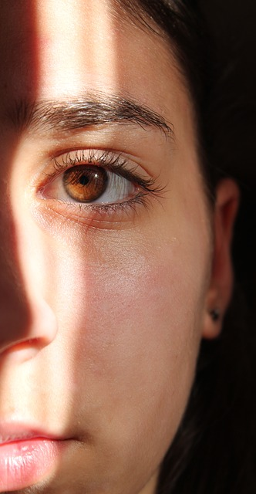
Windows Hello with Iris and Face
Inbox functionality
Works across a variety of devices running Windows 10
Integrated anti-spoofing countermeasures to mitigate physical attacks
Consistent image (via IR) in diverse lighting conditions
allows for subtle changes in appearance -- including facial hair, cosmetic makeup, eyewear, etc.

Slide 25
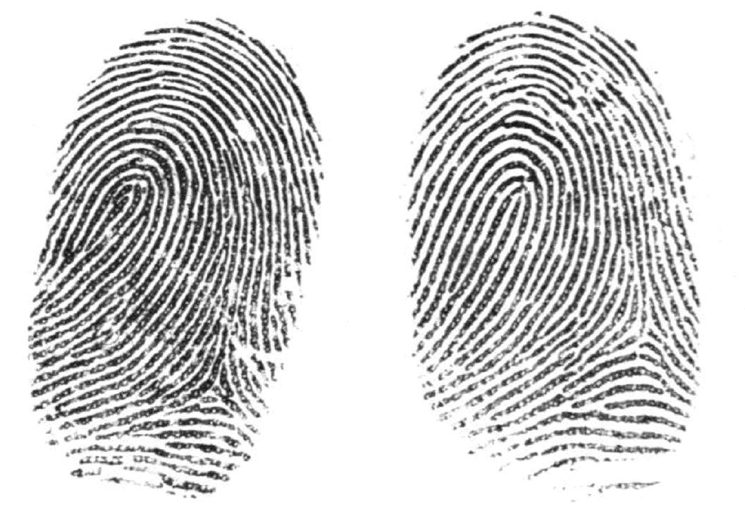
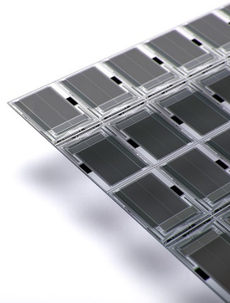
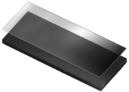
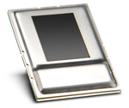
State of the Art – Windows Hello Fingerprints
The World is moving towards small, touch based Sensors.
These sensors can fit on almost any device
Taken from www.fingerprints.com – image of the Huawei’s Ascend Mate 7
Fingerprint Sensor FPC1021
Fingerprint Sensor FPC1150
Next Biometrics NB-1010-S
Thermal
Capacitive (CMOS)
Ultrasound

Slide 26
State of the Art – Windows Hello Fingerprints
So why do we need to change our experiences?

Slide 27
Summary
Windows 10 is moving the world to a more secure, password-free experience, powered by Microsoft Passport and Windows Hello……
Windows Hello introduces system support for biometric authentication
your face, iris, or fingerprint
convenient device logon and strong user authentication
enterprise level security and access to High Business Impact (HBI) data and resources via Microsoft Passport
consistent inbox user enrolment and usage experiences

Slide 28
Goodbye Ignite!

Slide 29
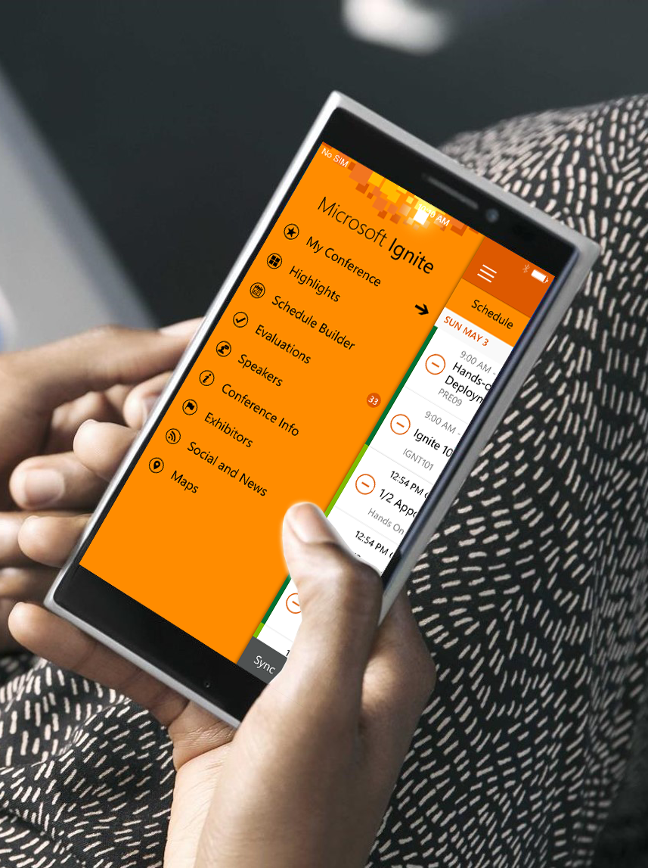
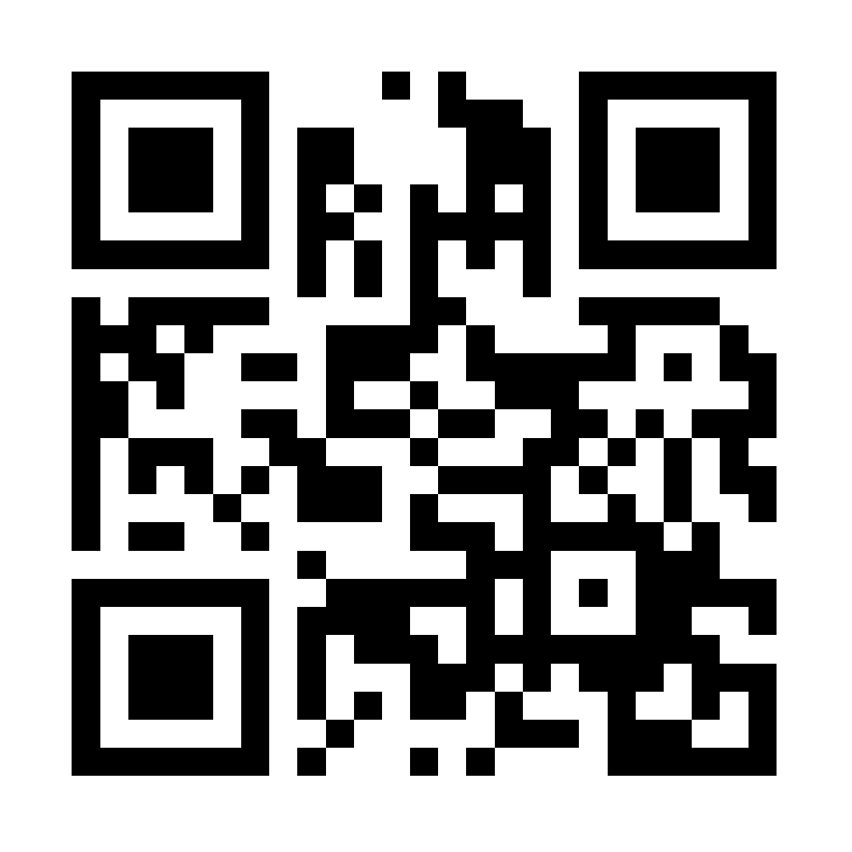
Please evaluate this session
Your feedback is important to us!
Visit Myignite at http://myignite.microsoft.com or download and use the Ignite Mobile App with the QR code above.

