Slide 2
Goodbye Passwords,
Say Hello to Microsoft Passport
BRK2333
Nelly Porter
Principal Program Manager Lead
OS Security

Slide 3
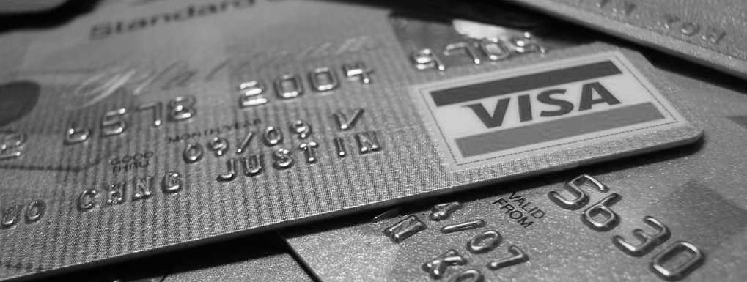
Password theft is today’s crisis
Hackers Steal 1.2 Billion Usernames and Passwords, Security Firm Says
“…Hackers hit some 420,000 Web addresses for both large and small sites.” … “including leaders in virtually all industries across the world, as well as a multitude of small or even personal websites,”
Danny Yadron
Wall Street Journal
August 5, 2014
Source: “Russian Hackers Steal 1.2 Billion Usernames…” Wall Street Journal, August 5, 2014

Slide 4
shhh!
Shared secrets
Easily breached, stolen, or phished

Slide 5
Replace passwords with a private key made available solely through a “user gesture” (PIN, Windows Hello, remote device, etc.)
introducing
Microsoft "Passport"
Support both local Passport and Passport2Go (phone, USB dongle, etc.)
Introduce MSFT Passport because of its convenience first and security first,
UX must be at least as good as with passwords
GOALS:

Slide 6
To IT it’s familiar as it’s based on certificate or asymmetrical key pair
using
Microsoft "Passport"
To the user, it’s familiar, Windows Hello or PIN user gesture
Proof-able with OTP, Code and PhoneFactor …
Public key of Passport is mapped to an user account
THE CREDENTIAL

Slide 7
Keys are ideally generated in hardware (TPM) first, software as a last resort
using
Microsoft "Passport"
Hardware-bound keys can be attested
Single “unlock gesture” provides access to multiple credentials origin isolated
THE USAGE
Browser support via JS/Webcrypto apis to create and use Passport for users

Slide 8
Authentication For Orgs & Consumers
Create Account or
Proves Identity
1
Create and trust my unique key or
Authenticate me by validating this signed request
User Unlock Windows identity container w/ PIN or Bio
2
IDP
Active Directory
Azure Active Directory
Microsoft Account
Other IDP’s
User
Here is your authentication token
I trust tokens from IDP
A NEW APPROACH: PASSPORT BASED
Intranet
Resource
4
3
So do I
Windows 10
Intranet
Resource
4

Slide 9
Authentication For Orgs & Consumers
Hardware Protected Keys
Default Container
Enterprise Container
Microsoft Account
Enterprise IDP
Consumer IDP 1
Consumer IDP 2
TPM

Slide 10
Passport 2Go

Slide 11


Slide 12
Passport Story

Slide 13
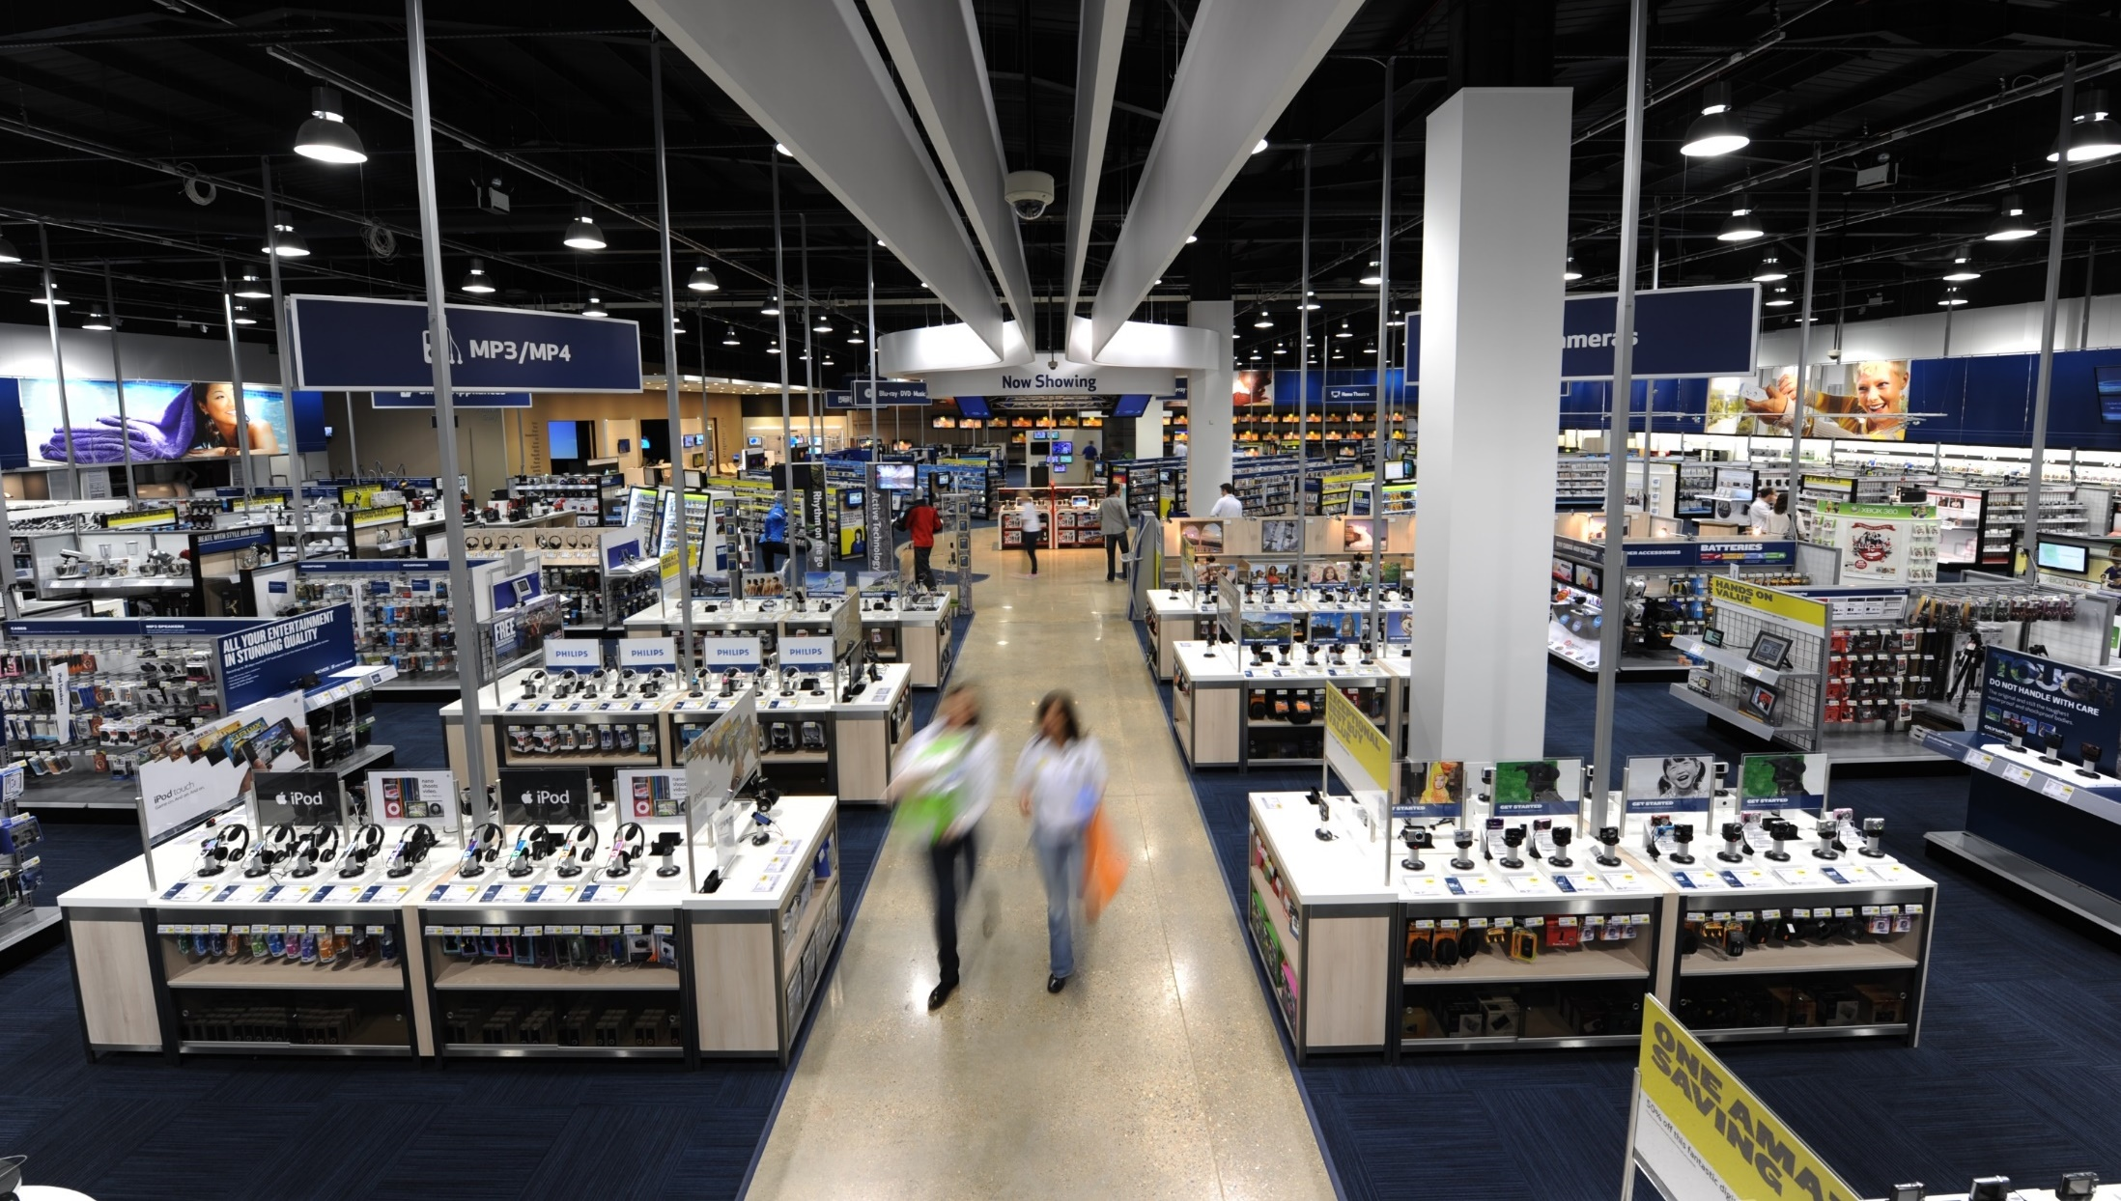

Slide 14
Irwin works for a company that provides consulting services to Contoso… Contoso provides cloud-only accounts (Azure AD) to its partners when necessary… Irwin has a long term engagement which requires him to have an AAD Starbucks account
As part of his engagement with Contoso he is given an allowance to purchase a device to use in Contoso related projects

Slide 15
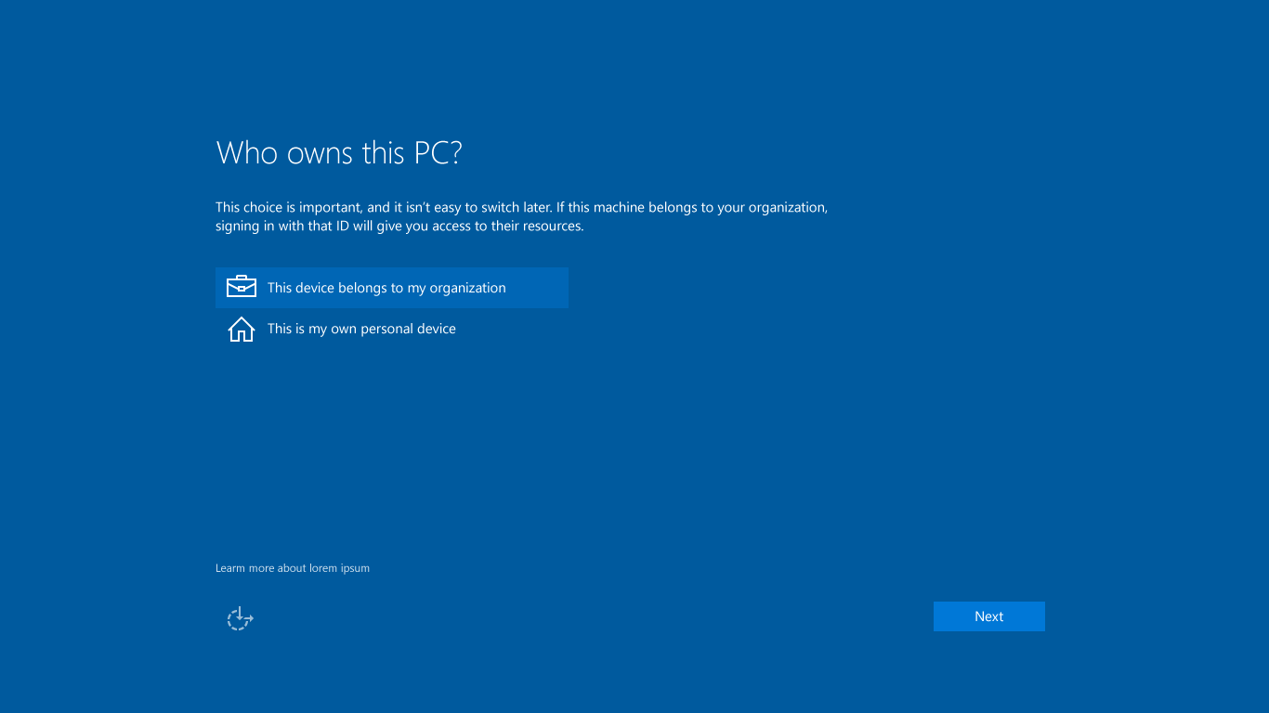

Screen painted by Membership team
Who owns this PC?
This choice is important, and it isn’t easy to switch later. If this machine belongs to your organization, signing in with that ID will give you access to their resources.
This device belongs to my organization
This device belongs to me
Help me choose
Next
Back
Next

Slide 16

Screen painted by IDX team
Choose how you’ll connect
You can connect Windows to your organization in one of two ways:

Join to Azure AD

Set up a local account (domain join later)
Choose this option if your organization uses Office 365 or other business services from Microsoft. Your organization might collect info about you, install or remove apps, change settings or disable features, delete content, or reset your device. Talk to your support staff to learn more.
Back
Continue

Slide 17
AAD sign in page, username entry
Let’s get you signed in
Work or school account
irwiin@starbucks.com
Password
I forgot my password
Which account should I use?
Sign in with the username and password you use with Office 365 (or other business services from Microsoft).
Skip this step
Privacy statement
Back
Sign in

Slide 18
AAD sign in page, home realm discovery
Let’s get you signed in
Work or school account
irwin@starbucks.com
٠ ٠ ٠ ٠ ٠ ٠٠
Password
I forgot my password
Which account should I use?
Sign in with the username and password you use with Office 365 (or other business services from Microsoft).
Skip this step
Privacy statement
Back
Sign in

Slide 19
AAD sign in page, password entered
Let’s get you signed in
Work or school account
irwin@starbucks.com
••••••••
I forgot my password
Need help?
Contact the Starbucks Help Desk at (206) 555-1234. This service is operated by Microsoft on behalf of Starbucks and is for the exclusive use of their employees and partners.
Skip this step
Privacy statement
Back
Sign in

Slide 20
AAD sign in page, redirect to ADFS (for federated user)
Taking you to the sign-in page for
your organization

Slide 21
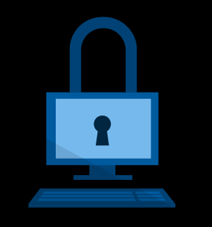
PIN collection for AAD NGC container (post logon task)
Create a work PIN
You’ll use your work PIN to unlock this device and access your organization’s apps and services.
A PIN is faster to use and more secure than a password. How can short PIN be safer than a long password?
Create PIN

Slide 22
Popup text with details
Create a work PIN
You’ll use your work PIN to unlock this device and access your organization’s apps and services.
A PIN is faster to use and more secure than a password. How can short PIN be safer than a long password?
Because it’s not about size, really.
What matters more is that your PIN doesn’t work with any device but this one.
Think of an ATM: A thief couldn’t just steal your PIN, then put his own card in a cash machine and take your money. He’d have to have your card. Similarly, the PIN you create here is useless to a distant hacker—your PIN works only with your device.
Create PIN

Slide 23

Select a verification option


Send a text message to my phone number ending in 77


Call me at my phone number ending in 77


Send a notification to my authenticator app


Use my authenticator app to get a security code
Back
Next

Slide 24
Select a verification option


Send a text message to my phone number ending in 77


Call me at my phone number ending in 77


Send a notification to my authenticator app


Use my authenticator app to get a security code
Back
Next

Slide 25
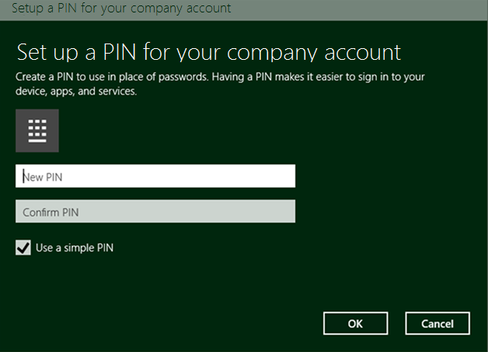
… which is immediately hidden by CredUI
Create a work PIN
Create a work PIN
You’ll use your work PIN to unlock this device and access your organization’s apps and services.
Use a 4-digit PIN

Slide 26
Cred UI version with custom complexity policy
Create a work PIN
Create a work PIN
You’ll use your work PIN to unlock this device and access your organization’s apps and services.
PIN complexity requirements

Slide 27
Cred UI version with custom complexity policy – more details shown on click
Create a work PIN
Create a work PIN
You’ll use your work PIN to unlock this device and access your organization’s apps and services.
Your organization has set the following PIN complexity requirements:
Minimum length is 8
Maximum length is 127
An uppercase letter is required
…

Slide 28
The moment the user clicks on “Create PIN”, we replace the page with a spinner…
Applying changes. This might take a minute…

Slide 29
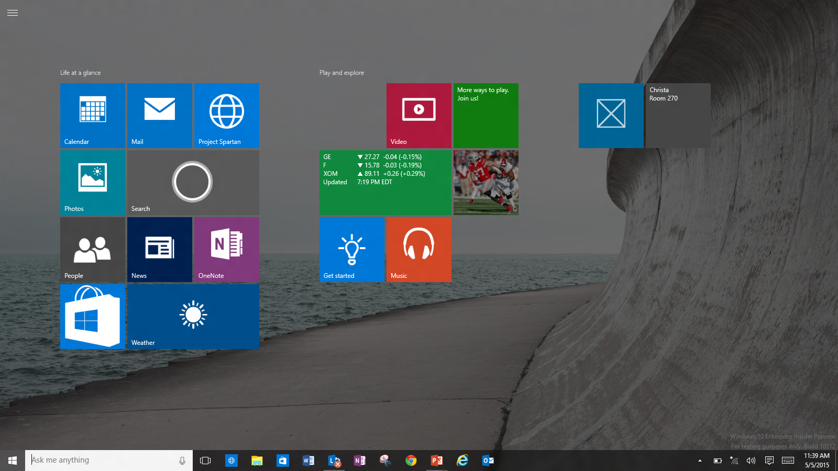
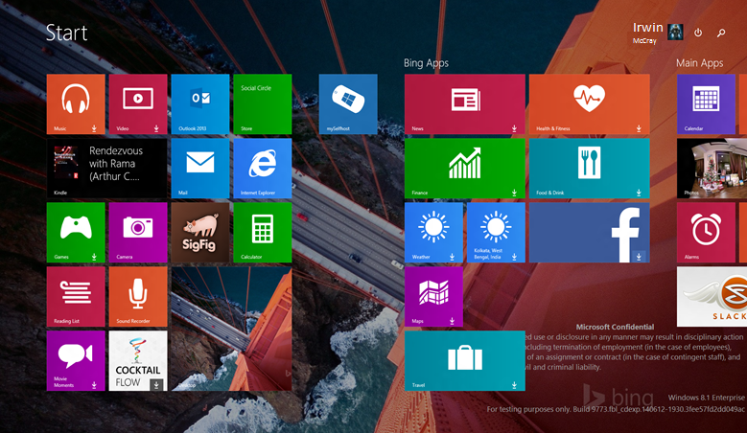

If user enters correct PIN and press OK, we return to the spinner page which will show while the NGC container is created. This may take a few seconds.
Surface

Slide 30



AZURE AD ONLY
Azure Federation Services
Active Directory
ADFS
Azure Device Registration Service
ADRS
3rd party
apps & clouds
Windows 10
Azure AD Joined or
Domain Joined or
BYOD + Add Work Account

Slide 31


HYBRID AD
Azure Federation Services
Active Directory
ADFS
Azure Device Registration Service
ADRS
3rd party
apps & clouds
AAD Sync
File Servers, Printers…
Apps on
Premises
Windows 10
Azure AD Joined or
Domain Joined or
BYOD + Add Work Account
Active Directory

Slide 32
ON PREM ONLY
AD Device Registration Service
ADRS
Active Directory Federation Services
ADFS
Windows 10
Azure AD Joined or
Domain Joined or
BYOD + Add Work Account
AD Site DCs
Apps on
Premises
File Servers, Printers…
Active Directory

Slide 33
Deployment requirements
Per Active Directory deployment configuration
Passport
Key-based
Cert-based

Slide 34
Deployment requirements
Per Active Directory deployment configuration
Passport | Azure AD only
Key-based | AAD subscription 3rd Party MDM/Intune
Cert-based | AAD subscription PKI infrastructure 3rd Party MDM/Intune

Slide 35
Deployment requirements
Per Active Directory deployment configuration
Passport | Azure AD only | Hybrid AD
Key-based | AAD subscription 3rd Party MDM/Intune | AAD subscription AAD Sync w/ Public key write-back 3rd Party MDM/Intune
Cert-based | AAD subscription PKI infrastructure 3rd Party MDM/Intune | AAD subscription PKI infrastructure SCCM 2012R2 SP2/2015 3rd Party MDM/Intune

Slide 36
Deployment requirements
Per Active Directory deployment configuration
Passport | Azure AD only | Hybrid AD | AD on-prem only
Key-based | AAD subscription 3rd Party MDM/Intune | AAD subscription AAD Sync w/ NGC key write-back 3rd Party MDM/Intune | AD DS 10 DCs AD FS 10 SCCM 2012R2 SP2/2015
Cert-based | AAD subscription PKI infrastructure 3rd Party MDM/Intune | AAD subscription PKI infrastructure SCCM 2012R2 SP2/2015 3rd Party MDM/Intune | AD DS 10 schema AD FS 10 PKI infrastructure SCCM 2012R2 SP2/2015

Slide 37
Passport Gestures

Slide 38
Windows Hello
  Windows Hello biometric authentication – using your face, iris, or fingerprint
  Convenient device logon and strong user authentication
  Consistent inbox user enrolment and usage across Windows enabled biometric devices

Slide 39
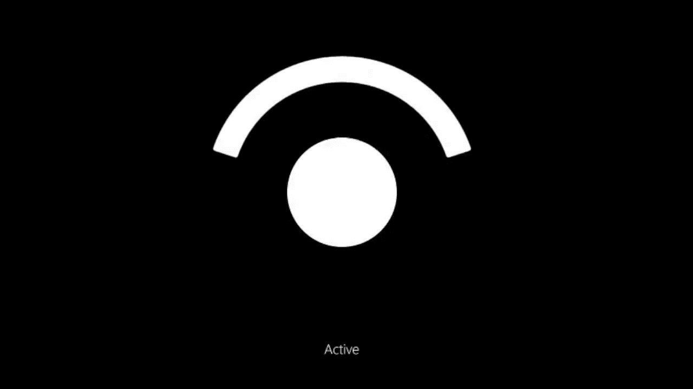
Introducing Windows Hello “Winky”

Slide 40

Windows Hello Security Requirements
Use Windows end to end experiences and scenarios
        share the same design language for enrollment and usage
Modality Meets OSS security requirements
        Demonstrate False Acceptance Rate (FAR): 1/100,000
        With False Rejection Rate: 2-4%,
        Provide live-ness measures
        Enable anti-spoofing detection
Integrated with Windows Biometric Framework

Slide 41
Summary
  Windows 10 is moving the world to a more secure, password-free experience, powered by Microsoft Passport and Biometrics……
  Microsoft Passport is the password replacement solution focusing on the convenience and security
  Windows Hello is your face, iris, or fingerprint
  Windows Hello and PIN are Microsoft Passport Gestures that provide truly two factor authentication right from the box, so easy to use, do you want to try?

Slide 42


Please evaluate this session
Your feedback is important to us!
Visit Myignite at http://myignite.microsoft.com
or download and use the Ignite Mobile App
with the QR code above.

