Slide 2
Recalling Windows Memories: Useful Guide to Retrieving and Analyzing Memory Content
BRK2342
Paula Januszkiewicz
MVP: Enterprise Security, MCT
CQURE: CEO, Penetration Tester / Security Expert
CQURE Academy: Trainer
Contact: paula@cqure.us | http://cqure.us
@paulacqure
@CQUREAcademy

Slide 3
Deeper research never hurts!

Slide 4
Agenda
Dumping Techniques
Live Memory Analysis
1
2
3
4
Memory Dump Analysis
Summary

Slide 5
Tools!
Check out the following links:
Our tools: http://cqure.pl ➔ Tools
http://www.gentilkiwi.com/ - Benjamin Delpy
http://code.google.com/p/volatility

Slide 6
Hidden Process, Crouching Handle
The curtain perspective

Slide 7
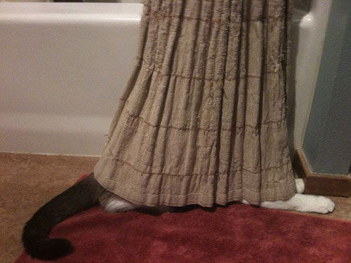

Slide 8
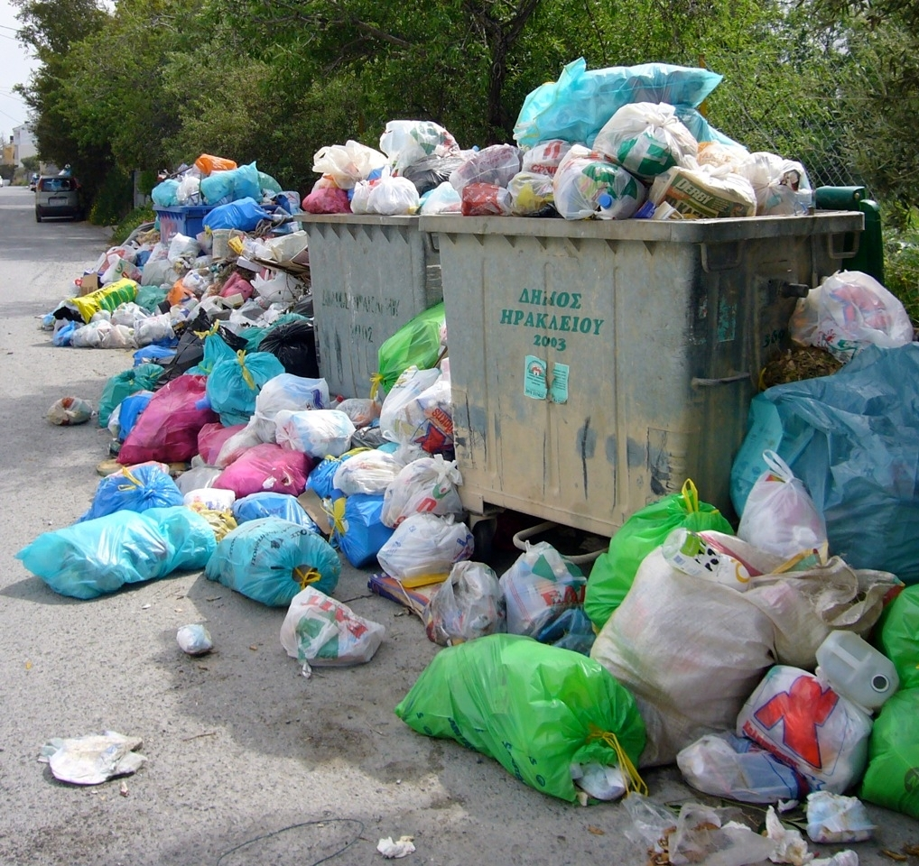
Memory Dumps: The Purpose
Whatever runs – it is in the memory
Whatever sensitive was used – it is in the memory
Done automatically
Used for detect suspicious behavior of processes
Saved in %windir%
Sharing is caring
Published carelessly on the public forums
Memory dumps contain personal information, but… how personal?

Slide 9
How to make a memory dump?
Process dumps:
Process Explorer, Process hacker
Task Manager
Procdump
System memory dumps:
Windbg (.dump)
MemDD, WinDD
Dumpit
System Recovery Settings
Memory Forensics grabs the data at the lowest level:
(most) malware cannot hide!

Slide 10
Memory Dump Techniques
Step By Step

Slide 11
Agenda
Dumping Techniques
Live Memory Analysis
1
2
3
4
Memory Dump Analysis
Summary

Slide 12
What to search for?
Processes
Threads
Modules
Handles
Registry
Apihooks
Services
UserAssist
Shellbags
ShimCache
Event Logs
Registry (again)
Timeline

Slide 13
Handles: More Than Files
Can be to processes, threads, registry, files, mutexes
Also to drives, dlls etc.
Csrss.exe – manages processes so it maintains handles
Hidden processes also have handles
Handles are used by every process
This is a good way of finding malware or narrowing down places to look

Slide 14
Memory Dump Analysis
Searching, Searching, Searching…

Slide 15
Registry can hide a lot of goodies…
Use volatility printkey to look at registry keys
Winlogon & run are common persistence keys

Slide 16
BitLocker Offline
Combining memory dump and disk dump

Slide 17
YARA and Other tools

Slide 18
YARA and Other Tools
YARA: Malware identification and classification tool
Even default rules can be very useful, and new rules are easy to write!
MemGator: Automates Extraction of data
Lists processes, network connections, malware detection, passwords & encryption keys and the registry
Memoryze: Live analysis
Used by professional forensic investigators

Slide 19
Agenda
Dumping Techniques
Live Memory Analysis
1
2
3
4
Memory Dump Analysis
Summary

Slide 20
Certificates
Procedures not to be certified

Slide 21
Remote Powershell
Procedures not to be certified

Slide 23
Kerberos tickets vs. Dumps

Slide 24
Agenda
Dumping Techniques
Live Memory Analysis
1
2
3
4
Memory Dump Analysis
Summary

Slide 25
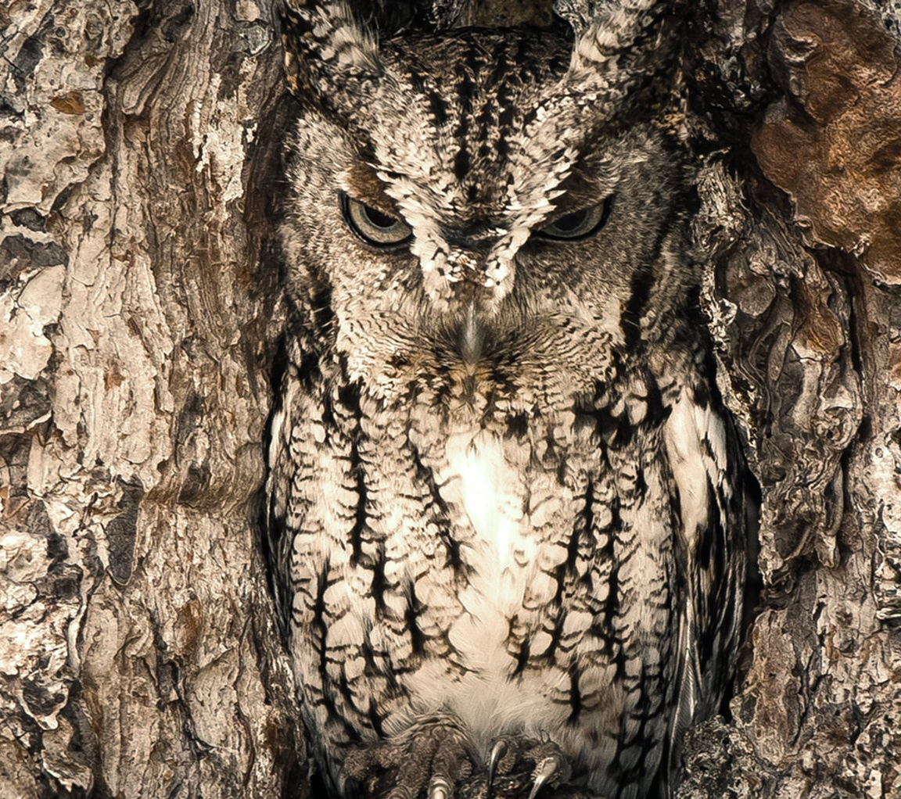
Memory Memories: Summary
Whatever works will be in memory
One more dump = more experience
Pay attention to the ’strange looking’ objects
Do not share dumps with others
Use them for troubleshooting

Slide 26
Tools!
Check out the following links:
Our tools: http://cqure.pl ➔ Tools
http://www.gentilkiwi.com/ - Benjamin Delpy
http://code.google.com/p/volatility

Slide 27
Paula - Sessions
The Ultimate Hardening Guide: What to Do to Make Hackers Pick Someone Else
Thursday, May 7th, 10:45AM - 12:00PM
Hidden Talents: Things Administrators Never Expect from Their Users Regarding Security
Thursday, May 7th, 03:15PM - 04:30PM
Recalling Windows Memories: A Useful Guide to Retrieving and Analyzing Memory Content
Friday, May 8th, 09:00AM - 10:15AM
Adventures in Underland: What Your System Stores on the Disk without Telling You
Friday, May 8th, 12:30PM - 01:45PM

Slide 28
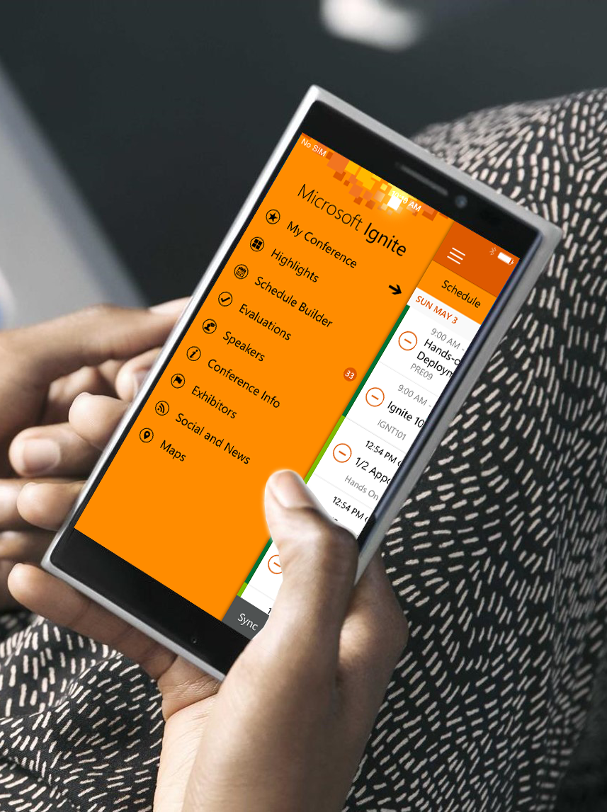
Please evaluate this session
Your feedback is important to us!
Visit Myignite at http://myignite.microsoft.com or download and use the Ignite Mobile App with the QR code above.

