Slide 2
A Tale of 3 Clouds
BRK2450
Saad Ansari, Lu Jin
Principal PM Manager (s)

Slide 3







Microsoft Cloud platform
Microsoft offers the most complete and flexible suite of capabilities—and the experience to back it up.
All devices
Open & interoperable
All data
Deployment choice
On-premises
Cloud
CUSTOMER DATACENTER
Windows Server 2012 R2
Systems Center 2012 R2
SQL Server 2014
BizTalk Server 2013 R
CONSISTENT
PLATFORM
MICROSOFT
AZURE
SERVICE PROVIDER

Slide 4
Microsoft Azure: A unified platform for modern business
Flexible
Microsoft Azure
Customer datacenter
Scale per
business
need
Faster business outcomes
Web
App
Data
Web
App
Data
Enterprise-proven

Slide 5
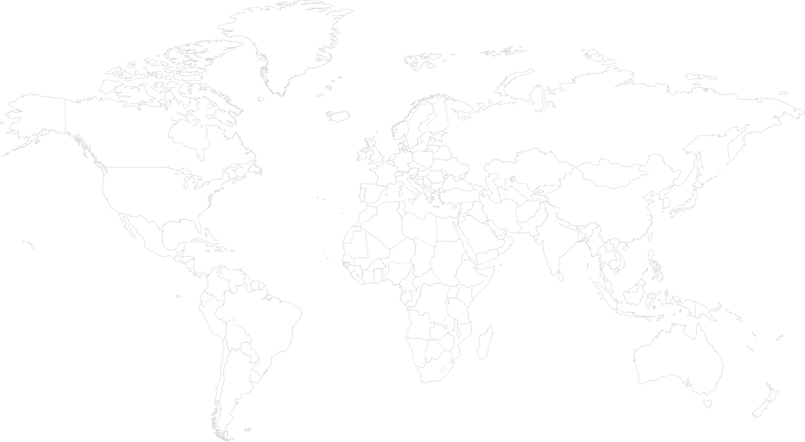





Azure: Comprehensive cloud services
Infrastructure
Fabric
Services
Frameworks
Compute
Caching
Europe Region
Virtual machines
Cloud services
North America Region
Identity
Central US
US Gov Iowa
N. Europe
Japan Region
East US
W. Europe
China Region
Japan E
Storage
West US
N. Central
US Gov VA
Japan W
Service Bus
S. Central
India Region
Latin America Region
Asia Region
E Asia
SQL
Database
NoSQL
Database
SE Asia
Australia Region
Media
Brazil S
Australia E
Australia SE
Blob storage
Recovery
Networking
Dedicated connections
Virtual
network
Notification
Hubs
Automated
Managed resources
Elastic
Usage based
Traffic Manager
Tasks
1
2
3

Slide 6




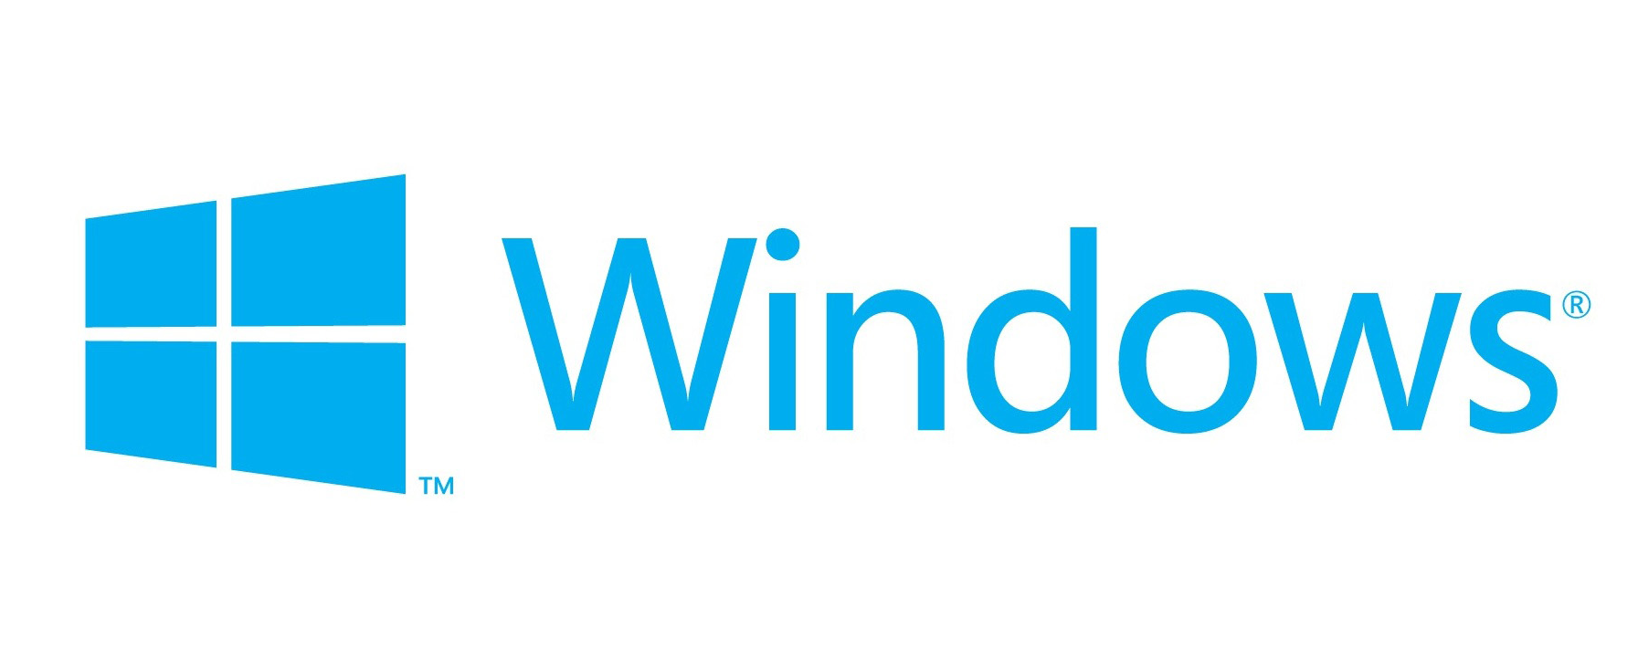



Azure: An open platform powered by choice
Microsoft is contributing to the open source community and working to make Azure the platform of choice for developers.
Linux
Partnering with open source communities through MS OPENTECH.
Interoperability between Microsoft and non-Microsoft technologies (i.e. Drupal, PHP, Node.JS, VM Depot and more).
Platform and tools independent.
Compatibility with the tools developers already know.
Most favored open source creative development frameworks.

Slide 7
Sovereign clouds – how did we get here?
The conversation has evolved from blockers to enablers
Operating at hyper scale we can achieve enormous economies of scale and pass on the savings
Microsoft is growing the cloud business globally
Microsoft is committing to provide choice or platform level capabilities
Services like Office 365, CRM online, and Azure allows Microsoft to offer a more complete Enterprise grade solution
Providing support of on-prem and hybrid scenarios allows customers
Couple this with specific security controls, regulatory requirements, laws and even sentiment, we start building sovereign clouds
Compliance
Choice
Hyper scale
Security
Data Sovereignty
High Availability
Hybrid
Enterprise grade
Platform
Data center reach

Slide 8
Introducing Microsoft Azure Government
A government-community cloud that extends world-class security and control for dedicated U.S. Public Sector workloads.
Provides a physical and network-isolated instance of Microsoft Azure.
Provides screened U.S. citizens and policies to help protect customer data and applications.
Stores data within the United States.
Offers continuous commitment to meet rigorous compliance demands (i.e. FedRAMP, CJIS, and HIPAA) of a government-community cloud.
Provides rich infrastructure, storage, and identity management capabilities delivered through cloud, on-premises, and hybrid solutions.
Delivers integrated, familiar experiences with Office 365 for Government in the cloud.

Slide 9




A commitment to industry-leading compliance
Microsoft is the first and only hyperscale cloud provider to meet CJIS security requirements for infrastructure and productivity.
CJIS
ECSB
FedRAMP
HIPAA

Slide 10
Powerful datacenter security
Customer data, applications, and hardware reside in the continental United States (CONUS) in specially constructed datacenters.
The datacenters are physically isolated from Azure commercial services and geographically distributed more than 500 miles apart to support business continuity scenarios.
  24x7 security staff
  Facility setback requirements
  Barriers
  Fencing
  Alarms
  Security operations center
  Seismic bracing
  East/Central locations: U.S. Gov. Iowa & U.S. Gov. Virginia
  Perimeter
  Buildings
Monitoring &
logging
Anti-virus/
anti-malware
Threat detection
Network isolation

Slide 11
Showcase: Law enforcement multimedia on Azure Government
A complete, end to end CJIS-compliant police video and surveillance management platform built on Azure Government.
Building surveillance systems
Body cameras (with varying degrees of resolution)
Dashboard cameras
Interview rooms and NVR
Police officer uploads videos from body cam
Prosecutor reviews evidence in secure CJIS-compliant storage vault
Detective searches for keywords spoken by witnesses to identify suspects and locations
Videos sourced from
VPN
Storage
Media Services
Law Enforcement uses
Service Bus
SQL
Cloud Services

Slide 12
Learn more
http://azure.microsoft.com/en-us/features/gov/
How to buy: Federal, State and Local
Compliance and trust: http://azure.microsoft.com/en-us/support/trust-center/

Slide 13
Azure in China
Lu Jin
Principal PM Manager

Slide 14
China == Opportunity

Slide 15

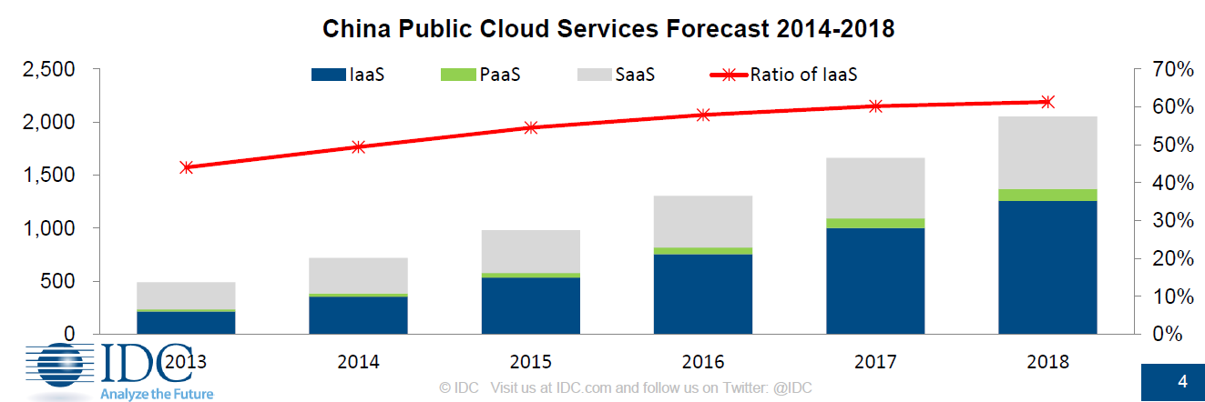


China - Public Cloud Opportunity

Slide 16
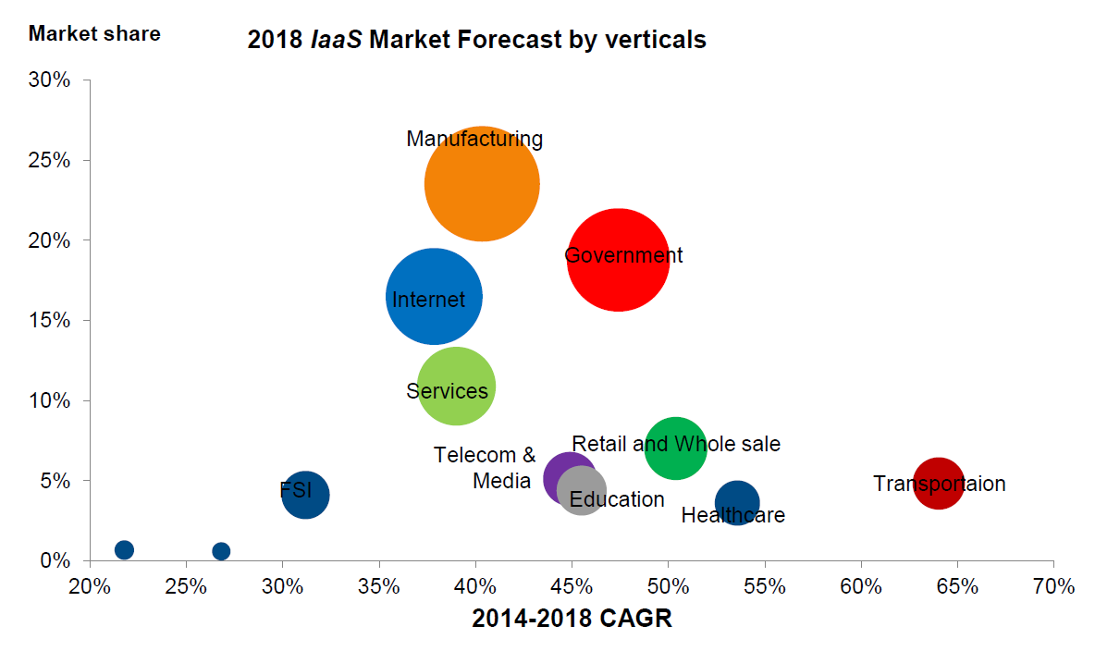

China - Public Cloud Opportunity

Slide 17
China == Challenge

Slide 18
Introducing Windows Azure Operated by 21 Vianet
A China-instance Azure that instantiates world-class Azure technology and operated by Chinese service provider
Microsoft licenses the technology and 21Vianet operates the services.
21Vianet holds the IDC/ISP license for the service, and protects the customer data.
Data Centers built within mainland China, separate from the global instance of Azure.
Offer continuous commitment to meet Chinese local compliance requirements (i.e. CCCPPF, MLPS, ISO 27001:2005, GB18030 …).
Same Cloud technology, SLA and Support standards as global Azure instance. Seamless experience for global customers moving workload onto Azure China.
Customers contract with 21Vianet, MS Sales & Marketing lead the customers into the channel.

Slide 19

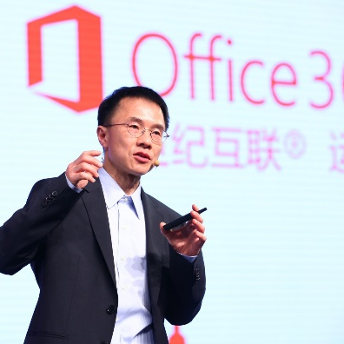
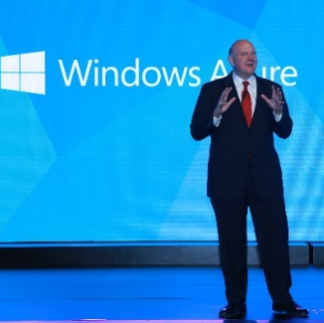
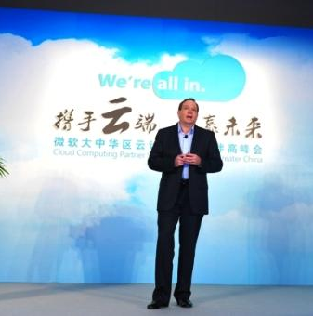


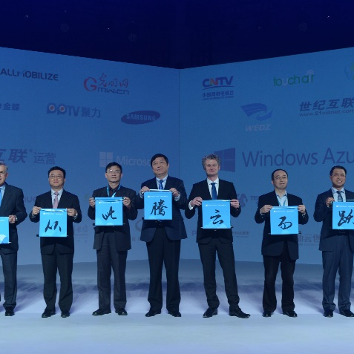
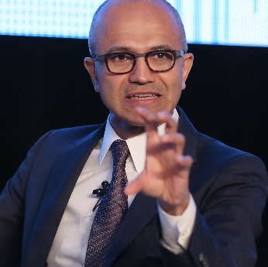
Windows Azure Operated by 21Vianet
Office 365 GA 4/14/2014
Cloud Computing Innovation Center established 9/2010
Azure Public Preview in China 6/6/2013
2010
2014
Mooncake Project formalized 10/2011
Shanghai government, Microsoft & 21v signed MOU 11/2012
Satya announced Azure Web offer
9/25/2014
Azure GA in China
3/26/2014

Slide 20

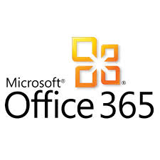










Platform
& Microsoft 1st party services
Rich services across IaaS, PaaS, SaaS
Support and Operation
21Vianet provides customer support and operation on physical h/w, network and service.
Customer Support, Operation, Risk Management, DC/HW management, Commerce
Global & Local Partnership
Enable local payment, UX & Chinese local partnership on the Azure platform.
Chinese Local Payment
ChinaCache CDN/400+ end points
Baidu Push
SAP
Security
Network & Edges
Triple egress / ingress in each datacenter.
Beijing Datacenters
Shanghai Datacenter
Data Centers
Beijing & Shanghai

Slide 21












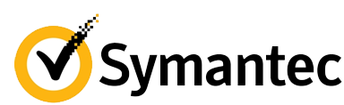






















Top Customers

Slide 22
Learn more
Marketing portal: http://windowsazure.cn/
Signing up for a trial: http://windowsazure.cn/pricing/1rmb-trial/
How to buy: http://windowsazure.cn/pricing/pia/

Slide 23
Questions?

Slide 24
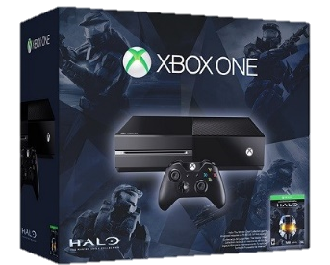
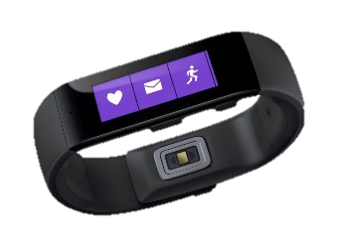
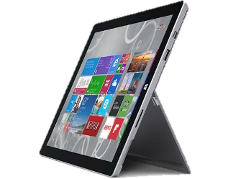

Ignite Azure Challenge Sweepstakes
Attend Azure sessions and activities, track your progress online, win raffle tickets for great prizes!
Aka.ms/MyAzureChallenge
Enter this session code online: BRK2450
NO PURCHASE NECESSARY. Open only to event attendees. Winners must be present to win. Game ends May 9th, 2015. For Official Rules, see The Cloud and Enterprise Lounge or myignite.com/challenge

Slide 25


Please evaluate this session
Your feedback is important to us!
Visit Myignite at http://myignite.microsoft.com
or download and use the Ignite Mobile App
with the QR code above.

