Slide 2
Azure Storage: Overview and New Capabilities
Vamshi Kommineni
@vamshikommineni
#AzureStorage

Slide 4
XBox and Azure Storage
One of the earliest and largest users of the Azure platform
Many different services – XBox Live, XBox Game DVR, XBox Music
Blobs:
Activity Feed
Game DVR
Leaderboards
Player Stats
Saved Games
Social Graph
Thunderhead
Tables:
Achievements
Comments
Friends
Matchmaking
Multiplayer
Push Notifications
Security (AuthN/AuthZ)

Slide 5
Huge infrastructure scale is the enabler
19 Regions ONLINE…huge datacenter capacity around the world…and we’re growing
North Europe
Ireland
West Europe
Netherlands
Central US
Iowa
North Central US
Illinois
US Gov
Iowa
China North
Beijing
East US
Virginia
Japan East
Saitama
West US
California
China South
Shanghai
East US 2
Virginia
Japan West
Osaka
US Gov
Virginia
India Central
TBD
India South
TBD
South Central US
Texas
East Asia
Hong Kong
SE Asia
Singapore
Australia East
Sydney
Brazil South
Sao Paulo
Australia West
Melbourne
1+ million servers
One of the top 3 networks in the world (coverage, speed, connections)
More regions than AWS and Google combined
Announced
Operational

Slide 6
Azure Storage
Foundational building block of the Azure cloud
Data offerings: Object storage (Blobs, Files), NoSQL (Tables), Reliable Queues, Persistent Disks
Hyper Scale
>50 Trillion objects
>6 Million tps
Open, multi-platform, multi-language support
REST APIs for all data abstractions
Open Source Client libraries - .Net, Java, C++, Node.js, Android, Xamarin, Python, Ruby, PHP, iOS (coming soon)
Hybrid
Backup and Disaster Recovery
StorSimple

Slide 7
Azure Storage Offerings
Blobs
“Highly scalable, REST based cloud object store”
Data sharing, Big Data, Backups
Block Blobs: Read and write data in blocks. Optimized for sequential IO. Most cost effective Storage.
Page Blobs: Sparse files, read/write in 512 byte pages. Optimized for random access

Slide 8
Azure Storage Offerings
Blobs
“Highly scalable, REST based cloud object store”
Tables
“Massive auto-scaling NoSQL store”
User, device and service metadata, structured data
Schema-less entities with strong consistency
No limits on number of table rows or table size
Dynamic load balancing of table regions
Best for Key/value lookups on partition key and row key
Entity group transactions for atomic batching

Slide 9
Azure Storage Offerings
Blobs
“Highly scalable, REST based cloud object store”
Tables
“Massive auto-scaling NoSQL store”
Queues
“Reliable messaging system at scale for cloud services”
Decouple components and scale them independently
Scheduling of asynchronous tasks
Building processes/work flows
No limits on number of queues or messages
Message visibility timeout to protect from component issues
UpdateMessage to checkpoint progress part way through

Slide 10
Azure Storage Offerings
Blobs
“Highly scalable, REST based cloud object store”
Tables
“Massive auto-scaling NoSQL store”
Queues
“Reliable messaging at scale for cloud services”

Slide 11
Blobs
Tables
Queues
Service APIs
List Containers
Set/GET Blob Service Properties
Preflight Blob Request
Get Blob Service Stats
Container APIs:
Create Container
Get/Set Container Properties/Metadata
Get/Set Container ACL
Lease Container
Delete Container
List Blobs
Blob APIs:
Put Blob
Get Blob
Get/Set Blob Properties
Delete Blob
Lease Blob
Snapshot Blob
Copy Blob
Service APIs
Set/Get Table Service Properties
Preflight Table Request
Get Table Service Stats
Query Tables
Table APIs
Create Table
Delete Table
Set/Get Table ACL
Entity APIs
Insert Entity
Update Entity
Merge Entity
Insert Or Merge Entity
Insert Or Replace Entity
Query Entity
Query Entities
Entity Group Transactions
Service APIs
Set/Get Queue Service Properties
Preflight Queue Request
Get Queue Service Stats
List Queues
Queue APIs
Create Queue
Delete Queue
Get/Set Queue Metadata
Get/Set Queue ACL
Message APIs
Put Message
Get Messages
Peek Messages
Delete Message
Update Message
Clear Messages

Slide 12
Azure Storage Offerings
Blobs
“Highly scalable, REST based cloud object store”
Tables
“Massive auto-scaling NoSQL store”
Queues
“Reliable messaging at scale for cloud services”
Disks
“Persistent disks for your Azure IaaS VMs”
All Azure IaaS VMs – Both OS and data disks
VHDs are backed to page blobs
3 synchronous, strongly consistent copies
Can stripe disks for more capacity/throughput
Premium Storage disks allow for scale up workloads

Slide 13
Azure Premium Storage Disks
For high-performance IO-intensive workloads (databases, etc.)
Consistent low latency and predictable high IO throughput
Durable - 3 strongly consistent copies in SSD storage
New class of VMs – DS Series
Supports up to 1 TB blob/disk size
Up to 32TB per VM and up to 64,000 IOPS per VM
Flexible Pricing – VMs and disks by the hour
Disk Types | P10 | P20 | P30
Disk Size | 128 GB | 512 GB | 1024 GB
IOPS Per Disk | 500 | 2,300 | 5,000
Throughput per Disk | 100 MB/Sec | 150 MB/Sec | 200 MB/Sec
Price per month | $17.92 per month | $66.56 per month | $122.88 per month

Slide 14
Azure Premium Storage
Deep Dive and Best Practices Session:
BRK4450 - Thursday May 7th 5p-6:15p – N231
Aung Oo & Sirius Kuttiyan

Slide 15
Azure Storage Offerings
Blobs
“Highly scalable, REST based cloud object store”
Tables
“Massive auto-scaling NoSQL store”
Queues
“Reliable messaging at scale for cloud services”
Disks
“Persistent disks for Azure IaaS VMs”
Files
“SMB Access to Azure Storage”
Lift and shift on-premise applications
Natively supported by OS APIs, libraries and tools
Built on SMB2.1, works with Windows and Linux
No limits on number of shares; 5TB and 1000 IOPS per share

Slide 16
Virtual Machine Storage Architecture
Azure Virtual Machine
C:\
OS Disk
D:\
Temporary Disk
E:\, F:\, etc.
Standard Data Disks
E:\, F:\, etc.
Premium Data Disks
Y:\, Z:\, etc.
SMB Share
Disk Cache
SSD Read Cache
Azure Page Blob
Azure Page Blobs (Premium Storage)
Azure Files

Slide 17
Other Azure Services
Blobs
“Highly scalable, REST based cloud object store”
Tables
“Massive auto-scaling NoSQL store”
Queues
“Reliable messaging at scale for cloud services”
Disks
“Persistent disks for Azure IaaS VMs”
Files
“SMB Access to Azure Storage”
Data Lake
“Big Data analytics with HDFS interface”
DocumentDB
“Managed NoSQL document store”
Service Bus
“Rich Enterprise messaging”
Azure SQL DB
“Managed Relational SQL databases”

Slide 18
Azure Storage Architecture
Import / Export
Client Libraries
(.NET, Java, C++, Android, Node.JS…)
SMB Client
REST
REST
REST
REST
SMB 2.1
Blob/Disk
Endpoint
Table
Endpoint
Queue
Endpoint
File Share
Endpoint
Front End Layer
Massive Scale Out & Auto Load Balancing Index Layer
Partition Layer
Distributed Replication Layer
Stream Layer
“Windows Azure Storage: A Highly Available Cloud Storage Service with Strong Consistency”, ACM Symposium on Operating System Principals (SOSP), Oct. 2011

Slide 19
Azure Storage Platform Capabilities
Scalability
Per account: 500TB of data , 20000 tps, 10Gbps ingress/20Gbps egress
Durability Options
Locally Redundant (LRS), Zone Redundant (ZRS), Geo-Redundant (GRS)
Read access from geo-secondary (RA-GRS)
Availability
99.9% for reads/writes, 99.99% for reads with RA-GRS. Backed by SLA.
Access Control
Symmetric shared key (AuthN)
Shared Access Signatures (SAS) - Delegated AuthZ
Public (blob service only)
Analytics
Rich perf-counter like metrics and detailed logs

Slide 20
Azure Storage Deep Dive
Deep dive into designing for scale, performance and security at:
BRK4702 - Friday May 8th 10:45a-12:00p – N231
Jeff Irwin

Slide 21
Azure Storage DevOps

Slide 22
DevOps – Monitoring production is key
Ensure your business KPI’s are being met
Find problems before your customers find them
Monitor service fundamentals
Service health
Availability
Performance
Scalability
Capacity

Slide 23
End to End Monitoring
Outside in
AppInsights, Gomez, Keynote etc
Inside out
Storage Analytics – Metrics and Logs
Storage Client Library - Logs
Network Trace - Message Analyzer,
Fiddler, WireShark
Service Health dashboard
Client Applications
Network
Storage Services

Slide 24
Azure Storage Monitoring and Diagnostics
Analytics Metrics
Perfmon for Storage
>40 metric types for Blobs, Tables and Queues
Summarized by hour and minute (w/ < 5 min delay)
Granularity and retention policies
Stored in tables – eg $MetricsMinuteTransactionsBlob

Slide 25
Azure Storage Monitoring and Diagnostics
Metrics
"Service health statistics"
Analytics Logs
Storage equiv. of IIS logs
All REST operations are logged
Includes most request characteristics
Timestamp, Status Code, Operation, E2ELatency etc
Granularity and retention policies
Use this for diagnosis and troubleshooting
Stored in blobs in a container called $logs

Slide 26
Azure Storage Monitoring and Diagnostics
Metrics
"Service health statistics"
Logs
"Service trace logs"
Client Logs
Detailed tracing for client operations
All libraries include logging
Use platform appropriate logging conventions
Useful for investigating client, network, SAS errors

Slide 27
Azure Storage Monitoring and Diagnostics
Metrics
"Service health statistics"
Logs
"Service trace logs"
Client Logs
"Client trace logs"
Network Logs
Familiarity with network logging tools useful – especially for client performance issues
Fiddler – useful for simple HTTP / HTTPS
Wireshark / Message Analyzer – useful for lower level network issues

Slide 28
Azure Storage Monitoring and Diagnostics
Metrics
"Service health statistics"
Logs
"Service trace logs"
Client Logs
"Client trace logs"
Network
"Network trace logs"
Correlation
"End to end tracing"
Correlation
Often need to analyze storage, client and network logs together
ClientRequestId – Unique Id per logical operation – batch and retries use same ClientRequestId
Client - Appears in OperationText field
Network – x-ms-client-request-id
Storage – Client-Request-Id
ServerRequestId – Unique Id per operation
Client – Appears in OperationText field
Network – x-ms-request-id
Storage – request-id-header

Slide 29
Azure Storage Design Patterns

Slide 30
Storage Design Patterns
Application Layer Encryption (New)
Direct Data Access using Delegated AuthZ
Large Scale Append (New)
Designing HA apps using RA-GRS

Slide 31
Application Layer Encryption
Encrypt Storage data in your applications
Automatically encrypt prior to sending to Storage
Automatically decrypt after receiving from Storage
Seamless integration
Blobs – Full blob upload, Full or range download
Tables – Read / Insert / Replace of entities with configurable attributes, Batch operations
Queues – Messages individually encrypted
Benefits
Storage service never sees your keys or unencrypted data
Proven security practices - standard envelope encryption, key rotation, etc.
Self contained – Key meta-data stored with each object
Interoperable across storage client libraries
Source code available on GitHub

Slide 32
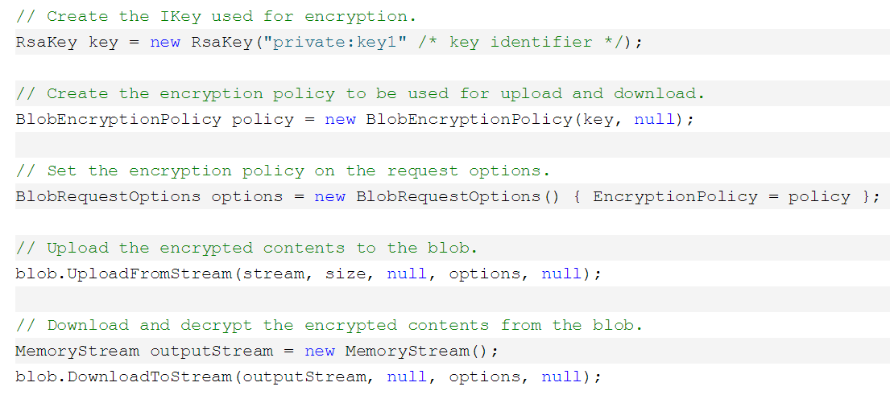
Encryption Client Library
Code is very straightforward:

Slide 33
Key Vault Integration
Microsoft cannot access your secrets
Manage, rotate, monitor master encryption keys and secrets
Contents are protected at rest with HSMs
Authentication via Azure Active Directory
Role separation between key owners and data manipulation
Storage Client library enables optional Key Vault integration
Enables content encryption key to be wrapped / unwrapped
Enables multiple key sources to be aggregated
Enables caching of keys for high-scale, low-latency storage operations

Slide 34
Storage Access Control Strategies
Multiple Access Control strategies
Storage account key – full access
Shared access signature (SAS) – token with configurable rights and time
Public – blob storage only
Shared Access Signature
Resources – account (coming soon), containers, blobs, queues, tables, table ranges
Permissions – read, write, delete etc
Time – start time, end time
IP (coming soon) – address or range
Protocol (coming soon) – http or https
https://storageaccount.blob.core.windows.net/sascontainer?sv=2012-02-12&se=2013-04-13 T00%3A12%3A08Z& sr=c&sp=wl&
sig=t%2BbzU9%2B7ry4okULN9S0wst%2F8MCUhTjrHyV9rDNLSe8g%3Dsss

Slide 35
Direct Data Access using Delegated AuthZ
Enable clients to access Storage directly
Mobile / IOT
SAS enables direct upload from millions of unstrusted devices
Web / Javascript
CORS + SAS enables direct access from Web apps
Big data
SAS enables write once, read many
SAS Token Issuer
Request / Renew
SAS Token
Client Applications
Storage Services
REST Request with
SAS token and CORS headers (Javascript only)

Slide 36
Large Scale Append
Optimized for large scale logging scenarios
Removes need for synchronization across clients
Block blob API consistency
Use with SAS for write-once, read many scenarios

Slide 37
Design HA Apps Using RA-GRS
Read only access to secondary delivers 99.99% on reads
Client libraries incorporate retry policies
Default backoff policy is Exponential
PrimaryOnly, PrimaryThenSecondary, SecondaryOnly, SecondaryThenPrimary
Your code needs to support a read only mode
Retry operation is stateless
Retries are suitable for transient failures
Implement short-circuit pattern for catastrophic outages or for use during application upgrades
Test failure conditions

Slide 38
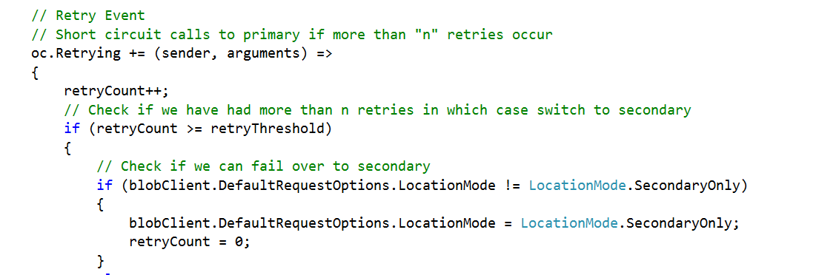
Short Circuit Pattern
Retry policies are ideal for transient failures
Circuit breaker prevents an application from repeatedly retrying for more severe issues
Circuit breaker can also automatically detect when resources come back online

Slide 39
Announcements
GA
Premium Storage
C++ client library v1
Preview / Coming Soon
Technical support now available for Azure Files
Storage support for new resource manager
Client side encryption library
Xamarin library
Append Blob
SAS improvements
iOS client library
Azure Import / Export in Australia and Japan

Slide 40
Azure Storage Team at Ignite
Other Azure Storage Sessions at Ignite:
BRK4450 : Thu, May 7, 5p-6:15p - Premium Storage Deep Dive
BRK4702: Fri, May 8, 10:45a-12p – Design for scale, performance and security
Meet us at the Expo Hall
We are present at all expo hours at the “Azure Storage/StorSimple” booth in the Cloud Platform area
Sign up for 30 minute slots for 1:1 time with an Azure Storage engineer at the end of this talk

Slide 41
Summary
Documentation: http://aka.ms/azurestoragedocs
Detailed Whitepapers:
Azure Storage Table Design Guide
Azure Storage Performance and Scalability Checklist
Monitoring, Diagnosing and Troubleshooting Guide
Blog: Azure Storage Blog
Forums: MSDN, StackOverflow (azure-storage)
Twitter: #AzureStorage, @vamshikommineni
Please provide session feedback!

Slide 42
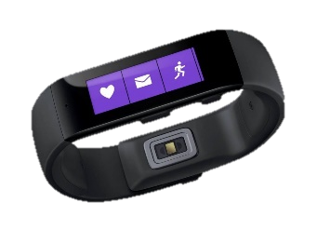
Ignite Azure Challenge Sweepstakes
Attend Azure sessions and activities, track your progress online, win raffle tickets for great prizes!
Aka.ms/MyAzureChallenge
Enter this session code online: BRK2458
NO PURCHASE NECESSARY. Open only to event attendees. Winners must be present to win. Game ends May 9th, 2015. For Official Rules, see The Cloud and Enterprise Lounge or myignite.com/challenge

Slide 43
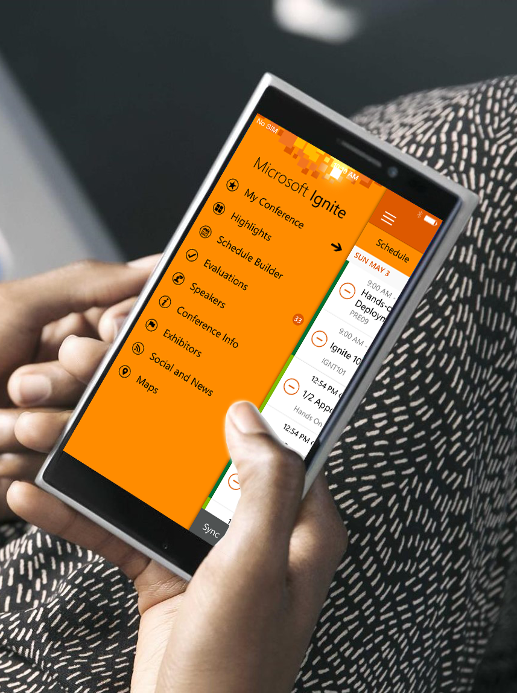
Please evaluate this session
Your feedback is important to us!
Visit Myignite at http://myignite.microsoft.com or download and use the Ignite Mobile App with the QR code above.

