Slide 2
Datacenter Transformation, Head into the Cloud While Keeping Your Feet on the Ground
BRK2468
Barry Shilmover
Microsoft Reference Architect
NetApp, Inc.

Slide 3
Agenda
NetApp – A very quick intro
An all too common scenario
NetApp and the Microsoft Cloud OS

Slide 4
NetApp – A very quick intro

Slide 5
NetApp is a global provider of software, systems and services to manage and store data
$6.3B
12,000+
3,000+
Annual Revenue
Global Employees
Patent Assets

Slide 6

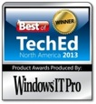
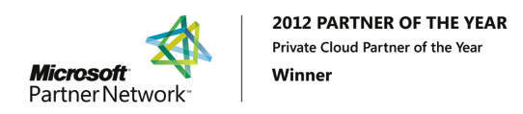
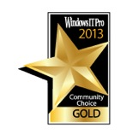
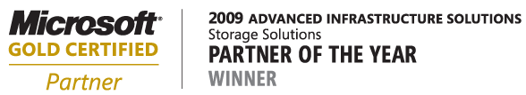
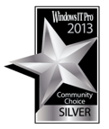
Seven consecutive years of award-winning Microsoft/industry recognition
2013 Server Platform
Partner of the Year Winner
Microsoft Partner
of the Year Finalist
2013 Best of TechEd Systems
Management
and Ops.
  ®
  2014 Management and Virtualization Partner of the Year Finalist
  2014 Public Sector, Public Safety and National Security Partner of the Year Finalist
  2013 Public Sector, Government Partner of the Year Finalist
  2013 Pre-Sales Specialist Partner
  of the Year Finalist
  2012 Management and Virtualization Partner of the Year Finalist
  2011 Private Cloud Partner of the
  Year Finalist
  2010 Global ISV Partner of the
  Year Finalist
  2010 Virtualization Partner of the
  Year Finalist
  2010 Server Platform Partner of
  the Year Finalist
  2008 Storage Solutions Partner
  of the Year Finalist
2012 Private Cloud
Partner of the Year Winner
2013 Windows IT Pro Community Choice GoldS
2009 Storage Solutions
Partner of the Year Winner
2013 Windows IT Pro Community Choice
Silver
  Pod

Slide 7

The Data Fabric Vision: Making modern IT systems work
Cloud Service
Providers
Hyperscale Cloud
Providers
Private
Cloud

Slide 8
What does the Data Fabric deliver?
Cloud Service
Providers
The data control
you need.
The choice of
cloud you want.
Hyperscale Cloud
Providers
Private
Cloud

Slide 9
An all too common Scenario

Slide 10
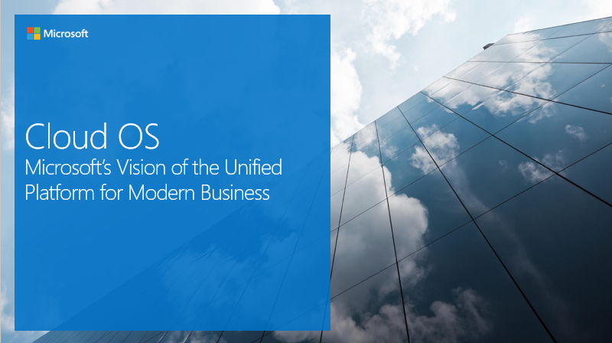

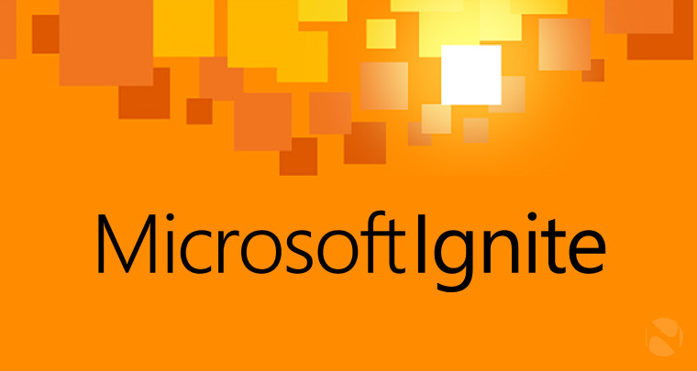
Your CIO
Microsoft Cloud OS Vision

Slide 11

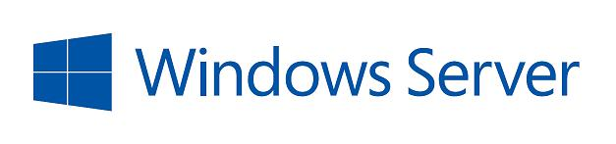
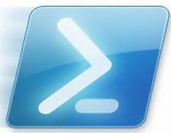
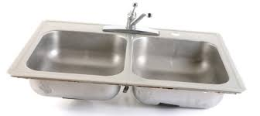

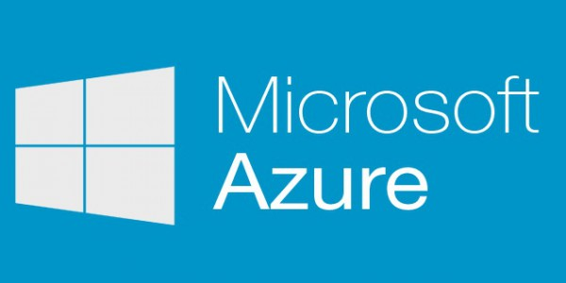
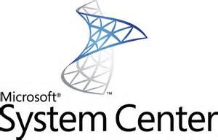
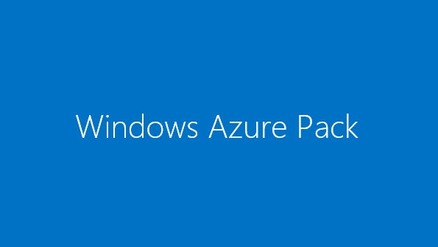
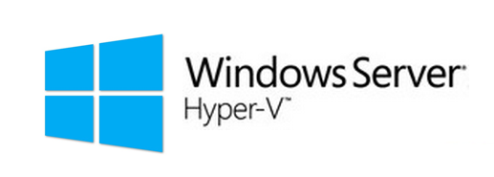

The Microsoft Cloud OS Vision
Customer
Azure Stack
ONE
Azure Site Recovery
Consistent
Platform
Service
Provider
Microsoft

Slide 12
Yeah… I’m going to need you to…
Bullet proof our SQL workloads. And…
We need to leverage Microsoft Azure. While…
Maintaining data sovereignty and full control of our data.
Don’t forget…
It needs to be backed up and secure!
Oh! Did you know we get Hyper-V licenses with our EA? I’m cutting back on our VMware licenses. So…
I need you to move all our VMs to Hyper-V.
Stat!!
Microsoft is retiring support for Windows Server 2003?!?
Half of our servers are Windows Server 2003!
Order new hardware and fix it!
And whatever you do…
It needs to be fully manageable!
With System Center.

Slide 13
NetApp and the Microsoft Cloud OS

Slide 14
NetApp Integration for Microsoft
Microsoft Azure:
  NetApp Private Storage for Azure
  Azure Site Recovery SAN Replication
  SteelStore
Windows and System Center:
  Data ONTAP PowerShell Toolkit
  Data ONTAP Plug-in for Microsoft
  SMI-S Provider
  OnCommand Shift
  SnapDrive for Windows
  SnapManager for Hyper-V
Microsoft Applications:
  SnapManager for SQL Server
  SnapManager for SharePoint
  SnapManager for Exchange

Slide 15
Yeah… I’m going to need you to…
Bullet proof our SQL workloads. And…
We need to leverage Microsoft Azure. While…
Maintaining data sovereignty and full control of our data.
Don’t forget…
It needs to be backed up and secure!
Oh! Did you know we get Hyper-V licenses with our EA? I’m cutting back on our VMware licenses. So…
I need you to move all our VMs to Hyper-V.
Stat!!
Microsoft is retiring support for Windows Server 2003?!?
Half of our servers are Windows Server 2003!
Order new hardware and fix it!
And whatever you do…
It needs to be fully manageable!
With System Center.

Slide 16
Our Scenario
Ask:
Enable scaleout of our SQL environment while..
  Leveraging Microsoft Azure’s connection speed, performance, scalability and cost
  Maintaining our data sovereignty
Solution:
  Microsoft Azure
  NetApp Private Storage for Azure

Slide 17


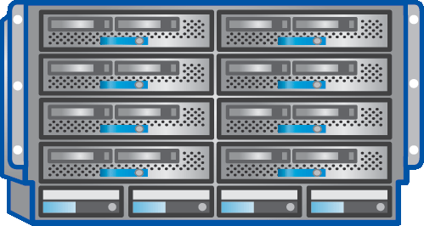
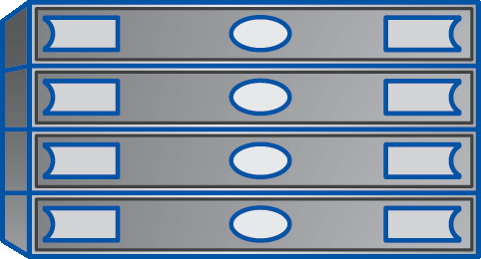
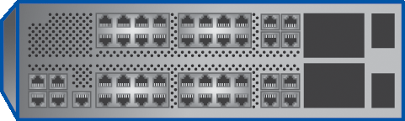


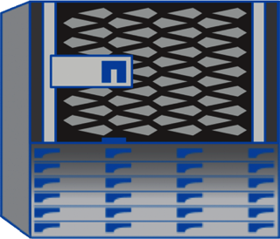
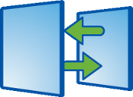
Our Scenario
Seattle Retail
Microsoft Azure
SQL Workload
SQL Workload
Burst to the cloud
Maintain Data Sovereignty
Multi-cloud solution
Operating System
Operating
System
Virtualization
Virtualization in Azure
Server
Azure
Compute
Network
Azure Network
Azure ExpressRoute
Seattle Retail
NetApp
Storage
NetApp
Storage
NetApp
SnapMirror®
SnapVault®

Slide 18
NPS for Azure Demo

Slide 19
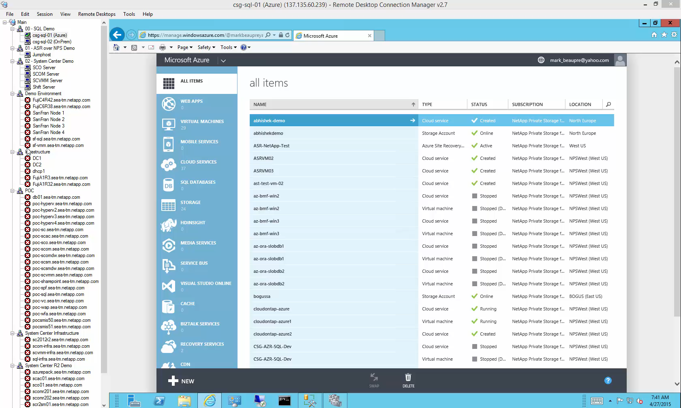

Slide 20
NetApp and Azure Site Recovery

Slide 21
A Common Scenario
Seattle Retail
Recovery Site
Microsoft Azure
Site Recovery
Microsoft System Center
Microsoft System Center
Operating System
Operating
System
Virtualization
Virtualization
Compute
Compute
Network
Network
NetApp
Storage
NetApp
Storage
NetApp
SnapMirror®
SnapVault®

Slide 22
Our Scenario
Ask:
Enable failover of our Mission Critical Virtual Machines while..
  Leveraging Microsoft Azure’s connection speed, performance, scalability and cost
  Maintaining our data sovereignty
  Saving the resources and costs of building and maintaining a recovery datacenter
Solution:
  Microsoft Azure
  Azure Site Recovery
  NetApp Private Storage for Azure

Slide 23
Our Scenario
Seattle Retail
Microsoft Azure
Microsoft System Center
Microsoft Azure
Site Recovery
Operating System
Operating
System
On demand datacenter
Only pay for compute when needed
Virtualization
Virtualization in Azure
Server
Azure
Compute
Network
Azure Network
Azure ExpressRoute
Seattle Retail
NetApp
Storage
NetApp
Storage
NetApp
SnapMirror®
SnapVault®

Slide 24
ASR with NPS for Azure Demo

Slide 25
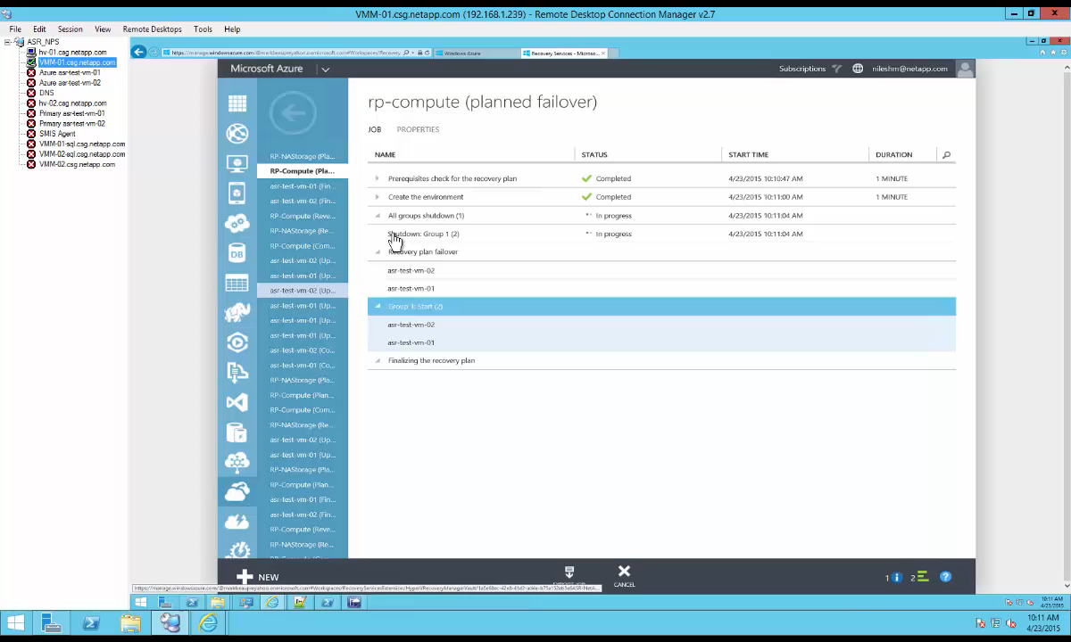

Slide 26
Yeah… I’m going to need you to…
Bullet proof our SQL workloads. And…
We need to leverage Microsoft Azure. While…
Maintaining data sovereignty and full control of our data.
Don’t forget…
It needs to be backed up and secure!
Oh! Did you know we get Hyper-V licenses with our EA? I’m cutting back on our VMware licenses. So…
I need you to move all our VMs to Hyper-V.
Stat!!
Microsoft is retiring support for Windows Server 2003?!?
Half of our servers are Windows Server 2003!
Order new hardware and fix it!
And whatever you do…
It needs to be fully manageable!
With System Center.

Slide 27
Our Scenario
Ask:
Backup our Mission Critical data while..
  Leveraging Microsoft Azure’s performance, scalability and cost
  Maintaining our data sovereignty
  Save public cloud storage costs by deduplicating our data
Solution:
  Microsoft Azure
  SteelStore

Slide 28


Our Scenario
Seattle Retail
Microsoft Azure
NetApp
SteelStore Appliance
Backup to the cloud
Encrypted, de-duped, compressed
OnPrem and Public Cloud backup optimization
Operating
System
Operating System
Virtualization in Azure
Virtualization
Azure
Compute
Server
Azure Network
Network
Azure Blob Storage
NetApp
Storage

Slide 29
SteelStore Demo

Slide 30
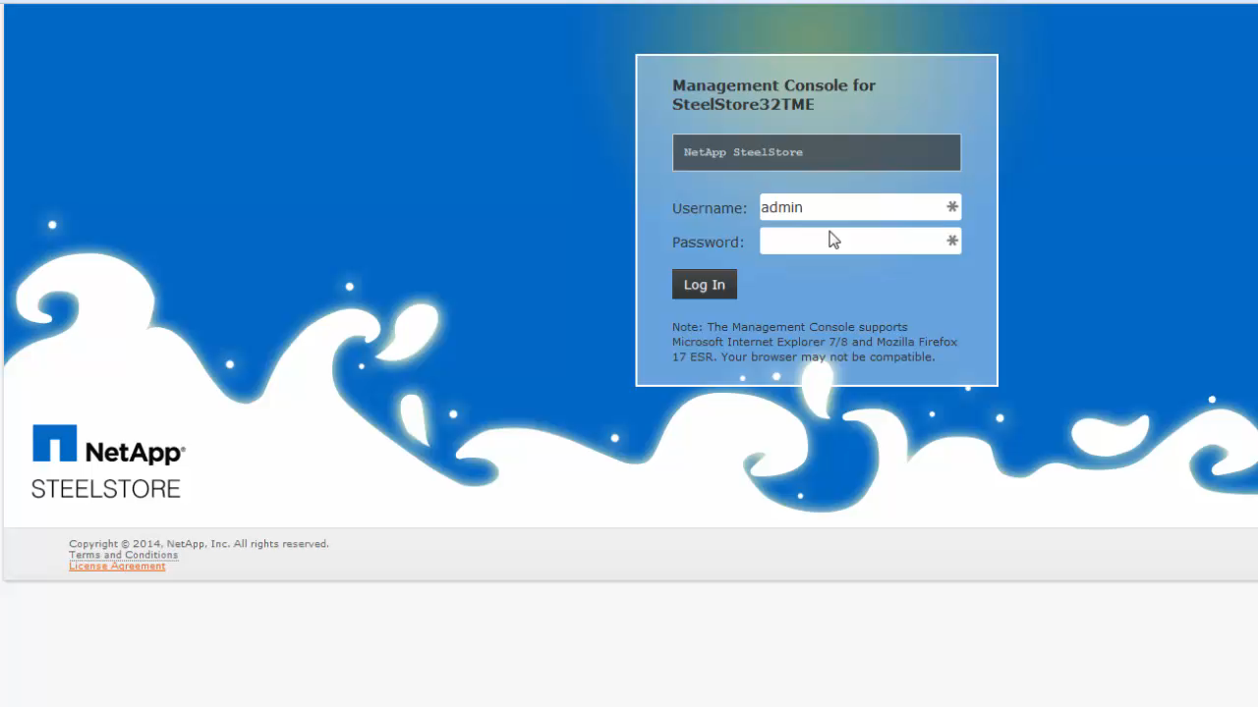

Slide 31
Yeah… I’m going to need you to…
Bullet proof our SQL workloads. And…
We need to leverage Microsoft Azure. While…
Maintaining data sovereignty and full control of our data.
Don’t forget…
It needs to be backed up and secure!
Oh! Did you know we get Hyper-V licenses with our EA? I’m cutting back on our VMware licenses. So…
I need you to move all our VMs to Hyper-V.
Stat!!
Microsoft is retiring support for Windows Server 2003?!?
Half of our servers are Windows Server 2003!
Order new hardware and fix it!
And whatever you do…
It needs to be fully manageable!
With System Center.

Slide 32
Our Scenario
Ask:
Migrate our critical Virtual Machines from VMware ESX to Microsoft Hyper-V while..
  Minimizing downtime
  Meeting our Maintenance windows
Solution:
  OnCommand Shift

Slide 33

Our Scenario
Seattle Retail
VMware ESXi Environment
Microsoft Hyper-V Environment
Operating System
OnCommand Shift Server
Operating System
Virtualization
Virtualization
Server
Server
Network
NetApp
Storage

Slide 34
OnCommand Shift
Fully supported VM Migration product
  Built on the success and learnings from the MAT4Shift tool
Bi-Directional migration of VMs between Microsoft Hyper-V and VMware ESXi
Fully converts/migrates the VMs
  Close to zero touch
Controlled via PowerShell Cmdlets
  Easily scriptable
Conversion take minutes from start to finish
  Regardless of size

Slide 35

OnCommand Shift in Action
ESXi VM
Hyper-V VM
Shift handles
differences
in file formats
Hypervisor
Shared
Storage Pool
VMDK
VHDX
Data ONTAP ®
and WAFL®
File System
A
A
B
B
C
C
D
D
E
F
FlexClone® powered, no data copy or import

Slide 36
Migration Flow (ESX to Hyper-V)
Clone and Convert VMDK(s) to VHDx(s)
VMware ESXi
Microsoft Hyper-V
Snapshot VM
Clone VMDK
Collect network/disk info
Uninstall VMware tools
Shutdown VM
Create VM
Mount VHDx(s)
Start VM
Rehydrate network and disks
Reboot VM

Slide 37
OnCommand Shift Demo

Slide 38
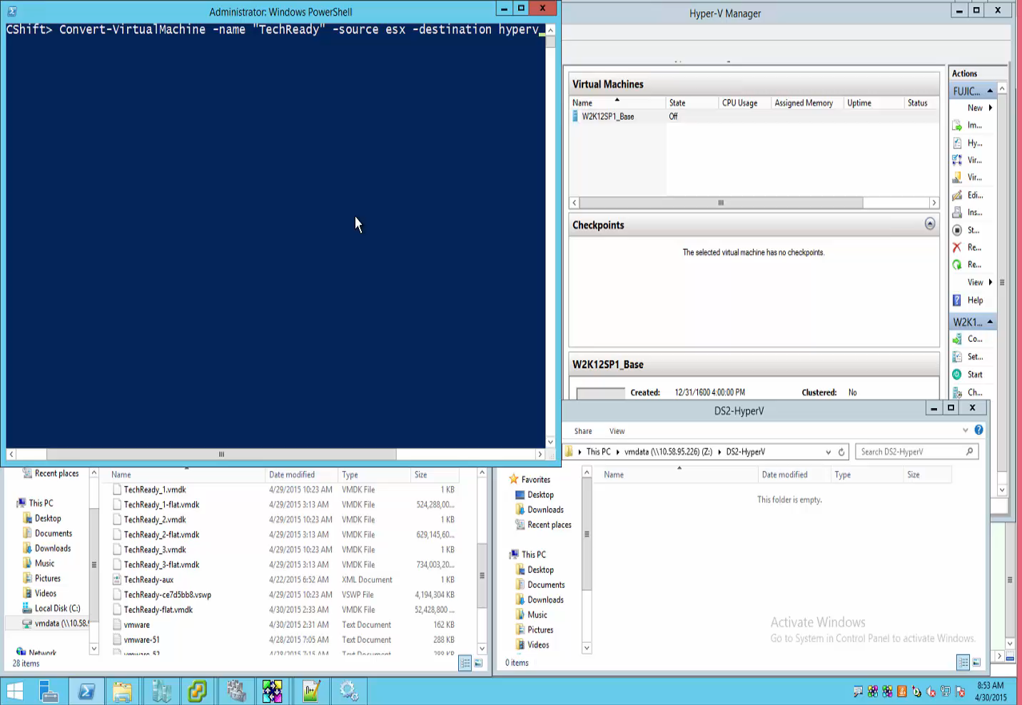

Slide 39
Yeah… I’m going to need you to…
Bullet proof our SQL workloads. And…
We need to leverage Microsoft Azure. While…
Maintaining data sovereignty and full control of our data.
Don’t forget…
It needs to be backed up and secure!
Oh! Did you know we get Hyper-V licenses with our EA? I’m cutting back on our VMware licenses. So…
I need you to move all our VMs to Hyper-V.
Stat!!
Microsoft is retiring support for Windows Server 2003?!?
Half of our servers are Windows Server 2003!
Order new hardware and fix it!
And whatever you do…
It needs to be fully manageable!
With System Center.

Slide 40
Our Scenario
Ask:
Deploy a new Storage, Network and Compute infrastructure while..
  Minimizing time to deployment
  Ensuring hardware and software compatibility
  Minimizing cost
Solution:
  FlexPod

Slide 41
FlexPod Accelerate

Slide 42
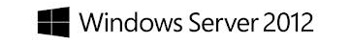

FlexPod Datacenter with Microsoft Private Cloud
Converged infrastructure platform from NetApp and Cisco for Microsoft Private Cloud: Deep integration with Windows Server 2012 R2 and System Center 2012 R2
Reduced Risk: pre-validated HW accelerates and simplifies deployment
Lower Cost: compute, network, storage and private cloud in a turnkey platform
More Efficient: Virtualize infrastructure and automate workflows with integrated management and orchestration.
Flexibility to Scale: Add or change servers and storage as needed, without breaking support
Cisco® UCS™ Blade and Rack Servers and UCS Manager
Cisco Nexus®
Family Switches
NetApp® FAS
Storage Systems

Slide 43
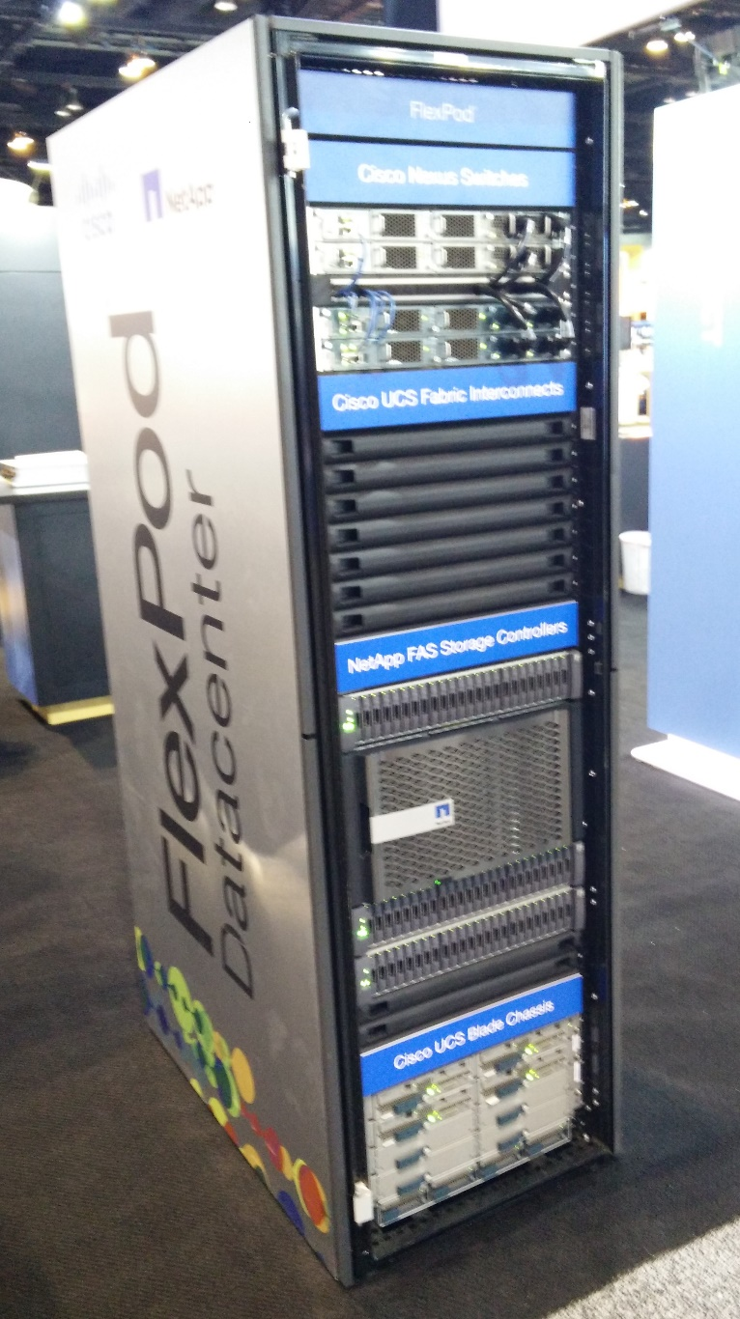
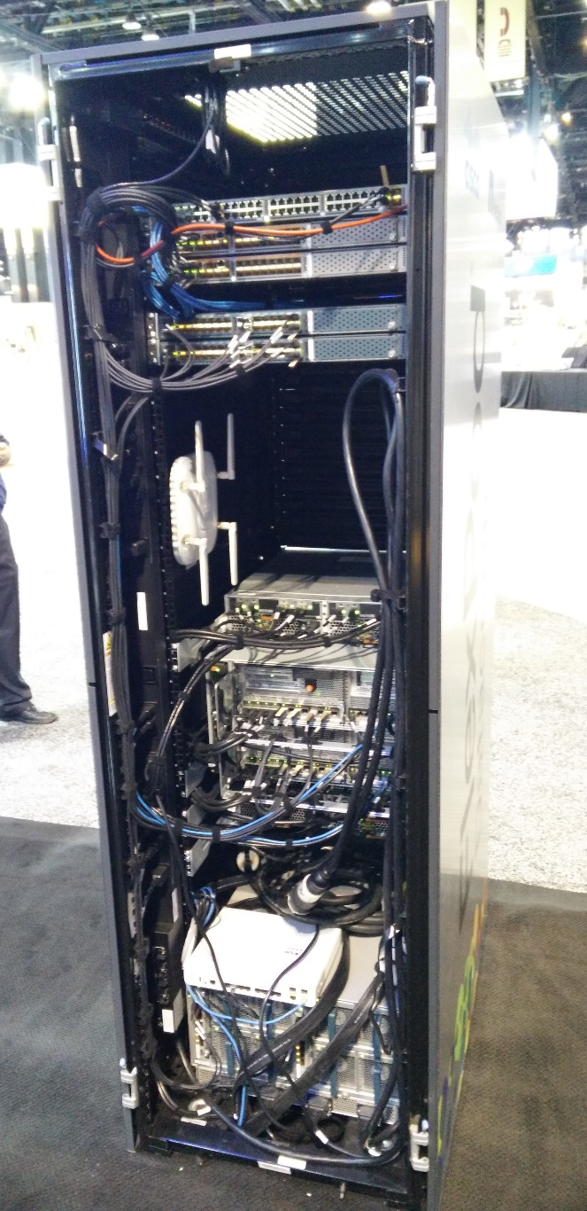
Come down and experience FlexPod

Slide 44
Yeah… I’m going to need you to…
Bullet proof our SQL workloads. And…
We need to leverage Microsoft Azure. While…
Maintaining data sovereignty and full control of our data.
Don’t forget…
It needs to be backed up and secure!
Oh! Did you know we get Hyper-V licenses with our EA? I’m cutting back on our VMware licenses. So…
I need you to move all our VMs to Hyper-V.
Stat!!
Microsoft is retiring support for Windows Server 2003?!?
Half of our servers are Windows Server 2003!
Order new hardware and fix it!
And whatever you do…
It needs to be fully manageable!
With System Center.

Slide 45
Our Scenario
Ask:
Manage our new infrastructure while..
  Eliminating the need for new Management Tools
Solution:
  OnCommand Plug-In for Microsoft
  OnCommand PowerShell Toolkit
  NetApp SMI-S Provider

Slide 46
Managing it all

Slide 47
Microsoft Private Cloud

Slide 48

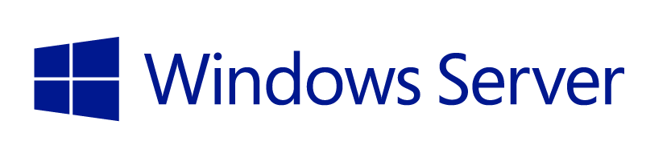

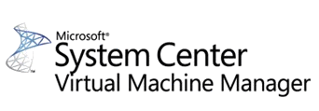
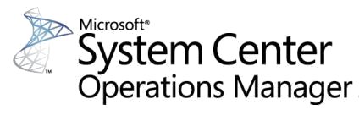
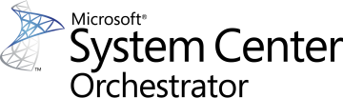
Microsoft Private Cloud
Microsoft
Applications
Microsoft
Infrastructure
with Hyper-V
Hardware:
Compute
Network
Storage
Windows Azure Pack
Provisioning | Monitoring | Automation

Slide 49
NetApp® for Microsoft Private Cloud

Slide 50

NetApp® for Microsoft Private Cloud
NetApp SnapManager for
Microsoft
Applications
with Hyper-V
Microsoft
Infrastructure
Windows Azure Pack
Provisioning | Monitoring | Automation
NetApp: OCPM, Data ONTAP, PowerShell Toolkit
NetApp
Management
Hardware:
Compute
Network
Storage
Provisioning | Monitoring | Automation
Configuration & Provisioning
Physical and Virtual Machine Monitoring
Network Management
Back Up & Recovery
Disaster Recovery
NetApp PowerShell Integration Packs

Slide 51
Management
OnCommand Plug-in for Microsoft 4.1
  SC Operations Manager Management Packs for discovering and monitoring NetApp Controllers
  (both 7-Mode and clustered Data ONTAP)
  SC Orchestrator Orchestration Packs for creating Automation Workflows with NetApp specific Activities
  SC Virtual Machine Manager UI Integration
Data ONTAP® SMI-S Agent 5.2
  Supports filers running Data ONTAP® 7.3.x, 8.0.x, 8.1.x, and 8.2.x
  Is agent based, can be run in Windows or Linux
  Passed SNIA Conformance Testing Program (CTP) 1.5 and supports
  SCVMM 2012 R2
Data ONTAP PowerShell Toolkit
  Windows PowerShell™ wrapper around the NetApp® Manage ONTAP® SDK
  Community
  As of version 3.2 over 1,400 cmdlets
  http://support.netapp.com/NOW/download/tools/powershell_toolkit/

Slide 52
NetApp and Microsoft Private Cloud Demo

Slide 53
Video

Slide 54
Summary
Scenario
NetApp Solution
Burst SQL to the cloud
Failover SQL to the cloud
Backup to the cloud
Migrate our VMs to Hyper-V
Deploy new Hardware
Manage it with System Center
NPS for Azure
ASR & NPS for Azure
NetApp Steelstore
OnCommand Shift
FlexPod
NetApp System Center Integrations

Slide 55
More information
NPS for Azure:
  http://www.netapp.com/us/solutions/cloud/microsoft-cloud/microsoft-azure.aspx?q=nps%20for%20azure&cp=1
ASR with NPS for Azure:
  http://aka.ms/asr_nps_microsoft_blog
SteelStore:
  http://www.netapp.com/us/products/protection-software/steelstore/index.aspx?q=steelstore&cp=1

Slide 56
More information
OnCommand Shift:
  www.netapp.com/us/products/management-software/oncommand-shift.aspx
FlexPod:
  http://www.netapp.com/us/solutions/flexpod/index.aspx?q=flexpod&cp=1
System Center Information:
  OnCommand Plug-in for Microsoft:
    http://www.netapp.com/us/products/management-software/oncommand-plug-ins-for-microsoft.aspx?q=oncommand%20plug-in%20for%20microsoft&cp=1
  SMI-S Provider:
    http://www.netapp.com/us/company/leadership/industry-standards/smi-s.aspx

Slide 57
Q/A

Slide 58
Text NetApp to 40691 for your chance to win 600+ prizes
Grand Prizes:
Surface Pro 3
XBox One Bundle
Parrot AR Drone
Go Pro Hero 4
Beats by Dre MIXRz
Visit NetApp booth 606 to claim your prize

Slide 59


Please evaluate this session
Your feedback is important to us!
Visit Myignite at http://myignite.microsoft.com
or download and use the Ignite Mobile App
with the QR code above.

