Slide 2
Platform Vision & Strategy (3 of 7): Networking Overview
BRK2471
Yousef Khalidi, Rajeev Nagar, Bala Rajagopalan

Slide 3
Azure Networking

Slide 4
Hyper-scale
Enterprise Grade
Hybrid

Slide 5

Hyper-scale Footprint
Azure compute regions

Slide 6
Hyper-scale Footprint
19
Azure compute regions open today
More than AWS and Google Cloud combined
Azure compute regions

Slide 7
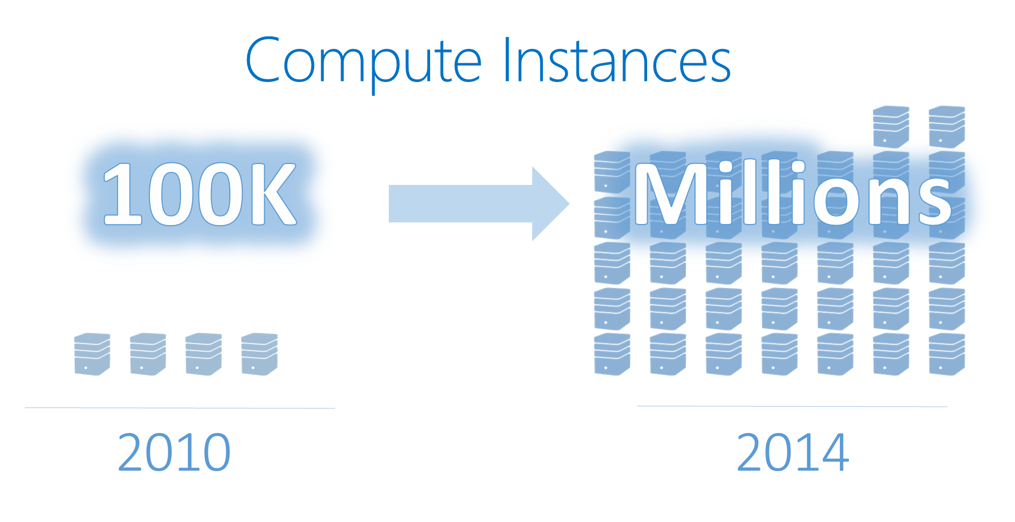
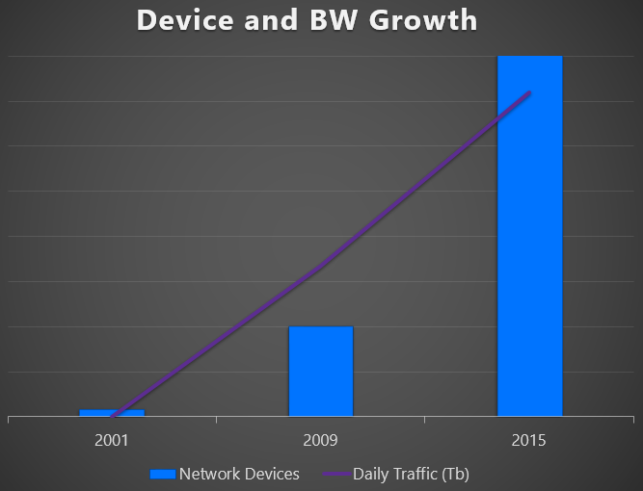
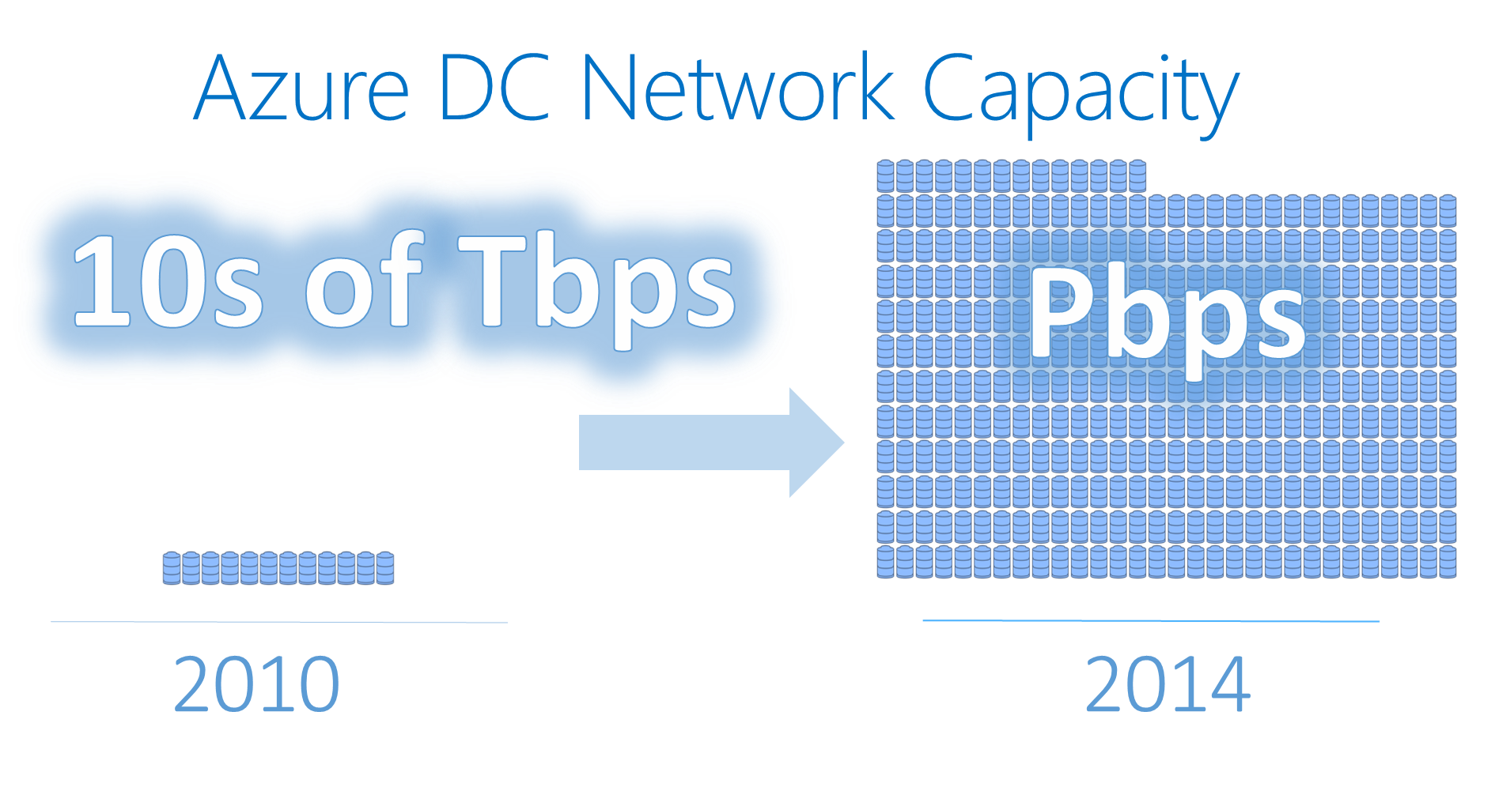
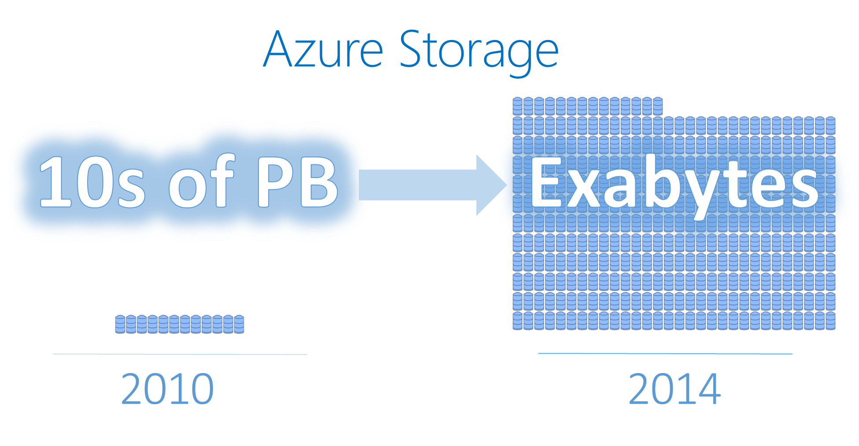
Tremendous Growth

Slide 8
Hyper-Growth
-- Hyper-Scale
5.1T
85 iXP
1.4M
50T
425M
4x
$15B
20M
AZURE STORAGE
TRANS. IN MARCH 2015
+ CONNECTIONS
TO 1695 NETWORKS
STORAGE OBJECTS
IN AZURE
MILES OF FIBER IN OUR DATA CENTERS
AZURE ACTIVE
DIRECTORY USERS
WRAP THE EARTH IN NORTH AMER FIBER
SQL DATABASE HOURS
USED EVERYDAY
MICROSOFT CLOUD INVESTMENT

Slide 9
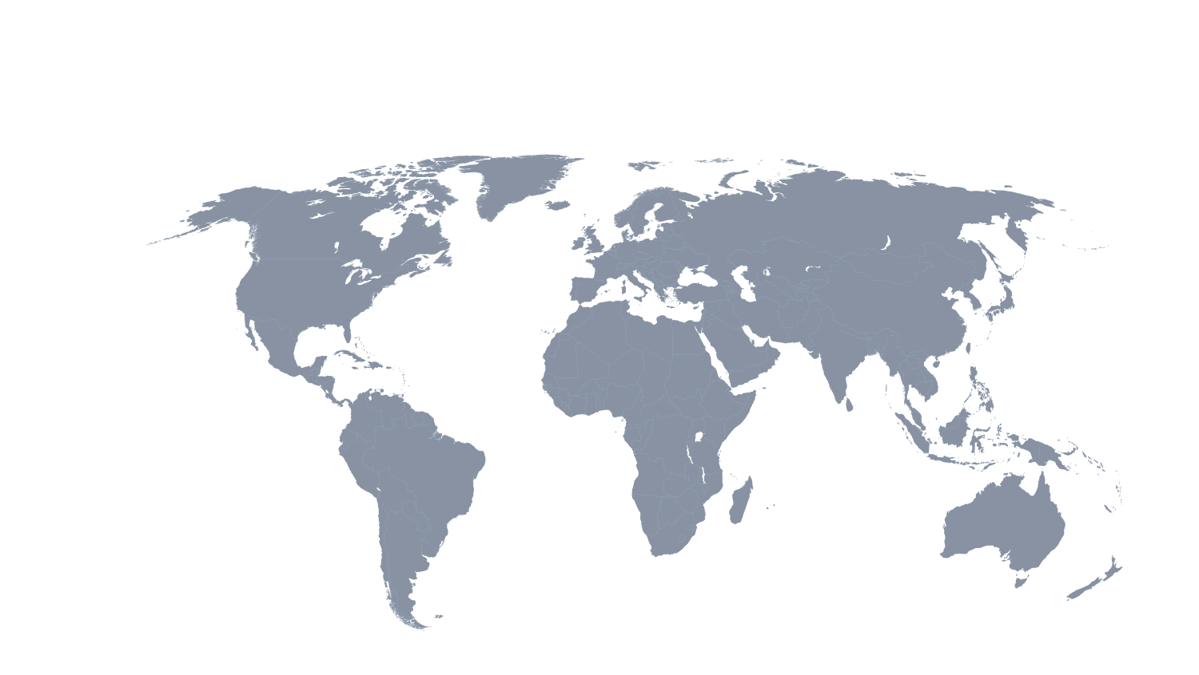
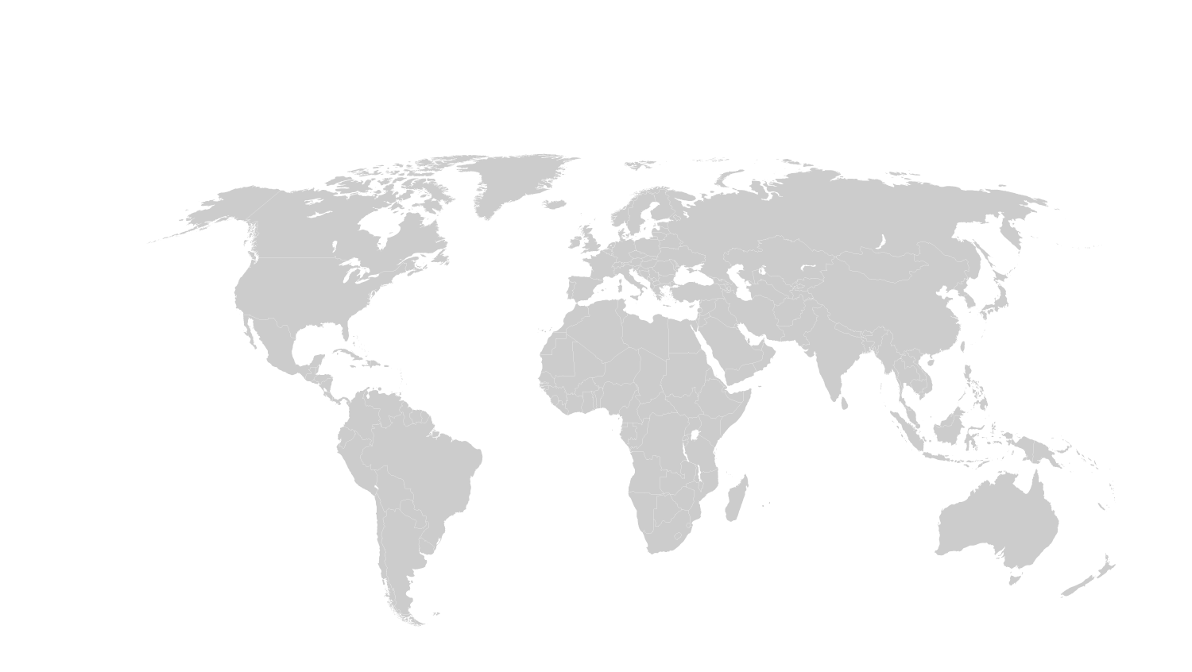
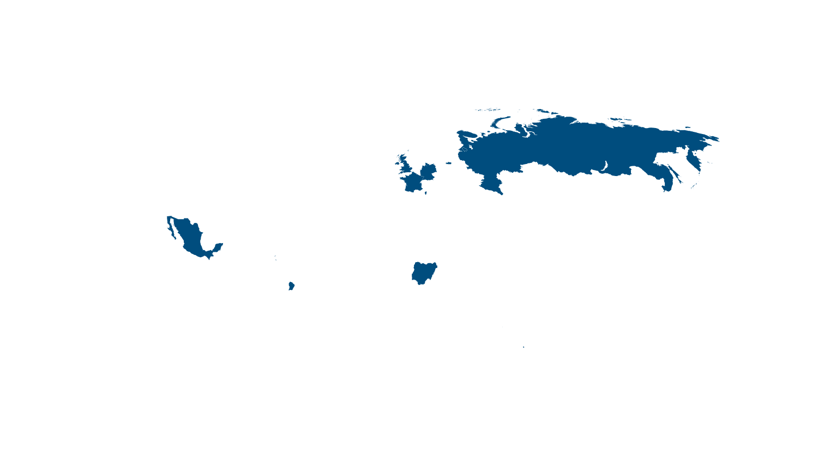
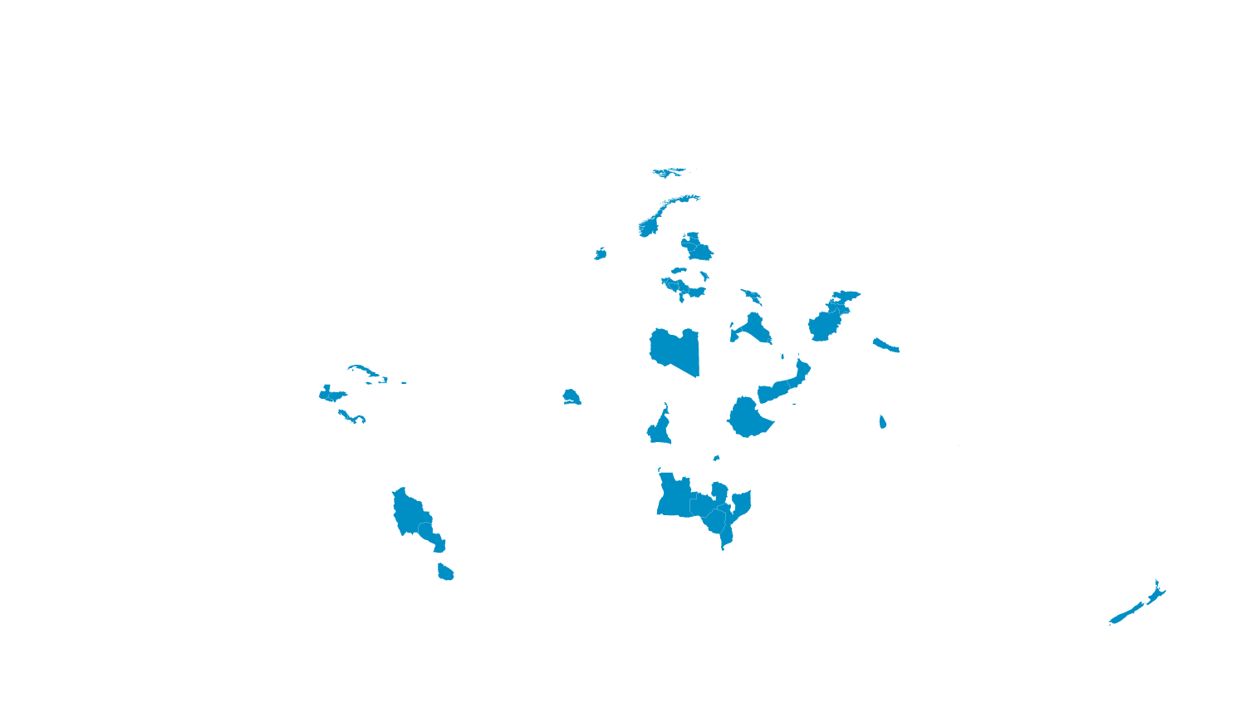
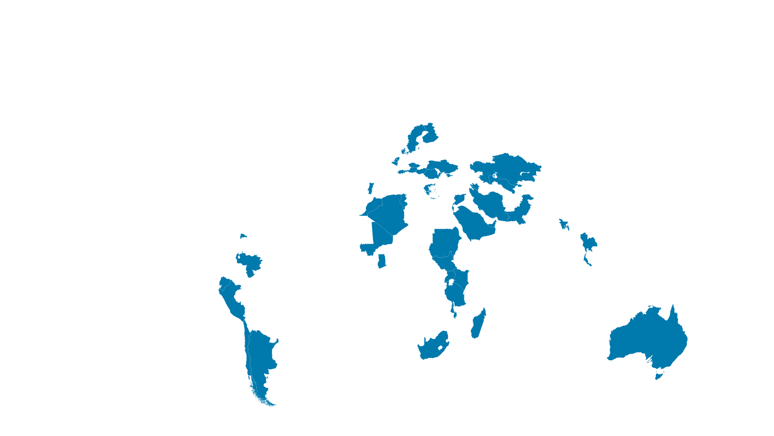
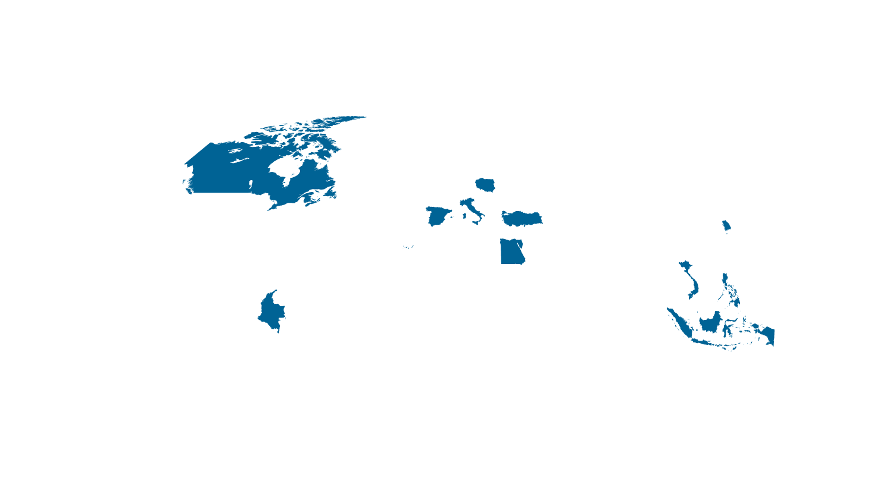
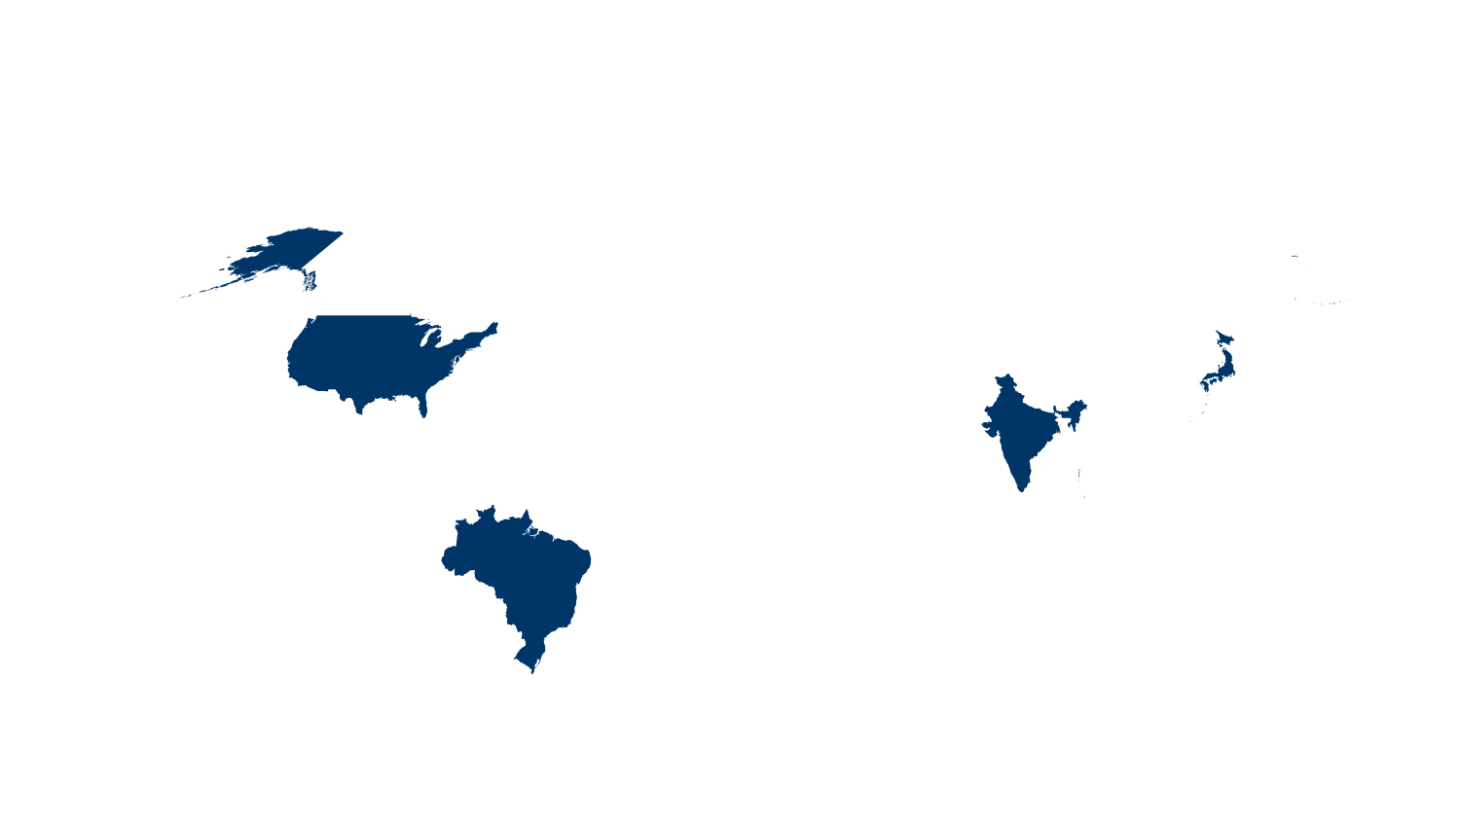

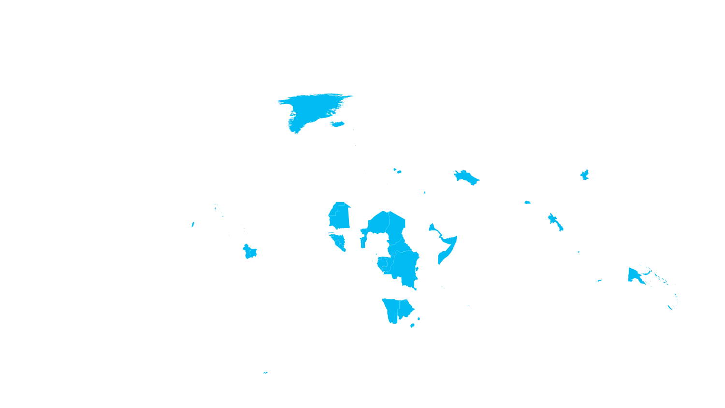




Internet connectivity by country
Microsoft Azure datacenter regions
Microsoft’s network is one of the largest in the world
INDIA NORTH
TBD
Internet users
■ 500,000,000+
■ 100,000,000 – 499,999,999
■ 50,000,000 – 99,999,999
■ 25,000,000 – 49,999,999
■ 5,000,000 – 24,999,999
■ 100,000 – 4,999,999
■ 50,000 – 999,999
■ 0 – 49,999
*Operated by 21Vianet

Slide 10
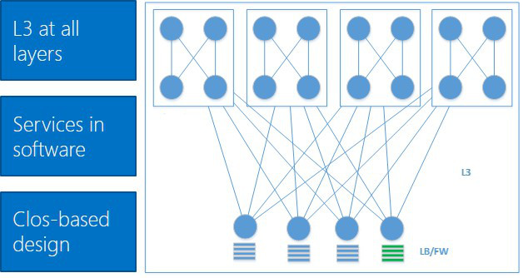
Classic vs. Hyper-scale networks
Large L2 Domains
L3 at all Layers
HW-based Service
Software
Service
L3
L2
Simple Tree Design
Clos-based design
Agility
Automated provisioning, integrated process
Diversity and manual provisioning
Complex hardware and lack of automated operations
Efficiency
Simplify requirements, optimized design, and unify infrastructure
Availability
Resilient, automated monitoring and remediation, low human involvement
High complexity and human error

Slide 11
Software-defined networking (SDN)
Building the right abstractions to enable Scale and Agility
Abstract
Management, Control, and Data planes
Tenant
Compose compute & storage roles and networks
Tell & Program
Instead of Discover and react
Azure
FrontEnd
Management
Plane
Application
Plane
Proprietary
Hardware
Appliance
Commodity
Hardware
Control
Plane
Controller
Physical
Transport
Plane
Control
Plane
Example: ACLs
Management | Create a tenant
Control | Plumb tenant ACLs to switches
Data | Apply ACLs to these flows
Switch

Slide 12
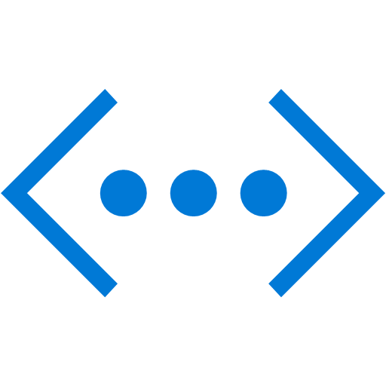
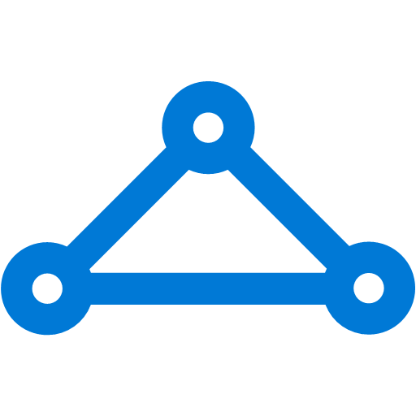
The Big (Network) Picture
Virtual Network
“Bring Your Own Network”
Segment with subnets and security groups
Control traffic flow with User Defined Routes
Azure
Virtual Network
Users
Internet
Front-End Access
Dynamic/Reserved Public IP addresses
Direct VM access, ACLs for security
Load balancing
DNS services: hosting, traffic management
DDoS protection
Backend Connectivity
Point-to-site for dev / test
VPN Gateways for secure site-to-site connectivity
ExpressRoute for private enterprise grade connectivity
Backend Connectivity
ExpressRoute
VPN Gateways

Slide 13

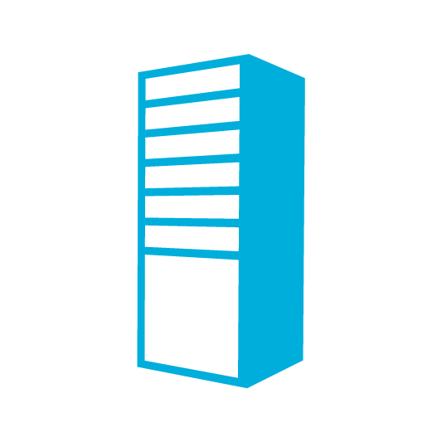
Virtual Network
On Premises
10.0/16
Bring your own network
Create subnets with your private or public IP addresses
Bring your own DNS or use Azure-provided DNS
Secure with Network Security Group ACLs
Control traffic flow with
User Defined Routes
Internet
VPN &
ExpressRoute
Direct Internet
Connectivity
Azure
VPN GW
Backend
10.3/16
Mid-tier
10.2/16
Frontend
10.1/16
AD / DNS
Virtual Network

Slide 14
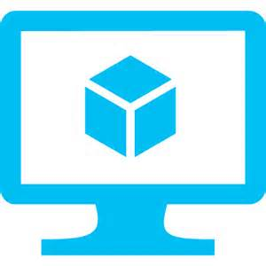


User Defined Routes
New
Control traffic flow in your network with custom routes
Attach route tables to subnets
Specify Nexthop for any Address prefix
Set 0/0 route to force tunnel all traffic to on-premises or appliance
Internet
Virtual Network
VM with “IP Forwarding”
Default Route
FrontEnd Subnet
BackEnd Subnet
Default Route
Default Route
VM/Appliance
User Defined Route

Slide 15
Network Security Groups
Segment network to meet security needs
5 tuple ACLs on both directions
Can protect Internet and internal traffic
Enables DMZ subnets
Associated to subnets/VMs and now NICs
ACLs can be updated independent of VMs
On Premises 10.0/16
Internet
ExpressRoute
and VPNs
√
√
√
√
VPN GW
Backend
10.3/16
Mid-tier
10.2/16
Frontend
10.1/16
Virtual Network

Slide 16
Layered Security, Protection, and Isolation
Cloud Services
&
Virtual Machines
Virtual
Network
Isolation
VM
Firewall
DDoS
Protection
NSG
ACLs
Internet

Slide 17
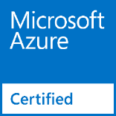
Network Virtual Appliances
Overview
  VMs that perform specific network functions
  Focus: Security (Firewall, IDS , IPS), Router/VPN, ADC (Application Delivery Controller), WAN Optimization
  Typically Linux or FreeBSD-based platforms running on Azure
Scenarios
  IT Policy & Compliance – Consistency between on premises & Azure
  Supplement/complement Azure capabilities
Azure Marketplace
  Available through Azure Certified Program to ensure quality
  and simplify deployment
  You can also bring your own appliance and license

Slide 18

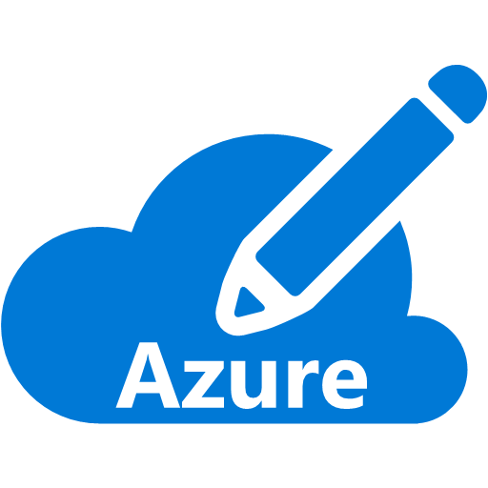
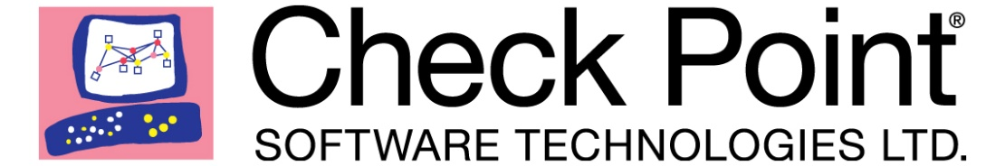


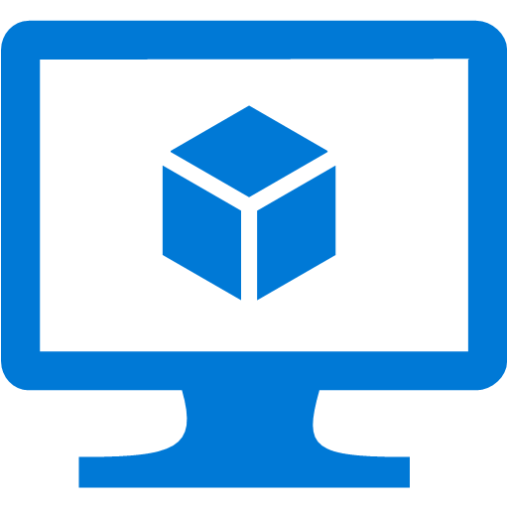


Virtual Appliances - Firewalls, IDS/IPS, VPNs
Secure your virtual networks in Azure
Azure Virtual Network
Internet
DMZ
Cross-premises connectivity
IDS
IPS

Slide 19



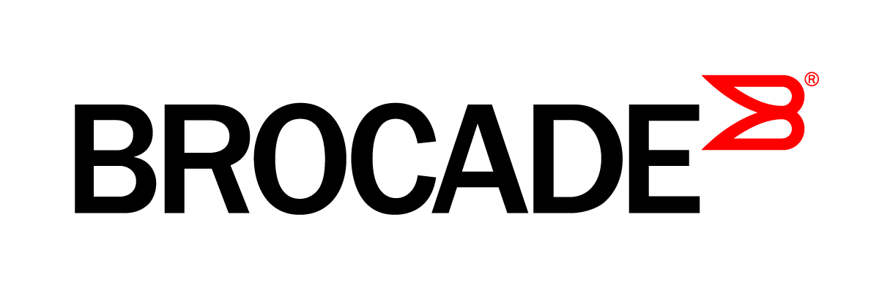





Network Virtual Appliance Ecosystem

Slide 20
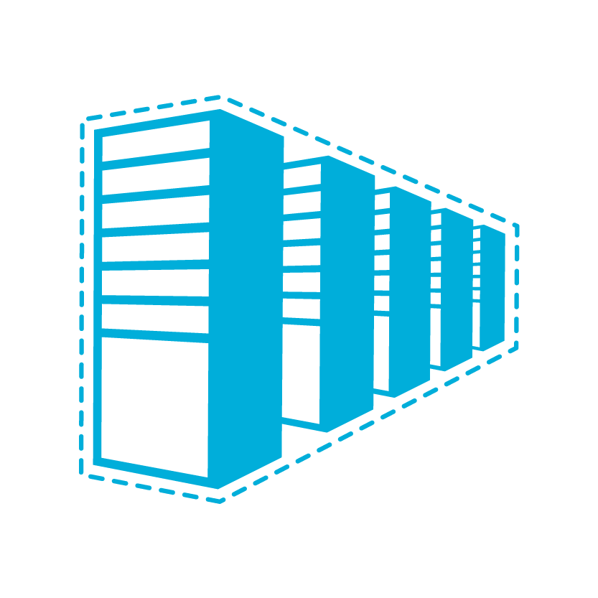

Connectivity Options and Hybrid Offerings
Cloud
Customer
Segment and workloads
Consumers
Access over public IP
DNS resolution
Connect from anywhere
Internet Connectivity
Developers
POC Efforts
Small scale deployments
Connect from anywhere
Secure point-to-site connectivity
SMB, Enterprises
Connect to Azure compute
Secure site-to-site
VPN connectivity
SMB & Enterprises
Mission critical workloads
Backup/DR, media, HPC
Connect to all Azure services
ExpressRoute private connectivity

Slide 21










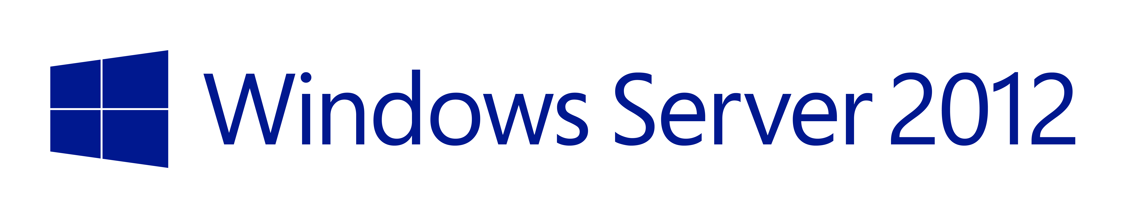
On-premises VPN Ecosystem

Slide 22

Connectivity choices: Internet or Private
Branch Office 2
Branch office 2
Microsoft
Microsoft
WAN
WAN
Branch office 1
Branch office 1
Public
internet
Public
internet
Corp HQ
Corp HQ
IPsec VPN over Internet
  Encrypted data traverses Internet to reach Azure
  Limited bandwidth and higher availability
Cloud on your WAN
  Traffic flows directly from customer WAN to Microsoft
  Reduces complexity
  Lower latency, higher bandwidth and higher availability

Slide 23
ExpressRoute
Branch office 2
Microsoft
Predictable performance
WAN
Branch office 1
Security
Public
internet
High throughput
Corp HQ
ExpressRoute provides a private,
dedicated, high-throughput network connection to Microsoft
Lower cost

Slide 24
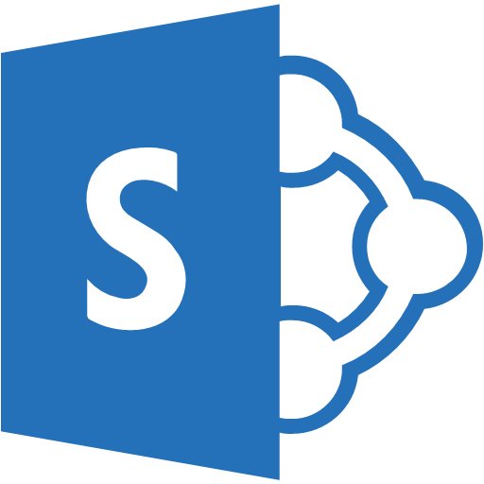
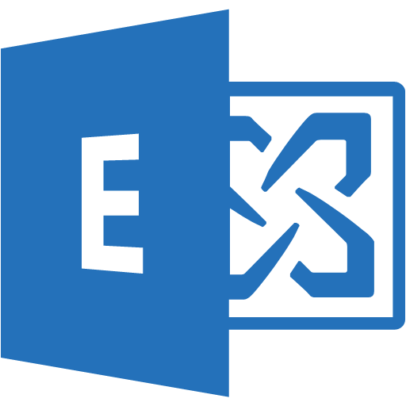



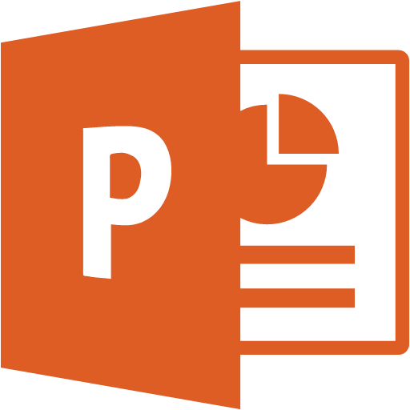
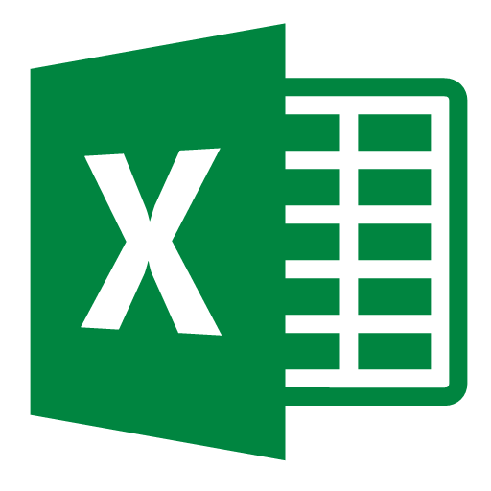
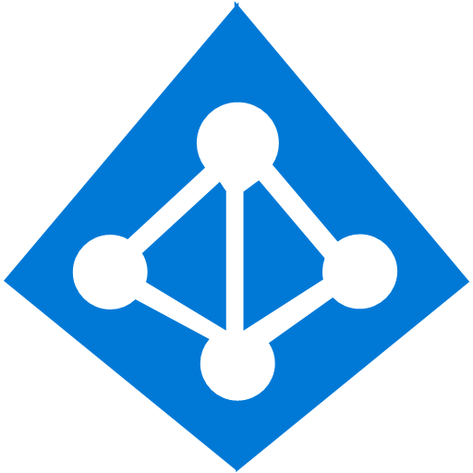


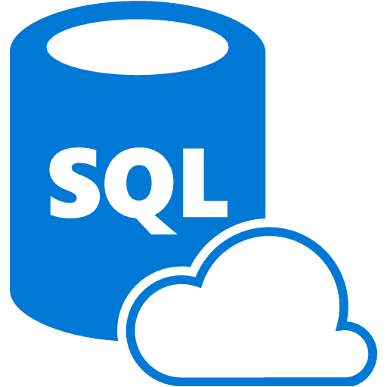
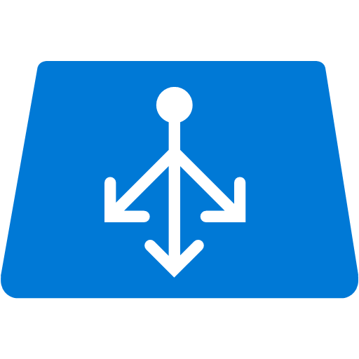

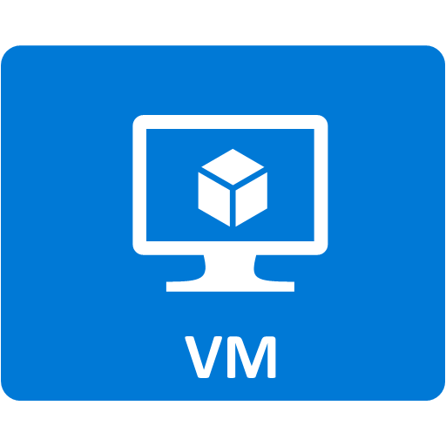
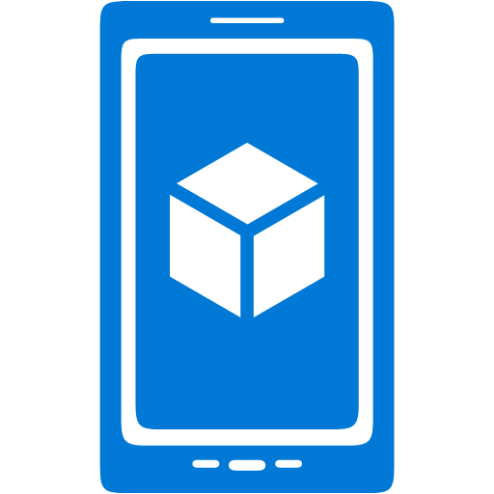

Private Connectivity to Azure and Office 365
O365
Public
internet
Branch office 2
WAN
ExpressRoute
Branch office 1
Azure
Corp HQ

Slide 25

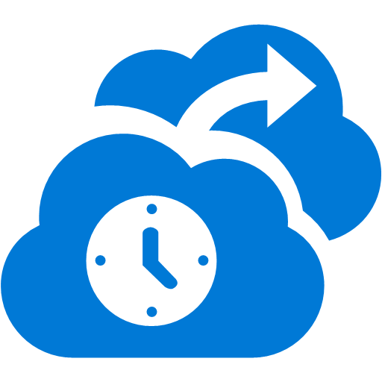



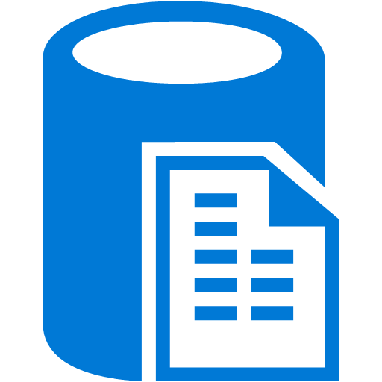
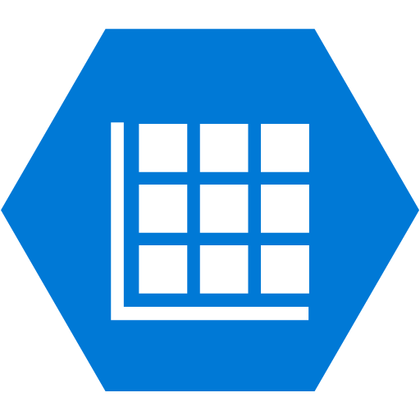
ExpressRoute and Microsoft Clouds
Partner Edge
Microsoft Edge
Customer’s
network
Customer’s
connection
Traffic to Office 365 Services
Traffic to public IP addresses in Azure
Traffic to Virtual Networks

Slide 26



Office 365 Timelines and Partners
Launch Partners
  Other providers soon to follow
Locations
  All Microsoft Regions
General Availability
  Q3 CY 2015
Supported Workloads
  Exchange Online & Exchange Online Protection
  SharePoint Online, OneDrive for Business, Office 365 Video, Delve
  Skype for Business Online (formerly Lync Online)
  Office Online
  Power BI and Project Online

Slide 27



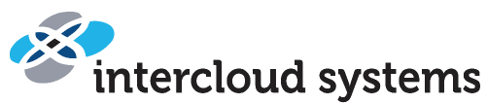

















ExpressRoute Sites and Partners
Atlanta
Chicago Chicago (Gov Cloud)
Dallas
LA
NY
Seattle
Silicon Valley
Washington DC
Washington DC (Gov Cloud)*
Amsterdam
Dublin*
London
Chennai*
Hong Kong
Mumbai*
Melbourne*
Osaka*
Singapore
Sydney
Tokyo
Sao Paulo

Slide 28


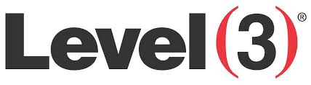









ExpressRoute Partners
Exchange Provider
Network Service Provider
Microsoft
Microsoft
Public
internet
Customer site 3
Customer site 2
WAN
Public
internet
Customer site
Exchange
Customer site 1

Slide 29
ExpressRoute Premium Add On
NEW
Global connectivity
  Link a Virtual Network from any Azure Region to your ExpressRoute circuit
More routes (IP prefixes)
  Supports up to 10,000 routes, increase from 4,000 routes
Connect more Virtual Networks
  Up to 100 virtual networks depending on bandwidth option

Slide 30

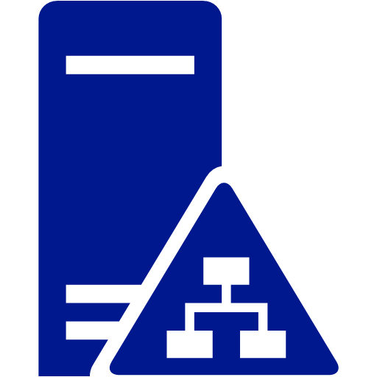

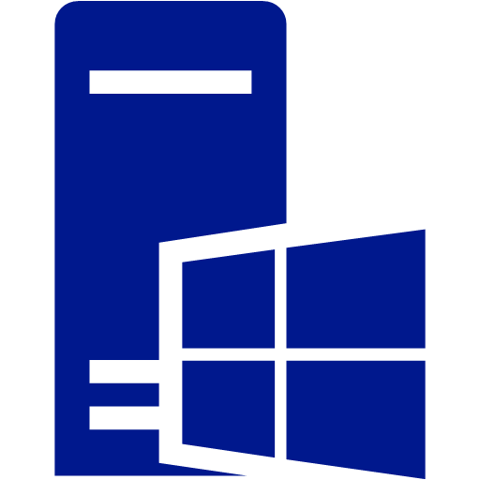
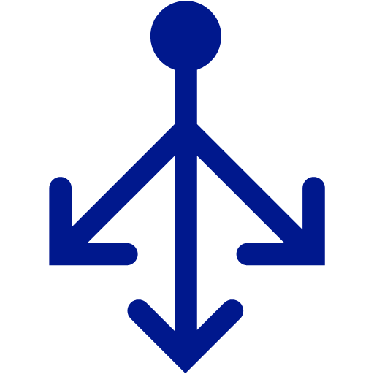
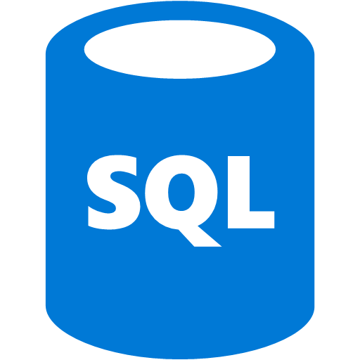
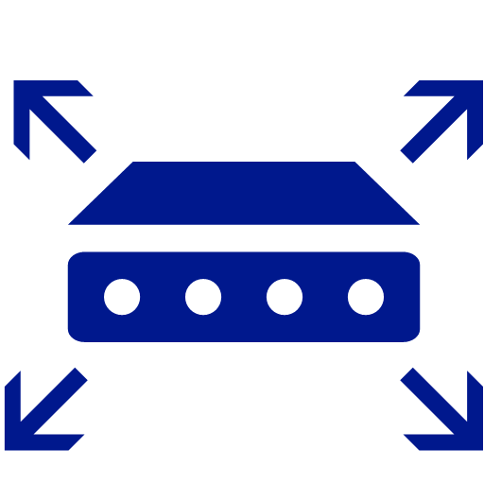

Putting it all together
User Defined Routes on subnets to direct flows to appliances
Network Security groups to secure subnets
Network Virtual Appliances for security, routing and ADC
Secure cross-premises connectivity with ExpressRoute and VPN Gateways
Internet connectivity
Site-to-site VPN
Front End – through firewalls
ExpressRoute
Middle Tier (exposed to FE and Infra)
Infrastructure (protected)

Slide 31
Cloud Inspired Infrastructure

Slide 32
Benefits: Cloud Inspired Network Infrastructure
  Unparalleled productivity
  Maximum flexibility
  Extreme
  efficiency
  Enterprise-grade reliability
  Cutting-edge protection
Programmatically provision
applications and
associate networks
in minutes, with simplicity &
consistency
Programmatically
instantiate network policy
Dynamically determine app
placement based on evolving
business needs
Achieve hybrid deployments
spanning self-operated
datacenters, service providers,
& Azure
Optimize capital and operational
expenditure leveraging advances
in merchant-silicon & virtualized
network services
Maximize utilization of high-
speed converged Ethernet fabric
for all network traffic
Leverage highly-available
software infrastructure
components resilient to failure
Benefit from automated
monitoring combined with
improved diagnosability
Securely share underlying physical
infrastructure via industry
standard interoperable protocols
Implement granular network
policy to appropriately protect
critical business assets and data

Slide 33
Infrastructure Deployable Today …

Slide 34
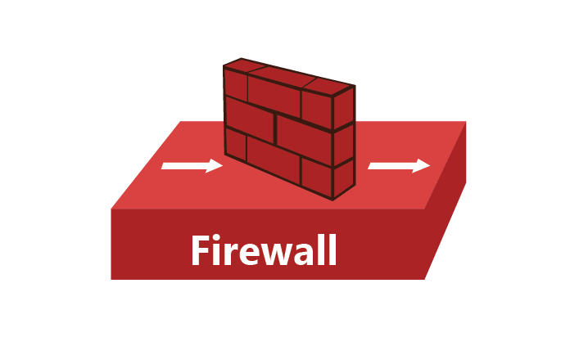
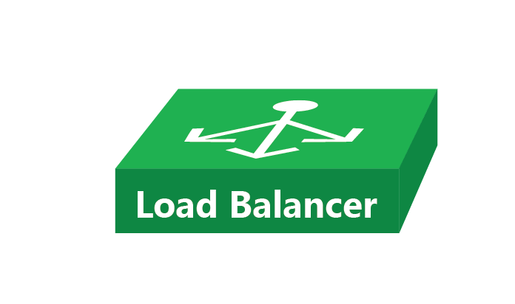
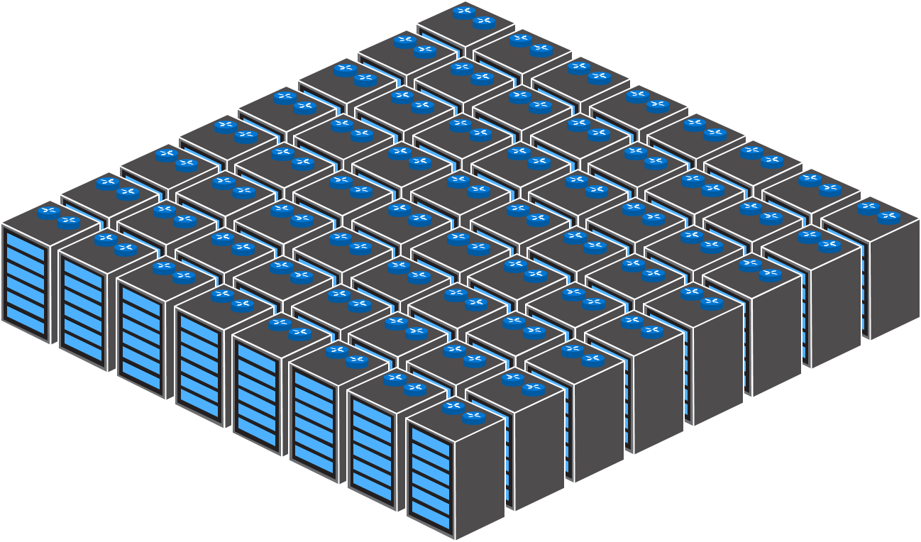
Edge Routers
Fixed-Function
Physical Appliances
Spine Switches/Routers
Compute/Storage
& TOR Switches
Datacenter

Slide 35
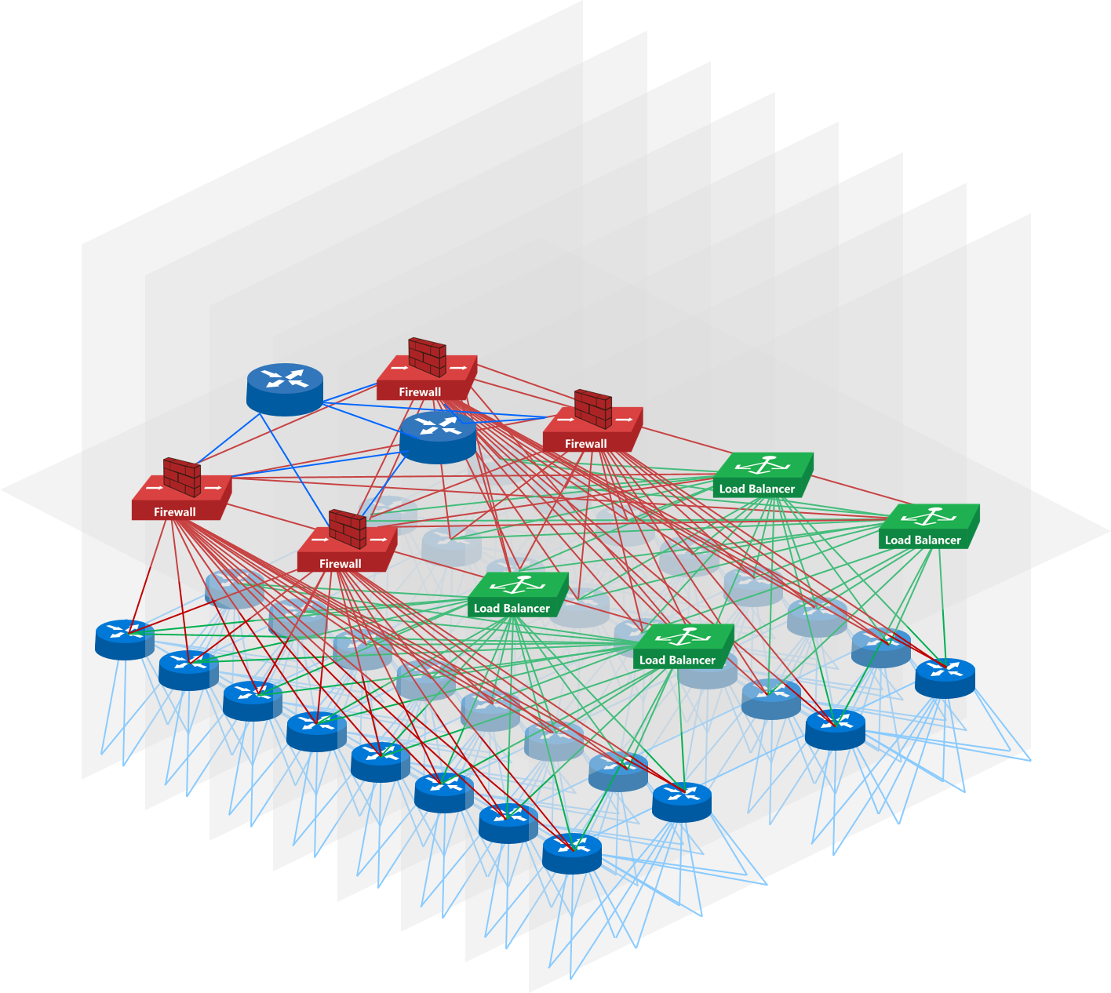
Physical Infrastructure
Datacenter

Slide 36


Software Layer
Physical Infrastructure
Datacenter

Slide 37
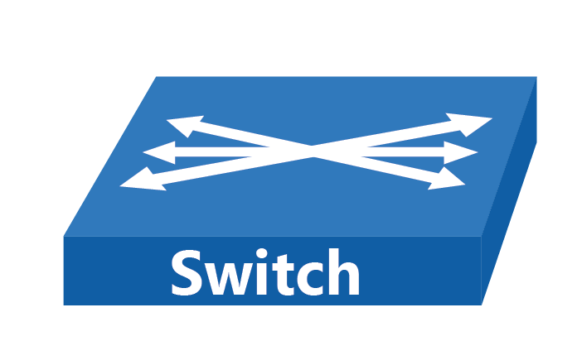
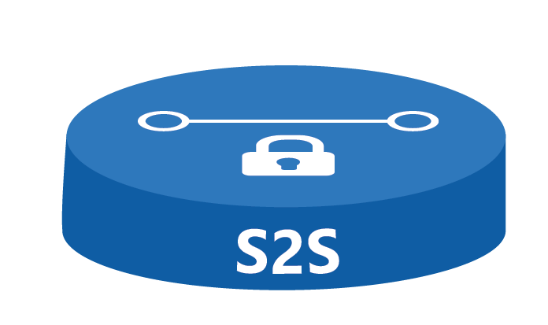
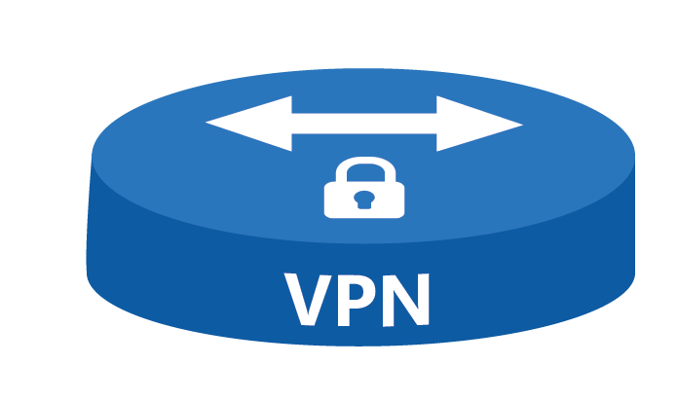







Edge Services
Edge Services
Core Services
Physical Infrastructure
Datacenter

Slide 38


PaaS
Database
IaaS
Network
Virtual Machine Manager (VMM)
Azure-Based Services
PaaS
Service bus
Orchestration
IaaS
Virtual machines
Control
PaaS
Websites
Monitoring
Resource
clouds
Automation
Billing
Tenant
management
Hosting
plan
Management
Edge Services
Core Services
Physical Infrastructure
Datacenter

Slide 39



Tenant Deployment
Multi-Tier LOB Application

Slide 40




Tenant Deployment
Multi-Tier LOB Application

Slide 41

Windows Azure Portal (WAP)
Virtual Machine Manager (VMM)
Edge Services
Core Services
Physical Infrastructure
Datacenter

Slide 42


Windows Azure Portal (WAP)
Virtual Machine Manager (VMM)
Edge Services
Core Services
Physical Infrastructure
Datacenter 1
Windows Azure Portal (WAP)
Windows Azure Portal (WAP)
Azure Fabric Manager
Virtual Machine Manager (VMM)
Edge Services
Edge Services
Core Services
Core Services
Physical Infrastructure
Microsoft Azure
Physical Infrastructure
Datacenter 2

Slide 43
Demo
Greg Cusanza, Yu-Shun Wang

Slide 44
Upcoming Enhancements …

Slide 45






Network Services
Core Services
Physical Infrastructure
Datacenter

Slide 46







Network Services
Network Services
Core Services
Core Services
Physical Infrastructure
Physical Infrastructure
Network Services
Datacenter 1
Core Services
Physical Infrastructure
Datacenter
Foundational Services

Slide 47
PaaS
Database
IaaS
Network
Virtual Machine Manager – Fabric Management
Azure-Based Services
PaaS
Service bus
Orchestration
IaaS
Virtual machines
Control
PaaS
Websites
Monitoring
Resource
clouds
Automation
Billing
Tenant
management
Hosting
plan
Management
Network Services
Core Services
Foundational Services
Network Services
Physical Infrastructure
Core Services
Foundational Services
Physical Infrastructure
Datacenter

Slide 48





Microsoft Azure Stack
Focus On Networking
PaaS
Database
IaaS
Network
Virtual Machine Manager – Fabric Management
Azure-Based Services
PaaS
Service bus
Orchestration
IaaS
Virtual machines
Control
PaaS
Websites
Monitoring
Resource
clouds
Automation
Billing
Tenant
management
Hosting
plan
Management
Programmatic Control
Network Services
Core Services
Foundational Services
Physical Infrastructure
Datacenter

Slide 49
Microsoft Azure Stack
Focus On Networking
PaaS
Database
IaaS
Network
Virtual Machine Manager – Fabric Management
Azure-Based Services
PaaS
Service bus
Orchestration
IaaS
Virtual machines
Control
PaaS
Websites
Monitoring
Resource
clouds
Automation
Billing
Tenant
management
Hosting
plan
Management
Network Services
Core Services
Foundational Services
Physical Infrastructure

Slide 50

Data Tier
Network
10.1.0.0/24
Middle-Tier DIP Network
10.0.2.0/24
Web Role DIP
Network
10.0.1.0/24
Middle-Tier VIP Network
192.168.0.0/24
Front-End VIP
Network
204.79.0.0/24

Slide 51



Tenant Deployment
Multi-Tier LOB Application

Slide 52
PaaS
Database
IaaS
Network
Virtual Machine Manager – Fabric Management
Azure-Based Services
PaaS
Service bus
Orchestration
IaaS
Virtual machines
Control
PaaS
Websites
Monitoring
Resource
clouds
Automation
Billing
Tenant
management
Hosting
plan
Management
Programmatic Control
Network Services
Core Services
Foundational Services
Physical Infrastructure
Datacenter

Slide 53


Programmatic Control
Programmatic Control
Programmatic Control

Slide 54
Demo
Greg Cusanza

Slide 55
Video
Bala Rajagopalan

Slide 56











Networking for the Microsoft Azure Stack
Programmatic Control
Services
Core
Foundation

Slide 57
Learn more with FREE
IT Pro Resources
Free technical training resources:
  On-demand online training: http://aka.ms/moderninfrastructure
Free ebooks:
  Deploying Hyper-V with Software-Defined
  Storage & Networking: http://aka.ms/deployinghyperv
  Microsoft System Center: Integrated Cloud Platform: http://aka.ms/cloud-platform-ebook
Expand your
Modern Infrastructure Knowledge
Get hands-on: Free virtual labs:
  Microsoft Virtualization with Windows Server
  and System Center: http://aka.ms/virtualization-lab
  Windows Azure Pack: Install and Configure: http://aka.ms/wap-lab
Join the IT Pro community:
  Twitter @MS_ITPro

Slide 58




Ignite Azure Challenge Sweepstakes
Attend Azure sessions and activities, track your progress online, win raffle tickets for great prizes!
Aka.ms/MyAzureChallenge
Enter this session code online: BRK2471
NO PURCHASE NECESSARY. Open only to event attendees. Winners must be present to win. Game ends May 9th, 2015. For Official Rules, see The Cloud and Enterprise Lounge or myignite.com/challenge

