Slide 2
The CPS team wants your feedback: http://aka.ms/cloudsolsurvey

Slide 3
Microsoft Cloud Platform System - Overview
BRK2472
Vijay Tewari
Principal Group Program Manager, Microsoft Corp

Slide 4
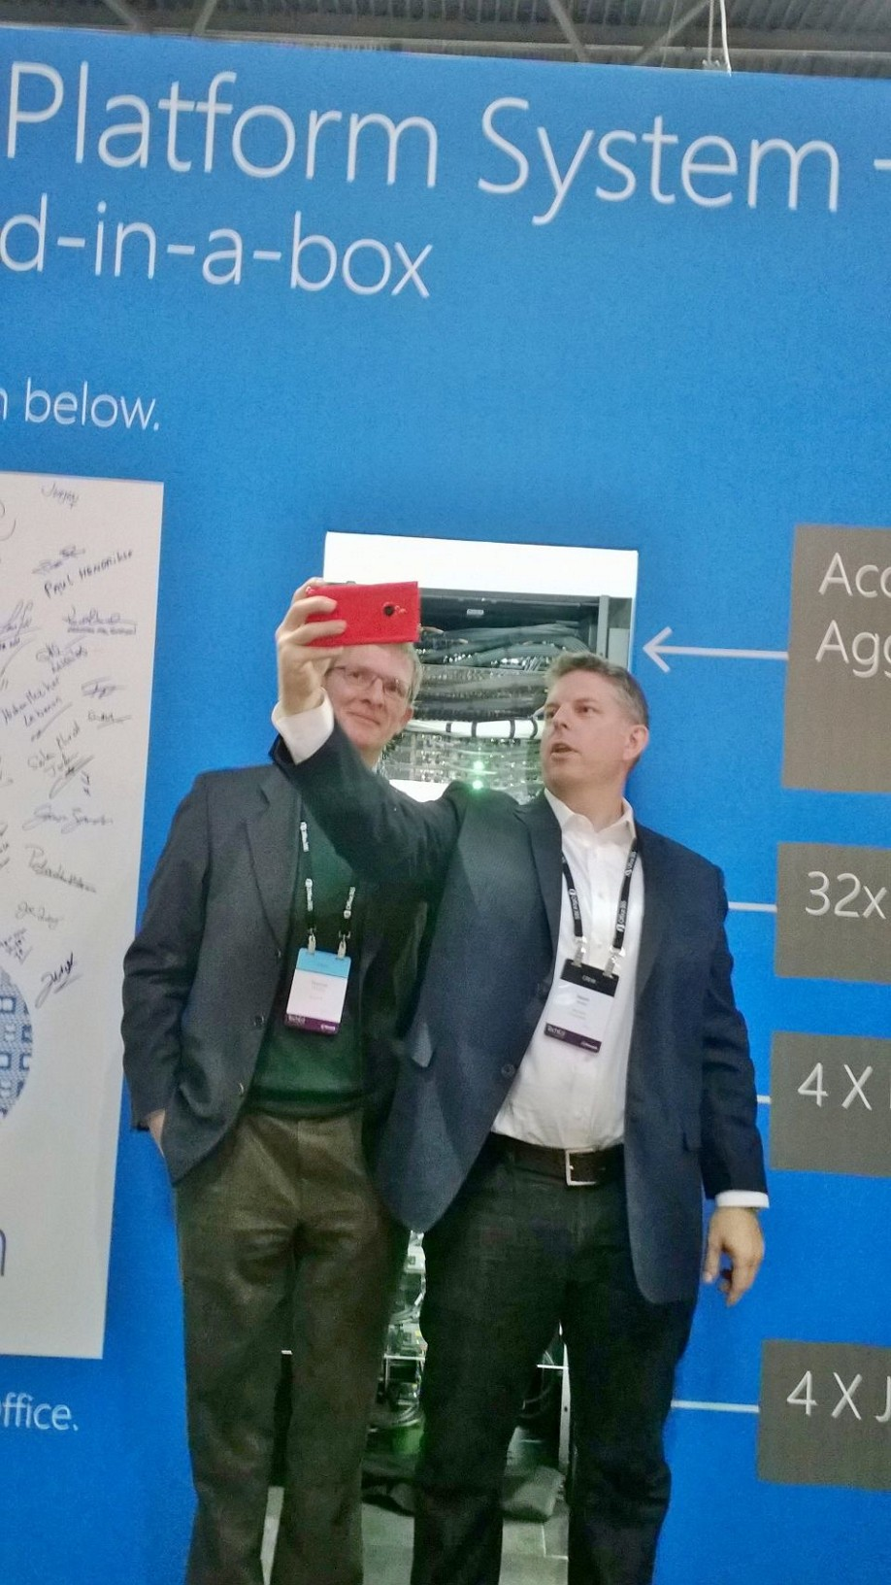
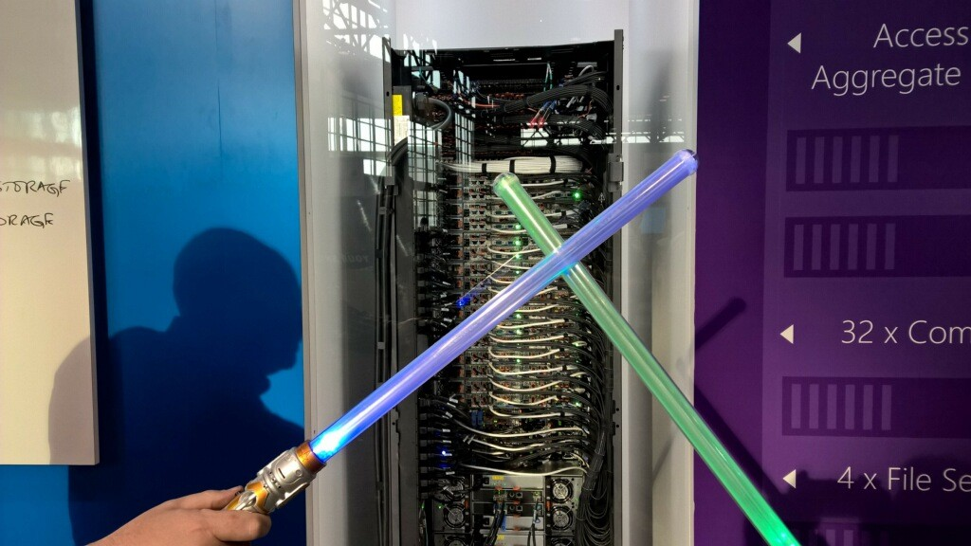
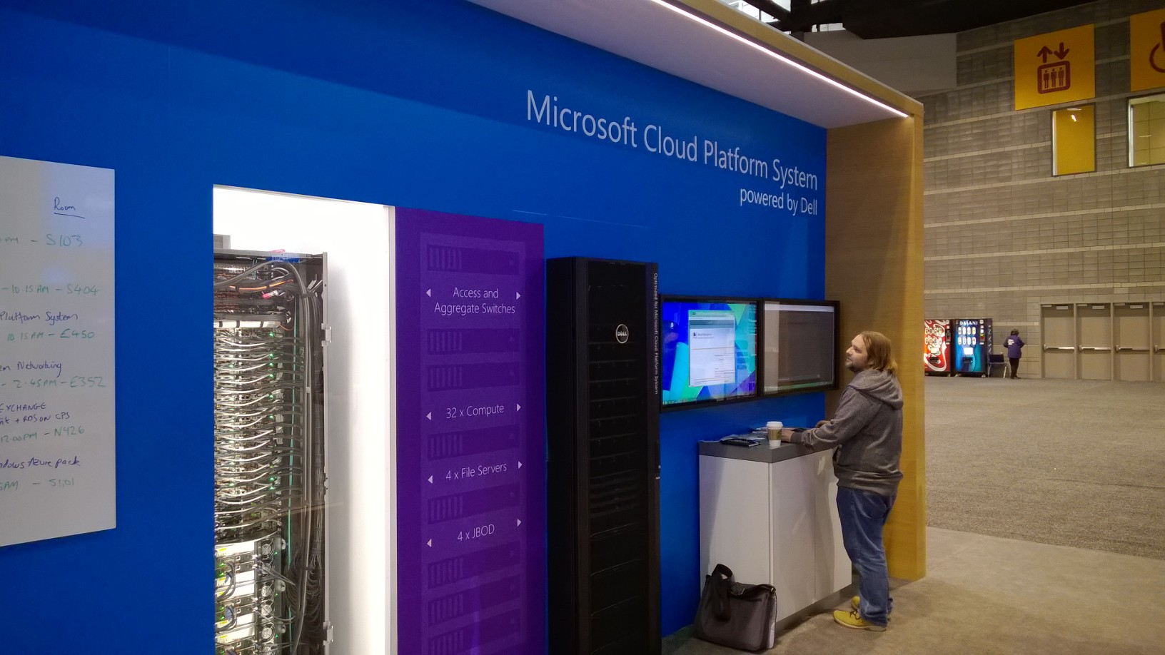
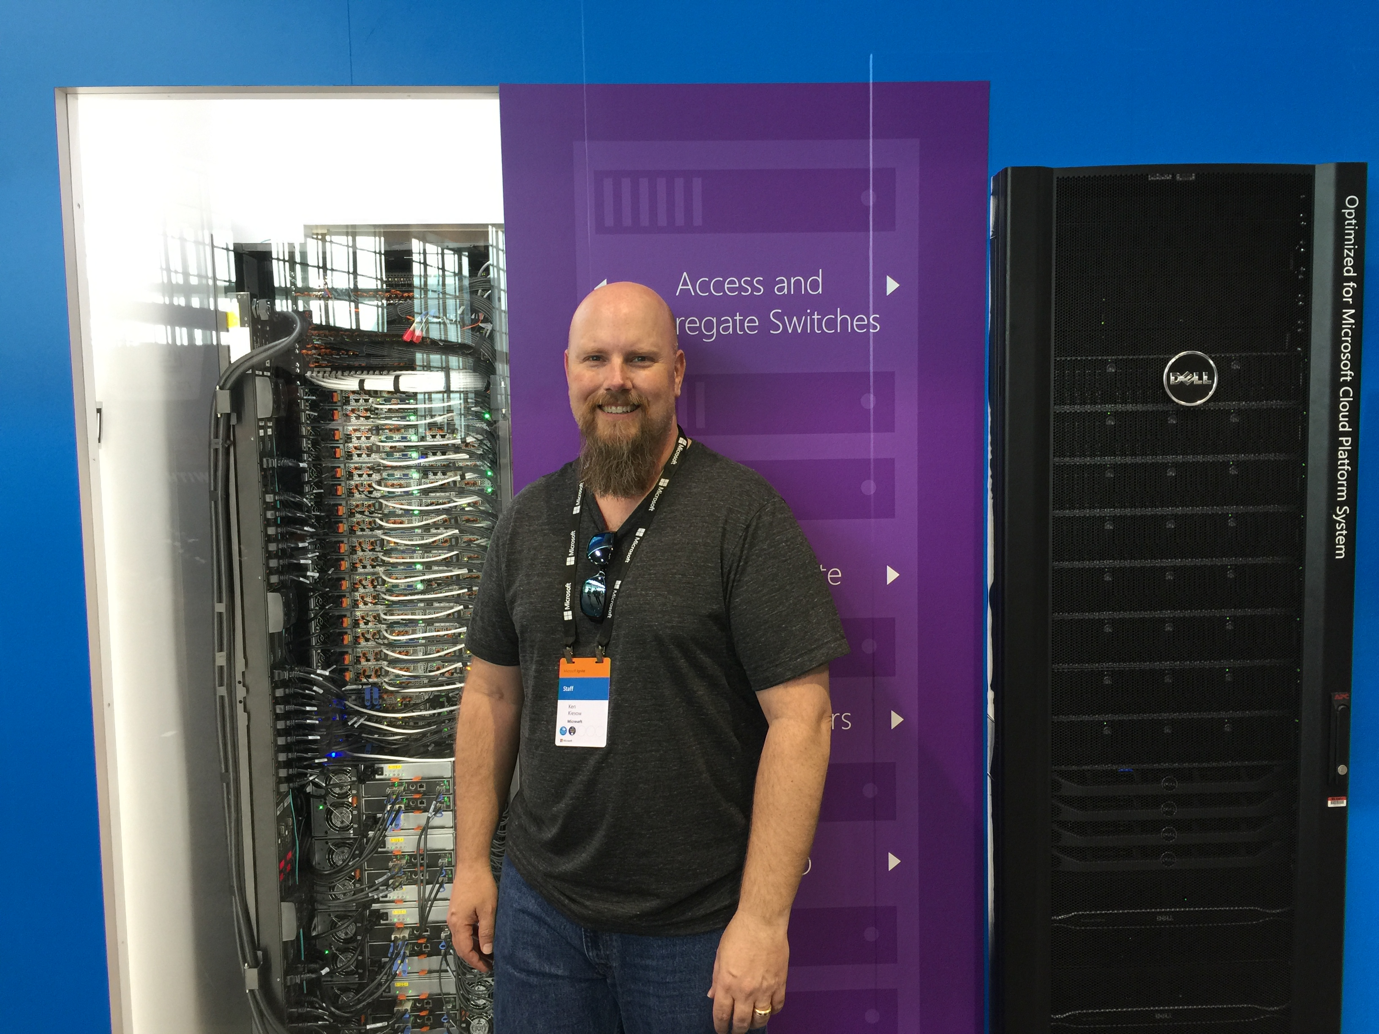
Session Objectives &
Takeaways
Session Objectives:
  Motivate the need for an integrated e2e Cloud solution.
  Share technical information about Microsoft Cloud Platform System (CPS), address common questions from you.
Key Takeaways
  Run Microsoft workloads optimally on CPS
  CPS is a validated solution for private cloud with a single point for SW & HW support with dramatic reduction in time to value for customer.
  CPS changes the development from delivering building blocks to solutions.
“relfie”
“relfie”

Slide 5
60-80%
Private Cloud Projects fail*
*Per Gartner

Slide 6
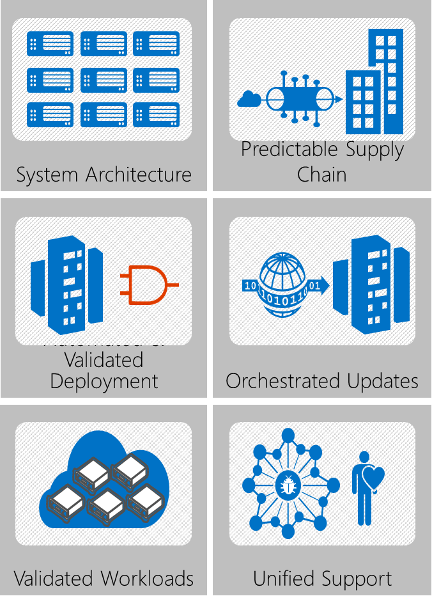



Customers Request
“I want my cloud and I want it now”
It’s a cloud, it should be always available
Portal and API
This just won’t cut it
  It’s a bug in the OS
  It’s a bug in the driver
  It’s a bug in the NIC firmware
  Can you collect logs
  Can you collect more logs
  Can you enable logging and then get a repro
  GOTO 1

Slide 7

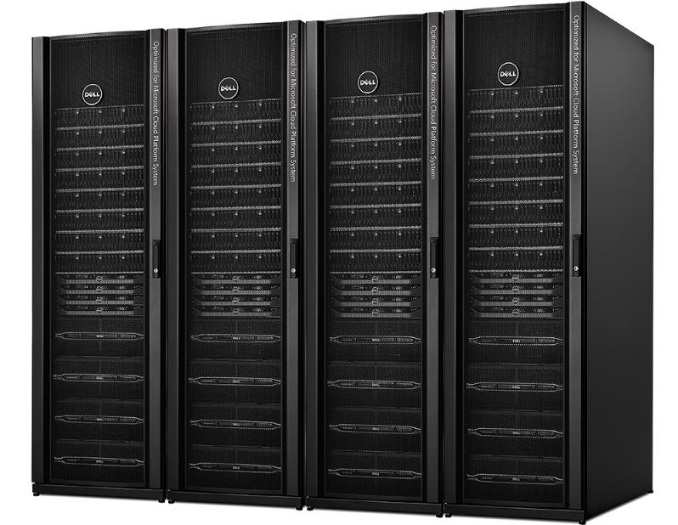
Microsoft Cloud Platform System - powered by Dell
Azure-consistent Cloud in a Box
Software defined technologies for optimal economics
Windows Server 2012 R2, System Center 2012 R2, Windows Azure Pack
Microsoft-designed architecture based on Public Cloud learning
Microsoft-led support & orchestrated updates
Dell PowerEdge servers
Dell dense Storage enclosures
Dell Networking switches
Tightly integrated components
Launched Oct 2014
You already know the software stack.

Slide 8
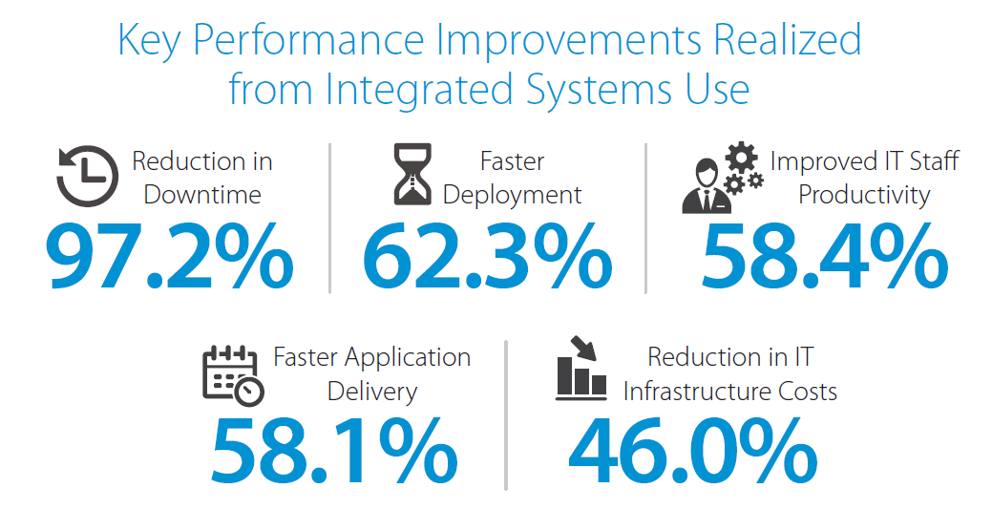
Why Integrated Systems matter
Source: IDC, 2015 (http://idcdocserv.com/IDC_Solution_Brief_254796)

Slide 9

Cloud Operating Model (example)
operate
use
Customers
Microsoft Engineers
use
operate
Customers
Amazon Engineers

Slide 10
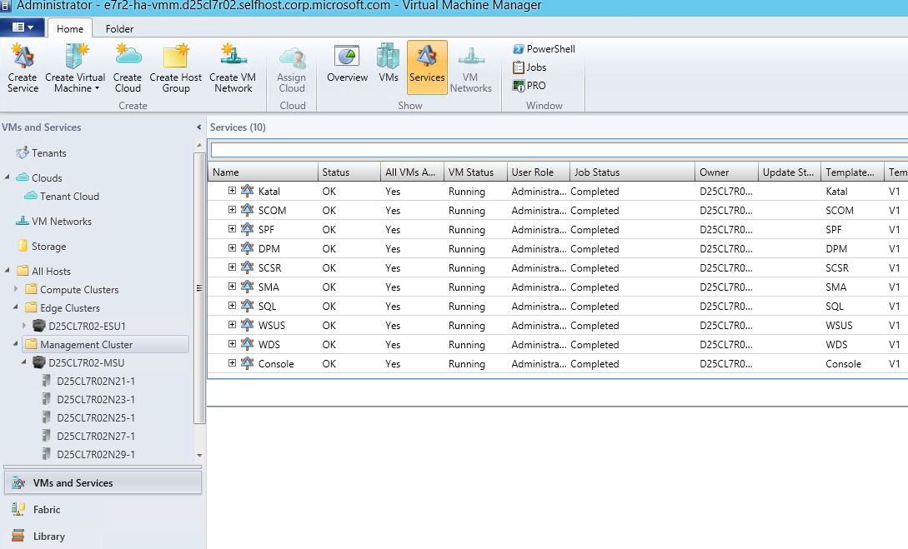
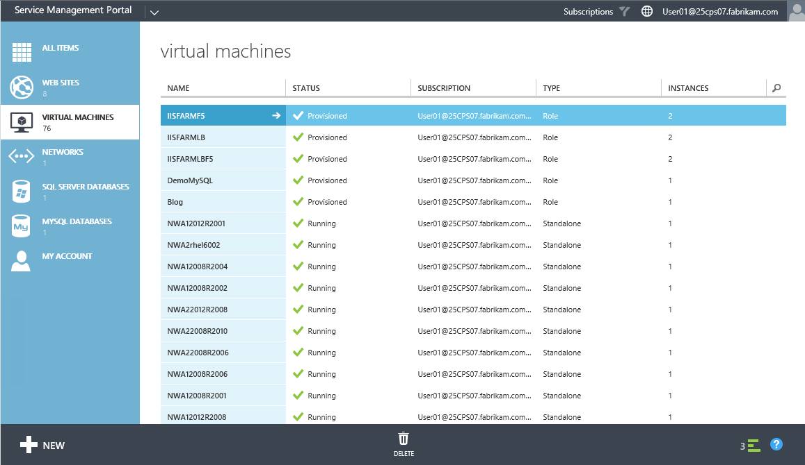
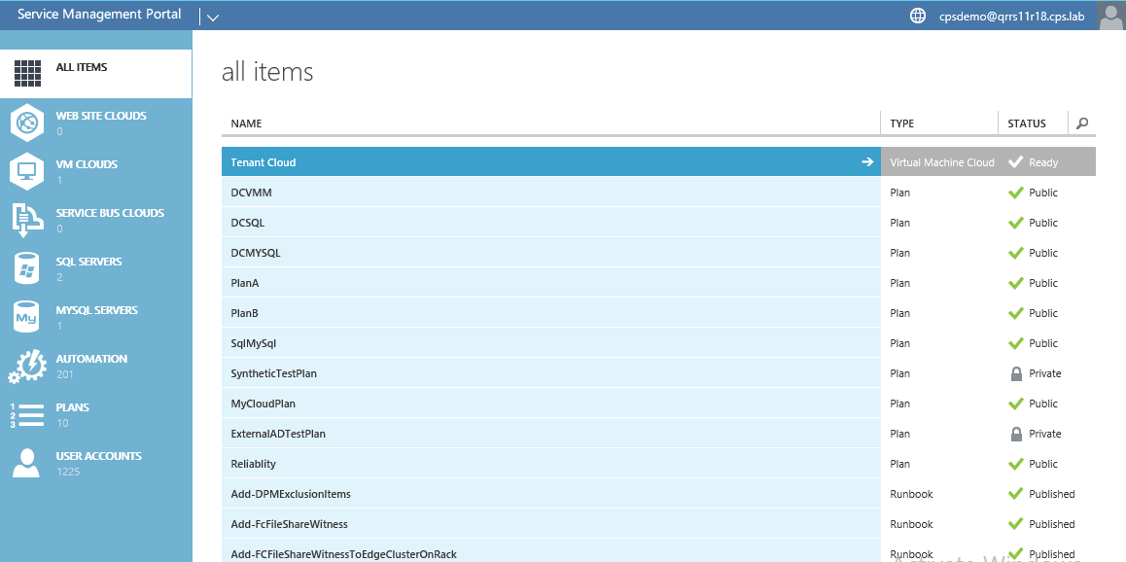
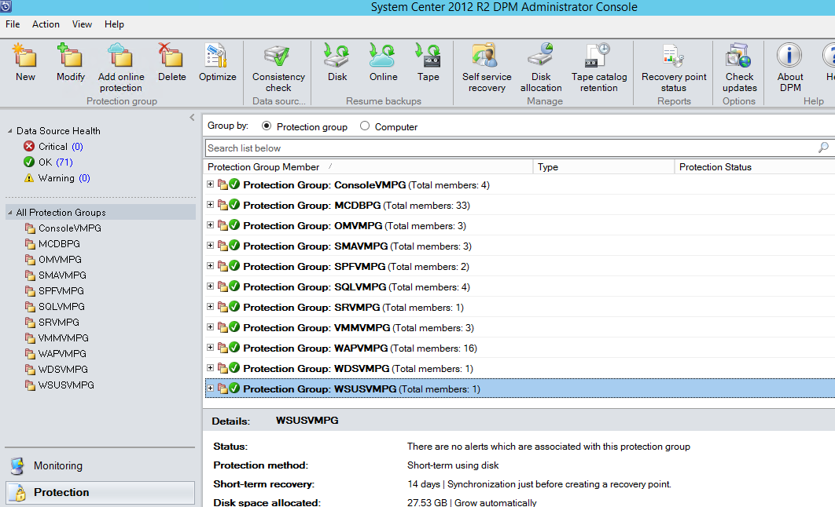
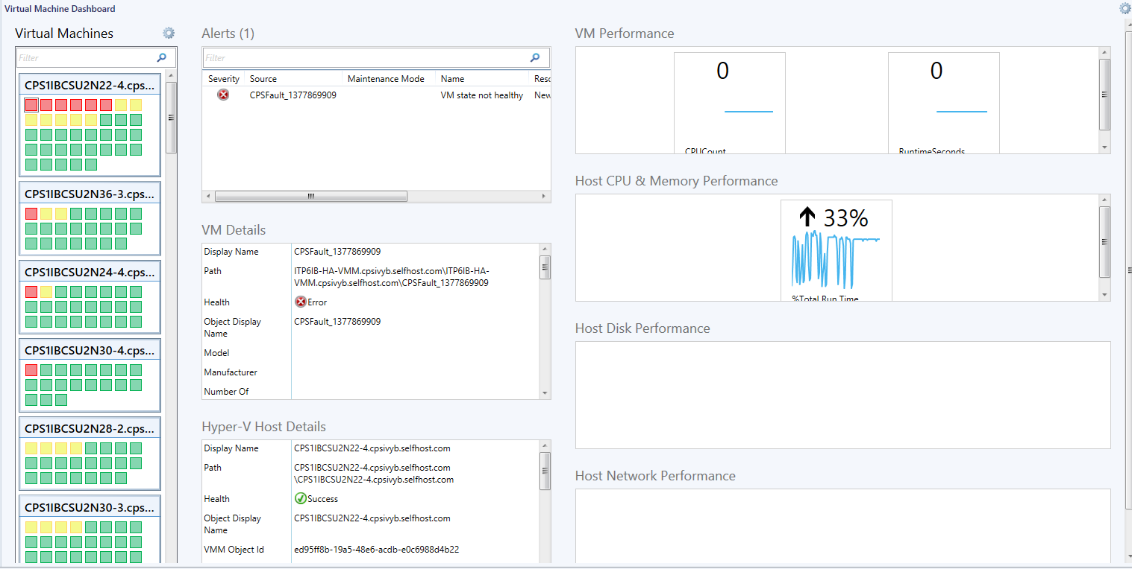
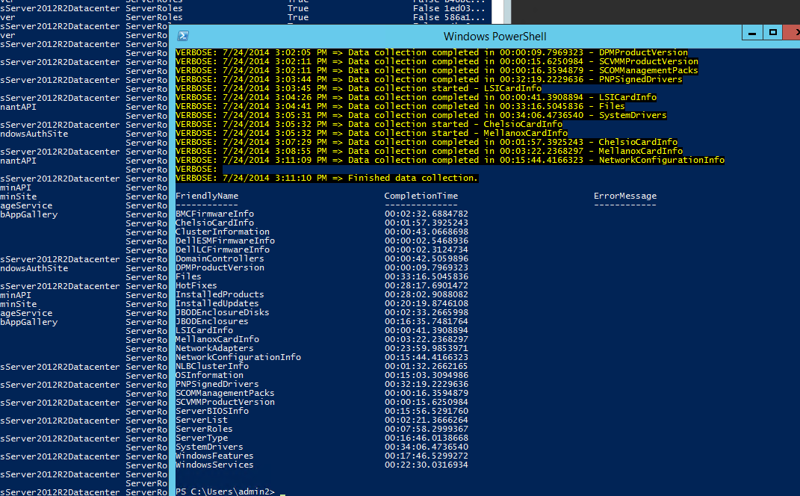
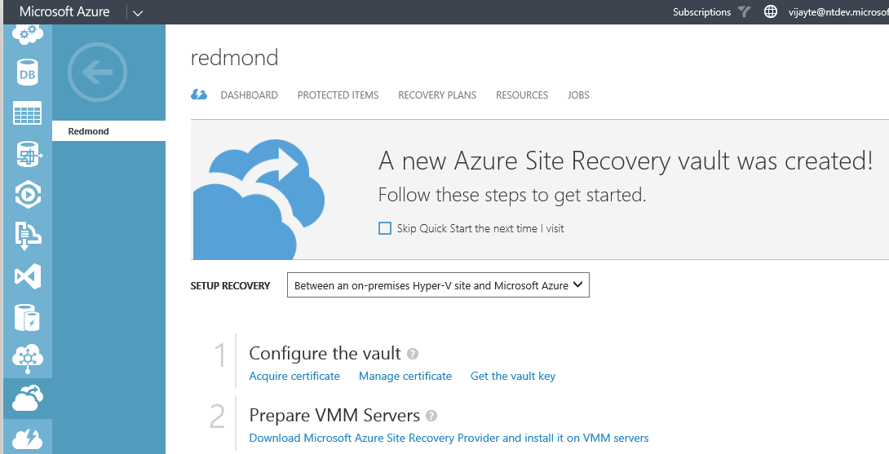
CPS brings the Cloud Model On-Premises
CPS
Configuration
Automation
use
Backup
Monitoring
Customer of
Service Provider
Jill@CONTOSO
Patching
Tenant Portal of
Service Provider (FABRIKAM)
Disaster Recovery
operate
*For enterprise scenarios treat Jill as being from FABRIKAM domain
Admins @FABRIKAM

Slide 11
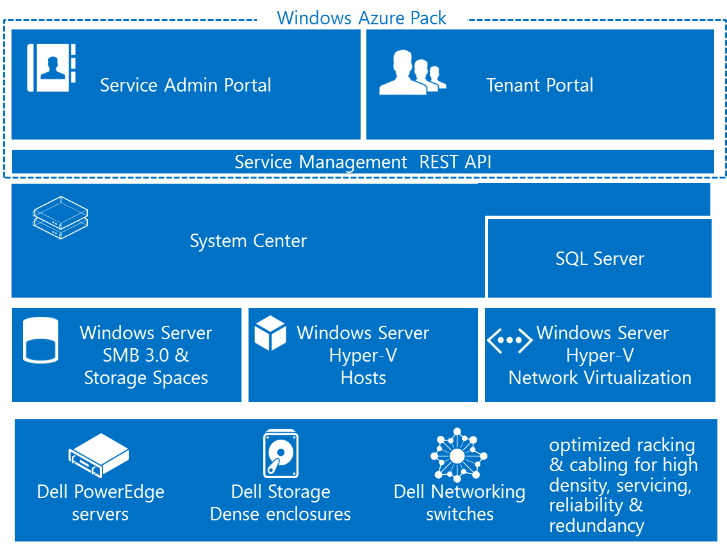
Cloud Platform System - Capabilities
Self-service portal (Windows Azure Pack)_ with integrated usage reporting
Pre-deployed stack configured by product team.
  Arrives fully deployed and integrated
  Optimal fault tolerant design
Integrated Management
  Service Administration
  Patching
  Monitoring
  Backup and DR
  Automation
One rack: 512 cores, 8 TB RAM, 156 TB Tiered Storage
Optimized deployment and operations for Microsoft and other standard workloads

Slide 12
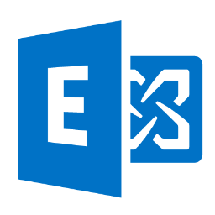
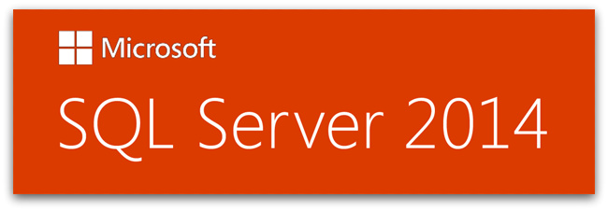
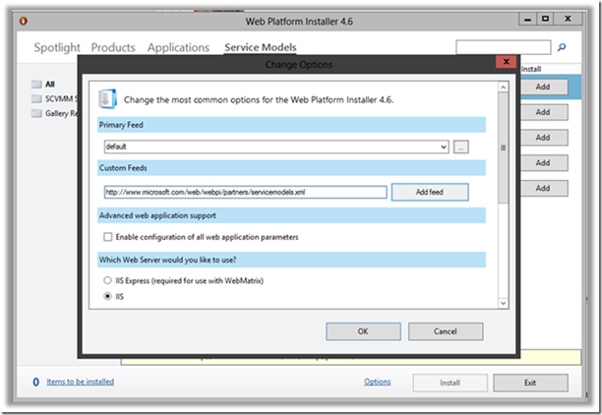
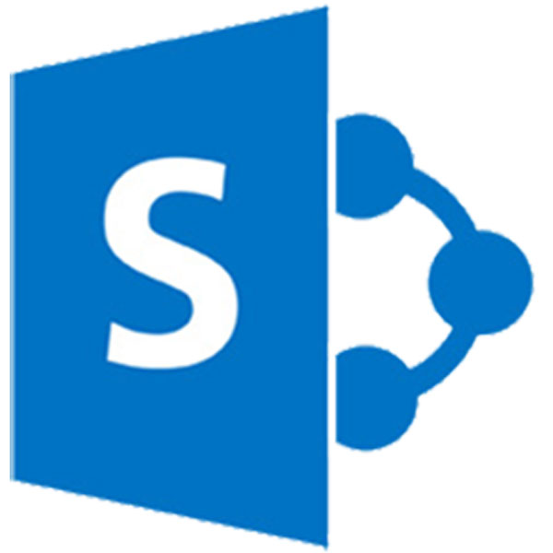

Self –Service Deployment of Workloads
Downloadable today via WebPI feed
Exchange
SQL Server
SharePoint
Skype for business (coming soon)
http://www.microsoft.com/web/webpi/partners/servicemodels.xml

Slide 13
Announcing
Microsoft VDI (RDS-H and Virtual Desktops) on CPS
Citrix XenDesktop on CPS

Slide 14
Demo: Self-Service and VDI

Slide 15
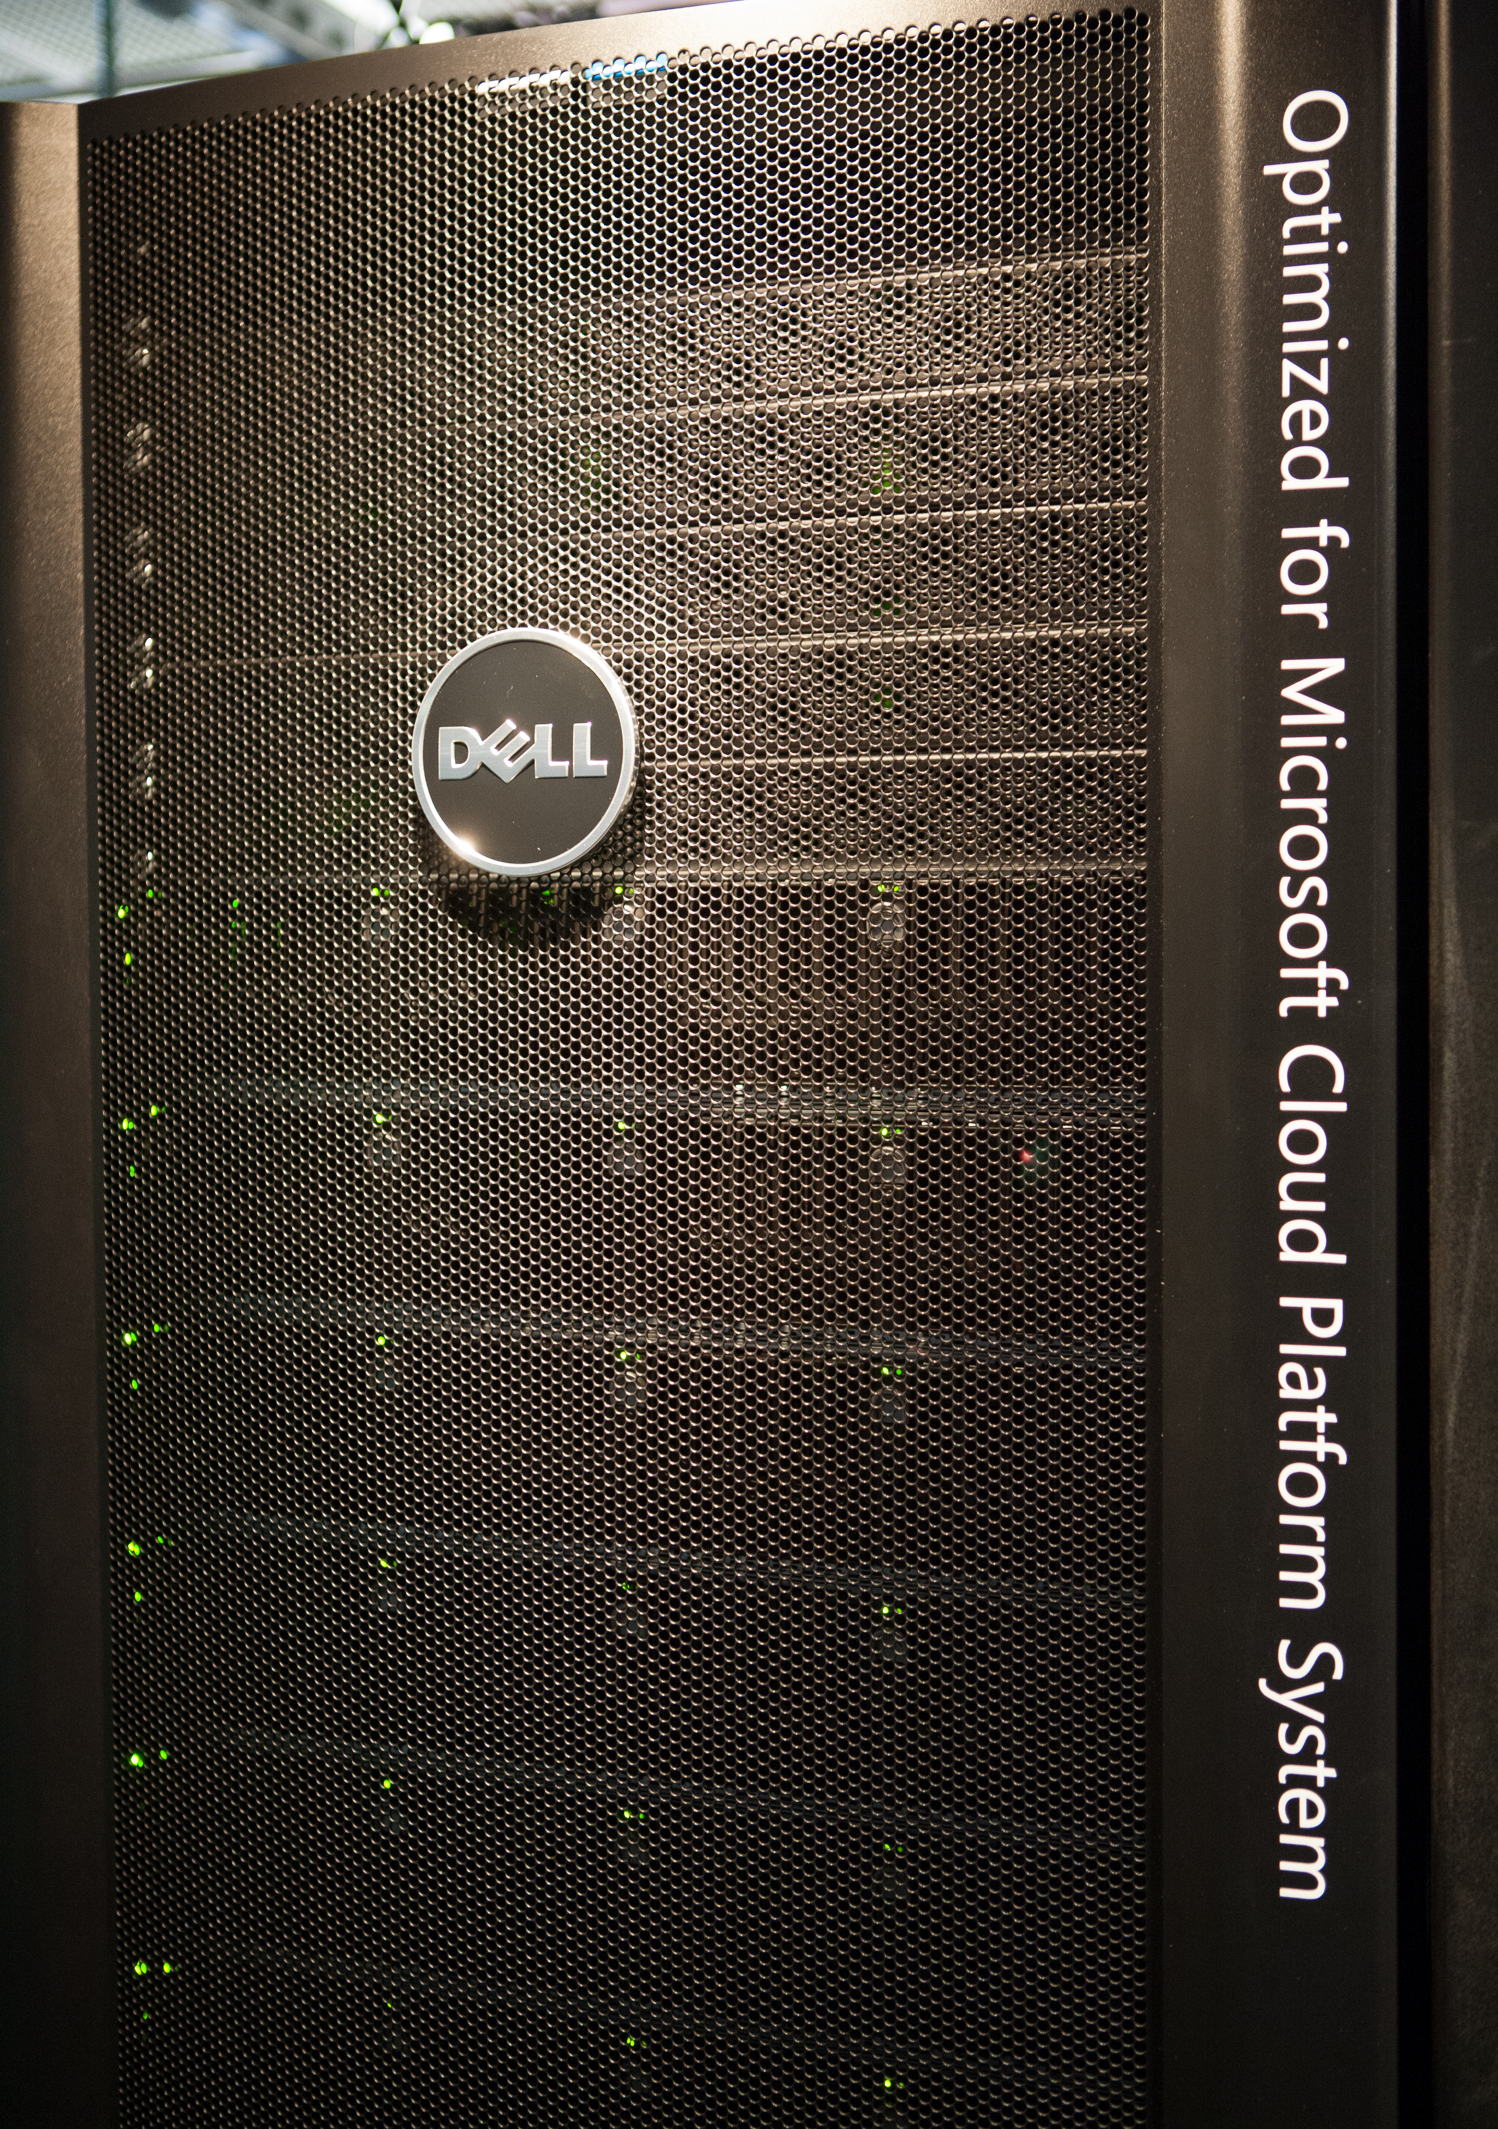
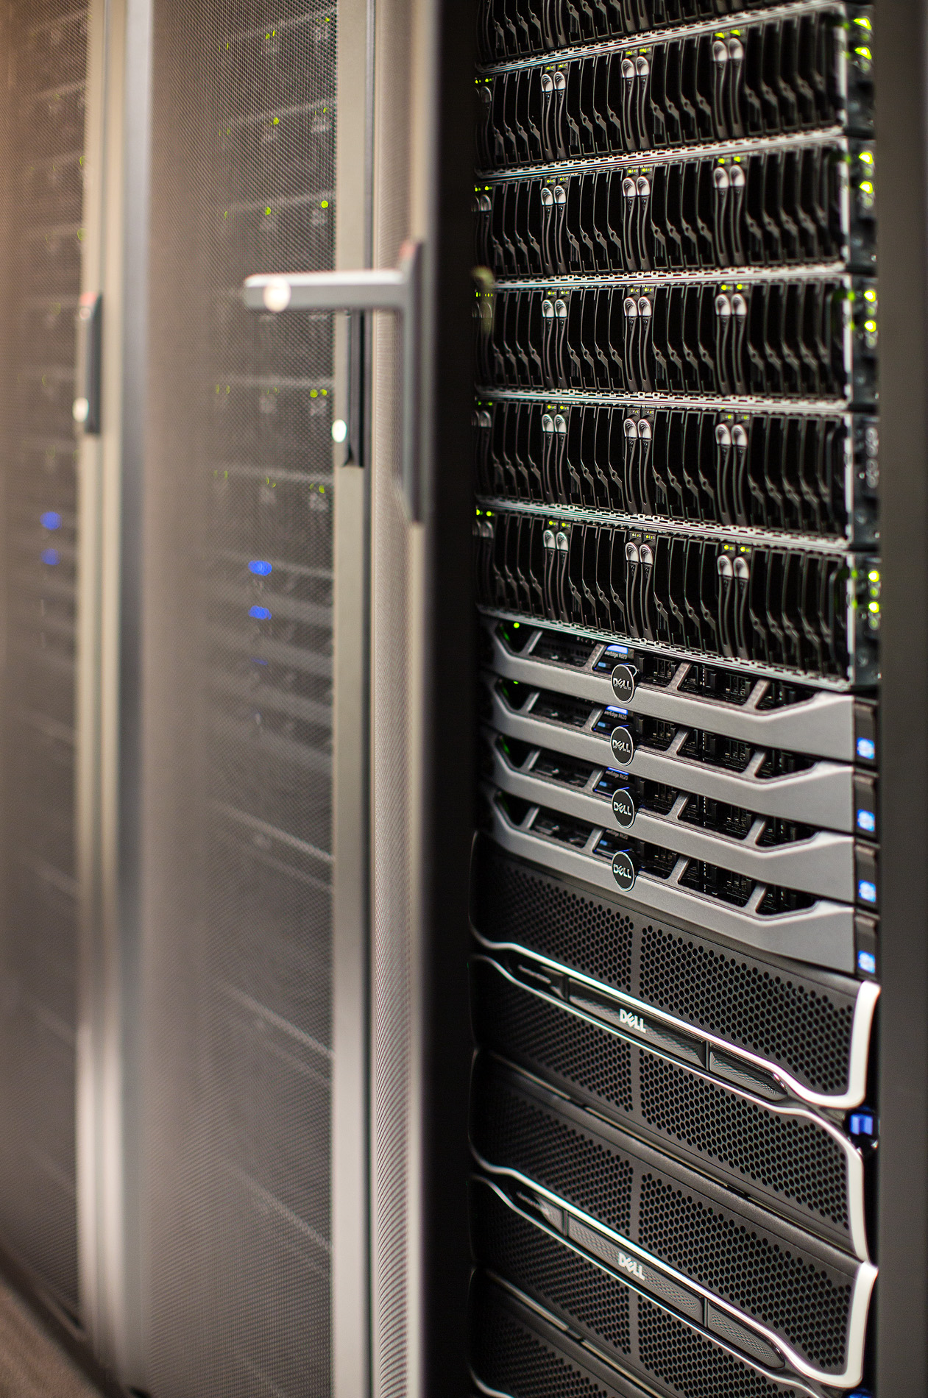
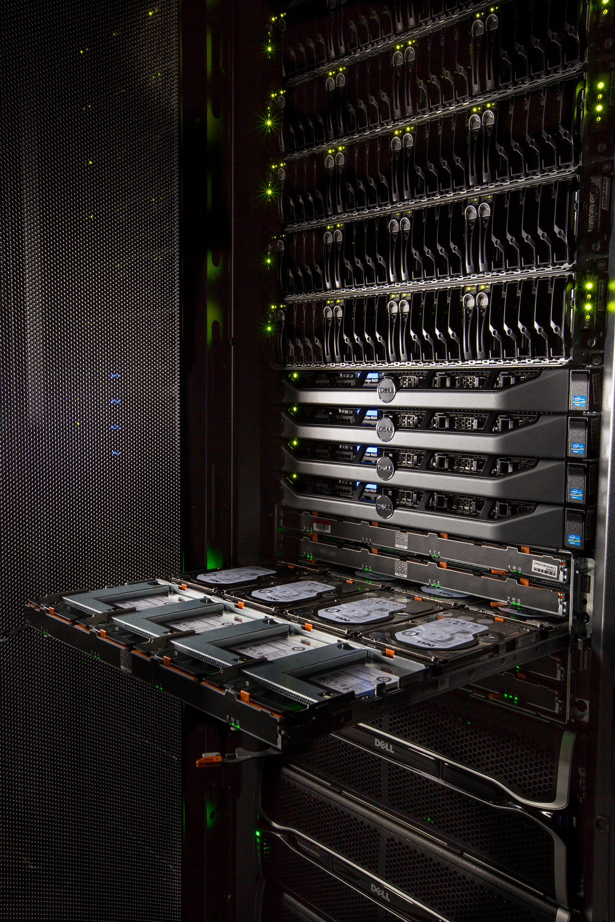
Microsoft Cloud Platform System powered by Dell

Slide 16
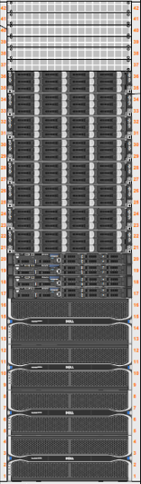
Converged Infrastructure
Converged Solution Combines:
Software Defined Storage
Software Defined Network
Software Defined Compute
Integrated Management
Rack 1
Rack 2
Rack 3
Rack 4
Network Scale Unit
Network Scale Unit
Network Scale Unit
Network Scale Unit
Edge Host Group
Compute Scale Unit
ComputeScale Unit
ComputeScale Unit
ComputeScale Unit
Net Edge
Net Edge
Net Edge
Net Edge
Mgmt Host Group
Mgmt (HA Cluster
Tenant Compute
(HA Cluster)
Tenant Compute
(HA Cluster)
Tenant Compute
(HA Cluster)
Tenant
Compute
(HA Cluster)
Compute Host
Group
Storage Scale Unit
Storage Scale Unit
Storage Scale Unit
Storage Scale Unit
Storage (Scale out File server and Storage Spaces)
Storage (Scale out File server and Storage Spaces)
Storage (Scale out File server and Storage Spaces)
Storage (Scale out File server and Storage Spaces)
Legend
Network Scale Unit
Compute Scale Unit
Storage Scale Unit

Slide 17
High-density, industry-standard hardware
 | Per Rack | Max per Stamp
Compute Nodes | 32 | 128
Cores | 512 | 2048
Memory | 8 TB | 32 TB
Storage Used for Backup | 126 TB | 504 TB
Storage Available for Workloads | 156 TB* | 605 TB
Total Storage | 282 TB | 1.1 PB
* Rack One has 136TB and 24 nodes available to workloads (20TB and 6 nodes are taken by the management stack)

Slide 18
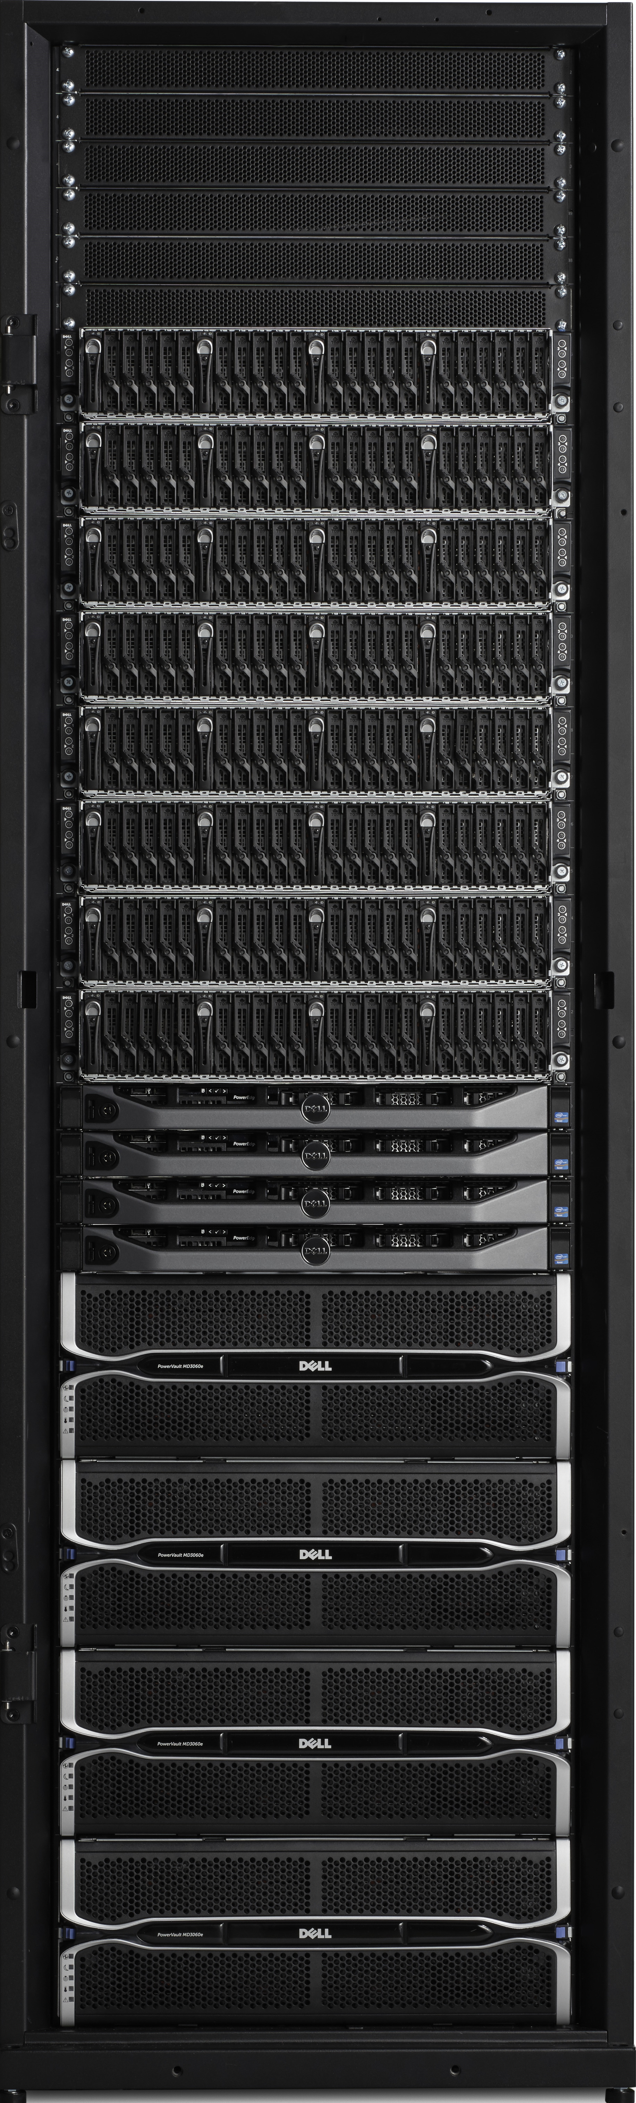
CPS - Integrated solution for HW and SW
Networking
6 x Force 10 – S4810P
1 x Force 10 – S55
F5 Loadbalancer (Vipiron 2200 chassis, 2 x 2150 blade, std LTM)
Compute Scale Unit (32 x Hyper-V hosts)
  Dell PowerEdge C6220ii – 4 Nodes per 2U
    Dual socket Intel IvyBridge (E5-2650v2 @ 2.6GHz)
    256 GB memory
    2 x 10 GbE Mellanox NIC’s (LBFO Team, NVGRE offload)
    2 x 10 GbE Chelsio (iWARP/RDMA)
    1 local SSD 200 GB(boot/paging)
Storage Scale Unit (4 x File servers, 4 x JBODS)
  Dell PowerEdge R630v2 Servers (4 Server for Scale Out File Server
    Dual socket Intel IvyBridge (E5-2650v2 @ 2.6GHz)
    2 x LSI 9207-8E SAS Controllers (shared storage)
    2 x 10 GbE Chelsio T520 (iWARP/RDMA)
  PowerVault MD3060e JBODs (48 HDD, 12 SSD)
  4 TB HDDs and 800 GB SSDs
One Rack
512 Cores
8TB RAM
282 TB usable storage
60 Gb/s external
1360 Gb/s internal connectivity
560 Gb/s inter-rack connectivity
2322 Lbs
42U
16.6 KwH Maximum
1 – 4 racks

Slide 19
What if I need additional storage?
CPS Rack
VM’s access storage as LUN’s (Data VHD’s on Scale Out File Server)
VM’s access data storage as LUN’s (via iSCSI)
iSCSI Accessible Storage
Dell Storage with Storage Spaces

Slide 20
Demo:
Logical layout of CPS

Slide 21
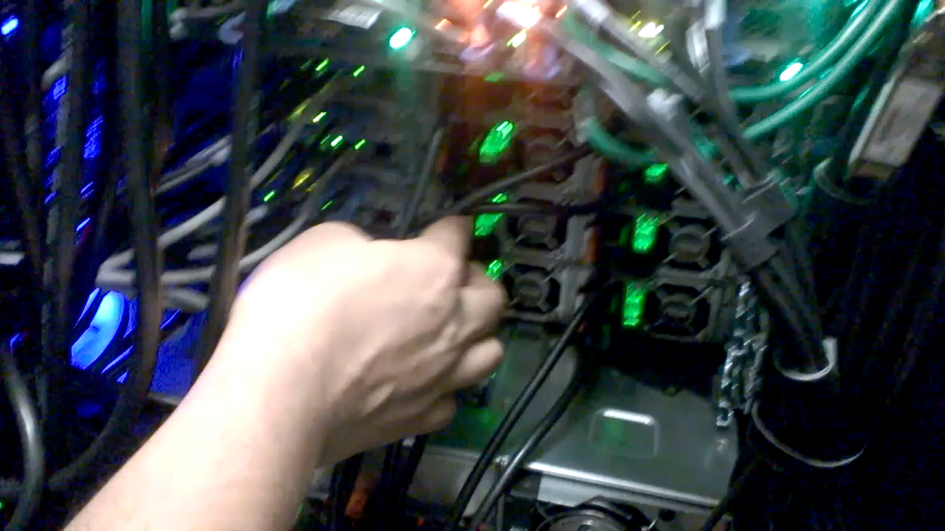
Cloud Reliability: Cloud Operations Simulation
1 year in 7 days
Operations | Simulated Failures
10,152 VMs live migrated 5,734 VMs storage migrated Create VM’s IO from VM’s | 376 node failures 1 JBOD failure per day 6 drive failures per day 28 NIC/Cable & 2 Switch failures 8 SAS Cable Pulls & 2 HBA failures

Slide 22
Inside CPS Clusters

Slide 23
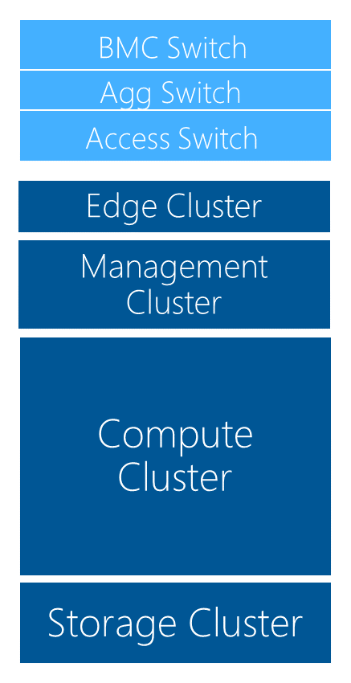
Storage Cluster
Space available
  Tenant: 152 terabytes
  Backup: 126 terabytes (+ deduplication)
4 JBODs
  192 HDDs @ 4 terabytes each = 768 terabytes RAW
  48 SSDs @ 800 terabytes each = 38 terabytes RAW
Storage Spaces configuration
  Tenant: 3-way mirror
  Backup: Dual parity
  Tiered storage
4 file servers
  128 GB memory
  3 x pools (2 x tenant, 1 x backup)
8 x 10 GbE RDMA for SMB3
\\SMBShare

Slide 24
Storage Scale Unit (SSU) Performance*
1 million read 4K IOPS from SSU
321K READ:WRITE (70:30) 4K IOPS
*From soon to be published storage performance whitepaper

Slide 25
Storage Scale Unit (SSU) Performance* – cont’d
1792 VM’s boot in less than 25 seconds
*From soon to be published storage performance whitepaper

Slide 26
Network designed for perf, scale, reliability
Flat layer 3 physical network with Hyper-V Network Virtualization for tenant networks
40Gb connections to aggregation layers utilizing equal cost multi-path (ECMP)
10Gbx2 to host for tenant traffic
10 Gbx2 for storage (SMB over RDMA)
Mulitple devices for redundancy
Aggregate
40Gb between each Access and Agg
Access
Teamed connections with LACP or pairs for 20Gbps each physical network
Compute nodes

Slide 27
Network Performance
CPS
LACP teaming
RSS enabled on Host and Guest
VMQ enabled
NVGRE offload

Slide 28
Management Cluster
Mgmt AD
AD/DNS/DHCP (3)
WDS (1)
WSUS (1)
WAP Tenant API (2)
WAP Admin Portal/API, Service Reporting (3)
ADFS (2)
IaaS RP (SPF) (2)
SMA (3)
Deployed for HA
VMM (2)
OM (3)
Console (4)
VMM Library (1)
Service Templates
SQL Cluster for dB’s (4 VM’s)
(VMM, OM, SPF, WSUS, SMA, WAP, DW, Analysis Services)
DPM (1) (for backing up Management cluster)
32 VM’s on a 6 x node Hyper-V failover cluster

Slide 29
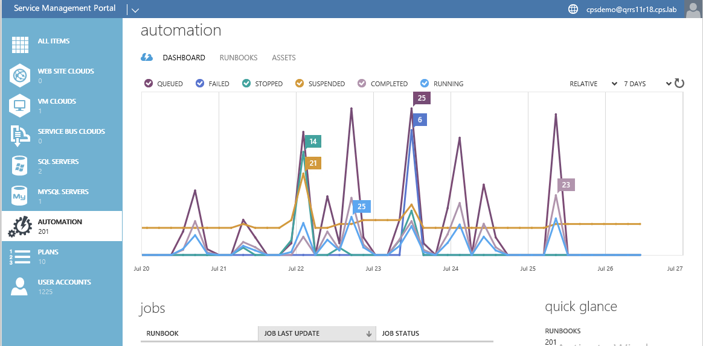
CPS – Management Services
VMM
Configure/deploy
WAP Admin Portal
Service Administration
DPM
Backup (Tenant/MC)
ASR
Disaster Recovery
OM
Monitoring
SMA
Automation
P&U for CPS
Patching

Slide 30
Demo:
Management
Services & Admin Guide

Slide 31
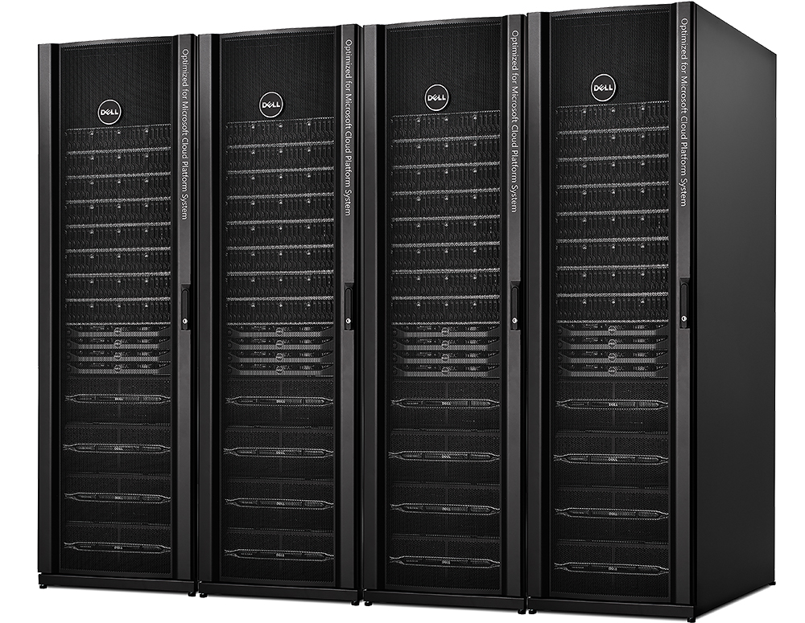
CPS Patch & Update
Inventory, update FW, Drivers, BIOS, WS, SC & WAP
Aggregate Patches (FW, Drivers, WS, SC, WAP)
Validated on Microsoft internal stamps and Nebula
Patch made available to customers
Compute Node
Highly Available Virtual Machine Workloads
Compute Node
Orchestration
Compute Node
Running Workloads Keep Running
Live Migration
Maintenance Mode
Zero downtime of tenant workload, minimal downtime for management services achieved via Patch and Update automation (uses Cluster Aware Updating, CAU)

Slide 32


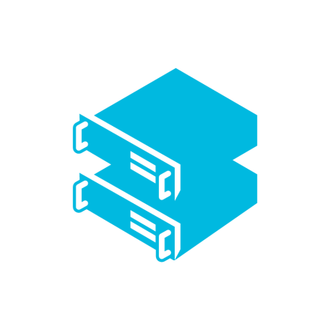
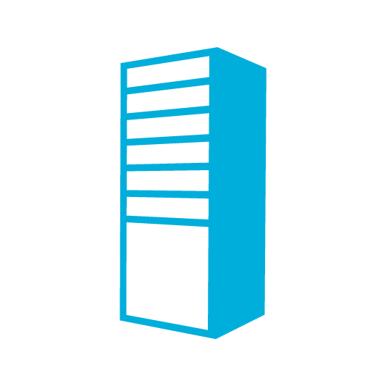
CPS DR with Azure Site Recovery (E2E)
CPS to CPS
  DR as a Plan/Add-On
  SMA runbook to enable/disable DR protection for all VMs in subscription
  Full integration of replica VMs with recovery site Azure Pack
DR Orchestration
DR Orchestration
Azure Site Recovery
Azure Pack
Azure Pack
SCVMM
SCVMM
DRP
DRP
Compute
Storage
Networks
Compute
Storage
Networks
CPS Stamp 1
Data Channel on Customer Network
(Hyper-V Replica)
CPS Stamp 2

Slide 33
Announcing
CPS : DR to Azure via ASR
Additional retention of backup copy off-stamp

Slide 34
CPS DR with Azure Site Recovery (E2A)
CPS to Azure
DR Orchestration
DR Orchestration
Azure Site Recovery
Azure Pack
SCVMM
DRP
Microsoft Azure
Compute
Storage
Networks
Compute
Storage
Networks
CPS Stamp
Extensible Data Channel
Secondary Site

Slide 35
CPS Roadmap
Regular updates, 3-4 a year till end of standard support, security fixes thereafter
CPS 1.0 Support
5 years standard (ends Nov 2019)
3 years extended (ends Jul 2022)
New capabilities in updates based on customer feedback
Update 3
Hardware refresh
Automation for deployment for PaaS Services
WS/SC/WAP/Firmware updates
Other capabilities based on feeback
Update 2
Off-stamp backup, DR to Azure
Encryption of data at rest
WS/SC/WAP/Firmware updates
Update 1
DE and FR support
WS/SC/WAP/Firmware updates
CPS vNext
Built with Microsoft Azure Stack
CPS 1.0 Launch

Slide 36
Customer deployments and availability
Deployed @ multiple customers and powers Microsoft’s internal Nebula cloud
US, Canada, Europe* & South Africa
* Austria, Belgium, Bulgaria, Croatia , Czech Republic, Denmark, Estonia, Finland, France, Germany, Greece, Hungary, Ireland, Italy, Latvia, Lithuania, Luxembourg, Netherlands, Norway, Poland, Portugal, Romania, Slovakia, Slovenia, Spain, Sweden, Switzerland, UK

Slide 37
Summary
CPS – A ready to run Azure consistent cloud in your datacenter
Microsoft validated, single vendor point of contact for support
Software defined innovations for cost optimized solution

Slide 38
Related content
BRK3460: Operating the Microsoft Cloud Platform System (Wed, 9.00 – 10.15 am)
BRK3459: Architectural deep dive on CPS (Thu, 9.00 – 10.15 am)
BRK2499: Deep dive on CPS Networking (Thu, 1.30 – 2.45 pm)
BRK3469: Automating workload provisioning (Fri, 10.45 am – 12.00 pm)

Slide 39
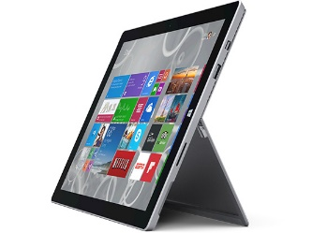
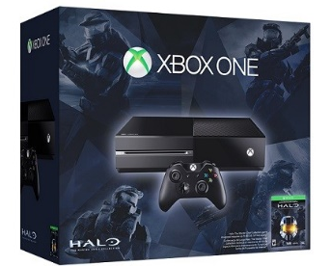
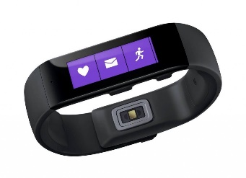

Ignite Azure Challenge Sweepstakes
Attend Azure sessions and activities, track your progress online, win raffle tickets for great prizes!
Aka.ms/MyAzureChallenge
Enter this session code online: “H8JC”
(10) - Microsoft Surface Pro 3
Core i5 256GB
(30) – Xbox One Master Chief Collection Bundle
(55) – Microsoft Band
Offers throughout the week
NO PURCHASE NECESSARY. Open only to event attendees. Winners must be present to win. Game ends May 9th, 2015. For Official Rules, see The Cloud and Enterprise Lounge or myignite.com/challenge

Slide 40
Backup

Slide 41
CPS Identity Integration - Tenant
Login using contoso\jill
Customer of Service Provider
Jill@CONTOSO
Tenant Portal of Service Provider (FABRIKAM)
Federation
Customer Domain (CONTOSO)
CPS ADFS
FABRIKAM, a happy CPS customer

Slide 42
CPS Identity Integration – Admin
CPS
Configuration
Automation
Backup
Monitoring
Patching
CPS Domain
Disaster Recovery
2-way trust
operate
Admins @FABRIKAM
Use their identity from FABRIKAM domain
FABRIKAMDomain

Slide 43
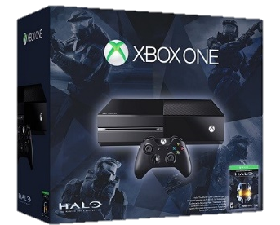
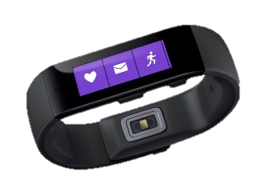
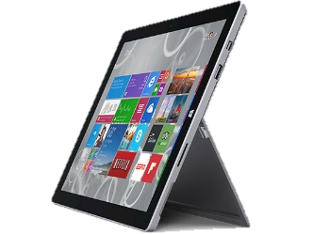
Ignite Azure Challenge Sweepstakes
Attend Azure sessions and activities, track your progress online, win raffle tickets for great prizes!
Aka.ms/MyAzureChallenge
Enter this session code online: BRK2472
NO PURCHASE NECESSARY. Open only to event attendees. Winners must be present to win. Game ends May 9th, 2015. For Official Rules, see The Cloud and Enterprise Lounge or myignite.com/challenge

Slide 44
Learn more with FREE
IT Pro Resources
Free technical training resources:
  On-demand online training: http://aka.ms/moderninfrastructure
Free ebooks:
  Deploying Hyper-V with Software-Defined
  Storage & Networking: http://aka.ms/deployinghyperv
  Microsoft System Center: Integrated Cloud Platform: http://aka.ms/cloud-platform-ebook
Expand your
Modern Infrastructure Knowledge
Get hands-on: Free virtual labs:
  Microsoft Virtualization with Windows Server
  and System Center: http://aka.ms/virtualization-lab
  Windows Azure Pack: Install and Configure: http://aka.ms/wap-lab
Join the IT Pro community:
  Twitter @MS_ITPro

Slide 45


Please evaluate this session
Your feedback is important to us!
Visit Myignite at http://myignite.microsoft.com
or download and use the Ignite Mobile App
with the QR code above.

