Slide 2
Microsoft System Center Virtual Machine Manager: Technical Overview and Roadmap
BRK2473
Jonobie Ford
Eric Winner
#Roadmap #SCVMM #MSIgnite

Slide 3
Agenda
SC 2012 R2 VMM
Listening to you
Delivering improvements via update rollups
Expanding capabilities via Operations Management Suite
SC 2016 VMM
Synchronized delivery with Windows Server 2016

Slide 4
SC 2012 R2 VMM

Slide 5
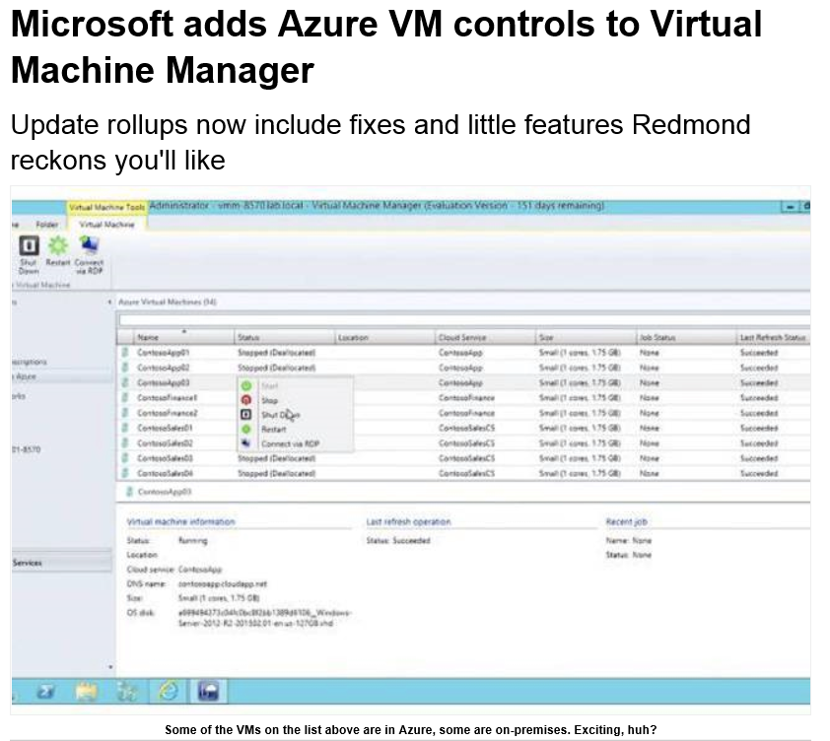
One week ago…

Slide 6
Faster!
Photo by John Talbot

Slide 7
Continuous delivery
2016
Continued Investments
Quarterly Updates
Aligned to Windows Server
2014
2015
2016
Ignite
System
Center 2016
System Center
Management
Services
Frequent Updates
Cloud Cadence
Build Measure Learn
Site Recovery
Backup
Automation
Op Insights
Service updates continue, more services added
Update Rollups

Slide 8
Data driven
Photo by JD Hancock

Slide 9
Trends in UR downloads

Slide 10
User Voice Giving feedback to the VMM Product Team
https://systemcentervmm.uservoice.com

Slide 11
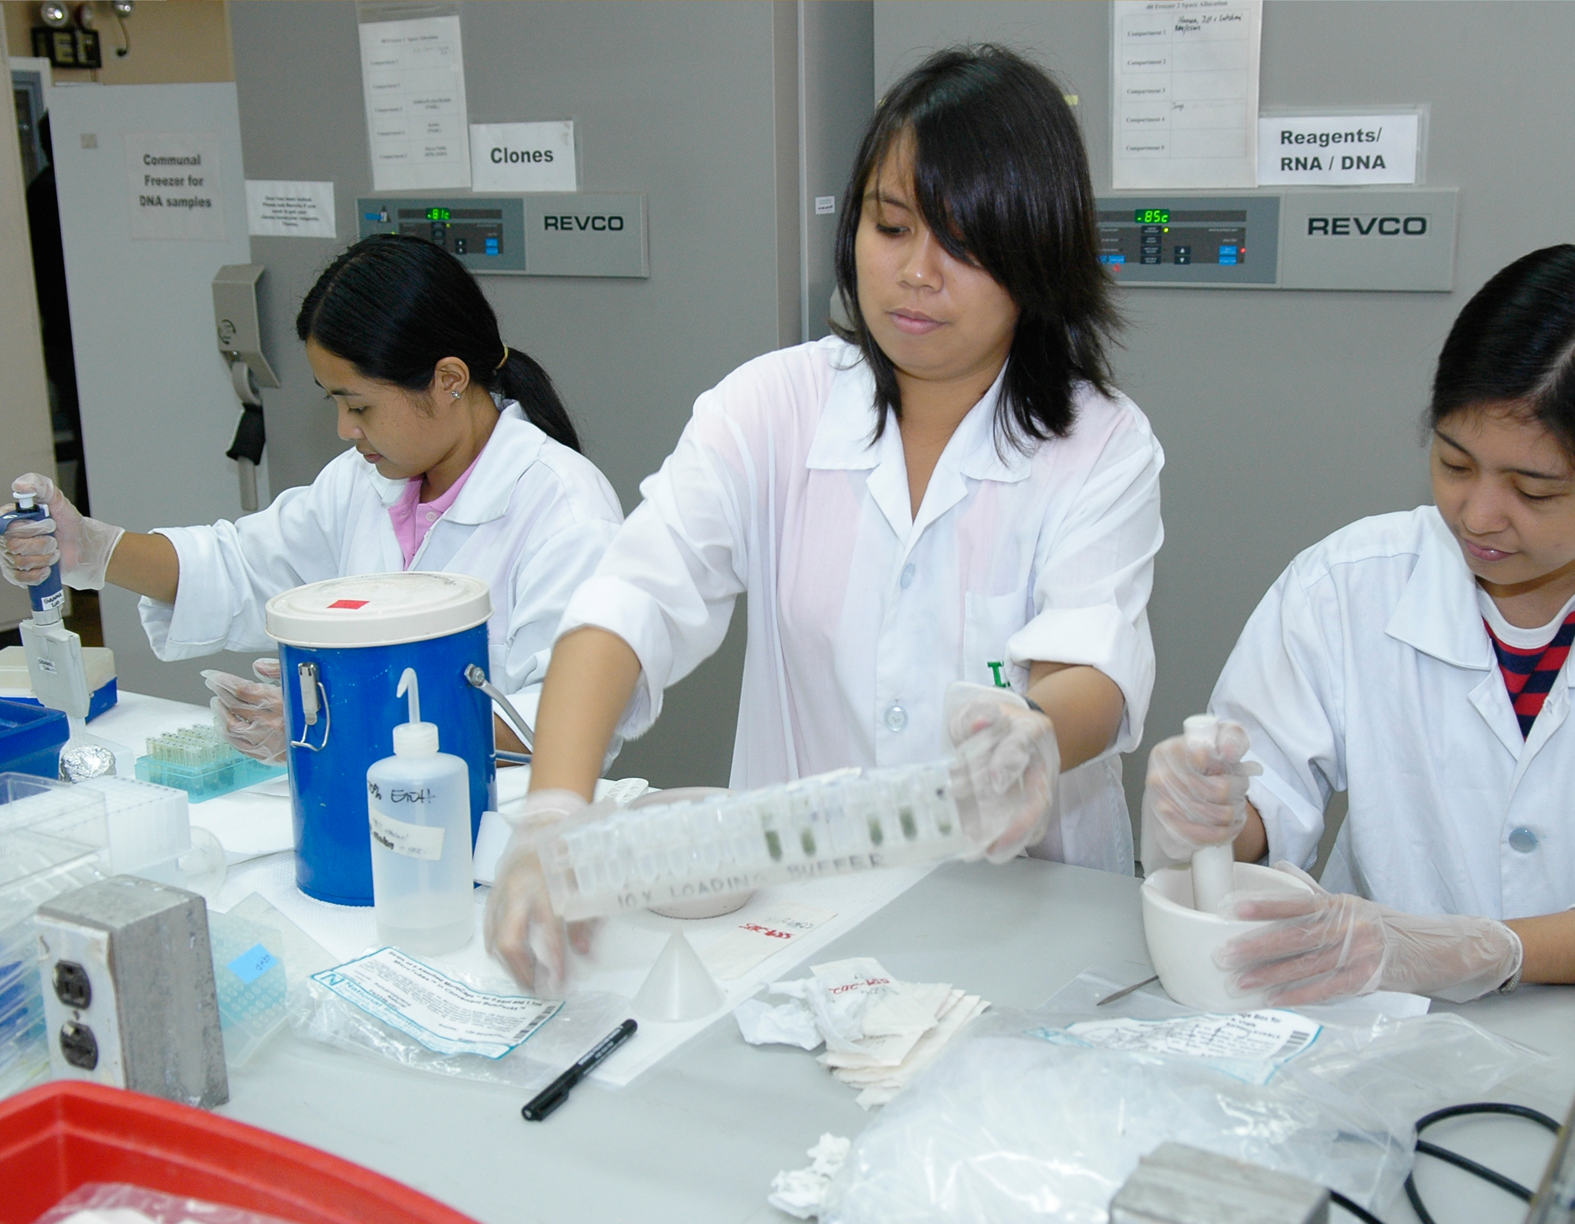
Cohort testing
Photo by IRRI Photos

Slide 12
Watson in action
Sends crash logs to Microsoft
Informs triage decisions
Last 3 URs: 27 Watson bugs fixed
Dedicated time to fix
Photo by Vectorportal

Slide 13
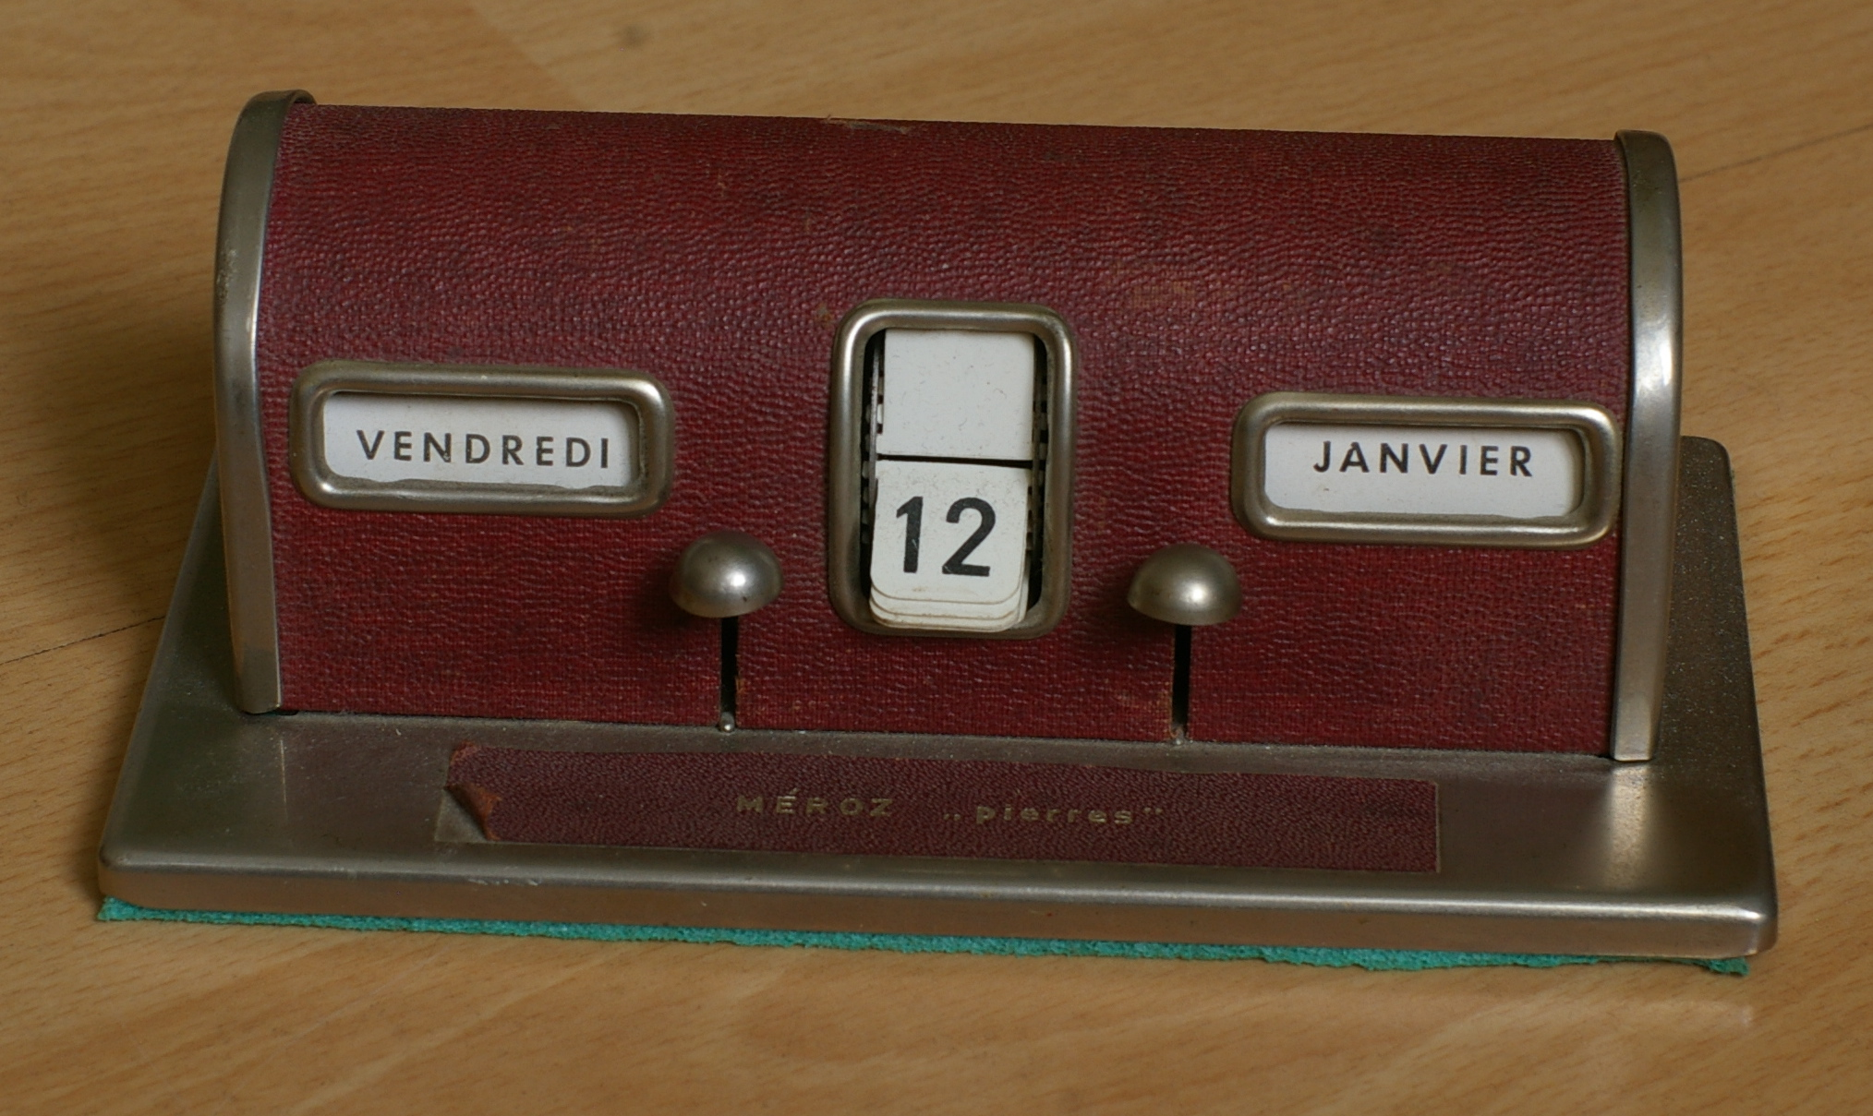
In the past year…
Photo by Plenty.r

Slide 14
Over 300 improvements!

Slide 15
Notable Improvements in the last 6 months
DHCP extension update
New Linux OS versions added
Maintenance mode behaviors fixed
Fixed lock contention in SQL for parallel jobs
Resilient to OOB changes
Allow one of the teamed NICs to be disabled
Support for special characters in user roles
OM integration for non-ENU environments
Deploy VMs with static IP when multiple IP Pools for one VM Subnet are configured
Protect against accidental removal of VMs in a service during Remove-Host
Improved performance over WAN links
Reduction of high amounts of streamed data over winRM when a host is refreshed
Quicker VM deletion by not merging the checkpoints
Allow user stamping on replica VM to provide a way to stamp user identity

Slide 16
UR5 New Features
Diff disk options for VMRole
Integrate SAN remote replication with ASR
SQL Server 2014 support

Slide 17
UR6 New Features
Initial management of VMware 5.5
Gen2 VMs in Service Templates and VMRoles
Replica Overcommit
Network Usage Metrics
Hybrid cloud: Azure View

Slide 18
UR6: Initial management of VMware 5.5
Management operations
Add VCenter and ESX Hosts
Create VMWare VM template with basic networking
Create VMs from templates
Perform VM lifecycle operations on VM
Start, stop, shutdown, repair, refresh, checkpoint
Connect to VM using console
Delete VMs
Create Resource Pool and bring under management
We need customer input for VMware 5.5 and 6.0 feature support.
Want to get early drops? Sign up here: http://aka.ms/joford

Slide 19
Generation 2 VMs in Service Templates
You said
We delivered
Should be clear we need Gen2 VM support for Service Templates. VM role deployments need Gen2 VM support too and from my point of view it’s a lack in VMM.
--Daniel Neumann, User Voice
Generation 2 VMs can now be used in Service Templates
Ability to designate a cloud “Gen 2 capable” for VMs deployed with WAP

Slide 20
Replica overcommit
You said
We delivered
We want to overcommit host groups and clouds for replica VMs. We don’t need all the VMs to boot at once!
Users can now set clouds and host groups to allow overcommit.

Slide 21
Network usage metrics
You said
We delivered
We want to be able to charge our customers based on network usage on an hourly basis.
-- Service providers
Two new rules targeting Hyper-V Hosts in our Management Pack:
Total Inbound vNic traffic
Total Outbound vNic traffic

Slide 22
Hybrid view of IaaS in VMM
You said
We delivered
Give us a lightweight way to view VMs in public clouds in VMM.
New Azure view from the console
Shows VMs in Azure
Allows most common operations on them

Slide 23
Hybrid Cloud Manage Azure using UR6 Manage AWS using Add-in released by Amazon
Jonobie Ford

Slide 24
Backlog
Easier setup and management of logical switches
Multi-select live migration in the UI
Support for VMware 5.5, 6.0
Management pack updates
Multiple external IP Addresses for a single VNET using NAT
Re-associate an orphaned VM to its service or VMRole
Automation for HNV network with NAT gateway
Down-level support for Threshold guests

Slide 25
A final UR tip…
UR 4…
UR 3
UR 2
UR 1

Slide 26
Expanding Capabilities with Microsoft Operations Management Suite

Slide 27
Evolving with you
System Center
for the
datacenter
Microsoft
Operations Management
Services
Private & Hybrid
Modern Management
Workload
Virtualization
as a service
Server
Proliferation
Enterprise Desktop
Heterogeneous
Open Platform
Cloud Inspired
Time to Value
Improved Productivity
Solution Orientated
a long-term partner you can bet with

Slide 28
Capacity Management and Disaster Recovery with Operations Management Suite
Jonobie Ford
Hector Linares

Slide 29
System Center 2016 Virtual Machine Manager

Slide 30
Continuous delivery
2016
Continued Investments
Quarterly Updates
Aligned to Windows Server
2014
2015
2016
Ignite
System
Center 2016
System Center
Management
Services
Frequent Updates
Cloud Cadence
Build Measure Learn
Site Recovery
Backup
Automation
Op Insights
Service updates continue, more services added
Update Rollups

Slide 31
VMM vNext Investment Areas
Ease of use
Security and Infrastructure
Expanded Fabric Management
Storage Replication Automation using Azure Site Recovery
Deploy guarded hosts
Protect tenant secrets
Manage shielded VMs
Improved Diff Disk management
Optimized eventing channel
Manage guarded hosts
Improved state consistency with Failover Cluster and Hyper-V manager
Patching of hosts during bare metal provisioning
Improved resiliency during intermittent faults for cluster availability
Flexible bare metal provisioning with post-deployment commands
Unified workflow for host and storage cluster creation
Manage a software load balancer and the network controller
CDN support for guests
Improved Storage Monitoring with Operation Manager
Easier cluster upgrades with rolling upgrade
Scale-out File Server with Storage Spaces Direct
Scale-out File Server with SAN storage automation
Storage QoS Policy Management
Simplified Logical Switch creation and deployment

Slide 32
Rolling Upgrade. Upgrade your clusters easily

Slide 33
Upgrading clusters has been hard
Weeks of effort
Extra hardware
Downtime

Slide 34
The solution? Mixed-mode clusters.
2012 R2 Host/File Server
2012 R2 Host/File Server
2012 R2 Host/File Server
2012 R2 Host/File Server
Threshold Host/File Server
Cluster
Functional Mode = 2012 R2

Slide 35
The solution? Mixed-mode clusters.
Threshold Host/File Server
Threshold Host/File Server
Threshold Host/File Server
Threshold Host/File Server
Cluster
Functional Mode = 2012 R2
Cluster
Functional Mode = Threshold

Slide 36
Ease of Use: Upgrading your clusters easily
John Patterson

Slide 37
Cluster upgrade in action

Slide 38
SMB3 in the Private Cloud
System Center
PowerShell
Storage Management API (WMI)
NAS Mgmt Provider
NAS Mgmt Provider
SAN Mgmt Provider
MS SDS Provider
MS SDS Provider
MS SDS Provider
NAS Head
Self-Contained NAS
SOFS
SOFS
SOFS
Shared Storage
Local Storage
SAN
Storage Spaces
Spaces Direct
SMB3 Partner Ecosystem
SOFS attached to SAN
SOFS attached to Shared JBOD
SOFS using Direct Attached Storage

Slide 39
Spaces Direct Management
Health and operational status monitoring via SMAPI and OM
Simple wizard based storage provisioning
Workload failover using Azure Site Recovery and Storage Replica
Discovery and Mapping
Deep discovery of device and components
Mapping from infrastructure to workloads
Deployment and Configuration
SOFS bare-metal provisioning
Configuration of Spaces Direct
Storage Provisioning
Storage pool management
Storage Monitoring and Alerting
File share creation
Integrated Health Service
Monitors for Subsystem, File Server, and File Share
Disaster Recovery
Configuration of Storage Replica per file share
Planned, unplanned, and test failover
Workload Placement and Migration
Storage Classification
Servicing and Updates
Mixed mode cluster support
Invoke script for automation
Offloaded VM deployment
Tiering and Dedup support
Disk Replacement
Node Expansion
Node rebuild
Fault domain awareness

Slide 40
Expanded Fabric Management: Managing Spaces Direct
Hector Linares

Slide 41
Resources
UR6 information:
KB article
Adding an Azure subscription in VMM
Join a VMware cohort:
http://aka.ms/joford
VMM vNext:
What’s New
Sign up for OMS:
http://www.microsoft.com/oms

Slide 42
Related Sessions
Day | Time | Title
Monday | 1:30 | Platform Vision & Strategy: Bringing Microsoft Azure to your Datacenter
Monday | 3:15 | Platform Vision & Strategy: Azure Consistent Service Delivery Overview
Tuesday | 5:00 | Platform Vision & Strategy (6 of 7): What’s New in System Center for Management
Wednesday | 10:45 | Windows Azure Pack Roadmap
Wednesday | 5:00 | Deploying Hyper-V Network Virtualization
Wednesday | 5:00 | Managing and Securing the Fabric with Microsoft System Center Virtual Machine Manager
Friday | 9:00 | Managing Storage with Microsoft System Center Virtual Machine Manager: A Deep Dive
Friday | 12:30 | Microsoft System Center Operations Manager: Monitoring in a Modern World

Slide 43
Learn more with FREE IT Pro Resources
Free technical training resources:
On-demand online training: http://aka.ms/moderninfrastructure
Free ebooks:
Deploying Hyper-V with Software-Defined Storage & Networking: http://aka.ms/deployinghyperv
Microsoft System Center: Integrated Cloud Platform: http://aka.ms/cloud-platform-ebook
Expand your Modern Infrastructure Knowledge
Get hands-on: Free virtual labs:
Microsoft Virtualization with Windows Server and System Center: http://aka.ms/virtualization-lab
Windows Azure Pack: Install and Configure: http://aka.ms/wap-lab
Join the IT Pro community:
Twitter @MS_ITPro

Slide 44
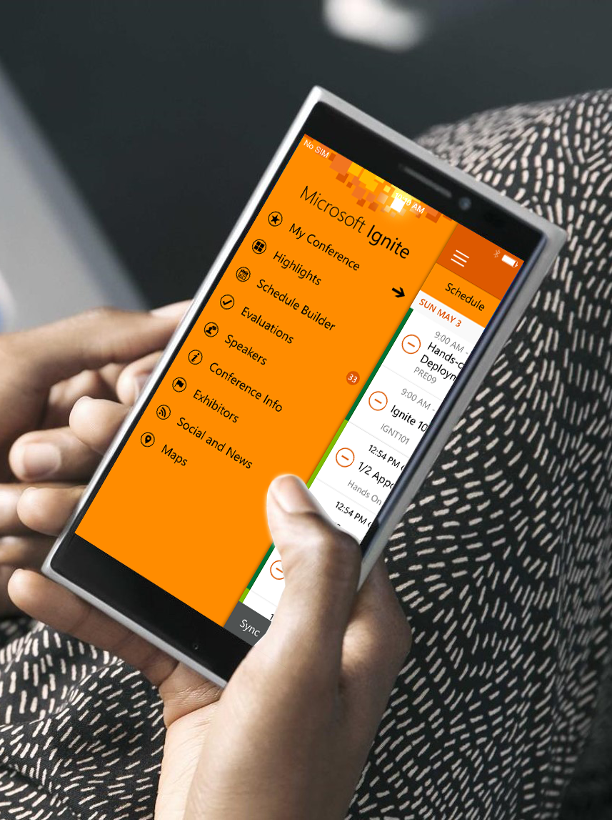
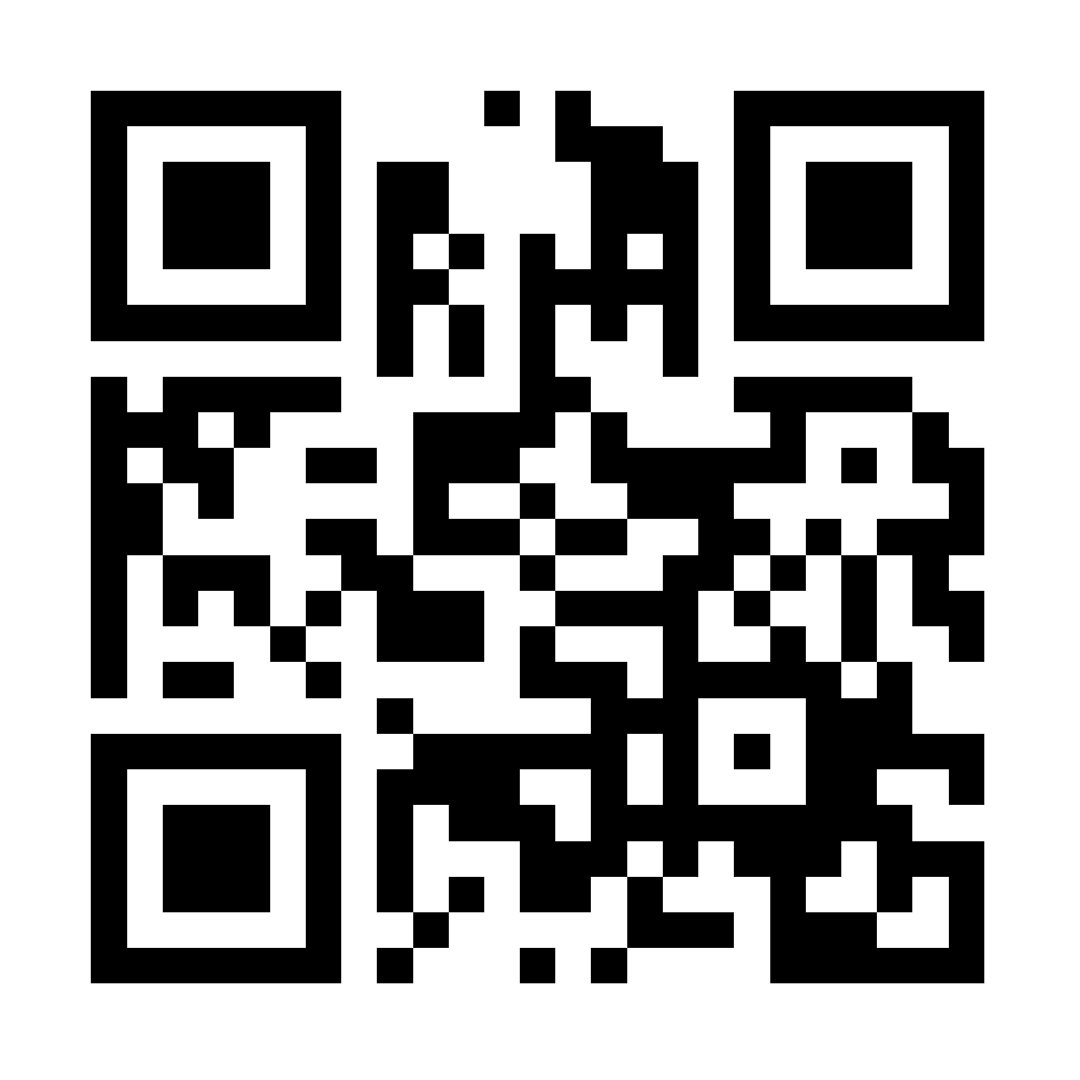
Please evaluate this session
Your feedback is important to us!
Visit Myignite at http://myignite.microsoft.com or download and use the Ignite Mobile App with the QR code above.

