Slide 2
Preparing your Fabric & Apps for Windows Server 2003 End of Support
Jeff Woolsey
Principal Program Manager

Slide 3
Session Objectives And Takeaways
Session Objective(s):
  Quick review of the technology of 2003
  Articulate the risks of staying on Windows Server 2003 post End-of-Support
  Articulate numerous benefits of moving to Modern Windows Server
Key Takeaway: Modernization is an opportunity

Slide 4
A few events from 2003…

Slide 5

Top 10 Movies by Revenue of 2003
LOTR: Return of the King ($377m)
Finding Nemo ($339m)
Pirates of the Caribbean ($305m)
The Matrix Reloaded ($281m)
Bruce Almighty ($242m)
X2 X-Men United ($214m)
Elf ($173m)
Terminator 3 ($150m)
The Matrix Revolutions ($139m)
Cheaper by the Dozen ($138m)

Slide 6
Sporting Events of 2003
Tampa Bay d. Oakland (49-21) in Super Bowl XXXVII
Florida d. New York (4-2) in World Series
San Antonio d. New Jersey (4-2) NBA Championship
Australia d. India (359-234) Cricket World Cup
England d. Australia (20-17) Rugby World Cup

Slide 7
Moving to the Present…

Slide 8
Transforming the datacenter
  Traditional datacenter
  Tight coupling between infrastructure and apps
  Expensive, proprietary, and vertically
  integrated hardware
  Siloed infrastructure and operations
  Highly customized processes and configurations
  Software-defined datacenter
  Loosely coupled apps, infrastructure resources,
  and physical hardware
  Industry-standard, low cost hardware
  Service-focused DevOps roles
  Standardized, automated processes and configurations

Slide 9
Microsoft vision for a new era
Cloud OS
Unified platform
for modern business
Enterprise-grade
Global reach, scale, and security for your business demands—all in a flexible and open platform
Hybrid design
Cloud capacity and services in a way that fits
your business needs and roadmap
Your Datacenter
People-focused
CONSISTENT
PLATFORM
Extends IT, developer, and employee skillsets to the cloud for new innovation
Microsoft
Service
Provider

Slide 10
A leader in Gartner magic quadrants
x86 Server Virtualization¹
Microsoft only leader in all four magic quadrants
Public Cloud Storage Services²
Cloud Infrastructure as a Service³
Enterprise Application Platform as a Service⁴
[1] Gartner “x86 Server Virtualization Infrastructure,” by Thomas J. Bittman, Philip Dawson, July 2 2014; [2] Gartner “Public Cloud Storage Services,” by Gene Ruth, Arun Chandrasekaran, July 9, 2014; [3] Gartner “Magic Quadrant for Cloud Infrastructure as a Service,” by Lydia Leong, Douglas Toombs, Bob Gill, Gregor Petri, Tiny Haynes, May 28, 2014; [4] Gartner “Enterprise Application Platform as a Service,” by Yefim V. Natis, Massimo Pezzini, Mark Driver, David Mitchell Smith, Kimihiko Iijima, Ross Altman, Jan, 7 2014.
Gartner does not endorse any vendor, product or service depicted in its research publications, and does not advise technology users to select only those vendors with the highest ratings or other designation. Gartner research publications consist of the opinions of Gartner's research organization and should not be construed as statements of fact. Gartner disclaims all warranties, expressed or implied, with respect to this research, including any warranties of merchantability or fitness for a particular purpose.

Slide 11
Windows Server & Technology of 2003…

Slide 12



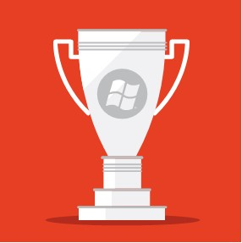
Windows Server 2003
The most widely deployed operating system of its time
New standards for security, reliability, and performance
IT driving competitive value for the business

Slide 13
Windows Server 2003: Ages Ago…
Processors then…
  32-bit were the norm
  Single core / Hyper-Threading was introduced
  No processor support for virtualization (AMD-V or Intel VT)
  Passmark: high end Intel 3.6 GHz Pentium 4 a score of 424
Processors today…
  64-bit is the norm
  Quad-core minimum/Octo-core norm
  Virtualization/Security support (AES/NI and more)
  Passmark: high end Intel Core i7 5960 3 GHz a score of 16026 (37x faster)

Slide 14
Windows Server 2003: Ages Ago…
Memory then…
  512 MB to 1 Gigabyte was the norm
  4 Gigabytes the max for 32-bit
Memory today…
  16 - 32 GB norm for physical workloads
  128 - 512 GB norm for virtualization hosts
  4 Terabytes is the maximum for Windows Server 2012 R2
    1000 times greater than Windows Server 2003

Slide 15
Windows Server 2003: Ages Ago…
Storage then…
  Hard drives measured in Megabytes
    (My phone has 144 Gigabytes…)
  Solid State Drives (SSD) did not exist
  Achieving 50,000 I/O operations per second (IOPs) cost >$1 million
Storage today…
  Hard drives are measured in Terabytes
  SSDs are mainstream
  Achieving >50,000 IOPs costs ~$200
    5,000 times more inexpensive

Slide 16
Windows Server 2003: Ages Ago…
Networking then…
  10/100 Mb was the norm
  1 Gb in market, pricey
  NIC Teaming an add-on
  Server 2003 doesn’t scale to support 10 Gb
Networking now…
  Multiple 1 Gb NICs are the minimum
  Dual 10 Gb NICs are the norm using Windows NIC Teaming
  40 Gb shipping, 100 Gb coming to market this year
    Performance 10 to 40 times greater than Windows Server 2003

Slide 17
Windows Server 2003: Ages Ago…
x86 Virtualization then…
  A science project (test/dev at best)
  No processor support (no AMD-V or Intel VT)
  Windows Server 2003 not tested or developed for virtualization
    Host: No virtualization support included in Windows Server 2003
    Guest: Windows Server 2003 doesn’t perform/scale optimally for virtualization
x86 Virtualization today…
  Mainstream technology that powers the world
  Extensive processor support (AMD-V/RVI or Intel VT/SLAT & more…)
  Windows Server tested, optimized and tuned for virtualization
    Host: World class Hyper-V hypervisor built-in Windows Server
    Guest: Windows Server scales linearly as a host and guest of virtualization

Slide 18
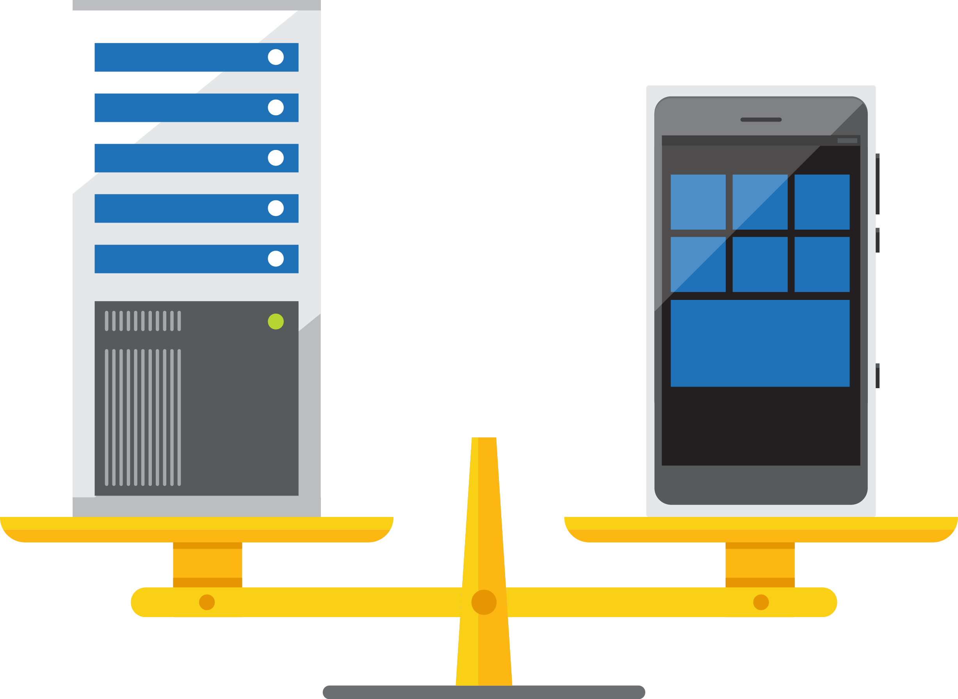
Revolutionary shifts in technology
2003
2015
Cloud, big data, and mobility
Your phone today probably meets the minimum requirements to run Windows Server 2003
Transformational change up and down the stack, in compute, storage, networking

Slide 19
The Big Windows Server 2003 EOS Question…

Slide 20
Q: Is Microsoft going to change the Windows Server 2003 End of Support date? Will they extend the date?

Slide 21

Windows Server 2003 reaches end of support on
July 14, 2015.

Slide 22

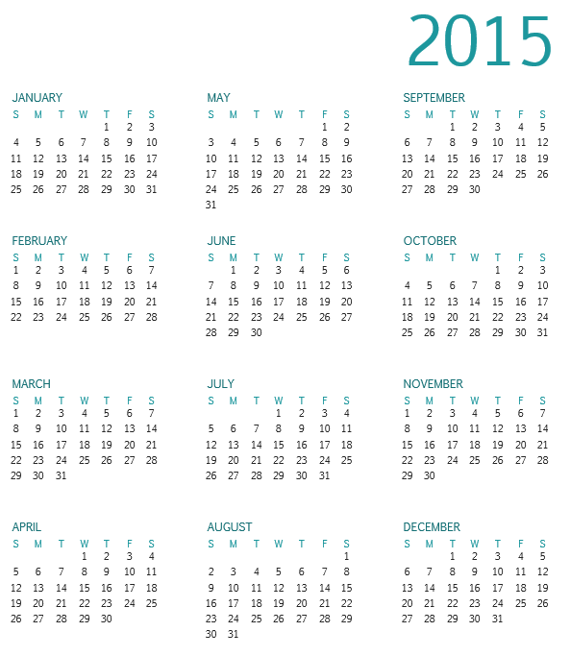
Less than 70 days until end of support
Optimistic estimates
Windows Server 2003 migration:
200 days
Application migration:
300+ days
14
14

Slide 23

What end of support means
No
compliance
No
updates
Windows 2003/R2 servers will not pass a compliance audit
Twenty-five critical and important updates released in 2014 for Windows Server 2003/R2

Slide 24

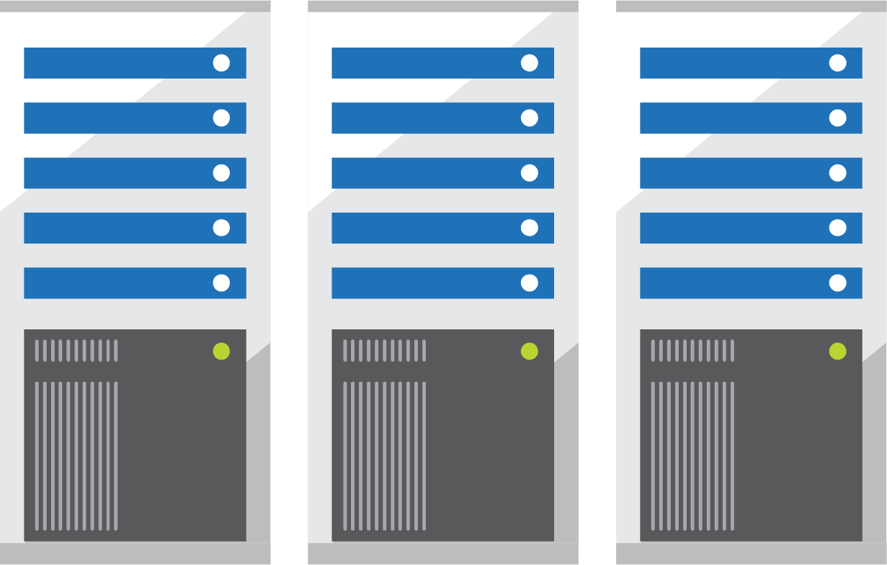
Compliance risks
Many regulatory bodies require up-to-date patches
A recognized issue in key industries including finance, healthcare, and retail
US Department of Homeland Security Alert regarding end of support for Windows Server 2003
November 10, 2014

Slide 25
Payment Card Industry (PCI)
PCI Compliance Data Security Standard 3.0
  Requirement 6: Develop and maintain secure systems and applications
    “Unscrupulous individuals use security vulnerabilities to gain privileged access to systems. Many of these vulnerabilities are fixed by vendor-provided security patches, which must be installed by the entities that manage the systems. All systems must have all appropriate software patches to protect against the exploitation and compromise of cardholder data by malicious individuals and malicious software.”
  And…

Slide 26
Payment Card Industry (PCI)
PCI Compliance Data Security Standard 3.0
  Section 6.2:
    “Ensure that all system components and software are protected from known vulnerabilities by installing applicable vendor supplied security patches. Install critical security patches within one month of release.”
Result:
  Windows Server 2003 is End of Support and not receiving security patches. This makes it a target for subsequent issues and thus taking the system out of PCI compliance.

Slide 27
Health Information Privacy (HIPAA)
HIPAA Security Rule FAQ:
  Q: “Does the Security Rule mandate minimum operating system requirements for the personal computer systems used by a covered entity?”
  A: “No…The Security Rule does not specify minimum requirements for personal computer operating systems, but it does mandate requirements for information systems that contain electronic protected health information (e-PHI). Therefore, as part of the information system, the security capabilities of the operating system may be used to comply with technical safeguards standards and implementation specifications such as audit controls, unique user identification, integrity, person or entity authentication, or transmission security. Additionally, any known security vulnerabilities of an operating system should be considered in the covered entity’s risk analysis (e.g., does an operating system include known vulnerabilities for which a security patch is unavailable, e.g., because the operating system is no longer supported by its manufacturer).

Slide 28
What end of support means
Now is the time to act
No
safe haven
Start planning your migration and begin modernizing your infrastructure today
No
compliance
Impact on both physical and virtualized servers
Increased operations costs
Discontinued support for many applications
Instances not protected
in the cloud
No
updates
Windows 2003/R2 servers will not pass a compliance audit
Twenty-five critical and important updates released in 2014 for Windows Server 2003/R2

Slide 29



Migration is your opportunity
By migrating to Windows Server 2012 R2, Microsoft Azure, or Office 365, you can:
Enhance performance
Reduce cost
Improve security and reliability
But more importantly, you have options to increase competitive edge:
New apps with mobility built in
Cloud options for speed, flexibility
Increased agility in the datacenter

Slide 30

Mapping your migration journey

Slide 31




Migration process
Discover
Catalog your software and workloads
Assess
Categorize applications and workloads
Target
Identify your workload destination(s)
Migrate
Make the move

Slide 32


Discover what you have
Self-service tools
      Microsoft Assessment and Planning (MAP) Toolkit
      Dell ChangeBASE
      Lakeside Software SysTrack
Systems integration partners
          Microsoft Services Discovery
          and Rationalization
          Microsoft partners

Slide 33



Assess your inventory
By type
        Microsoft server roles
        Microsoft applications
        Custom applications
        Third party applications
By importance
        Mission critical
        Important
        Marginal
        Can be retired
By complexity and risk
        Low
        Medium
        High

Slide 34
Evaluate options for each application and workload
Windows Server
2012 R2
Microsoft
Azure
Cloud OS
Network
Office 365

Slide 35
Upgrade your apps
  Line-of-business apps
  Email and collaboration
  File Server
  Database, including SQL Server 2005
  Web
  Active Directory
Migrate to modern platforms
Support a mobile workforce or customer base
Increase competitive impact
Take advantage of cloud scale and flexibility

Slide 36
Upgrade your database
  Line-of-business apps
  Email and collaboration
  File Server
  Database, including SQL Server 2005
  Web
  Active Directory
Mission-critical performance, scalable across compute, networking and storage
Faster insights from any data with a complete
BI solution
Data platform optimization, across
on-premises and cloud deployments

Slide 37
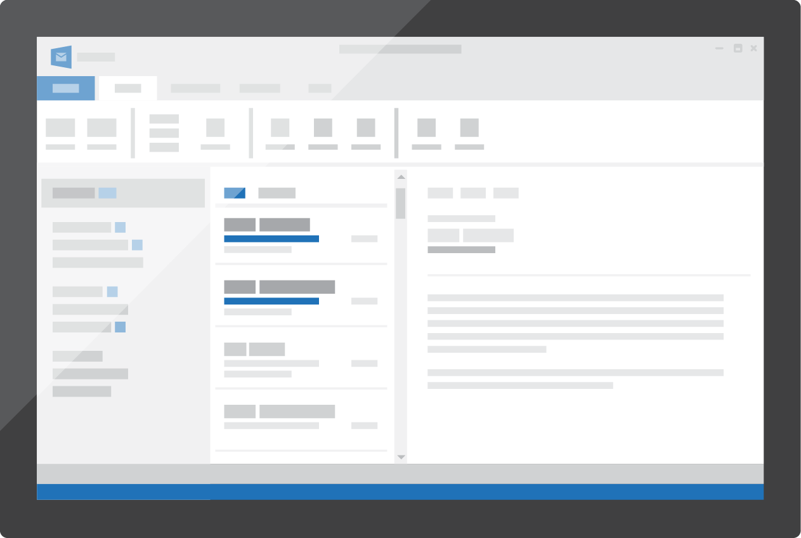
Upgrade email and collaboration
  Line-of-business apps
  Email and collaboration
  File Server
  Database, including SQL Server 2005
  Web
  Active Directory
Make the move to cloud with Office 365
Easier migration and deployment
Scale deployments to meet growing business needs

Slide 38

Upgrade web applications
  Line-of-business apps
  Email and collaboration
  File Server
  Database, including SQL Server 2005
  Web
  Active Directory
Move to cloud with Microsoft Azure
Take advantage of global reach
Easily handle unpredictable demand and scale to meet emerging needs

Slide 39

Upgrade File Server
  Line-of-business apps
  Email and collaboration
  File Server
  Database, including SQL Server 2005
  Web
  Active Directory
Consolidate unmanaged, costly and slow file servers
Take advantage of software-defined storage solutions
Increase agility and reduce costs

Slide 40
Upgrade Active Directory
  Line-of-business apps
  Email and collaboration
  File Server
  Database, including SQL Server 2005
  Web
  Active Directory
Manage user identities more efficiently with federated identity
Enable mobile users without sacrificing security
Make hybrid identity a part of your toolkit

Slide 41
Migrate your workloads
Partner with app owners on timelines
Consider service offerings
Plan self-service migration
Get the benefits of a modern platform

Slide 42

Microsoft Services
Enterprise Modernization Solution
Strategize
Develop a strategy that meets your needs
Discover
Catalog your servers, applications, and workloads
Target
Identify your destination(s)
Migrate
Make the move
Support
Keep your apps and datacenter running smoothly
Strategy Workshop
Discovery and Rationalization
Target and
Deploy Platform
Migration Jumpstart
Ongoing Support

Slide 43
What is your cloud strategy?
The world is hybrid
Microsoft Azure
Service Provider
Your datacenter
Your cloud
Windows Server | System Center | Microsoft Azure

Slide 44
Next steps:
More information online at: www.Microsoft.com/ws2003eos
Learn more about Windows Server 2012 R2: www.Microsoft.com/windowsserver
Learn more about Microsoft Azure: www.azure.com

Slide 45
Modernization is an opportunity

Slide 46
Where do you want to be?

Slide 47
Do you want to stay on-premises?

Slide 48
Azure Pack
System Center
Windows Server 2012 R2

Slide 49
Enables zero downtime upgrades…
Zero Downtime Cloud Upgrades: Storage (Scale Out File Server) or Hyper-V Cluster
Win2012 R2
Win2012 R2
vNext

Slide 50
Do you want hybrid?

Slide 51
Azure Pack
System Center
Windows Server 2012 R2

Slide 52

Microsoft cloud platform
The platform for hybrid cloud
enables IT to:
Customer
Empower enterprise mobility
Create the Internet of your things
Enable application innovation
Unlock insights on any data
Transform the datacenter
CONSISTENT
PLATFORM
Service
Provider
Microsoft
Microsoft: To provide our valued customers the best cloud whenever and wherever it makes business sense.

Slide 53
Learn more with FREE
IT Pro Resources
Free technical training resources:
  On-demand online training: http://aka.ms/moderninfrastructure
Free ebooks:
  Deploying Hyper-V with Software-Defined
  Storage & Networking: http://aka.ms/deployinghyperv
  Microsoft System Center: Integrated Cloud Platform: http://aka.ms/cloud-platform-ebook
Expand your
Modern Infrastructure Knowledge
Get hands-on: Free virtual labs:
  Microsoft Virtualization with Windows Server
  and System Center: http://aka.ms/virtualization-lab
  Windows Azure Pack: Install and Configure: http://aka.ms/wap-lab
Join the IT Pro community:
  Twitter @MS_ITPro

Slide 54


Please evaluate this session
Your feedback is important to us!
Visit Myignite at http://myignite.microsoft.com
or download and use the Ignite Mobile App
with the QR code above.

Slide 56
Appendix

Slide 57
Why Windows Server 2012 R2?
Enterprise-class scale and performance
Shared nothing live migration with Remote Direct Memory Access
Hyper-V Network Virtualization
Low-cost, highly available file-based storage
Backup and recovery
Hybrid
applications
Windows
PowerShell 4.0
Active Directory Virtualization and Dynamic Access Control
>_

Slide 58
New in Windows Server 2012 R2 Hyper-V
High performance live migration (compression/RDMA)
Zero downtime upgrades
Automatic VM Activation
Live VM export
App consistent guest backup
Enhanced VMConnect
Dynamic memory host balancing
First class Linux support – Dynamic memory, file system consistent host based backup
RemoteFX over WAN
Generation 2 Virtual Machines
Secure boot in a VM
High performance auto tiered storage spaces
Write back cache with spaces
Storage QoS
Shared VHDX for guest clustering
VHDX online resize
Storage deduplication with live VMs for VDI
Hyper-V Recovery Manager (Microsoft Azure Site recovery)
Azure Backup
Inbox multi-tenant site-to-site VPN gateway for physical & virtual networks
Protected VM Networks/Virtual RSS
Enhanced LBFO performance with NIC teaming

Slide 59
Windows Server 2012 R2 Hyper-V
High performance live migration (compression/RDMA)
Zero downtime upgrades
Automatic VM Activation
Live VM export
App consistent guest backup
Enhanced VMConnect
Dynamic memory host balancing
First class Linux support – Dynamic memory, file system consistent host based backup
RemoteFX over WAN
Generation 2 Virtual Machines
Secure boot in a VM
User defined meta data for VHDX
PowerShell for all Hyper-V operations
Hyper-V Metrics
Shared nothing live migration
High performance auto tiered storage spaces
Write back cache with spaces
Storage QoS
Shared VHDX for guest clustering
VHDX online resize
Storage deduplication with live VMs for VDI
Hyper-V Recovery Manager (Microsoft Azure Site recovery)
Azure Backup
Inbox multi-tenant site-to-site VPN gateway for physical & virtual networks
Protected VM Networks/Virtual RSS
Enhanced LBFO performance with NIC teaming
Hyper-V Extensible Switch
4K Sector support
Hyper-V over SMB
Hyper-V over Spaces & ReFS
64 VP, 1 TB Monster VMs
SR-IOV for 10+GB networking
64TB VHDX
Hyper-V Replica
Network Virtualization
USB redirection over RemoteFX vGPU
Hot add/remove of storage
VHDX resiliency
Dynamic & differencing VHDX performance improvements
384 LP, 4TB physical system
2+ Million IOPS to a single VM
Resource Pools
NUMA in a VM
1024 running VMs on a host

