Slide 2
Hybrid Cloud Backup
BRK2479
Shreesh Dubey
Principal Group Program Manager
Microsoft Corporation
Vijay Tandra Sistla
Senior Lead Program Manager
Microsoft Corporation

Slide 3
3 key takeaways for this session
Microsoft hybrid cloud backup:
… differentiated
… cost effective
… for private/public cloud deployments
1
2
3

Slide 4
Availability on Demand with Azure
Datacenter
Microsoft Azure
Recovery
Devtest
Analytics
Azure Site Recovery
Migration
Cloud Bursting
Backup
Azure Backup
Long-term Retention

Slide 5



Today’s backup strategy
Expensive storage and tape infrastructure
Operational Backups
Offsite secondary backup
Management across sites
Offsite tape backup
Offsite backup challenges

Slide 6
Benefits of cloud in your backup strategy
1
Lower CAPEX
2
Lower OPEX
3
Replace Tapes
“If you don’t adopt the public infrastructure and move your value up the chain to some
other differentiator, your competitor will and you will be soon filing for chapter 11”

Slide 7
Architecture matters
Cloud as a storage target
Backup software in IaaS
1
1
Egress costs
Cost of IaaS Compute
2
2
Retrieve full backup
Network costs

Slide 8
Our Approach – Cloud First
Azure Backup as a SaaS Application
1
Low OPEX, CAPEX
2
No egress costs for retrieval
3
Unlimited Scale
4
Single-plane-of-glass management
 | Backup app in IaaS A4 VM | Azure Backup
Maximum Backup Storage | 16 TB (max possible storage in IaaS A4 VM) | Unlimited
Compute costs borne by customer | $536/month | Included
Data Transfer cost for restores | $0.087/GB - $.181/GB | Included
Comparing Azure Backup Service to a Backup application running in an IaaS VM

Slide 9
Hybrid Cloud Backup
Microsoft Azure
Virtual machines
Production Data
Data Protection Manager
Production Data

Slide 10
Hybrid Cloud Backup Scenarios

Slide 11
Enterprise Backup
Microsoft
Azure
Azure Backup
Value proposition:
Cloud as tape replacement
Minimize local storage
Centralized management
Workload backup to Azure
Data Protection Manager
Production Data

Slide 12
Branch Office Backup
Value proposition:
Eliminate Branch storage
Reduce BO/HO network Central Management

Slide 13
Client Protection to Azure
Value proposition:
No on-premises storage
No VPN or corpnet required
Data encryption
Self-service backup/recovery

Slide 14
Backup of Azure IaaS VMs
Microsoft Azure
Virtual machines
Cloud Data Backup
Value proposition:
Enterprise scale backup in Azure
Fabric level protection
No customer resources for backup

Slide 15
Server Recovery Demo

Slide 16
Hybrid Cloud Backup Capabilities

Slide 17
Long term retention (LTR)
Business needs
Compliance/Legal
Reduce costs
}
Storage
new!
Capacity
Azure backup
Data grows
exponentially
(50 – 60% Annually)
Cloud Backup Opportunity
(LTR, Offsite, DR)
1 – 100 years
90% Restores from Short-Term-Retention (30 days or less)
Tape
Local Backup
Time

Slide 18
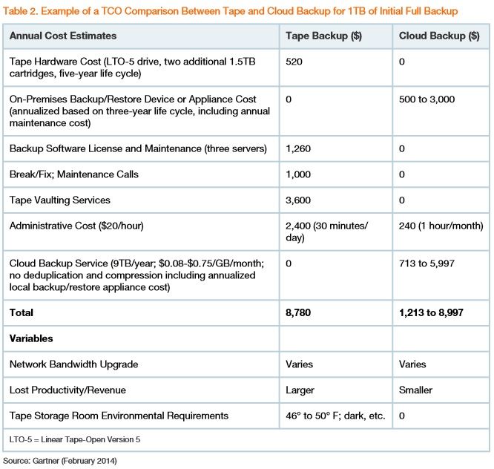
Tape vs. Cloud - TCO
“Although tape media is very inexpensive, a majority of the cost of tape-based backup is the "soft" costs, which occur around backup software, maintenance and staff time”
Gartner ID:G00261961

Slide 19
Long Term Retention Demo

Slide 20
Key Capabilities for LTR
1
Pricing Model Change
2
Networking and Security
3
Workload Support

Slide 21
Pricing Model Principles
1. Economical
2. Flexible
Software
+
Storage
Independent of data growth and retention.
Based only on size of machine (“front-end”).
Smaller tiers for lower software bill.
Block blob LRS.
Azure Storage at cost.
Block blob GRS also available: user choice.
http://aka.ms/abpricing

Slide 22
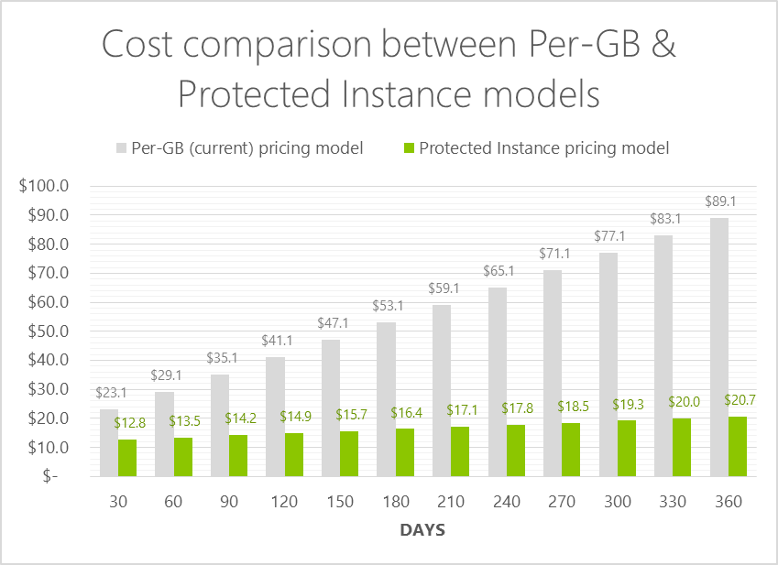
Pricing Model
100GB of data
Daily backup
1% daily churn
360 days retention
Backup
Profile
~77%
savings
with new
Pricing model
Long term retention

Slide 23


Network efficiency
Customer Premises
1. Identify changed blocks
2. Compress
Efficient change tracking
Transfer only changed content
Compression for low bandwidth consumption

Slide 24
Network security
Customer Premises
Azure Backup
1. Identify changed blocks
2. Compress
3. Encrypt
256-bit encryption
4. Encrypted data in backup vault
In transit and at rest
Admin owns and manages keys

Slide 25
Express Route Support
Value Proposition:
Guaranteed backup SLA
Reduce backup time
Reduced RTO
Lower cost
Private Network
ExpressRoute
Customer site 1
Azure
Customer DC
MPLS like connectivity to Azure
Azure is an extension to customer’s data center

Slide 26
Offline IR
Seeding your initial backup data without network consumption.
This is great for customers who do not have a lot of bandwidth to spare
(or)
Bandwidth is costly
Value proposition:
Faster seeding of Azure Backup data
Lower bandwidth requirements
Better backup SLAs

Slide 27


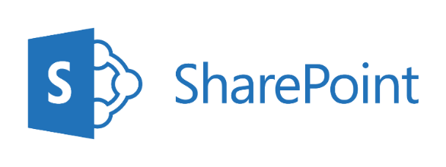


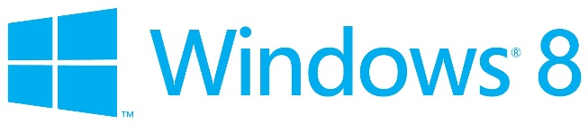
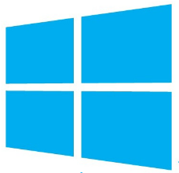
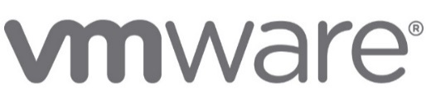
Protecting key workloads to Azure
Specialized workloads
Virtual machines
File/Folders/Volumes
on Hyper-V and Azure
Exchange
2012 and 2012 R2
2008 and 2008 R2
2003 and 2003 R2
Linux
XP, 7, 8 and 8.1
Windows
Server
Hyper-V
Microsoft
Azure
(Physical servers)

Slide 28
SharePoint Recovery Demo

Slide 29
Recap of hybrid cloud backup capabilities
99
Years
Microsoft
Azure
Azure Backup
Feature set:
Restore anywhere
Restore post DR
Retain data forever
Choice of cloud storage
Full workload support
Data Protection Manager
Production Data

Slide 30
Protecting Azure IaaS VMs

Slide 31
Data Protection challenges in Azure
Downtime for workloads
Lack of application consistency
Cumbersome to manage backup

Slide 32
Azure IaaS VM Backup Scenarios
Data Loss or Corruption
Accidental deletion of VM
Create VM copy

Slide 33
Azure IaaS VM backup demo

Slide 34


Azure IaaS VM backup
Azure Backup Vault
Azure IaaS VM
R3 | 1 | 2 | 3 | 4
Recovery Points
R2 | 1 | 2 | 3 | 4
R1 | 1 | 2 | 3 | 4
Snapshots
Production
…
1
3
3
1
2
3
4
Data Blocks
Value Proposition:
Incremental Backup
Performant Storage

Slide 35
IaaS VM backup - Road to GA
Geo expansion
Powershell support
Reporting and Alerting
Built-in Policies

Slide 36
Hyper-V Protection

Slide 37

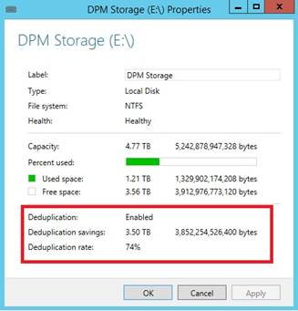
Deduplication Support
General guidelines
Generally dedup savings depend on the type and mix of data
Dedup deployment savings for backup can be expected to range from 30 to 90%
“Dedup ratio for DPM [for backup data] is 74%”

Slide 38
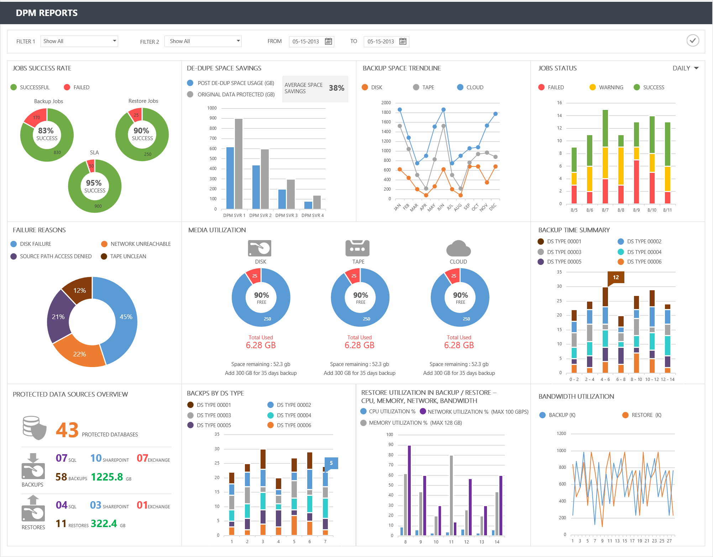

Slide 39
Deploying DPM with dedup
Hyper-V
Scale-out File Server
DPM
Server
Dedup-Enabled Volume
The VHDs are stored on an SMB3 shared folder on a Scale-Out File Server, configured on a dedup-enabled volume
DPM runs in a guest VM, saving backup files to mounted VHDs
SMB
VHD
VHD
See the complete details in the TechNet article “Deduplicating DPM storage”:
    https://technet.microsoft.com/en-us/library/dn891438.aspx
Ignite Insider
We are investigating virtualized DPM with local storage. We expect to publish initial guidance on configurations and limitations in coming months. Stay tuned!

Slide 40
Planned improvements to Dedup+DPM
Simpler volume sizing – use the volume size you need, up to 64TB
Multi-threaded optimization per volume
Processing scales with available CPUs, memory, and I/O
Simplified Virtualized Backup Support
  Enable-DedupVolume –Volume <volume> -UsageType Backup
Ignite Insider

Slide 41
The Demo

Slide 42

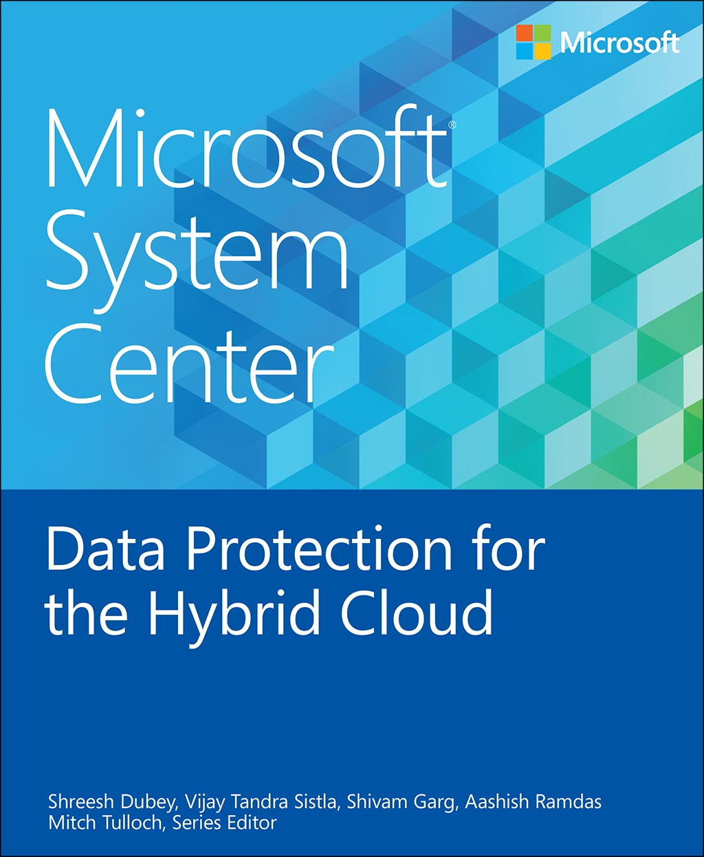
Data protection trends and challenges
Overview of Hybrid Cloud Backup
Protecting Microsoft workloads
Protecting Azure IaaS workloads
Private cloud protection in Hyper-V
Private cloud protection in VMware
Protecting the Microsoft Cloud Platform System
Optimizing backup storage
Integration with System Center
Integration with Azure Backup
Protecting Azure IaaS virtual machines
Will be available shortly….

Slide 43
Backup journey – Continuous Investments
2012
2013
2014
2015
 |  |  | DPM Attach to Azure
 |  | Private Cloud Scale | Long Term Retention
Certificate based protection | Hyper-V over CSV, SMB | MS workloads on VMWare | Workload backup to Azure
Express Full backup of HV | VM Migration | Backup of Linux VMs | Backup of IaaS VM
 | Protect to Azure | Client Backup to Azure | Reporting
 |  |  | Heterogeneous support

Slide 44
Rewind: 3 key takeaways for this session
Microsoft provides..
a differentiated hybrid cloud backup solution that is cost effective and works across clouds
Microsoft Azure
Virtual machines
Production Data
Data Protection Manager
Production Data

Slide 45
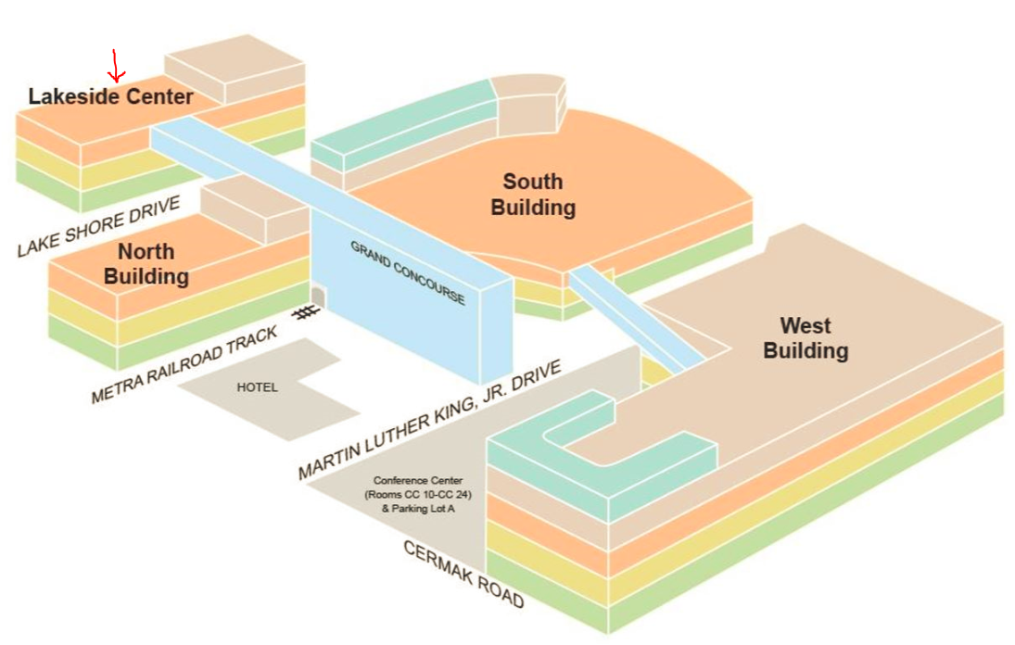
Hybrid Cloud Backup Focus Group
Time:
Wednesday May 6 from 9-10:30 AM
Venue:
Lakeside Center, Level 2, E255

Slide 46
Resources
  http://azure.microsoft.com/en-in/services/backup/
  http://aka.ms/azurebackup
  http://aka.ms/dpm
  http://aka.ms/azurebackupblog
  https://twitter.com/azurebackup
  http://channel9.msdn.com/Series/Azure-Backup

Slide 47
Related Sessions and Content
Enterprise Backup: Custom Reporting, BAAS and Real-World Deployments in DPM (BRK3491)
Platform Vision & Strategy (6 of 7): What’s New in System Center for Management (BRK2459)
Best Practices for Disaster Recovery for Azure Applications (BRK2486)

Slide 48
Learn more with FREE
IT Pro Resources
Free technical training resources:
  On-demand online training: http://aka.ms/learnhybrid
Free ebooks:
  Rethinking Enterprise Storage: A Hybrid Cloud Model: http://aka.ms/hybrid-storage-ebook
  Microsoft Azure Essentials: Fundamentals of Azure: http://aka.ms/azure-fundamentals-ebook
Expand your
Hybrid Infrastructure Knowledge
Join the IT Pro community:
  Twitter @MS_ITPro

Slide 49
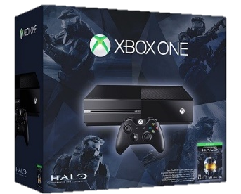
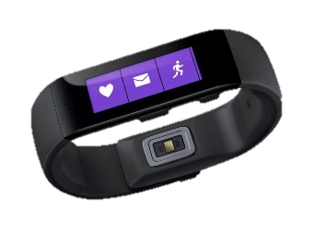


Ignite Azure Challenge Sweepstakes
Attend Azure sessions and activities, track your progress online, win raffle tickets for great prizes!
Aka.ms/MyAzureChallenge
Enter this session code online: BRK2479
NO PURCHASE NECESSARY. Open only to event attendees. Winners must be present to win. Game ends May 9th, 2015. For Official Rules, see The Cloud and Enterprise Lounge or myignite.com/challenge

Slide 50


Please evaluate this session
Your feedback is important to us!
Visit Myignite at http://myignite.microsoft.com
or download and use the Ignite Mobile App
with the QR code above.

