Slide 2
Disaster Recovery Best Practices for Azure Applications
BRK2486
Hongfei Guo, PhD
Principal PM Manager
Microsoft Corporation
HongfeiG@microsoft.com
Patrick Wickline
Senior Program Manager
Microsoft Corporation
PatW@microsoft.com

Slide 3
Related Sessions - Business Continuity
Type | Session | Date and Time
Cloud to Cloud | Microsoft Azure Regional Strategy: Availability, DR, Proximity, and Residency | Tuesday, May 5th 09:00AM - 10:15AM
 | Best Practices for Disaster Recovery for Azure Applications | Wednesday, May 6th 09:00AM - 10:15AM
Hybrid | Azure Site Recovery: Microsoft Azure as a destination for Disaster Recovery | Wednesday, May 6th 01:30PM - 02:45PM
 | Best Practices for deploying Disaster recovery Services with Azure Site Recovery | Friday, May 8th 12:30PM - 01:45PM
 | Cloud Integrated Backup with System Center and Azure Backup | Tuesday, May 5th 10:45AM - 12:00PM
 | Cloud Integrated Backup with Microsoft System Center and Azure Backup | Tuesday, May 5th 10:45AM - 12:00PM
 | Enterprise Backup: Custom Reporting, BAAS and Real-World Deployments in Data Protection Manager | Tuesday, May 5th 05:00PM - 06:15PM
 | CommVault: How to Operationalize Recovery and Disaster Recovery in Microsoft Azure | Thursday, May 7th 01:30PM - 02:45PM
 | Using SQL Server 2014 AlwaysOn Availability Groups for SharePoint On-Premises and Azure SQL Replicas | Thursday, May 7th 11:35AM - 11:55AM
 | Protecting Your VMware and Physical Servers by Using Microsoft Azure Site Recovery | Thursday, May 7th 03:15PM - 04:30PM
 | Elastic SharePoint Storage with StorSimple and Microsoft Azure | Friday, May 8th 09:00AM - 10:15AM
 | End-to-End Azure Site Recovery Solutions for Small & Medium Enterprises | Thursday, May 7th 12:05PM - 12:25PM
On-prem | Microsoft SQL Server End-to-End High Availability and Disaster Recovery | Thursday, May 7th 09:00AM - 10:15AM
 | Stretching Failover Clusters and Using Storage Replica in Windows Server vNext | Thursday, May 7th 10:45AM - 12:00PM
Skype | Managing Backup and Restore in Skype for Business | Tuesday, May 5th 10:45AM - 12:00PM
O365 | What Really Happens When There Is a Service Incident with Office 365, and What's My Role? | Thursday, May 7th 03:15PM - 04:30PM
 | Experts Unplugged: Exchange Server High Availability and Site Resilience Deep Dive | Thursday, May 7 3:15 PM - 4:30 PM

Slide 4
Session Objectives And Takeaways
Session Objective(s)
  Understand the resiliency and disaster recovery provided by the platform by default
  Understand the capabilities provided by Azure to enable application specific disaster recovery solutions
  Understand the customer responsibilities for implementation of highly available and disaster tolerant services
Takeaways:
Azure provides default resilience to many failure modes
Cross-region high availability requires application specific work

Slide 5
Agenda
Azure Services Disaster Recovery Capability Overview
Best Practices for Core Azure Services
Example Design Pattern
Demo

Slide 6
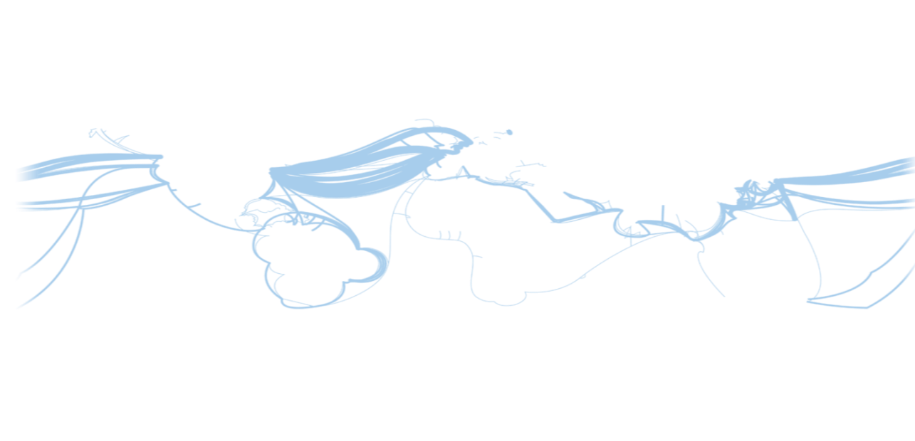
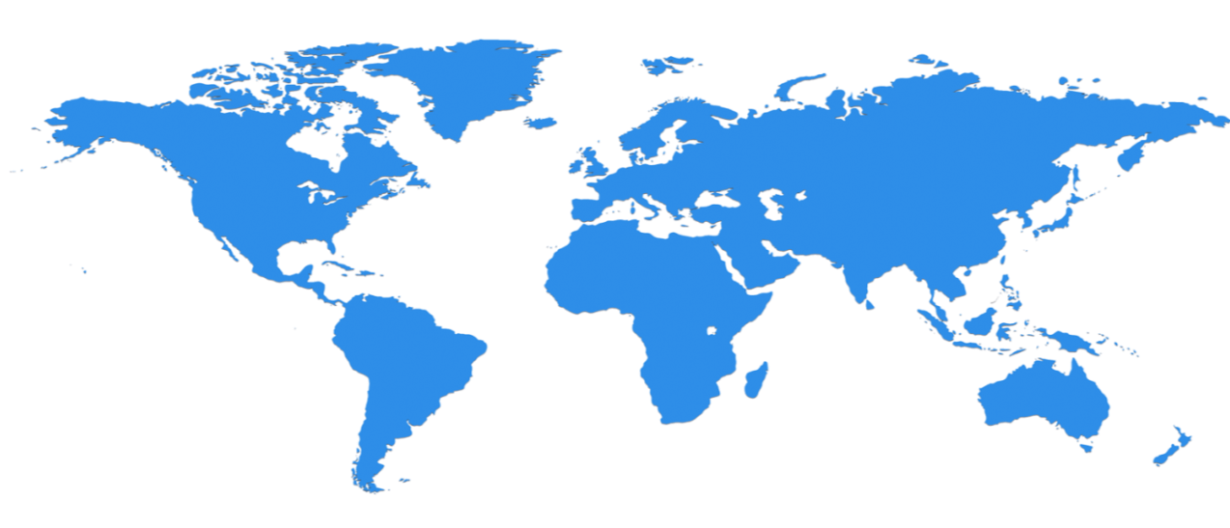

Regional and Cross Region Services
Microsoft Azure is divided physically and logically into units called regions
Dublin
Amsterdam
Chicago
Beijing
Des Moines
Bay Area
Virginia
East Japan
Shanghai
India*
West Japan
San Antonio
Hong Kong
Singapore
Brazil
East Australia
SE Australia
  North America, Europe, Asia, Australia and India are Geographies
  19 Azure Regions in 2015: More than AWS and Google combined
  A huge investment in datacenters
* India available late 2015

Slide 7
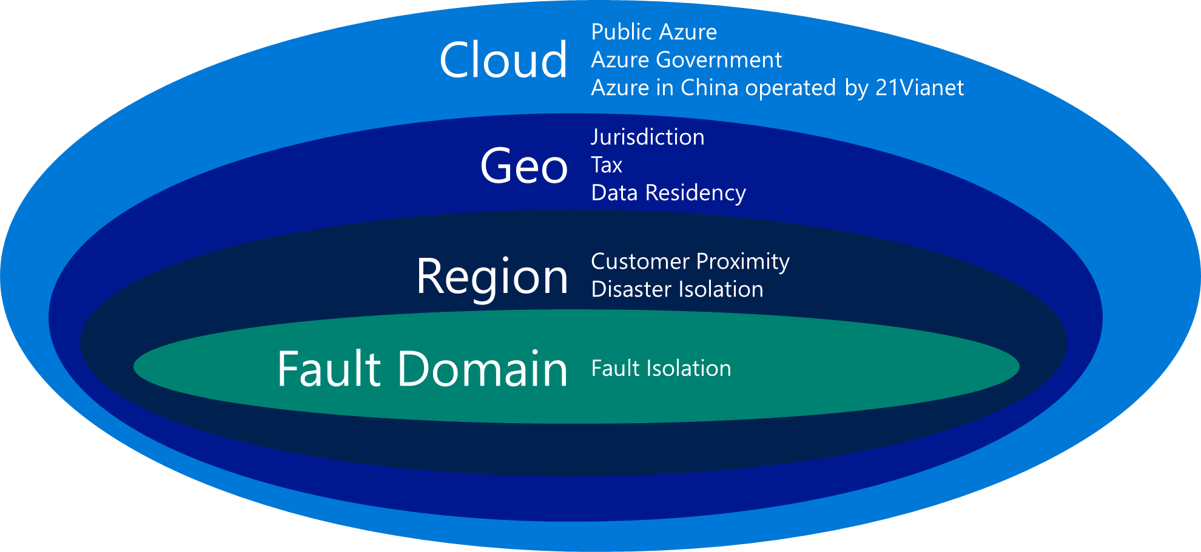
Key Azure Concepts
Primary | Secondary
North Central US | South Central US
South Central US | North Central US
East US | West US
West US | East US
US East 2 | Central US
Central US | US East 2
North Europe | West Europe
West Europe | North Europe
South East Asia | East Asia
East Asia | South East Asia
East China | North China
North China | East China
Japan East | Japan West
Japan West | Japan East
Brazil South | South Central US
Australia East | Australia Southeast
Australia Southeast | Australia East
US Gov Iowa | US Gov Virginia
US Gov Virginia | US Gov Iowa
Paired Regions
Each Azure region is paired up with another within the same Geo* to form Paired Regions. Azure guarantees DR isolation between paired regions against both physical and logical failures
* Exception: Brazil South region is paired with South Central US.

Slide 8
Regional and Cross-Region Services
Regional Services
No cross-region guarantees Customers are responsible for cross-region resiliency solution for their applications
Cross-Region Services
Cross-region high availability. No customer actions required
Compute | Virtual Machines
 | Cloud Services
 | Batch
 | Remote App
Web & Mobile | App Service
 | Web App
 | Mobile Apps
 | Logic App
 | API App
 | API Management
 | Notification Hubs
 | Mobile Engagement
Data and Storage | SQL Database
 | Document DB
 | Redis Cache
 | Storage
 | StorSimple
 | Azure Search
Analytics/IoT | HDInsight
 | Machine Learning
 | Stream Analytics
 | Data Factory
 | Event Hubs
Networking | Virtual Network
 | Express Route
Media & CDN | Media Services
Hybrid Integration | BizTalk Services
 | Service Bus
 | Backup
 | Site Recovery
Identity and Access Management | Access Control
Developer Services Management | Application Insights
 | Scheduler
 | Automation
 | Operational Insights
 | Key Vault
Networking | Traffic Manager
Media & CDN | CDN
Identity and Access Management | Multi-Factor Authentication
 | Azure Active Directory

Slide 9
Azure Virtual Machines

Slide 10
Platform Capability: Azure Resource Management (ARM) HA
Resource management operations for Compute and Networking in all Azure regions are fully isolated from other regions
Failures of an entire region have no effect upon any other region
Guaranteed In-region HA: Resource management operations are distributed across all clusters and all fault domains in the region
West Europe
Azure Cluster 1
Azure Cluster 2
Azure Cluster 3
Compute Service Mgmt
Compute Service Mgmt
Compute Service Mgmt

Slide 11
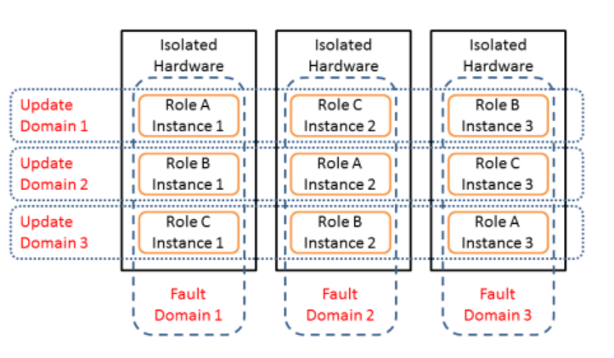

Customer Responsibility: Building In-Region High Availability
Key Points
Deploy Availability Set:
across multiple fault domains (up to 3) for unplanned maintenance
Across multiple update domains for planned maintenance
Role A Instance 1
Role C Instance 2
Role B Instance 3
Role B Instance 1
Role A Instance 2
Role C Instance 3
Role C Instance 1
Role B Instance 2
Role A Instance 3

Slide 12

Customer Responsibility: Building Cross-Region High Availability
Basic Topology
❷
Failover Secondary: North Central US Region
Front End Availability Set
SQL AlwaysOn Availability Set
DNS
Availability Probes
AZURE LOAD BALANCER
❶
❸
AZURE TRAFFIC MANAGER
FAILOVER ROUTING RULE
DB MIRROR TRAFFIC
Primary: South Central US Region
Front End Availability Set
SQL AlwaysOn Availability Set
❹
CLIENT PC
AZURE LOAD BALANCER

Slide 13

Basic Compute HA Building Blocks
Azure Traffic Manager
Global load balancing across regions
Supports Geo-routing, Round Robin and Failover traffic options
AZURE TRAFFIC MANAGER
Azure IaaS Availability Sets
Runs multiple redundant VMs across failure domains within a region to ensure high availability
Ideal for stateless front-end or middle tiers
Azure IaaS Availability Set
Microsoft SQL AlwaysOn
Transparent HA and data protection from local failures
Automatic data synchronization of geo-replicated databases
SQL
Region A
SQL
Region B
Azure Resource Manager Templates
Automation of repeatable complex deployments across regions and dev, integration, staging, production environments
Ideal for dev/ops models, integrated with github

Slide 14
SQL Server Virtual Machine

Slide 15
SQL Server Business Continuity
    SQL Server HA within an Azure Region
      Availability of SQL Server in Azure VM
      Protect from issues impacting SQL Server or Azure VM
      Use a replica SQL Server in another Azure VM in same Region
    SQL Server DR between Azure regions
      Availability of SQL Server in Azure VM
      Protect from issues impacting the Azure data center
      Use another SQL Server VM in different Azure DC

Slide 16




Availability within an Azure Region
Witness
    SLA: No data loss
    If VM becomes unavailable, restart in another host
    SLA: 1 of 2 VMs in Availability Set
    99.95% (<22 min downtime p/month)
    Includes
      Planned downtime due to (monthly) host OS servicing
      Unplanned downtime due to physical failures
    Doesn’t include servicing of guest OS or software inside (e.g. SQL)
    SQL AlwaysOn provides higher availability
    If one SQL VM becomes unavailable, SQL fails over to another VM: ~20s
    Based on customer feedback/Telemetry: 99.99% (<4 minutes of downtime)
VM
S
S
P
P
VM
VM

Slide 17
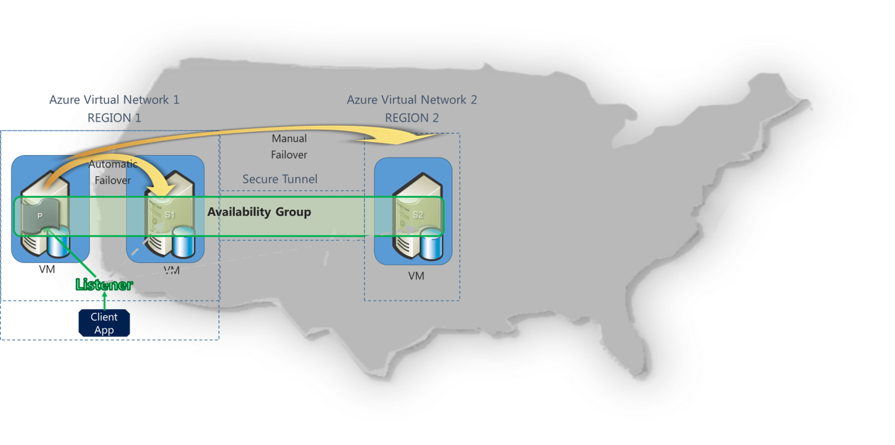
SQL Server DR between Azure Regions
SQL Server Disaster Recovery
  Configure an AlwaysOn Availability Group between VMs in different regions
  Configure a VPN Tunnel: Communications between replicas is secure
  Manual Failover (~15 seconds). Test it at any time!

Slide 18
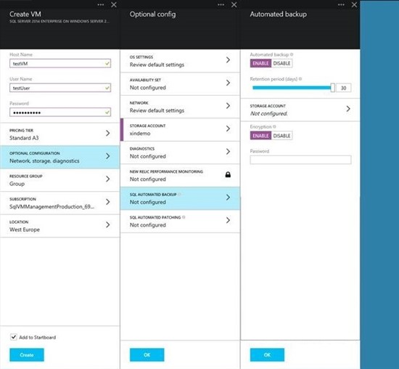
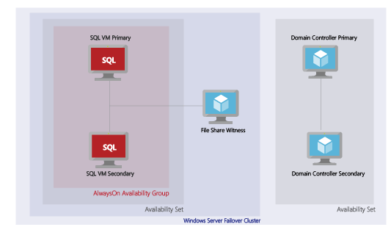
Easily Deploying AlwaysOn!
AlwaysOn Gallery Template
  Provision an AlwaysOn deployment
    To a new/existing Windows Domain
  Fast: 30 min (manually: ~3 hours)
  Easy: Just specify a name for the deployment and the Listener

Slide 19
Azure SQL Database

Slide 20
Roles and Responsibilities
Azure SQL Database
Customer (subscription owner)
Geo-distributed service
Customer metadata protection and recovery
Transparent high availability and data protection from local platform failures
Automatic geo-distributed backups
Automatic data synchronization of geo-replicated databases
Platform compliance testing and certification
Alerting impacted customers about their servers’ degradation during regional failures
Detecting user errors and initiating point in time restore
Planning, database prioritization and region selection for disaster recovery
Initiating geo-restore to the selected region
Initiating failover of the geo-replicated databases
Application DR drills

Slide 21
BCDR Tiered Model
Basic
tier
Standard tier
Premium tier
Uptime SLA | 99.99%
Predictable Performance | B | S0, S1 or S2 | P1, P2 or P3
 | Transactions per hour | Transactions per minute | Transactions per second
Database size limit | 2GB | 250GB | 500GB
Point In Time Restore (“oops” recovery) | Any point <7 days | Any point <14 days | Any point <35 days
Geo-Restore (restore last daily backup to another region) | RTO<24h*, RPO<24h | RTO<24h*, RPO<24h | RTO<24h*, RPO<24h
Standard geo-replication (offline secondary, fixed DR pairing) | Not included | RTO<2h RPO<30m | RTO<2h RPO<30m
Active geo-replication (up to 4 online secondaries, configurable regions) | Not included | Not included | RTO<1h, RPO<5m

Slide 22
BCDR Scenario Support in Service Tiers
Scenario | Basic | Standard | Premium
Local failures | ✓ | ✓ | ✓
Azure SQL Database service maintenance | ✓ | ✓ | ✓
Accidental data modifications | ✓ | ✓ | ✓
Regional disaster | ✓ | ✓ | ✓
DR Drill | ✓ | ✓ | ✓
Online application upgrade |  |  | ✓
Online application relocation |  |  | ✓
Load balancing |  |  | ✓

Slide 23
Database Backup Based Solutions

Slide 24
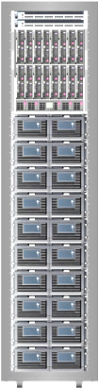



Point in Time Restore
RA-GRS
sabcp01bl21
sabcp02bl21
sabcp03bl21
Automatic Backup
  Full backups weekly, diff backup daily,
  log backups every 5 min
  Daily and weekly backups automatically uploaded to geo-redundant Azure Storage
Self-service restore
  REST API, PowerShell or Portal
  Creates a new database in the same logical server
Tiered Retention Policy
  Basic - 7 days, Standard - 14 days, Premium - 35 days
Copy backups to Azure Storage
LS XYZ
DB
Backups
DB1
Backups
Restore as a new database from local backups

Slide 25
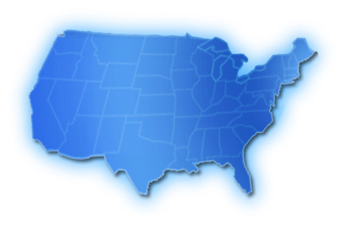

Geo Restore
RA-GRS
RA-GRS
sabcp01bl21
US West
Storage geo-replication
sabcp02bl21
sabcp01bl21
sabcp03bl21
sabcp02bl21
sabcp03bl21
Restore to any server when needed
LS ABC
LS XYZ
Automatic copies of daily backups
DB
DB
Self-service restore API
Restores last daily backup
No extra cost, no capacity guarantee
RTO>=24h, RPO=24h
Database URL will change after restore
US West
US East

Slide 26
Database Replication Based Solutions

Slide 27
Standard Geo Replication
US West
LS OPQ
DB
LS ABC
Geo-replication
LS XYZ
DB
North Central
US
DB
Failover and activation of secondary
(during incident)
West US
RTO<2h, RPO<5m
REST and PowerShell API to opt-in and failover
Automatic data replication and synchronization
DMV+REST to monitor and guide failover decisions
Single offline secondary with matching performance level in the DR paired region
East US

Slide 28
Active Geo-Replication
North Central US
LS DFE
Geo-replication
DB1
Failover and activation of secondary (any time)
Geo-replication
Geo-replication
LS XYZ
Geo-replication
LS OPQ
DB1
DB1.old
DB1
LS ABC
DB1
West US
RTO<1h, RPO<5m
REST and PowerShell API to opt-in and failover
DMV+REST to monitor and guide failover decisions
Automatic data replication and synchronization
Up to 4 online secondary databases with matching performance level in any region
East US
South Central US

Slide 29
Demo

Slide 30
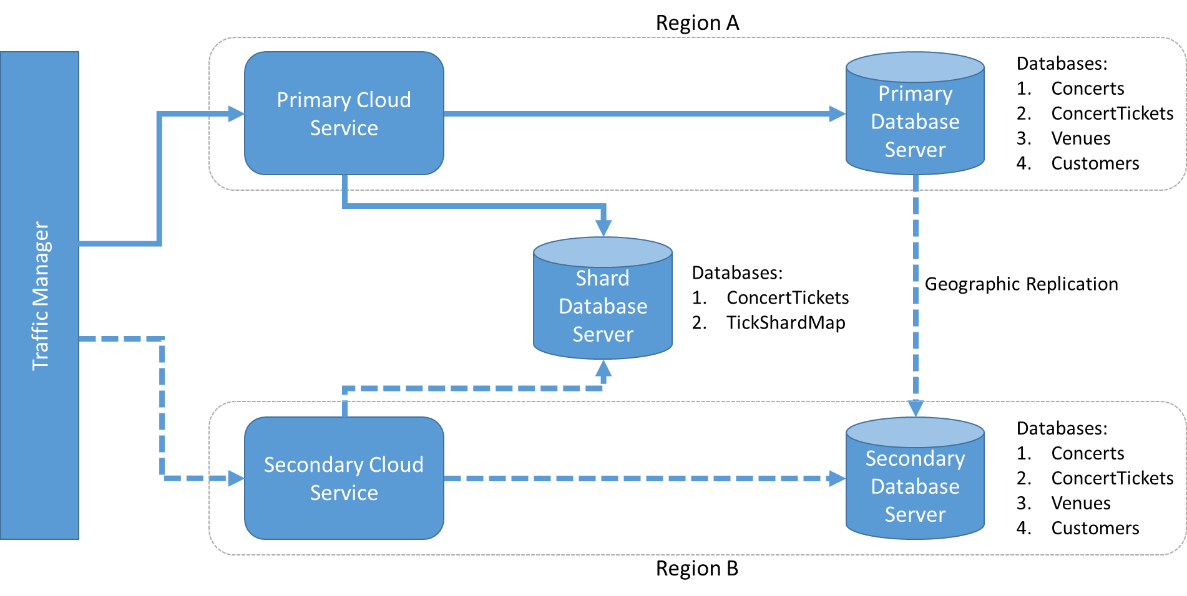
Demo Architecture

Slide 31
Azure Storage

Slide 32
Roles and responsibilities
Azure Storage
Customer (subscription owner)
Transparent high availability and data protection from hardware failures
Geo-replicated service
Platform compliance testing and certification
Configure the appropriate geo-replication option
  Geo-Redundant Storage (GRS)
  Read Access Geo-Redundant Storage (RA-GRS)
Creating point in time backups (blob snapshot)
Use appropriate read options for Read Access Secondaries
Monitor replication latency to enforce RPO
If cross-region HA is required implement appropriate design pattern

Slide 33
BCDR Tiered Model
 | Blobs, Tables, Queues, VM Disks |  |  | VM Disks
 | LRS | GRS | RA-GRS | VM Disk Premium
Uptime SLA | 99.9 | 99.9 | Read 99.99 Write 99.9 | 99.9
Synchronous Replication In-Region | Yes | Yes | Yes | Yes
Asynchronous Replication Across Regions | No | Yes | Yes | No
Read Availability in case of regional outage | No | No | Yes | No
Total copies of data | 3 | 6 | 6 | 3
LRS: Locally Redundant Storage
GRS: Geo-Redundant Storage
RA-GRS: Read Access Geo-Redundant Storage

Slide 34
Azure Storage Cross-Region DR Design
Cross Region DR Design Patterns for Blob, Table, Queue
RO-Secondary | For applications that optimize for highly available reads (eventual consistency)
Multiple-RW Accounts + RO Secondary | For applications that optimize for highly available reads and writes (eventually consistent)
Azure Replicated Table Library (RTable) | For applications that optimize for strong data consistency over performance

Slide 35
Design Pattern: Read Access Geo-redundant Storage (RA-GRS)
US-West
US-East
Key Points
Same account key for both endpoints
Consistency
    All Writes go to the Primary
    Reads to Primary are Strongly Consistent
    Reads to Secondary are Eventually Consistent
Handle eventually consistent reads from secondary --Applications can query the current max geo-replication delay for each service (blob, table, queue) in their storage account
Separate storage analytics metrics for monitoring and tracking primary and secondary locations
Read/Write
Primary Account
      accountname.<service>.core.windows.net
Read Access Secondary Account
      accountname-secondary.<service>.core.windows.net
Async
Replication
Client Library
Read Retry Options
PrimaryOnly
SecondaryOnly
PrimaryThenSecondary
SecondaryThenPrimary
Application
Legend
Write
Read

Slide 36
Design Pattern: RW Secondary
US-West
US-East
Key Points
Read Access Secondary design pattern + separate primary account in secondary region
Application implements lookup table to track account corresponding to the data
Good for add only pattern
Read/Write
Primary Account
Read Access Secondary
Async
Replication
On primary relocation, first copy data (app specific)
Read/Write
Primary
Application
Legend
Lookup table
Write
Read

Slide 37
Design Pattern: Azure Replicated Table Library (RTable)
Key Points
Client library on top of Azure Tables
Synchronous Writes
Read from any replica
Can tolerate n-1
Application controls when a replica is taken out of rotation
Open Source on GitHub
https://github.com/Azure/rtable/
US-West
US-N.Central
US-East
Head Replica
Replica
Tail Replica
RTable Client Lib
Legend
Write
Application
Read

Slide 38
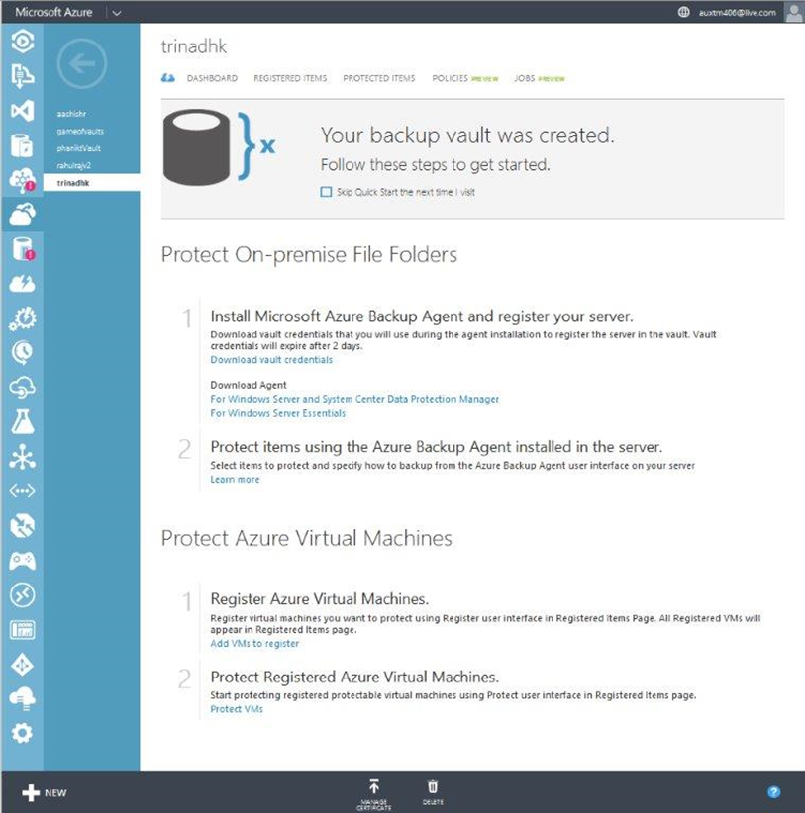
Azure Backup for Azure VM Disk
Key Features
Scheduled Backup
Granular Recovery
Compressed
Encrypted
Proxy server support
Backup agents run on source servers
Backup vault lives in Azure Storage
Integrated with DPM
Scenarios
Recovery of VM in case of VM deletion
Recovery of VM in case of Data loss inside VM
Recovery of VM in case of VM Corruption
Create a copy of VM from Older point in time
Value Proposition
Backup virtual machines without need to shutdown the VMs
VMs running Windows OSes can be protected at application level consistency while those running Linux OSes can be protected at file-system level consistency.
Flexible, Scalable and easy-to-use backup management

Slide 39
Demo

Slide 40
Example – An Azure Application with DR Design

Slide 41
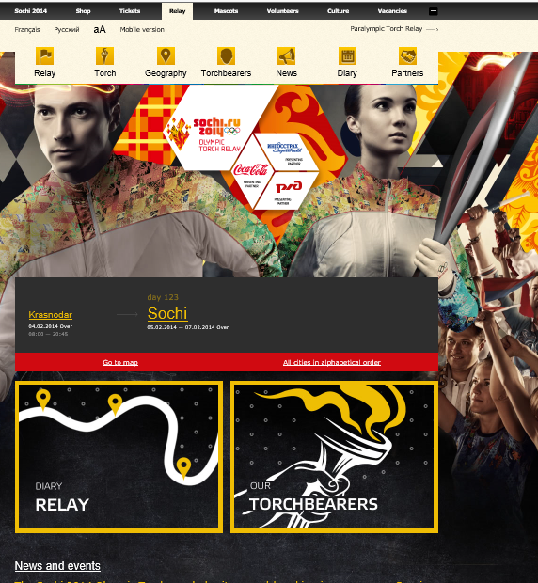
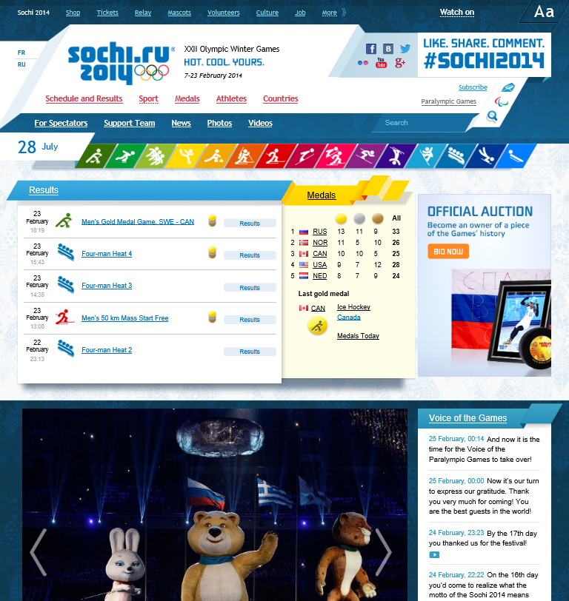

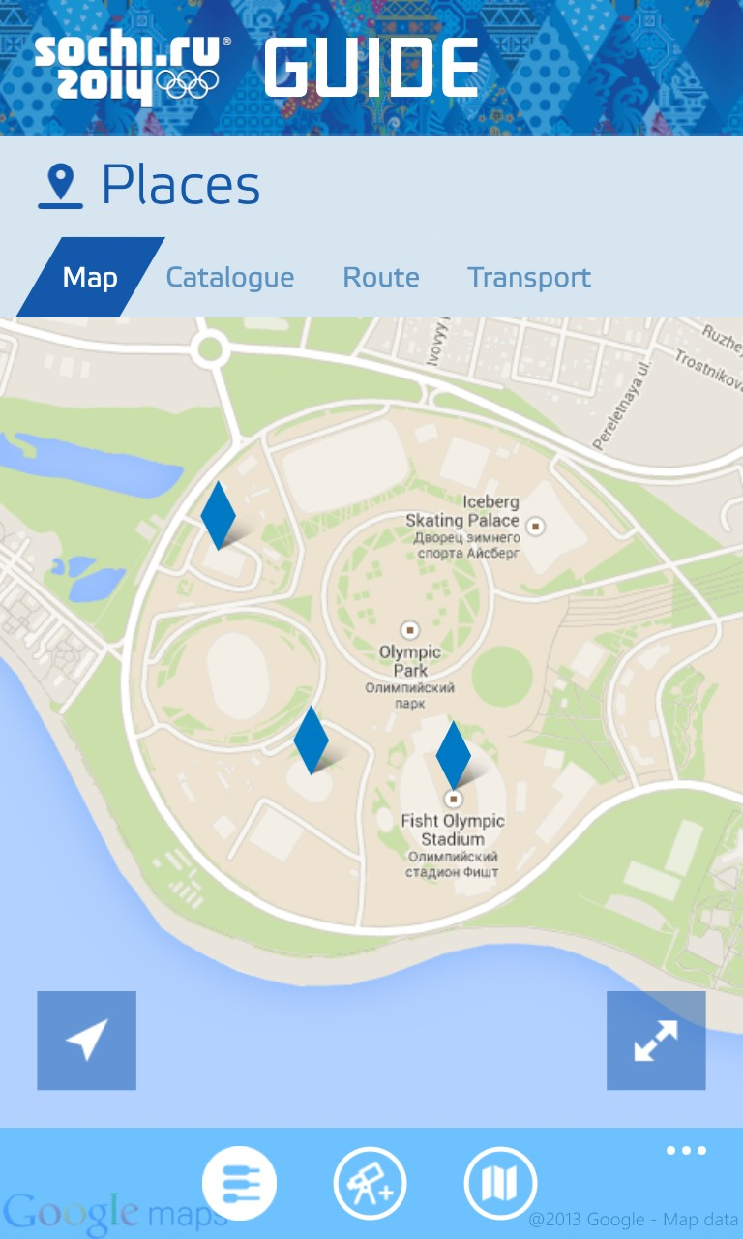
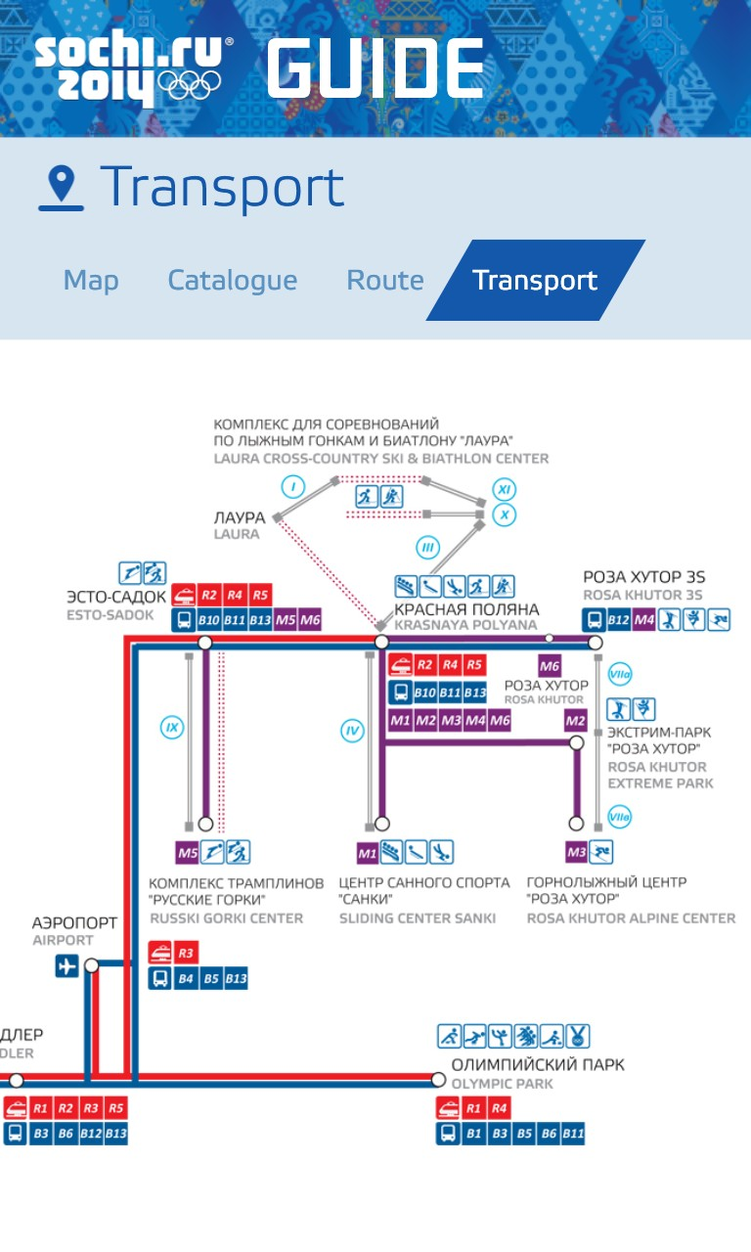
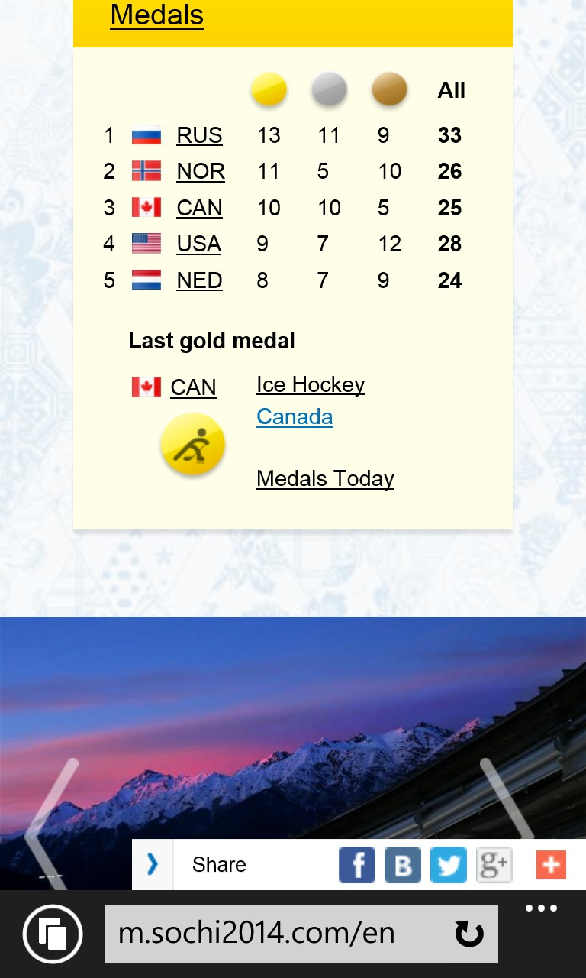
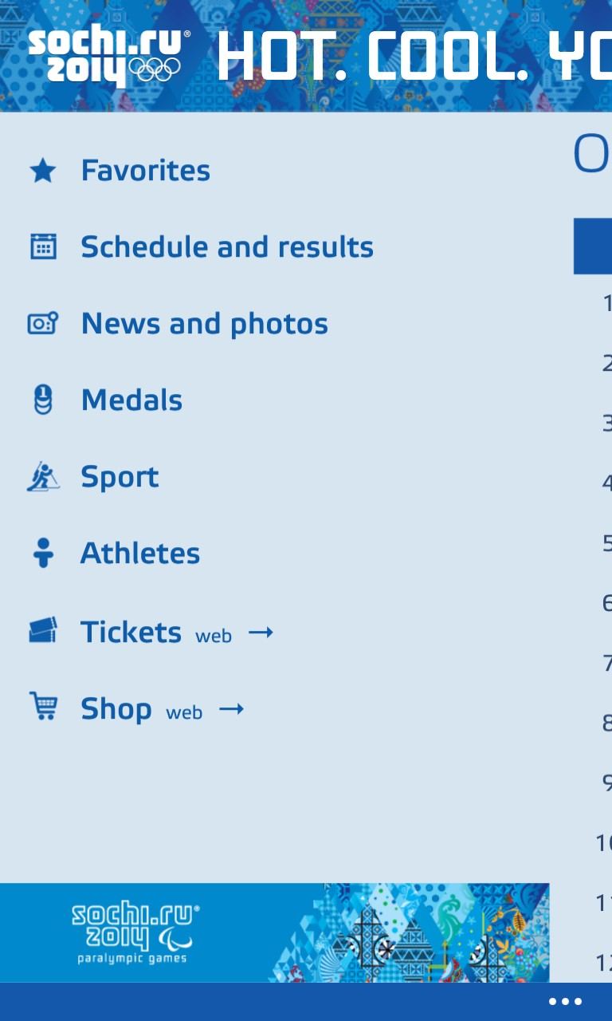
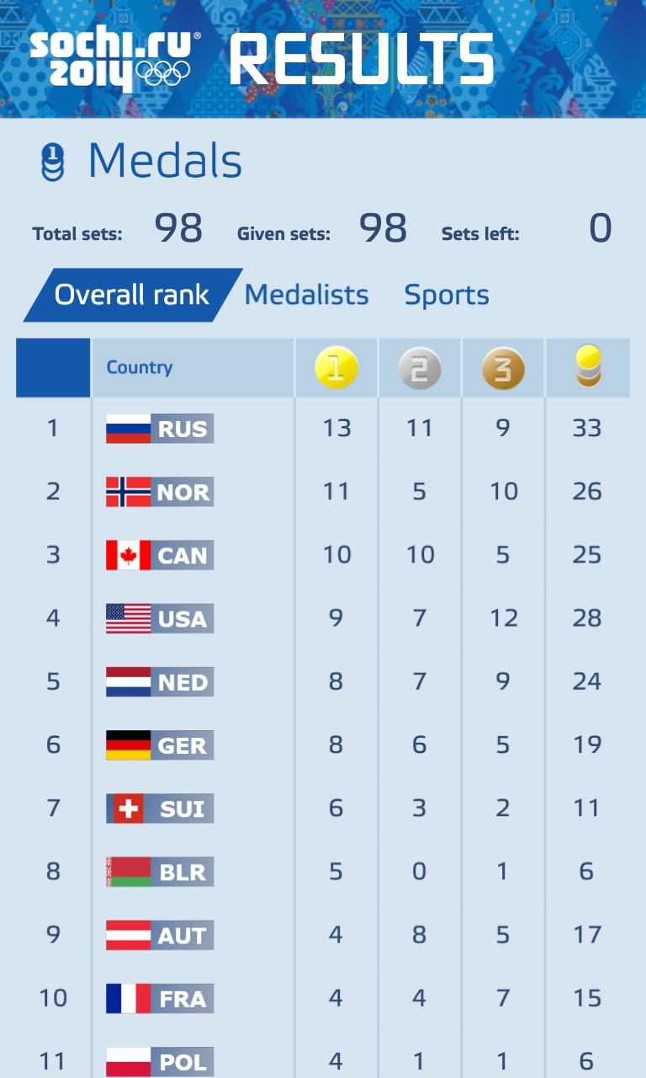
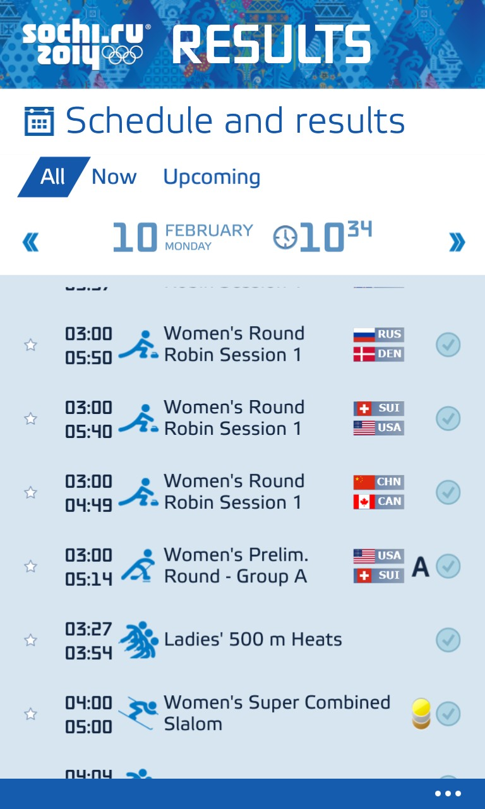
Olympic Experience
Torch Relay website
Games Time website
Mobile
Mobile Apps
v
v
v

Slide 42
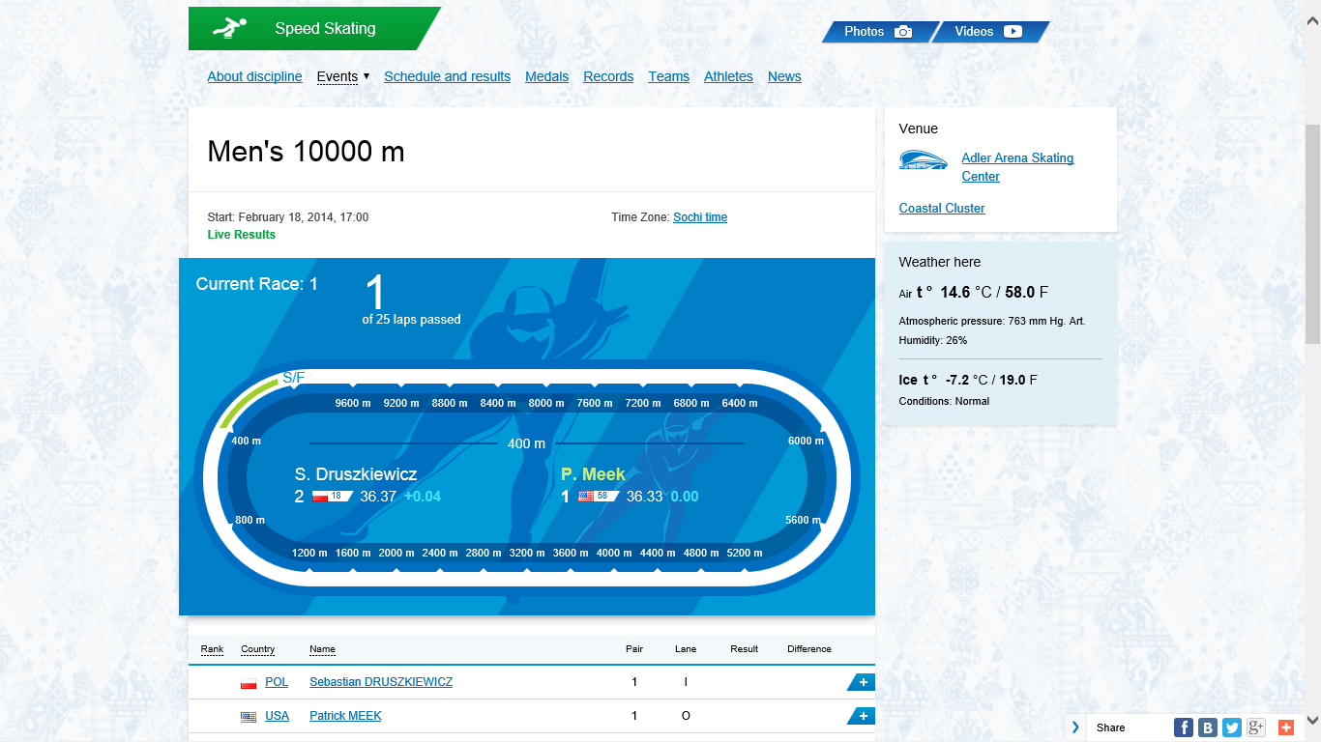


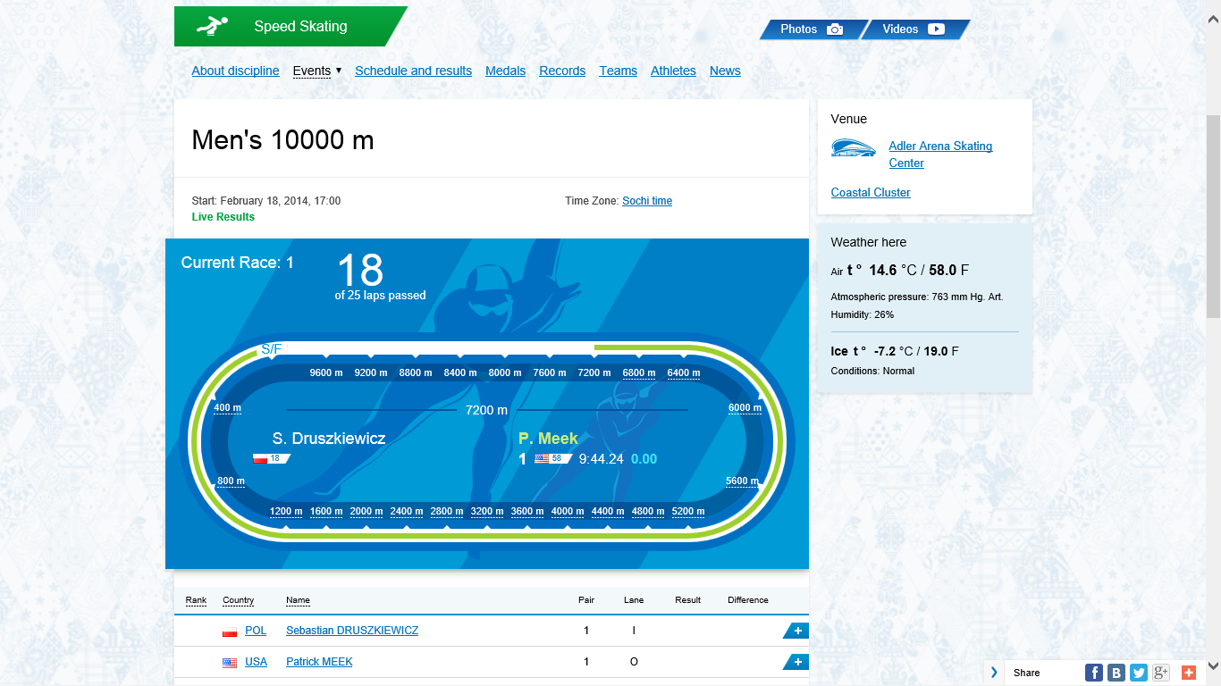
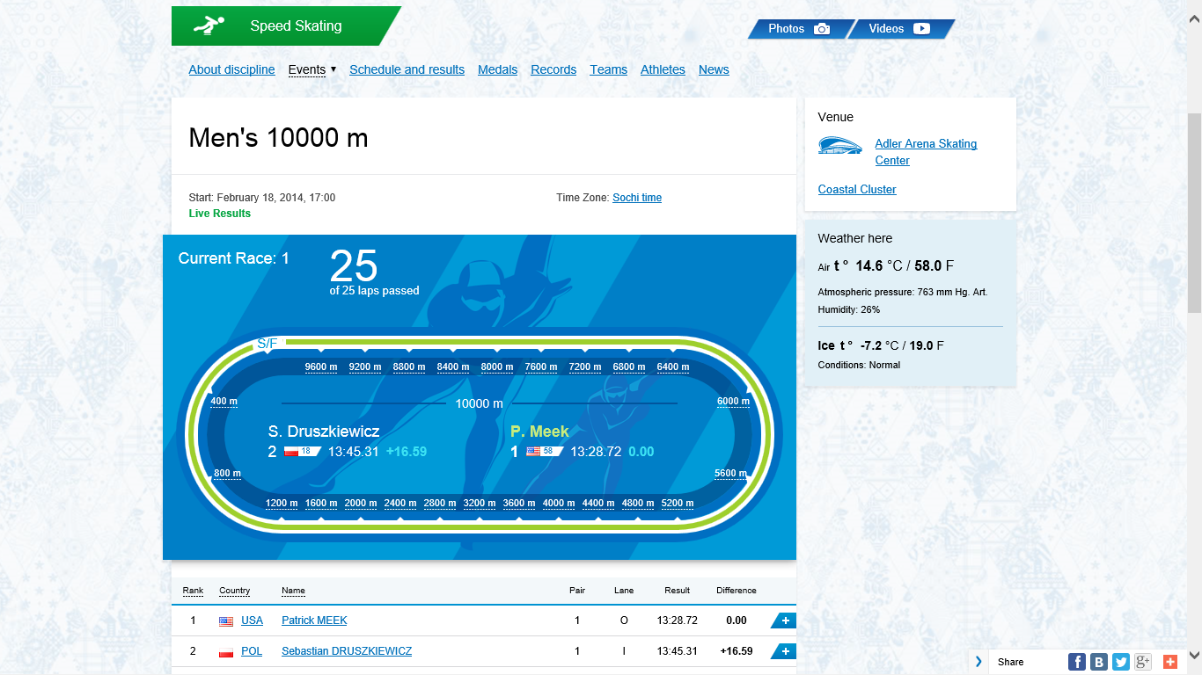

Slide 43

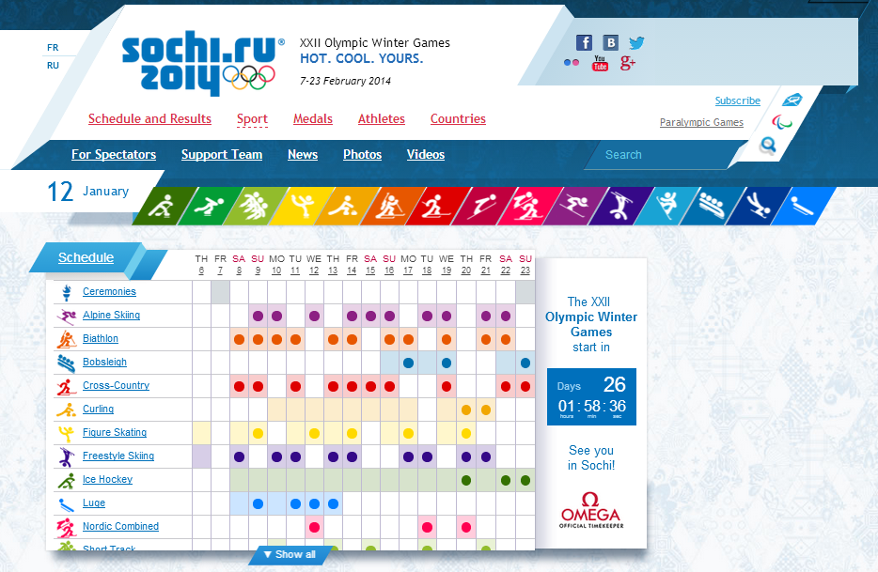







Sochi 2014 Web Platform
v
v
{
sports: [ {
cod: “Hck”, name: “Ice Hockey”, …
}, {
code: “Skj”, name: “Ski Jumping”, …
},
}
www.sochi2014.com
torchrelay.sochi2014.com
mapi.sochi2014.com
Notification Hub
Web App Firewall & Static CDN
Push notifications

Slide 44
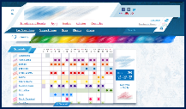
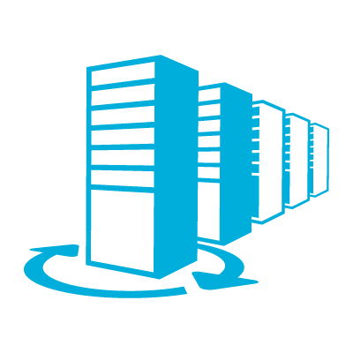
Big Picture
4 Subscriptions
80 Cloud services
80 Storage accounts
15 Service buses
9 VNets

Slide 45
As well as…
+25B requests hit Azure VMs (Cloud services)
Delivered +150 Million push notifications
+500 Million page views
+100 Million visits to the website

Slide 46






Architecture
Frontend
Backend
Results Cache Role
SQL Store
Results Role
Tables
Tables
Public WebRole
Sync WorkerRole
Qs
Backoffice Role
Users
Content editors
Olympic Data feed

Slide 47
Architecture
Frontend
Backend
Results Cache Role
SQL Store
Results Role
Tables
Tables
Public WebRole
Sync WorkerRole
Qs
Backoffice Role
Users
Content editors
Olympic Data feed

Slide 48
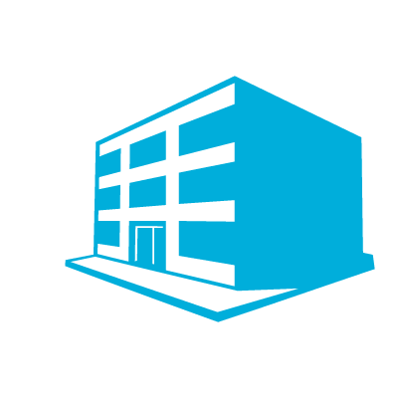

Architecture
W. Europe
N. Europe
W. US
W. Europe
N. Europe
E. Asia
Content Editors
Olympic Data Feed
Akamai Web App Firewall
sochi2014.com.akadns.net
sochi2014.com

Slide 49

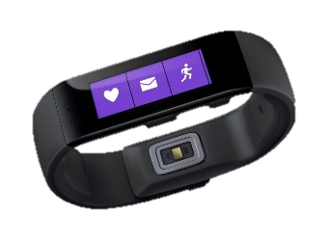


Ignite Azure Challenge Sweepstakes
Attend Azure sessions and activities, track your progress online, win raffle tickets for great prizes!
Aka.ms/MyAzureChallenge
Enter this session code online: BRK2486
NO PURCHASE NECESSARY. Open only to event attendees. Winners must be present to win. Game ends May 9th, 2015. For Official Rules, see The Cloud and Enterprise Lounge or myignite.com/challenge

Slide 50


Please evaluate this session
Your feedback is important to us!
Visit Myignite at http://myignite.microsoft.com
or download and use the Ignite Mobile App
with the QR code above.

