Slide 2
Successfully Deploy Windows 10 in the Enterprise Using System Center Configuration Manager
Deepak Kumar
deepak@adaptiva.com

Slide 4
Deployment Challenges For Massive Scale
PXE
IP helpers
DHCP scope options
Servers everywhere
Content distribution and storage
Huge content sizes, narrow WAN pipes
Servers everywhere
User state migration
Huge amount of data, narrow WAN pipes
Servers everywhere
Version control
Images change, so do all applications
Who should sync all images across 1000s of locations?
Servers everywhere

Slide 5
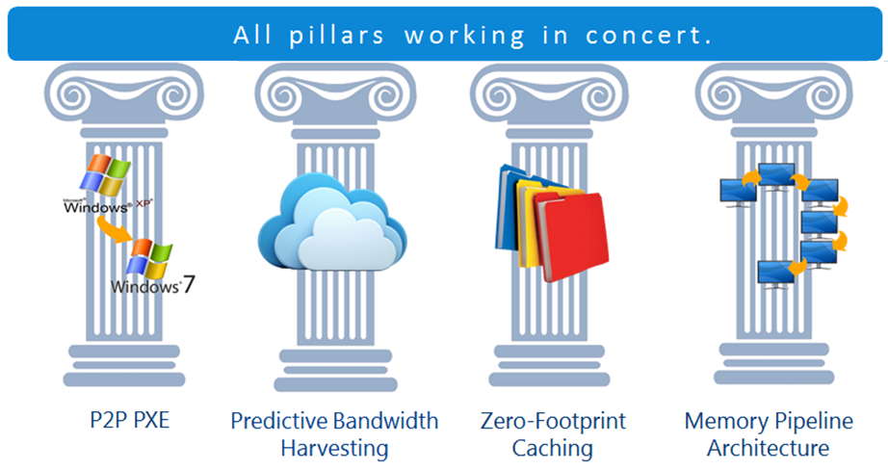
Four Technology Pillars

Slide 6
More Information info@adaptiva.com 425 823-4500 deepak@adaptiva.com

Slide 7
Please evaluate this session
Your feedback is important to us!
Visit Myignite at http://myignite.microsoft.com or download and use the Ignite Mobile App with the QR code above.

