Slide 2
Microsoft SQL Server on Azure Virtual Machines
BRK2553
Nosheen Syed Group Program Manager
Pravin Mittal Group Engineering Manager

Slide 3
Goal: Make Azure the best cloud platform to run SQL Server
    Best infrastructure: performance, scalability, availability, security, and deployment
    We give full complete control of the VMs but automate experiences
    Microsoft is well positioned to do this
    Azure evolves as needed by SQL Server & SQL Server leverages Azure optimally

Slide 4






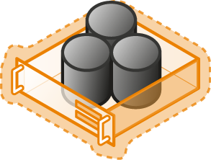


SQL Server Cloud Continuum
Hybrid
Cloud
On premises
Shared
Lower cost
SaaS
PaaS
Azure SQL Database
IaaS
Virtualized Databases
SQL Server in Azure VM
Virtual
Virtualized Machines
Dedicated
Higher cost
SQL Server Private Cloud
Physical
Virtualized Machines
SQL Server
Off premises
Physical Machines
High Control | High Maintenance
Low Control | Low Maintenance

Slide 5
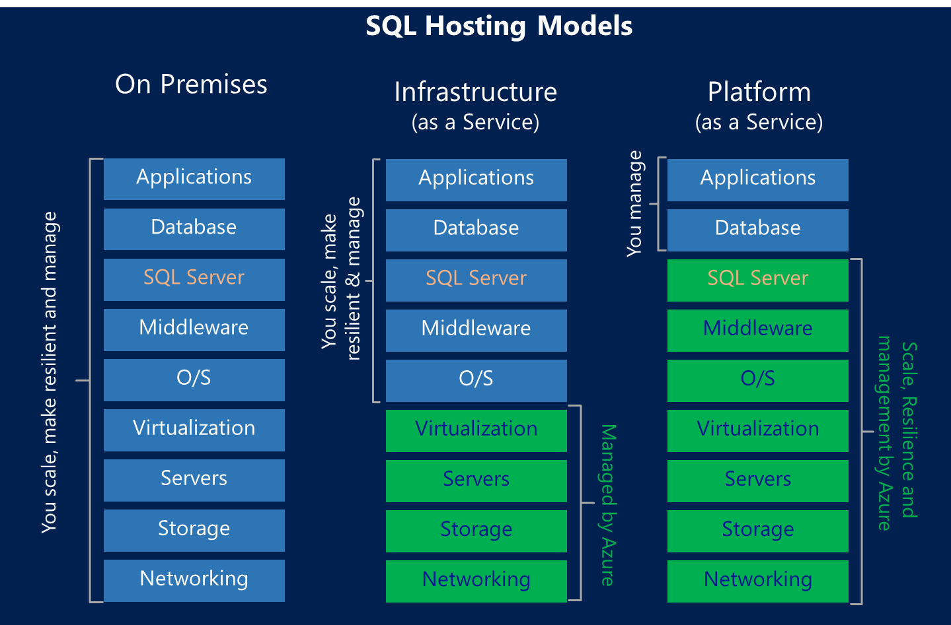
Hosting Choices for SQL Customers

Slide 6
SQL Server in Azure VM
Azure SQL Database
You access a VM with SQL Server
You manage SQL Server and Windows: High Availability, Backups, Patching (automation available)
Full on-premise compatibility
Different VM sizes: A0 (1 core, 1GB mem, 100GB) to G5 (32 cores, 512GB mem, 32TB)
VM availability SLA: 99.95%: In practice SQL AlwaysOn provides higher availability (~99.99%)
Reuse on-premise infrastructure (e.g. Active Directory)
You can run any SQL Server version and edition
You access a DB
DB is fully managed: High Availability, Backups, Patching
Runs latest SQL Server version, based on Enterprise edition
New paradigm of databases and modern app building
Different DB sizes: Basic (2GB, 5tps) to Premium (500GB, 735tps)
DB availability SLA: 99.99%

Slide 7



Microsoft Azure VMs
    VMs hosted on Microsoft Azure Infrastructure (“IaaS”)
      From Microsoft images or your own images
      Fast provisioning (~10 minutes)
      Accessible via RDP and Powershell
    Pay per use
      Per minute (only when running)
      Cost depends on size and licensing (You can use your existing SQL licenses)
      Network: only outgoing (not incoming)
      Storage: only used (not allocated)
    Elasticity
      1 core / 2GB mem / 1TB ← → 32 cores / 512 GB mem / 32TB

Slide 8
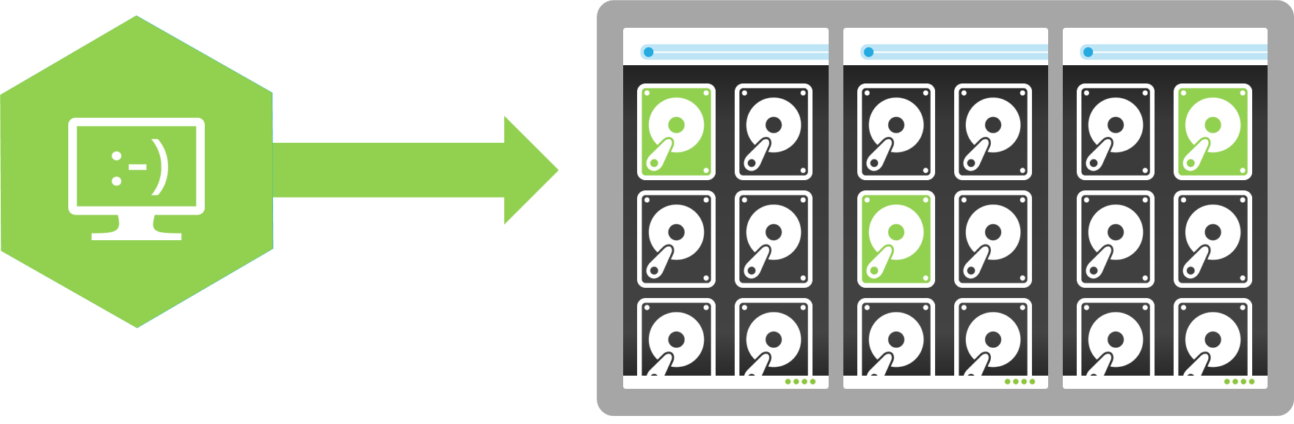
Microsoft Azure VMs - Storage
    Every VM disk is a BLOB in Azure Storage
    3 sync local copies
    No data loss
    Highly available (transparent to VM)
    3 more async remote copies (if geo-replication enabled)
    For disaster recovery (manually managed by Microsoft)

Slide 9




Microsoft Azure VMs - Availability
    SLA: No data loss
    If VM becomes unavailable, restart in another host
    SLA: 1 of 2 VMs in Availability Set:
    99.95% (<22 min downtime p/month)
    Includes
      Planned downtime due to (monthly) host OS servicing
      Unplanned downtime due to physical failures
    Doesn’t include servicing of guest OS or software inside (e.g. SQL)
    SQL AlwaysOn provides higher availability
    If one SQL VM becomes unavailable, SQL fails over to another VM: ~20s
    Based on customer feedback/Telemetry: 99.99% (<4 minutes of downtime)
Witness
VM
S
S
P
P
VM
VM

Slide 10
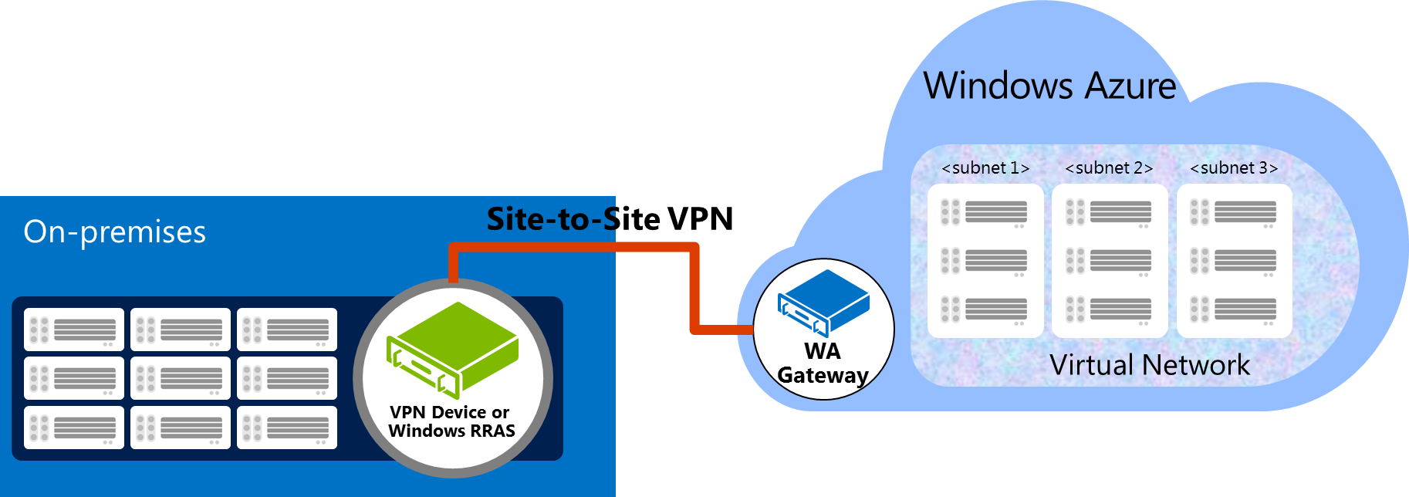



Microsoft Azure VMs - Connectivity
    Over the Internet
    Endpoints for connectivity
    Over a site-to-site tunnel
    Secure tunnel
    Extend on-premise network to Azure
      Can join Azure VMs to on-premise domain
    VPN Device / Windows Server RRAS

Slide 11
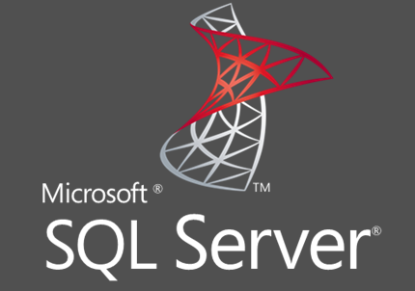
SQL Server in Azure VMs
    Many SQL versions supported
  SQL 2014 (Enterprise / Standard / Web)
  SQL 2012 (Enterprise / Standard / Web)
  SQL 2008 R2 (Enterprise / Standard / Web)
  On-Demand version support as needed
    Optimized images
  Transactional Processing or Data Warehousing
  Implement multiple optimizations (e.g. storage pools with multiple disks, best stripe sizes, disk caching, SQL traceflags)
    (Almost) 100% compatibility
      SQL Failover Clusters coming soon..

Slide 12
Recent Enhancements
Performance
    G-Series VMs (largest VM sizes in the market: up to 32 cores & 512 GB memory)
    SSD support for TempDB and BPE (higher performance)
    Provisioned IOPs (5,000 8K IOPs p/disk at 1-5ms latency)
    SQL Snapshot Backups (instantaneous backups on Azure Storage)
Business Continuity
    AlwaysOn Gallery Template support replicas in remote regions (DR and Read-ScaleOut)
    Security
  SQL Database Encryption and Backup Encryption support Azure Key Vault
  Support Azure Active Directory (allow SQL service and clients to use AAD accounts, without deploying domain controllers)
Deployment
  Optimized Gallery Images for OLTP and for DW (Implement best practices)
  AlwaysOn Gallery Template (easy deployment)
Management
  Monitoring of SQL counters in Portal
  Automated Patching (OS and SQL are patched within specified window)
  Automated Backup (backups are taken based on workload)

Slide 13
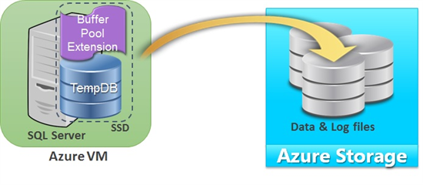
SQL Server in Azure VMs – Performance
SSD support for TempDB and Buffer Pool Extensions
  D-Series VMs come with local SSDs (up to 800GB)
    SSDs provide high throughput (~32,000 IOPs) at low latency (<1ms)
  Improve performance of SQL workloads
    That use TempDB heavily (e.g. queries handling large recordsets, index rebuilds, temp tables, row versioning isolation levels, ..)
    That don’t fit in memory
USE MASTER
GO
ALTER DATABASE tempdb MODIFY FILE (NAME= tempdev, FILENAME= 'D:\tempdb.mdf')
GO
ALTER DATABASE tempdb MODIFY FILE (name = templog, filename = 'D:\templog.ldf')
GO
ALTER SERVER CONFIGURATION
SET BUFFER POOL EXTENSION ON
( FILENAME = 'D:\ExtensionFile.BPE' , SIZE = <size> [ KB | MB | GB ] )

Slide 14
SQL Server in Azure VMs – Performance
Premium Storage
  High throughput (up to 50,000 IOPs, 6x more than Standard Storage)
  Low latency (1-5ms, 10x less than Standard Storage)
  SSD disks in the backend
  Local SSD-based cache (up to 800 GB)
VM Size | CPU cores | Max. IOPS | Max. Disk Bandwidth
STANDARD_DS1 | 1 | 3,200 | 32 MB per second
STANDARD_DS2 | 2 | 6,400 | 64 MB per second
STANDARD_DS3 | 4 | 12,800 | 128 MB per second
STANDARD_DS4 | 8 | 25,600 | 256 MB per second
STANDARD_DS11 | 2 | 6,400 | 64 MB per second
STANDARD_DS12 | 4 | 12,800 | 128 MB per second
STANDARD_DS13 | 8 | 25,600 | 256 MB per second
STANDARD_DS14 | 16 | 50,000 | 512 MB per second
SAT | Backups (2.1 TB Database) | Restores (2.1 TB Database) | Database Creation (1 TB for Transaction Log)
Normal Storage | 24 hrs | 36 hrs | 10 hrs
Premium Storage | 6 hrs | 1.2 hrs | 30 min

Slide 15
XIO Demo

Slide 16

SQL Server vNext: Backup to Azure with File Snapshots
Super fast backups for databases storing Data Files directly in Azure Storage
Based on Azure Storage Snapshots (create pointer to files instead of read and write log)
Still allows point-in-time restore
SQL Server
Windows Azure Storage
Database
MDF
MDF
LDF
LDF
BAK
Azure VM
BACKUP DATABASE database TO
URL = N'https://<account>.blob.core.windows.net/<container>/<backupfileblob1>‘
WITH FILE_SNAPSHOT

Slide 17
Snapshot Backup Demo

Slide 18
Public Gallery Component
- SQL Server version / ship cycle independent
- Published on Azure gallery
- Installed during Provisioning / Runtime
- Automatic Hotfix / Minor version upgrade
Configuration Management
- SysAdmin on Azure M SQL Server instance
- Azure Active Directory (no public endpoint)
- JSON based configurations
- Portal, PowerShell, CSM, RDFE support
Azure Portal & Tools
- Integrated Portal Heartbeat and Status
- Azure PowerShell Cmdlets
- Azure Portal support
SQL IaaS Agent

Slide 19
SQL IaaS Agent
Plug-In Design
- Multiple Features Support (plug-ins)
- Each feature exposes a configuration JSON
data model
- User can send configuration to a specific
or all features
- Feature specific status reporting accessible
via Azure Portal and PowerShell
- No Major Version upgrade required to
deploy a new feature

Slide 20
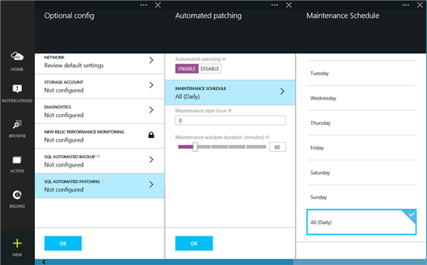
SQL Server in Azure VMs – Management
Automated Patching
  Predictable solution for patching (Windows & SQL)
  Simple: just specify a time window
  Built on top of Windows Update
  Supported in Portal and Powershell

Slide 21
SQL Server in Azure VMs – Management
Automated Backup
  For all DBs in the SQL instance
  Simple: just specify a retention period
  Supports Compression and Encryption
  Supported in Portal and Powershell

Slide 22
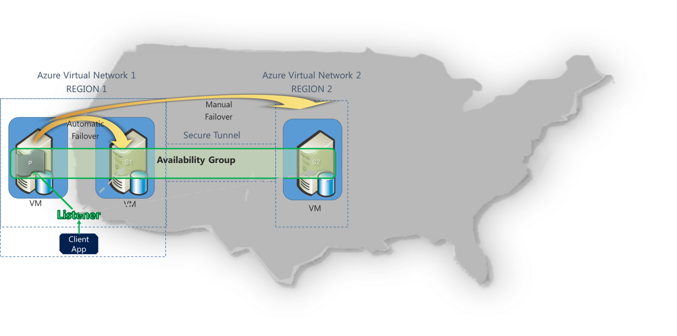
SQL Server in Azure VMs – Business Continuity
SQL Server Disaster Recovery
  Configure an AlwaysOn Availability Group between VMs in different regions
  Communications between replicas is secure
  Manual Failover (~15 seconds). Test it at any time!

Slide 23
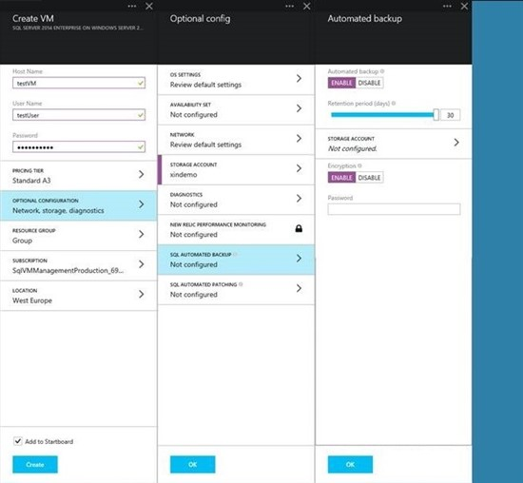
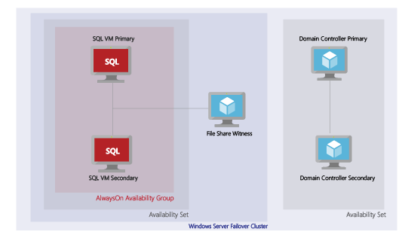
SQL Server in Azure VMs – Deployment
AlwaysOn Gallery Template
  Provision an AlwaysOn deployment
    To a new/existing Windows Domain
  Fast: 30 min (manually: ~3 hours)
  Easy: Just specify a name for the deployment and the Listener

Slide 24
Auto* Demo

Slide 25





















“SQL Server on Azure VM is 100% compatible with our on-premise SQL Server. This reduced the time required to migrate apps from our data centers to days instead of weeks. In addition, Azure’s Express Route allows us to reuse our on-premise domain users and policies for our SQL Servers in Azure”
“SQL Server on Azure VM with 2 AlwaysOn local replicas and one remote replica guarantees the uptime that our customers expect. Even in case of a disaster we can failover across data centers in 30 seconds. There is no way we could achieve a comparable level of redundancy ourselves”
“SQL Server on Azure VM and the SQL 2014 Enterprise features allows us to successfully run the tax filing/processing system for 150 million invoices per day. Compression, Data Partitioning, and Data Files on Azure Storage enable us to scale on databases that grow various TBs p/month. In addition, with AlwaysOn we achieve 99.99% availability”

Slide 26
SQL Server integrates cloud services from Azure better than any other cloud platform providing end-to-end experiences that are optimized and use familiar interfaces

Slide 27
Questions ?

Slide 28


Please evaluate this session
Your feedback is important to us!
Visit Myignite at http://myignite.microsoft.com
or download and use the Ignite Mobile App
with the QR code above.

Slide 30
Appendix

Slide 31
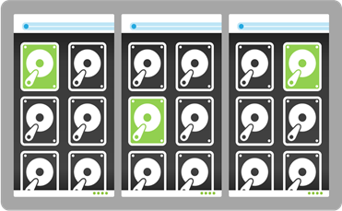
Cloud resources
Azure Storage
    Unlimited storage
    No data loss
      3 local sync copies and 3 remote async copies
      Automated data verification
    Highly available (transparent request routing)
    Low cost: $0.02 p/GB/month
Azure VMs
    VMs hosted in Azure
    Created from Microsoft Gallery Images or your own Images
    Elastic: 1 core, 2 GB RAM, 1 TB data → 16 cores, 56 GB RAM, 16 TB data
    Highly available (automated VM healing)
    Cost: $0.40 p/h for SQL Standard on 4-core, 8GB RAM
VM

Slide 32


Accessing cloud resources
  Over the Internet
      Public endpoints
      Free
  Over a site-to-site VPN tunnel
      VPN Device or Windows Server RRAS
      Encrypted (IKE, AES)
      ~8MB p/sec (480MB p/min, 28GB p/hour)
      Free

Slide 33
Auto Patching Demo

Slide 34
Auto Backup Demo

Slide 35
Auto-HA
Fully automated deployment of a complete SQL AlwaysOn cluster on Azure
Simple Azure Portal \ PowerShel deployment (40 min) for a very complex feature
User can deploy new DC or use existing DC on Azure
Supports Standard and Premium Azure storage
Does not require Brooklyn \ ExpressRoute tunnel, or public endpoints.
Deployment can be configured with a DR replica on different Azure region.

Slide 36
Auto HA Demo

Slide 37
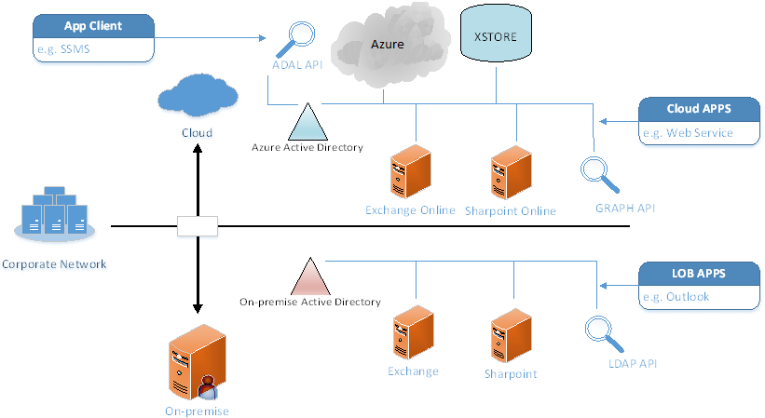
Azure Active Directory (AAD)

Slide 38
SSMS AAD Integration
Sign-in using Azure user account
(managed & federated)
Common UX experience for all Azure tools in SSMS
Supports multi-tenancy (user session is based on Windows login id)
Uses existing Windows secure store to store session token
Integrated with SSMS user settings (last selected subscription)
Eliminated certificate & storage keys to login to Azure cluster

Slide 39
Q&A

Slide 40
Auto-Patching
SQL IaaS Agent
Provides predictable VM Guest OS update
Configurable maintenance schedule and duration
Patching Status on Azure Portal
Based on Windows Update API
Securely accessible via Azure Portal and Management API
Available during VM provisioning and runtime
Supports System Restore
Independent of SQL Server version

Slide 41
Auto-Backup
SQL IaaS Agent
Available for SQL14 Servers
Configure SQL Managed Backup (Azure storage)
Configurable backup retention period
Support Encrypted backup
Report SQL backup status available on Azure Portal
Securely accessible via Azure Management API
Available during VM provisioning and runtime

Slide 42
Coming Enhancements
Performance
  Provisioned IOPs (5,000 8K IOPs p/disk at 1-5ms latency)
  SQL Snapshot Backups (instantaneous backups on Azure Storage)
Business Continuity
  Support for SQL Clusters (another HA option, 100% on-prem compat using Azure files)
  Soft Host Reboots (reduce VM downtime during host upgrades from 10 minutes to 1 minute)
  API to detect and delay a coming host upgrade (allowing SQL operations to complete)
Deployment
  AlwaysOn Gallery Template support replicas in remote regions (DR and Read-ScaleOut)
  Support Azure Active Directory (allow SQL service and clients to use AAD accounts, without deploying domain controllers)
Management
  Advisor Service (Analyze best practices and allow applying them)
  Billing
  Simplify using your own SQL license for a new/existing VM

