Slide 2

Please tweet using any of these #tags
#PowerBI,
#MSIgnite,
#msbirocks,
#mspowerbi

Slide 3
Microsoft BI Overview
BRK2556
Kamal Hathi
Partner Director Program Management

Slide 4
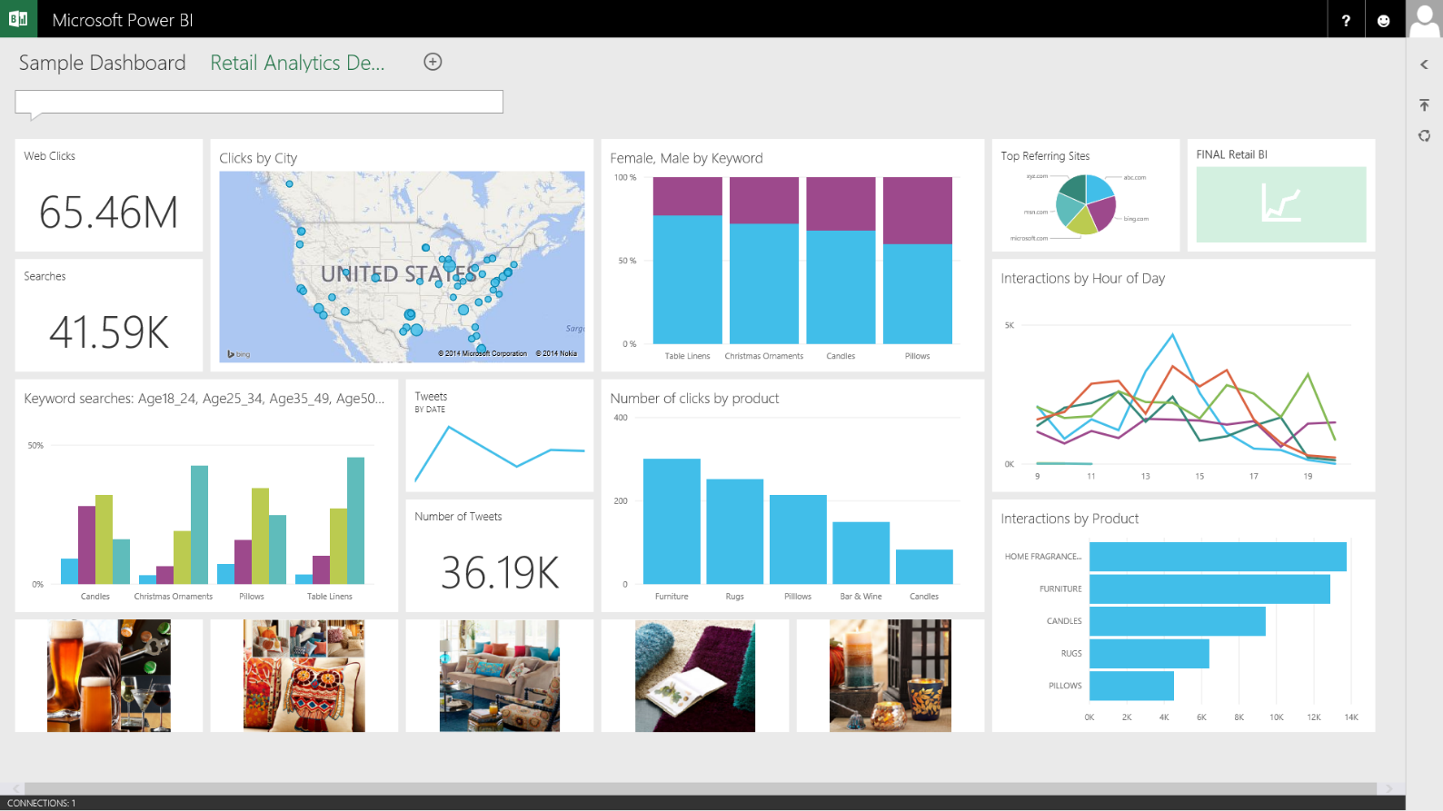
2015

Slide 5

1996

Slide 6
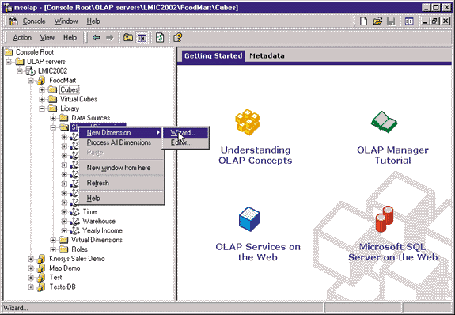

Slide 7
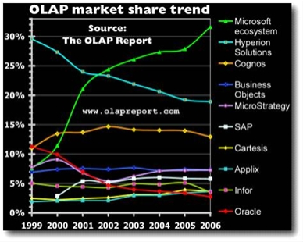

Slide 8
Technical BI

Slide 9
Yes, We Can!
2008

Slide 10

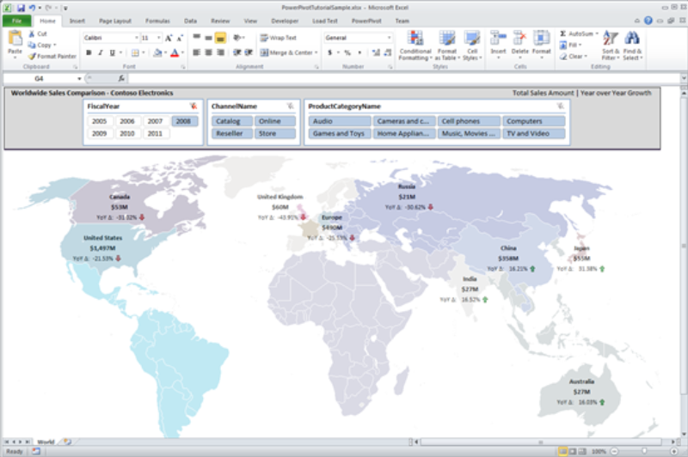


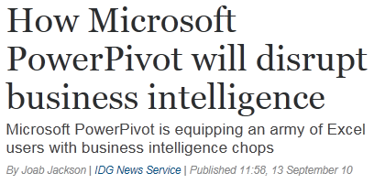
Power Pivot
2010 Products of the Year: PowerPivot
One of my favorite products of the year was Microsoft's free add-in for Excel 2010, PowerPivot. …
“PowerPivot to BI is what the printing press was to literacy…”

Slide 11
Self Service BI

Slide 12
1st Wave
Technical BI
2nd Wave
Self Service BI
3rd Wave
End User BI
IT
End User
Analyst
End User
Everyone

Slide 13


How SaaS has shaped markets
\\fileshare
BI

Slide 14
3rd Wave of BI: Everyone
Technical BI
Self Service BI
End User BI

Slide 15
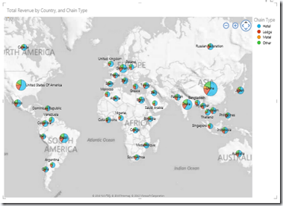
BI on your
terms

Slide 16
Empowering IT & BI Pro

Slide 17
SQL Server
BI core investment areas
Hybrid BI
Modern
Reports
Enhanced
analysis
Mobile BI

Slide 18
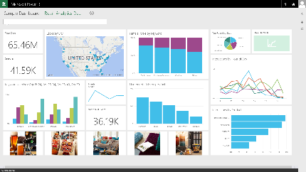
Hybrid
Easily connect to Power BI
Live Power BI reports & dashboards
    Faster time to insight with a hybrid BI solution
    Manage and secure data on-premises with SQL Server Analysis Services
    Scheduled refresh of data stored in Power BI
Live
Query
Scheduled
Refresh
Cloud
On-premises
SQL Server
Analysis Services
Data

Slide 19

Enhanced Analysis- Tabular
SQL Server 2016 Analysis Services
  Advanced modeling
  (M:M, BI Directional Cross Filtering)
  Time intelligence
  New DAX functions
  Performance
  (Query and Metadata operations)
  Parallel Partition Processing

Slide 20
Enhanced Analysis - Multidimensional
SQL Server 2016 Analysis Services
  Netezza as a Data Source
  Performance improvements
  DBCC support

Slide 21
SQL Server 2016
Reporting Services
Run in modern browsers
Improved parameters
Modern themes
New chart types

Slide 22
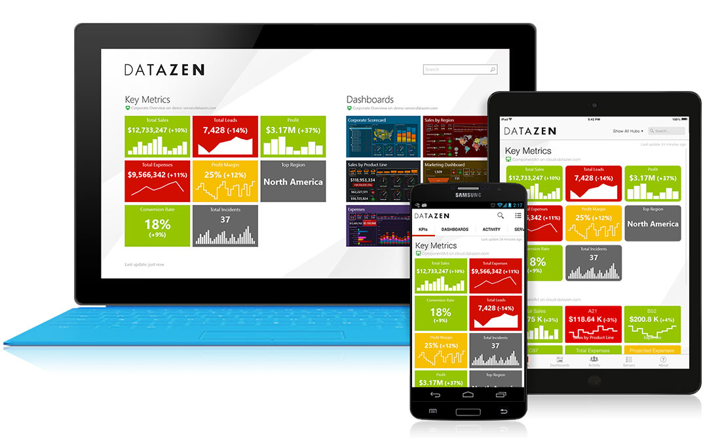
DATAZEN
Mobile BI Apps for SQL Server
  For solutions implemented on-premises.
  Rich, interactive data visualization on all major mobile platforms
  Download at no additional cost for SQL Server Enterprise Edition customers 2008 or later and Software Assurance

Slide 23
Demo: DATAZEN

Slide 24
Empowering the Business Analyst

Slide 25
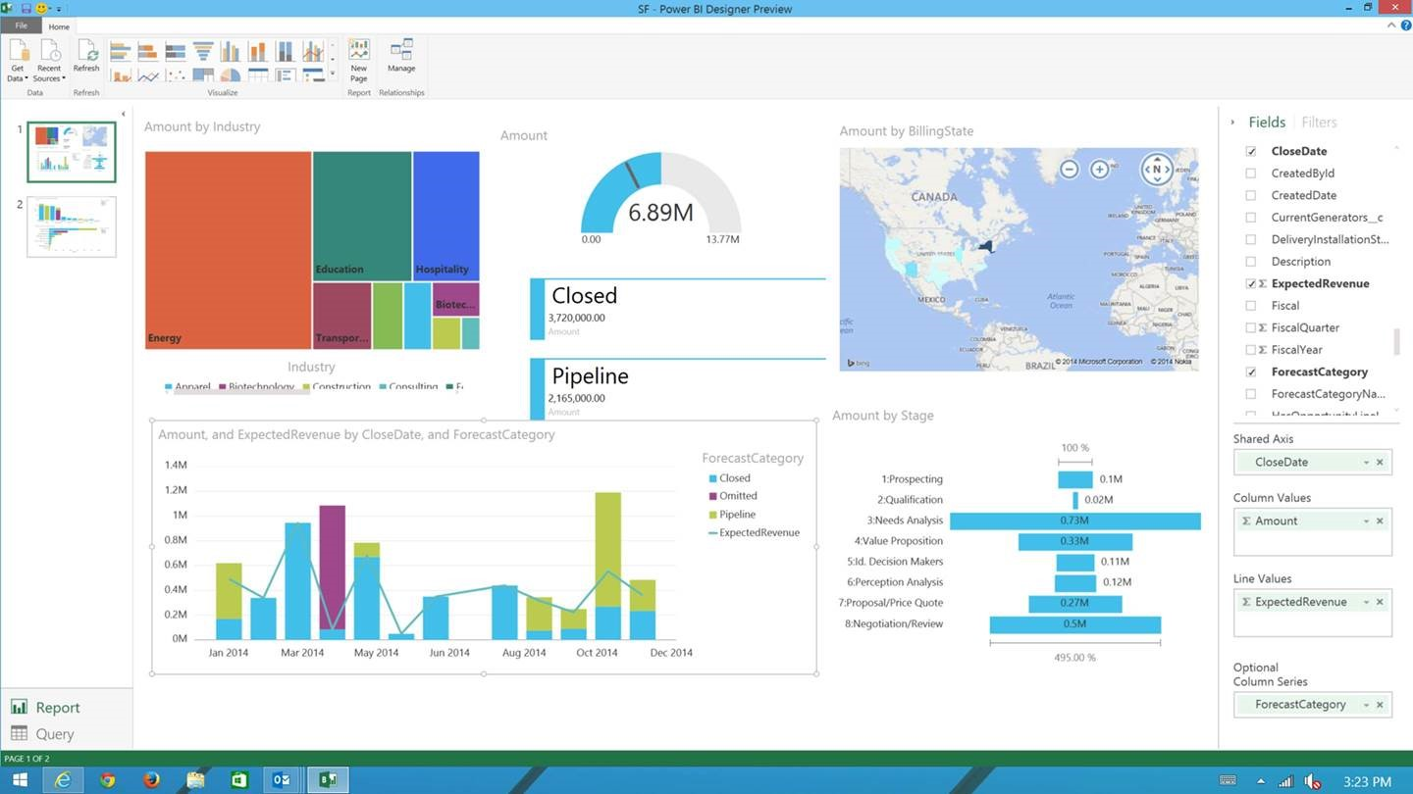
Power BI Designer
A freely downloadable 32/64bit desktop companion optimized for use with the Power BI Service.
Visual data exploration and reporting tool complementary to Excel.
Combines the power of Power Query, Power Pivot & Power View.
Effortlessly publish and share interactive visual reports to users of Power BI
Power BI Designer is a visual data exploration and reporting tool

Slide 26
Demo: Power BI Designer
Sanjay Soni

Slide 27
Empowering Business Users

Slide 28
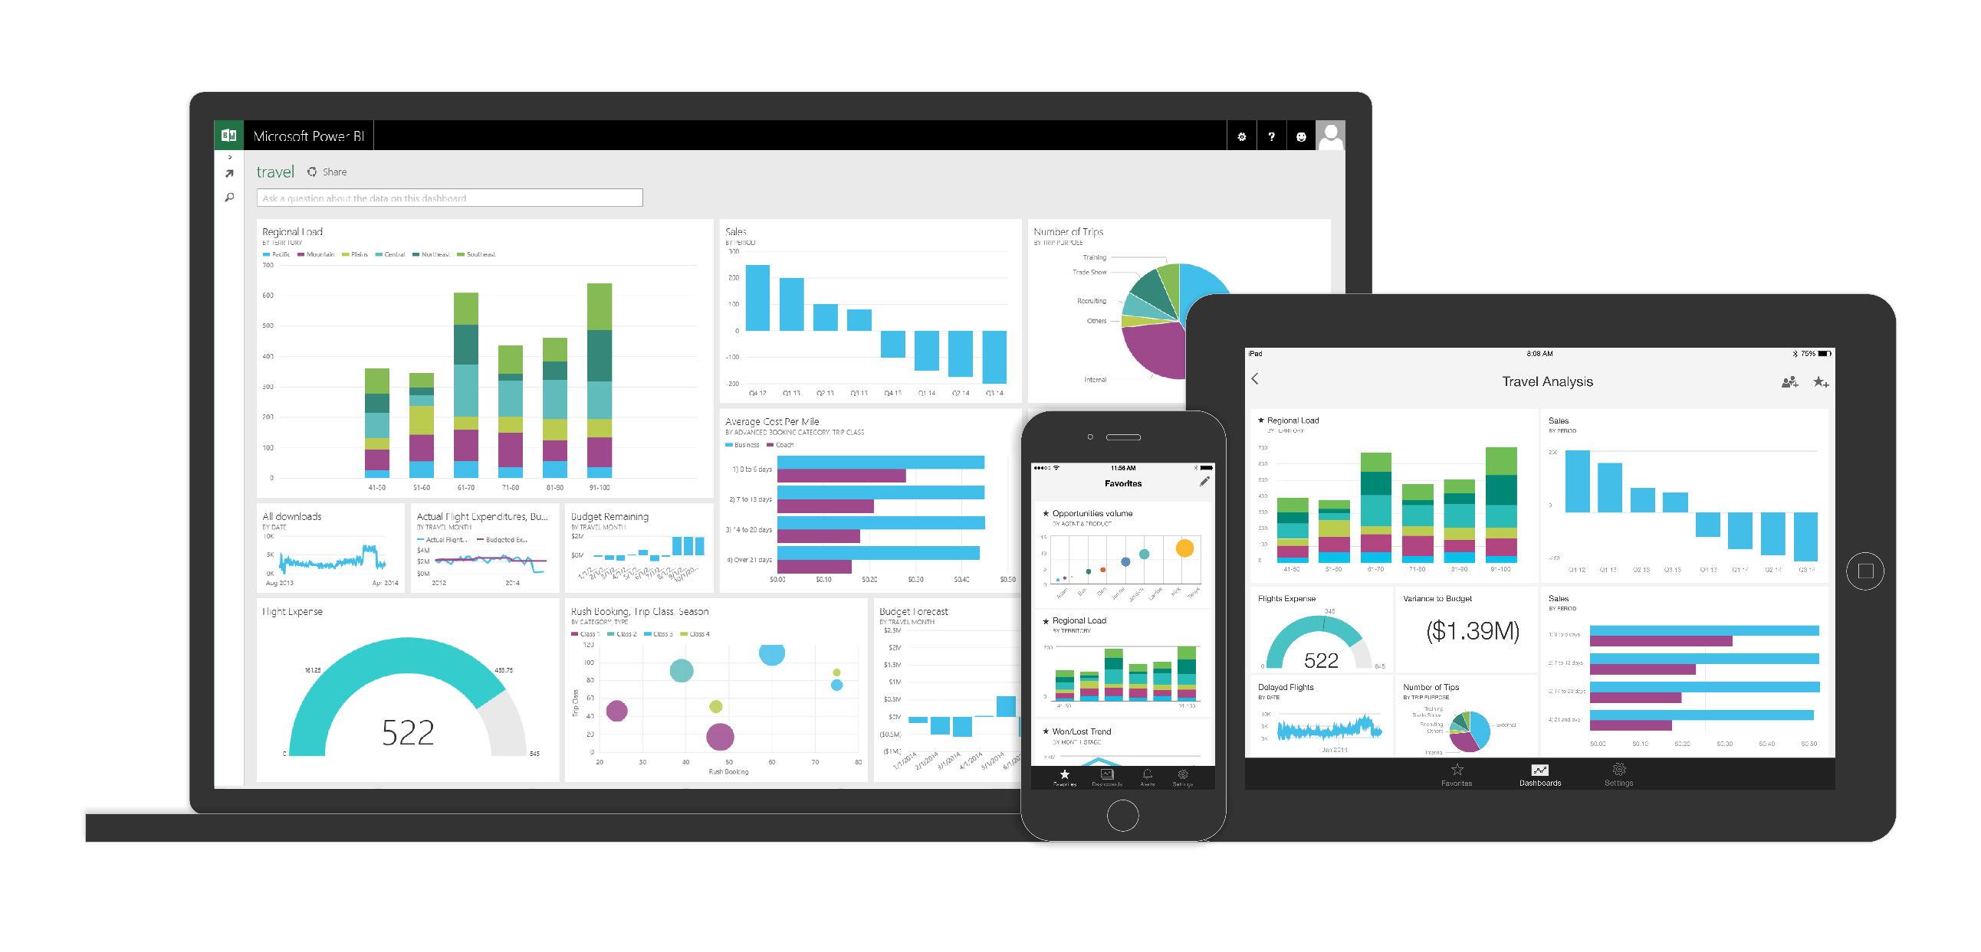
Power BI

Slide 29
Demo: Power BI

Slide 30
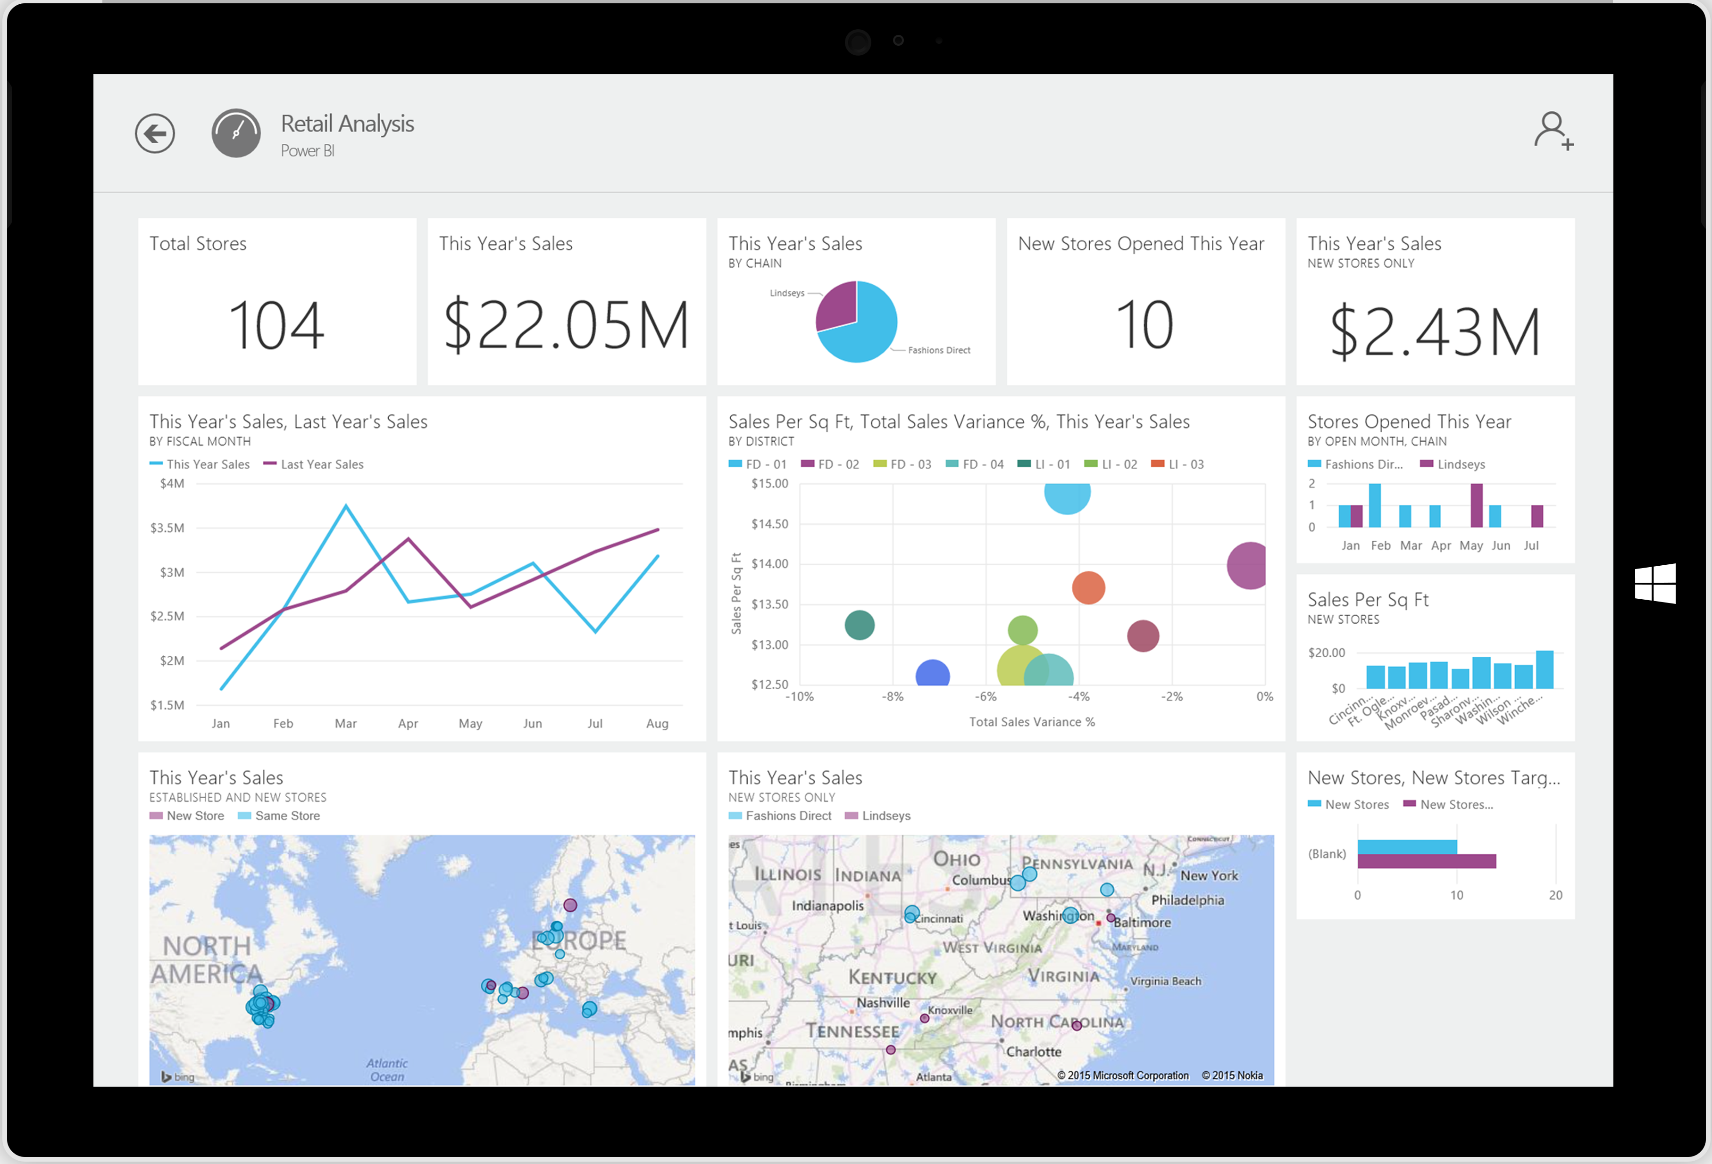

Power BI App for Windows 8 Desktop and Surface
Available on May 7th

Slide 31












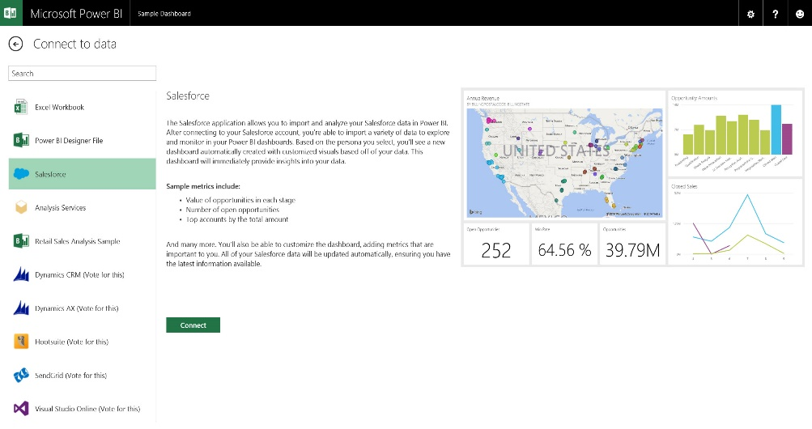

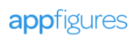


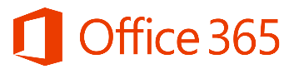







Get started quickly
Prebuilt content packs for popular services
TODAY
Dynamics Marketing
COMING SOON
* Some solutions not yet available in preview

Slide 32



VISUALIZE + DECIDE
Apps
Reports
Dashboards
Ask
Mobile
TRANSFORM + ANALYZE
Orchestration
Extract, transform, load
Information management
Prediction
The Microsoft
data platform
COLLECT + MANAGE
Relational
Non-relational
Analytical
Streaming
Internal & external
{ }
✓

Slide 33
Demo: End to End
Patrick Baumgartner

Slide 34
It’s easy to get started…
PowerBI.com

Slide 35
Investment across all BI waves
1st Wave
Technical BI
2nd Wave
Self Service BI
3rd Wave
End User BI
IT/BI PRO
Business Analyst
Everyone

Slide 36
Our BI Sessions at this conference
Title | Date/Time | Location
Power BI Overview | Tuesday, 10:45am | N426
Microsoft SQL Server BI Drill Down | Tuesday, 01:30PM | S104
End to end Microsoft Business Analytics solution - Real world scenario and demo | Wednesday, 03:15PM | S102
Advanced modelling and calculations using the Power BI designer | Thursday, 10:45am | N230
Power BI for developers | Thursday, 5:00pm | N228
Power BI labs Instructor Led | Tuesday, 10:45AM | ILL2550
Hands on Labs Creating a Microsoft Power BI Dashboard | On-Demand | HOL2555
Creating a Microsoft Power BI Designer Solution | On-Demand | HOL2557

Slide 37


Please evaluate this session
Your feedback is important to us!
Visit Myignite at http://myignite.microsoft.com
or download and use the Ignite Mobile App
with the QR code above.

