Slide 2
SQL Server In-Memory Overview
BRK2563
Kevin Farlee

Slide 3
Recent SQL Server Investments
In-Memory Technologies
Enhanced
High Availability
New Hybrid
Scenarios
Other investments
In-Memory OLTP
5-25x performance gain for OLTP integrated into SQL Server
Greater scaling
In-Memory DW
5-25x performance gain and high data compression
Updatable and clustered
Readable Secondary for Column Store
Always On Enhancements
Increased availability and improved manageability of active secondaries
Performance improvements
Online Database Operations
Increased availability for index/partition maintenance
Backup to Azure
Easy to implement and cost effective Disaster Recovery solution to Azure Storage
HA to Azure VM
Easy to implement and cost effective high availability solution with Windows Azure VM
Deploy to Azure
Deployment wizard to migrate database
Better together with Windows Server
WS2012 ReFS support
Online resizing VHDx
Hyper-V replica
WS 2012 R2 support
Windows Server 2016 support
Extending Power View
Enable Power View on existing analytic models and support new multi-dimensional models.

Slide 4
SQL Server In-Memory Technology
In-Memory Technologies
Applicable to
Transactional workloads:
Concurrent data entry, processing and retrieval
In-Memory OLTP
5-20X performance gain for OLTP integrated into SQL Server
In-Memory DW
5-25X performance gain and high data compression
Updatable and clustered
Applicable to
Decision support workloads:
Large scans and aggregates

Slide 5
Outline
In-Memory OLTP Overview
Motivating trends – hardware, software, apps
In-memory OLTP architecture & integration into SQL Server
Performance and customer results
New in SQL Server 2016
In-Memory Data Warehousing Overview
Scenarios
Benefits
How it works
New in SQL Server 2016

Slide 6
Why In-memory OLTP (aka Hekaton)
Customer demand for ever higher throughput and performance OLTP at a lower cost
Hardware trends demand architectural changes on RDBMS to meet those demands
In-memory OLTP is:
High performance,
Memory-optimized OLTP engine,
Integrated into SQL Server and
Architected for modern hardware

Slide 7
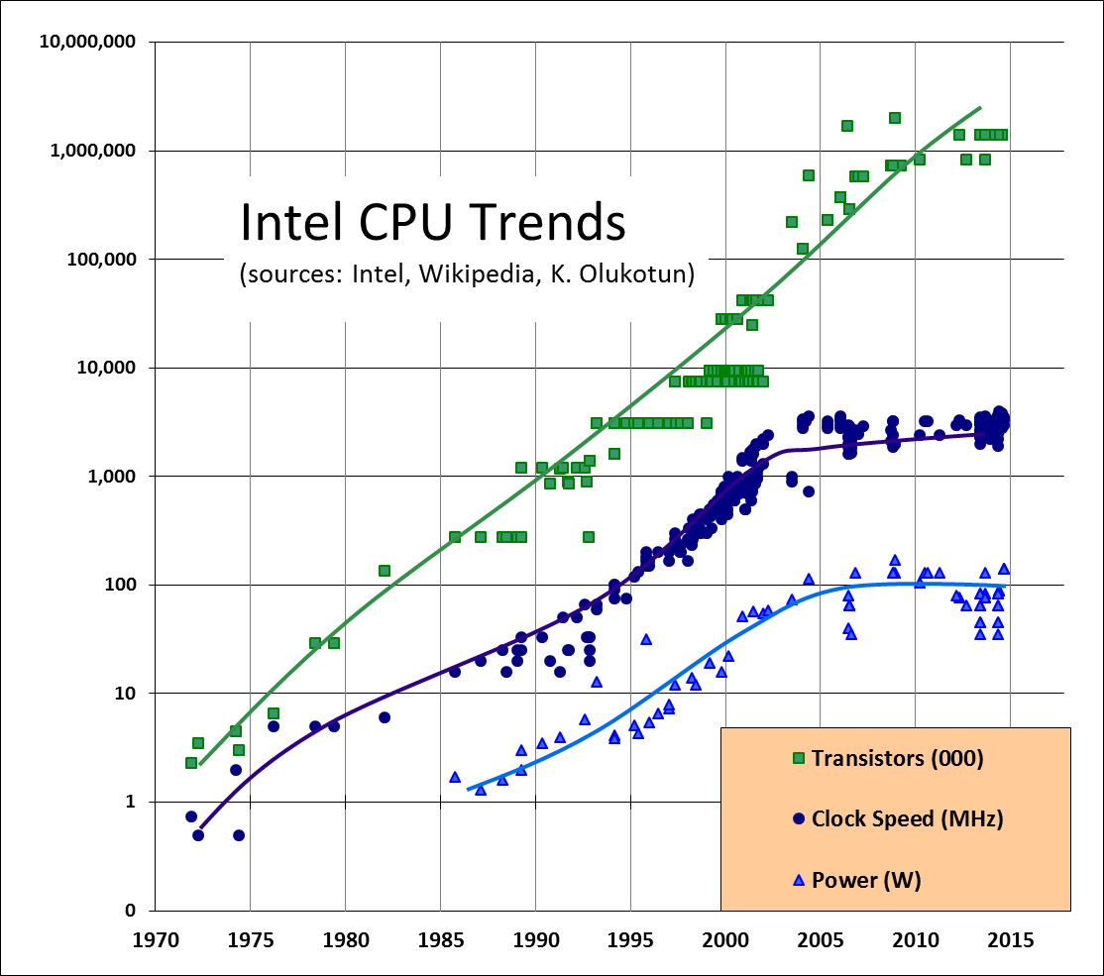
Hardware Trends
Moore’s Law on total CPU processing power holds but in parallel processing…
New CPU won’t run a short transaction much faster
CPU clock rate stalled…
Because processors would melt…
Meanwhile RAM cost continues to drop

Slide 8
Outline
In-Memory OLTP Overview
Motivating trends – hardware, software, apps
In-memory OLTP architecture & integration into SQL Server
Performance and customer results
In-Memory Data Warehousing Overview
Scenarios
Benefits
How it works
Coming in SQL Server 2016

Slide 9
In-Memory OLTP Architectural Pillars
Principles
Performance-critical data fits in memory
Push decisions to compilation time
Conflicts are Rare
Built-In
Architectural Pillars
Main-Memory Optimized
T-SQL Compiled to Native Machine Code
Non-Blocking Execution
SQL Server Integration
Direct pointers to rows
Indexes exist only in memory
No buffer pool
No write-ahead logging
Stream-based storage
T-SQL compiled to machine code leveraging VC compiler
Procedure and its queries, becomes a C function
Aggressive compile-time optimizations
Multi-version optimistic concurrency control, full ACID support
Lock-free data structures
No locks, latches or spinlocks,
No I/O in transaction
Same manageability, administration & development experience
Integrated queries & transactions
Integrated HA and backup/restore
Results
In-memory cache speed with capabilities of a database
Queries & business logic run at native-code speed
Transactions execute to completion without blocking
Hybrid engine and integrated experience

Slide 10
In-Memory OLTP: Integration and Application Migration
Application
Few improvements in comm layers
TDS Handler and Session Management
Key
SQL Server.exe
Existing SQL Component
Parser, Catalog, Optimizer
Execution Plan cache for ad-hoc T-SQL and SPs
Native-Compiled SPs and Schema
Hekaton Compiler
20-40x more efficient
Real Apps see 2-30x
T-SQL Interpreter
Hekaton Component
Access Methods
Hekaton Engine: Memory_optimized Tables & Indexes
Generated .dll
Non-durable Table option
Query Interop
Buffer Pool
T1
T2
T3
Tables
Reduced log contention; Low latency still critical for performance
T1
T2
T3
Indexes
Memory-optimized Table Filegroup
Transaction Log
Data Filegroup
T1
T2
T3
T1
T2
T3
T1
T2
T3
T1
T2
T3

Slide 11
Create Table DDL
CREATE TABLE [Customer](
[CustomerID] INT NOT NULL
PRIMARY KEY NONCLUSTERED HASH WITH (BUCKET_COUNT = 1000000),
[Name] NVARCHAR(250) NOT NULL,
[CustomerSince] DATETIME NULL
INDEX [ICustomerSince] NONCLUSTERED
INDEX [ICustomerID-Since] NONCLUSTERED (CustomerID, CustomerSince)
)
WITH (MEMORY_OPTIMIZED = ON,
DURABILITY = SCHEMA_AND_DATA);
Hash Index
BUCKET_COUNT
Use 2x # of unique index key values
Indexes may be specified inline
NONCLUSTERED indexes are supported
Multi-Column indexes are supported
This table is memory optimized
This table is durable.
Non-durable tables:
DURABILITY=SCHEMA_ONLY

Slide 12
Memory Optimized Tables
Optimized for high-throughput OLTP
Optimized for in-memory

Slide 13
Create Procedure DDL
CREATE PROCEDURE [dbo].[InsertOrder] @id INT, @date DATETIME
WITH
NATIVE_COMPILATION,
SCHEMABINDING,
EXECUTE AS OWNER
AS
BEGIN ATOMIC
WITH
(TRANSACTION
ISOLATION LEVEL = SNAPSHOT,
LANGUAGE = 'us_english')
-- insert T-SQL here
END
This proc is natively compiled
Native procs must be schema-bound
Execution context is required
Atomic blocks
Create a transaction if there is none
Otherwise, create a savepoint
Session settings are fixed at create time

Slide 14
Outline
In-Memory OLTP Overview
Motivating trends – hardware, software, apps
In-memory OLTP architecture & integration into SQL Server
Performance and customer results
New in SQL Server 2016
In-Memory Data Warehousing Overview
Scenarios
Benefits
How it works
New in SQL Server 2016

Slide 15
Early Customer Performance Gains
Apps that take full advantage: e.g. web app session state
Apps with periodic bulk updates & heavy random reads
Existing apps typically see 4-7x improvement
Despite 20 years of optimizing for OLTP benchmarks – we still get 2x on a workload derived from TPC-C

Slide 16
Suitable Application Characteristics
Application is suited for in-memory processing
All performance critical data already fits in memory
Transaction locking or physical latching causing stalls and blocking
Application is “OLTP-Like”
Relatively short-lived transactions
High degree of concurrent transactions from many connections
Examples: Stock trading, travel reservations, order processing
Application migration simplified if
Stored procedures used
Performance problems isolated to subset of tables and SPs

Slide 17
Production Customers
Customer | App Pattern
SQL Common Labs Event Reporting | Shock Absorber
BWIN - Session State | Relational Cache
Saxobank | Read Scale
Baltika Breweries | OLTP
Edgenet | Read Scale
Derivco | Relational Cache
SBI Liquidity | OLTP
Plenty Of Fish | Read Scale
CareGroup | Shock Absorber

Slide 18
New in SQL Server 2016
Enhanced scaling
Greatly improved surface area
Security Enhancements
More scenarios supported
More platforms supported

Slide 19
Outline
In-Memory OLTP Overview
Motivating trends – hardware, software, apps
In-memory OLTP architecture & integration into SQL Server
Performance and customer results
New in SQL Server 2016
In-Memory Data Warehousing Overview
Scenarios
Benefits
How it works
New in SQL Server 2016

Slide 20
In-memory DW (ColumnStore)
Typical scenarios
Data is typically written once and read many times
Queries are against large amounts of data
Aggregating, filtering are common
Star & snowflake schemas are common using dimension and fact tables
New data is typically appended to fact tables

Slide 21
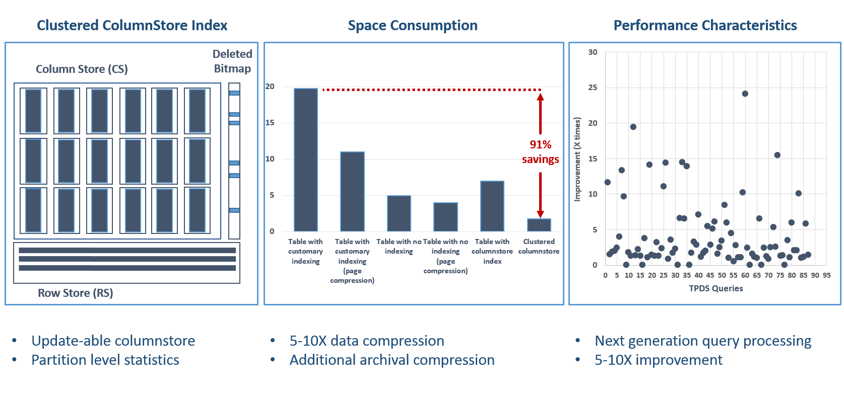
In-memory DW overview

Slide 22
Columnstore internals
Data stored as rows
Data stored as columns
C1
C2
C3
C4
C5
Benefits:
Improved compression:
Data from same domain compress better
Reduced I/O:
Fetch only columns needed
Improved Performance:
More data fits in memory
…

Slide 23
ColumnStore Index Example
OrderDateKey | ProductKey | StoreKey | RegionKey | Quantity | SalesAmount
20101107 | 106 | 01 | 1 | 6 | 30.00
20101107 | 103 | 04 | 2 | 1 | 17.00
20101107 | 109 | 04 | 2 | 2 | 20.00
20101107 | 103 | 03 | 2 | 1 | 17.00
20101107 | 106 | 05 | 3 | 4 | 20.00
20101108 | 106 | 02 | 1 | 5 | 25.00
20101108 | 102 | 02 | 1 | 1 | 14.00
20101108 | 106 | 03 | 2 | 5 | 25.00
20101108 | 109 | 01 | 1 | 1 | 10.00
20101109 | 106 | 04 | 2 | 4 | 20.00
20101109 | 106 | 04 | 2 | 5 | 25.00
20101109 | 103 | 01 | 1 | 1 | 17.00

Slide 24
1. Horizontally Partition (create Row Groups)
OrderDateKey | ProductKey | StoreKey | RegionKey | Quantity | SalesAmount
20101107 | 106 | 01 | 1 | 6 | 30.00
20101107 | 103 | 04 | 2 | 1 | 17.00
20101107 | 109 | 04 | 2 | 2 | 20.00
20101107 | 103 | 03 | 2 | 1 | 17.00
20101107 | 106 | 05 | 3 | 4 | 20.00
20101108 | 106 | 02 | 1 | 5 | 25.00
~1M rows
OrderDateKey | ProductKey | StoreKey | RegionKey | Quantity | SalesAmount
20101108 | 102 | 02 | 1 | 1 | 14.00
20101108 | 106 | 03 | 2 | 5 | 25.00
20101108 | 109 | 01 | 1 | 1 | 10.00
20101109 | 106 | 04 | 2 | 4 | 20.00
20101109 | 106 | 04 | 2 | 5 | 25.00
20101109 | 103 | 01 | 1 | 1 | 17.00

Slide 25
2. Vertically Partition (create Segments)
OrderDateKey
20101107
20101107
20101107
20101107
20101107
20101108
ProductKey
106
103
109
103
106
106
StoreKey
01
04
04
03
05
02
RegionKey
1
2
2
2
3
1
Quantity
6
1
2
1
4
5
SalesAmount
30.00
17.00
20.00
17.00
20.00
25.00
OrderDateKey
20101108
20101108
20101108
20101109
20101109
20101109
ProductKey
102
106
109
106
106
103
StoreKey
02
03
01
04
04
01
RegionKey
1
2
1
2
2
1
Quantity
1
5
1
4
5
1
SalesAmount
14.00
25.00
10.00
20.00
25.00
17.00

Slide 26
3. Compress Each Segment
OrderDateKey
20101107
20101107
20101107
20101107
20101107
20101108
ProductKey
106
103
109
103
106
106
StoreKey
01
04
04
03
05
02
RegionKey
1
2
2
2
3
1
Quantity
6
1
2
1
4
5
SalesAmount
30.00
17.00
20.00
17.00
20.00
25.00
OrderDateKey
20101108
20101108
20101108
20101109
20101109
20101109
RegionKey
1
2
1
2
2
1
ProductKey
102
106
109
106
106
103
StoreKey
02
03
01
04
04
01
Quantity
1
5
1
4
5
1
SalesAmount
14.00
25.00
10.00
20.00
25.00
17.00
Some segments will compress more than others
*Encoding and reordering not shown

Slide 27
4. Read The Data
SELECT ProductKey, SUM (SalesAmount)
FROM SalesTable
WHERE OrderDateKey < 20101108
OrderDateKey
20101107
20101107
20101107
20101107
20101107
20101108
ProductKey
106
103
109
103
106
106
StoreKey
01
04
04
03
05
02
RegionKey
1
2
2
2
3
1
Quantity
6
1
2
1
4
5
SalesAmount
30.00
17.00
20.00
17.00
20.00
25.00
OrderDateKey
20101108
20101108
20101108
20101109
20101109
20101109
RegionKey
1
2
1
2
2
1
ProductKey
102
106
109
106
106
103
StoreKey
02
03
01
04
04
01
Quantity
1
5
1
4
5
1
SalesAmount
14.00
25.00
10.00
20.00
25.00
17.00
Segment
Elimination
Column Elimination

Slide 28
Updatable Columnstore Index
Table consists of column store and row store
DML (update, delete, insert) operations leverage delta store
INSERT Values
Always lands into delta store
DELETE
Logical operation
Data physically remove after REBUILD operation is performed.
UPDATE
DELETE followed by INSERT.
BULK INSERT
if batch < 100k, inserts go into delta store, otherwise columnstore
SELECT
Unifies data from Column and Row stores - internal UNION operation.
“Tuple mover” converts data into columnar format once segment is full (1M of rows)
REORGANIZE statement forces tuple mover to start.
C1
C2
C3
C4
C5
C6
Delta (row)
store
C1
C2
C3
C4
C5
C6
Column
Store
tuple mover

Slide 29
ColumnStore: SQL Server 2016
Functionality:
Fast equality search and short-range scans
PK/FK enforcement
Coarser Concurrency
Locking Granularity – Impact MERGE load or UPDATES
No support of SI/RCSI
Full Support of MARS (no updates)
Improved Supportability
Performance and HA
Online Index Maintenance
Batch Operations for
SORT
Window Aggregates
Single Threaded Execution
String predicate push down
SYMD support
Aggregate Pushdown
Parallel Insert
Loading data is very primitive
Query offload to AlwaysOn/RS

Slide 30
Towards Seamless Integration in SQL 2014
SQL Server RDBMS
Column-Store Engine for DW
Disk-optimized, row-store engine
Memory-optimized OLTP engine
Available only in one engine
Batch Query Operators
Blobs
Native-Compiled Procedures
Work across two engines with limitations
Range + Column secondary indexes
Readable Secondaries
Work across all engines but with limitations
Transactions, Queries, Stored Procedures
AlwaysOn, Backup/Restore, Security, Admin, Deployment
Nearly seamless across all engines
Not comprehensive - only representative examples.

Slide 31
Other Relevant Sessions:
BRK2563: In-Memory Technologies Overview for Microsoft SQL Server and Microsoft Azure; Tuesday 10:45-12:00
BRK4552: Operational Analytics in SQL Server; Tuesday 3:15-4:30
BRK3576: In-Memory OLTP – The Road Ahead; Tuesday 5:00-6:15
BRK2574: ColumnStore Index: Microsoft SQL Server 2014 and Beyond; Wednesday 1:30-2:45PM
Lab: In-Memory OLTP Monitoring & Troubleshooting; Thursday 9-10:15
BRK3554 Microsoft SQL Server 2014 In-Memory OLTP and Columnstore Customer Deployments; Thursday 1:30-2:45
BRK2563: Microsoft SQL Server Unplugged; Thursday 3:15-4:30
*Other In-Memory OLTP Labs are available as well throughout the conference

Slide 32
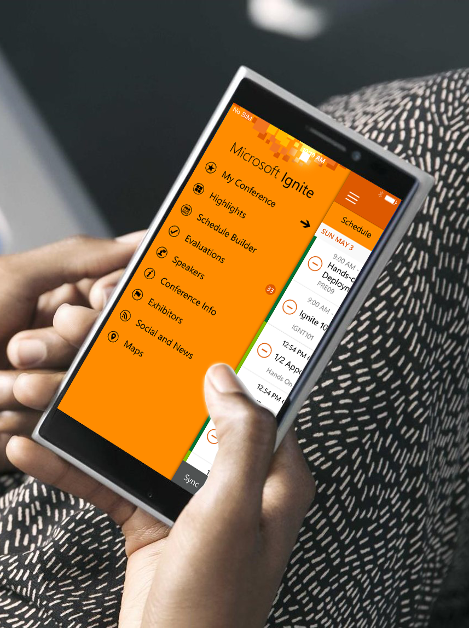
Please evaluate this session
Your feedback is important to us!
Visit Myignite at http://myignite.microsoft.com or download and use the Ignite Mobile App with the QR code above.

