Slide 2
Azure SQL Database overview
BRK2564
Tracy Daugherty & Torsten Grabs

Slide 3
How we develop SQL
SQL Server
Azure
SQL Virtual Machines
Azure
SQL Database
DB
Cloud-first but not Cloud Only
Using Azure SQL DB to improve core SQL Server features & cadence
Many interesting and compelling on-premises ←→ Cloud scenarios

Slide 4
Azure SQL Database
Fully managed SQL database service so you can focus on your business
Built for SaaS and Enterprise applications
Predictable performance & Pricing
Elastic database pool for unpredictable SaaS workloads
99.99% availability built-in
Geo-replication and restore services for data protection
Secure and compliant for your sensitive data
Fully compatible with SQL Server 2014 databases

Slide 5
A single customer creates DBs
Single customer application with DB
Use of Azure SQL DB
60k / every week
114 k
133countries
Logins
Database in use
Database hours
350 M / everyday
1.4 M / as of today
20 M / per day

Slide 6
What are customers doing with SQL Database?
ISVs and SaaS
Enterprise Apps Serving Customer
Enterprise Apps
Serving Employees
Multi-tenant software application using thousands of databases to service their cloud hosted customers
Applications designed for elasticity and scale with efficient and agile operational model
Line of business applications empowering employees while remove CAPEX, reduce OPEX

Slide 7
Rapid delivery of new mobile functionalities
New customers
Mobile apps to personalize auto insurance quote
“Our app is very much a product of its time, we can take advantage of capabilities that were unavailable before”
Aviva
David Whitby
Solutions Delivery Center Director
Mobile apps
Driving information
Familiar dev tools
On-Premise
Faster market response
Internal application
quote system
SQL database
structured data
Table store
unstructured data

Slide 8
Database Service Tiers
Basic
Standard
Premium
Intended Use
Light transactional workloads
Go-to option for most business applications
High throughput and business-critical databases
Performance
•
••
•••
Workload Elasticity
Isolated databases and elastic database pools
Programming Surface
Fully compatible with SQL Server 2014 databases
Availability
99.99%*

Slide 9
Database Performance and Throughput
Compute
DTU database throughput unit
Writes
Reads
Memory

Slide 10
Predictable Performance
Basic, Standard, and Premium provide increasing performance levels
Scale individual databases up/down via portal, PS, APIs, or T-SQL to reflect actual or anticipated demand
Database remains online while scaling
Hourly billing provides cost efficiency
P3
P2
P1
S3
S2
S0
S1
B
DTUs
5
10
20
50
100
125
250
1000

Slide 11
Create Database
Demo

Slide 12
Azure SQL Database V12
Better support for large databases
Table partitioning + parallel queries
Online + large index rebuild
No transaction size limit
Expanded programming surface area
CLR, Full-Text Search, Change tracking, heaps, analytics…
Deeper database insights
Full set of dynamic management views (DMV)
Greater premium performance
In-memory Columnstore
SSD based IO
SQL DB
V12

Slide 13
Advance security & compliance for sensitive data
Transparent Data encryption
Row-level Security
Auditing
Dynamic Data Masking
Compliance: FedRAMP, ISO, HIPPA, PCI, EU MC, UK G-Cloud

Slide 14
Data Protection
Regional Disaster Protection
Geo-Restore | Geo-Redundant Backups | RPO < 1 hour | Recovery Time Minutes to Hours
Geo-Replication | Asynchronous Replication | RPO < 5 seconds | Recovery Time < 30 seconds
Oops Recovery
Point in time restore | Continuous backup | Restore to any-point | Recovery Time Minutes to Hours
Accidental Database deletion | Tail-end backup | Restore to point of deletion | Recovery Time Minutes to Hours

Slide 15
Geo-Replication
Demo

Slide 16
PREVIEW
Elastic Database Model
Elastic databases, Elastic database pools
Pooled resources leveraged by many databases
Standard elastic pool provides 200-1200* DTUs for up to 100* databases
Elastic Standard databases can burst up to 100 DTUs (S3 level)
Created/configure pool via portal, PowerShell, REST APIs
Move databases in/out using portal, PowerShell, REST APIs, T-SQL
Databases remain online throughout
Monitoring and alerting is available on both pool and databases
Max per-database burst level
DTUs
200
400
800
1200
*Additional pricing tiers may be introduced, and the ranges and limits may be increased during the preview

Slide 21
Elastic Database Demo
Demo

Slide 22
Azure SQL Database Summary
DB
DB
DB
✓ Global database as a service
✓ Predictable workloads
✓ Unpredictable workloads at massive scale for SaaS applications
✓ Easy development, simple self-service management
DB
DB

Slide 23
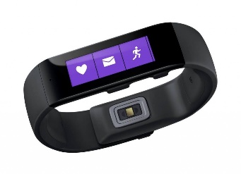
Ignite Azure Challenge Sweepstakes
Attend Azure sessions and activities, track your progress online, win raffle tickets for great prizes!
Aka.ms/MyAzureChallenge
Enter this session code online: “NGFC”
(10) - Microsoft Surface Pro 3
Core i5 256GB
(30) – Xbox One Master Chief Collection Bundle
(55) – Microsoft Band
Offers throughout the week
NO PURCHASE NECESSARY. Open only to event attendees. Winners must be present to win. Game ends May 9th, 2015. For Official Rules, see The Cloud and Enterprise Lounge or myignite.com/challenge

Slide 24
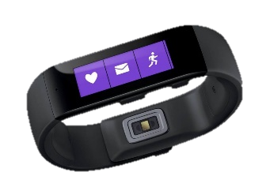
Ignite Azure Challenge Sweepstakes
Attend Azure sessions and activities, track your progress online, win raffle tickets for great prizes!
Aka.ms/MyAzureChallenge
Enter this session code online: BRK2564
NO PURCHASE NECESSARY. Open only to event attendees. Winners must be present to win. Game ends May 9th, 2015. For Official Rules, see The Cloud and Enterprise Lounge or myignite.com/challenge

Slide 25
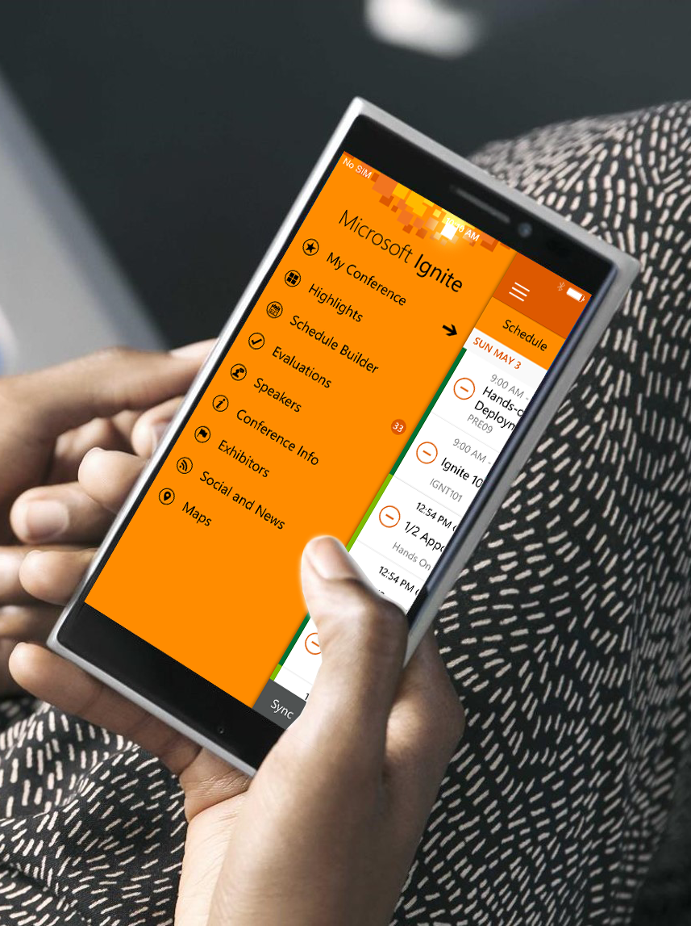
Please evaluate this session
Your feedback is important to us!
Visit Myignite at http://myignite.microsoft.com or download and use the Ignite Mobile App with the QR code above.

