Slide 2
Adding Search Capabilities to Your Business Applications Using Microsoft Azure Search
BRK2565
Liam Cavanagh
Sr. Program Manager – Azure Search
@liamca

Slide 3
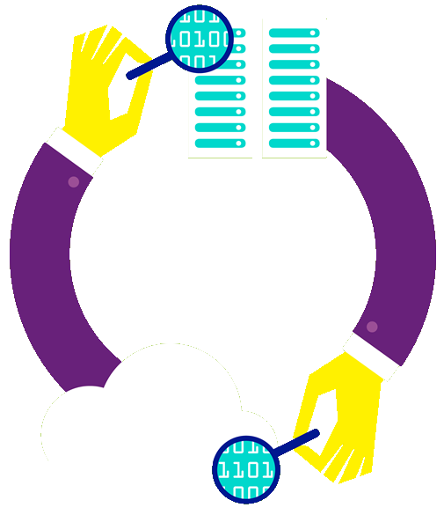
What is Azure Search?
A search-as-a-service solution allowing developers to incorporate great search experiences into applications without managing infrastructure or needing to become search experts.

Slide 5
Man
Contacts
Manfred Donaldson
Manny Bickers
Ben Manners
Mary Mathers
Accounts
Managed Pro Corp.
Metro Manufacturing
Menlo Park Outfitters
Type Ahead

Slide 6
Man
Contacts
Manfred Donaldson
Manny Bickers
Ben Manners
Mary Mathers
Accounts
Managed Pro Corp.
Metro Manufacturing
Menlo Park Outfitters
Spelling Mistakes
Spelling Mistakes
Spelling Mistakes

Slide 7
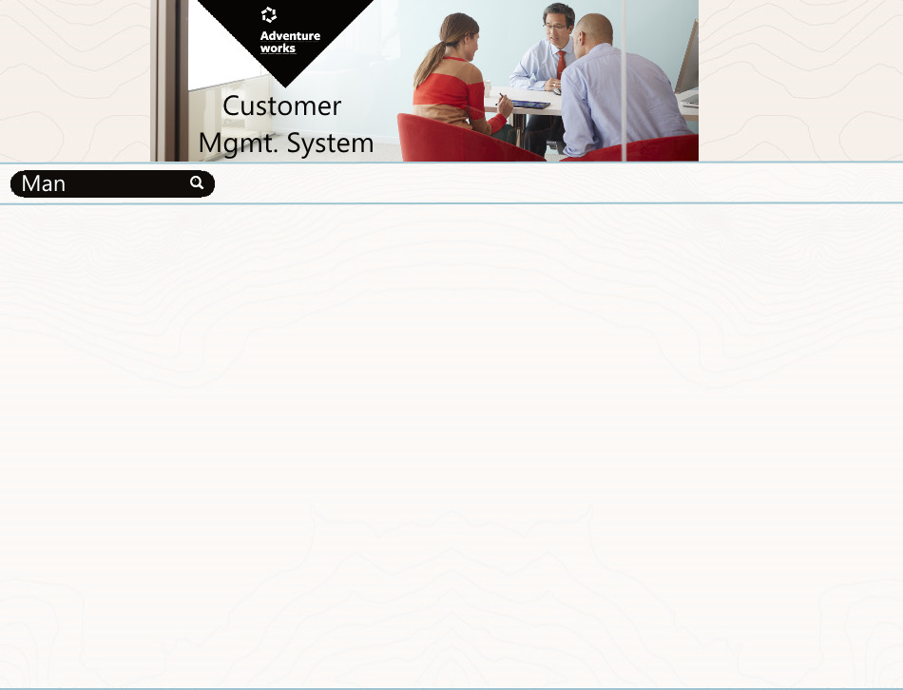
Sort by:
Refine by:
Type
Contact (63)
Account (21)
Report (9)
Activity (3)
State
Washington (73)
Oregon (19)
Idaho (8)
Vertical
Manufacturing (43)
Engineering (32)
Food & beverage (17)
Transportation (9)
Real Estate (3)
Manfred Donaldson
Eastside Department Store
Seattle, WA
(206) 555-0101
Manny Bickers
Cross-Country Riding Supplies
Boise, ID
(208) 555-3244
Donald Blanton
Managed Pro Corp.
Portland, OR
(971) 555-8943
Betty Haines
Metro Manufacturing

Slide 8
Sort by:
Refine by:
Type
Contact (63)
Account (21)
Report (9)
Activity (3)
State
Washington (73)
Oregon (19)
Idaho (8)
Vertical
Manufacturing (43)
Engineering (32)
Food & beverage (17)
Transportation (9)
Real Estate (3)
Manfred Donaldson
Eastside Department Store
Seattle, WA
(206) 555-0101
Manny Bickers
Cross-Country Riding Supplies
Boise, ID
(208) 555-3244
Donald Blanton
Managed Pro Corp.
Portland, OR
(971) 555-8943
Betty Haines
Metro Manufacturing
Facets
Facets
Facets & Filters

Slide 9
Sort by:
Refine by:
Type
Contact (63)
Account (21)
Report (9)
Activity (3)
State
Washington (73)
Oregon (19)
Idaho (8)
Vertical
Manufacturing (43)
Engineering (32)
Food & beverage (17)
Transportation (9)
Real Estate (3)
Manfred Donaldson
Eastside Department Store
Seattle, WA
(206) 555-0101
Manny Bickers
Cross-Country Riding Supplies
Boise, ID
(208) 555-3244
Donald Blanton
Managed Pro Corp.
Portland, OR
(971) 555-8943
Betty Haines
Metro Manufacturing
Paging

Slide 10
Sort by:
Refine by:
Type
Contact (63)
Account (21)
Report (9)
Activity (3)
State
Washington (73)
Oregon (19)
Idaho (8)
Vertical
Manufacturing (43)
Engineering (32)
Food & beverage (17)
Transportation (9)
Real Estate (3)
Manfred Donaldson
Eastside Department Store
Seattle, WA
(206) 555-0101
Manny Bickers
Cross-Country Riding Supplies
Boise, ID
(208) 555-3244
Donald Blanton
Managed Pro Corp.
Portland, OR
(971) 555-8943
Betty Haines
Metro Manufacturing
Hit Highlighting
Hit Highlighting

Slide 11
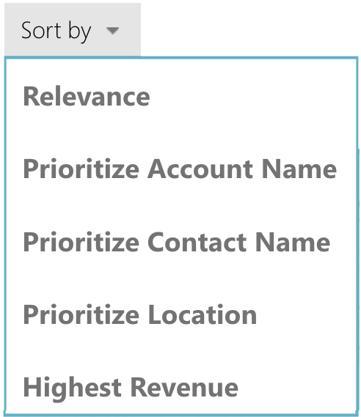
Refine by:
Type
Contact (63)
Account (21)
Report (9)
Activity (3)
State
Washington (73)
Oregon (19)
Idaho (8)
Vertical
Manufacturing (43)
Engineering (32)
Food & beverage (17)
Transportation (9)
Real Estate (3)
Manfred Donaldson
Eastside Department Store
Seattle, WA
(206) 555-0101
Manny Bickers
Cross-Country Riding Supplies
Boise, ID
(208) 555-3244
Donald Blanton
Managed Pro Corp.
Portland, OR
(971) 555-8943
Betty Haines
Metro Manufacturing
Sorting

Slide 12
Refine by:
Type
Contact (63)
Account (21)
Report (9)
Activity (3)
State
Washington (73)
Oregon (19)
Idaho (8)
Vertical
Manufacturing (43)
Engineering (32)
Food & beverage (17)
Transportation (9)
Real Estate (3)
Manfred Donaldson
Eastside Department Store
Seattle, WA
(206) 555-0101
Manny Bickers
Cross-Country Riding Supplies
Boise, ID
(208) 555-3244
Donald Blanton
Managed Pro Corp.
Portland, OR
(971) 555-8943
Betty Haines
Metro Manufacturing
Scoring & Index Tuning
Scoring & Index Tuning

Slide 13
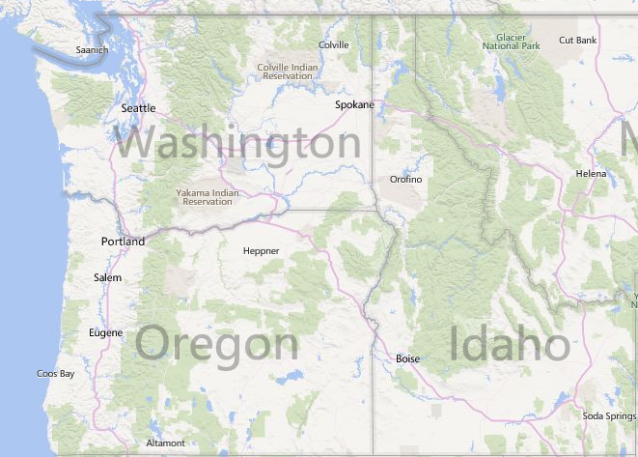
Geo-Spatial Search
Refine by:
Type
Contact (63)
Account (21)
Report (9)
Activity (3)
State
Washington (73)
Oregon (19)
Idaho (8)
Vertical
Manufacturing (43)
Engineering (32)
Food & beverage (17)
Transportation (9)
Real Estate (3)

Slide 14
eCommerce
Enable retail customers to find products through search and provide a great search experience with spelling corrections, suggestions and faceting
Fine-tuned ranking models accommodating:
Popularity and rating
Inventory
Margin, discounts and vendor promotions
Support frequent index updates of price and stock levels
High query rate

Slide 15
User Generated Content
Examples of this kind of applications include:
Knowledge base articles
Sites and apps for recipes, restaurant reviews
User-contributed news sites
Social networks and forums
Document sharing tools
Support large volumes of text-heavy documents
Ranking models connect results to business objectives
i.e., boost relevant KB articles that are newer

Slide 16
Business Applications
Enable users to navigate content using Search rather than menus and traditional access paths allowing:
Quicker, natural and more efficient information retrieval
Support for many different data types
Single entry point to discover content

Slide 17
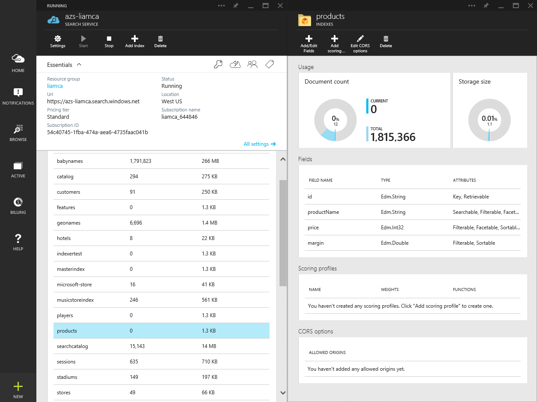
Create a Search Service
Use Azure portal or API to create a search service that will hold one or more search indexes, defining:
Geographic location
Azure Subscription
Scale of service
Choose between Free (shared) and Standard (dedicated) search services

Slide 18
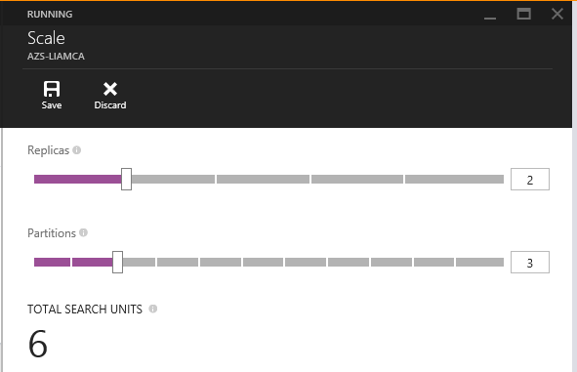
Scaling a Search Service
Capacity can dialed up and down at the search service level for standard services
Added capacity will increase queries per second, number of documents uploaded/updated per second and total count of documents in the search service
Billing is connected to capacity
Azure Search is designed to handle applications with hundreds of queries per second and millions of documents per search service

Slide 19
Demo – Creating a Search Service
Liam Cavanagh

Slide 20
What is a Search Index?
Consists of fields and documents and is the container used to execute search queries against
Similar in concept to a SQL “table” (but not to be confused with a SQL Index)
Fields have properties such as “Searchable” and “Facetable”
Documents are uploaded to the Search index

Slide 21
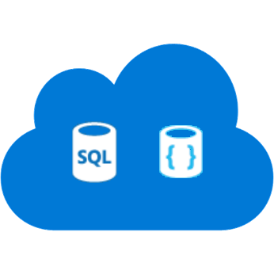
Indexing Data Options
Push - using indexing API
POST to /indexes/<name>/docs/index
Up to 1000 actions per batch
Actions can be upload, merge, delete, etc.
WebJobs are great for regular execution
Great for near real-time updates
Pull - using indexers
Azure SQL DB and DocumentDB
Change detection, deletion markers
Point it at the data source, define policy, done
Runs as often as every 5 min

Slide 22
Demo – Creating a Search Index
Liam Cavanagh

Slide 23
Key Search Features
Search Text: Text as written by the user used for full text search
Faceting: Aggregate counts of results by categories
Highlighting: Define fields used for hit highlighting
Filter: Used to further limit results
Sorting: Sort results by values in document fields instead of score
Paging: Limit the number of results to be returned
Projection: Limits results to a subset of the fields
Count: Total count of fetched items
Lookup: Retrieves a specific document from Azure Search by its key

Slide 24
Demo – Working with a Search Index
Liam Cavanagh

Slide 25
Suggestions (Auto-Complete)
Allows developers to provide type-ahead suggestions
as the user types
Provides mechanism for users to find content quickly
Supports:
Infix matching for suggestions
Optional fuzzy matching enabling more flexibility for spelling mistakes
Support for up to 100 suggestions per result
No limit in length other than field limits
No minimum length to number of characters used

Slide 26
Ranking & Tuning a Search Index
Scoring refers to the computation of a search score for every item returned in search results
Is an indicator of an item's relevance in context of the current search operation
Higher score, means more relevancy and will boost item in search results
Scoring can be customized using scoring profiles
Scoring profiles allow you to boost items based business value or to improve user experience
E.g., Promote newer items, or boost items that have been in inventory too long

Slide 27
Scoring Profiles
Scoring profile is part of index definition and can include:
Weighted fields: Assigns a relative weight to a field in the case where a search result found in one field is more important than another
Freshness: Allows weighted boosting of new or old an item is using a datetime fields
Magnitude: Enables boosting based on how high or low a numeric value is such as a product rating
Distance: Provided boosting based on proximity or geographic location of item to that of a location specified by the users using a geo.distance fields
Tag Boosting: Affects scoring based on common tags in document and search queries

Slide 28
Demo – Scoring
Liam Cavanagh

Slide 29
Geo-Spatial Search
Allows developer to store and query data that represents objects defined in a geometric space including:
Distance: Given a points stored within the search index and one passed by the user, calculate the distance
Intersection: Determine if a given point stored in the index is within a given polygon supplied by the user
Can be used in filters, sorting and scoring profiles

Slide 30
Multilanguage Search
Support for 50 languages
Word breaking, stop words, inflections
Lucene analyzers
Well-known analyzer stack
Stemming
Microsoft analyzers
Same NLP stack used by parts of Office, Bing
Lematization in many languages
Provides an even deeper understanding of the languages (plurality, masculine, feminine, etc)

Slide 31
Demo – MultiLanguage Search
Liam Cavanagh

Slide 32
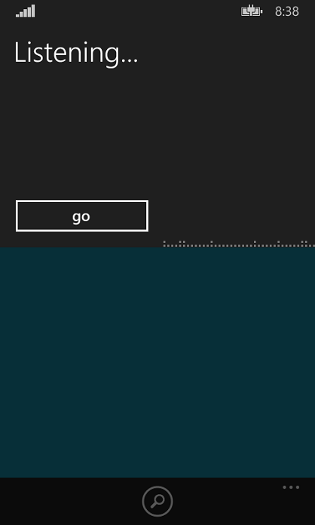
Cortana Extensibility (Speech Recognition)
Cortana extensibility
Available today in Windows Phone 8.1
Much more powerful in Windows 10
Search is a natural backend for Cortana
Take a bunch of words → apply linguistics → return relevant results

Slide 33
Demo – Cortana Search
Liam Cavanagh

Slide 34
Recommended Resources
Demos from Today (Github)
Azure Search Course (MVA)
MSDN Documentation
Introduction to Azure Search
Scenarios and Capabilities
Azure Search Technical Overview
Service REST API
Get started with Azure Search in:
.NET
Java
NodeJS

Slide 35
Questions?
Liam Cavanagh
liamca@microsoft.com
@liamca

Slide 36
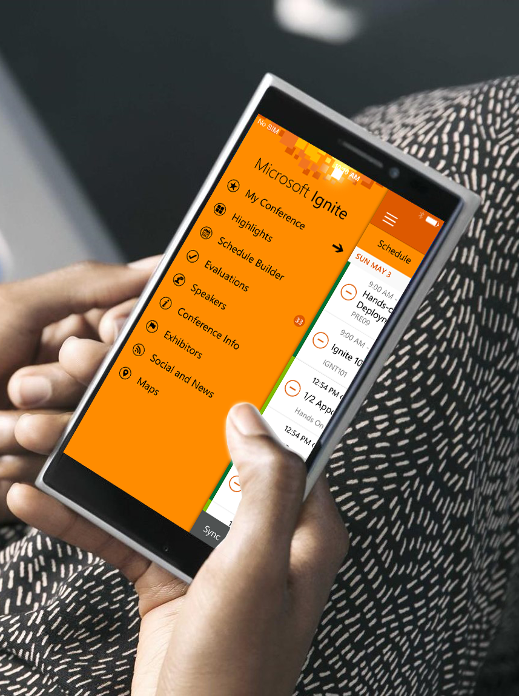
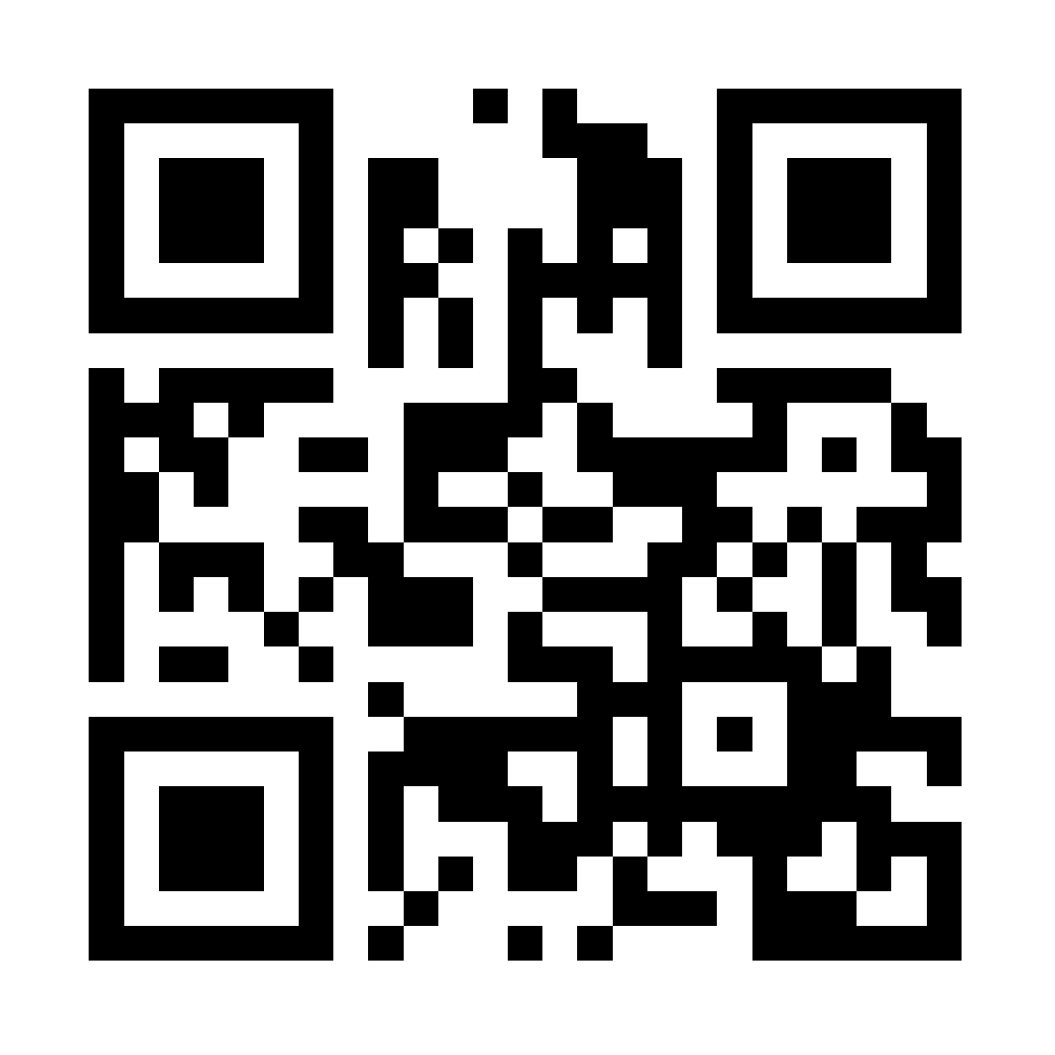
Please evaluate this session
Your feedback is important to us!
Visit Myignite at http://myignite.microsoft.com or download and use the Ignite Mobile App with the QR code above.

