Slide 2
Azure SQL DB - Elastic Database Pool Drilldown
BRK2573
Torsten Grabs

Slide 3
Azure SQL Database
Fully managed SQL database service so you can focus on your business
Built for SaaS and Enterprise applications
Predictable performance & Pricing
Elastic database pool for unpredictable SaaS workloads
99.99% availability built-in
Geo-replication and restore services for data protection
Secure and compliant for your sensitive data
Fully compatible with SQL Server 2014 databases

Slide 4
Database Service Tiers
Basic
Standard
Premium
Intended Use
Light transactional workloads
Go-to option for most business applications
High throughput and business-critical databases
Performance
•
••
•••
Workload Elasticity
Isolated databases and elastic database pools
Programming Surface
Fully compatible with SQL Server 2014 databases
Availability
99.99%*

Slide 5
Database Throughput Unit (DTU)
Bounding Box
Monitoring
% of current performance level
Compute
Utilization
DB workload
Writes
Reads
75%
50%
50%
60%
Read
Write
CPU
Memory
Memory
DTU:
Represents the amount of resources assigned to the database.
Allows for relative comparison of resources provided across different performance levels.
Provides an abstraction from the underlying hardware.
Blended measure of CPU, memory, read rates, and write rates.

Slide 6
Predictable Performance
Basic, Standard, and Premium provide increasing performance levels
Scale individual databases up/down via portal, PS, APIs, or T-SQL to reflect actual or anticipated demand
Guaranteed resources
Database remains online while scaling
Hourly billing provides cost efficiency
P3
P2
P1
S3
S2
S0
S1
B
DTUs
5
10
20
50
100
125
250
1000

Slide 11
The SaaS scenario
Sweet Spot for Basic, Standard, and Premium for single databases
Predictable consistent load
Well understood usage patterns
Few idle periods
Performance guarantees for peak resource demand.
Risk of overprovisioning to accommodate bursts
The SaaS application pattern addressed by elastic pooling
Large number of databases
Bursts followed by low activity periods
Not all databases concurrently active
Varying or unpredictable usage pattern per database
Single database
Database resources are fixed and defined by a performance level (Basic, S0 – S3, P1 – P3).
Performance levels are a measure of compute resources such as CPU and IO, and defined by DTUs.
S3: 100 DTUs
S2: 50 DTUs
S0: 10 DTUs
S1: 20 DTUs
Many databases
…
Bursty usage
S3
S0
S2

Slide 12
Elastic pool concepts
“Elastic database pool provides large scale SaaS CSVs a simple cost effective solution to achieve performance goals for a group of databases with widely varying and unpredictable usage patterns.”
Resource allocation
Database throughput units (DTUs) are shared across databases in the pool to accommodate unpredictable periods of burst activity by individual databases.
DTU requirement for the pool is determined by the aggregate utilization of its concurrently active databases.
Storage limit per pool determined by DTU guarantee for the pool.
Performance settings
Choose DTU for the pool.
Choose DTU max cap and min reserved for the databases.
Pricing
Pay for DTU of the pool.
Pay for database existence.
DTU
DTU of pool
DTU utilization of pool
DTU max per database
DB
DB
…
DB
DTU utilization of database
DTU min per database

Slide 13
Elastic pool service tiers
Service tier | Basic Elastic Pool | Standard Elastic Pool | Premium Elastic Pool
Database features | Basic | Standard | Premium
Storage limit per database | TBD | 250 GB | TBD
DTU max per database |  | 10, 20, 50, 100 DTUs (S3)
DTU min per database |  | 0, 10, 20, 50 DTUs (S2)
Database limit per pool |  | 100 databases
Storage limit per pool |  | 1 GB per DTU
DTU per pool |  | 200, 400, 800, 1200 DTUs
Existence price per month | $A per database | $2.50 per database | $X per database
DTU price per month | $B per DTU | $4.50 per DTU | $Y per DTU
Database
Pool
Pricing *
* Prices listed are anticipated GA release prices.
Prices for public preview are discounted by 50%.

Slide 14
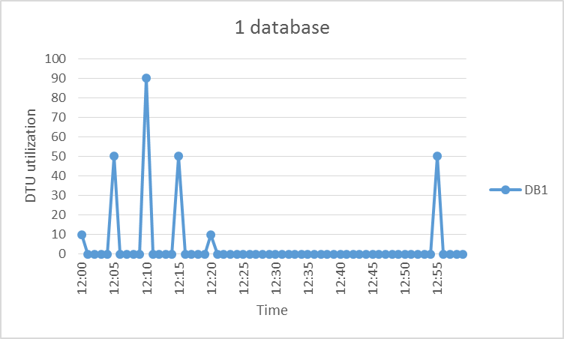
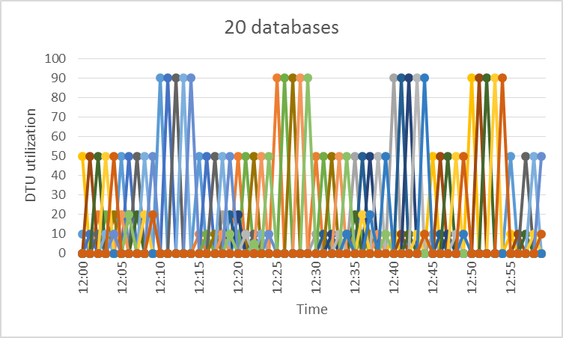
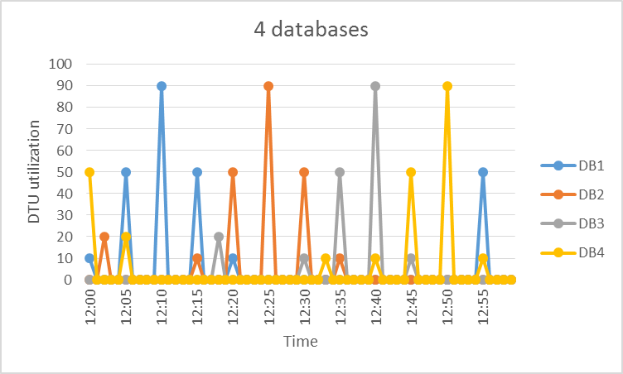
SaaS ISV app pattern using existing perf tiers
DBs bursting to S3 performance levels
Performance level | Price ($/month)
S0 | $15
S1 | $30
S2 | $75
S3 | $150
20x S3 databases | $3,000

Slide 15
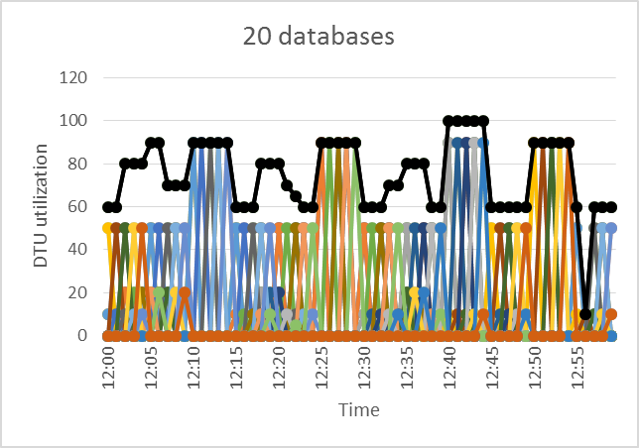
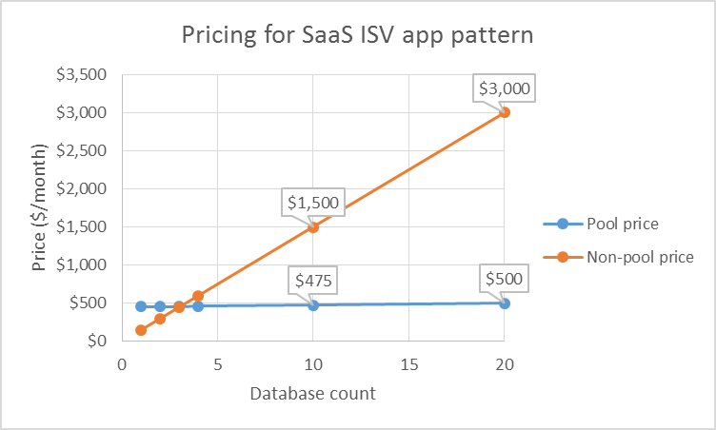
SaaS ISV app pattern using elastic pool
DBs bursting to S3 performance levels

Slide 16
Friction free user experience
Relationship of servers and pools
Azure region
A pool is contained by a single server.
A server can contain multiple pools.
Logical server
Elastic pool
Elastic pool
Setting performance goals is friction free
Create new
A new database can be created in a pool.
An existing database can be moved between pools or to a performance level for a standalone database.
A pool can be resized.
DB
DB
…
Move between
…
Add existing
DB
DB
DB
Changing performance settings is online
Per database DTU settings
Per pool DTU and storage limit settings.

Slide 17
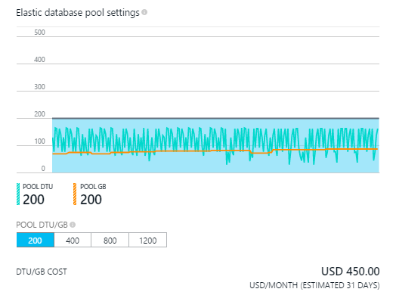
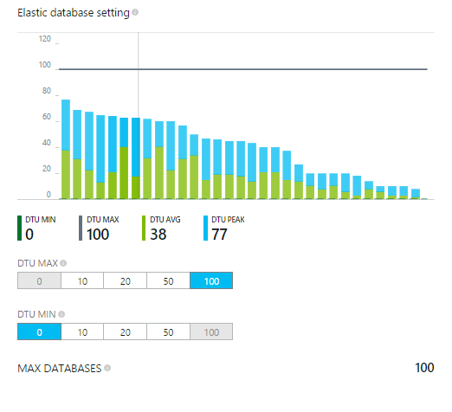
Creating the pool
Service analyzes every server worldwide daily
Pick databases in server to see performance recommendation
Accept recommendation or adjust and create the pool

Slide 18
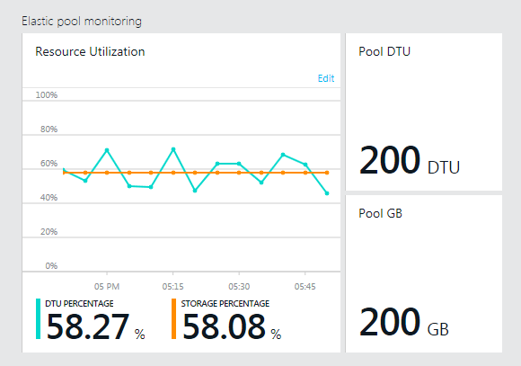
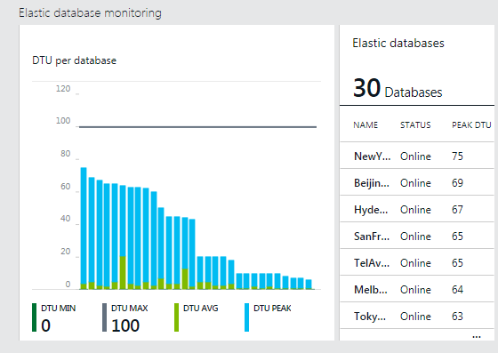
Managing the pool
Set alerts for DTU and storage utilization
Monitor pool and database utilization
Adjust pool settings in response to alerts

Slide 19
Elastic Database Demo
Demo

Slide 20
PowerShell UX
Create new elastic pool
PS C:\> New-AzureSqlElasticPool –ResourceGroupName “ResourceGroup1”
–ServerName “server1” –ElasticPoolName “Pool1” –Edition Standard –Dtu 200 –DatabaseDtuMax 50 –DatabaseDtuMin 0
Create new database in elastic pool
PS C:\> New-AzureSqlDatabase –DatabaseName ”db1” –ElasticPoolName ”Pool1” –ServerName “server1” –ResourceGroupName “ResourceGroup1”
Add existing database to elastic pool
PS C:\> Set-AzureSqlDatabase –DatabaseName ”db1” –ElasticPoolName ”Pool1” –ServerName “server1” –ResourceGroupName “ResourceGroup1”
Remove existing database from elastic pool
PS C:\> Set-AzureSqlDatabase –DatabaseName db1 –ServerName server1
–ResourceGroupName “ResourceGroup1”–RequestedServiceObjectiveName S3
Change performance settings of elastic pool
PS C:\> Set-AzureSqlElasticPool –ResourceGroupName “ResourceGroup1”
–ServerName “server1” –ElasticPoolName “Pool1” –Dtu 1200 –DatabaseDtuMax 100 –DatabaseDtuMin 10

Slide 21
Future considerations
Support for Basic and Premium elastic pools.
Increase database count limit per pool.
Increase DTU and storage limit per pool.
T-SQL support for creating and moving databases in pools.
Migration support from v11 servers to pools in v12 servers.

Slide 22
Getting started
Documentation
http://azure.microsoft.com/en-us/documentation/articles/sql-database-elastic-pool
Portal
https://portal.azure.com
PowerShell
http://go.microsoft.com/fwlink/p/?linkid=320376&clcid=0x409

Slide 23
Azure SQL Database Summary
DB
DB
DB
✓ Global database as a service
✓ Predictable workloads
✓ Unpredictable workloads at massive scale for SaaS applications
✓ Easy development, simple self-service management
DB
DB

Slide 24
Ignite Azure Challenge Sweepstakes
Attend Azure sessions and activities, track your progress online, win raffle tickets for great prizes!
Aka.ms/MyAzureChallenge
Enter this session code online: “TZDL”
(10) - Microsoft Surface Pro 3
Core i5 256GB
(30) – Xbox One
(55) – Microsoft Band
Offers throughout the week
NO PURCHASE NECESSARY. Open only to event attendees. Winners must be present to win. Game ends May 9th, 2015. For Official Rules, see The Cloud Platform Lounge or aka.ms/myazurechallenge

Slide 25
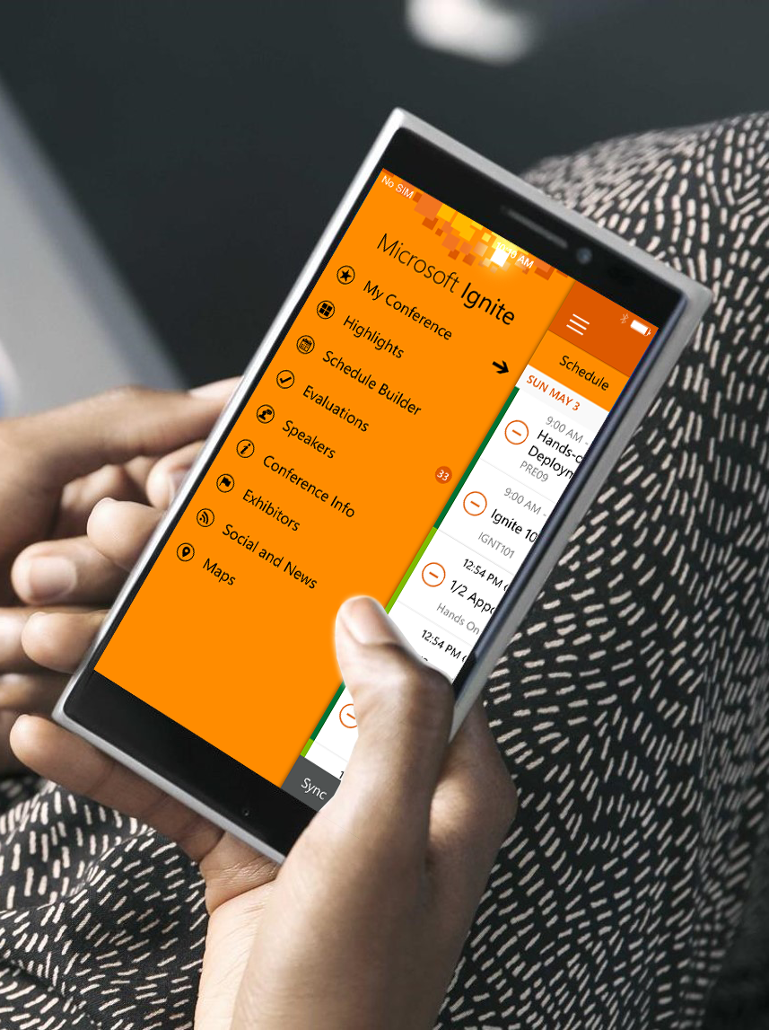
Please evaluate this session
Your feedback is important to us!
Visit Myignite at http://myignite.microsoft.com or download and use the Ignite Mobile App with the QR code above.

